Slide 1
Introduction to Ecological Modeling
Lec 6 — Spatial Statistics - Kriging
in Ecological Systems
Geostatistics · Spatial Interpolation · Variogram Modeling · Uncertainty Quantification
Dr. Naomi Unkelos-Shpigel

Slide 2
1
GeoSpatial challenge

Slide 3
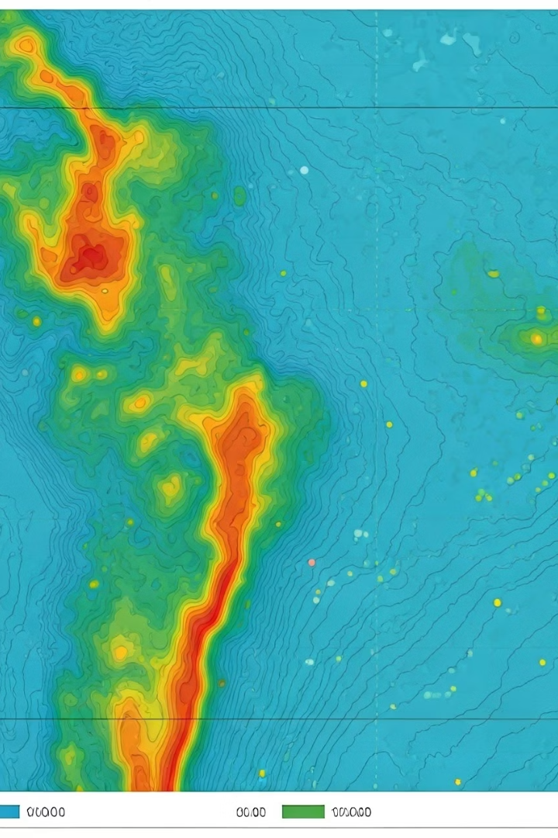
Spatial Statistics and Geographic Analysis
GIS integration
Core Concept
Geographic Information Systems enable habitat modeling, landscape metrics, conservation planning, and invasive species tracking.
Moran's I and Geary's C measure the degree to which ecological features are clustered or dispersed across space.
Matheron, G. (1963). Principles of geostatistics. Economic Geology.

Slide 4
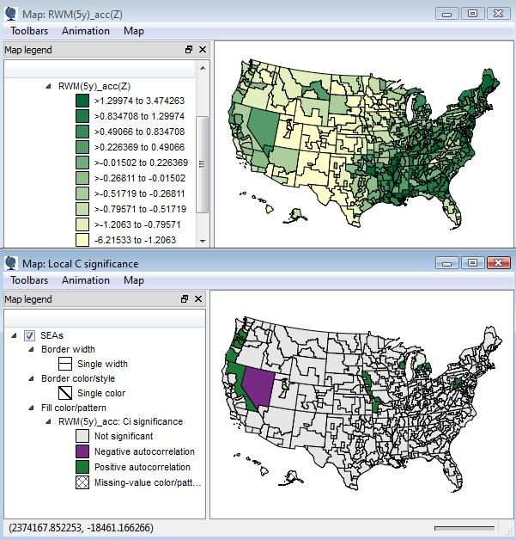
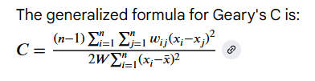
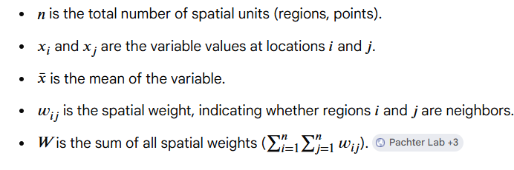
https://colab.research.google.com/github/pachterlab/voyager/blob/documentation/vignettes/vig2_visium.ipynb#scrollTo=d5f48a82
Geary’s C (Geary, 1954)
GIS integration
C < 1: Indicates Positive Spatial Autocorrelation. Similar values cluster together on the map (e.g., high values next to high values).C = 1: Indicates No Spatial Autocorrelation. Spatial randomness; values are arranged independently of geography.C > 1: Indicates Negative Spatial Autocorrelation. Dissimilar values cluster together (e.g., high values next to low values).

Slide 5
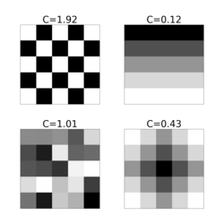
Geary’s C (Geary, 1954) example
Suppose we have five districts in a city with median house prices, and we want to know if prices form a spatial cluster. [1]
1. Our Data (\(x\)):
District 1: $100,000
District 2: $110,000
District 3: $105,000
District 4: $150,000
District 5: $155,000 (Mean price \(\bar{x} = \$124,000\))
2. Spatial Weights (\(w_{ij}\)): Assume the districts form a line: D1 connects to D2, D2 connects to D3, etc. We use a simple binary weight (\(1\) if neighbors, \(0\) otherwise) to create our \(w_{ij}\) table.
We calculate the squared difference between all neighbor pairs and divide it by the overall variance of the city's housing prices. [1, 2]
Because Districts 1, 2, and 3 have similar prices and are located next to each other, their local differences are small.
If our final equation yields \(C = 0.75\), this number is less than 1.
Conclusion: There is positive spatial autocorrelation; housing prices are spatially clustered rather than randomly distributed across the city. [1]
GIS integration

Slide 6
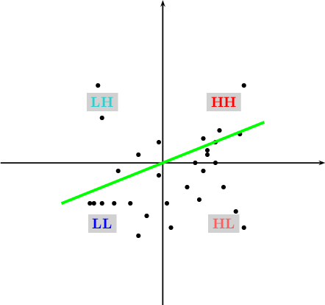

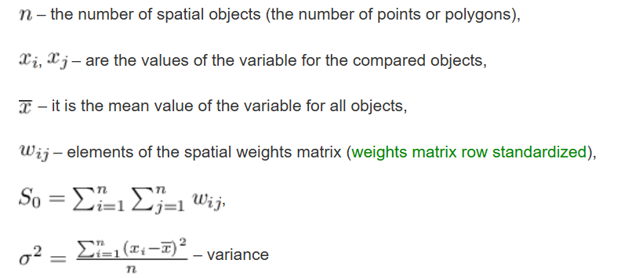
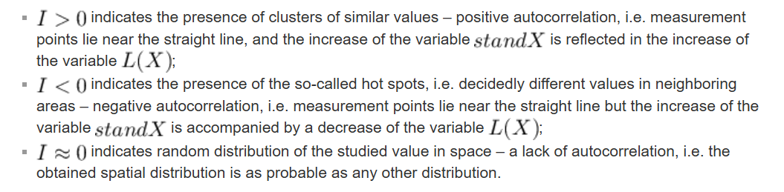
https://manuals.pqstat.pl/en:przestrzenpl:autocorpl:gmoranpl
Moran's I (Moran, 1948)
GIS integration

Slide 7
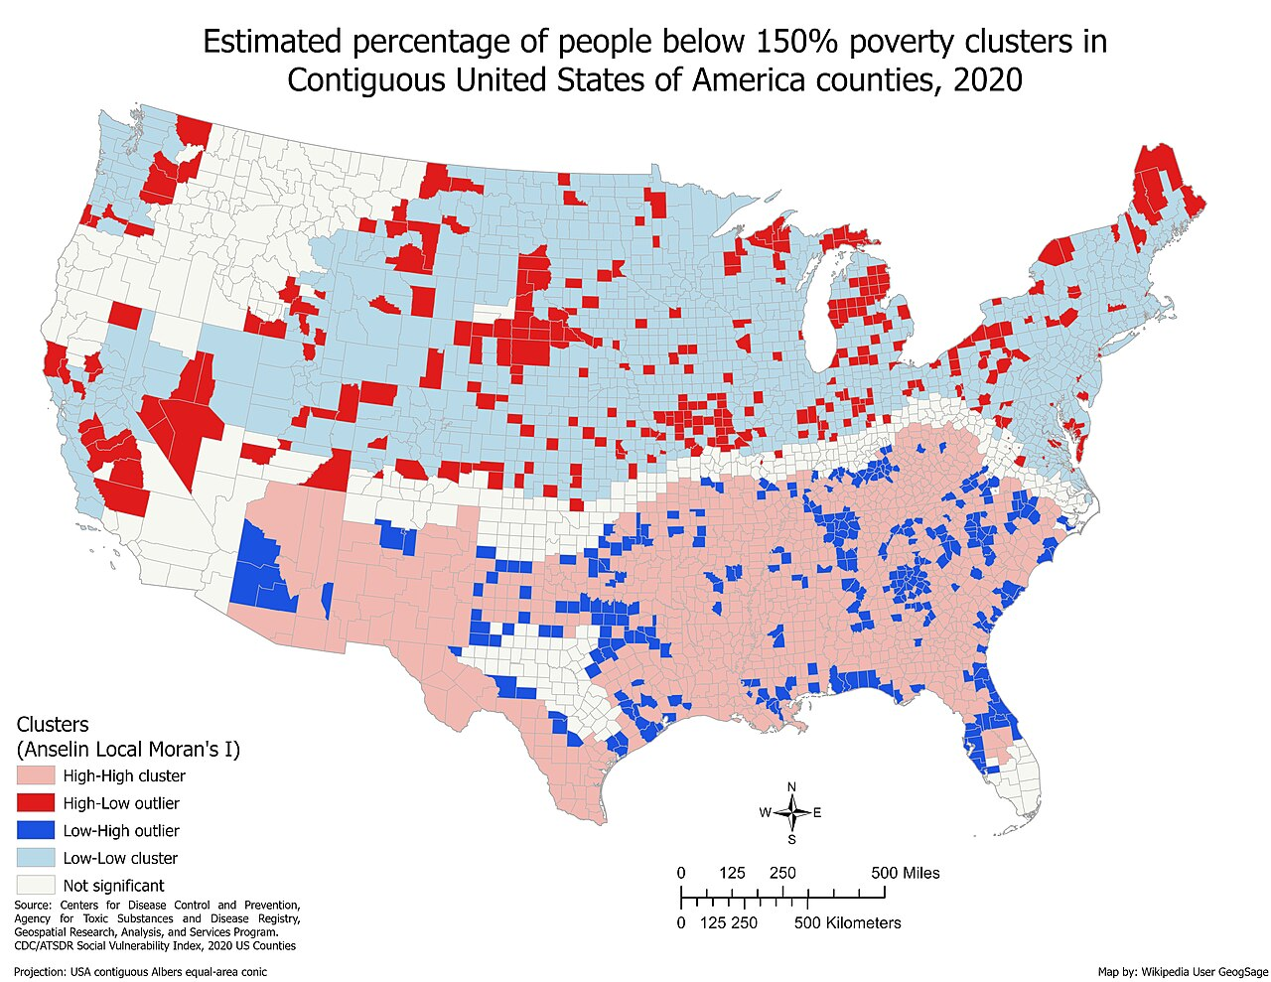

Moran I example
GIS integration

Slide 8
2
The Kriging Workflow

Slide 9
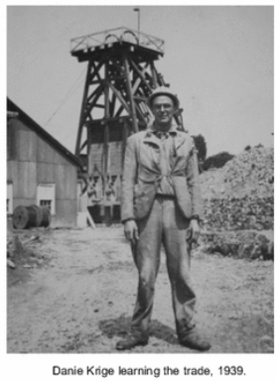
Kriging: Geostatistical Interpolation
Kriging predicts values at unsampled locations using the spatial structure of measured points, producing both estimates and uncertainty.
Origin & Development
Core Concept
Key Advantages
Named after South African mining engineer Danie Krige, who pioneered the approach for mineral resource estimation in the 1950s.
Later formalized mathematically by French mathematician Georges Matheron in the 1960s as part of his development of geostatistics.
· Creates a continuous surface from scattered observations
· Accounts for spatial autocorrelation — nearby points are more similar
· Produces predictions AND quantified uncertainty (kriging variance)
· Optimal weights derived from data structure, not arbitrary rules
Functions as a Best Linear Unbiased Predictor (BLUP), minimizing estimation error variance while ensuring unbiased predictions.
Can incorporate anisotropy — spatial correlation varying by direction — and prevents overweighting of densely sampled areas.

Slide 10
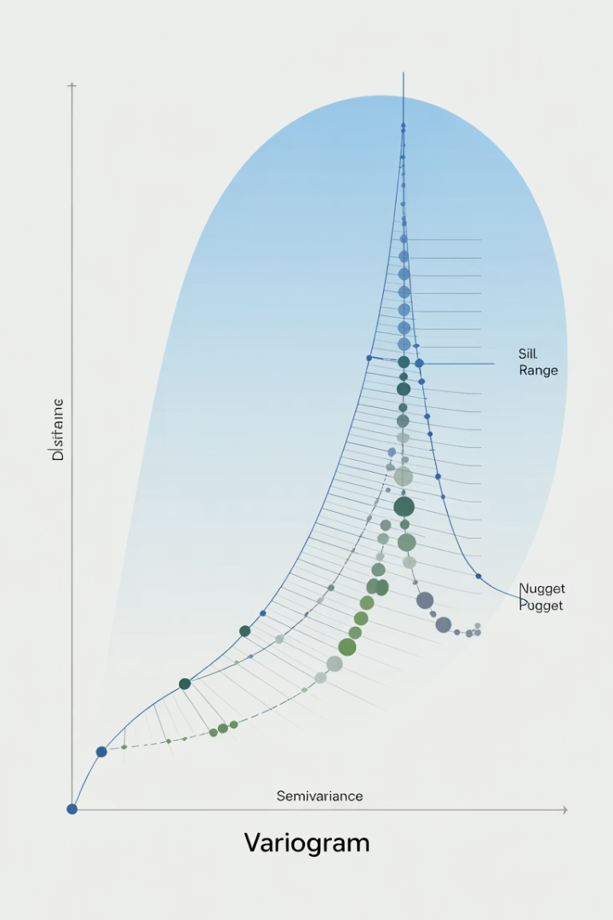
The Variogram: Foundation of Kriging
The variogram quantifies how spatial dissimilarity increases with distance — it is the key input for calculating kriging weights.
Variogram Parameters
Common Variogram Models
Nugget (C₀): variance at zero distance — represents measurement error or microscale variation below sampling resolution.
Sill (C₀+C): the plateau value where the variogram levels off — equal to the total variance of the dataset.
Range (a): the distance at which the variogram reaches the sill — beyond this distance, points are spatially independent.
Formula: γ(h) = (1/2n) · Σ[Z(xᵢ) − Z(xᵢ+h)]²
Spherical: linear near origin, levels off at range. Most common for natural phenomena.
Exponential: steep initial rise, approaches sill asymptotically. Good for gradual spatial transitions.
Gaussian: S-shaped curve, very smooth near origin. For highly continuous phenomena.
Linear: no defined sill, continuous increase. For unbounded spatial variance.
Key Assumption: Stationarity
Kriging assumes stationarity — that the mean and spatial structure are consistent across the study area. This allows the variogram estimated from sample pairs to be applied everywhere. When stationarity fails in large or heterogeneous areas, Universal Kriging or local variograms are used instead.

Slide 11
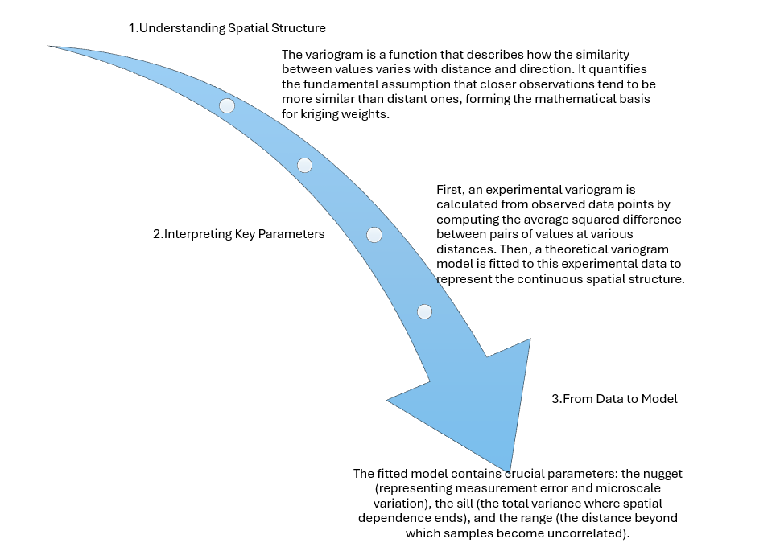
Kriging in a nutshell
Kriging workflow step by step

Slide 12
Types of Kriging Methods
Each variant is suited to different data conditions — choose based on what you know about the mean, trend, and available variables.
Ordinary Kriging
Simple Kriging
Universal Kriging
Assumption
Unknown constant mean
Best for
Most environmental and ecological data
★ Most widely used variant
Assumption
Known constant mean (user-specified)
Best for
Small areas with well-understood average conditions
Uncommon in practice
Assumption
Known functional spatial trend (drift)
Best for
Pollution plumes, elevation gradients, directional drift
When a spatial trend is present
Co-Kriging
Indicator Kriging
Block Kriging
Assumption
Correlation with secondary variable(s)
Best for
When a correlated variable is easier or cheaper to measure
E.g., DEM elevation to improve rainfall maps
Assumption
Data coded as binary (above/below threshold)
Best for
Risk mapping, regulatory threshold exceedance probability
Outputs probability, not a continuous value
Assumption
Area-averaged prediction needed (not point values)
Best for
Mining block valuation, watershed averages, land use
Lower variance than point kriging
Default choice: Ordinary Kriging works for most applications. Use Universal when a trend exists, Co-Kriging when a correlated secondary variable is available, Indicator Kriging for probability/risk outputs, and Block Kriging for area-averaged estimates.

Slide 13
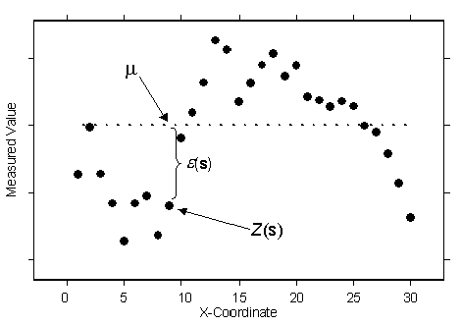
01
Ordinary Kriging
★ Default choice for most applications
Assumption
Best For
When to Avoid
Unknown constant mean — the mean is estimated locally from the data rather than specified in advance.
Most environmental and ecological datasets
Soil properties, rainfall, species distribution
Any application where the global mean is unknown
Avoid when a strong spatial trend is present — use Universal Kriging instead.
Z*(x₀) = Σ λᵢ Z(xᵢ) with Σ λᵢ = 1
https://doc.esri.com/en/arcgis-pro/latest/help/analysis/geostatistical-analyst/understanding-ordinary-kriging.html

Slide 14
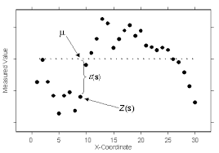
02
Simple Kriging
○ Uncommon in practice
Assumption
Best For
When to Avoid
Known constant mean — the user supplies the mean value before interpolation begins.
Small, well-studied areas with a known global mean
Simulated or synthetic datasets with controlled statistics
Situations where the mean is determined from external data
Avoid when the mean is uncertain — misspecifying it biases all predictions.
Z*(x₀) = μ + Σ λᵢ [Z(xᵢ) − μ]
https://doc.esri.com/en/arcgis-pro/latest/help/analysis/geostatistical-analyst/understanding-simple-kriging.html

Slide 15
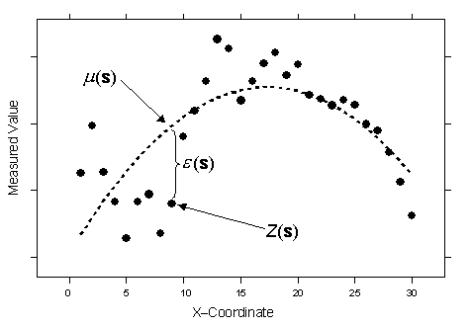
03
Universal Kriging
↗ Use when a spatial drift is present
Assumption
Best For
When to Avoid
Known functional spatial trend (drift) — the mean varies systematically across space according to a known function.
Pollution gradients (e.g., concentrations downwind of a source)
Elevation-dependent climate variables
Any variable with a clear directional or polynomial trend
Avoid when no trend exists — it will overfit and produce poor cross-validation results.
Z(x) = m(x) + ε(x) where m(x) is the deterministic trend
https://desktop.arcgis.com/fr/arcmap/latest/extensions/geostatistical-analyst/understanding-universal-kriging.htm

Slide 16
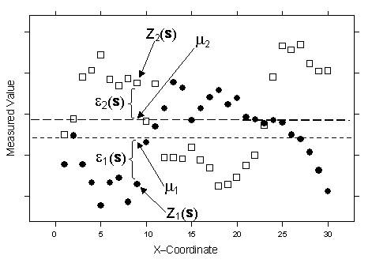
04
Co-Kriging
⊕ Leverage a correlated secondary variable
Assumption
Best For
When to Avoid
Spatial correlation between the primary variable and one or more secondary variables that are cheaper or denser to sample.
Soil carbon estimated using cheaper soil texture measurements
Rainfall improved by dense elevation (DEM) data
Any case where a correlated variable is more abundant
Avoid when the secondary variable is weakly correlated — the added complexity won't improve accuracy.
Z*(x₀) = Σ λᵢ Z(xᵢ) + Σ μⱼ Y(xⱼ) [Y = secondary]
https://desktop.arcgis.com/en/arcmap/latest/extensions/geostatistical-analyst/understanding-cokriging.htm

Slide 17
05
Indicator Kriging
⚑ Maps probability, not a continuous value
Assumption
Best For
When to Avoid
Data are transformed to binary indicators (1 if above a threshold, 0 if below) before kriging is applied.
Probability of contamination exceeding a regulatory limit
Risk maps for disease incidence or flood hazard
Any application where threshold exceedance probability matters
Avoid when a continuous estimate is needed — it outputs probability, not a value.
I(x; zₖ) = 1 if Z(x) > zₖ, 0 otherwise → P[Z(x₀) > zₖ]
Dr. Naomi Unkelos-Shpigel · Introduction to Ecological Modeling · Lec 4.2 — Spatial Statistics

Slide 18
06
Block Kriging
▦ For area-averaged estimates
Assumption
Best For
When to Avoid
The prediction target is the average value over an area (block) rather than at a single point.
Mining: average ore grade within excavation blocks
Watershed or catchment average nutrient loads
Land-use planning requiring areal summaries
Avoid when point-level precision is needed — block estimates smooth out local variability.
Z*(B) = (1/|B|) ∫_B Z*(x) dx → lower variance than point kriging

Slide 19
3
Kriging in Practice

Slide 20
Step 1: Data Exploration
Understanding your data's distribution and spatial structure is essential before kriging.
Exploration Tasks
Calculate Experimental Variogram
Examine the distribution of your spatial data: look for trends, outliers, and patterns.
Check for normality. If data is skewed (e.g., pollutant concentrations), apply log or Box-Cox transformation before kriging.
Create initial visualizations to understand spatial structure:
· Histogram and QQ-plot for normality assessment
· Map of sample locations to check coverage and clustering
Identify spatial trends or directional effects (anisotropy) before fitting the variogram.
γ(h) = (1/2n) · Σ[Z(xᵢ) − Z(xᵢ+h)]²
Where:
h = separation distance (lag distance)
n = number of point pairs at distance h
Z = measured values at sample locations
Compute by grouping point pairs into distance classes and averaging:
· Group pairs by distance interval (lag)
· Average squared differences within each lag class
In Python: gs.Variogram(coordinates, values)
In R: variogram(value~1, data=sp_object)

Slide 21
Step 2: Fit the Theoretical Variogram
Fitting a mathematical model to the experimental variogram defines the spatial structure used to calculate kriging weights.
Model Selection
Spherical Model (most common)
Choose a theoretical model that best matches the experimental variogram shape:
· Compare Spherical, Exponential, and Gaussian models visually
· Use weighted least squares — short-distance pairs are most important
· Check for anisotropy by examining directional variograms
Estimate three key parameters: nugget (C₀), sill (C₀+C), and range (a).
The fitted model must be positive definite to guarantee a valid kriging system.
In ecology: soil nutrients, rainfall, and species density all show distance-dependent structure that the variogram captures.
γ(h) = C₀ + C·[1.5(h/a) − 0.5(h/a)³] for h ≤ a
γ(h) = C₀ + C for h > a
Parameters estimated from data:
C₀ = nugget (y-intercept at lag zero)
C = partial sill (structured variance)
a = range (distance where sill is reached)
Cross-validation (leave-one-out):
· Mean Standardized Error should be ≈ 0 (unbiased)
· RMSSE (Root Mean Square Standardized Error) should be ≈ 1
In Python: gs.fit_variogram(variogram, model)
In R: fit.variogram(v, model=vgm("Sph"))

Slide 22
Step 3: Solve the Kriging Equations
The kriging prediction at any location is a weighted average of nearby observations — weights are derived from the variogram.
Z*(x₀) = Σ λᵢ Z(xᵢ)
Prediction Formula
Weight Determination (Ordinary Kriging)
Kriging Variance
Z*(x₀) is the predicted value at unsampled location x₀.
Z(xᵢ) are the known values at nearby sampling locations.
λᵢ are the weights, determined by solving the variogram-based system of equations.
Unlike IDW (which uses 1/distance), kriging derives weights from the actual measured spatial structure.
Weights are found by solving this constrained system:
Σ λⱼ γ(xᵢ, xⱼ) + μ = γ(xᵢ, x₀) for all i
Σ λᵢ = 1 (unbiasedness constraint)
μ = Lagrange multiplier ensuring predictions are unbiased.
Prediction uncertainty is calculated simultaneously:
σ²(x₀) = Σ λᵢ γ(xᵢ, x₀) + μ
· Variance = 0 at sample points (exact interpolator)
· Variance increases with distance from sample points
· Depends only on sample geometry, not on measured values
This provides a statistical basis for confidence intervals around every prediction.

Slide 23
Steps 4 & 5: Generate Predictions & Uncertainty Maps
The final steps apply the fitted kriging model across a full prediction grid and visualize both estimates and their uncertainty.
Step 4: Generate the Prediction Surface
Step 5: Create Uncertainty Maps
Apply the kriging equations to every node in a regular prediction grid.
Each grid node receives a predicted value Z*(x₀) calculated from surrounding sample points within the variogram range.
Grid resolution considerations:
· Finer grid = smoother surface but higher computation time
· Resolution should be consistent with the variogram range
· Avoid extrapolating beyond the convex hull of sample points
Example: 60 soil samples over 500 acres → 100×100 prediction grid using Ordinary Kriging with spherical variogram.
σ²(x₀) = Σ λᵢ γ(xᵢ, x₀) + μ
The kriging variance map shows prediction confidence across the entire study area.
High variance zones = far from samples or sparse sampling density.
Uncertainty maps are used to:
· Guide additional sampling campaigns
· Build 95% confidence intervals around predictions
· Identify areas requiring remediation vs. continued monitoring
In Python: ok = OrdinaryKriging(x, y, z, variogram_model="spherical")
z_pred, ss = ok.execute("grid", gridx, gridy)
In R: krige(value~1, data=sp, newdata=grid, model=fit)

Slide 24
Kriging Workflow Summary
1
2
3
4
5
Explore
Experimental
Variogram
Fit
Model
Cross-
Validate
Krige
& Map
Check normality, outliers, spatial trends
Calculate average squared differences by distance
Select spherical/exponential/Gaussian model
Test model via leave-one-out validation
Predict values and variance across full grid
Python Implementation
import numpy as np
import matplotlib.pyplot as plt
from pykrige.ok import OrdinaryKriging
from pykrige.uk import UniversalKriging
from matplotlib import cm

Slide 25
4
Kriging case studies

Slide 26
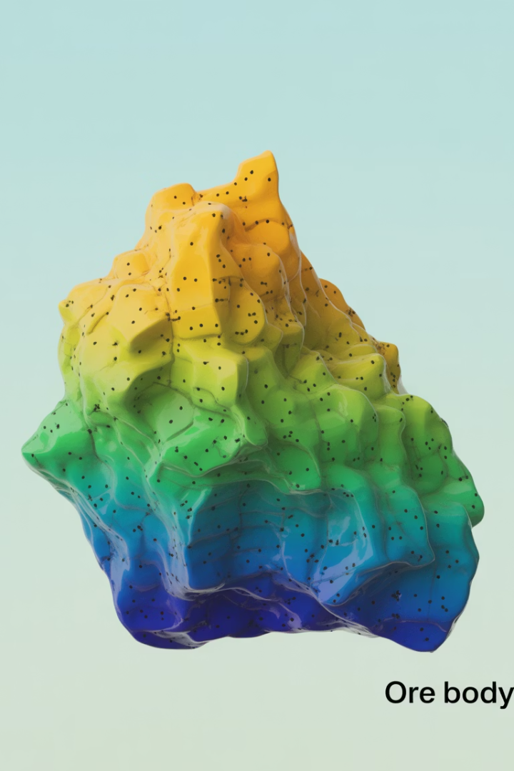
Case Study: Soil Contamination Mapping
60 soil samples across a 500-acre former industrial site → kriged map of lead contamination.
Project Background
Results and Impact
Sample
Easting
Northing
Pb mg/kg
log(Pb)
...
Prediction Surface
S-01
312
487
145
5.0
...
Continuous Pb surface across 500 acres from 60 sample points
95% confidence upper-bound map guided conservative remediation
High-uncertainty zones targeted for additional sampling
S-02
455
502
890
6.8
...
S-03
5.0
623
34
3.5
...
S-04
290
418
2100
7.6
...
Cost Savings
...
...
...
...
...
...
30% cost reduction vs. traditional grid-based sampling approach
Better risk management through quantified prediction uncertainty
Defensible regulatory compliance documentation produced
60 samples, log-transformed Pb concentrations
Directional variograms revealed anisotropy:
Stronger correlation east-west (historical transport)
Range: 180m (E-W) vs 110m (N-S)
Spherical anisotropic variogram fitted
Result: Kriging transformed 60 discrete soil samples into a comprehensive decision support tool for site remediation planning, achieving a 30% cost reduction while improving risk assessment quality.

Slide 27
Applications: Environmental Science
Kriging enables continuous mapping of pollution, water, and climate variables from sparse monitoring networks.
Pollution Mapping
Groundwater Monitoring
Climate Interpolation
Continuous contamination surfaces from discrete monitoring stations
Identifies hotspots invisible in raw point data
Guides remediation and assesses regulatory compliance
Maps water table levels and contaminant plumes from well networks
Predicts contamination spread for remediation system design
Uncertainty maps prioritise new monitoring wells
Interpolates temperature and rainfall between sparse weather stations
Produces gridded climate surfaces for ecological models
Universal Kriging incorporates elevation as external drift variable
Key References
Key References
Key References
[1] Goovaerts (1997). Geostatistics for Natural Resources Evaluation. Oxford UP.
[2] Oliver & Webster (2014). Tutorial guide to geostatistics. Catena, 113, 56–69.
[3] Ahmadi & Sedghamiz (2007). Geostatistical analysis of groundwater. Env. Monitor. Assess., 129, 277–285.
[4] Delhomme (1978). Kriging in the hydrosciences. Adv. Water Resources, 1(5), 251–266.
[5] Ly et al. (2013). Geostatistical interpolation of daily rainfall. J. Hydrology, 498, 60–73.
[6] Lloyd (2005). Integrating elevation into kriging for rainfall. Hydrol. Processes, 19, 1235–1252.

Slide 28
Applications: Ecology & Conservation
Spatial interpolation supports habitat modelling, species management, and conservation planning across landscapes.
Critical Habitat Identification
Wildlife Corridor Design
Invasive Species Management
Kriged species-density surfaces identify core habitat from sparse survey data
Uncertainty maps guide prioritisation of field surveys
Combined with SDMs for multi-species reserve design
Interpolates landscape resistance surfaces from field-sampled variables
Identifies least-cost movement paths between habitat patches
Designs corridors that maintain genetic connectivity
Indicator Kriging maps probability of presence exceeding a density threshold
Spread-front predictions from interpolated occurrence data
Guides allocation of control resources to high-risk areas
Key References
Key References
Key References
[7] Guisan & Zimmermann (2000). Predictive habitat distribution models. Ecol. Modelling, 135, 147–186.
[8] Kerr & Ostrovsky (2003). From space to species. Trends Ecol. Evol., 18, 299–305.
Berardi, D., Galuppi, M., Proietti, P., Libertà, A., & Lombardi, M. (2026). Geostatistical modeling of meteorological condition for a decision support system in wildfire resilience management. Natural Hazards, 122(7), 274.
[11] Elith & Leathwick (2009). Species distribution models. Annu. Rev. Ecol. Evol. Syst., 40, 677–697.
[12] Pebesma (2004). Multivariable geostatistics in S: gstat. Computers & Geosci., 30, 683–691.

Slide 29
Applications: Mining, Petroleum & Public Health
Kriging originated in mining and has since expanded to resource estimation, reservoir modelling, and epidemiology.
Ore Grade Estimation
Reservoir Characterisation
Disease Risk Mapping
Original application — estimating mineral concentrations from drill cores
Block Kriging provides average grade per excavation block for mine planning
Probabilistic resource estimation quantifies investment risk
Co-Kriging maps porosity and permeability using seismic data as secondary variable
Reduces uncertainty in reservoir volume estimates
Guides well placement and production strategy in oil/gas fields
Kriging interpolates disease incidence rates from surveillance data
Indicator Kriging maps probability of exceeding epidemic thresholds
Exposure surfaces used to assess environmental health risks
Key References
Key References
Key References
[13] Krige (1951). Statistical approach to mine valuation. J. Chem. Metall. Min. Soc. S. Afr., 52(6), 119–139.
[14] Matheron (1963). Principles of geostatistics. Economic Geology, 58(8), 1246–1266.
[15] Deutsch & Journel (1998). GSLIB: Geostatistical Software Library (2nd ed.). Oxford UP.
[16] Journel & Huijbregts (1978). Mining Geostatistics. Academic Press.
[17] Diggle et al. (1998). Model-based geostatistics. Appl. Statistics, 47, 299–350.
[18] Gething et al. (2011). New world malaria map: P. falciparum. Malaria J., 10, 378.

Slide 30
Exercise
https://drive.google.com/drive/folders/1ExuDQkC2TDyESGstQCtYFKsMUgGknUe6?usp=sharing

Slide 31
Resources for Geostatistics & Kriging
Programming Libraries
Key Texts
Online Resources
R: gstat, geoR, sp, sf, terra, automap
Webster & Oliver (2007). Geostatistics for Environmental Scientists. Wiley.
https://desktop.arcgis.com/en/arcmap/latest/extensions/geostatistical-analyst/kriging-in-geostatistical-analyst.htm
https://en.wikipedia.org/wiki/Geary%27s_C
Python: PyKrige, scikit-gstat, gstools, scipy
https://manuals.pqstat.pl/en:przestrzenpl:autocorpl:gmoranpl
ArcGIS Geostatistical Analyst — GUI-based kriging with visualization
Cressie, N. (1993). Statistics for Spatial Data. Wiley.
ESRI Learn: Introduction to Kriging — esri.com
GSLIB — Geostatistical Software Library (Deutsch & Journel)
Wackernagel, H. (2003). Multivariate Geostatistics. Springer.
https://doc.esri.com/en/arcgis-pro/latest/help/analysis/geostatistical-analyst/how-inverse-distance-weighted-interpolation-works.html
Surfer (Golden Software) — dedicated kriging and contouring tool
Matheron, G. (1963). Principles of geostatistics. Economic Geology.
Pebesma (2004). Multivariable geostatistics in S. Computers & Geosciences.

Slide 32





Future directions
Remote Sensing Integration
Machine Learning Applications
Real-time Monitoring
Developing systems for continuous spatial data collection through sensor networks and mobile technologies to track dynamic ecological processes.
Combining high-resolution remote sensing data with ground-based observations to create more comprehensive spatial analyses at multiple scales.
Implementing advanced machine learning algorithms to detect complex spatial patterns and relationships that traditional statistics might miss.
3D Spatial Analysis
Network-based Approaches
Moving beyond 2D representations to incorporate vertical structure in ecological systems, especially important for forest and marine ecosystems.
Analyzing ecological systems as interconnected networks to better understand flow, connectivity, and resilience across landscapes.
The field of ecological spatial analysis continues to evolve with technological advances and new statistical methods. These innovations promise deeper insights into spatial relationships in natural systems, supporting more effective conservation and management decisions.

Slide 33
Limitations & Best Practices
Understanding kriging's constraints is essential for producing reliable, defensible results.
Key Limitations
Best Practices
When to Use Kriging vs. Alternatives
Stationarity assumption — spatial patterns must be consistent across the study area
· Test for normality and transform data if needed (log, Box-Cox)
Use Kriging when spatial structure is present and uncertainty quantification matters.
Requires ≥30–50 well-distributed sample points for reliable variogram estimation
· Examine directional variograms to detect anisotropy
Use IDW when speed matters and no uncertainty estimate is needed.
Computationally intensive — becomes unwieldy with very large datasets
· Test multiple theoretical variogram models before selecting
Use Splines for smooth surfaces with dense, evenly distributed data.
Smoothing effect — may underestimate extreme values
· Perform rigorous cross-validation (check RMSE, ME, RMSSE)
Use Co-Kriging when a correlated secondary variable is cheaper to measure.
Subjectivity in variogram model selection
· Always present prediction maps alongside uncertainty maps
Use Indicator Kriging for probability or threshold exceedance mapping.
Do not extrapolate predictions beyond the data boundary

Slide 34
References
Full citations with DOIs. Books without DOI list ISBN. Krige (1951) predates the DOI system.
1
Goovaerts (1997). Geostatistics for Natural Resources Evaluation. Oxford UP. ISBN: 978-0-19-511538-3
10
Zeller et al. (2012). Estimating landscape resistance to movement. Landscape Ecol., 27, 777–797. DOI: 10.1007/s10980-012-9737-0
2
Oliver & Webster (2014). Tutorial guide to geostatistics. Catena, 113, 56–69. DOI: 10.1016/j.catena.2013.09.006
11
Elith & Leathwick (2009). Species distribution models. Annu. Rev. Ecol. Evol. Syst., 40, 677–697. DOI: 10.1146/annurev.ecolsys.110308.120159
3
Ahmadi & Sedghamiz (2007). Geostatistical analysis of groundwater. Env. Monitor. Assess., 129, 277–285. DOI: 10.1007/s10661-006-9362-4
12
Pebesma (2004). Multivariable geostatistics in S: gstat. Computers & Geosci., 30, 683–691. DOI: 10.1016/j.cageo.2004.03.012
4
Delhomme (1978). Kriging in the hydrosciences. Adv. Water Resources, 1(5), 251–266. DOI: 10.1016/0309-1708(78)90039-9
13
Krige, D. G. (1951). A statistical approach to some basic mine valuation problems on the Witwatersrand. Journal of the Southern African Institute of Mining and Metallurgy, 52(6), 119-139.. Pre-DOI era — no DOI assigned
5
Ly et al. (2013). Geostatistical interpolation of daily rainfall. J. Hydrology, 498, 60–73. DOI: 10.1016/j.jhydrol.2013.06.022
14
Matheron (1963). Principles of geostatistics. Economic Geology, 58(8), 1246–1266. DOI: 10.2113/gsecongeo.58.8.1246
6
Lloyd (2005). Integrating elevation into kriging for rainfall. Hydrol. Processes, 19, 1235–1252. DOI: 10.1002/hyp.5578
15
Deutsch, C. V., & Journel, A. G. (1992). Geostatistical software library and user’s guide. New York, 119(147), 578.. ISBN: 978-0-19-510015-0
7
Guisan & Zimmermann (2000). Predictive habitat distribution models. Ecol. Modelling, 135, 147–186. DOI: 10.1016/S0304-3800(00)00354-9
16
Journel & Huijbregts (1978). Mining Geostatistics. Academic Press. ISBN: 978-0-12-391250-9
8
Kerr & Ostrovsky (2003). From space to species. Trends Ecol. Evol., 18, 299–305. DOI: 10.1016/S0169-5347(03)00071-5
17
Diggle et al. (1998). Model-based geostatistics. Appl. Statistics, 47, 299–350. DOI: 10.1111/1467-9876.00113
9
McRae et al. (2008). Circuit theory for connectivity in ecology. Ecology, 89, 2712–2724. DOI: 10.1890/07-1861.1
18
Gething et al. (2011). New world malaria map: P. falciparum. Malaria J., 10, 378. DOI: 10.1186/1475-2875-10-378
Dr. Naomi Unkelos-Shpigel · Introduction to Ecological Modeling · Lec 4.2 — Spatial Statistics & Kriging

Slide 35
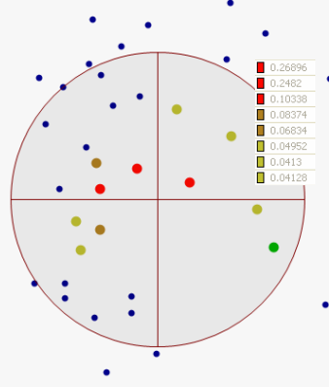
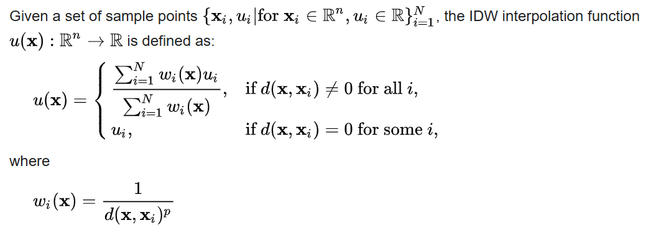
IDW
Inverse Distance Weighting
✦ A simple, deterministic interpolation method — no variogram required
Core Concept & Formula
Parameters & Behaviour
The Idea
Power parameter (p)
Predicts a value at an unsampled location as a weighted average of nearby observations. The key principle: closer points receive proportionally higher weight than distant ones. No geostatistical model is needed — only the distances between points.
The single most important tuning parameter. Controls how sharply weights decline with distance:
• p = 1 → linear decay — distant points retain meaningful influence
• p = 2 → quadratic decay — standard default, recommended for most uses
• p → ∞ → converges to nearest-neighbour interpolation
Higher p = more local, more pronounced bull's-eye artefact.
Prediction formula
Z*(x₀) = Σ wᵢ · Z(xᵢ)
wᵢ = (1 / dᵢᵖ) / Σ (1 / dᵢᵖ)
dᵢ = distance from x₀ to sample xᵢ
Search neighbourhood
Can be fixed radius or variable (k nearest neighbours).
Using all points is mathematically exact but computationally expensive for large datasets. A limited search radius avoids influence of distant, irrelevant observations and improves speed significantly.
Key property: exact interpolator
Predicted values equal observed values exactly at all sample locations — the surface passes through every data point. Unlike kriging, IDW produces no estimate of prediction uncertainty.
Minimum neighbours
Sets a floor on how many sample points must be found within the search radius before a prediction is made. Prevents unreliable single-point predictions in data-sparse areas. Typically 3–10.
https://doc.esri.com/en/arcgis-pro/latest/help/analysis/geostatistical-analyst/how-inverse-distance-weighted-interpolation-works.html
Bull's-eye effect
A visual artefact where isolated extreme values create concentric rings of predicted values around sample points. Worsens with higher p or sparser, more clustered data. Minimised by lower p or a wider search radius.

Slide 36
IDW
Inverse Distance Weighting
✦ When to use IDW, when to prefer Kriging, and a side-by-side comparison
✔ Use IDW When
✘ Avoid IDW When
Speed and simplicity matter
No variogram fitting or model selection needed. Just set p and run — ideal for quick exploratory maps or fieldwork planning.
Uncertainty maps are needed
IDW produces no error estimate. For confidence intervals, risk maps, or probability surfaces, use Kriging.
Dense, uniform sampling
Bull's-eye artefacts are minimal when samples are abundant and evenly distributed. IDW performs comparably to kriging.
Spatial structure should be modelled
IDW ignores autocorrelation. If the data show a clear variogram structure (range, sill, nugget), Kriging outperforms IDW.
Uncertainty is not required
When the interpolated map is the final output and no confidence intervals or probability surfaces are needed.
Data are sparse and clustered
Bull's-eye artefacts dominate when samples are sparse or irregularly clustered, making predictions unreliable.
Only standard GIS is available
IDW is built into ArcGIS, QGIS, GRASS, and every major GIS package. No specialist geostatistical library needed.
Anisotropy is present
IDW weights equally in all directions. If spatial correlation varies by direction (e.g., downwind), use Universal Kriging.
IDW vs Kriging — at a glance
Aspect
IDW
Kriging (Ordinary)
Theoretical basis
None — heuristic distance rule
Rigorous geostatistics (variogram)
Uncertainty output
✘ No uncertainty map
✔ Kriging variance map produced
Spatial structure
Ignored
Explicitly modelled via variogram
Anisotropy
✘ Not supported
✔ Fully supported
Speed / setup
✔ Very fast, minimal setup
Slower — variogram fitting required
Bull's-eye effect
Common with sparse or clustered data
Absent
Optimal weights
No — arbitrary 1/dᵖ rule
✔ Yes — minimises error variance
https://doc.esri.com/en/arcgis-pro/latest/help/analysis/geostatistical-analyst/how-inverse-distance-weighted-interpolation-works.html

Slide 37
Spatial Interpolation Methods Compared
Kriging is one of several spatial interpolation methods — each suited to different data conditions and research goals.
Method
Strengths & When to Use
Ordinary Kriging
Optimal, unbiased; quantifies uncertainty — best general-purpose choice for environmental mapping
Inverse Distance Weighting (IDW)
Fast and simple; no spatial structure needed — good for dense, uniform sampling
Spline Interpolation
Smooth visually appealing surfaces — best for dense data and smooth phenomena (topography)
Co-Kriging
Incorporates a secondary correlated variable — improves accuracy when primary data is sparse
Indicator Kriging
Maps probability of threshold exceedance — ideal for risk and regulatory compliance mapping
Regression-Kriging
Combines trend surface with kriged residuals — powerful hybrid for non-stationary data

