Slide 1
Introduction to Ecological Modeling
Lec 5 — Energy Flow Models
in Ecological Systems
& Statistical Techniques for Ecological Data Analysis
Energy flow · Trophic efficiency · Statistical analysis · Hypothesis testing
Naomi Unkelos-Shpigel

Slide 2
1
Energy Flow
Models

Slide 3
Ecological Energy Flow: Core Concepts
Energy moves through ecosystems following fundamental thermodynamic principles.
One-Directional Flow
Thermodynamic Loss
Solar Origin
Energy moves through food chains in one direction.
Unlike nutrients, energy does not cycle — it flows from producers upward and is lost as heat at each transfer.
· Nutrients cycle; energy flows
· No recycling of energy between levels
· Each link loses ~90% as heat
~90% of energy lost between trophic levels.
The Second Law of Thermodynamics dictates that energy conversions are never 100% efficient.
· 10% rule (Lindeman, 1942)
· Respiration & heat dissipation
· Limits food chain length to 4-5 links
All ecological energy originates from the sun.
Photosynthesis by producers captures solar radiation and converts it to chemical energy stored in organic compounds.
· ~1% of solar energy captured
· Plants = primary energy fixers
· Base of every food web

Slide 4
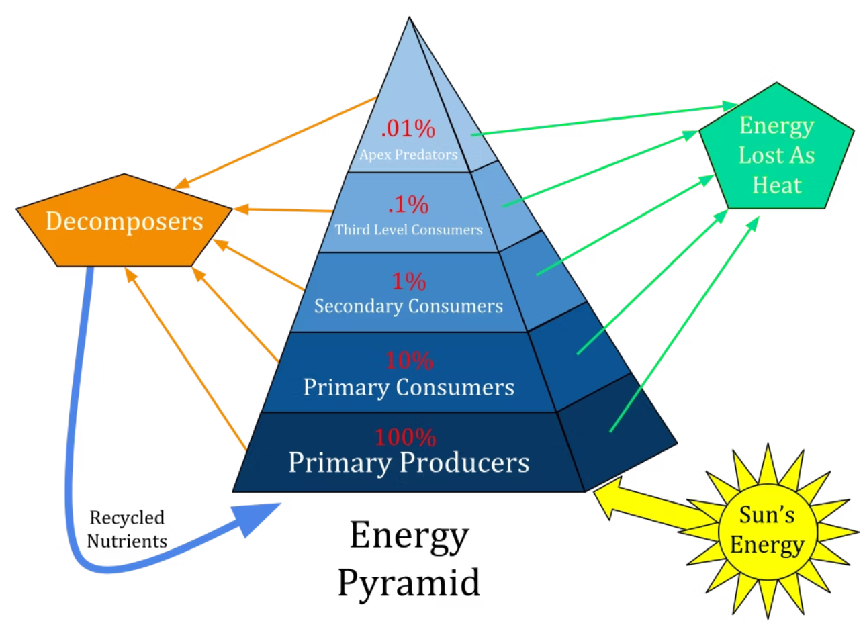
Odum's Energy Flow Model: Systems Thinking
Energy Source
Consumers
Herbivores and carnivores transfer energy up trophic levels.
Each level retains ~10% of energy received from the level below.
· Herbivores → Carnivores
Primarily solar radiation.
Drives all biological processes in the ecosystem.
· Shortwave radiation
· ~10^17 W global input
Producers
Energy Sinks
Plants convert solar energy via photosynthesis.
Gross Primary Production (GPP) minus respiration = Net Primary Production (NPP).
· Algae, plants, cyanobacteria
Heat loss at each trophic transfer.
Decomposers break down dead organisms, releasing remaining energy as heat.
· Heat dissipation
· Decomposition

Slide 5
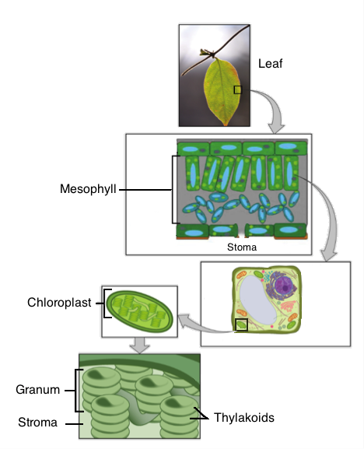
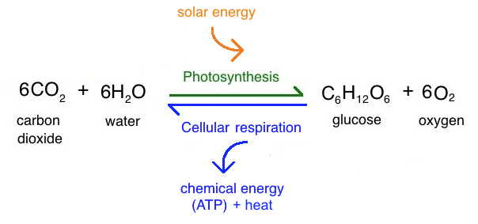
Example for energy flow: Photosynthesis
https://www.khanacademy.org/science/ap-biology/cellular-energetics/photosynthesis/a/intro-to-photosynthesis
‹#›

Slide 6

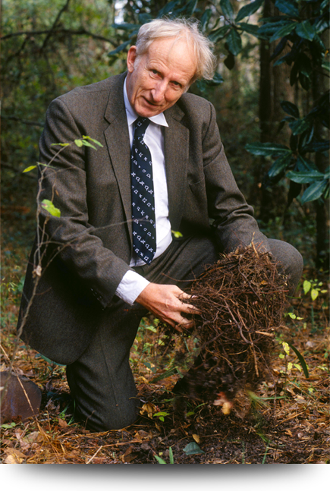
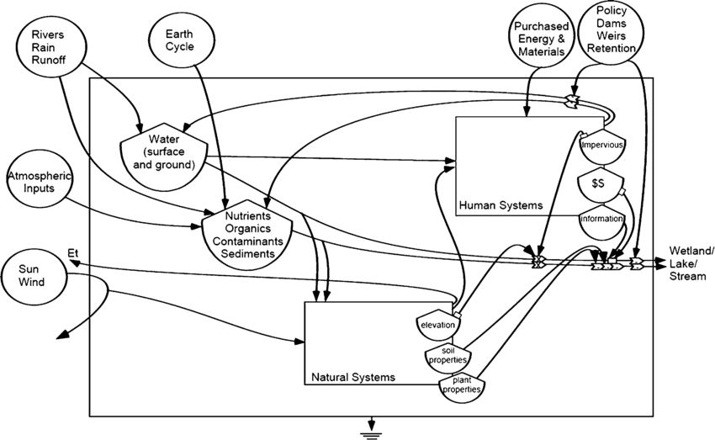










https://www.youtube.com/watch?v=Wn5qsJwk_YQ
Odum's Energy Flow Model: Systems Thinking
Each trophic level retains only ~10% of the energy from the level below.
Producers
Energy Source
Plants convert solar energy
Primarily solar radiation
Consumers
Herbivores and carnivores
Energy Sinks
Heat loss at each transfer
Decomposers
Break down organic matter
Odum, H. T. (1994). Ecological and general systems: an introduction to systems ecology. Rev.‏
‹#›

Slide 7
The 10% Rule in Energy Transfer
This exponential energy loss explains why food chains rarely exceed 4-5 links.
Producers 1,000 kcal
Primary Consumers 100 kcal
Secondary Consumers 10 kcal
Tertiary Consumers 1 kcal
Capture only ~1% of incoming solar energy.
Base of all food webs; greatest energy available at this level.
· Photosynthesis efficiency ~1%
· Total available: 1,000 kcal
Herbivores retain 10% of plant energy.
Remaining 90% lost to respiration, heat, waste.
· 900 kcal lost as heat
· 100 kcal retained
Carnivores retain 10% of herbivore energy.
Only 1% of original producer energy remains.
· 90 kcal lost
· 10 kcal retained
Top predators access minimal energy.
Only 0.1% of original solar energy fixation remains at this level.
· Most energy dissipated
· Limits chain length

Slide 8
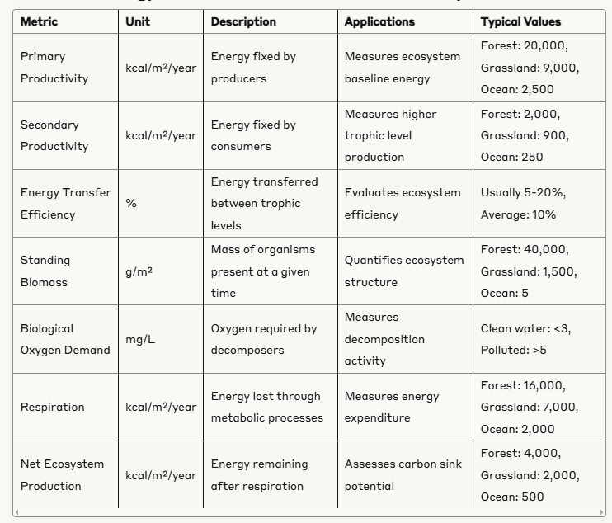
Typical metrics for the energy models

Slide 9
Lindeman's Trophic Efficiency
Raymond Lindeman (1942) quantified energy transfer between trophic levels.
10–15%
10–12%
5–10%
Producers → Primary
Primary → Secondary
Secondary → Tertiary
Energy transfer efficiency from plants to herbivores. Limited by plant digestibility and herbivore metabolic costs.
Energy retained from herbivores to first-level carnivores. Reflects metabolic and activity costs of mobile predators.
Transfer efficiency to top predators. Lowest rate — apex predators are energetically expensive to support.

Slide 10
Energy Flow Simulation Approaches
Models range from simple compartment equations to spatially explicit agent-based simulations.
Simple Models
Complex Models
Implementation
Difference equations with transfer coefficients.
· N-compartment ODE models
· E(t+1) = E(t) × ε (transfer efficiency)
· Easy to parameterize
· Ideal for teaching and quick estimates
Best for: classroom models, quick sensitivity analysis.
Agent-based and spatially explicit models.
· Agent-based: individual energy tracking
· Grid-based: spatial heterogeneity
· Network flow with feedback loops
· Ecopath with Ecosim (EwE)
Best for: real ecosystem management.
Conservation laws must be enforced.
· Energy cannot be created or destroyed
· Validate against empirical data
· Python: scipy.integrate
· R: deSolve, EcoSimR
Always check energy balance at each step.

Slide 11
https://docs.google.com/spreadsheets/d/1auUv9uh2k9ZILqzDjUGj9XsnF-Pwp0JBEBJT-ibYAYU/edit?usp=sharing
Ecosystem Analysis Exercise
Apply energy flow concepts to a real ecosystem.
1
Select an Ecosystem
Choose from: forest, coral reef, grassland, or farm system.
2
Create Energy Flow Diagram
Map energy inputs, producers, consumers, and decomposers with approximate kcal values.
3
Apply the 10% Rule
Calculate expected energy at each trophic level. Identify where losses are greatest.
4
Analyze Vulnerabilities
Discuss climate change impacts on energy flow and propose conservation solutions.
Work in teams. Identify where energy efficiency peaks and where losses occur. Consider system boundaries carefully.

Slide 12
2
Statistical Techniques
for Ecological Data (recap)

Slide 13
Introduction to Ecological Data Analysis
Statistical methods transform raw field observations into ecological insights.
Ecological Data
Unique Challenges
Analysis Objectives
Information about natural systems, populations, species, and habitats.
· Population counts & densities
· Species occurrence records
· Environmental measurements
· Time-series abundance data
Characterized by high natural variability.
Ecological data violate many classical statistical assumptions.
· High variability between sites
· Small and unbalanced samples
· Multiple correlated variables
· Spatial & temporal autocorrelation
Requires specialized methods.
Turn data into ecological understanding.
· Identify trends over time
· Understand species interactions
· Predict responses to change
· Test mechanistic hypotheses
Always link stats back to biology.

Slide 14
Descriptive Statistics in Ecological Context
Summarize the central tendency, spread, and shape of ecological data distributions.
Basic Measures
Ecological Applications
Interpreting Results
Mean, median, and mode.
Range, standard deviation, variance.
Coefficient of variation (CV).
· Use median when data are skewed
· CV useful for comparing variability across populations
Average population size across sites.
Species density variation within habitats.
Spatial distribution of organisms.
Example — Plant density: 12.5 per m² (SD: 3.2)
Example — Fish length: Mean 18.7 cm, Median 16.2 cm
Mean > Median implies right-skewed distribution.
Some large individuals inflate the mean.
· Higher mean than median suggests large outliers
· Use IQR for robust spread estimates
· Always visualize before analyzing

Slide 15
The Four Main Variable Types
Selecting the correct variable type determines which statistical tests are valid.
Variable Type
Definition
Ecological Example
Key Property
Nominal
Categories with no order
Species names, habitat types
Identity only
Ordinal
Categories with meaningful order
Disturbance severity (low/med/high)
Order, not equal intervals
Interval
Equal intervals, no true zero
Temperature (°C), pH
Differences meaningful
Ratio
Equal intervals, true zero
Biomass (g), population count
Ratios meaningful

Slide 16
Choosing the Right Analysis for Each Variable Type
Using mean-based statistics on nominal data can lead to misleading conclusions.
Variable Type
Appropriate Measures
Visualization
Statistical Tests
Nominal
Mode, frequency, proportion
Bar charts, pie charts
Chi-square, Fisher's exact
Ordinal
Median, percentiles, IQR
Ordered bar charts, stacked bars
Mann-Whitney, Kruskal-Wallis
Interval
Mean, standard deviation
Histograms, box plots
t-tests, ANOVA
Ratio
All above + ratios, CV
All above + scatter plots
All parametric + non-parametric

Slide 17
Visualization of Ecological Data
The right plot reveals patterns that tables cannot. Always visualize before modeling.
Chart Types
Visualization Tools
Best Practices
Histograms and box plots — distribution shape.
Scatter plots — relationships between variables.
Heat maps — spatial or community data.
Time series graphs — population dynamics.
Example: Species richness shows hump-shaped relationship with elevation. Peak diversity at 1500-2000 m.
Python: matplotlib, seaborn.
D3.js for interactive web views: https://d3js.org/
Geographical data:
https://qgis.org/
· Choose tool for your audience
· Reproducible figures from code
· Export at 300 dpi for publication
Label all axes with units.
Show raw data alongside summaries.
Use color-blind-friendly palettes.
Caption figures self-sufficiently.
· Error bars: show what they represent
· Avoid 3D charts — they distort perception
· Keep it simple: one message per plot

Slide 18
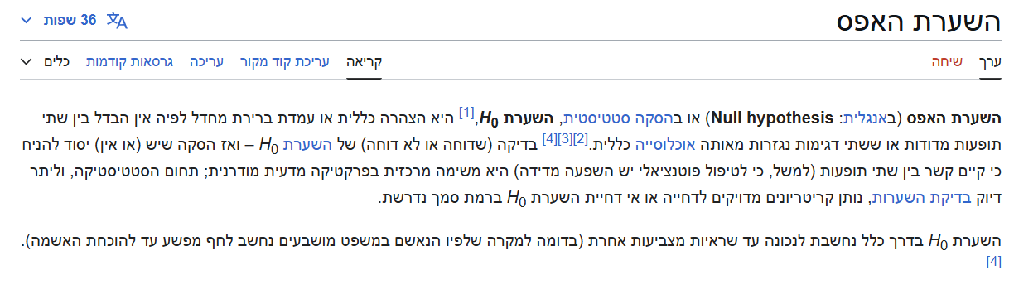
Hypothesis Testing in Ecology: t-tests
Determine if observed differences between two groups exceed natural variation.
The t-test Framework
Real-World Example
Null Hypothesis (H₀): No difference between groups.
Alternative (H₁): A real difference exists.
t = (mean₁ - mean₂) / (pooled standard error)
Larger t-values = stronger evidence of difference.
p < 0.05: Strong evidence (95% confident)
p < 0.01: Very strong evidence (99% confident)
p > 0.05: Insufficient evidence
Comparing plant growth in shaded vs. sunlit plots:
Group A (shaded): Mean 8.3 cm, SD = 1.4, n = 20
Group B (sunlit): Mean 12.7 cm, SD = 1.9, n = 20
t-test result: t = 8.84, p < 0.0001
Conclusion: Sunlit plots produce significantly taller plants — light availability has a strong positive effect.
⚠ The t-test assumes normality and equal variances.

Slide 19
Hypothesis Testing in Ecology: ANOVA
Compare means across three or more groups simultaneously.
How ANOVA Works
Ecological Example
Analysis of Variance: generalization of the t-test for 3+ groups.
F-ratio = Between-group variation / Within-group variation
Large F → groups differ more than chance would predict.
When F > critical value: Reject H₀
Follow up with post-hoc tests to identify which groups differ.
Comparing species richness in three habitat types:
Forest: Mean 42.3 spp, SD = 6.2, n = 15
Grassland: Mean 28.7 spp, SD = 5.4, n = 15
Wetland: Mean 35.1 spp, SD = 7.0, n = 15
ANOVA: F = 22.4, p < 0.0001
Post-hoc (Tukey): All three habitats differ significantly.
⚠ ANOVA only tells you if differences exist — not which groups differ. Always run post-hoc tests.

Slide 20
Hypothesis Testing in Ecology: Chi-Square
Test relationships between categorical variables.
Chi-Square Framework
Ecological Example
Tests if observed frequencies differ from expected frequencies.
χ² = Σ (Observed - Expected)² / Expected
Degrees of freedom = (rows - 1) × (cols - 1)
When to use:
· Species presence/absence by habitat
· Breeding success by nest site type
· Feeding preference by prey type
Do bird species use habitat types in proportion to availability?
Observed: Forest 45, Shrubland 20, Grassland 10
Expected (by area): Forest 30, Shrubland 25, Grassland 20
χ² = 10.83, df = 2, p = 0.004
Conclusion: Birds use habitats non-randomly — strong preference for forest over open habitats.
⚠ Chi-square assumes each expected cell frequency ≥ 5. Use Fisher's exact test for small samples.

Slide 21
ANOVA: Common Pitfalls and Assumptions
Violating ANOVA assumptions can invalidate results. Always check before interpreting p-values.
Normality:** ANOVA assumes data within each group follow a normal distribution. Test with Shapiro-Wilk; for large n, ANOVA is robust to mild non-normality.
Independence:** Observations must be independent. Correlated or paired data require repeated-measures ANOVA.
Post-hoc testing:** ANOVA only detects whether any groups differ. Use Tukey's HSD, Bonferroni, or Dunnett's test to identify which pairs differ.
Small sample sizes:** Reduce statistical power. Use effect sizes (η²) alongside p-values to quantify the magnitude of differences.
⚠ Always report effect size (η² or partial η²) alongside the F-statistic — statistical significance depends on sample size, but effect size does not.

Slide 22
Linear Models and Regression
Model continuous relationships between ecological variables.
1
Simple Linear Regression
Y = a + bX + ε — predicting biomass from precipitation. Slope b gives the effect per unit change in X.
2
Multiple Regression
Y = a + b₁X₁ + b₂X₂ + ... + ε — predicting population size from multiple environmental variables.
3
Interpreting Coefficients
Each coefficient gives the partial effect of one predictor holding others constant. Check sign, magnitude, and p-value.
4
Goodness of Fit
R² = proportion of variance explained. RMSE = average prediction error. Adjusted R² penalizes for extra predictors.
5
Model Validation
Check residual plots for patterns. Use AIC for model selection. Cross-validate against held-out data.

Slide 23
Ecological Data: Unique Statistical Challenges
Standard statistical assumptions are frequently violated in ecological datasets.
Non-Normality
Spatial Autocorrelation
Temporal Autocorrelation
Hierarchical Structure
Count data often follow Poisson or negative binomial distributions.
· Zero-inflation common
· Use GLMs with appropriate link functions
· Poisson for counts, binomial for presence/absence
Nearby observations are usually more similar than distant ones.
· Violates independence assumption
· Use variograms to diagnose
· Spatial models: GLS, GAMs, kriging
Sequential observations in time series are correlated.
· Standard errors are underestimated
· Use ARIMA or mixed models
· Test with Durbin-Watson statistic
Data nested within sites, regions, or time periods.
· Pseudo-replication is common
· Use mixed-effects models (lme4 in R)
· Account for random effects

Slide 24
Summary
Energy Flow
Statistical Techniques
· One-directional; ~10% efficiency per level
· Odum's systems model: source → producers → consumers → sinks
· Lindeman's rule: 10-15% transfer efficiency
· Simulation: ODEs, agent-based, network flow
· Descriptive: mean, SD, CV — match to variable type
· t-tests: compare two group means
· ANOVA: compare 3+ groups; always use post-hoc
· Chi-square: test categorical associations
Key Concepts
Implementation
· Variable types determine valid statistical tests
· Ecological data: non-normal, autocorrelated, hierarchical
· Regression: simple, multiple, GLM
· Validate models; report effect sizes
· Python: scipy.stats, statsmodels, matplotlib
· R: vegan, lme4, ggplot2, deSolve
· Always visualize before modeling
· Check assumptions before interpreting p-values

Slide 25
Questions and Discussion
When is the 10% rule a good approximation?
Q
A: It is a useful teaching heuristic. Real transfer efficiencies range from 5-20% and vary by ecosystem, trophic level, and organism type.
Which statistical test should I use for my ecological data?
Q
A: Match the test to your variable type, number of groups, and data distribution. Always check assumptions first.
How do I handle non-normal ecological data?
Q
A: Use GLMs with an appropriate family (Poisson, negative binomial). Or transform data and verify normality post-transformation.
Can simple energy flow models predict real ecosystem dynamics?
Q
A: Yes — compartment models capture key patterns well. Start simple, then add complexity only where data support it.

Slide 26
Ecosystem Analysis Exercise — 2
Identify research variables, formulate questions, and choose appropriate statistical methods.
1
Identify Research Variables
Classify variables as nominal, ordinal, interval, or ratio. Identify dependent and independent variables. Use the Google Sheet data provided.
2
Formulate Research Questions
Write one H₀ and one H₁ for each variable pair. Questions must be testable and ecologically meaningful.
3
Choose Statistical Methods
Select the appropriate test (t-test, ANOVA, chi-square, regression) based on your variable types and research question.
4
Justify and Interpret
Explain why each method is appropriate. What assumptions must hold? What result would support H₁?
Work in teams. Use the shared Google Sheet: https://docs.google.com/spreadsheets/d/1auUv9uh2k9ZILqzDjUGj9XsnF-Pwp0JBEBJT-ibYAYU/edit?usp=sharing

Slide 27
Resources for Ecological Data Analysis
Programming Libraries
Key Texts
Online Resources
· R: vegan, ade4, lme4, nlme, mgcv
· Python: scipy.stats, scikit-learn, statsmodels
· QGIS and GeoDa for spatial analysis
· EcoSimR — null model analysis
· ggplot2 — publication-quality graphics
· Gotelli & Ellison (2004). A Primer of Ecological Statistics. Sinauer.
· Quinn & Keough (2002). Experimental Design & Data Analysis. Cambridge.
· Edelstein-Keshet (2005). Mathematical Models in Biology. SIAM.
· Odum, H.T. (1994). Ecological and General Systems. Rev.
· Lindeman (1942). The Trophic-Dynamic Aspect of Ecology. Ecology 23(4).
· Ecological Society of America: esa.org
· Khan Academy — Photosynthesis
· DataCamp: Ecological Statistics in R
· NatureServe developer resources
· Wolfram Demonstrations: ecological models

