Slide 1
Conway's Game of Life
Cellular Automata and Emergence
A journey into the fascinating world of cellular automata,
where simple rules create complex behaviors and emergent patterns.
Dr. Naomi Unkelos-Shpigel

Slide 2
1
Foundations
Origins, biography, and the zero-player game

Slide 3
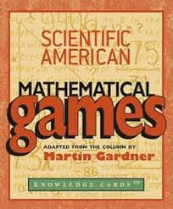
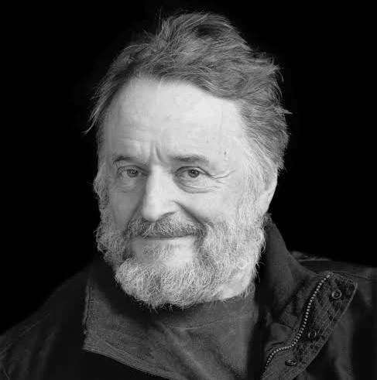
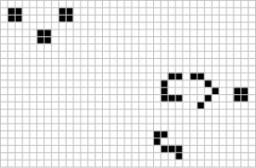
Introduction to the Game of Life
Mathematical Origins
Public Debut
Zero-Player Game
Emergent Complexity
Created by British mathematician John Horton Conway in 1970. One of the most celebrated discoveries in recreational mathematics.
Introduced in Martin Gardner's "Mathematical Games" column in Scientific American, October 1970. Spread rapidly among computer scientists.
Evolution is determined solely by the initial configuration. No further human input required — the rules run themselves to completion.
Demonstrates how extraordinarily complex behavior can emerge from just two states (alive/dead) and four simple transition rules.

Slide 4
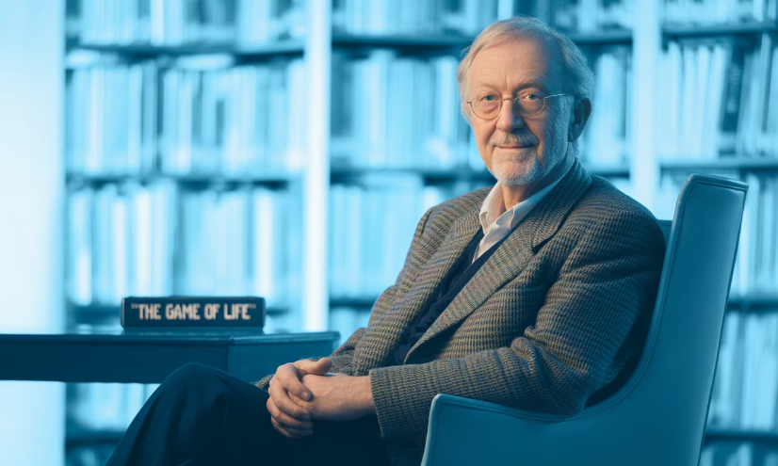
John Horton Conway (1937–2020)
Mathematical Legacy
Honors & Recognition
John Horton Conway was one of the most creative mathematicians of the 20th century. He made fundamental contributions to: · Group theory (Monster group and Monstrous Moonshine) · Knot theory · Number theory (surreal numbers) · Combinatorial game theory Known for his playful approach to serious mathematics, his ability to explain deep ideas informally, and his infectious love of puzzles.
Fellow of the Royal Society · Berwick Prize · Pólya Prize
Full Professor at Princeton University (1986–2020)
"I'm interested in having fun." — Conway
Conway died on April 11, 2020,. He had once said the Game of Life was the achievement he was most proud of — and also the one that annoyed him most, as it overshadowed his deeper mathematical work.

Slide 5


The Rules of Life
The Universe
Neighborhood
Survival Rule
Birth Rule
An infinite two-dimensional grid of square cells. Each cell can be in one of two states: alive (on) or dead (off).
Each cell interacts with its 8 adjacent neighbors — horizontally, vertically, and diagonally surrounding it.
A live cell with exactly 2 or 3 live neighbors survives to the next generation. All other live cells die (underpopulation or overcrowding).
A dead cell with exactly 3 live neighbors becomes alive in the next generation. All other dead cells remain dead.
Notation: B3/S23 — Born with 3 neighbors, Survives with 2 or 3 neighbors. This is the only rule set Conway settled on after extensive testing.

Slide 6
Conway's Design Goals
Unlimited Growth
Emergent Complexity
Unpredictability
Balanced Dynamics
Create patterns that could grow without a clear limit — disproving the assumption that all starting configurations must eventually stabilize.
Generate rich, unpredictable complexity from the simplest possible initial configurations — just a handful of cells.
Make long-term evolution difficult or impossible to predict without actually running the simulation step by step.
Neither grow too quickly (filling the grid) nor die out too easily — strike a balance between order and chaos.
Conway reportedly spent 18 months testing rules before settling on B3/S23. Many rule sets either explode immediately or die out within a few generations.

Slide 7
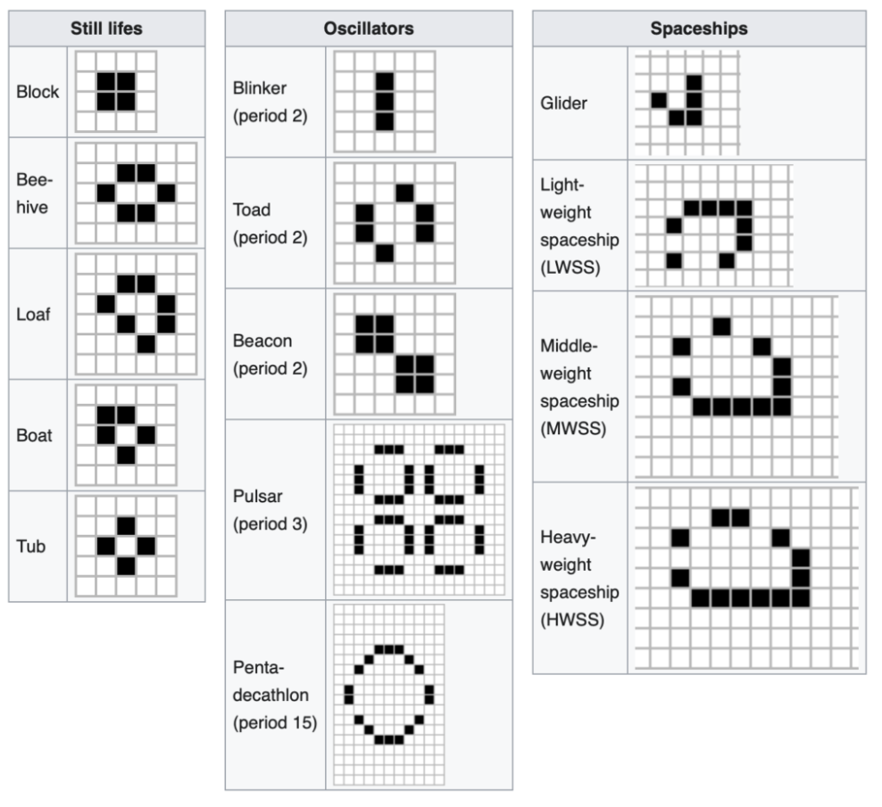
2
Patterns
Still lifes, oscillators, spaceships, and Methuselahs

Slide 8

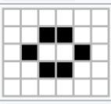
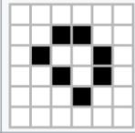
Common Patterns: Still Lifes
Still lifes are stable patterns that don't change from one generation to the next. They demonstrate how certain configurations achieve perfect equilibrium between the birth and survival rules.
Block (4 cells)
Beehive (6 cells)
Loaf (7 cells)
The simplest still life: a 2×2 square. Each of the 4 live cells has exactly 3 live neighbors — ensuring survival. Each adjacent dead cell has exactly 2 live neighbors — preventing birth. Discovered immediately when the game was first played.
A hexagonal shape that is the most common still life found in random soup experiments. Each live cell has 2 or 3 live neighbors; border dead cells have at most 2. Extremely stable and frequently produced by other patterns.
An asymmetric still life slightly more complex than the beehive. Particularly interesting because it is asymmetric yet perfectly stable. Common in random soups and frequently produced as the endpoint of pattern evolution.

Slide 9

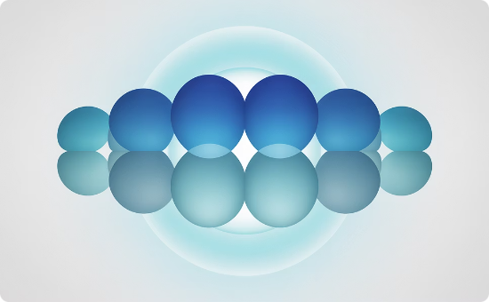

Common Patterns: Oscillators
Oscillators are patterns that return to their initial state after a fixed number of generations (their period). They cycle indefinitely without moving.
Blinker (period 2)
Toad (period 2)
Pulsar (period 3)
Three cells in a row. The simplest oscillator in Life — alternates every generation between a horizontal and vertical bar. Incredibly common in random experiments and pattern evolution.
Six cells that oscillate between two configurations with period 2 in a toad-like pattern. One of the smallest period-2 oscillators. Often produced near the end of pattern evolution from random soups.
A complex 48-cell pattern with 12-fold symmetry and period 3. The most common period-3 oscillator. Visually striking and was among Conway's early discoveries. Frequently emerges from collisions between larger patterns.
Notable: Pentadecathlon (period 15) is one of the longest-period oscillators in the standard Life rule set.

Slide 10
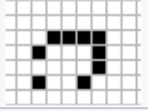
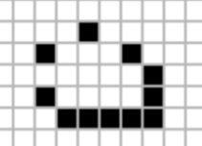
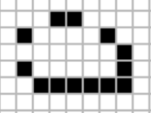
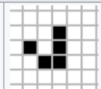
Common Patterns: Spaceships
Spaceships are patterns that move across the grid, returning to their original shape (possibly translated or rotated) after some number of generations.
Glider (5 cells)
LWSS (9 cells)
MWSS (11 cells)
HWSS (13 cells)
The smallest and most famous spaceship. Moves diagonally at speed c/4 (one cell every 4 generations). Discovered by Richard Guy in 1970. Has become the unofficial symbol of the Game of Life and hacker culture.
Lightweight Spaceship. The smallest orthogonally-moving spaceship, travelling at c/2. Four natural variants. The workhorse of Life computation — used extensively in signal routing.
Middleweight Spaceship. Eleven cells, travels horizontally or vertically at c/2 like the LWSS. Slightly less common in random soups but plays a role in larger pattern constructions.
Heavyweight Spaceship. Thirteen cells, also at c/2. Maintains stability while moving across the grid. All three orthogonal spaceships share the same speed and similar structure.

Slide 11
Remarkable Discoveries: Methuselahs
Methuselahs are small initial patterns that take a very long time to stabilize, generating large, complex populations along the way. Named after the biblical figure who lived 969 years.
R-pentomino (5 cells)
Diehard (7 cells)
Acorn (7 cells)
Lives for 1,103 generations before stabilizing. One of Conway's earliest discoveries. The simple 2×3 pattern with one corner missing produces 116 cells, 8 gliders, and numerous still lifes. The canonical example of a Methuselah.
A 7-cell pattern that completely disappears after exactly 130 generations — leaving nothing behind. Demonstrates that not all long-lived patterns stabilize to a static population; some simply vanish.
Seven cells arranged asymmetrically that takes 5,206 generations to stabilize, producing 633 cells and 13 gliders. One of the most extreme Methuselahs known, discovered by Charles Corderman in 1971.
https://www.youtube.com/watch?v=bTPN3spiq1I

Slide 12
3
Remarkable Discoveries
Glider guns, eaters, logic gates, and self-replication

Slide 13
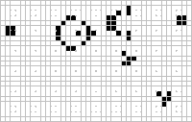
Remarkable Discoveries: Glider Gun
1
Conway's Challenge
2
Gosper's Discovery
Conway conjectured in 1970 that no finite initial pattern could produce an unbounded number of cells. He offered $50 to anyone who could prove or disprove this.
Bill Gosper at MIT discovered the Glider Gun in November 1970, winning the prize. The pattern uses 36 cells and emits a new glider every 30 generations.
3
Operation
4
Impact on Computation
The gun oscillates with period 30, periodically emitting gliders that travel diagonally away from it. The first pattern proven to grow indefinitely.
The Glider Gun became the foundation for building logic circuits within Life. Gliders act as signals; guns provide a continuous clock pulse for computation.

Slide 14
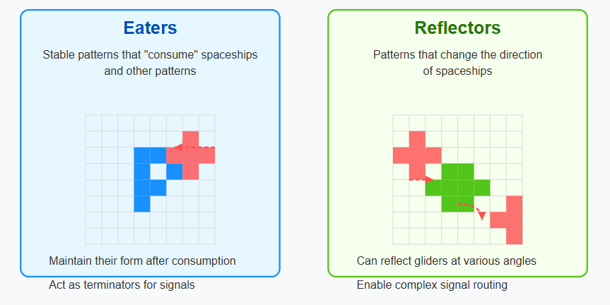
Remarkable Discoveries: Eaters and Reflectors
Two essential classes of static structures that enable controlled computation by managing glider signals.
Eaters
Reflectors
The Eater-1 (7 cells) is the simplest and most common eater. It absorbs gliders and other small patterns that collide with it while restoring its own shape completely. Key properties: · Maintains its form after consuming a glider
· Acts as a signal terminator
· Essential for controlled computation
· Can absorb signals from specific directions
Reflectors redirect gliders at specified angles while restoring their own shape, allowing signal routing in complex computation circuits. Key properties: · Can reflect gliders at 90° or 180°
· Enable complex signal routing
· Create computational logic circuits
· Period-1 reflectors allow full speed routing

Slide 15
Variations of the Game of Life
Life is just one of infinitely many outer-totalistic cellular automata. Changing the birth/survival counts yields radically different behaviors.
Rule Notation | Name | Description | Special Properties
B3/S23 | Standard Life | The canonical Game of Life — balanced birth and survival rules | Balance of chaos and order; Turing-complete
B36/S23 | HighLife | Adds birth at 6 neighbors to the standard rules | Self-replicating glider exists; similar chaos to Life
B3678/S34678 | Day & Night | Symmetric rule: complement of a pattern behaves identically | Dead and alive regions are interchangeable
B2/S | Seeds | All live cells die each step; born only with exactly 2 neighbors | Explosive growth that never stabilizes
B368/S245 | Morley | Also known as Move — spaceships travel at c/4 diagonally | Has a natural replicator called the 'spacefiller'

Slide 16
4
Computation & Theory
Universality, self-replication, and philosophical implications

Slide 17
Computational Universality
Game of Life is Turing-complete — it can compute anything that is algorithmically computable.
Logic Gates
Turing Machine in Life
Universal Constructor
AND: two glider streams collide only when both are present. OR: either stream triggers an output. NOT: a glider destroys an incoming signal stream.
These three gates are sufficient to implement any Boolean circuit.
Paul Rendell (2000) constructed a working Turing machine entirely within Life. A complete universal computer running Life inside Life also exists — demonstrating infinite recursive simulation is theoretically possible.
A Universal Constructor is a pattern that, given a description of any Life pattern as input (encoded as a glider stream), builds that pattern at a remote location. The existence of such constructors was proven in the 1990s.

Slide 18
Self-Replication in Life
Can a pattern in Life build an exact copy of itself? Yes — and this has profound implications for theories of life, computation, and von Neumann's original question.
1
Pattern Reading
2
Interpretation
The initial pattern contains both an 'instruction tape' (description of the pattern) and a construction arm. The instruction tape is read like a genetic sequence.
Instructions are decoded from the glider stream into a sequence of construction operations. The construction arm reads these and determines where each cell must be placed.
3
Construction
4
Activation
The construction arm builds a new copy of the original pattern cell by cell at a remote location, following the decoded instructions exactly.
Once construction is complete, the copy is activated and begins its own replication cycle — creating a potentially infinite chain of self-reproducing machines.

Slide 19
Philosophical Implications
Emergence
Determinism vs. Unpredictability
Levels of Description
Artificial Life
Profoundly complex phenomena — gliders, guns, computers — arise from just four rules applied to binary cells. No central controller; no global plan. Order from local interactions.
The system is completely deterministic: the same initial state always produces the same future. Yet predicting the outcome of most configurations requires running them — there is no shortcut.
Patterns and behaviors exist at multiple levels: cell states, local patterns (gliders), functional modules (gates), and complete computers. Each level has its own valid description language.
Life blurs the boundary between living and non-living. Self-replicating, computing, evolving patterns challenge definitions of life — and suggest that life itself may be a computational process.

Slide 20
5
Applications & Connections
Science, biology, ecology, and cultural impact

Slide 21
Applications in Science
Complex Systems Modeling
Pattern Formation
Artificial Life Research
Education
Life illustrates how global order emerges from local interactions — a core principle of complex systems science. Used to study phase transitions, self-organized criticality, and edge-of-chaos dynamics.
Models for biological pattern development (Turing patterns, morphogenesis). Cellular automata frameworks derived from Life are used to simulate reaction-diffusion systems and developmental biology.
Life is a prototype for studying artificial life forms — entities that exhibit lifelike behaviors (metabolism, reproduction, adaptation) in a computational substrate. Langton's Loops extend this directly.
One of the most effective teaching tools for computer science, mathematics, complexity theory, and programming. Widely used in introductory courses worldwide due to its simplicity and depth.

Slide 22

Connections to Biology and Ecology
Cellular Processes
Population Dynamics
Pattern Formation
Cell division, death, and interaction follow local rules. Life provides intuition for how multicellular organisms develop from single cells following simple genetic instructions. Cellular automata models of tumor growth use Life-like rules.
Spatial ecological models — including predator-prey lattice models and epidemiological spread — use Life-like frameworks. Local birth/death/movement rules produce observed spatial clustering and wave patterns.
Alan Turing's reaction-diffusion equations and Klausmeier's vegetation models produce stripe/spot patterns similar to Life patterns. The 'local rule → global pattern' principle is shared across all these systems.
https://packaged-media.redd.it/ze6aaqtc6h3c1/pb/m2-res_720p.mp4?m=DASHPlaylist.mpd&var=sgpssan&v=1&e=1779886800&s=ba507a452764c30317808e7f10c5c344477b4484

Slide 23
Connections to Biology and Ecology
Emergence in Ecosystems
Limitations
Research Directions
Ecosystem-level properties (stability, resilience, biodiversity) emerge from species interactions, just as gliders emerge from cell rules. Neither is explicitly programmed — both arise from lower-level dynamics.
Life uses a uniform grid, synchronous updating, and binary states. Real biological systems have continuous values, asynchronous dynamics, stochasticity, and three-dimensional structure. Life is a metaphor, not a model.
Probabilistic cellular automata, off-lattice models, and agent-based systems extend Life's principles toward realistic ecological modeling while preserving the core insight: complexity from simplicity.
https://www.nature.com/articles/353255a0.pdf

Slide 24
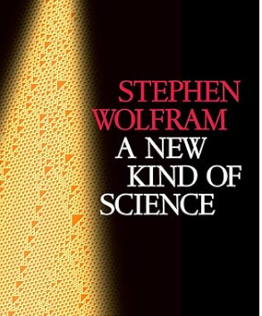
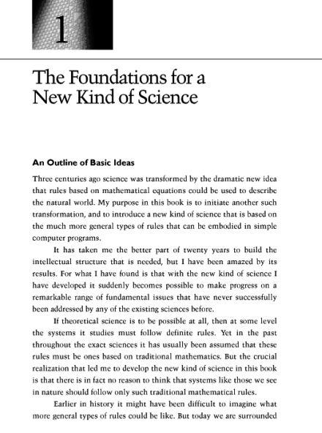
Cultural Impact
Digital Art & Generative Design
Education & Programming
Computing & Philosophy
Life is the foundation of algorithmic art. Its patterns — especially gliders and guns — appear in countless artworks, animations, and music visualizations. The glider became the hacker community's emblem, proposed by Eric Raymond in 2003.
Implementing Life is a classic programming exercise. It teaches 2D arrays, simulation loops, boundary conditions, and optimization. Many programmers cite Life as their first complex program. Still widely used in CS education.
Life influenced thinking in computer science (parallelism, cellular computation), philosophy of mind (substrate independence), and physics (digital physics hypothesis: Is the universe a cellular automaton?). Wolfram's 'A New Kind of Science' (2002) extends these ideas.
https://golly.sourceforge.io/

Slide 25
6
Further Exploration
Resources, simulators, and key references

Slide 26
Further Exploration
Key Books
Online Resources
Try It Yourself
· Gardner (1970): Scientific American articles
· Conway et al.: Winning Ways for Mathematical Plays (Vol. 2)
· Poundstone: The Recursive Universe (1985)
· Wolfram: A New Kind of Science (2002)
· Berlekamp et al.: Winning Ways (1982)
· LifeWiki (conwaylife.com/wiki) — the pattern encyclopedia
· Golly simulator — fast, multi-rule cellular automaton simulator
· ConwayLife.com forums — active community
· Paul Rendell's Turing Machine page
· catagolue.appspot.com — soup search statistics
· Copy a Life pattern from LifeWiki and paste into Golly
· Build a Glider Gun from scratch
· Start with a random soup and observe stabilization
· Implement Life in Python in under 30 lines
· Search for your own Methuselahs

Slide 27
References
[1] J. Conway, "The Game of Life," Scientific American, vol. 223, no. 4, pp. 4–10, 1970.
[2] M. Gardner, "Mathematical games: The fantastic combinations of John Conway's new solitaire game 'life'," Scientific American, vol. 223, no. 4, pp. 120–123, 1970.
[3] S. Wolfram, "Statistical mechanics of cellular automata," Reviews of Modern Physics, vol. 55, no. 3, pp. 601–644, 1983.
[4] S. Wolfram, A New Kind of Science, Wolfram Media, 2002.
[5] E. R. Berlekamp, J. H. Conway, and R. K. Guy, Winning Ways for Your Mathematical Plays, Volume 2, Academic Press, 1982.
[6] T. Toffoli and N. Margolus, Cellular Automata Machines: A New Environment for Modeling, MIT Press, 1987.
[7] B. Chopard and M. Droz, Cellular Automata Modeling of Physical Systems, Cambridge University Press, 1998.
[8] A. Ilachinski, Cellular Automata: A Discrete Universe, World Scientific, 2001.
[9] M. A. Nowak and R. M. May, "Evolutionary games and spatial chaos," Nature, vol. 359, pp. 826–829, 1992.
[10] R. M. May, "Simple mathematical models with very complicated dynamics," Nature, vol. 261, pp. 459–467, 1976.
[11] D. Tilman and P. Kareiva, Spatial Ecology: The Role of Space in Population Dynamics, Princeton University Press, 1997.
[12] S. A. Levin, "The problem of pattern and scale in ecology," Ecology, vol. 73, no. 6, pp. 1943–1967, 1992.
[13] A. Hastings, "Complex interactions between dispersal and dynamics," Ecology, vol. 74, no. 5, pp. 1362–1372, 1993.
[14] M. P. Hassell, H. N. Comins, and R. M. May, "Spatial structure and chaos in insect population dynamics," Nature, vol. 353, pp. 255–258, 1991.
[15] B. T. Grenfell, O. N. Bjørnstad, and J. Kappey, "Travelling waves and spatial hierarchies in measles epidemics," Nature, vol. 414, pp. 716–723, 2001.
Dr. Naomi Shpigel · Introduction to Ecological Modeling · Lec 5 — Game of Life

Slide 28
References (cont.)
[16] C. A. Klausmeier, "Regular and irregular patterns in semiarid vegetation," Science, vol. 284, no. 5421, pp. 1826–1828, 1999.
[17] M. Rietkerk and J. van de Koppel, "Regular pattern formation in real ecosystems," Trends in Ecology & Evolution, vol. 23, no. 3, pp. 169–175, 2008.
[18] R. Durrett and S. Levin, "The importance of being discrete (and spatial)," Theoretical Population Biology, vol. 46, no. 3, pp. 363–394, 1994.
[19] M. Begon, C. R. Townsend, and J. L. Harper, Ecology: From Individuals to Ecosystems, 4th ed., Blackwell, 2006.
[20] J. D. Murray, Mathematical Biology I: An Introduction, 3rd ed., Springer, 2002.
[21] J. D. Murray, Mathematical Biology II: Spatial Models and Biomedical Applications, 3rd ed., Springer, 2003.
[22] A. Okubo and S. A. Levin, Diffusion and Ecological Problems: Modern Perspectives, 2nd ed., Springer, 2001.
[23] M. Droz, A. Pękalski, and K. Sznajd-Weron, "Phase transitions in cellular automata models," Physical Review E, vol. 91, no. 2, pp. 022705, 2015.
[24] G. Ermentrout and L. Edelstein-Keshet, "Cellular automata approaches to biological modeling," J. Theoretical Biology, vol. 160, no. 1, pp. 97–133, 1993.
[25] M. A. Nowak, Evolutionary Dynamics: Exploring the Equations of Life, Harvard University Press, 2006.
[26] R. Sole and J. Bascompte, Self-Organization in Complex Ecosystems, Princeton University Press, 2006.
[27] C. Langton, "Computation at the edge of chaos," Physica D, vol. 42, pp. 12–37, 1990.
[28] S. Kauffman, The Origins of Order: Self-Organization and Selection in Evolution, Oxford University Press, 1993.
[29] P. Bak, C. Tang, and K. Wiesenfeld, "Self-organized criticality," Physical Review A, vol. 38, no. 1, pp. 364–374, 1988.
[30] M. Scheffer et al., "Early-warning signals for critical transitions," Nature, vol. 461, pp. 53–59, 2009.
Dr. Naomi Shpigel · Introduction to Ecological Modeling · Lec 5 — Game of Life

