Slide 1
Introduction to Ecological Modeling
Lec 5 — Series analysis - PCA
in Ecological Systems
Spatial and temporal analysis· Dimensionality Reduction · Eigendecomposition · Ecological Analysis
Dr. Naomi Unkelos-Shpigel

Slide 2
1
What is PCA?

Slide 3
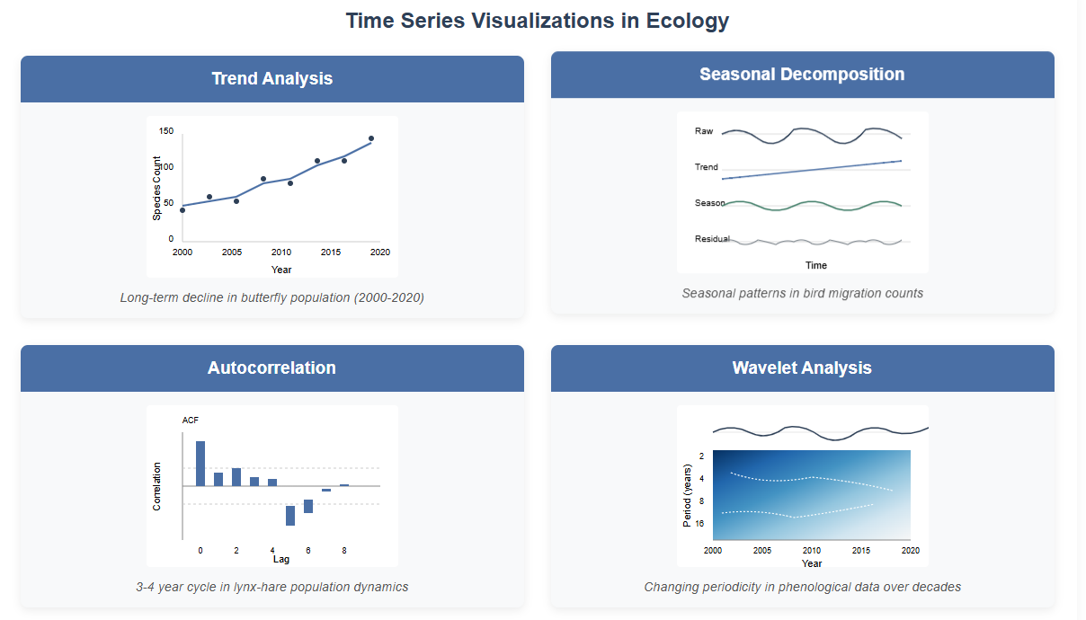
Temporal analysis

Slide 4
Principal Component Analysis (PCA)
PCA reduces the number of dimensions in large datasets while retaining most of the original information.
Definition
Key Uses
Why It Matters
PCA transforms potentially correlated variables into a smaller set of uncorrelated variables called principal components.
Developed by Karl Pearson in 1901, it became widely used with the rise of computational power.
· Visualizing high-dimensional ecological datasets
· Detecting trends, patterns, and outliers
· Data preprocessing for machine learning
· Extracting the most informative features
Each new feature added to a model negatively impacts performance — the 'curse of dimensionality.'
PCA solves this by compressing information without losing key patterns.
https://www.ibm.com/think/topics/principal-component-analysis

Slide 5
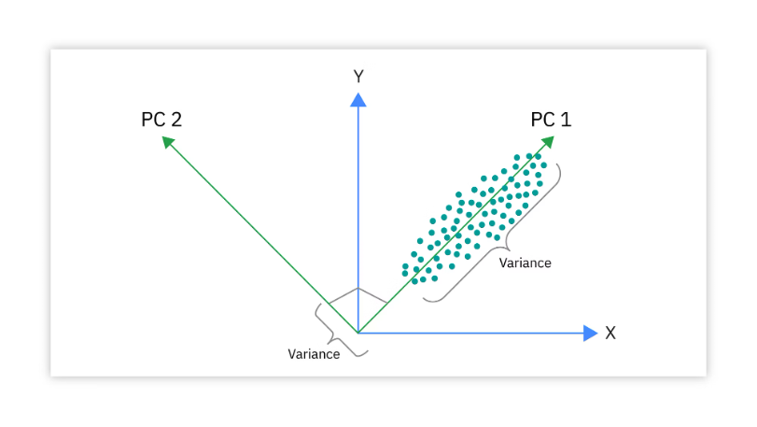
Understanding Principal Components
Each principal component captures a portion of variance in the data, ordered from most to least informative.
First Principal Component (PC1)
Second Principal Component (PC2)
PC1 is the direction in space along which the data points have the highest variance.
It is the line that best represents the shape of the projected data.
The larger the variability in PC1, the more information is retained from the original dataset.
No other component can have higher variability.
PC2 accounts for the next highest variance in the dataset.
Crucially, PC2 must be uncorrelated with PC1 — it is orthogonal (perpendicular) to PC1.
This means: correlation(PC1, PC2) = 0.
A scatterplot of PC1 vs. PC2 will always show perpendicular axes.
Key Property: Orthogonality
Each successive principal component explains the maximum possible remaining variance while being completely orthogonal to all previous components. This guarantees that principal components carry non-redundant information, making PCA ideal for ecological datasets where environmental variables are often correlated.

Slide 6
2
The PCA Workflow

Slide 7
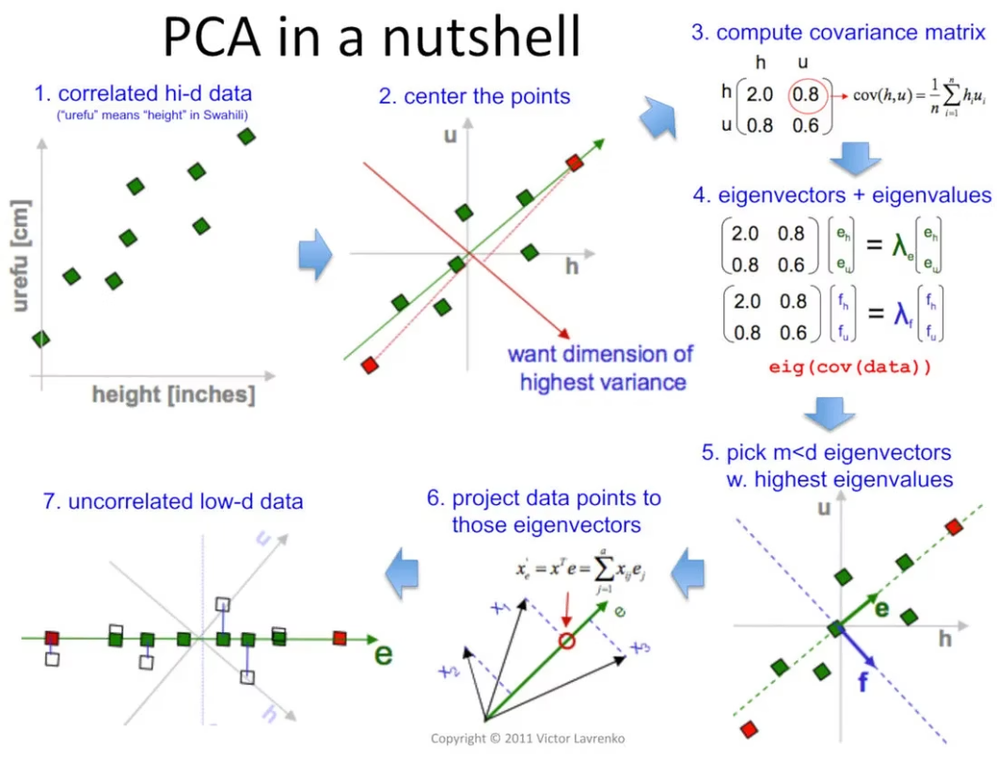
PCA in a nutshell
PCA workflow step by step

Slide 8
Step 1: Standardize the Data
PCA is sensitive to the scale of variables — standardization is always the first step.
Why Standardize?
The Formula
Variables with larger magnitudes would dominate the principal components if left unscaled.
For example: if one variable is measured in meters (0–5,000) and another as a proportion (0–1), PCA would treat the first as far more important.
Standardization transforms all features to have:
· Mean = 0
· Standard deviation = 1
This ensures equal contribution from each variable.
X_scaled = (X − μ) / σ
Where:
X = the original data matrix
μ = mean of each feature
σ = standard deviation of each feature
After standardization, the scaled data matrix X_scaled has:
· Each column with mean ≈ 0
· Each column with std dev = 1
In Python: sklearn.preprocessing.StandardScaler()
In R: scale(data)

Slide 9
Step 2: Compute the Covariance Matrix
Covariance measures how much two features vary together — the foundation for finding principal components.
What is Covariance?
The Formula
Covariance between two variables x and y:
· Positive: they increase together
· Negative: one increases as the other decreases
· Near zero: they are largely independent
The covariance matrix C is a square p×p matrix (where p = number of features).
It captures all pairwise relationships between variables.
In ecology: species abundance, temperature, and precipitation may all co-vary — the covariance matrix quantifies this structure.
C = (1/n) · X_scaledᵀ · X_scaled
For X_scaled with dimensions n × p:
C is a symmetric p×p matrix
Diagonal elements: variance of each feature
Off-diagonal: covariance between feature pairs
Key properties:
· Always symmetric: C = Cᵀ
· Positive semi-definite
· Diagonal values = variances ≥ 0
In Python: np.cov(X_scaled.T)
In R: cov(X_scaled)

Slide 10
Step 3: Compute Eigenvalues & Eigenvectors
Eigendecomposition finds the directions of maximum variance — the heart of PCA.
Cv = λv
Eigenvectors (v)
Eigenvalues (λ)
Selection Rule
Represent the directions of the principal components.
Each eigenvector defines an axis in the transformed space.
They are orthogonal to each other — guaranteeing uncorrelated components.
The eigenvectors are the 'new axes' onto which data is projected.
Measure the amount of variance captured by each eigenvector.
Larger eigenvalue = more variance explained = more information.
Sorted in descending order: PC1 has the largest eigenvalue.
Used to calculate the proportion of variance explained by each component.
After sorting eigenvalues, select the top k eigenvectors.
Common rules:
· Keep components explaining >80% cumulative variance
· Kaiser rule: keep eigenvalues > 1
· Scree plot: look for the 'elbow'
This reduces p dimensions to k dimensions.

Slide 11
Steps 4 & 5: Select Components & Project Data
The final steps complete the dimensionality reduction by selecting and applying the principal components.
Step 4: Select Top k Components
Step 5: Project the Data
Rank all eigenvalues in descending order.
Choose the top k eigenvectors that together capture sufficient variance (typically 80–95%).
How to decide k:
· Cumulative variance plot
· Scree plot — look for the 'elbow'
· Kaiser criterion: eigenvalue > 1
Example: In a 15-variable ecological dataset, the first 3 PCs might explain 85% of variance — reducing 15 dimensions to 3.
Z = X_scaled · W
Where W is the matrix of top k eigenvectors.
Z is the reduced dataset: n rows × k columns
This new representation:
· Has k << p dimensions
· Preserves most of the variance
· Removes redundant correlations
In Python: pca = PCA(n_components=k)
Z = pca.fit_transform(X_scaled)
In R: prcomp(X_scaled, scale=TRUE)

Slide 12
PCA Workflow Summary
1
2
3
4
5
Standardize
Covariance
Matrix
Eigen
Decomposition
Select
Components
Project
Data
Center mean to 0, scale variance to 1
Compute pairwise feature relationships
Find eigenvectors and eigenvalues
Keep top k components by variance
Transform to reduced k-dimensional space
Python Implementation
from sklearn.preprocessing import StandardScaler
from sklearn.decomposition import PCA
scaler = StandardScaler()
X_scaled = scaler.fit_transform(X)
pca = PCA(n_components=0.85) # keep 85% variance
Z = pca.fit_transform(X_scaled)

Slide 13
3
PCA in Ecology

Slide 14
Example 1: Community Composition in Forest Plots
50 forest plots × 12 tree species abundance → reduced to 2 principal components.
The Dataset
Ecological Interpretation
Plot
Oak
Pine
Beech
Birch
...
PC1 — Moisture Gradient (48%)
Plot 1
42
3
17
0
...
High positive loadings: Oak, Beech (mesic species)
High negative loadings: Pine, Birch (xeric species)
Interpretation: PC1 separates dry vs. wet forest types
Plot 2
5
38
2
21
...
Plot 3
0
41
1
33
...
Plot 4
31
8
22
4
...
PC2 — Disturbance Axis (23%)
...
...
...
...
...
...
High positive loadings: Birch, Aspen (pioneer species)
High negative loadings: Beech, Spruce (late-successional)
Interpretation: PC2 captures disturbance history
12 species variables, 50 plots
After standardization → covariance matrix → eigendecomposition:
PC1 explains 48% variance
PC2 explains 23% variance
Total: 71% with just 2 components
Result: Plotting PC1 vs PC2 reveals two distinct forest clusters — wet mature forest vs. dry disturbed forest — that were invisible in the raw 12-variable data.

Slide 15
Example 2: Environmental Gradient Analysis
8 correlated climate variables across 120 sites → 2 PCs explain 81% of variance.
Input Variables (8)
PC Loadings
Result
Mean Annual Temperature
PC1 — Temperature Axis (53%)
PC2
Min Winter Temp
Mean Temp
0.91
Max Summer
0.88
Max Summer Temp
Min Winter
0.85
PC1
Annual Precipitation
Humidity
0.62
Summer Precipitation
Precip
0.41
Mediterranean
Temperate
Relative Humidity
PC2 — Precipitation Axis (28%)
Boreal
Annual Precip
0.89
Solar Radiation
Summer Precip
0.84
Wind Speed
Wind Speed
0.71
3 climate zones emerge clearly from 8 correlated variables — no pre-labeling required.

Slide 16
Example 3: Morphological Variation in Bird Species
6 body measurements across 3 finch species (n=180) — can PCA separate them without using species labels?
Variables Measured
PCA Findings
Ecological Meaning
Bill length (mm)
PC1 (61%): overall body size — all variables load positively
PC1 = body size axis: separates large vs. small species
Bill depth (mm)
PC2 (19%): bill shape — bill depth & width vs. wing & tarsus
PC2 = bill morphology axis: linked to dietary niche
Bill width (mm)
PC3 (9%): residual variation
Species clusters reflect resource partitioning
Wing chord (mm)
PC1 + PC2 = 80% total variance
No labels needed — PCA 'discovers' the groupings
Tarsus length (mm)
3 species form distinct clusters on PC1–PC2 biplot
Used in studies of adaptive radiation (e.g. Darwin's finches)
Body mass (g)

Slide 17
Reading a Scree Plot & Choosing Components
The scree plot shows eigenvalues in descending order. The 'elbow' marks how many components to keep.
5
Variance Explained
4.8
elbow
PC
Eigenvalue
% Variance
Cumulative
4
1
4.80
60.0%
60.0%
Eigenvalue
2
2.10
26.3%
86.3%
3
3
0.90
11.2%
97.5%
2.1
4
0.50
6.3%
103.8%
2
5
0.35
4.4%
—
6
0.22
2.8%
—
1
0.9
7
0.08
1.0%
—
0.5
8
0.07
0.9%
—
0
PC1
PC2
PC3
PC4
PC5
PC6
PC7
PC8
Principal Component
Decision: Keep PC1 and PC2 (86.3% cumulative variance, elbow at PC3). This is a common outcome in ecological datasets — a small number of components capture most biological signal.

Slide 18
4
Exercise and additional methods

Slide 19
PCA Analysis Exercise
Analyze Vulnerabilities: Discuss climate change impacts on energy flow and propose conservation solutions.
Explore the Dataset
Apply PCA
Interpret Results
Open the provided ecological dataset.
Identify the variables and their units.
Check for missing values and outliers.
Describe what each variable represents ecologically.
Standardize all variables.
Compute the covariance matrix.
Extract eigenvalues and eigenvectors.
Decide how many components to retain using a scree plot.
Plot PC1 vs. PC2 as a biplot.
Identify which variables load heavily on each component.
Interpret the ecological meaning of each axis.
Link PCA findings to climate change vulnerability.
Work in teams. Document your assumptions and model limitations. Be prepared to present results to the class.

Slide 20
Multivariate Statistical Methods in Ecology
PCA is one of several multivariate techniques used to analyze complex ecological data.
Method
Purpose & Application
Principal Component Analysis (PCA)
Dimension reduction; find main axes of variation
Cluster Analysis
Group similar observations or species together
Discriminant Analysis
Classify observations into predefined groups
Canonical Correspondence Analysis (CCA)
Species–environment relationships; constrained ordination
Non-metric MDS (NMDS)
Ordination based on rank dissimilarities; community data
Structural Equation Modeling (SEM)
Test causal pathways and latent variable relationships

Slide 21
Resources for Ecological Data Analysis
Programming Libraries
Key Texts
Online Resources
R: vegan, ade4, lme4, nlme, mgcv
Gotelli & Ellison (2004). A Primer of Ecological Statistics. Sinauer.
Ecological Society of America: esa.org
Python: scipy.stats, scikit-learn, statsmodels
Quinn & Keough (2002). Experimental Design & Data Analysis. Cambridge.
Khan Academy — Photosynthesis & Ecology
QGIS and GeoDa for spatial analysis
Edelstein-Keshet (2005). Mathematical Models in Biology. SIAM.
DataCamp: Ecological Statistics in R
EcoSimR — null model analysis
Odum, H.T. (1994). Ecological and General Systems.
IBM: PCA Explained — ibm.com/think/topics/pca
ggplot2 — publication-quality graphics
Lindeman (1942). Trophic-Dynamic Aspect of Ecology.
Wolfram Demonstrations: ecological models

