Slide 1


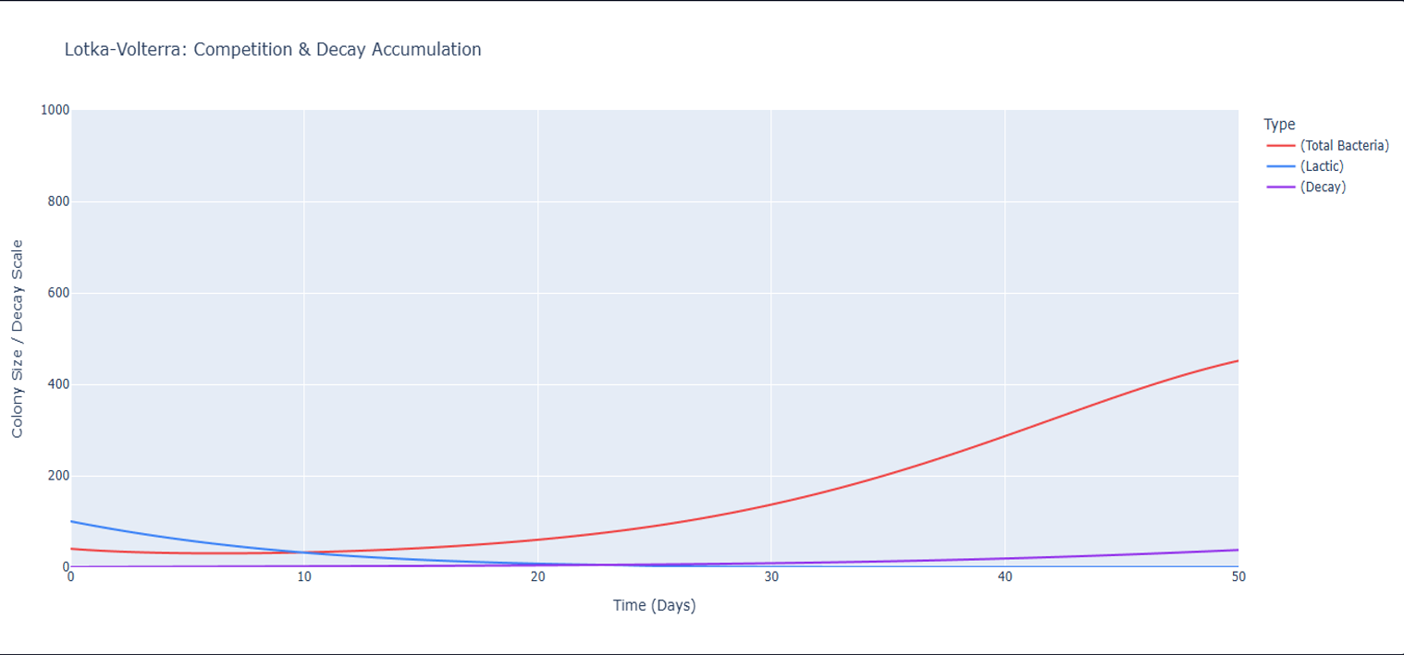
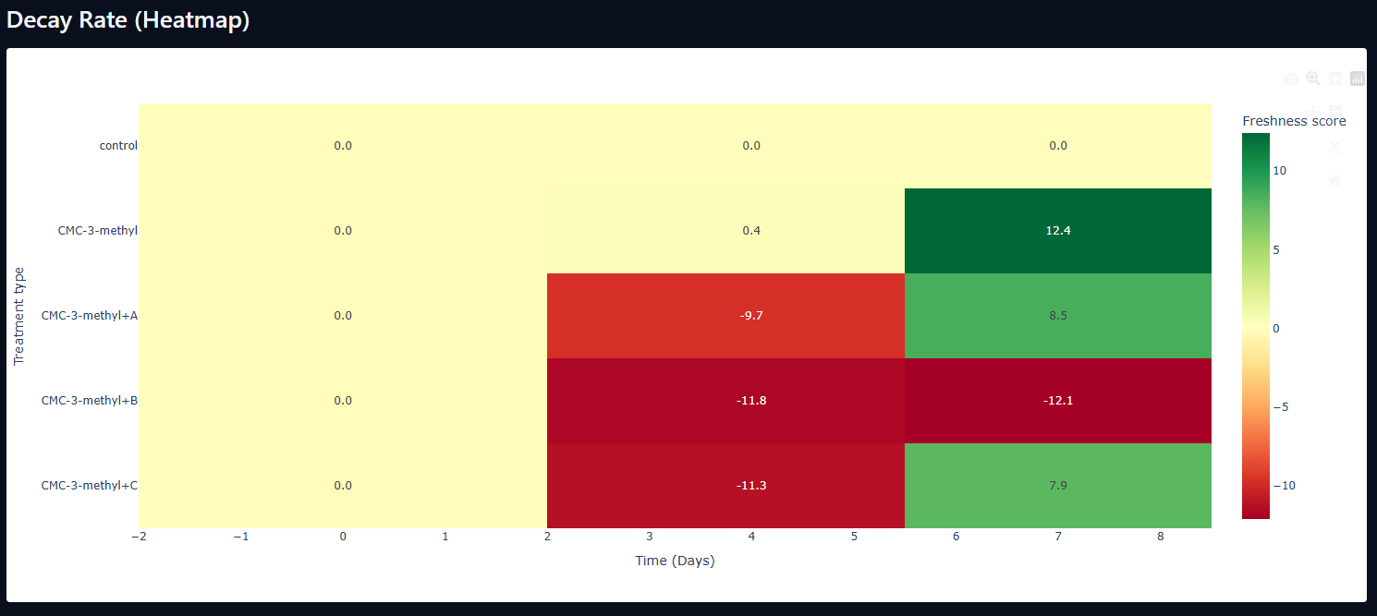



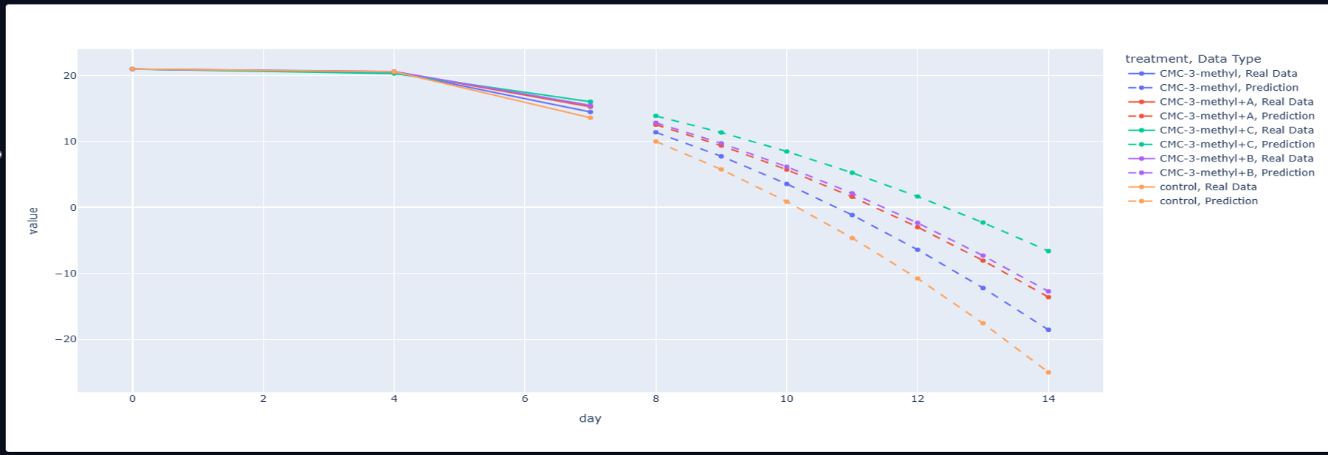



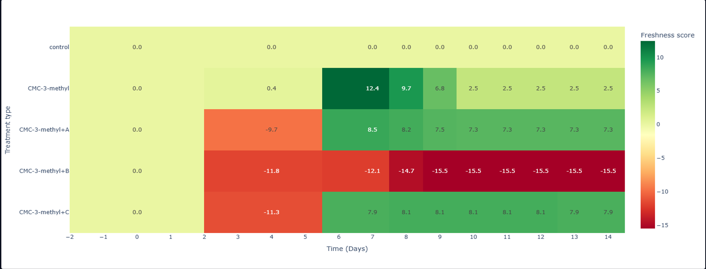
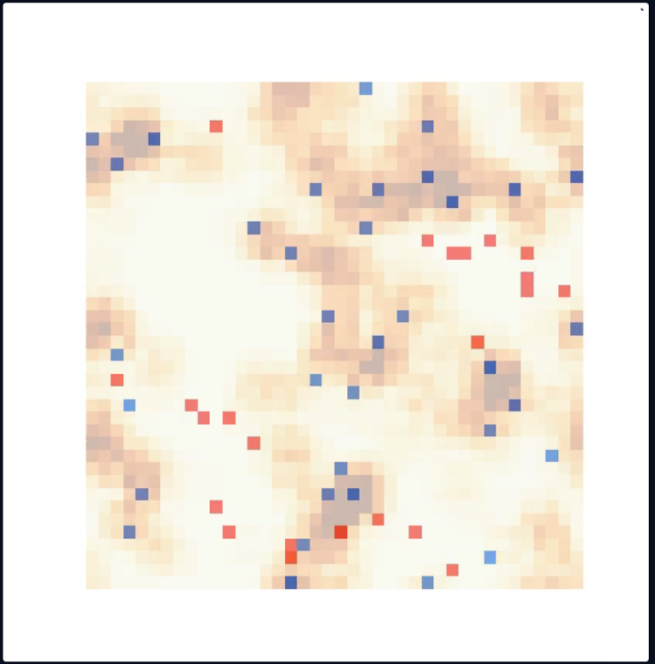
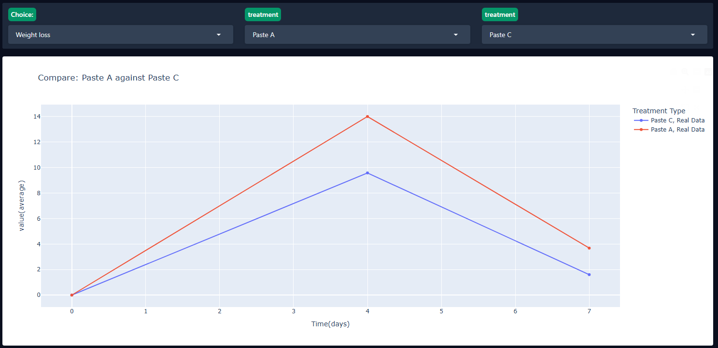
CROP SURVIVE
Engineering Platform for Shelf-Life Prediction
Developed & Presented by: Yoni Grinberg | Supervisor: Dr. Unkelos Shpigel Naomi
RESEARCH QUESTIONS
LOTKA-VOLTERRA COMPETITION MODEL
DECAY RATE HEATMAP (Day 7)
Hypothesis 1 — Inhibition
Competitive bacterial dynamics — 50-day simulation of spoilage vs. protective populations
Formulation × Time — decay score comparison
Will a higher concentration of protective lactic acid bacteria inhibit the replication of spoilage microflora, thereby reducing the overall decay rate of the lettuce?
Hypothesis 2 — Kinetics
Will the overall rate of lettuce tissue decay accelerate over time as a direct consequence of the natural mortality and depletion of the protective lactic bacteria?
Bacteria Competition
Decay Kinetics
Shelf-Life Extension
KEY FINDINGS
STUDY DESIGN
PREDICTIVE SHELF-LIFE ESTIMATION
CMC-3-methyl+C exhibits superior decay mitigation, yielding outstanding structural integrity preservation vs. untreated control by Day 7.
Formulations
2nd-degree polynomial regression — decay score by formulation over 14 days
4 distinct bio-coating formulations evaluated across all experimental conditions — including an untreated control group for baseline comparison.
2nd-degree polynomial regression delivers highly stable predictive trends on sparse datasets (Days 0, 4, 7) without overfitting — ideal for low-density lab data.
Lotka-Volterra ODE + ABM successfully replicate post-harvest tissue decay tipping points, providing accurate qualitative validation for experimental observations.
★ Top Performer: CMC-3-methyl+A
Most effective bio-coating across all measured metrics
Timeline
CONCLUSIONS & RECOMMENDATIONS
21-day post-harvest study with structured data collection at Days 0, 4, and 7 — capturing early, mid, and late-stage decay progression.
Prioritize Microbial Bio-Coatings
AGENT-BASED MODEL (ABM)
Deploy CMC-3-methyl+A to significantly extend commercial shipping windows and reduce post-harvest losses.
Spatial decay distribution across 50×50 cell grid — microbial competition
Lactic Bacteria
Use Deterministic Fitting Algorithms
Emitted Ph
Prefer 2nd-degree polynomial regression over complex neural networks for sparse lab datasets.
Destructive bacteria's
Decayed cells
Severe (tissue collapse)
Embed Real-Time Decay Sliders
Data Acquisition
The spatial ABM distributes 50×50 agents across simulated lettuce tissue. Each agent's state (healthy → decaying → necrotic) is governed by:
• Local lactic acid bacteria density
• Spoilage microflora competition
• Nutrient availability & edge-proximity
Decay propagates outward from the lettuce edge inward — matching observed real-world spoilage patterns. The model successfully replicates post-harvest tissue decay "tipping points" validated against experimental data.
This approach enables simulation of uneven spoilage across bulk storage containers, giving growers and logistics teams actionable insight into shelf-life variability before shipment.
Integrate dynamic decay estimation tools in grower-facing logistics software for live shelf-life projections.
Multiple dependent variables tracked across all formulations and control groups, including visual tissue integrity, microbial counts, Co2 & O2 emissions, weight loss and structural measurements,
Apply ABM simulation to model uneven decay distribution across bulk produce storage containers.
Analytical Framework
Integration of Principal Component Analysis (PCA), competitive Lotka-Volterra ODE solver, and spatial Agent-Based Modeling (ABM) to synthesize and validate decay kinetics across formulations.
STUDY LIMITATIONS
Low-density sampling intervals (Days 0, 4, 7 only)
Evaluation restricted to Romaine Lettuce tissue
Constant lab conditions — real-world shipping temperature & humidity stress not modeled
CROP SURVIVE · Engineering Platform for Shelf-Life Prediction · Braude College of Engineering
Yoni Grinberg
Supervisor: Dr. Unkelos Shpigel Naomi

