Slide 1
Unity 3D
Making a pong game
By Jason Wroe

Slide 2
What is Unity3D?
Unity3D is cross platform game engine which can be used to develop 3D and 2D video games.
Unity uses a system of GameObjects which contain a number of Components with different responsibility's such as Drawing a mesh, Sprite, Collision Box or Scripts.
Scripts are written in the C# programming language, Java can also be used.

Slide 3
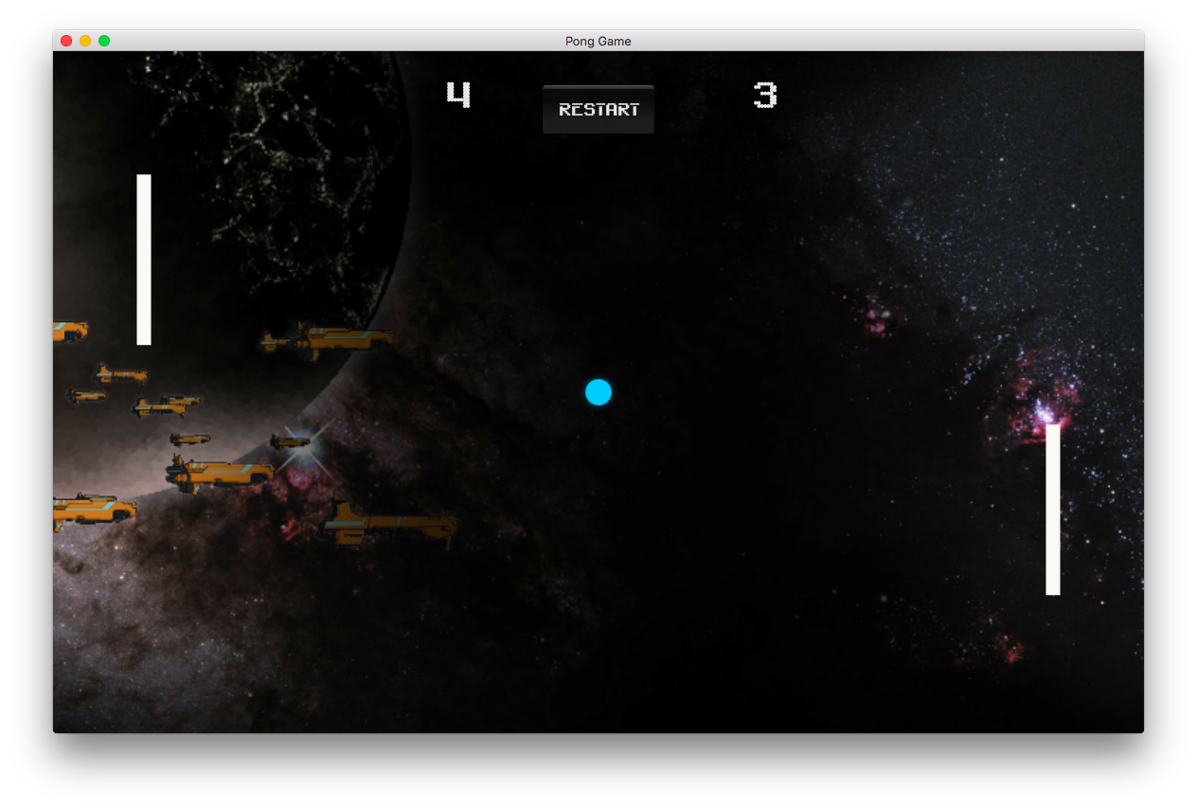
We are going to try create a simple 2d game - Pong

Slide 4
Install Unity and copy assets if you want to follow along. ☺
Copy “Pong Assets” folder onto your desktop.
www.awesomeincu.com/tutorials/unity-pong if you wish to continue this tutorial.
The Unity3D web site also has a lot of good tutorials as well as YouTube.
MSDN and google are good resources to learn C#
https://docs.microsoft.com/en-us/dotnet/csharp/quick-starts/

Slide 5
Challenge
Can you improve the user interface
Game Menu
Can you add different game modes
Squash, Doubles
Can you add juice ?
Ball trail
Screen shake
Can you add sound to the game?
Can you make the game 3D?
Use blender meshes or standard default meshes

