Slide 1
Angular2
HTML ve Javascript ( Typescript , Dart) tabanlı web application framework
HTML template’lerden (Angularized-markup) ,
Bu templateri yöneten ( render ve kullanıcı etkileşimi) Component’ler
Business logic olusturan ve Compoent tarafından kullanılan Servisler

Slide 2
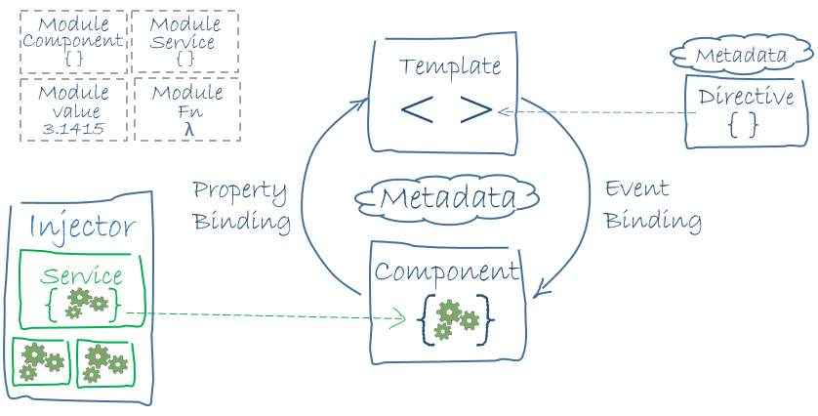

Slide 3
Teknolojiler
WebComponents (Custom elements, html imports, templates, Shadow Dom)
ES5 ,ES6( classes , interface, annotations ) , Typescript
Observables in RxJS

Slide 4
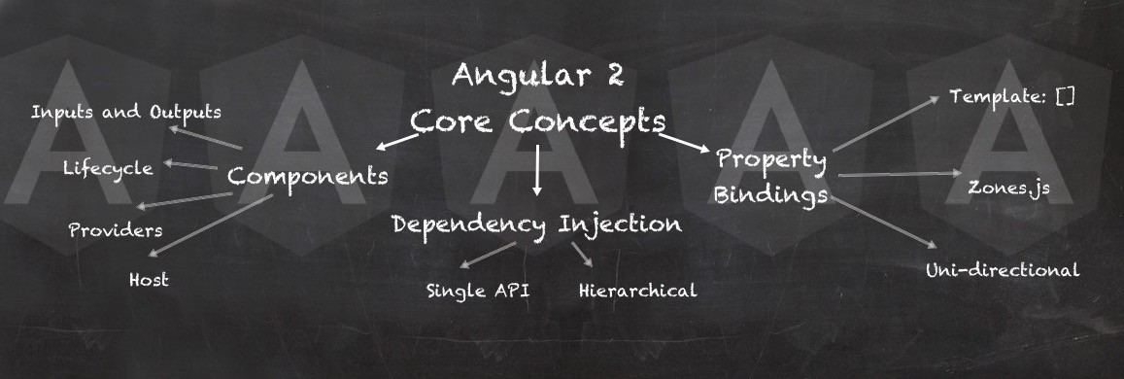
Angular2 Temel Kavramlar

Slide 5
Angular2 Temel Kavramlar
Components
Service ve Depency Injection
Data ve Property Binding
Directives
Pipes
Routing

Slide 6
Component
Ekranlar tamamem compoment tabanlı tasarlanır
Component’ler arasında parent->child hiyerarşi ( tree of components)
Template render/manage ve kullanıcı etkişimi
Extends Directive

Slide 7
Component Hiyerarşi
App Component
Dashbord component
Manage component
Stok summary list component
Stock detail component
Stock-summary component (1....n)

Slide 8
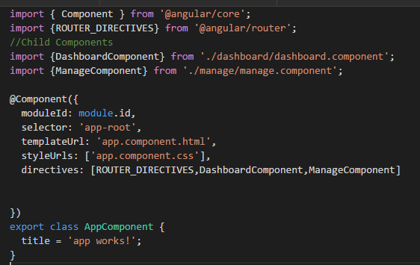
Component Syntax

Slide 9
Services & Dependency Injection
Register injector by Providers That create service instance for application
@Injectable
Hierarchical Dependency Injection system
Component level injection

Slide 10
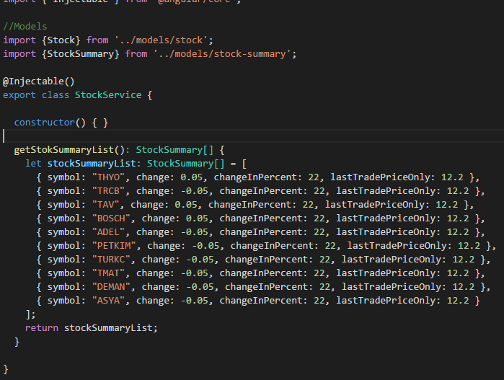
Syntax

Slide 11
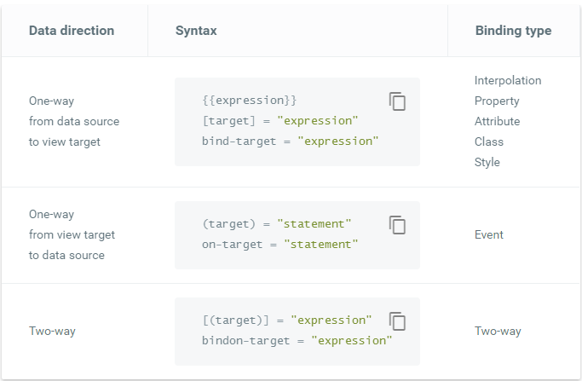
Property & Event Binding

Slide 12
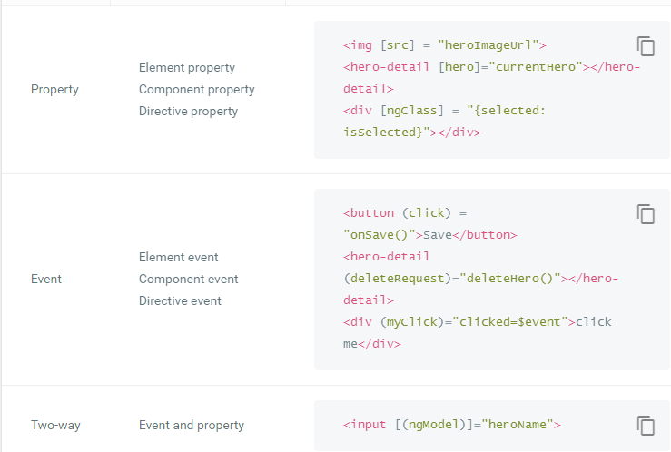
Property & Event Binding (@Input() & @Output() decarator)

Slide 13
Directives
<p [style.background]="'lime'">I am green with envy!</p>
Add behaviour to an existing DOM element
Compenents
Attribute Directives (change style , behaviour).
For example:<p [style.background]="'lime'">I am green with envy!</p>
Structure Directives ( change dom layout by adding or removing)
For example ng-if , ng-for

Slide 14
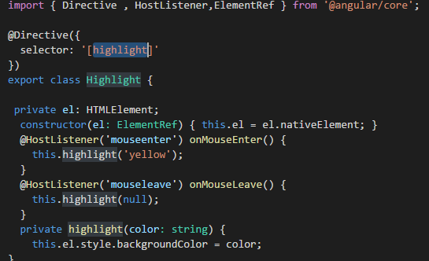
Directives

Slide 15
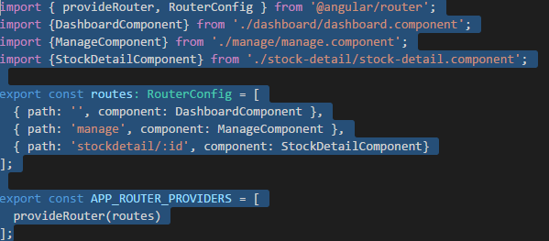
Routing

Slide 16
Http Service
Browser/server communication
Get ,post, put, delete
Observable instead of Promise (still you can promise)

