Slide 1
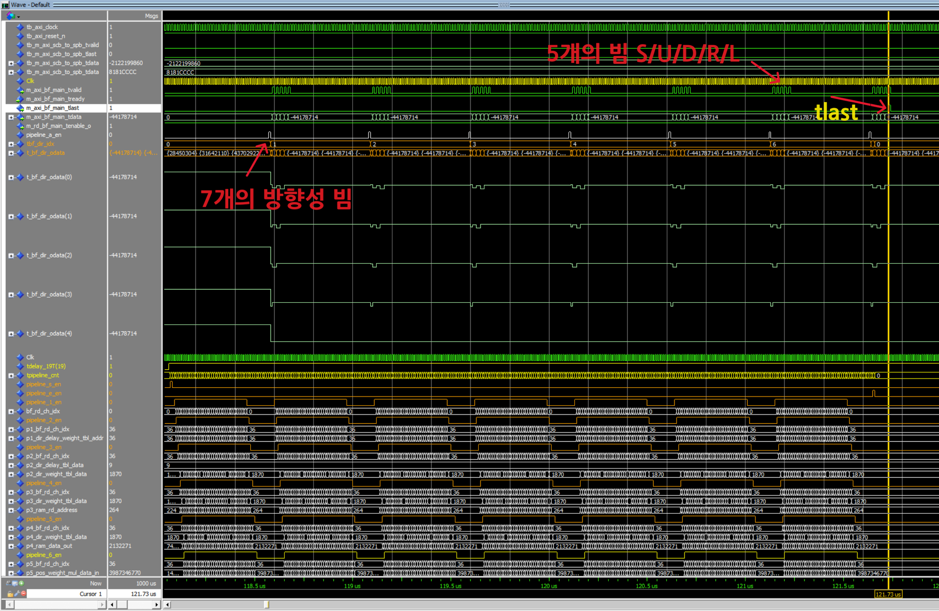
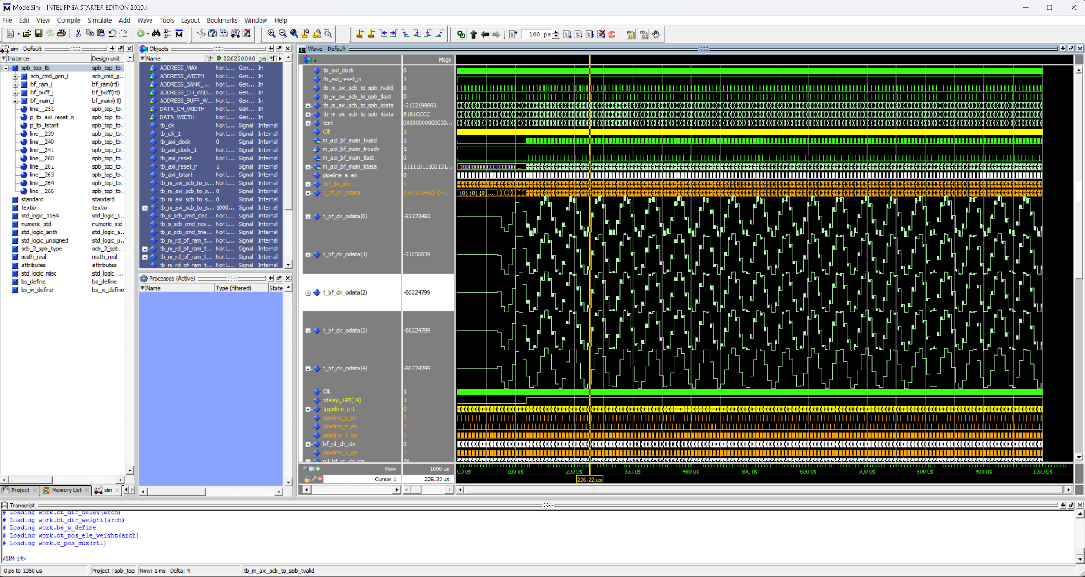
component scb_cmd_gen is
port (
m_axi_scb_to_spb_clk : out std_logic;
m_axi_scb_to_spb_tvalid : out std_logic;
m_axi_scb_to_spb_tlast : out std_logic;
m_axi_scb_to_spb_tdata : out std_logic_vector(31 downto 0);
--
s_scb_cmd_clock_i : in std_logic;
s_scb_cmd_reset_n_i : in std_logic;
s_scb_cmd_tnext_i : in std_logic
--
);
end component;
component scb_cmd_gen_table is
port (
m_axi_scb_to_spb_clk : out std_logic;
m_axi_scb_to_spb_tvalid : out std_logic;
m_axi_scb_to_spb_tlast : out std_logic;
m_axi_scb_to_spb_tdata : out std_logic_vector(31 downto 0);
--
s_scb_cmd_clock_i : in std_logic;
s_scb_cmd_reset_n_i : in std_logic;
s_scb_cmd_tnext_i : in std_logic
--
);
end component;
Spb_top_tb.vhd 에서 클럭과 리셋을 만들어서 scb_cmd_gen에 넣어 주어서 패킷을 생성하게 만들어서 bf_ram에 저장하게 합니다.
저장의 끝을 전파하여 bf_buff에서 읽어가서 채널 정보만 저장하게 됩니다. 18T 정보가 저장 이후에 bf_main 에서 다음 단계로 전송하게 됩니다.
그 이전에는 프로세싱을 하지만 전송은 하지 않습니다.
DPRAM
300 bytes
75 packet
32 bit
DOUBLE
BF
pipe line
DPRAM
64 CH
24 bit
32T
component bf_ram is
generic (
ADDRESS_MAX : natural := 75; -- 300 / 4 = 75
ADDRESS_WIDTH : natural := 7;
DATA_WIDTH : natural := 32
);
port (
s_axi_scb_to_spb_clk : in std_logic;
s_axi_scb_to_spb_reset_n : in std_logic;
s_axi_scb_to_spb_tvalid : in std_logic;
s_axi_scb_to_spb_tlast : in std_logic;
s_axi_scb_to_spb_tdata : in std_logic_vector(DATA_WIDTH - 1 downto 0);
--
s_rd_bf_ram_tenable_i : in std_logic;
s_rd_bf_ram_taddr : in std_logic_vector(ADDRESS_WIDTH - 1 downto 0);
s_rd_bf_ram_tdata : out std_logic_vector(DATA_WIDTH - 1 downto 0);
--
s_bf_ram_clock_i : in std_logic;
s_bf_ram_tnext_o : out std_logic
--
);
end component;
component bf_buff is
generic (
ADDRESS_MAX : natural := 75; -- 300 / 4 = 75
ADDRESS_WIDTH : natural := 7;
ADDRESS_BANK_WIDTH : natural := 5; -- 18T (32:5)
ADDRESS_CH_WIDTH : natural := 6; -- 37 ch (64:6)
ADDRESS_BUFF_WIDTH : natural := 11;
DATA_CH_WIDTH : natural := 24;
DATA_WIDTH : natural := 32
);
port (
m_rd_bf_ram_tenable_o : out std_logic;
m_rd_bf_ram_taddr : out std_logic_vector(ADDRESS_WIDTH - 1 downto 0);
m_rd_bf_ram_tdata : in std_logic_vector(DATA_WIDTH - 1 downto 0);
m_rd_bf_ram_tnext_i : in std_logic;
--
s_rd_bf_main_ram_tenable_i : in std_logic;
s_rd_bf_main_ram_taddr : in std_logic_vector(ADDRESS_BUFF_WIDTH - 1 downto 0);
s_rd_bf_main_ram_tdata : out std_logic_vector(DATA_CH_WIDTH - 1 downto 0);
--
s_bf_main_ram_tclock_i : in std_logic;
s_bf_main_ram_treset_n_i : in std_logic;
s_bf_main_ram_tnext_o : out std_logic
--
);
end component;
component bf_main is
generic (
ADDRESS_MAX : natural := 75; -- 300 / 4 = 75
ADDRESS_WIDTH : natural := 7;
ADDRESS_BANK_WIDTH : natural := 5; -- 18T (32:5)
ADDRESS_CH_WIDTH : natural := 6; -- 37 ch (64:6)
ADDRESS_BUFF_WIDTH : natural := 11;
DATA_CH_WIDTH : natural := 24;
DATA_WIDTH : natural := 32
);
port (
m_axi_bf_main_tvalid : out std_logic;
m_axi_bf_main_tready : in std_logic;
m_axi_bf_main_tlast : out std_logic;
m_axi_bf_main_tdata : out std_logic_vector(DATA_WIDTH - 1 downto 0);
--
m_rd_bf_main_tenable_o : out std_logic;
m_rd_bf_main_taddr : out std_logic_vector(ADDRESS_BUFF_WIDTH - 1 downto 0);
m_rd_bf_main_tdata : in std_logic_vector(DATA_CH_WIDTH - 1 downto 0);
m_rd_bf_main_tnext_i : in std_logic;
--
m_bf_main_ram_tclock_i : in std_logic;
m_bf_main_ram_treset_n_i : in std_logic;
m_bf_main_ram_tnext_o : out std_logic
--
);
end component;

