Slide 1
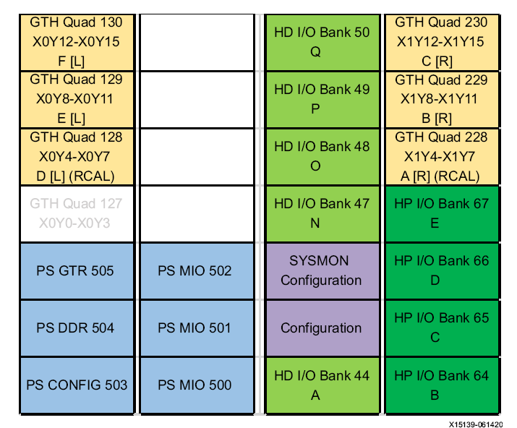
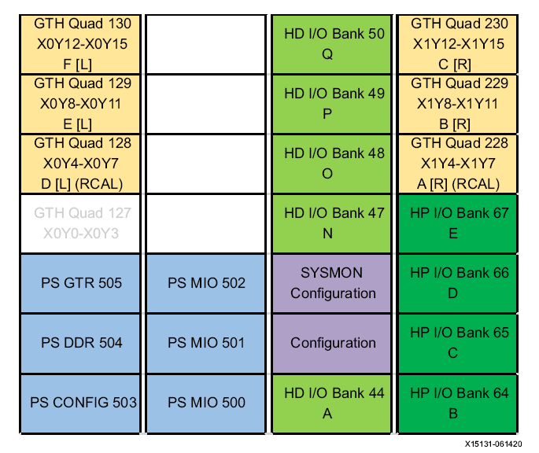
(XCZU15EG-ffvb1156-2-i)
(XCZU6CG-ffvb1156-2-i)
Simple Data Flow Chart for aurora module (v4)
AX7102 : XC7A100T-FGG484-2-I
AX7201 : XC7A200T-FBG484-2-I
AXU3EGB : XCZU3EG-SFVC784-1-I
AXU15EGB : XCZU15EG-FFVB1156-2-I
0,1,2,3,,35,36(S_L3),...,73,74(end) : 300 bytes
0,1,2,3,,35,36(ch1),,72(ch37),73,74(end) : 300 bytes
SP_SC(0):CLK1
CLK0(2)(X1Y14)
GTY Quad 230
X1Y12-X1Y15
AH_P1
XX(1)(X0Y4)
GTY Quad 128
X0Y4-X0Y7
P1_P2
CLK1(0)(X1Y12)
P1_AH
CLK1(2)(X1Y14)
P1_BF
CLK1(3)(X1Y15)
GTY Quad 230
X1Y12-X1Y15
b_rx
BS_AURORA_RX(1)
m_axis
BS_AURORA_RAM
m_rd
BS_AURORA_ATX_EXT
SP_SC(1):CLK1
CLK0(0)(X1Y12)
GTY Quad 230
X1Y12-X1Y15
BF_P1
XX(3)(X0Y7)
GTY Quad 128
X0Y4-X0Y7
AH_TE
CLK1(0)(X1Y8)
GTY Quad 229
X1Y8-X1Y11
AH_P2
XX(0)(X1Y4)
GTY Quad 228
X1Y4-X1Y7
P2_BF
CLK1(0)(X1Y12)
P2_AH
CLK1(2)(X1Y14)
P2_P1
CLK1(3)(X1Y15)
GTY Quad 230
X1Y12-X1Y15
DR_SP
CLK0(0)(X1Y4)
GTY Quad 228
X1Y4-X1Y7
b_tx
BS_AURORA_TX(1)
m_axis
DR_TE
CLK1(3)(X1Y15)
GTY Quad 230
X1Y12-X1Y15
DR_SP
CLK1(3)(X0Y15)
GTY Quad 130
X0Y12-X0Y15
BF_P2
XX(2)(X1Y6)
GTY Quad 228
X1Y4-X1Y7
a_rx
BS_AURORA_RX(0)
m_axis
BS_ILA_DEBUG
BS_SCB_DATA_RECORD_PIN
a_tx
BS_AURORA_TX(0)
m_axis
BS_AURORA_ATX_DATA_RAMP_GEN
CLK
BS_RESET_N
reset_n
BS_5US
5us
BS_CNT
BS_CNT
5sec
CLK
SFP1
CLK0(2)(X1Y6)
GTY Quad 228
X1Y4-X1Y7
SFP2
CLK0(0)(X1Y4)
GTY Quad 228
X1Y4-X1Y7
txd
BS_UART_TX_RD
m_rd
BS_UART_RAM_TX_32
m_axis
BS_UART_ATX_EXT
(75,8,32)
rxd
BS_UART_RX
m_axis
BS_UART_RAM_RX_32
m_rd

