Slide 1
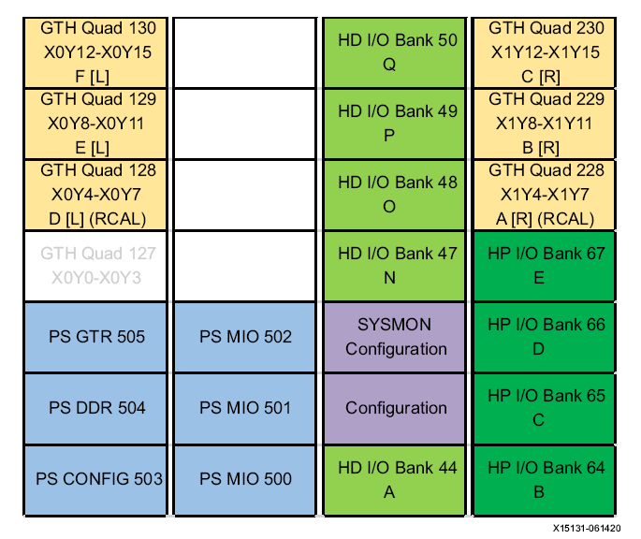
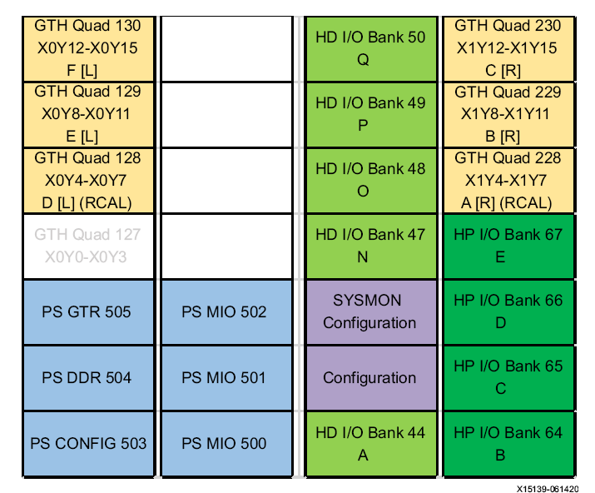
(XCZU15EG-ffvb1156-2-i)
(XCZU6CG-ffvb1156-2-i)
Simple Data Flow Chart for tb_lig_test_aurora_v3
AX7102 : XC7A100T-FGG484-2-I
AX7201 : XC7A200T-FBG484-2-I
AXU3EGB : XCZU3EG-SFVC784-1-I
AXU15EGB : XCZU15EG-FFVB1156-2-I
0,1,2,3,,35,36(S_L3),...,73,74(end) : 300 bytes
0,1,2,3,,35,36(ch1),,72(ch37),73,74(end) : 300 bytes
SFP1
CLK0(2)(X1Y6)
GTY Quad 228
X1Y4-X1Y7
61(31)
SCB(0)
31(61)
SP_SC(0):CLK1
CLK0(2)(X1Y14)
GTY Quad 230
X1Y12-X1Y15
11(23)
P1_P2
CLK1(0)(X1Y12)
12(36)
P1_AH
CLK1(2)(X1Y14)
13(35)
P1_BF
CLK1(3)(X1Y15)
GTY Quad 230
X1Y12-X1Y15
35(13)
BF_P1
130_CLK1(3)(X0Y7)
GTY Quad 128
X0Y4-X0Y7
SFP2
CLK0(0)(X1Y4)
GTY Quad 228
X1Y4-X1Y7
62(32)
SCB(1)
32(62)
SP_SC(1):CLK1
CLK0(0)(X1Y12)
GTY Quad 230
X1Y12-X1Y15
36(12)
AH_P1
130_CLK1(1)(X0Y5)
GTY Quad 128
X0Y4-X0Y7
#################################################################################
# BANK130 : 130_X0Y12_X0Y15_CLK1_3_X0Y15_DR_SP_E27_E28
# BANK129 : 129_X0Y8_X0Y11
# BANK128 : 128_X0Y4_X0Y7_CLKX_3_X0Y7_BF_P1
# BANK128 : 128_X0Y4_X0Y7_CLKX_1_X0Y5_AH_P1
#################################################################################
# BANK230 : 230_X1Y12_X1Y15_CLK0_2_X1Y14_SP_SC_0_C8_C7__B10_B9
# BANK230 : 230_X1Y12_X1Y15_CLK0_0_X1Y12_SP_SC_1_C8_C7__B10_B9
# BANK229 : 229_X1Y8_X1Y11_CLK1_0_X1Y8_AH_TE_E8_E7
# BANK228 : 228_X1Y4_X1Y7_CLKX_2_X1Y6_BF_P2
# BANK228 : 228_X1Y4_X1Y7_CLKX_0_X1Y4_AH_P2
#################################################################################
51(33)
TE
33(51)
AH_TE
CLK1(0)(X1Y8)
GTY Quad 229
X1Y8-X1Y11
21(37)
P2_BF
CLK1(0)(X1Y12)
22(38)
P2_AH
CLK1(2)(X1Y14)
23(11)
P2_P1
CLK1(3)(X1Y15)
GTY Quad 230
X1Y12-X1Y15
41(33)
DR_TE
CLK1(3)(X1Y15)
GTY Quad 230
X1Y12-X1Y15
37(21)
BF_P2
230_CLK1(2)(X1Y6)
GTY Quad 228
X1Y4-X1Y7
#################################################################################
# BANK230 : 230_X1Y12_X1Y15_CLK1_0_X1Y12_P1_P2_B10_B9
# BANK230 : 230_X1Y12_X1Y15_CLK1_2_X1Y14_P1_AH_B10_B9
# BANK230 : 230_X1Y12_X1Y15_CLK1_3_X1Y15_P1_BF_B10_B9
#################################################################################
# BANK230 : 230_X1Y12_X1Y15_CLK1_0_X1Y12_P2_BF_B10_B9
# BANK230 : 230_X1Y12_X1Y15_CLK1_2_X1Y14_P2_AH_B10_B9
# BANK230 : 230_X1Y12_X1Y15_CLK1_3_X1Y15_P2_P1_B10_B9
#################################################################################
42(34)
DR_SP
CLK0(0)(X1Y4)
GTY Quad 228
X1Y4-X1Y7
34(42)
DR_SP
CLK1(3)(X0Y15)
GTY Quad 130
X0Y12-X0Y15
38(22)
AH_P2
230_CLK1(0)(X1Y4)
GTY Quad 228
X1Y4-X1Y7
#################################################################################
# BANK230 : 228_X1Y4_X1Y7_CLK0_0_X1Y4_DR_AH_L8_L7
# BANK230 : 230_X1Y12_X1Y15_CLK1_3_X1Y15_DR_TE_B10_B9
#################################################################################
clk_wiz
util_vector_logic
bs_scb_data_record
gt_reset : 50MHz
reset : user_clk
ch_up and lane => reset_n
ext gt clk => dual pin
in clk => single pin
bs_usec_reset_n
bs_ila_debug
bs_scb_data_record_pin
a_drm_prj : bd_drm
a_p1_prj : bd_p1
a_p2_prj : bd_p2
a_bf_prj : bd_bf
bs_scb_record_table_gen
bs_sw_led_xx
ila
aurora_8b10b
bs_reset
bs_scb_record_table_gen
aurora_8b10b
bs_ila_debug
bs_scb_data_record_pin
ila

