Slide 1
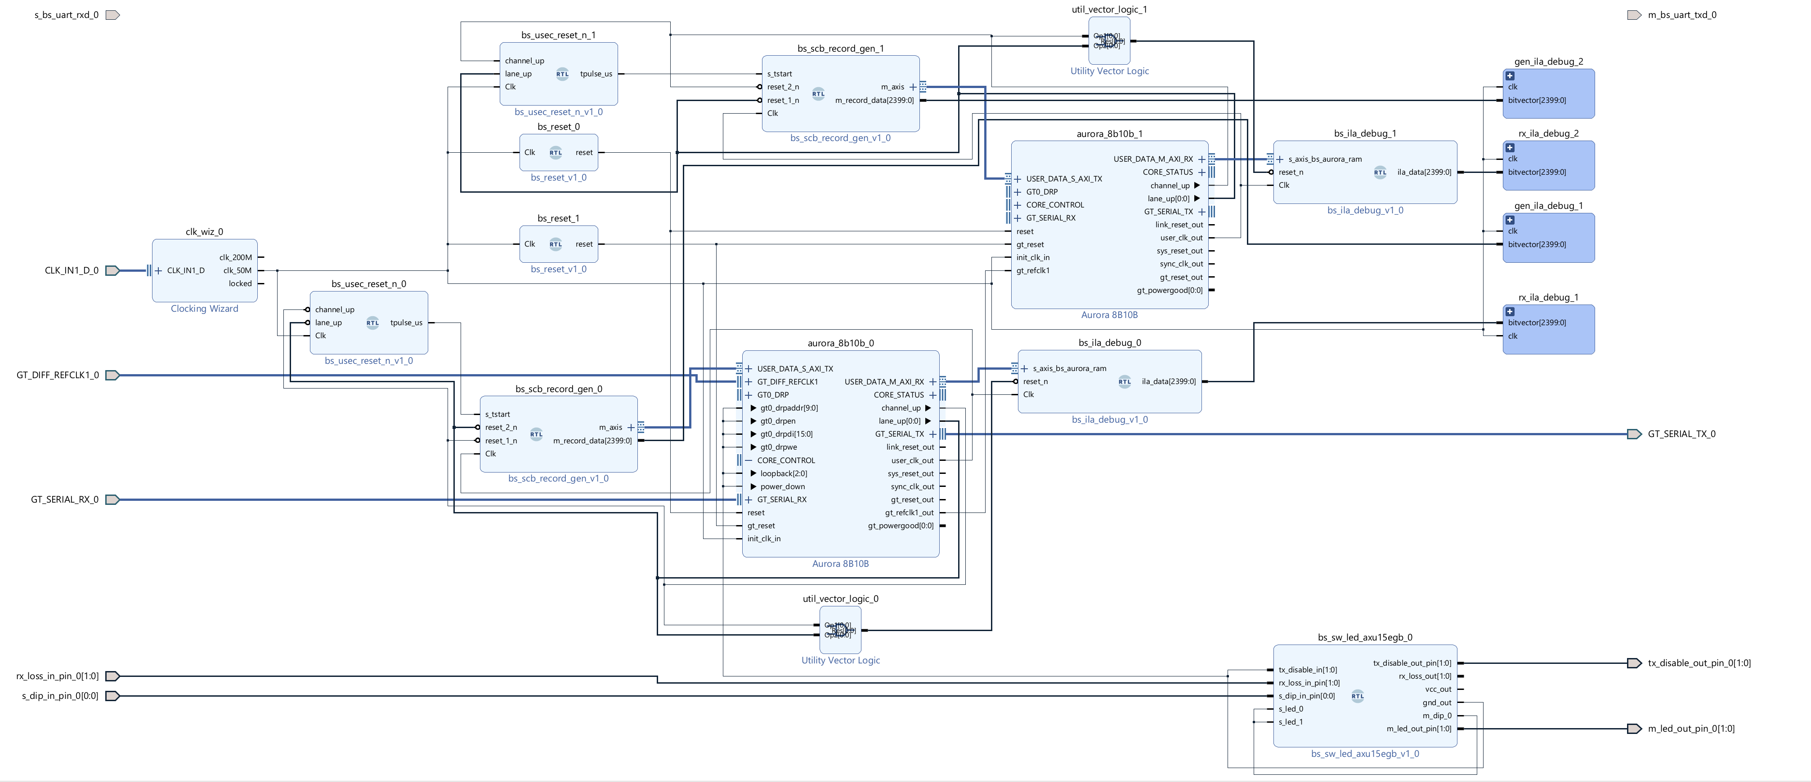
Simple Data Flow Chart for tb_lig_test_v1
(XCZU15EG-ffvb1156-2-i)
(XCZU6CG-ffvb1156-2-i)
clk_wiz
bs_usec_reset_n
bs_scb_record_gen
aurora_8b10b
util_vector_logic
bs_ila_debug
bs_sw_led
bs_gt_reset
bs_scb_data_record
bs_scb_data_record_pin
ila
bs_scb_record_gen
aurora_8b10b
bs_ila_debug
bs_scb_data_record_pin
ila

