Slide 1
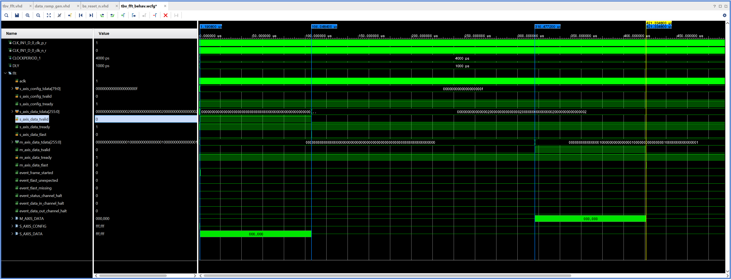
Simple Data Flow Chart (v2) for bs_p1_test_v2.pptx
(XCZU15EG-ffvb1156-2-i)
(XCZU6CG-ffvb1156-2-i)
0,1,2,3,,35,36(S_L3),...,73,74(end) : 300 bytes
0,1,2,3,,35,36(ch1),,72(ch37),73,74(end) : 300 bytes
P1_ATX_DATA_RAMP_GEN
16K * 64 * 19
1m
1920 MBPS
1cmd
35b
10u
S_MAXIS_BS_CMD_DATA
P1_LAST_CMD_RAM
PORT(PS)
c0+3 dir beam (7+3*4=19)
P1_BF
(AURORA)
GTH Quad 230
X1Y12-X1Y15
CLK1(X1Y15:3)
P1_RAM
P1_MAIN
RAM
(32K)
32K
1m
P1_ATX_EXT
P1_FFT_32K
P1_LAST_RAM
PORT
(PS)
RAM
(32K)
RAM
(32K)
RAM
(32K)
P1_BUFF32K
(32K)
Sum_L3/L2/L1/C0/R1/R2/R3, U/D/R/L (7+4*3=19)
CLK & RESET & CONTROL
DIP_SW & LED
P1_P2
(AURORA)
GTH Quad 230
X1Y12-X1Y15
CLK1(X1Y12:0)
PORT
(PS)
P1_AH
(AURORA)
GTH Quad 230
X1Y12-X1Y15
CLK1(X1Y14:2)
ch3 : im(255:224), re(223:192)
ch2 : im(191:160), re(159:128)
ch1 : im(127:96), re(95:64)
ch0 : im(63:32), re(31:0)
FWD_IMV : 4bit : “1111”
1 : Forward
0 : reverse
1 usec/106 usec/316 usec/421 usec
32K : 105 usec
fft : 210 usec
32K : 105 usec

