Slide 1
The Battle of Neighborhoods

Slide 2
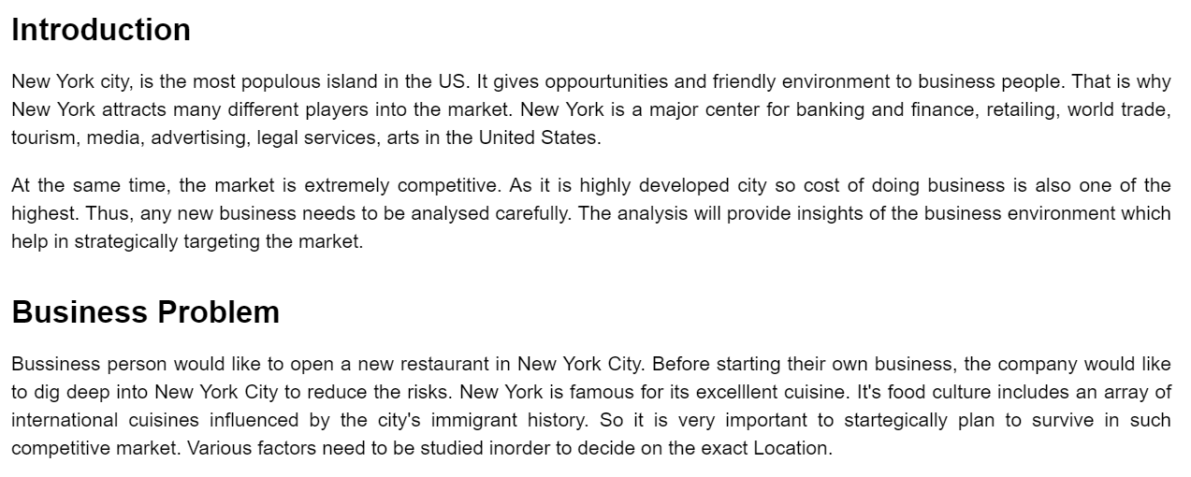

Slide 3
Data & Methodology
I organized two data sets of zipcode and neighborhoods with latitude and longtude for each city from multiple online sources
Majorly relied on Foursquare API to retrieve all venues of each neighborhoods, then group by each neighborhoods and to count how many venues before filter top 10 most common venue types of each neighborhoods

Slide 4
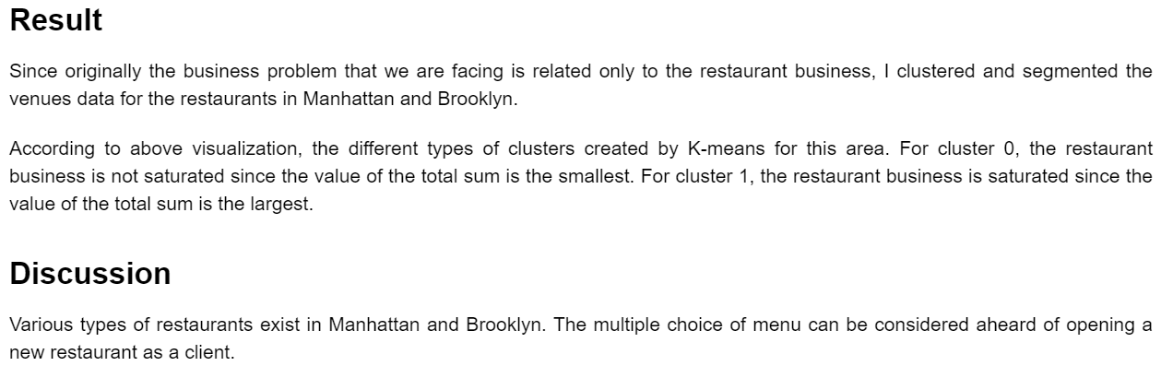

Slide 5
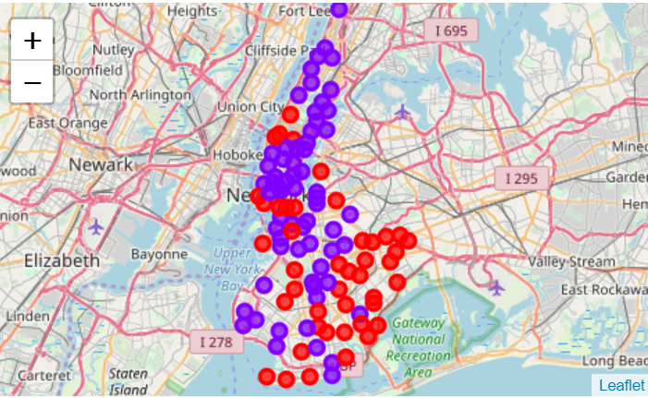

Slide 6
