Slide 1
Computer Vision
Fall 2018
Problem Set #6
Junle Lu
junle.lu@gatech.edu
Computer Vision @ GT

Slide 2
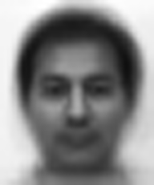
1a: Average face
ps6-1-a-1.png
Computer Vision @ GT

Slide 3
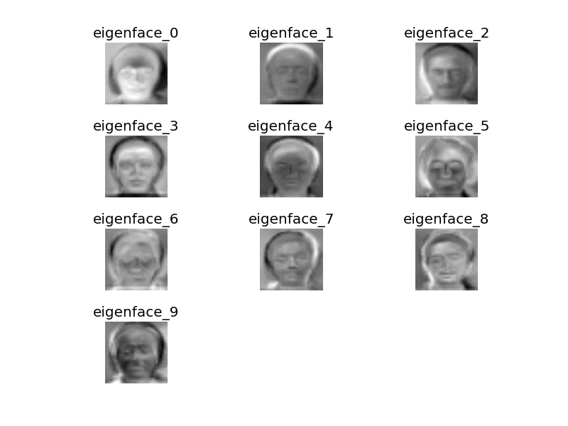
1b: Eigenvectors
ps6-1-b-1.png
Computer Vision @ GT

Slide 4
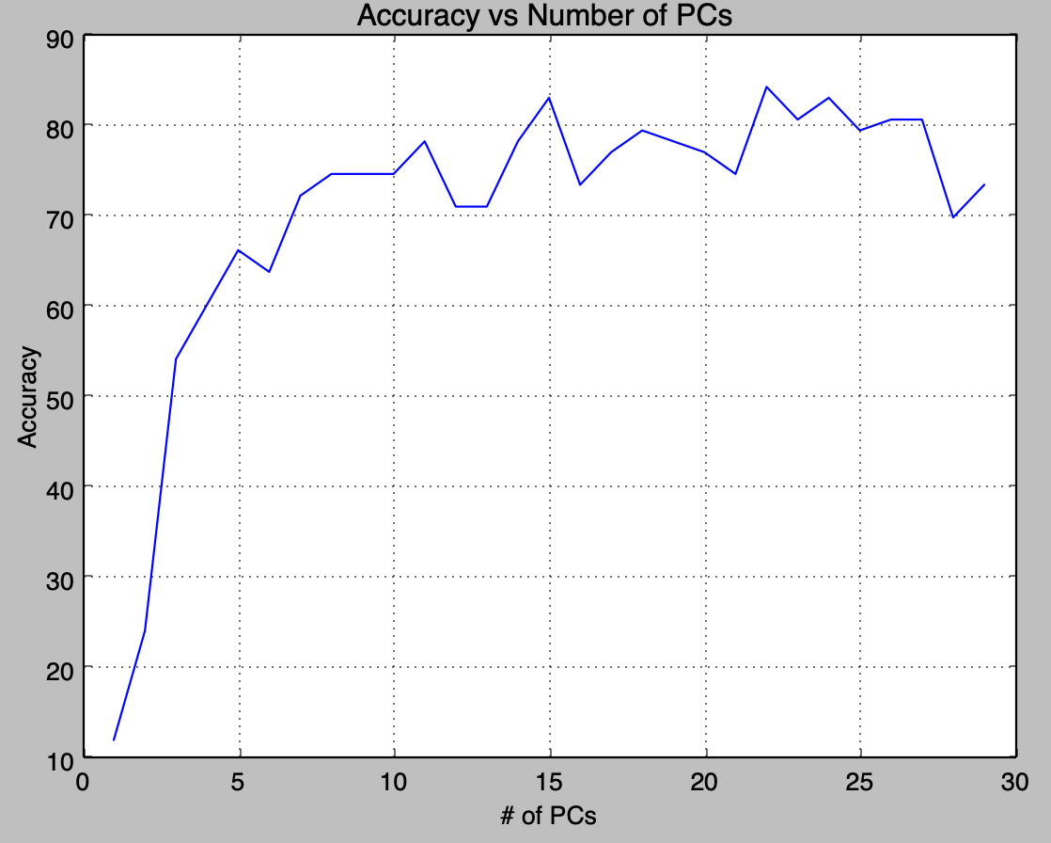
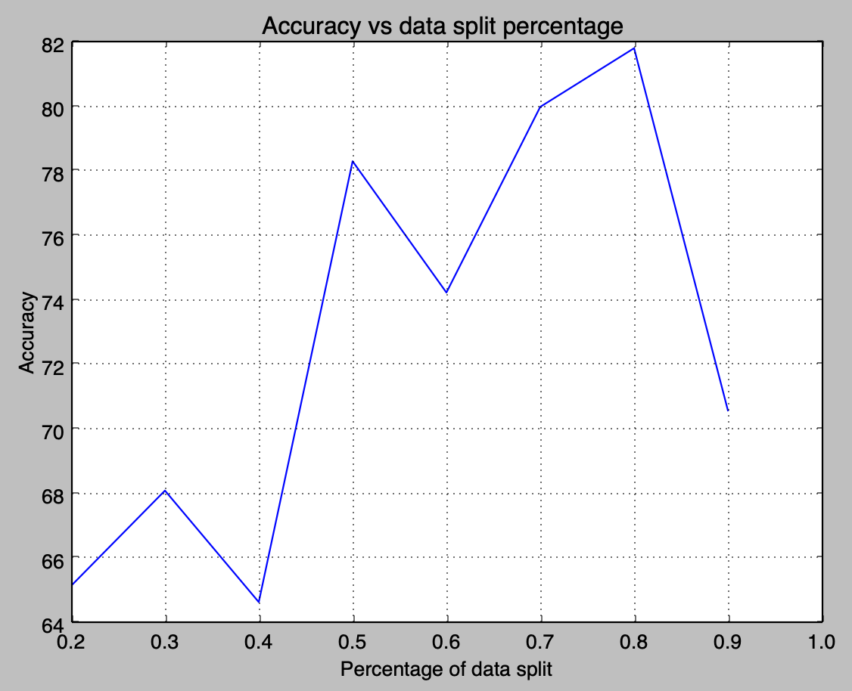
1c: Analysis
I observed the ‘predictions’ are better than randomly selecting a label between 1 and 15
K value: I ran the experiment for k values from 1-30 and p = 50. From the figure below, it generated the expected curve for the prediction accuracy vs the number of PCs (k values). The first 10 PCs has the most significant contribution to the accuracy. By increasing the PCs furthermore, it won’t improve the accuracy much. Therefore, the dimensionality can be reduced to 10 PCs.
Data split percentage: I ran the experiment with fixed k value (10), and iterates through p from 0.2 to 0.9. The result is expected as the 0.7-0.8 yields the best accuracy. This aligns with common Machine Learning practice when splits the data into training and testing sets.
Computer Vision @ GT

Slide 5
2a: Average accuracy
20 iterations, data split = 0.8:
('(Random) Training accuracy', '48.97 %')
('(Weak) Training accuracy', '87.61 %')
('(Boosting) Training accuracy', '91.49 %')
('(Random) Testing accuracy:', '47.13 %')
('(Weak) Testing accuracy', '86.35 %')
('(Boosting) Testing accuracy', '91.11 %')
20 iterations, data split = 0.5:
('(Random) Training accuracy', '48.81 %')
('(Weak) Training accuracy', '88.04 %')
('(Boosting) Training accuracy', '94.21 %')
('(Random) Testing accuracy:', '52.11 %')
('(Weak) Testing accuracy', '86.32 %')
('(Boosting) Testing accuracy', '89.22 %')
5 iterations, data split = 0.8:
('(Random) Training accuracy', '47.15 %')
('(Weak) Training accuracy', '82.38 %')
('(Boosting) Training accuracy', '86.83 %')
('(Random) Testing accuracy:', '47.42 %')
('(Weak) Testing accuracy', '79.96 %')
('(Boosting) Testing accuracy', '81.99 %')
Computer Vision @ GT

Slide 6
2a: Analysis
As expected, the random classifier has the worst accuracy. Weak classifier is better than random, and the Boosting classifier has slightly better accuracy than Weak classifier. The change in data split percentage does not seem to affect much in this case. Random classifier produces consistent result regardless the number of iteration and data split percentage. For the other two classifier, the accuracy improves with increasing number of iterations.
Computer Vision @ GT

Slide 7

3a: Haar Features
ps6-3-a-1.png
Computer Vision @ GT

Slide 8

3a: Haar Features
ps6-3-a-2.png
Computer Vision @ GT

Slide 9
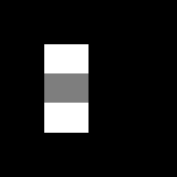
3a: Haar Features
ps6-3-a-3.png
Computer Vision @ GT

Slide 10

3a: Haar Features
ps6-3-a-4.png
Computer Vision @ GT

Slide 11

3a: Haar Features
ps6-3-a-5.png
Computer Vision @ GT

Slide 12
3c: Analysis
With integral images, the computation time is dramatically reduced. With np.sum, the value of each pixel is added each window. The integral image approach allows us to use the previously computed sum to find the sum for the new region of the image. It is much more efficient this way, especially with large of pixels.
Computer Vision @ GT

Slide 13
4b: Viola Jones Features
Prediction accuracy on training: 95.71%
Prediction accuracy on testing: 85.71%
ps6-4-b-1.png
Computer Vision @ GT

Slide 14
4b: Viola Jones Features
Prediction accuracy on training: 95.71%
Prediction accuracy on testing: 85.71%
ps6-4-b-2.png
Computer Vision @ GT

Slide 15
4b: Analysis
The feature ps6-4-b-1 is good for matching eyes and nose. For example, our eyes with dark skin region in between. The second feature is hard to explain how it is used on our facial. It may be due to the training images we used that somehow it thinks that it is a significant feature. Normally, I would expect feature that aligns with our forehead, nose, and eye to be the top features.
Computer Vision @ GT

Slide 16

4c: Viola Jones Face Recognition
ps6-4-c-1.png
Computer Vision @ GT

