Slide 1
Computer Vision
Fall 2018
Problem Set #1
Junle Lu
junle.lu@gatech.edu
Computer Vision @ GT

Slide 2
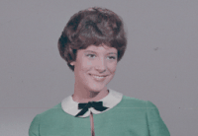
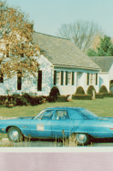
1a: Interesting Images
Image 1 - ps1-1-a-1.png
Image 2 - ps1-1-a-2.png
Computer Vision @ GT

Slide 3
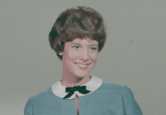
2a: Swapped Green and Blue
ps1-2-a-1.png
Computer Vision @ GT

Slide 4
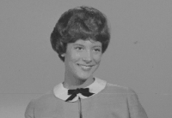
2b: Monochrome Green
Img1_green - ps1-2-b-1.png
Computer Vision @ GT

Slide 5
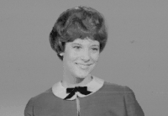
2c: Monochrome Red
Img1_red - ps1-2-c-1.png
Computer Vision @ GT

Slide 6
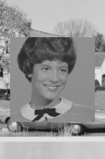
3a: Replacement of Pixels
ps1-3-a-1.png
Computer Vision @ GT

Slide 7
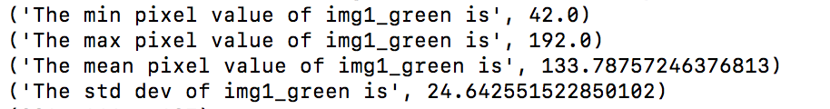
4a: Image Stats
Min, max, mean, and standard deviation
Computer Vision @ GT

Slide 8
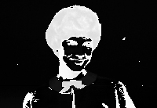
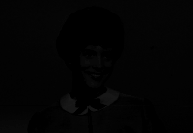
4b: Arithmetic Operation
ps1-4-b-1.png (numpy.float64 data type)
Note: center_and_normalize(image, scale) function needs to return floating data (image) in order to pass Bonnie auto-grader. I converted it to uint8 when producing this image.
ps1-4-b-1.png (numpy.uint8 data type)
Computer Vision @ GT

Slide 9

4c: Shifted Image
ps1-4-c-1.png
Computer Vision @ GT

Slide 10
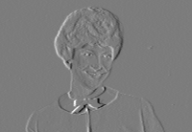
4d: Difference Image
ps1-4-d-1.png
Computer Vision @ GT

Slide 11
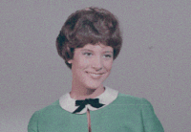
5a: Noisy Green Channel
ps1-5-a-1.png
Computer Vision @ GT

Slide 12

5b: Noisy Blue Channel
ps1-5-b-1.png
Computer Vision @ GT

Slide 13
6a: Discussion (3 slides)
Q: Use the image southafricaflagface.png and look at all three channels individually as monochrome. Between all color channels, which channel most resembles a grayscale conversion of the original? Why is this? Does it matter if you use other images? (For this problem, you will have to read a bit on how the eye works/cameras to discover which channel is more prevalent and widely used)
Ans: From testing and generating different monochrome images (see last slide), it is clear that green channel monochrome image most resembles a grayscale conversion of the original. It is because that human eyes (retina) are twice as sensitive to green color than red and blue colors [1][3]. Due to this biological structure, the camera is also designed to filter in twice as many green color than other two colors, which is known as Bayer filter[4]. Therefore, green color has more weight on the luminance of the image. A grayscale image represents the luminance of a image (the shades from black to white). A typical equation to generate grayscale is “Gray = (Red * 0.299 + Green * 0.587 + Blue * 0.114)” [3]. Green color has much larger coefficient than the other two. It does matter if I use the other image. For an extreme case, if the original image has zero value for the green channel, then green channel has no weight on the grayscale equation. In this case, I would think that red channel monochrome will be closer to the grayscale image.
Computer Vision @ GT

Slide 14
6b&c:
Q: What does it mean when an image has negative pixel values stored? Why is it important to maintain negative pixel values?
Ans: The important concept is the pixel values are relative to each other. For example, green channel value of -5 means that it is less ”green” than a green channel value of 0. The negative pixel values allow us to perform computation on the images or between images. The final pixel values can always be normalize to have only positive values. Conceptually, a negative pixel can potentially defined to represent a invisible light.
Q: In question 5, noise was added to the green channel and also to the blue channel. Which looks better to you? Why? What sigma was used to detect any discernable difference?
Ans: The blue channel looks better to me as it has less visible noise with the same sigma value (5). It is because that human eyes are more sensitive to green color due to our biology structure. There are much more light receptors can be stimulated by green color in the eyes[3]. For the posted images in this slide, the sigma value of 5 was used. But I can see the difference with lower sigma value (e.g 2) if I inspect the images carefully.

Slide 15
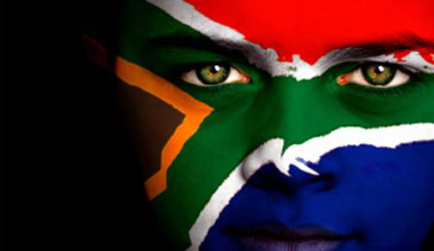
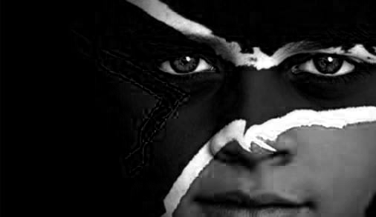
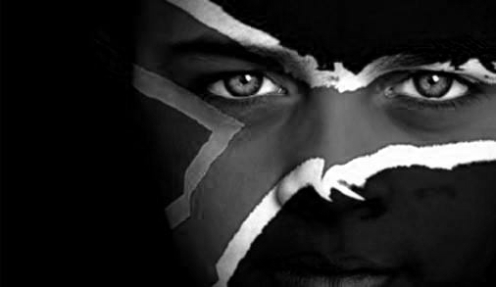
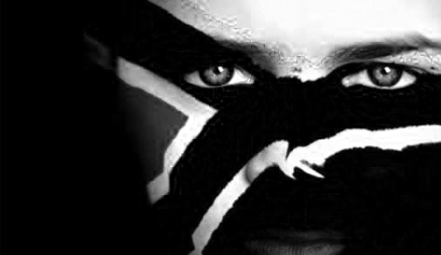
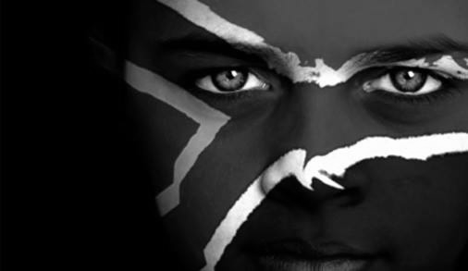
southafricaflagface.png
Monochrome blue channel
Monochrome green channel
References:
[1] https://en.wikipedia.org/wiki/Retina
[2] http://www.tannerhelland.com/3643/grayscale-image-algorithm-vb6/
[3] https://hypertextbook.com/facts/2007/SusanZhao.shtml
[4] https://en.wikipedia.org/wiki/Bayer_filter
Monochrome red channel
OpenCV Grayscale

