Slide 1

itcoin
The next big thing – already is

Slide 2

The Creator
Known as Satoshi Nakamoto.
Published 9-page document on Bitcoin.
Started off Bitcoin with a group of developers.
Transferred all his work to Gavin Andresen before disappearing.

Slide 3
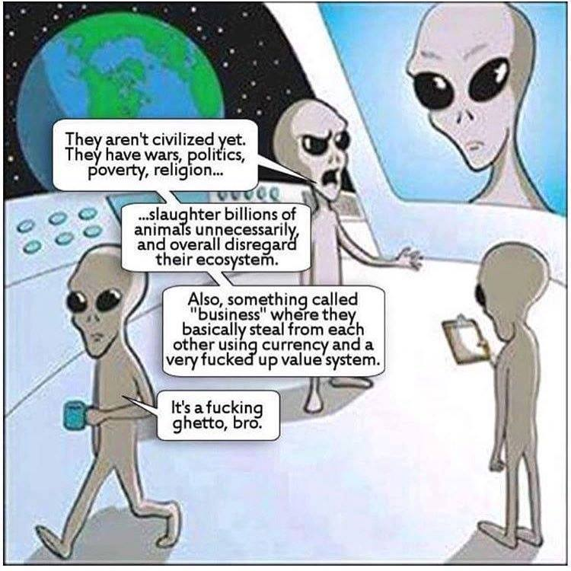
Currency is …
A system of money (monetary units) in common use, especially in a nation.
Main purpose is to exchange.
As of NOW WE SEPARATE BITCOIN from real money!

Slide 4
Transaction
Person | Cash Value
Ali | 95
Bakar | 88
Abu | 90
Transfer ”10” money to Abu
Centralized
System
Deduct 10 from Ali
Person | Cash Value
Ali | 85
Bakar | 88
Abu | 100
Transferred 10 to Abu

Slide 5
Trade/Make transactions
Accomplishing it technically

Slide 6
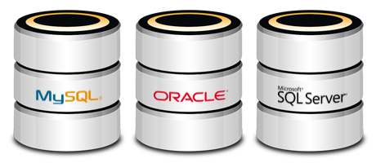
Database/RDBMS
Database, Transactional Database
Commit
Rollback
Deadlock

Slide 7


Other Storage Option ?
Paper documents
History of transactions(Ledger)
Hiring and trust.
No SQL
Treat documents not tables
No support for Normalization
Transaction is difficult

Slide 8
Decentralizing
Crowd sourcing! Everyone keeps the ledger.
ABU
ALI
BAKAR
Person | C/D | Cash Value
Ali | Debit | 90
Bakar | Debit | 90
Abu | Debit | 90
Ali | Credit | 10
Bakar | Debit | 10
Person | C/D | Cash Value
Ali | Debit | 90
Bakar | Debit | 90
Abu | Debit | 90
Ali | Credit | 10
Bakar | Debit | 10
Person | C/D | Cash Value
Ali | Debit | 90
Bakar | Debit | 90
Abu | Debit | 90
Ali | Credit | 10
Bakar | Debit | 10

Slide 9

Cryptocurrency

Slide 10
Maybe you should know (1/3)
Q: Who approves the transaction ?
A: Majority > 50% within the community.
Q: Who keeps the ledger (history of transactions) ?
A: Basically everyone, replication may take time.
Q: Does everyone need to install a client to join ?
A: No.
* Client - Bitcoin Core (requires 145GB)
* Bitcoin Wallet

Slide 11
Maybe you should know (2/3)
Q: If everyone keeps it, then it’s possible to change it!
A: Added security by encrypting it.
* Math rules !
* Majority who approves, get’s the upper hand.
* Miners help to encrypt it!
Q: Miners ? (Explained later)
A: Synonym to Gold. A worker mined gold and is add to the reserved, who mines it, who gets the incentive.
Q: When system starts up, who makes the first quantity ?
A: Big Bang Theory. Satoshi – let there be Bitcoin.

Slide 12
Maybe you should know (3/3)
Q: 1 Bitcoin = USD 8000, how to use it?
A: Lowest denomination is 0.00000001 (x 8 – a byte). Known as Satoshi.
Q: So is Bitcoin a company or a technology? (Explained later)
A: Neither? It’s just running.
These are called Cryptocurrency.
The technology is Blockchain.
There are company; one well known is Ethereum.

Slide 13

End of Session 1
Question ?
Fragen ?

