Slide 1

What makes cryptocurrency, a cryptocurrency
A presentation - Walcron

Slide 2
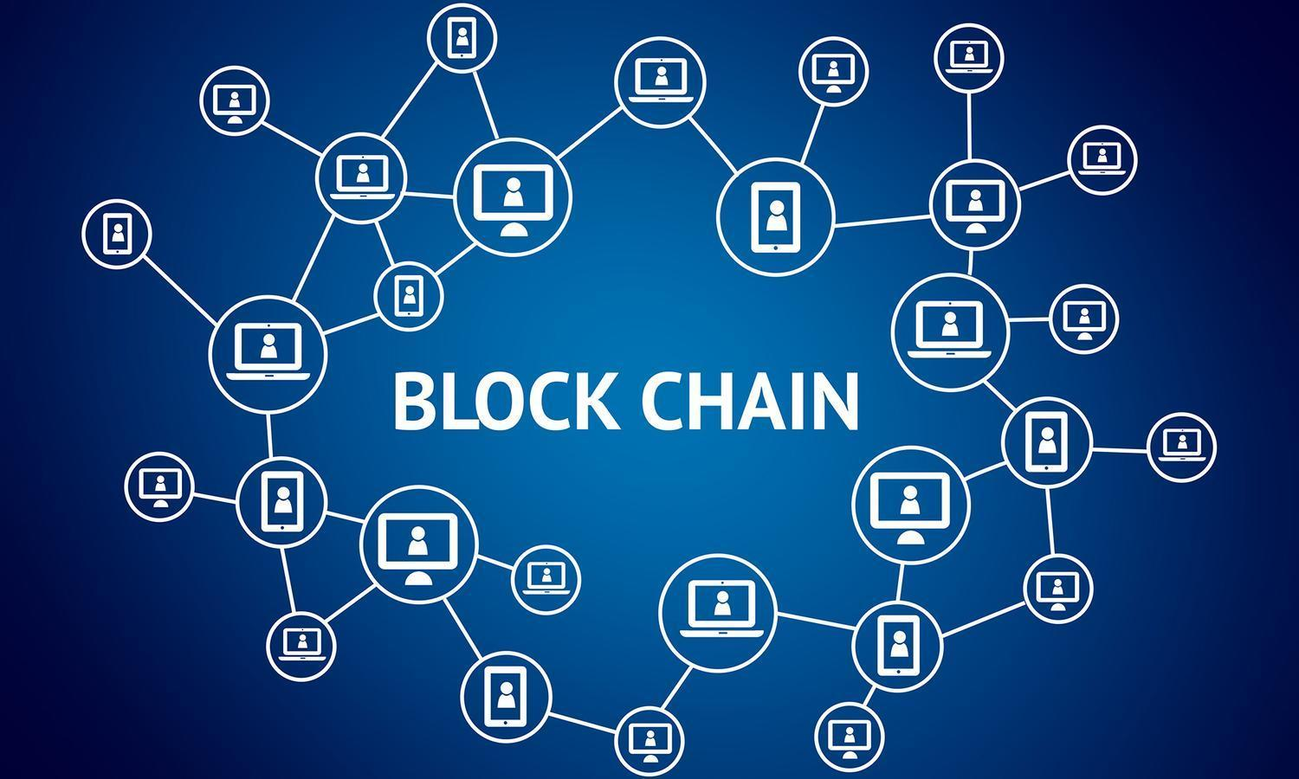

Slide 3
SUBJECT A
BTC 20

Slide 4
RECEIVER
SUBJECT A
BTC 20

Slide 5
PEER-TO-PEER

Slide 6
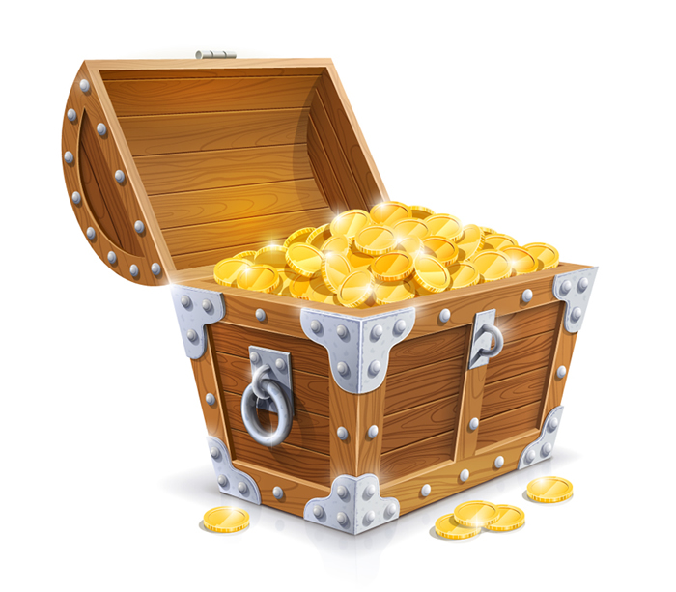


SECURITY MEASUREMENT (Cryptography)
Usage of PUBLIC and PRIVATE key.
PUBLIC key = to unlock the Message
PRIVATE key = to lock the Message
Message = data/treasure
If you can decrypt the message encrypted with the PRIVATE KEY using the PUBLIC KEY, means that the message has not been tempered.
It is paired, both can work the other way.

Slide 7
RECIpient
Private key => Public key => Address
Public/Address are generated one way, so never lose the private key !
This address is like Paypal account (unique per user)
A to B, means “Address of A” to “Address of B”
Private keys generated are unique

Slide 8
TRANSFER
Address A
Create Message Transfer 20 BTC
**Encrypt SHA256
Encrypt with PRIVATE KEY
SIGNATURE
SIGNATURE + MESSAGE + PUBLIC KEY

Slide 9
SIGNATURE + MESSAGE + PUBLIC KEY

Slide 10
TRANSFER
Address A
Create Message Transfer 20 BTC
Encrypt with PRIVATE KEY
Encrypt SHA256
SIGNATURE
SIGNATURE + MESSAGE + PUBLIC KEY
Address B
Decrypt with PUBLIC KEY
SIGNATURE
Message of Transfer 20 BTC
EQUALS (=)
Encrypt SHA256

Slide 11
WRITE TO THE LEDGER
Verified ! Write to ledger.
Write Transaction to ledger.
T1
T2
T3

Slide 12
Ledger EXIST, WHY DOUBLE TO WORK ?
Peer to peer, you don’t necessary need Address B to validate. All nodes can help to validate a broadcasted transaction.
This case, Address B don’t need to be Online!

Slide 14
WAIT !
There are NO Balance/Deposit to update.
It’s just moving coins.
Resolves Double spending!
From Person | To Person | Coins
Z | A | 90
W | A | 90
A | D | 90
E | F | 10
A | B | 10
A’s balance
90 + 90 – 90 -10 = 80
B’s balance
10

Slide 15
ORGanizing into Blocks
Why not put do in batch to validate transactions and write into Ledger!
Exactly what is done, pool of transactions are put into Blocks
T1
T3
T2
TIME

Slide 16
Demo – https://Blockchain.INFO

Slide 17
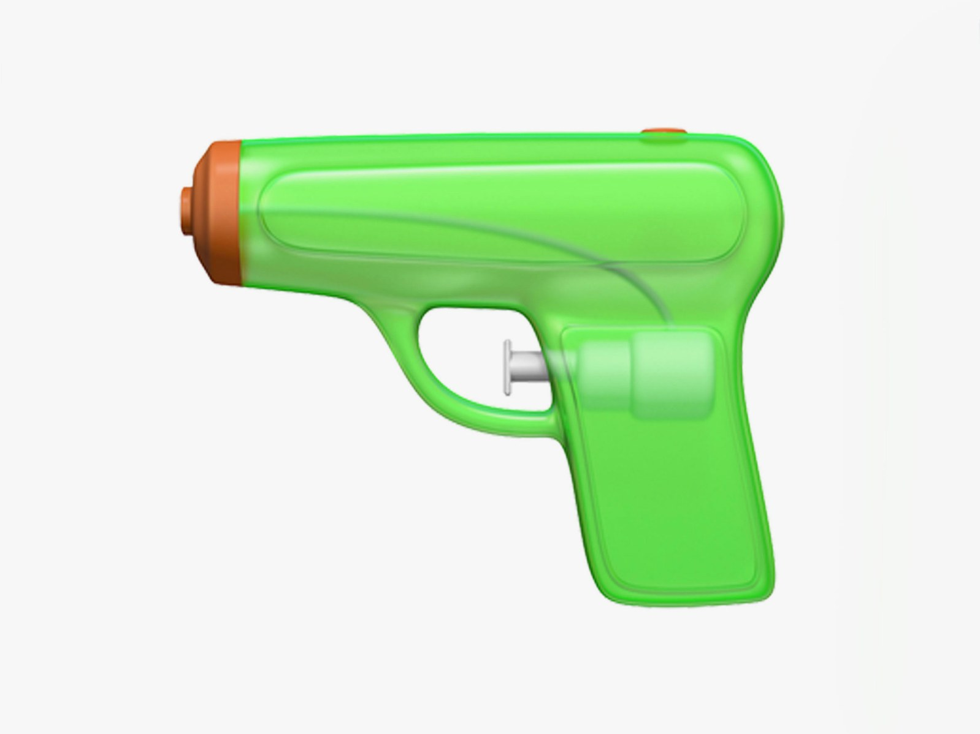
TO KEEP IN TRACK, DROP THE CONVENTIONAL thinking
Non-offensive

Slide 18
UNDERSTANDING THE BLOCK
PREVIOUS PREVIOUS BLOCK
PREVIOUS BLOCK
NEXT BLOCK
NEXT NEXT BLOCK
BLOCKCHAIN – TADA!!!

Slide 19
Looking DEEPER
NEXT BLOCK
PREVIOUS PREVIOUS BLOCK
PREVIOUS BLOCK
NEXT NEXT BLOCK

Slide 20
DEMO TIME
https://anders.com/blockchain/hash.html

Slide 21
Miners
Validate a block of transactions.
Validate “next” block chains.
Reward if their validated blockchain are written to the ledger (longest). i.e. Proof of work.
Rewards are “out of thin air” coins. Users need to pay miners when Bitcoin/Blockchain run out of coins.

Slide 22
UNEXPLAINED
In depth of moving coins.
Merkle Tree
Data Type ( Timed based distribution )
Transactions
Group signing (Ethereum)
Wallets
Many Many more

Slide 23
END
Question ?
Fragen ?

