Slide 1
Parallelism
–2018

Slide 2
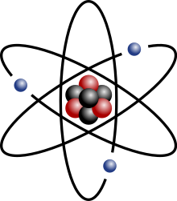
Disclaimer
…the Bohr model is still commonly taught to introduce students to quantum mechanics or energy level diagrams before moving on to the more accurate, but more complex, valence shell atom.

Slide 3
Threading
Non-blocking I/O
Concurrent / Parallel

Slide 4
Think again ?
Heavyweights / Kernel.
Lightweights / User threads.
Fiber/ Green threads. Quasar.
Concurrency (non-multicore) vs Parallelism

Slide 5
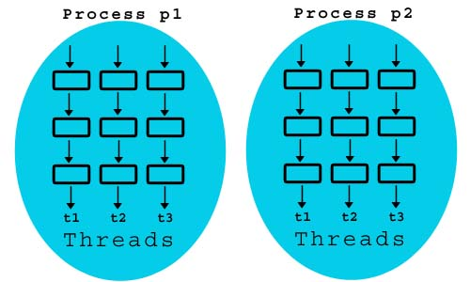
Lightweight vs Heavyweight
Switching threads within process.
Context switch.

Slide 6
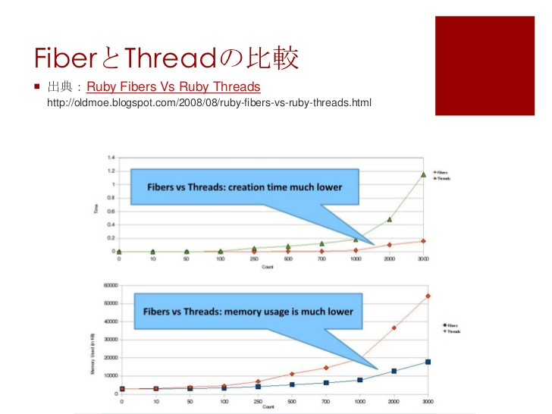
Comparison Green/Fiber Thread
Manual yield.
Available in Erlang, Ruby, Go.
For Java – Quasar library

Slide 7
Java Threads
Extends Thread / implements Runnable / implements Callable
threadPool = Executors.newFixedThreadPool(4);
..
completionService = new ExecutorCompletionService<SearchResultList<T>>(threadPool);
…
Future<SearchResultList<T>> workerResultFut = completionService.take();
…
public class SearchWorker<T> implements Callable<SearchResultList<T>> {…}

Slide 8
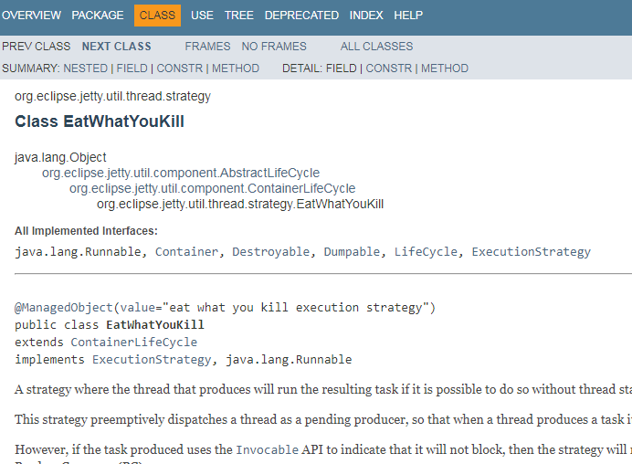
Even more ..
Thread pool
Fork Join / Work Stealing
Eat What You Kill

Slide 9
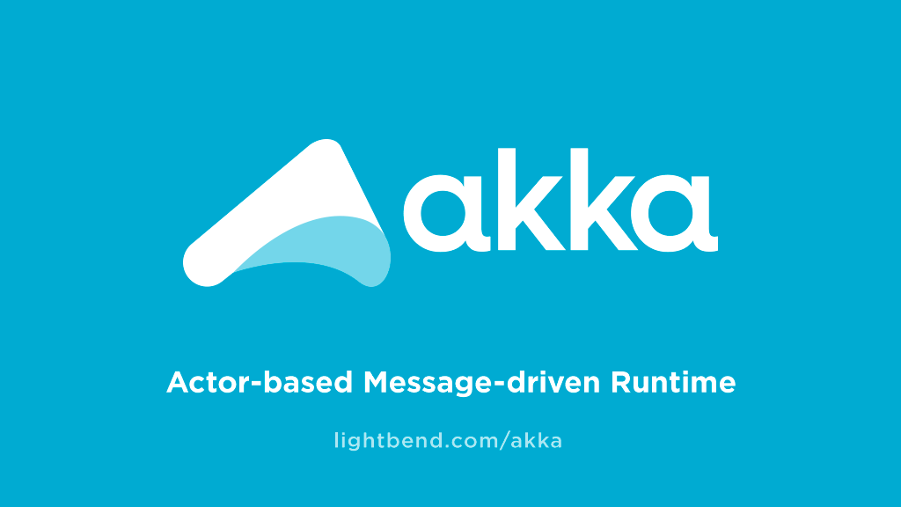
Introducing Akka
Design influenced by Erlang
No Fiber
Actors == lightweight thread
Layer on top of Java thread

Slide 10
Introduction to Scala
REPL (You now have this in Java 9)
Object Oriented and Functional Programming
A layer on top on Java → Java Bytecodes.
Partially similar to Kotlin with totally different goal.

Slide 11
PRINCIPAL I: Immutability
Functional Programming ?

Slide 12
Immutability
Stick with Constants.
Avoid mutable state. **
Builder Pattern.
Functional Programming / Lambda / LinQ / Streams(Java 8 above)
Create new instances for modified data.
** Mutable are welcomed if codes does not produce side-effects. How can you be sure ?

Slide 13
Demo
Something you can achieve with a Builder Pattern.

Slide 14
PRINCIPAL II: Inheritance
A thread within a thread within a thread within a thread within a thread within a thread within a thread within a thread within a thread within a thread within a thread within a thread ...

Slide 15
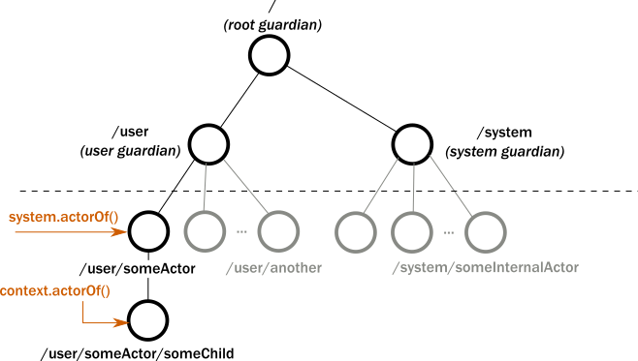
Tree hierarchy
Pass data, not sharing instances.
Take note on immutable sharing from parent.

Slide 16
PRINCIPAL III: Message Queue
The forth dimension

Slide 17
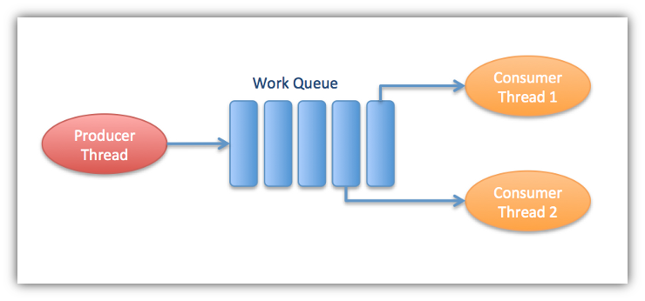
Mailboxes
Sequence / Prioritization
Timeout
Akka Streams **
Persistence / Durable
Backpressure
Default: ConcurrentLinkedQueue

Slide 18
PRINCIPAL IV: Futures
The forth dimension

Slide 19
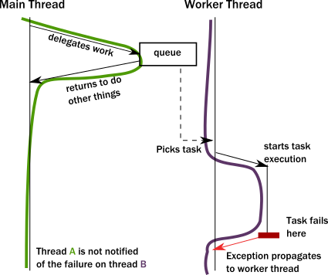
Non-blocking attitude
Fire-and-forget / 1-way.
Non-blocking.
Promises. Being called.
Futures. Response = Either, Success/Failure
Java: Callable**
** To verify on Java Future vs Scala Futures

Slide 20
Demo
Mom: Bring out the trash !
Me: Later la.

Slide 21
Diagram
/User
Ticket Seller Creator
Ticket Seller Creator
Ticket Seller Creator
Ticket Seller
Ticket Seller
Ticket Seller

Slide 22
PRINCIPAL IV: Let It Crash
I don’t care, I love it!

Slide 23
Erlang’s - Philosophy
Let it crash.
Deal your own sh*t before hand.
Start dealing with codes without checked exception. E.g. FileNotFound
Logs.

Slide 24
Scenario
Start
Processing it downstream.
Database is down
Stop processing and log ?
Retry
Can your process be restarted ?
Switch Database

Slide 25
Demo
Deal with it

Slide 26
Testing – Not covered
https://doc.akka.io/docs/akka/2.5/testing.html

Slide 27
Monitoring
Jconsole, Kamon

Slide 28
Use cases
Thread importance ?

Slide 29
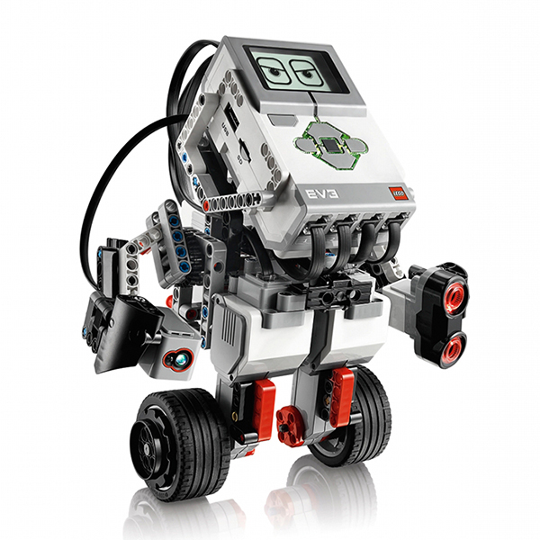
Robotics
Processor
Threading plays a very important role in mechanics
Gyroscope
Light sensor
Motors

Slide 30
EVERYTHING ELSE
You used it in everything else, just you did not notice it!

Slide 31
Demo
10000101010100101010

Slide 32
Question ?
Stopping a moving vehicle

Slide 33
Parallel
Not concurrency

Slide 34
BEYOND HYPERTHREADING
Horizontal scaling
Actor != Thread
Computer A
Task
MAIN COMPUTER
Task
Computer B
Task
Computer C
Task

Slide 35
AKKA-REMOTE EXTENSION

Slide 36
Demo
Peanut butter spread.

Slide 37
Entering Microservices
An architecture

Slide 38
No, it’s not a framework
Like REST, it’s an architecture, not a framework.
Distributed and small, hence maintainable.
Go Reactive!

Slide 39
But have you consider about ?!
Patterns
Circuit Breaking
CQRS
Aggregate, Event Sourcing and State
Saga
Publish/Subscribe

Slide 40



Lagom
Implementing what’s needed for a Microservice
Default, a combination of
Akka – threading and cluster
Kafka – Publish and Subscribe
Cassandra – State
Play - Service Descriptor, Front-facing.

Slide 41
Demo
Pay attention a bit la.

Slide 42
SIMILARITIES
With Akka, Threads and Microservices shares similarities
Architecture vs technology
Stateful vs Stateless
Serialization
Speed
Monitoring
** This is my own opinion.

Slide 43
Main goal
To perform as Roomba

Slide 44
Lesson Learned
Sharing

Slide 45

Piece of crap
Battery consumption
Wifi vs Bluetooth (power safe)
Jackhammer approach
Performance & Complexity
I do not need persistence
Still hates framework

Slide 46
Futures
Augmented Reality.
OpenCV
Calculate with augmentation
RxJava
Pure Controller
Akka Cluster / UDP transaction
Play framework / Akka Streams
Data Collection
Getting point A to B with data

Slide 47
Is this the end?
Almost the end

Slide 48
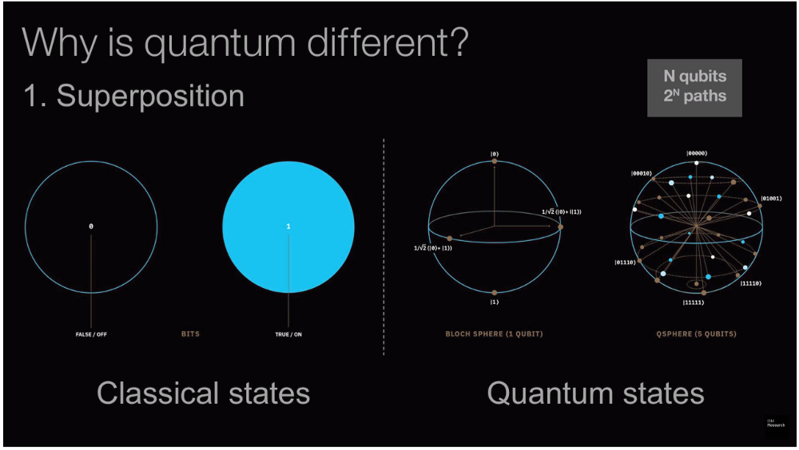
Quantum Programming
When bits are not 1 or 0, but both.
We are at 72-bits now.
Look for “Forest”

Slide 49
Again, Is this the end?
No, at the meantime – go Reactive

