Slide 1
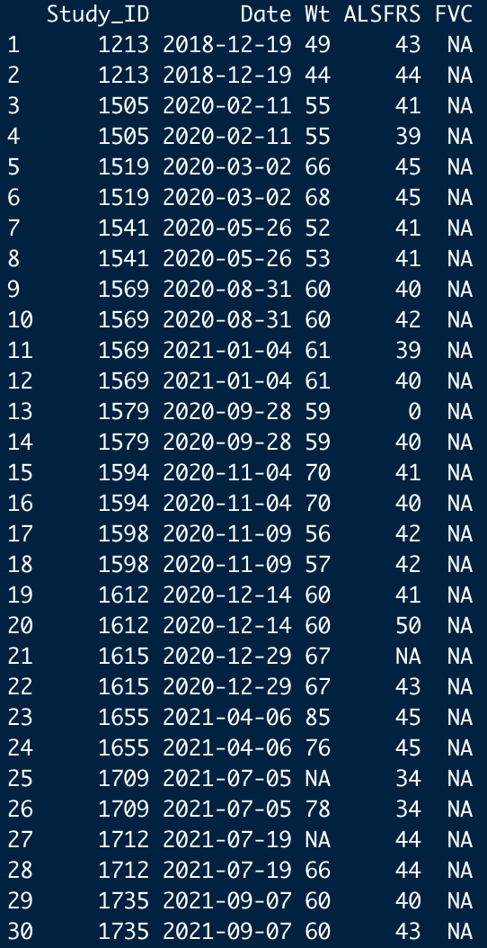
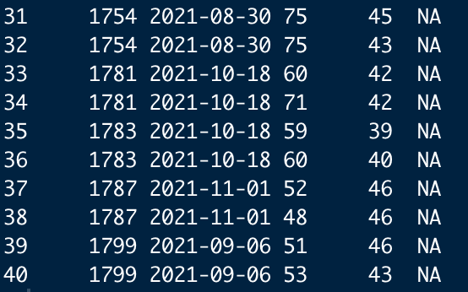
Inconsistent value
: the same Study_ID, Date, but different
Wt, ALSFRS, FVC
: inconsistency btw Dx and FU tables

Slide 2
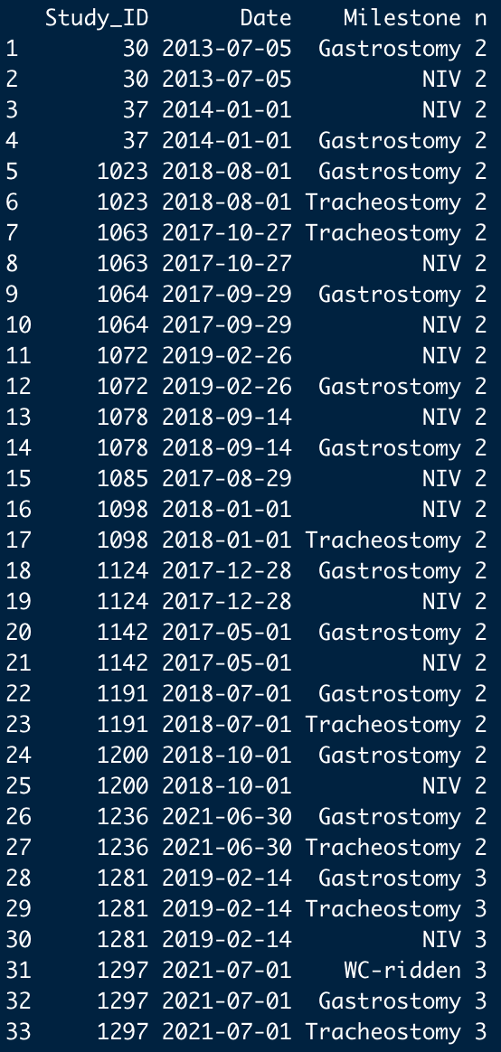
Tracheostomy and NIV at the same day?
WC-ridden, valid?

