Slide 1
Breast Cancer Prediction
Team 7: Code Breakers
(Sarah Asif, Aga Wlodarska, Yooni Chung)

Slide 2
Goal
Malignant vs Benign (categorical)
Mean, standard error & extreme values of
Radius
Texture
Perimeter
Area
Smoothness
Compactness
Concavity
Concave points
Symmetry
Fractal dimensions
10 x 3 = 30 features
⇒ to improve the early detection of breast cancer by training machine learning models which predict whether the cancer is benign or malignant – a classification problem

Slide 3
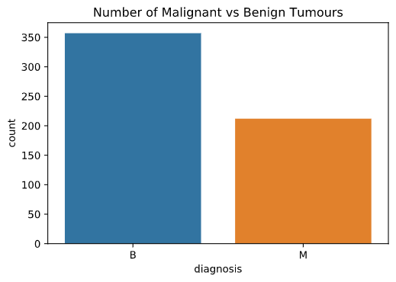
Data Exploration
Benign vs Malignant
352
62.7%
212
37.3%

Slide 4
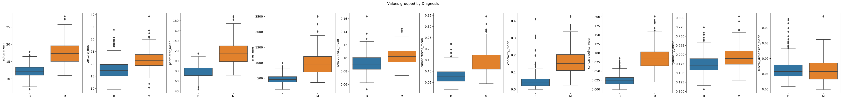
Data Exploration: malignant tumours seem to have more extreme features
Notes:
Similar patterns seen in SE & worst values

Slide 5
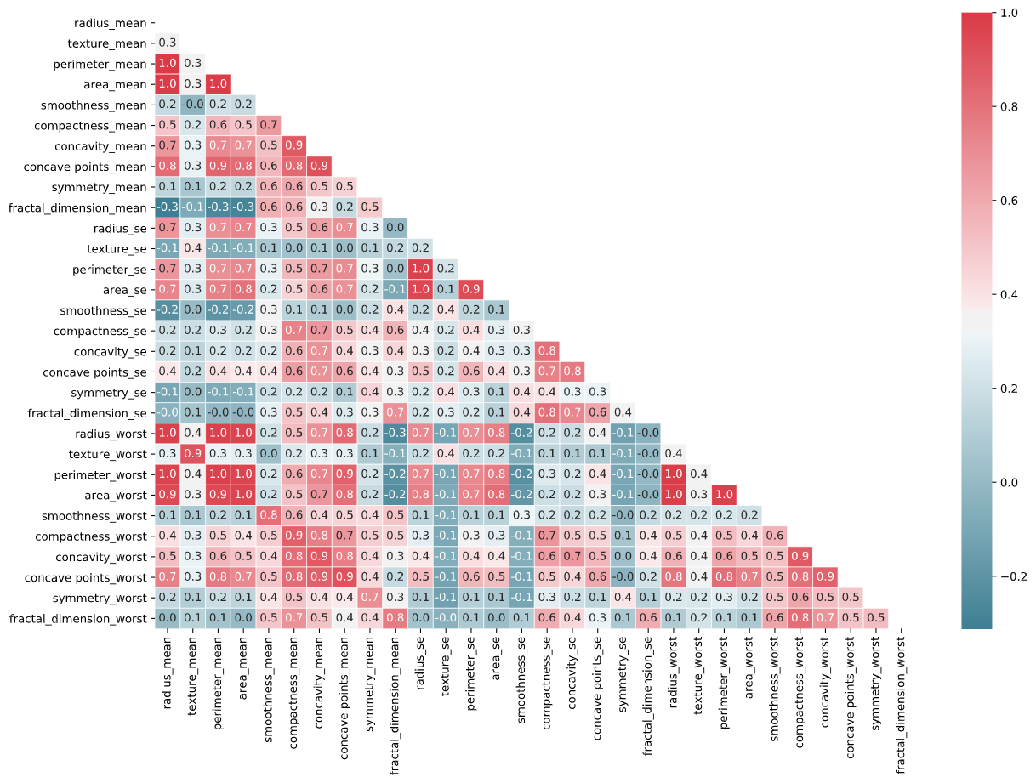
PCA
Clearly very high correlation between variables
Redundancy in the data (mean, SE, worst)
⇒ removed using PCA
Split the data into training & test (80:20)
Standardisation
PCA
Fitting on training set only

Slide 6
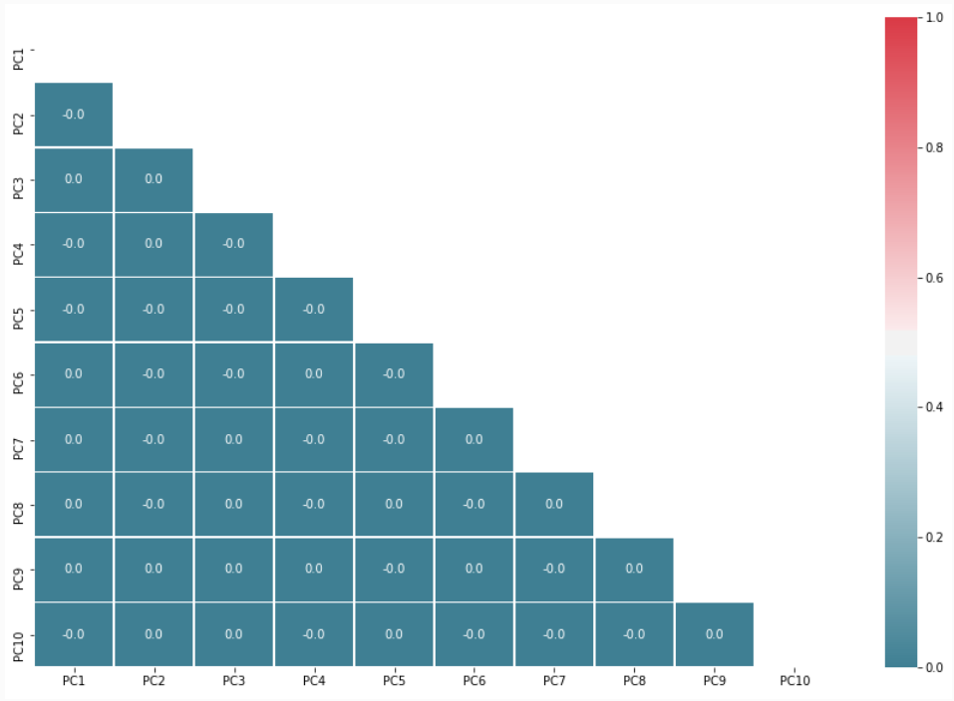
PCA
⇒ decided to use 10 PCs which explained more than 95% of the variance in the data

Slide 7
1. Logistic Regression
Accuracy: 92.1%/98.2%
Precision: 94.7%/100%
Recall: 83.7%/95.3%
AUC: 0.98/0.99
69/71 TN | 2/0 FP
7/ 2 FN | 36/41 TP
True label
M (+) B (-)
B (-) M (+)
Predicted label
With PCA
Without PCA
Notes:
The simplest model for classification

Slide 8
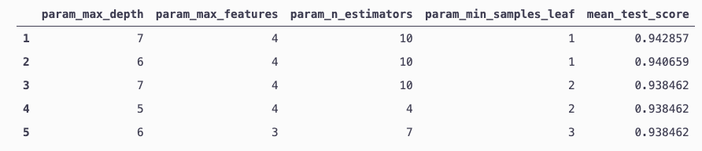
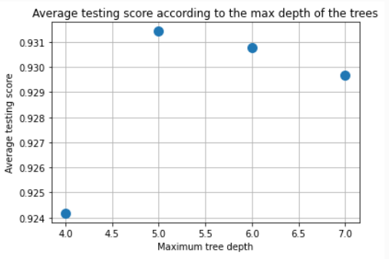
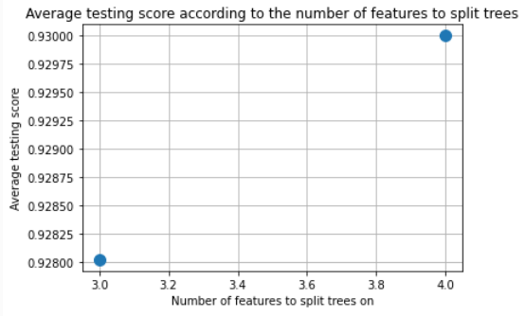
2. Random Forest

Slide 9
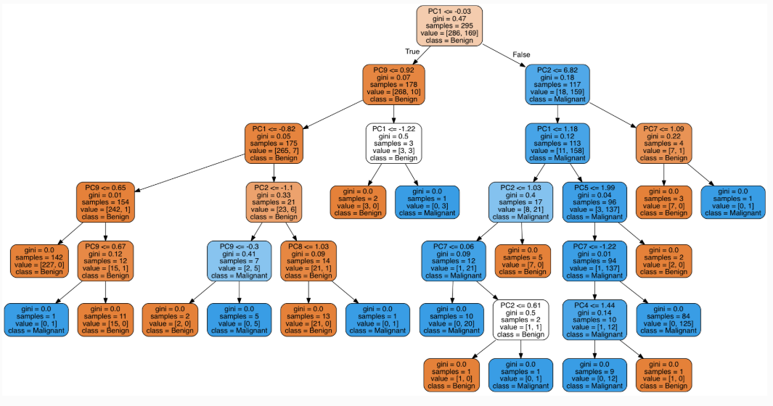
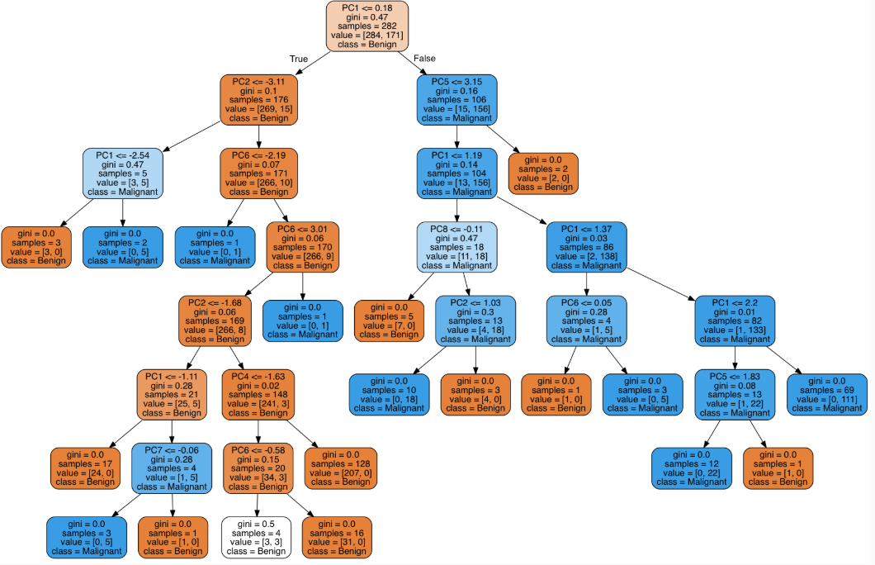
2. Random Forest
Example tree 1
Accuracy: 94.7%
Precision: 95.1%
Recall: 90.7%
AUC: 0.98
69 TN | 2 FP
4 FN | 39 TP
True label
M (+) B (-)
Example tree 2
B (-) M (+)
Predicted label

Slide 10
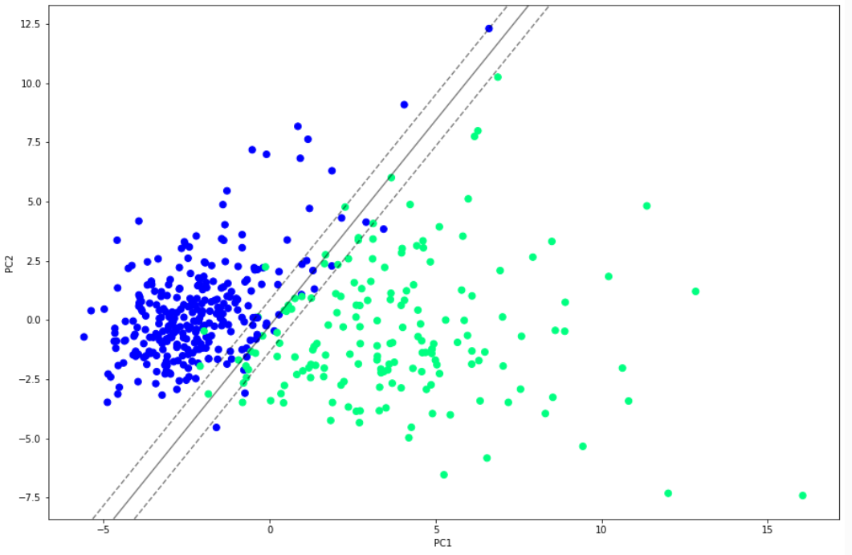
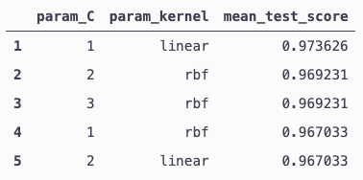
3. Support Vector Classifier (SVC)
PC2
71 TN | 0 FP
3 FN | 40 TP
True label
M (+) B (-)
Accuracy: 97.4%
Precision: 100%
Recall: 93.0 %
AUC: 0.98
B (-) M (+)
Predicted label
PC1

Slide 11
4. K-Nearest Neighbour (KNN)
Notes:
KNN
Similar to K-means clustering in that it assumes that similar things exist in close proximity/near each other
Process
Specify k (number of nearest neighbours) – generally an odd number if the number of classes is 2 to prevent tie situations
Compute distance between each data point & the test data & find closest k-points in the training set
The test data then assigned to the class most common among its k-nearest neighbours
Lazy/instance-based: makes no generalisations – no explicit/minimal training = doesn’t explicitly learn a model & only uses the training instances when a query is made
Pros
Non-parametric: no assumptions on underlying data distribution
Quite intuitive
Cons
Computationally expensive (the testing phase not the training phase) + high memory cost (as it needs to store a potentially huge data set)
Must find an optimal k value
Requires scaling + PCA
Poor at classifying data points at the boundary

Slide 12
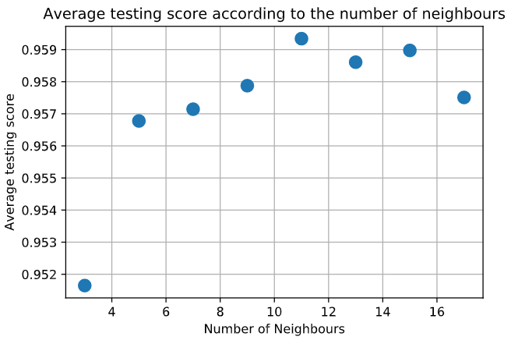
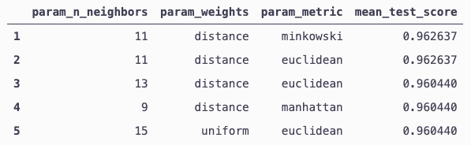
4. K-Nearest Neighbour (KNN)
Notes:
Parameters – grid search
n_neighbors : 11
- weights: ‘uniform’ (each neighbor within the boundary carries the same weight) or ‘distance’ (closer points be more heavily weighted toward the decision – can deal with skewed class distributions)
NB. if weights = 'distance’: the class with the highest number in the boundary may not “win the vote” - metric: how the distance of neighboring points is chosen from the unknown point (difficult to visualise if higher than 3D) – minkowski (a metric in Normed vector space) as opposed to Euclidean or Manhattan
Leaf size: 30
Algorithm: auto

Slide 13
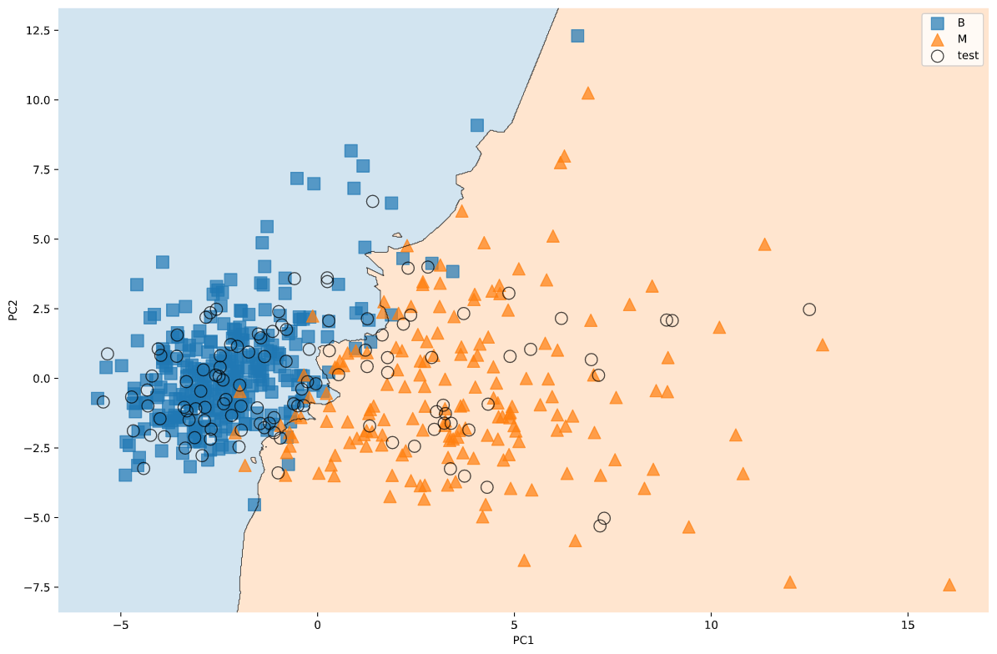
4. K-Nearest Neighbour (KNN)
71 TN | 0 FP
4 FN | 39 TP
PC2
True label
M (+) B (-)
B (-) M (+)
Predicted label
Accuracy: 96.5%
Precision: 100%
Recall: 90.1%
AUC: 0.98
PC1
Notes:
Voronoi diagram: Only showing 2 PCs for visualisation purposes – showing decision boundaries for each class
Ie) separates the data points into regions which are actually the classes they belong to
The smaller the k – the more jagged the decision boundaries = high variance + low bias
The larger the k – the smoother the decision boundaries = lower variance + higher bias
Quite good at separating between blue rectangles (B) & orange traingles (M)

Slide 14
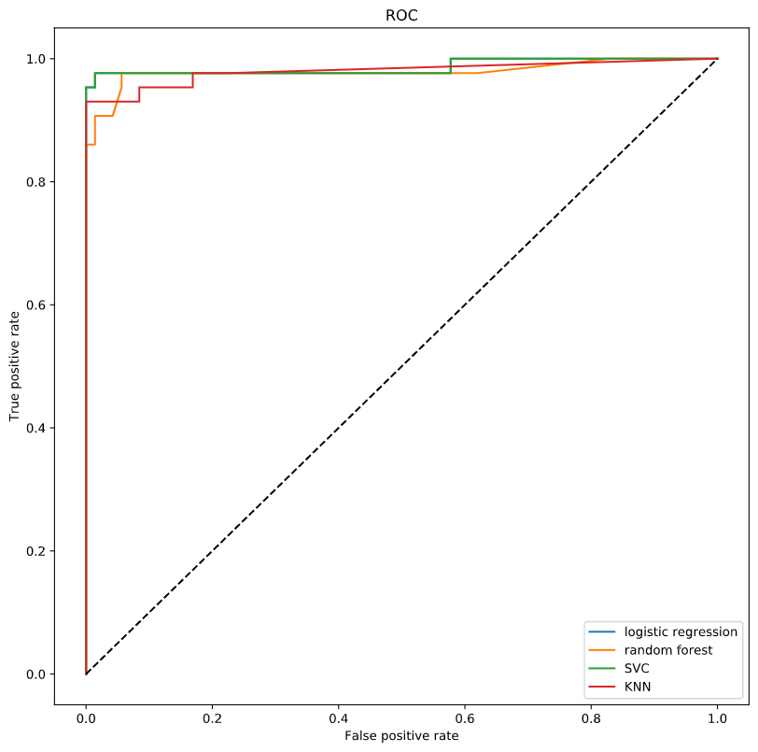
Comparison
ROC
Model | Accuracy (%) | Precision (%) | Recall (%) | AUC
Logistic Regression | 98.2 | 100 | 95.3 | 0.99
Random Forest | 94.7/93.9 | 95.1/94.6 | 90.7/87.5 | 0.98/0.98
SVC | 97.4/96.5 | 100/95.0 | 93.0/95.0 | 0.99/0.99
KNN | 96.5/95.6 | 100/97.3 | 90.1/90.0 | 0.98/0.99
TPR
⇒ logistic regression with PCA seems to be the best model
⇒ hyperparameter tuning increase model performance
FPR
Without hyperparemeter tuning
Notes:
Can predict with quite high accuracy
Surprising that logistic regression performed so well
SVC: handles outliers better as it derives maximum margin solution
Accuracy: ratio of correctly predicted observations to the total observations
Precision: ratio of correctly predicted positive observations to the total predicted positive observations - false positives
Recall/sensitivity: ratio of correctly predicted positive observations to the all observations in actual class – false negatives
F1 score: the weighted average of precision & recall

Slide 15
Things to consider
Quite a small number of samples (569 observations)
Bias in the data (62.7% B)
outliers
Additionally
With PCA vs without PCA for all models
Feature importance
Correlation between variables & PCs
Other models: ex) naïve Bayes classifier, neural networks
Notes:
RF deals well with bias
SVC deals well with outliers

Slide 16
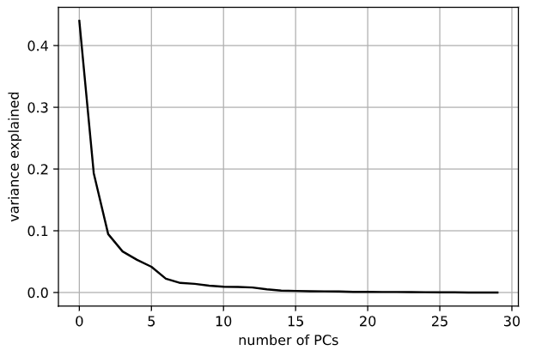
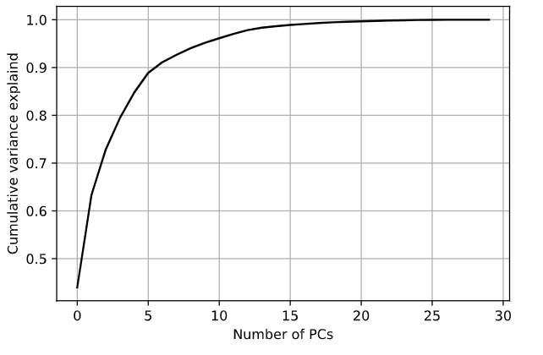
Appendix I: PCA
⇒ decided to use 10 PCs which explain more than 95% of the variance in the data

Slide 17
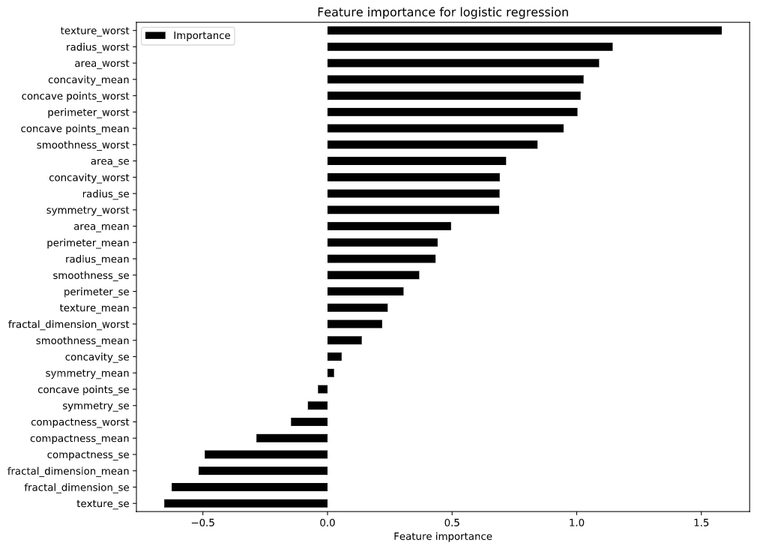
Appendix II: Feature Importance

