Slide 1
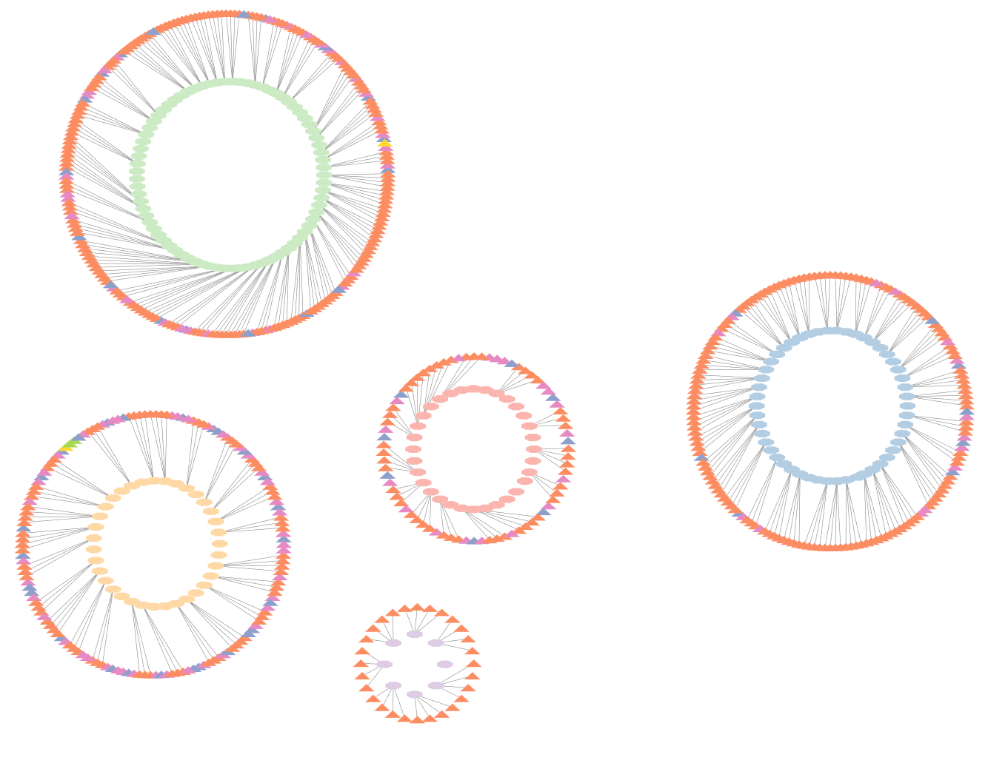
Phosphoribosylformylglycinamidine cyclo-ligase [EC:6.3.3.1]
Veillonella Parvula_A
Adenylosuccinate lyase[EC:4.3.2.2]
Phosphoribosylamine—glycine ligase[EC:6.3.4.13]
Phosphoribosylaminoimidazole-succinocarboxamide synthase [EC:6.3.2.6]

