Slide 1
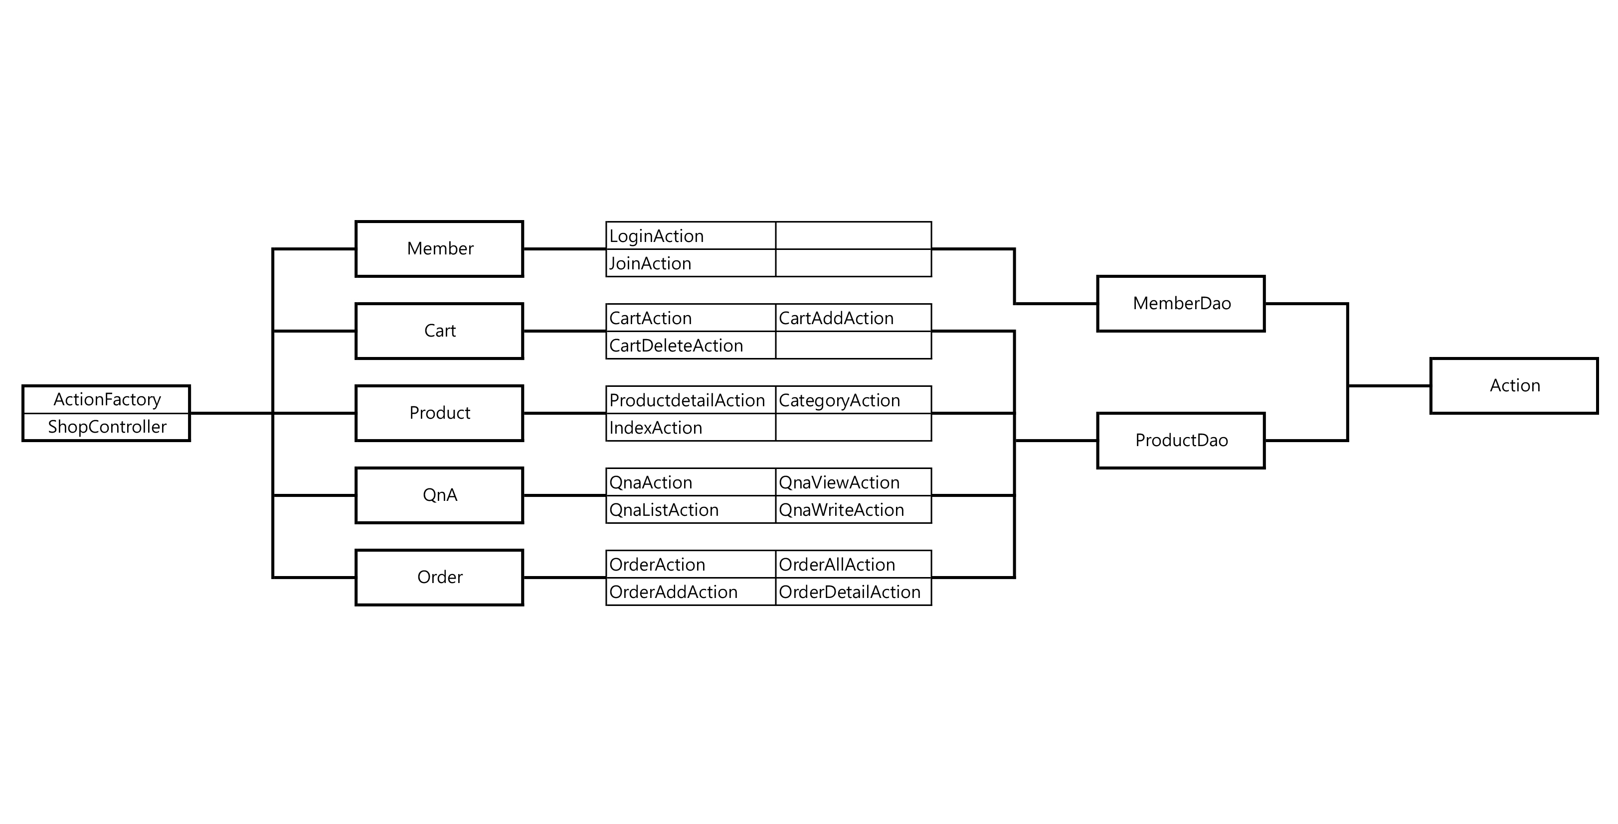
PointAction
MemberGradeAction
WorldCupAction
Review
ReviewWriteAction ReviewListAction ReviewViewAction
Coupon
CouponUseAction
CouponCreateAction
CouponDao

