Slide 1
Model-Free Learning Monte Carlo Methods
CogPsi
2019/08/05
YK Lee

Slide 2
References
[1] Reinforcement Learning: An Introduction (2nd edition) by Richard S. Sutton and Andrew G. Barto
[2] Richard Sutton Lecture Notes: http://incompleteideas.net/609%20dropbox/slides%20(pdf%20and%20keynote)/9-10-MC.pdf
[3] David Silver (Lecture 4: Model-Free Prediction) http://www0.cs.ucl.ac.uk/staff/d.silver/web/Teaching_files/MC-TD.pdf

Slide 3
Monte Carlo?
Learning from experience (values, policy)
Estimating value functions and discover optimal policies
Averaging (complete) sample returns
Can be used in two ways:
Model-free : no model necessary and still attains optimality
Simulated: needs only a simulation, not a full model

Slide 4
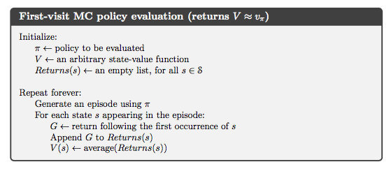
[1]
* visit to s
** first visit to s
*** every visit to s
Notes:
visit to s
= a state-action pair s,a is said to be visited in an episode if ever the state s is visited and action a is taken in it.

Slide 5
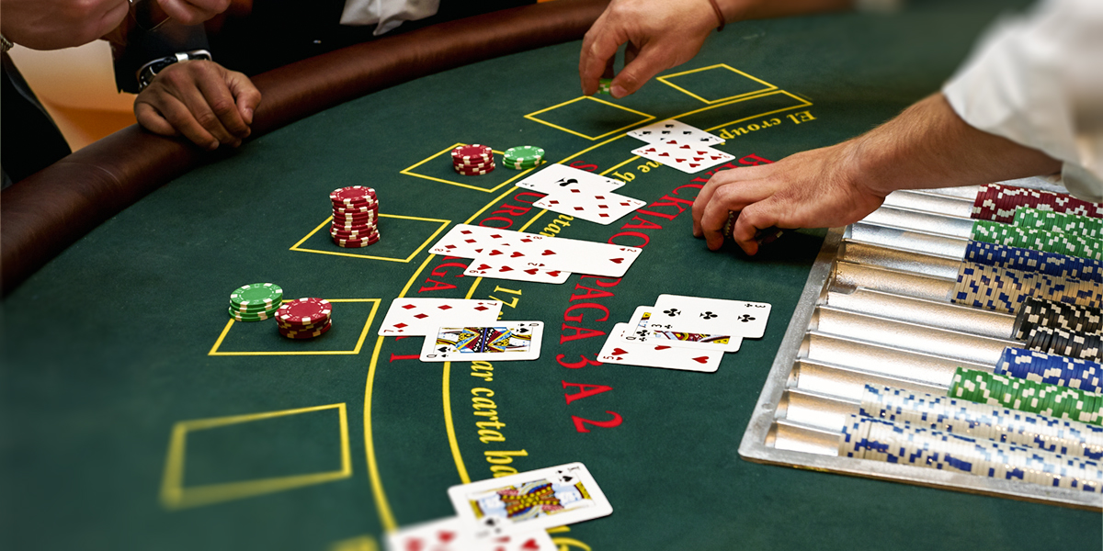
MC Example 5.1 : Blackjack
Rewards
Win +1
Draw 0
Lose -1
No discount
Actions: [hit, stick, bust]
Total 200 states
Current sum (12-21)
Dealer’s one showing card (ace-10)
Hold/not hold usable ace

Slide 6
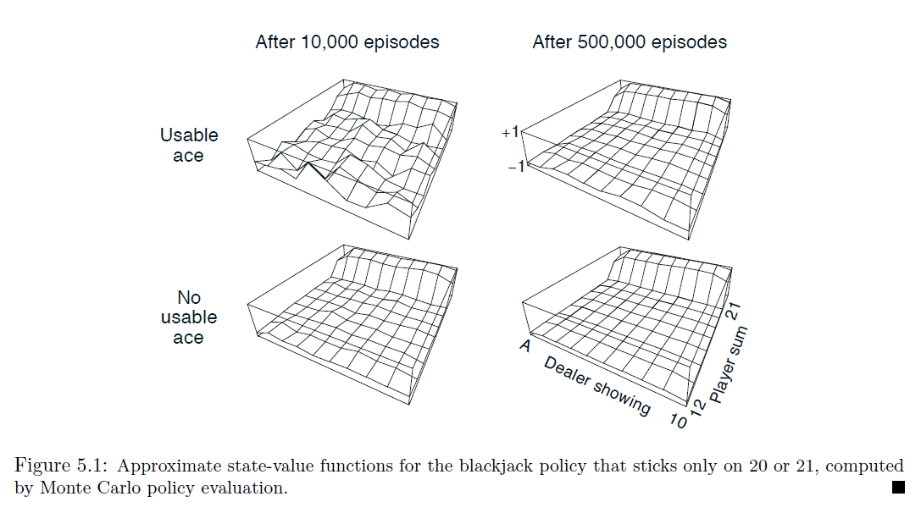
[1]
a
Front-most height
a > b, Why?
Fall
Jump
b

Slide 7
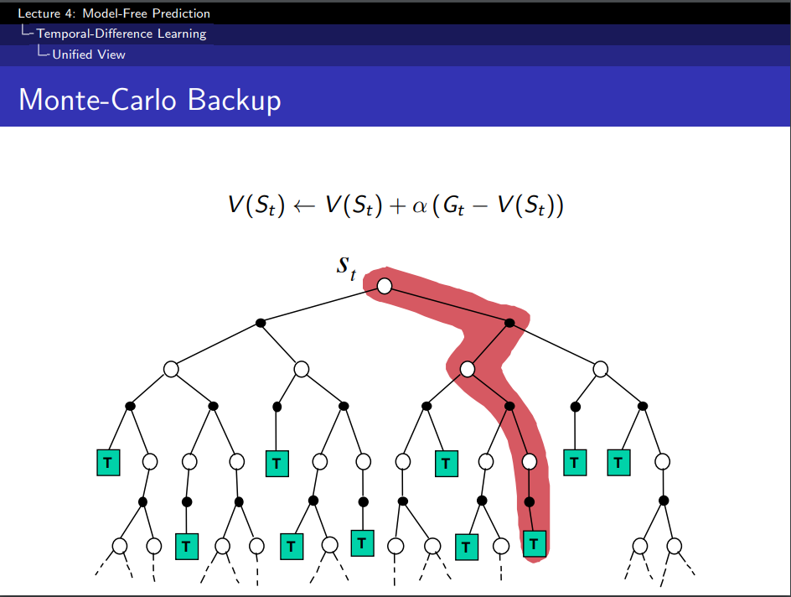
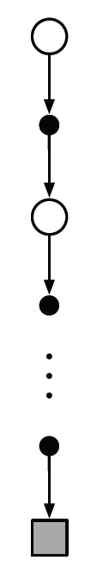
Backup diagrams
[3]
Notes:
“This can make Monte Carlo methods particularly attractive when one requires the value of only one or a subset of states”
“one can generate only one or a subset of states.
“actual experience”, “simulated experience” advantage over DP?

Slide 8
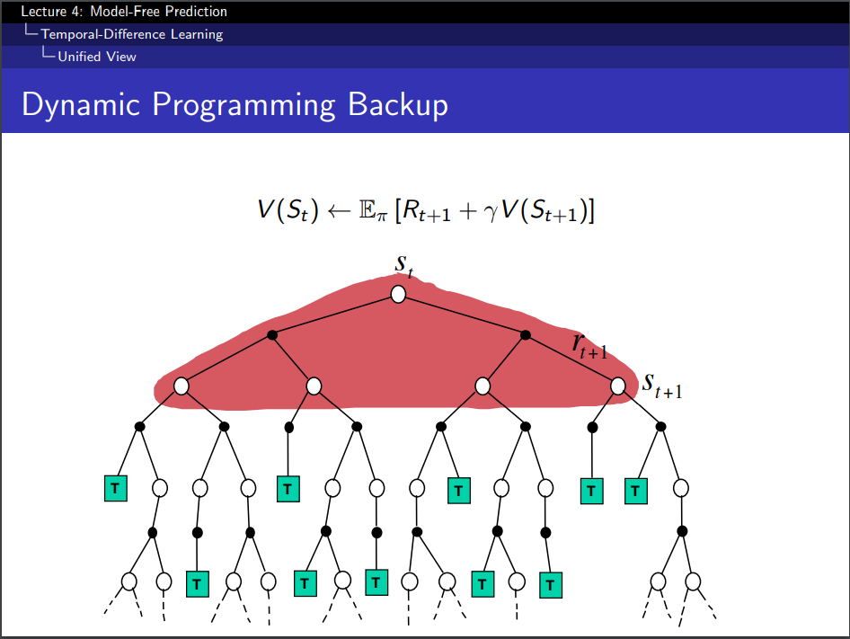
[3]

Slide 9
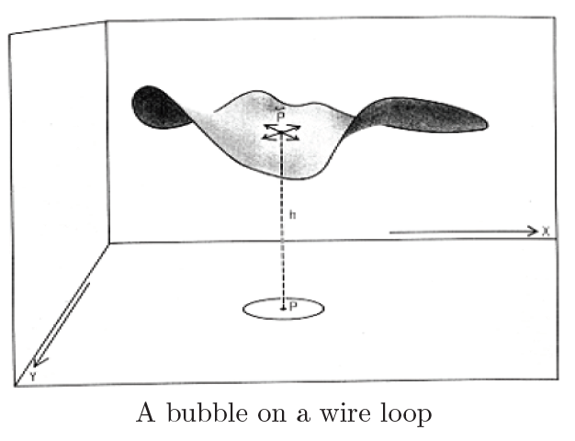
Example 5.2: Soap Bubble
[1]
If the geometry of the wire frame is irregular but known, how can you compute the shape of the surface?
One can closely approximate the height of the surface at a point by simply averaging the height of the surface at a point by simply averaging the boundary heights of many walks started at the point
[1]

Slide 10
5.2. Monte Carlo Estimation of Action Values
Estimate q*.
Estimate q_pi(s,a) for visited s
Problem?
Many state-action pairs may never be visited
We need to estimate the value of all the actions from each state, not just the one we currently favor.
Exploring starts
Consider only policies that are stochastic with a non-zero probability of selecting all actions in each state.

Slide 11
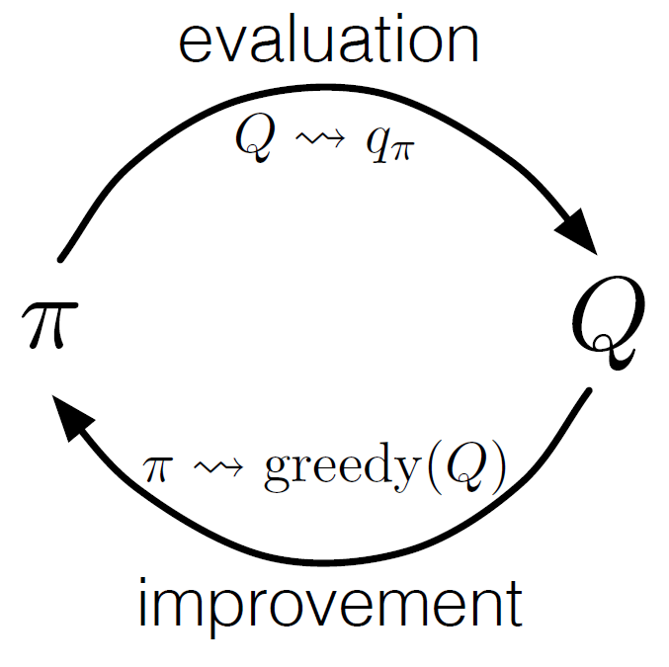
5.3. Monte Carlo Control
[1]
Complete policy evaluation
Complete policy improvement

Slide 12
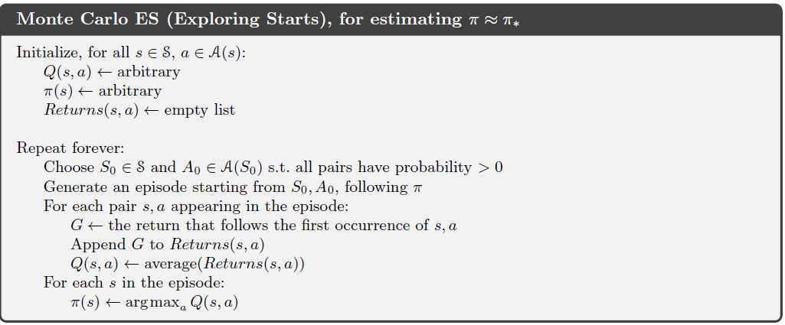
Monte Carlo ES
[1]

Slide 13
Example 5.3. Solving Blackjack
[1]
One simply picks the dealer’s cards, the player’s sum and whether or not the player has a usable acc, all at random with equal probability
Initial policy = sticks only on 20 or 21,
Initial action-value function = 0 for all state-action pairs

Slide 14
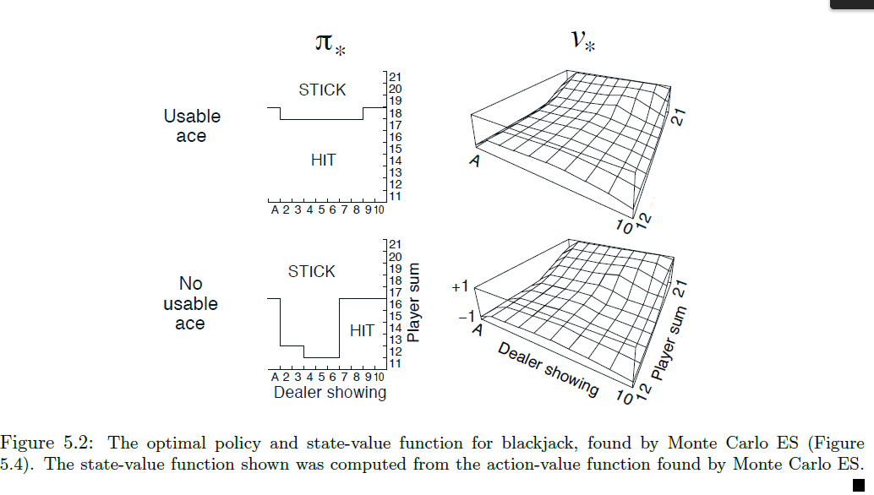
“basic” strategy of Thorp(1966)
Except Leftmost notch
[1]

Slide 15
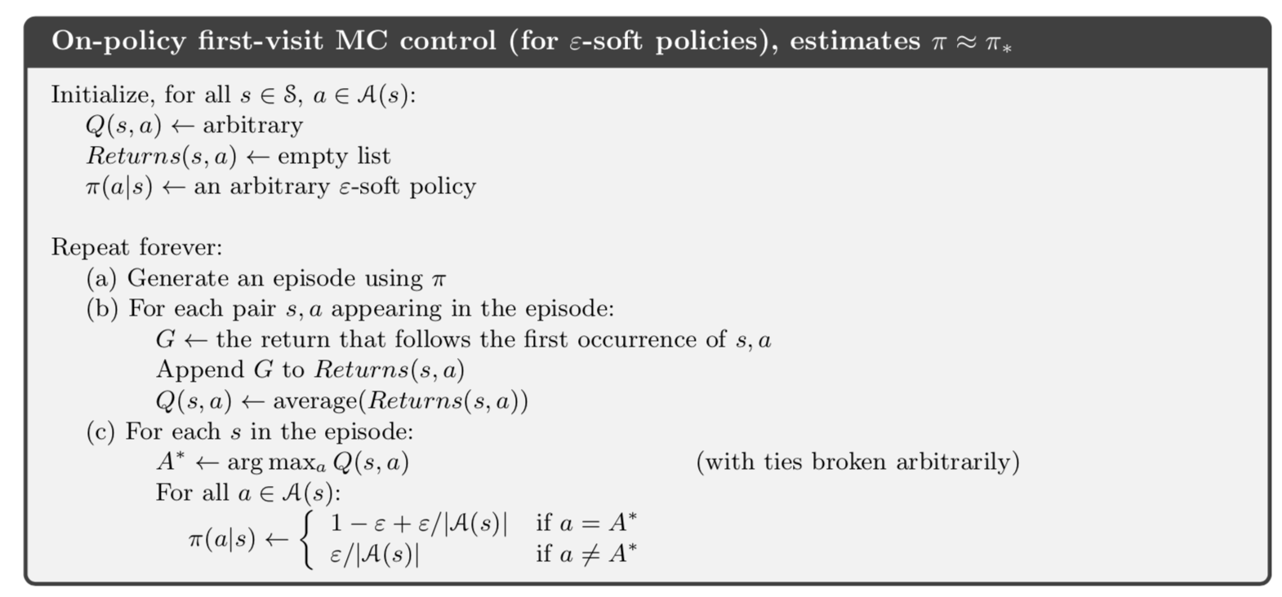
5.4. Monte Carlo Control without Exploring Starts
[1]

Slide 16
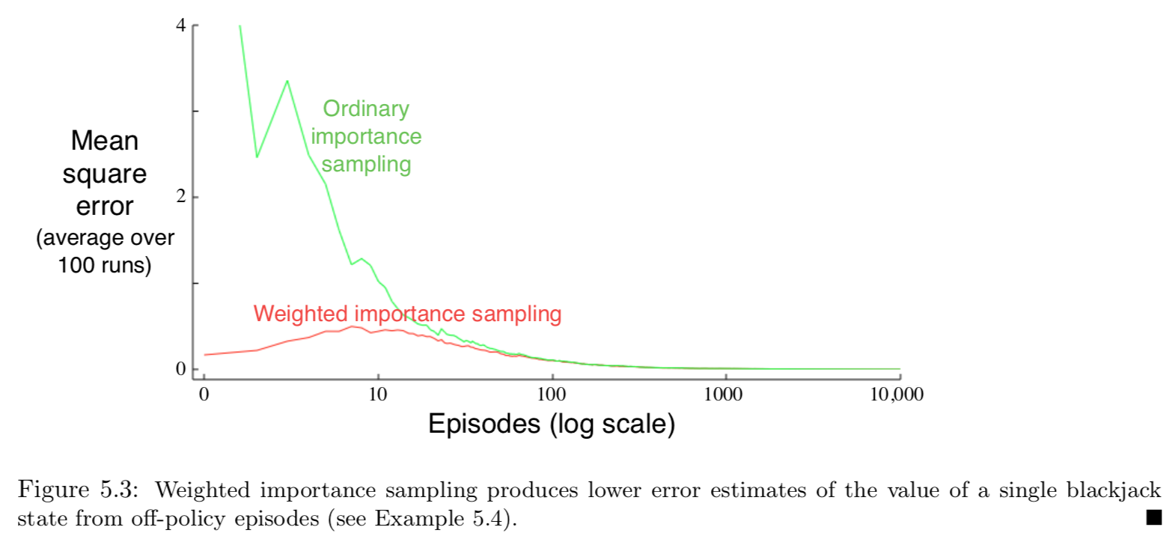
Example 5.4: Off-policy Estimation of a Blackjack State Value
5.5. Off-policy Prediction via Importance Sampling
[1]

Slide 17
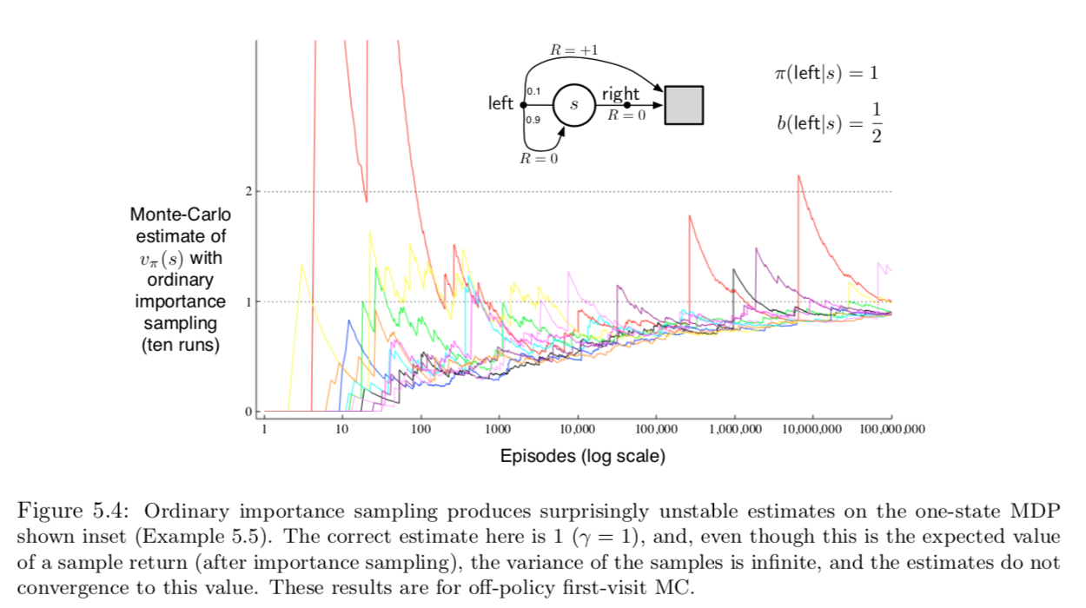
Example 5.5: Infinite Variance
[1]

Slide 18
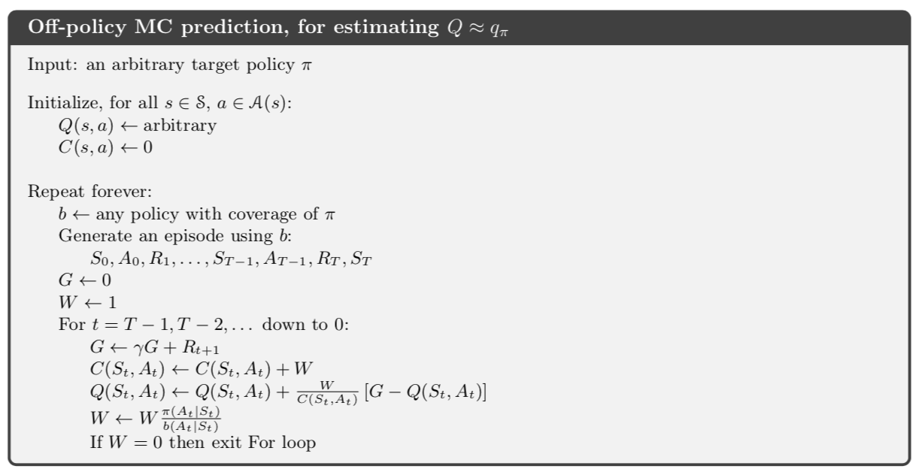
5.6. Incremental Implementation
[1]

Slide 19
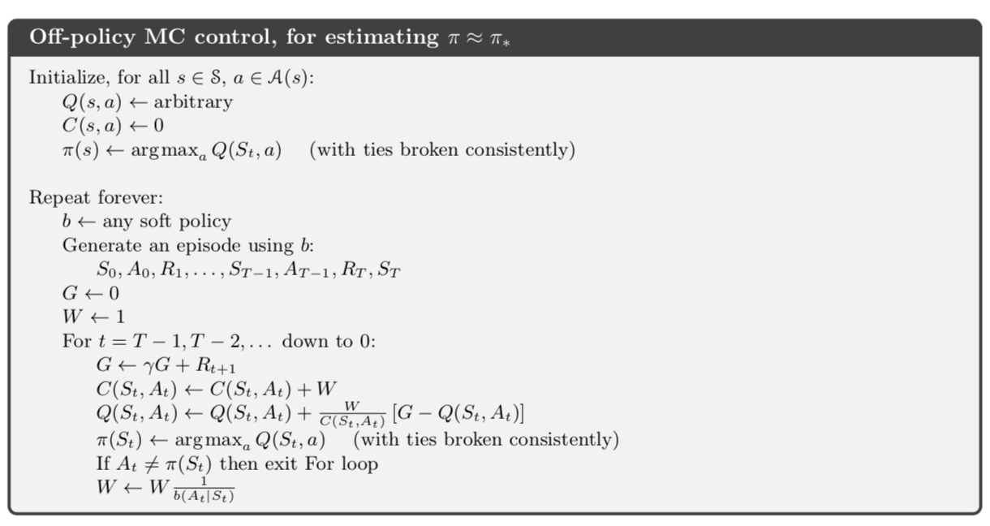
5.7. Off-policy Monte Carlo Control
[1]

Slide 20
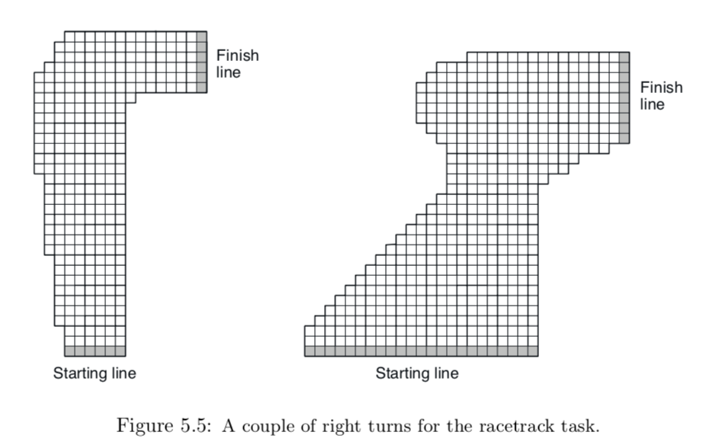
Ex. 5.8: Racetrack
[1]

Slide 21
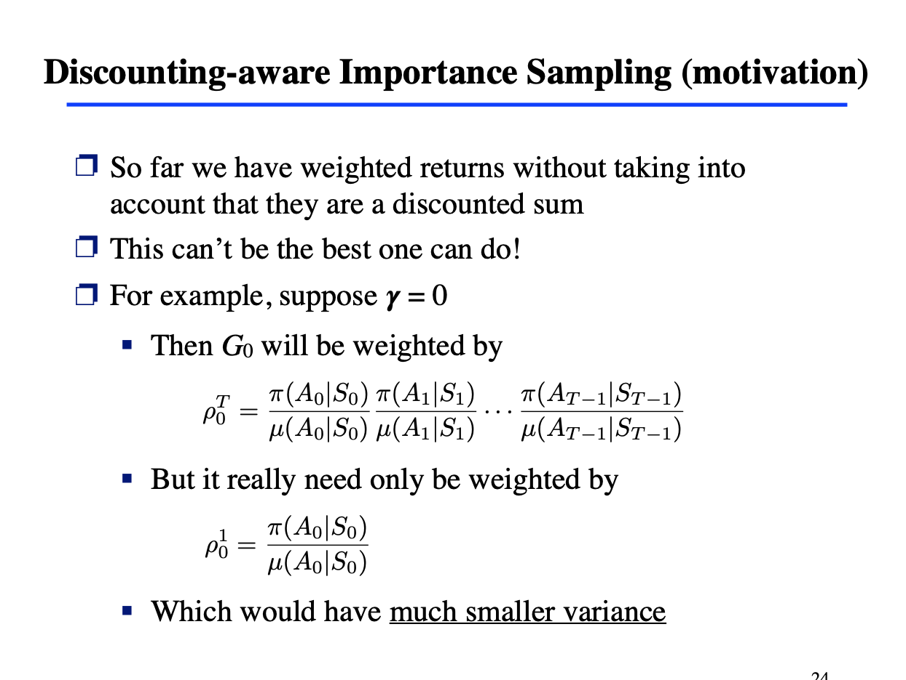
5.8. Discounting-aware Importance Sampling
[2]
http://incompleteideas.net/609%20dropbox/slides%20(pdf%20and%20keynote)/9-10-MC.pdf

Slide 22
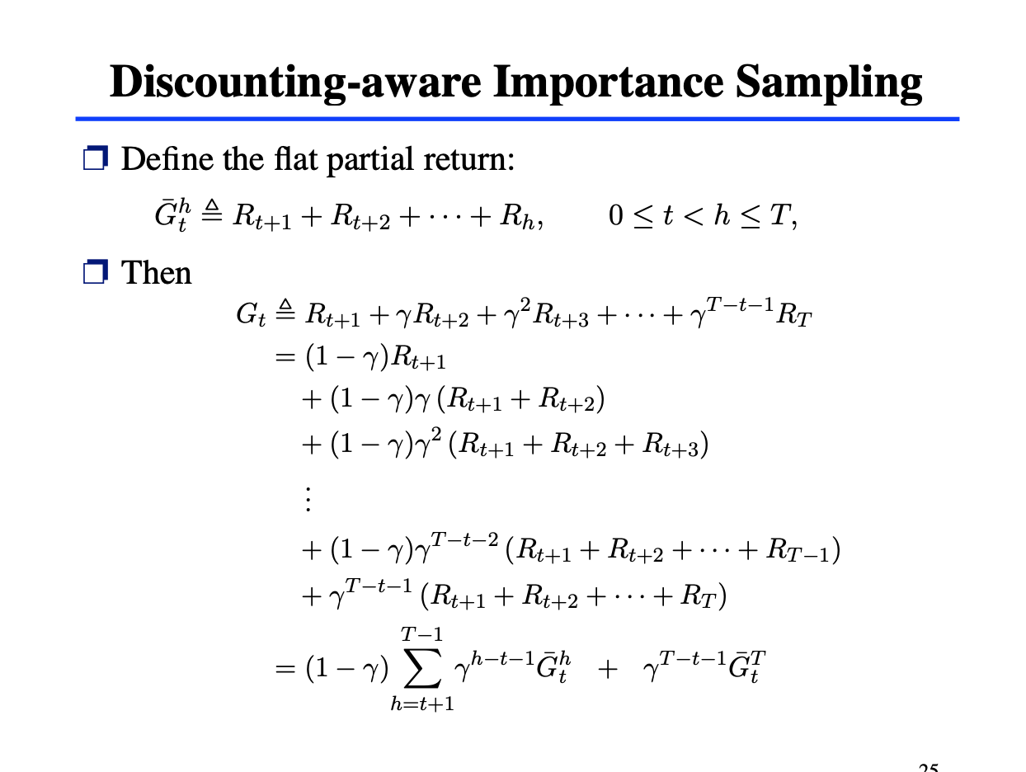
[2]
http://incompleteideas.net/609%20dropbox/slides%20(pdf%20and%20keynote)/9-10-MC.pdf

Slide 23
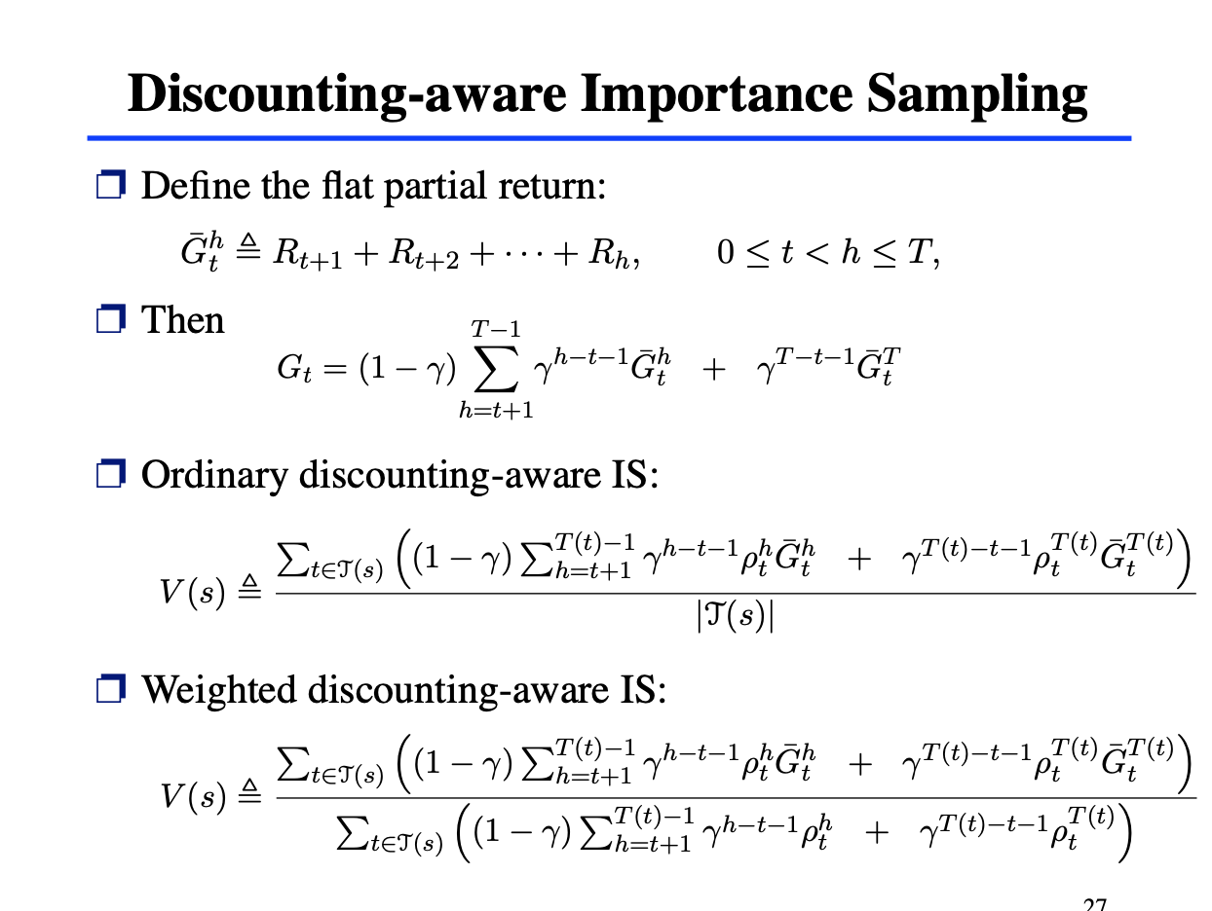
[2]
http://incompleteideas.net/609%20dropbox/slides%20(pdf%20and%20keynote)/9-10-MC.pdf

Slide 24
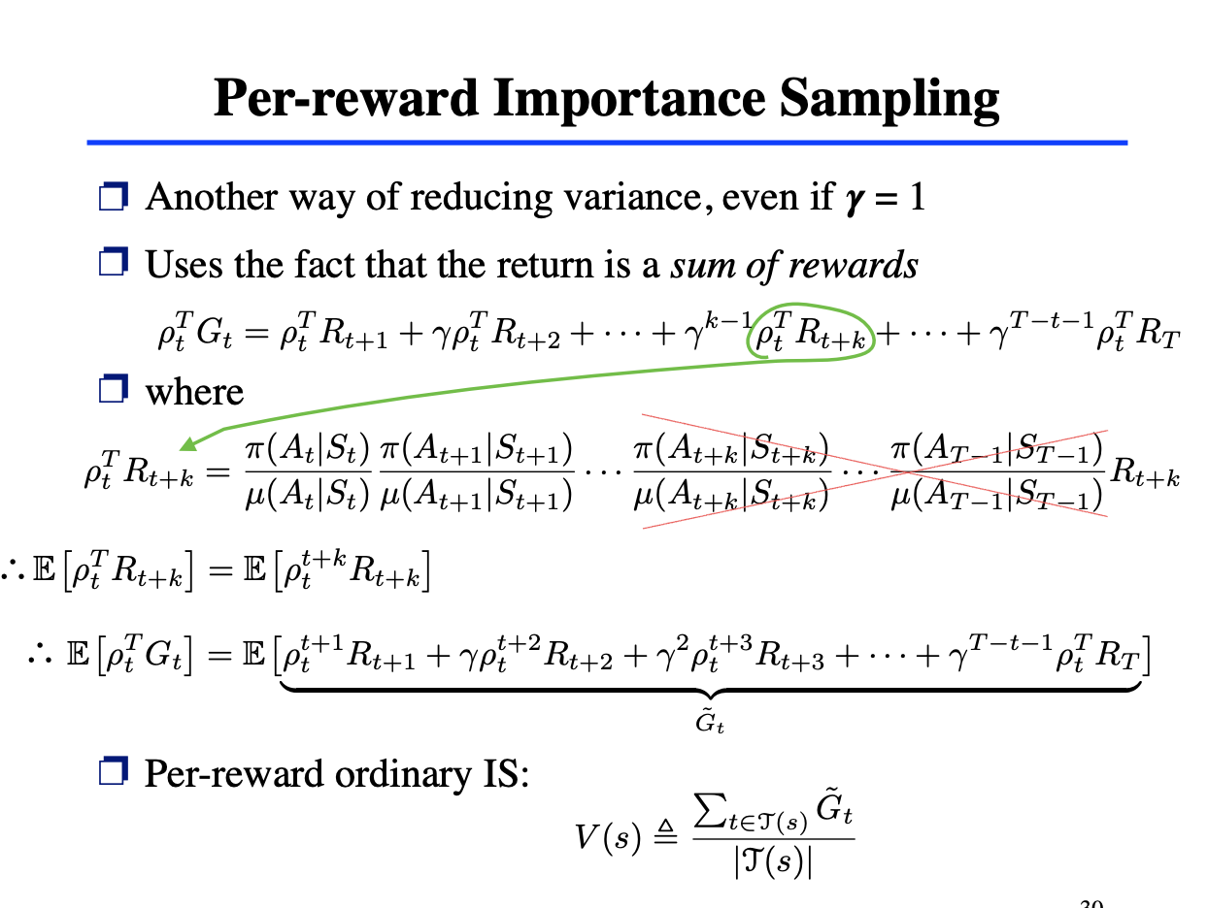
5.9. Per-reward Importance Sampling
[2]
http://incompleteideas.net/609%20dropbox/slides%20(pdf%20and%20keynote)/9-10-MC.pdf

Slide 25
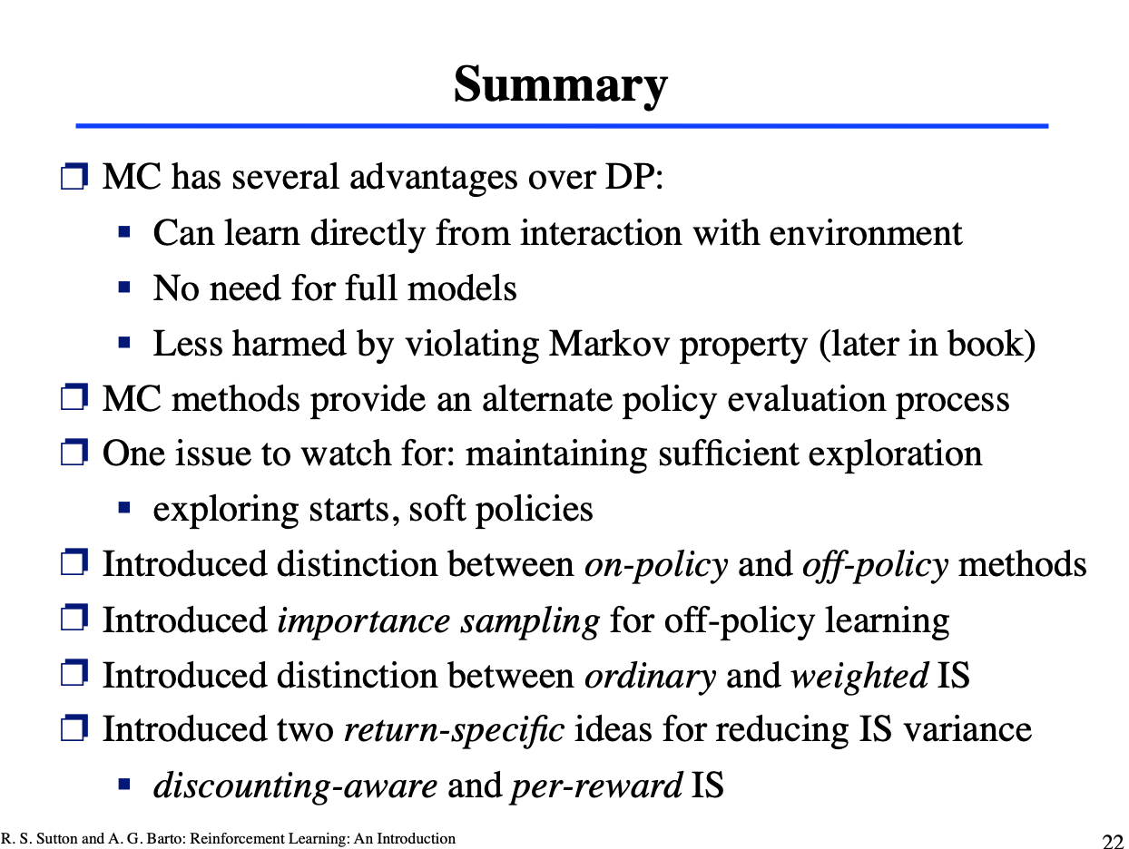
5.10. Summary
[2]
http://incompleteideas.net/609%20dropbox/slides%20(pdf%20and%20keynote)/9-10-MC.pdf

