Slide 1
<SolutionName> Barn Raising
Chris Stanley
<Practice Lead>

Slide 2
<SolutionName> Barn Raising
Agenda
Welcome and Logistics
Introductions and Objective
Pre-Engineered Solution Construct
Services Engagement Crafting and Scoping

Slide 3
<SolutionName> Barn Raising
Day 1: Monday
Duration | Topic | Presenter | Notes
8am – Noon | Team Arrival |  | Please eat lunch before arrival.
Noon – 1 pm | Kickoff Introductions and Objective Pre-Engineered Solution Construct Services Engagement Crafting and Scoping | Chris S. <Practice Lead>
1pm – 3pm | Solution Overview Definition Problem Statement Target Market Profile | <Solution Owner>
3pm – 4pm | Value Modeling Requirements | Bruce R.
4pm – 5pm | Process Centric Approach | Dave B.
5pm – 6pm | Confirm Week Schedule | Chris S.
Notes:
Lisa Monk will be supporting Dave remotely (EMT) as needed.

Slide 4
<SolutionName> Barn Raising
Day 2,3,4: Tuesday, Wednesday, Thursday
Hours | Activity | Presenter | Notes
7:30am – 8:30am | Breakfast, Arrivals, Emails
8:30am – 9am | Daily Review | Chris S., <Practice Lead>
9am – Noon | Asset Development | N/A
Lunch Break
1pm – 1:30pm | Deliverable Review Team Questions | Asset Author(s)
1:30 pm – 5:00 pm | Asset Development | N/A
5:00 pm – 5:30 pm | Status Check Daily Achievements Work Impediments Issues / Risks | Asset Author(s)
Note: Asset development will be prioritized and assessed each day.
Team Dinner will be Tuesday night. Time and Location TBD
Notes:
Priority:
Process Deliverables
Process Overview
Process Swimlane
Practice Storyboard
3 Complete – 3 need to be created.
Value Model (Divi and Bruce)
Scorecard
Metrics
Engagement Crafting and Scoping
Estimation Guideline
SOW

Slide 5
<SolutionName> Barn Raising
Agenda
Welcome and Logistics
Introductions and Objective
Pre-Engineered Solution Construct
Services Engagement Crafting and Scoping

Slide 6
<SolutionName> Barn Raising
Introductions
Name | Title | Role
Chris Stanley | Portfolio Lead / Client Manager | Portfolio Lead
David Burnet | Consultant, Fellow | Application Community Lead
Bruce Robitaille | Process Consultant Fellow | Value Planning Lead
 |  | Practice Lead
 |  | Solution Owner
 |  | Segment SME
 |  | Practice SME
 |  | Product Owner(s)
 |  | Client Management
John Wylie | VP of Product Management | Solution Framework SME
John Archer | Director of Process Management | Solution Framework SME

Slide 7
<SolutionName> Barn Raising
Objective of Barn Raising Events
Creation of Service Assets
Proactively develop Service Assets to support the scoping and definition of a solution
Value Assets (Bruce Robitaille)
Process Assets (Dave Burnet)
Scoping and Engagement Crafting (Practice Lead, CM and SME)
Alignment of Roles and Content Ownership
Segment and Global Services align on the scope of the solution
Align on accountability for the creation and maintenance of each asset
Course of Action following the Barn Raising Event

Slide 8
<Solution Name> Barn Raising
Pre-Requisites
Align and agree on Scope of the Barn Raising Event
Solution Level and Implementation Units
Identify a field opportunity to co-develop and validate the offering kit
RVP Awareness / Knowledge
Work Streams and Concepts
Process Led Approach Presentation Review
Value Planning Presentation Review
Solution Readiness
Solution Definition Document
Best Practice Summary Slides (Inventory and Completeness)
Process Overview Presentation
Engagement Crafting and Scoping
Sample SOW and Estimation Framework

Slide 9
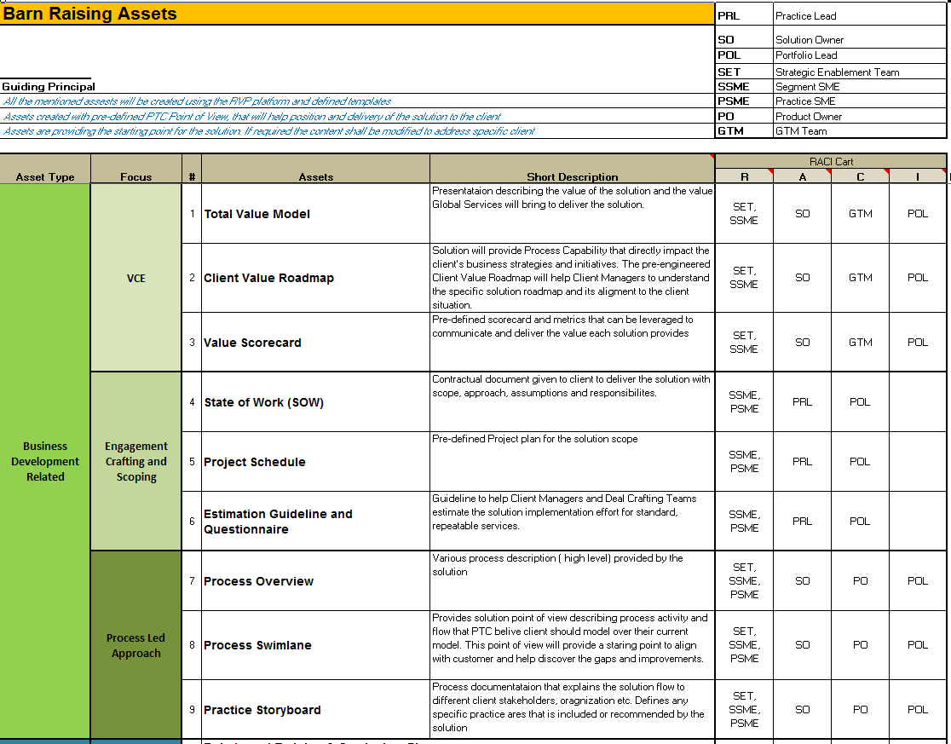
<SolutionName> Barn Raising
Service Assets

Slide 10
<SolutionName> Barn Raising
Expected Outcome at the end of the event
Services Assets created and loaded in ProjectLink
The percent completion of the Services Assets is clear to the team and logged in JIRA
The plan to finish the Services Assets is proposed and agreed
Resource commitment

Slide 11
<SolutionName> Barn Raising
Agenda
Welcome and Logistics
Introductions and Objective
Pre-Engineered Solution Construct
Services Engagement Crafting and Scoping

Slide 12
Strategic Enablement: Pre-Engineered Offerings
Enable Global Services to be a premium service provider to our clients by developing Pre-Engineered Services Offerings that enable predictable high value deployments in support of PTC’s Solutions
Mission
Design the DNA of a standard Pre-Engineered Deployment Offering (Deliverables/Outcomes) leveraging the RVP “process led” approach with a delineation between business development and delivery assets
Establish a standard approach to proactively (“barn raising”) develop the business development assets of a Preconfigured Solution
Aggressively drive the execution of the barn raising events to create a portfolio of Pre-Engineered Services Offerings for each of the launched PTC Solutions
Maintain a master development schedule of the pre-engineered solutions while collaborating with Practice Leads to coordinate communication and adoption events
Conduct quarterly reviews on the effectiveness of the Pre-engineered Services Offers to consistently tune the DNA
Strategy
Full Portfolio of Pre-Engineered Service Offerings in support all released PTC Solutions
Client Managers actively leveraging the Business Development assets to efficiently sell well crafted Deployment offerings
Delivery Teams actively leveraging the Delivery Assets to repeatedly deliver Deployment engagements
Improved Client Satisfaction and Global Services margins as a function of more repeatable and predictable deployment engagements
Desired Outcomes

Slide 13
Ecosystem to leverage for creation of the Pre-Engineered Solutions
PLM: Greg Marin
ALM: Ryan Lloyd
RVP: Ann King
SCM: Serge Romano
SLM: Anica Godwin
CM: Luis Brito
Leadership
Consulting: Kurt
ALM Patrick Mullen
Value Planning: Bruce
R.
Process led: Dave Burnet
SCM: Fred
R.
SLM: Craig Ballard
PLM: Mark Dorsett

Slide 14
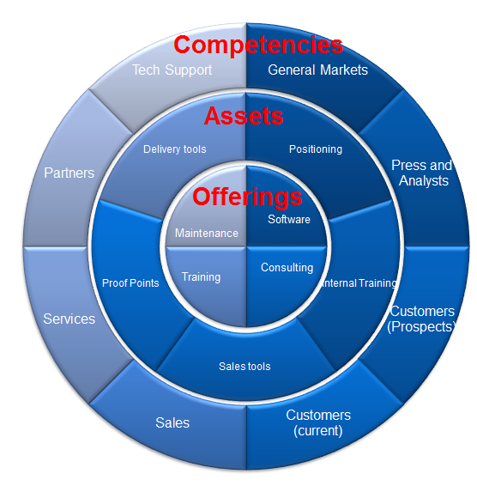
Solution Overview
A solution…
…Is a saleable offering designed to solve a specific business problem
…typically has 3 levels of maturity; each delivers defined value
…may be deployed in phases
…may be deployed concurrently with other solutions
…are comprised of technology best practices and associated services
…are supported by an array of assets and competency-building tools/training

Slide 15
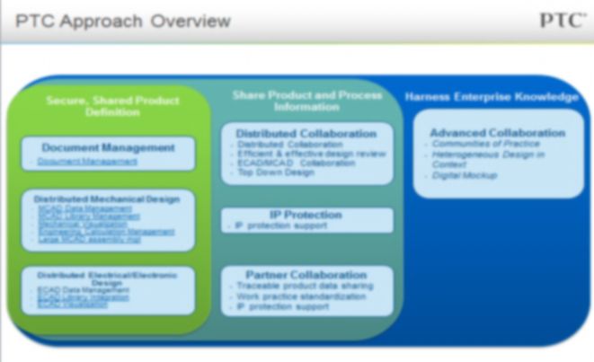
Solution Structure
What is a Value Centric Solution?
Defined set of answers to business problems that are easily understood by customers during Value Modeling
Solution
Implementation Units
Best Practices
Capabilities
Adoption Phase
Levels of value achievable by customers based on realistic adoption phases
Inter-related set of practices that are required to ensure measureable Value attainment
Working methods that transform how users generate value
Practice-enabling features that optimize and standardize execution

Slide 16
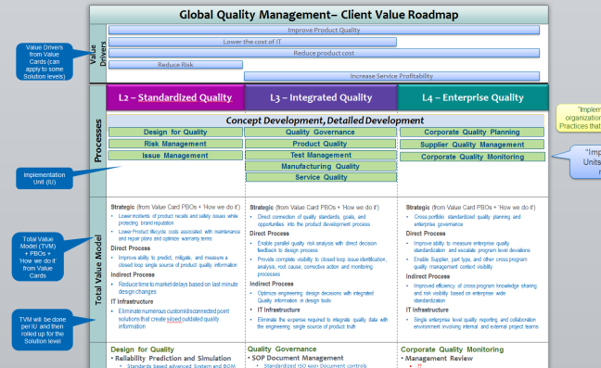
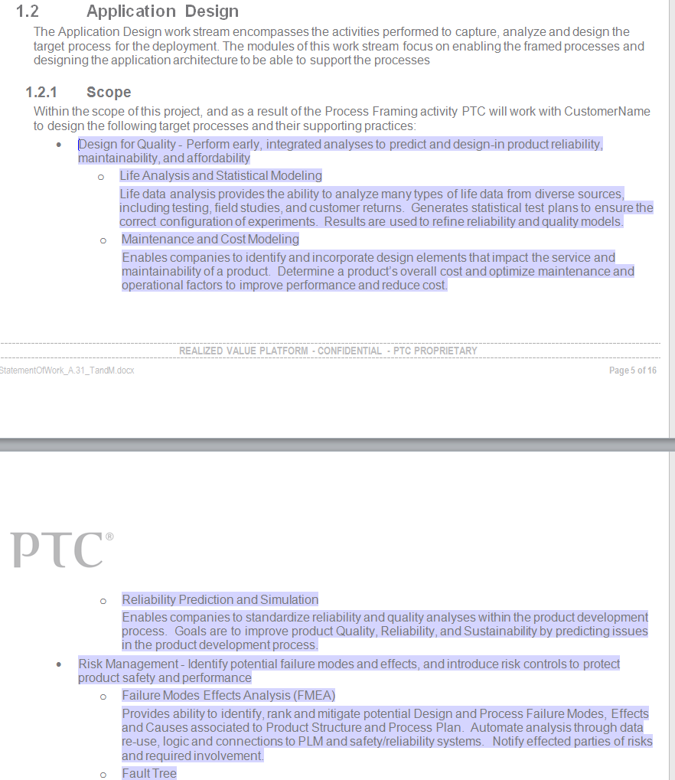
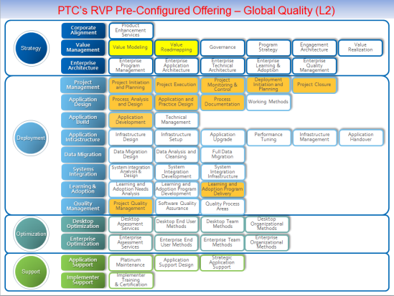
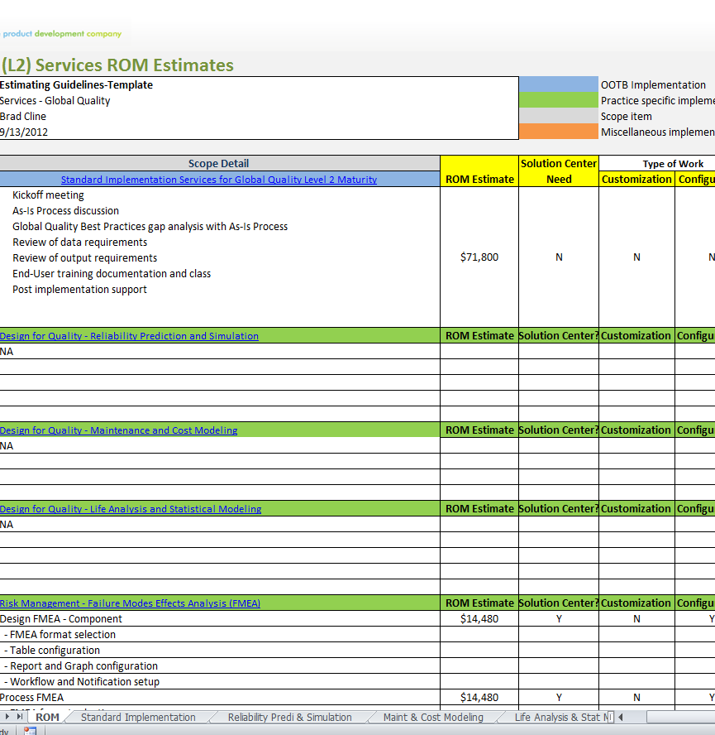
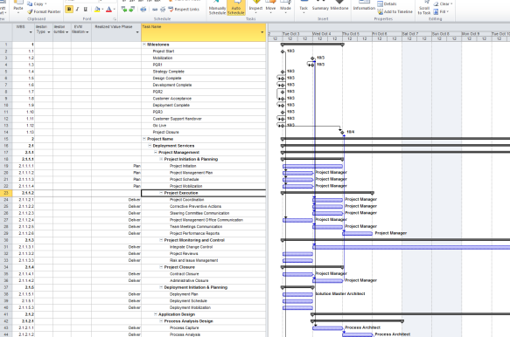
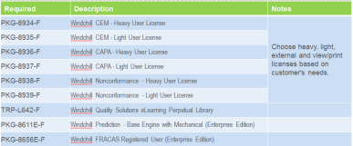
Solution Business Development Kits
Visibility: Internal
User: Client Manager
Use: Modular set of Services selling tools aligned to sales driven value model
Contents (by Adoption Phase):
Template SOW
Estimation Guide
Project Schedule
Total Value Model
Client Value Roadmap
Value Scorecard
Value Model aligned Client Value Roadmap
Modular Solution aligned SOW Scope
Implementation Phase level Solution WBS
Implementation Unit and Practice level Estimation Guide
Work Breakdown aligned Project Schedule

Slide 17
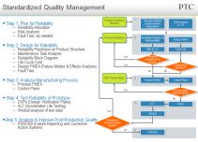
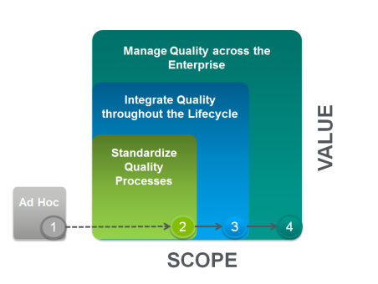
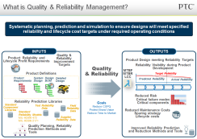
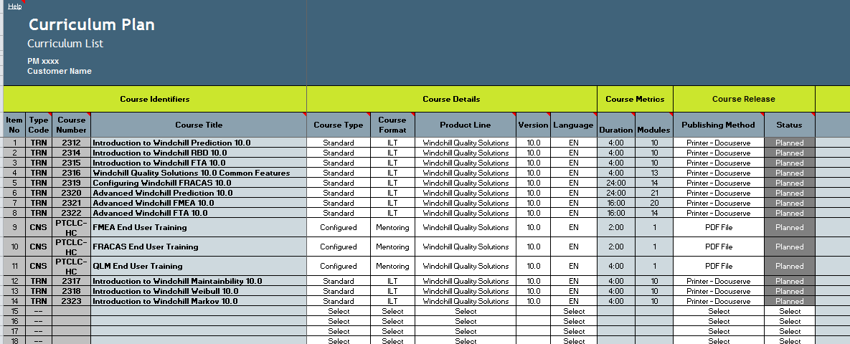
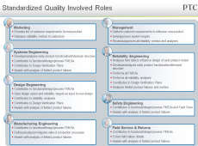
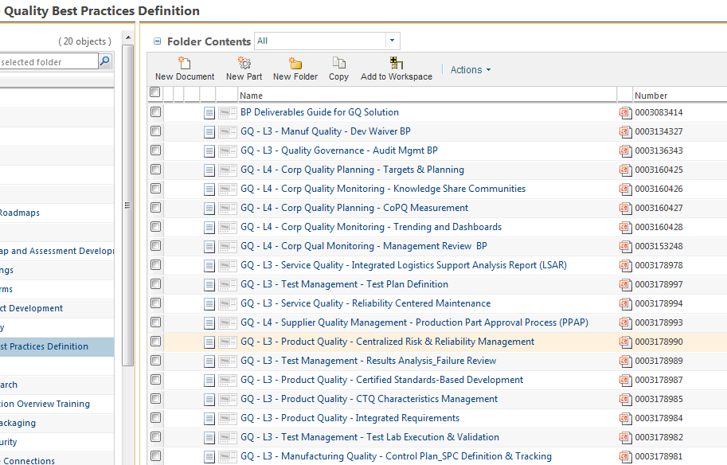
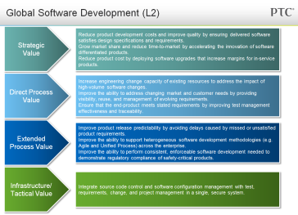
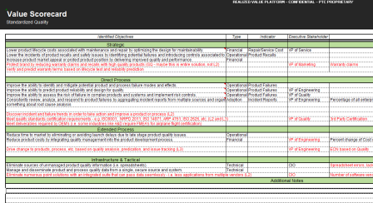
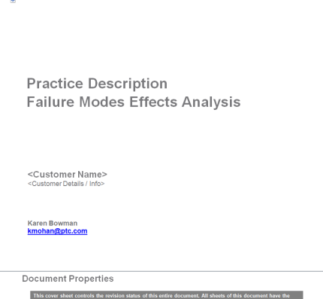
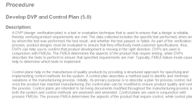
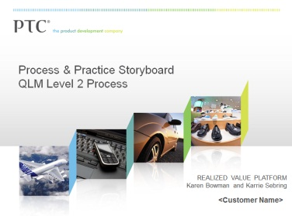
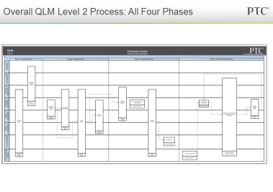
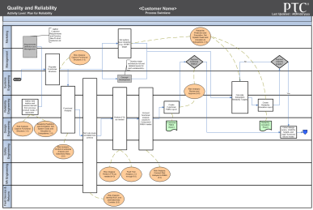
Solution Value Planning & Delivery Kits
Visibility: Internal
User: Sales/Services
Use: To help transition from Value Model to Value Plan
QTY: 5 primary artifact types per IU targeted workshop (+2-3 Solution level Deliverables)
Workshop Kickoff Presentation
Solution Curriculum Plan
Value Model/Scorecard
Practice Summary Sheet
Practice/Process Description Document
Solution Level Practice Storyboard

Slide 18
Pre-Engineered Offerings
Service Assets

Slide 19
<SolutionName> Barn Raising
Agenda
Welcome and Logistics
Introductions and Objective
Pre-Engineered Solution Construct
Services Engagement Crafting and Scoping

Slide 20
<SolutionName> Barn Raising
Questions
Once an opportunity has been identified, how long should it take a Client Manager to craft a ROM proposal for the implementation effort aligned with customer requirements?
ROM includes HIGH LEVEL: Scope of work, Implementation Approach, Assumptions, Implementation Schedule, Budgetary Costs, Roles & Responsibilities
Once an opportunity has been identified, how long should it take a Client Manager to craft a Statement of Work for the implementation effort aligned with customer requirements?
SOW includes DETAILED: Scope of work, Implementation Approach, Assumptions, Implementation Schedule, Costs, Roles & Responsibilities

Slide 21
Engagement Crafting and Scoping
Scoping
Value Modeling engagement
Preplanning / Phase 0
New Opportunity / Existing Customer
New Opportunity / New Customer
Crafting and Collaborating
Endorsement by Construction
Segments and SMEs
Top/Down
Bottom/Up
Approvals
ISU/Technical Deal Review
ROM ⇒ Proposal
Finance Deal Review
SOW
Negotiations
Rates vs. Utilization
Pricing and VSOE policies
RACI
VCE
Scope
Craft & Collaborate
Approve
Negotiate
PREDICT

Slide 22
Engagement Crafting and Scoping
The Process
RVP Execution Steps
Assess Scope
Ad hoc Data Gathering
Tribal knowledge: Sales, iCenter, meetings
Technical Questionnaires from Program Strategy and Architecture Definition module
Domain-specific questionnaires
SME assistance
PDSVA
Value drivers
High-level process scope and prioritization
VI&P
Value roadmap and scorecard
Detailed strategies
Process framing alignment
Organizational Adoption
Assess Scope and Derive Estimates
Review Scope with Client and Internal PTC
Create SOW Based Upon Scope and Estimates
Deliver SOW

Slide 23
Engagement Crafting and Scoping
The Process
RVP Execution Steps
Derive Estimates
Top Down Estimate
Comparison to similar projects
Team structure over time
Bottoms-Up Estimate
Develop Work Breakdown Structure
Estimate at Module or Element Level with SMEs
Endorsement by Construction (EBC) Teams
Business Practice representatives
Arbortext
InSight
Relex
Emerging Products
Solution Centers
EDC
Reconciliation
Work with ISU Leads to qualify staffing model
Work with sales team to maintain deal viability
Assess Scope and Derive Estimates
Review Scope with Client and Internal PTC
Create SOW Based Upon Scope and Estimates
Deliver SOW
(Continued)

Slide 24
Engagement Crafting and Scoping
The Process
RVP Execution Steps
Review Scope with Client
ROM
Powerpoint of Top-Down estimate
Typically for budgetary purposes
±40%
Proposal
Working session of Project Schedule
Working session of team load
Powerpoint of detailed estimate
±10-20%
This is the point where most robust negotiations should occur
Assess Scope and Derive Estimates
Review Scope with Client and Internal PTC
Create SOW Based Upon Scope and Estimates
Deliver SOW

Slide 25
Engagement Crafting and Scoping
The Process
RVP Execution Steps
…And Internal PTC
Refine estimates with SMEs
Endorsement by Construction (EBC)
Business Practice representatives
Arbortext
InSight
Relex
Emerging Products
Solution Centers
Review Risk Management Plan and Staffing Model with ISU Leadership (Pascuzzi, Palmer or Heintz)
Update staffing request with latest detail
Assess Scope and Derive Estimates
Review Scope with Client and Internal PTC
Create SOW Based Upon Scope and Estimates
Deliver SOW
(Continued)

Slide 26
Engagement Crafting and Scoping
The Process
RVP Execution Steps
Create SOW
Start writing SOW early and iterate it as scope and assumptions change to ensure risk mitigations are captured
Provides an extra level of detail for EBC discussions and review
Finance Deal Review should occur when most other negotiating points are settled
Assess Scope and Derive Estimates
Review Scope with Client and Internal PTC
Create SOW Based Upon Scope and Estimates
Deliver SOW

Slide 27
Engagement Crafting and Scoping
The Process
RVP Execution Steps
Deliver SOW
Review with customer in detail, jointly markup and negotiate
Assess Scope and Derive Estimates
Review Scope with Client and Internal PTC
Create SOW Based Upon Scope and Estimates
Deliver SOW

Slide 28
<SolutionName> Barn Raising
Services Engagement Crafting and Scoping
Guiding Principals
Develop assets that augment and streamline the customer engagement and deal crafting process
Target standard, repeatable services
Assume common solution configurations, provide guidance on where variability may exist
Provide transparency on solution maturity

Slide 29
Backup

Slide 30
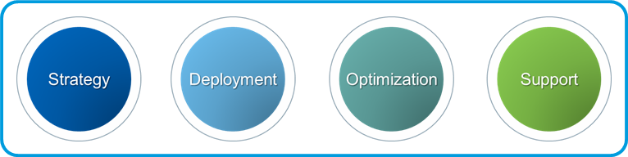



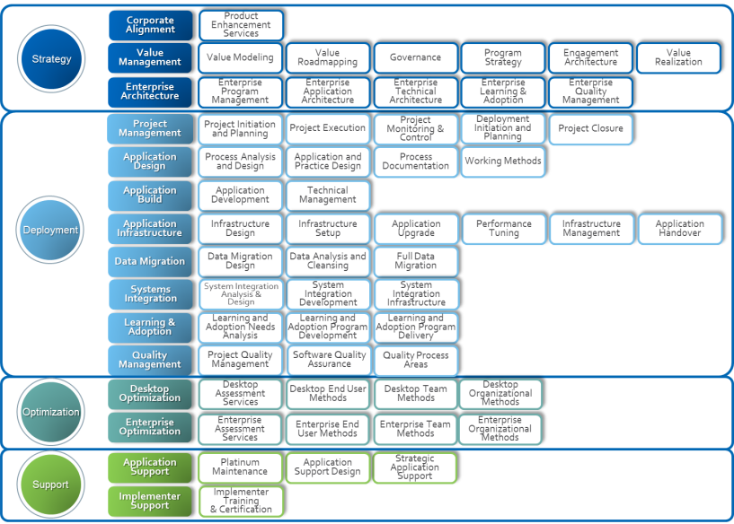
Portfolio Operational Model
View in Presentation Mode
Creation of Offerings
Consistency of Offerings
Strategy Offerings
Domain & Process Thought Leadership;
Offering alignment to Solutions
WW Capacity/Skills/IP for Segment
Ability to Execute as PSP
SEGMENT
ISU’S
Value Planning
PLM
……..
TSAM
PLM Lead
Blueprinting
SCM
……..
Application Support
SCM Lead
CLIENT MGMT COMMUNITY
Portfolio Lead
Core Team
ALM
……..
Hosting
ALM Lead
PES
……..
…..
Adoption Strategy
SLM
……..
……
SLM Lead
CAD
……..
…….
CAD Lead
PROGRAM MGMT COMMUNITY
CM LEAD
CONSULTING COMMUNITY
RVP Lead
PM LEAD
AA LEAD
TA LEAD
LEARNING COMMUNITY
LA LEAD
Architecture
Evolution of methods
Consistency Methods
Integration of Workstreams
Bus Dev and Deliver Support
Community Development
Capacity/Skills across Segments for ISU
How work is performed

Slide 31
<SolutionName> Barn Raising
Services Engagement Crafting and Scoping
Effectively set and manage Customer Expectations
Provide Estimation Guidelines for Bottom Up Estimates
Clear definition of Scope and Assumptions
Understand the project risk and product issues
Have a strong point of view to guide the Client discussions

