Slide 1
Common UX Guidelines, Tools, and Templates ~ TUX Program
TUX Summit - March 30-31, 2010

Slide 2

Common UX Guidelines, Tools, and Templates
TUX
Status Report
Phil Muller
Mar. 31, 2010
Objective(s): Establish processes and methodologies to standardize elements of PTC’s user experience and ease the design of our products Ensure that members of all product organizations can leverage and contribute to this body of work as it evolves
Status Last Report | Status This Report
Green | Green
Milestones | Plan | F’cast | Actual | Comment
Agreement on scope, objectives, goals | Jan. ’10 | Jan. ’10 | Feb. ’10
Conclude UX resource center pilot | May ’10 | May ’10
Finalize plan for UX resource center go-live | TBD | TBD
Finalize UX principles | May ’10 | May ’10
Finalize requirements for pattern library | May ’10 | May ’10
Finalize plan for pattern library implementation | Jun. ’10 | Jun. ’10
Pattern library go-live | TBD | TBD
Propose process & staffing for visual style | TBD | TBD
Agenda
User Experience Resource Center
User Experience Principles
Design Standards
Product Visual Director
Progress: Planning for SP2010 pilot of UX resource center. Reviewed a draft of UX principles; revised draft to be reviewed at TUX Summit. Prepared a draft of high-level requirements for design pattern library. Formulated high-level role and organization options for product visual director.
Plans: Finalize requirements for UX resource center; identify platform owner; plan to migrate existing resources. Finalize and distribute UX principles. Obtain approval for design pattern library; identify platform owner; gather product group plans to populate. Obtain approval for product visual director; recruit, hire, and staff.

Slide 3
User Experience Resource Center
Guidelines, Tools & Templates ~ TUX Program

Slide 4
User Experience Resource Center
Clearinghouse for TUX deliverables and other UX resources
Vision, principles, personas, design research, standards, articles, discussions …
Leaning towards a SharePoint-based solution
Linked from new Product Development communication site (PD-JAM)
Participate in month-long pilot beginning in April
Focus initially on general organizational access to TUX deliverables and other UX resources
Expand to include working sites for TUX teams

Slide 5
User Experience Principles
Guidelines, Tools & Templates ~ TUX Program

Slide 6
PTC User Experience Principles
PTC strives to create products that are useful, fast, simple, engaging, unifying, innovative, beautiful, trustworthy, universal, and personable
Achieving the harmonious balance of these ten principles is a constant challenge
Products that get the balance right will satisfy and delight users all over the world
Embracing this “Design Code of Conduct” is the first step in realizing our User Experience Vision
Vision
Principles
Personas,
User Observation,
Design Patterns …
Strategy
Execution

Slide 7
PTC User Experience Principles
Useful Focus on people – their work, their objectives, their careers
Fast Every millisecond counts
Simple Simplicity is powerful
Engaging Engage beginners and attract experts
Unifying The whole is greater than the sum of its parts
Innovative Dare to innovate
Beautiful Delight the eye without distracting the mind
Trustworthy Be worthy of people’s trust
Universal Design for the world
Personable Add a human touch

Slide 8
Useful PTC User Experience Principles
Focus on people – their work, their objectives, their careers
PTC product teams work to discover the actual needs of product development professionals, including needs they can't always articulate. Armed with that information, PTC can create products that solve real-world problems and spark the creativity of all kinds of people. Improving people's jobs, not just easing step-by-step tasks, is our goal.
Above all, a well-designed PTC product is useful in daily work. It doesn't try to impress users with its flashy technology or visual style – though it might have both. It doesn't strong-arm people to use features they don't want – but it does provide a natural growth path for those who are interested. PTC products open the door for those who want to work more quickly and creatively, share ideas with their colleagues or the world, and make the world’s next great product.
Back to top

Slide 9
Fast PTC User Experience Principles
Every millisecond counts
Nothing is more valuable than people's time. PTC products load and work quickly. Even during lengthy operations, users can remain productive. The most essential features and information are placed in the easiest-to-find locations. Unnecessary clicks, typing, steps, and other actions are eliminated. PTC products ask for information only once and include smart defaults. Tasks are streamlined.
Speed is an asset to users. It is also a competitive advantage that PTC doesn't sacrifice without good reason.
Back to top

Slide 10
Simple PTC User Experience Principles
Simplicity is powerful
Simplicity fuels many elements of good design, including ease of use, speed, visual appeal, and accessibility. Simplicity starts with the design of a product’s fundamental functions. The best PTC designs appear quite simple on the surface, but include powerful capabilities that are easily accessible to those users who want them.
PTC teams think twice before sacrificing simplicity in pursuit of a less important feature. Our hope is to evolve products in new directions, instead of just adding more features.
Back to top

Slide 11
Engaging PTC User Experience Principles
Engage beginners and attract experts
Designing for many people doesn't mean designing for the lowest common denominator. Our intent is to invite beginners with a great initial experience, while also attracting power users whose excitement and expertise will draw others to the product.
A well-designed PTC product lets new users jump in, offers help when necessary, and ensures that users can make simple and intuitive use of the product's most valuable features. Progressive disclosure of advanced features encourages people to expand their usage of the product.
Back to top

Slide 12
Unifying PTC User Experience Principles
The whole is greater than the sum of its parts
PTC’s products are designed to work together and provide a smooth experience for all users who engage with more than one. Product teams ensure that business considerations integrate seamlessly with the goals of users, so they can participate successfully in the process of making great products, no matter what their role.
Our users do not exist in isolation. They belong to teams, both formal and informal, whose members have common goals, responsibilities, and interests. PTC products recognize and foster those relationships in ways that are desirable and beneficial to our users, while offering expected levels of protection and control.
Back to top

Slide 13
Innovative PTC User Experience Principles
Dare to innovate
PTC product teams encourage new ideas to come out and play. Being great at something is a starting point, not an ending point. Through innovation and iteration, we aim to take things that work well and improve upon them in unexpected ways.
The element of imagination transforms designs from ho-hum to delightful. Instead of just matching the features of existing products, PTC wants to change the game.
Back to top

Slide 14
Beautiful PTC User Experience Principles
Delight the eye without distracting the mind
If people looked at a PTC product and said "Wow, that's beautiful!" the product team would cheer. A positive first impression makes users comfortable, assures them that the product is reliable and professional, and encourages people to make the product their own.
A professional aesthetic makes sense for most PTC products because a clean, clutter-free design loads quickly and doesn't distract users from their goals. Colors, fonts, and images that are modern and uplifting are balanced against the needs for speed, scannable text, and easy navigation. Still, "simple elegance" is not the best fit for every product. Audience and cultural context matter. A PTC product's visual design should please its users and improve usability for them.
Back to top

Slide 15
Trustworthy PTC User Experience Principles
Be worthy of people’s trust
Good design can go a long way to earn the trust of people who use PTC products. Establishing PTC's reliability starts with the basics – for example, making sure the interface is efficient and professional, actions are easily reversed, terminology is consistent, and users are never unhappily surprised. In addition, PTC products open themselves to the world by supporting industry standards and encouraging users to build custom extensions.
A greater challenge is to make sure that PTC demonstrates respect for users' right to control their own data. PTC is transparent about how it uses information and how that information is shared with others (if at all), so that users can make informed choices.
Back to top

Slide 16
Universal PTC User Experience Principles
Design for the world
Product development has become a global activity. Many users could be interacting with PTC products while strolling with a mobile device, not sitting at a desk with a personal computer. Our goal is to design products that are contextually relevant and available through the media and methods that make sense to users. Product teams research the fundamental differences in user experiences throughout the world and work to design the right products for each audience, environment, and culture.
PTC is also committed to improving the accessibility of its products. Our desire to provide a useful and enjoyable experience for everyone, including those with physical and cognitive limitations, requires support for assistive technologies.
Back to top

Slide 17
Personable PTC User Experience Principles
Add a human touch
PTC includes a wide range of personalities, and our designs have personality too. Text and design elements are professional, helpful, and smart – not quirky, gratuitous, or arrogant. PTC text talks directly to people and offers the same practical, informal assistance that anyone would offer to a trusted colleague who asked a question. And PTC doesn't let fun or personality interfere with other elements of a design, especially when people's livelihood, or their ability to accomplish “mission critical” goals, is at stake.
PTC doesn't know everything, and no design is perfect. Our products ask for feedback, and PTC acts on that feedback. When practicing these design principles, PTC product teams seek the best possible balance in the time available for each product. Then the cycle of iteration, innovation, and improvement continues.
Back to top

Slide 18
Design Standards
Guidelines, Tools & Templates ~ TUX Program

Slide 19
Design Standards – Traditional Methods
The Challenge
How do you effectively distribute responsibility for user experience throughout the organization?
How do you get the whole organization on the same page vis-à-vis design?
How do you get the organization off to a good start with designs that are guaranteed to work and are easy to implement?
How do you get the organization to leverage the experience of the design team and to avoid mistakes that will generate even more work for the already overwhelmed design team?
Design Approval
All designs are approved (if not created) by a centralized design team
Effective “policing” (or design throughput) is overwhelmed by shear volume
Templates
Safe starting point that’s “guaranteed” to produce satisfactory results
Too many templates to maintain, most of which yield unsatisfactory results (lowest common denominator)
Style Guide (Design Guidelines)
“Rules to live by” that are proven and tested
Too broad or ambiguous to implement effectively in specific situations
Different design problems require different design solutions
These methods are too slow, too specific, or too general to be effective!

Slide 20

Design Patterns – A Catalog of Desired Behaviors
What is a Design Pattern?
A pattern describes an optimal solution to a common problem within a specific context
Leverage the rich history of things-implemented-before to make the user interface design process easier
Required design information is readily approachable by the project team
Choosing usable components that work smoothly for users becomes the path of least resistance
Innovation, while not prohibited, is reserved for cases in which it is really necessary
Examples
ID/password entry, new account, date picker, etc…
Anatomy – Patterns include:
Pattern Name, Description, How It Works, Specifications
Context of Use, Where Used, Co-requisites, Related Patterns
Pattern History, Usability Results and User Feedback, Discussion, Competitive Approaches
…plus access to related prototypes, source code, etc
Usage – Anyone can:
Identify pattern(s) that might satisfy the design objectives – browse, search
Determine which pattern works best for the design context
Obtain related prototype or production representations
Update “where used”, “user feedback”, etc
As needed, initiate and define a distinct new pattern to fill identified gaps
Notes:
Template – describes the whole of a “type of design solution” (e.g. dialog box for specific type of tool).
Style Guide – describes rules to follow (e.g. place the label above/left of certain component types).
Pattern – describes a specific element of design, alternatives, and rationale/discussion for choosing (or avoiding) it in specific contexts.
Patterns support mixing & matching elements appropriately for the purpose at hand, the heart of a good design solution.
Exclusive vs. Inclusive – patterns say, “design team trusts others to make the right decision, given the benefit of our experience.”

Slide 21
A Case for Design Patterns – Benefits
Re-use: Speed and efficiency allow teams to iterate faster, giving them a chance to play with the design while it’s still malleable
“Less exciting” tasks such as re-creation/re-invention are likely to get less attention, yielding an experience that is unusable and frustrating
Culture: All team members can participate in aspects of the design process
Completeness: More likely to get a completed design sooner, with all the little nuances and details that make for a great experience
Consistency: More likely to meet users’ expectations by behaving consistently (when it’s expected)

Slide 22
A Case for Design Patterns – Challenges
Ramp-up: Significant initial cost
Identifying and documenting the current set of elements takes time and practice
Breadth: Accommodating all product-specific behaviors and needs
Off-the-shelf libraries, though well documented and inexpensive, do not consider our specific technological constraints and business requirements
Maintenance: Keeping the library up-to-date is an ongoing and demanding task
Full-time curator to encourage expansion and maintain existing content

Slide 23
Design Patterns – Future Extensions
Component: Reusable code supporting design patterns
Speeds the development process, from early prototypes through stabilization and maintenance
Ready-made elements that, once built, can plug into any new project
Embodies the specific interaction behavior
Specify the design response to the pixel level
Contains the brand styling elements, such as fonts, color, and look
Framework: Subsystem of patterns
High-level abstraction serves as a checklist to ensure required patterns exist
Created by looking at what other designs have done
Example: ‘Login’ subsystem
Includes patterns for ID/password entry, password recovery, new account, password change, etc

Slide 24
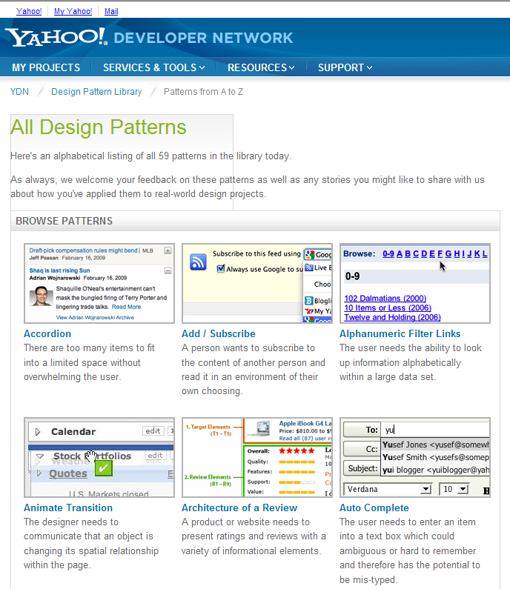
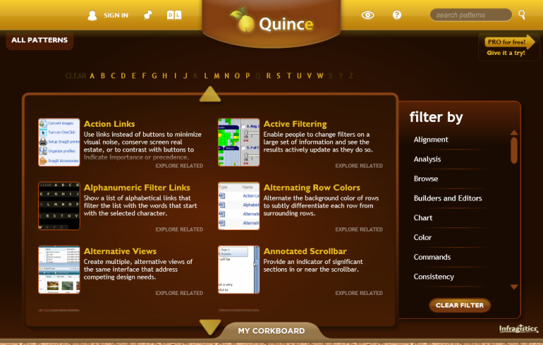
Building PTC’s Design Pattern Library – Requirements
Evolving rich content to support design decisions
Pattern template with required/optional sections
Quick, easy editing w/ inline images, links, etc
Finding the right pattern
Visual browsing
Search by keyword, product, etc (name, description, other sections, full text, etc)
Meta-data / tagging (product class, product, release, etc)
Maintaining content… and our confidence in it
Iteration management, access control, editorial review process, etc
Access related pattern prototypes
Image, Balsamiq, code, etc
Investigating a SharePoint-based solution

Slide 25
Product Visual Director
Guidelines, Tools & Templates ~ TUX Program

Slide 26
Product Visual Director
Responsibilities
Develop and maintain PTC’s strategy for product visual style
Manage the extension/leverage of PTC’s corporate identity into product design
Work with acquired teams to ramp-up re: product visual strategy
Organization
Reporting / management outside of product teams
Hub-and-spoke
Direction centralized
Execution distributed
Service bureau
Direction centralized
Execution centralized
This option is recommended/preferred by existing visual design resources
Product
Product
Product
Product
Product
Visual Designer
Visual Director
Visual Designer
Visual Designer
Product
Product
Product
Product
Product
Visual Director
Visual Designer
Visual Designer
Visual Designer

Slide 27

Questions

