Slide 1
Windchill 10.0 Update – Document Management Feature Function
January 2011
Notes:
Introduction to the new product capabilities for Windchill Document Management.

Slide 2
Objectives
After successfully completing this module, you should be able to:
Describe new product capabilities in Windchill 10 enabling improved Document Management
Manage Documents using Windchill Desktop Integration
Configure Windchill Application to meet various business requirements for Document Management

Slide 3
Agenda
General User Improvement
Desktop Integration Configuration
Managing Microsoft Word Content
Managing Outlook Content
Creating a Document Template
Windchill Integration with Windows Explorer

Slide 4
Windchill Document Management
General User Improvement
Notes:
Windchill 10.0 Update

Slide 5
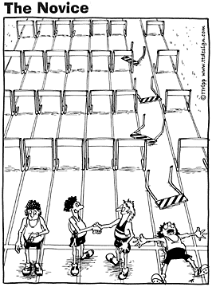
Document Management improvements in Windchill 10
Focus: Make Windchill Document Management easier to use…
… especially for the novice user!

Slide 6
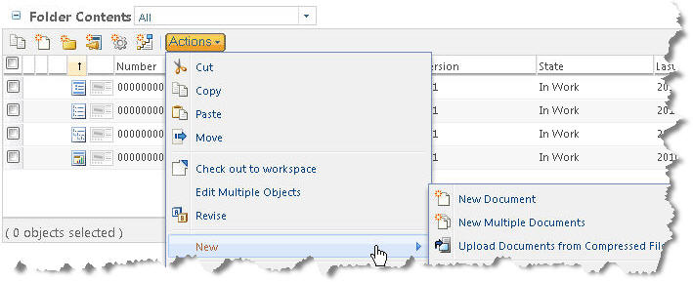
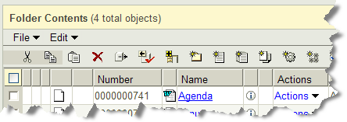
Simplify document creation user interfaces
New document From Template
New Multiple Documents
New Document
Add New Document with or without attached content
New Multiple Documents
Before
Windchill 10

Slide 7
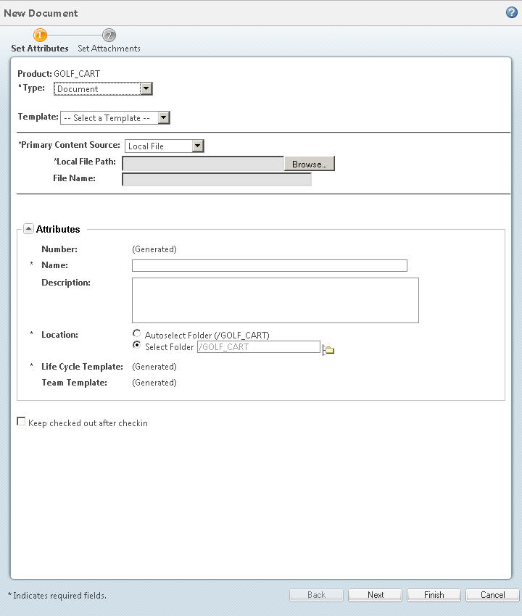
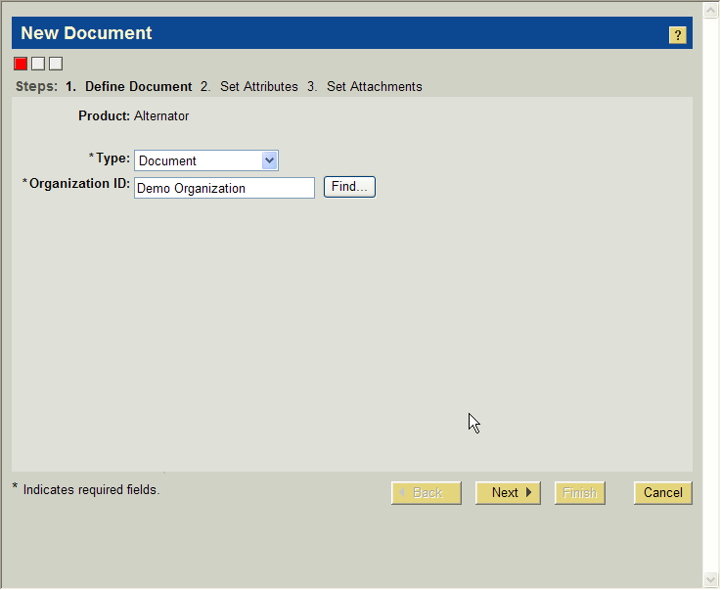
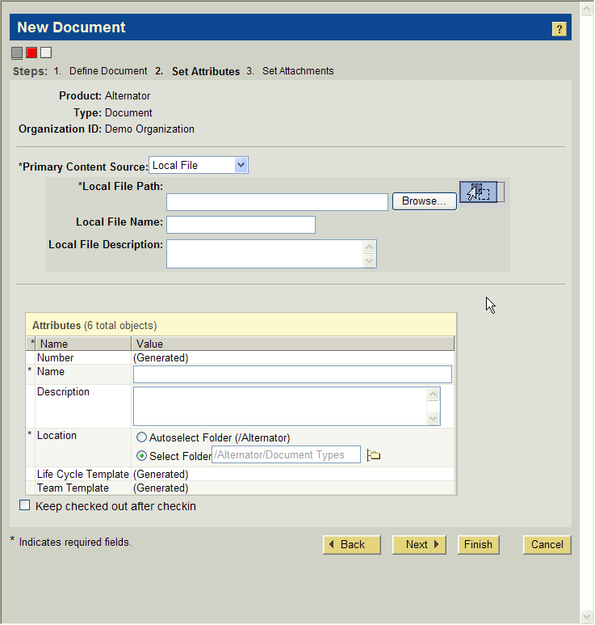
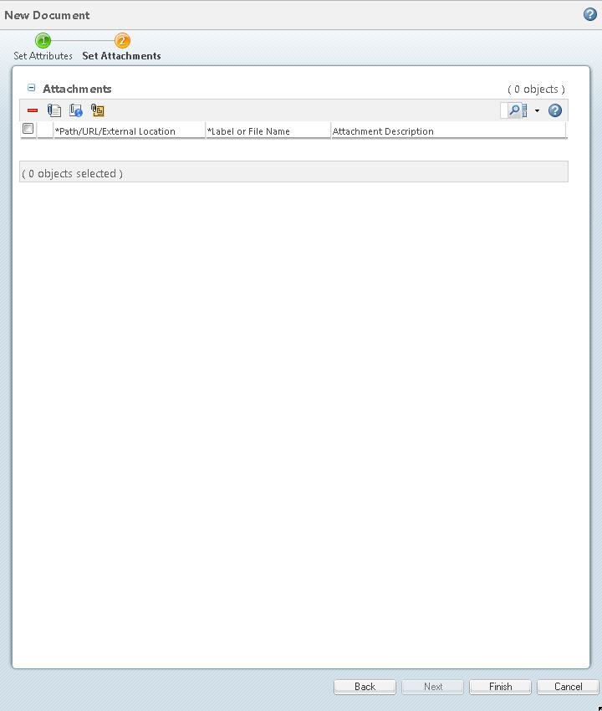
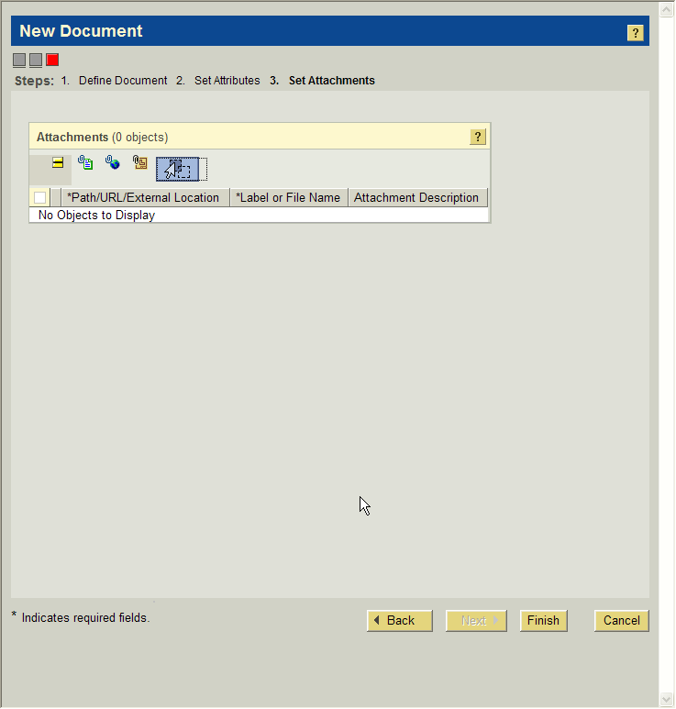
Simplify Document Creation User Interfaces
Before
Windchill 10

Slide 8
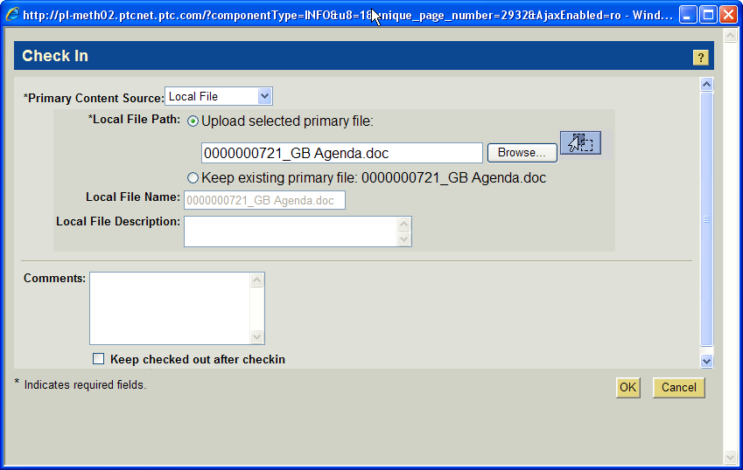
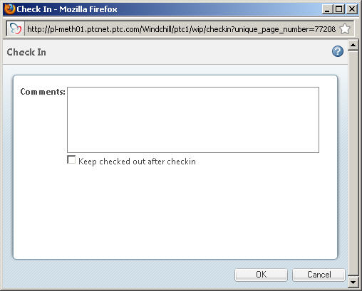
Simplify the Check in Page following “Edit Document” Action
Before
Windchill 10

Slide 9
Exercise: (Optional) Creating and Updating Generic Windchill Document Objects
Scenario:
The end user will create new and update existing documents using the simplified Windchill 10.0 interface for Document Management.
Objectives:
Create Windchill Documents using Traditional User Interface.
Describe the Simplification of Document Creation provided with product enhancements
Steps:
Create New Document
Create New Multiple Document
Use Edit Document Action to Check-in Modification
Duration: 20 minutes
NOTE: Detailed Steps for Exercises is available in Feature Function guide.
TO DO
Add the detailed steps for this to the exercise book (Mosaic)

Slide 10
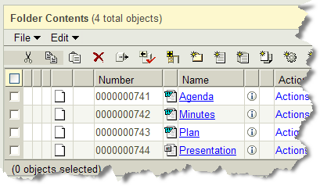
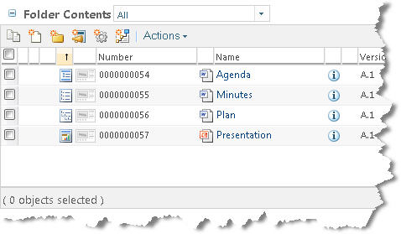
Add Icons for the Out-of-the-box Documents Subtypes
Windchill 10
Before

Slide 11
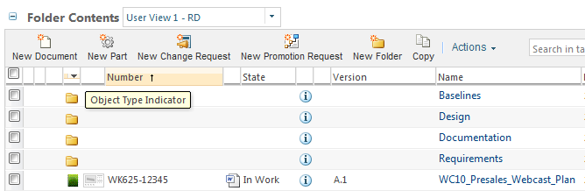
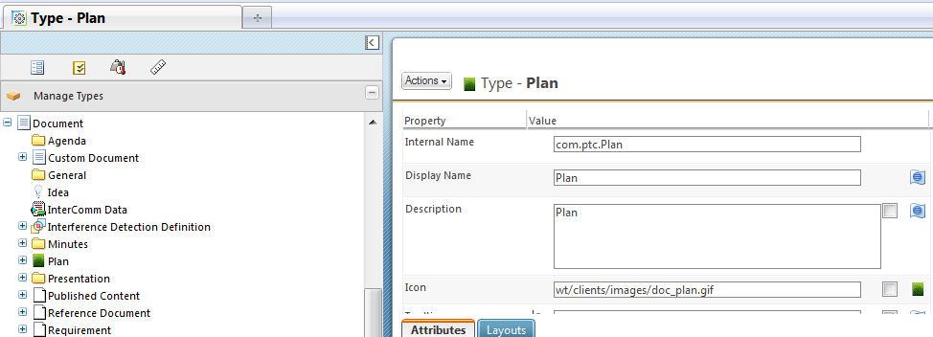
How to add icons for Document Sub-Types
Add icons to the [Windchill loadpoint]\codebase\wt\clients\images folder
Recommended size 16x16 pixels
Edit Document subtype
Enter icon file location: wt/clients/images/doc_plan.gif

Slide 12
Exercise: Configure Icons for Document Soft-Types
Scenario:
The system administrator will configure the icons for different document object soft types..
Objectives:
Configure Windchill to use different icons for document out of the box soft types.
Display different document icons for various soft types.
Steps:
Locate or create icons to use for soft-types
Add icons to the appropriate folder on Windchill
Edit the different soft-type definitions to update location for the icon.
Create various sample objects of these soft-types in a test folder
Visually identify the different soft-types in the testing folder.
Duration: 30 minutes
NOTE: Detailed Steps for Exercises is available in Feature Function guide.
TO DO
Add the detailed steps for this to the exercise book (Mosaic)

Slide 13
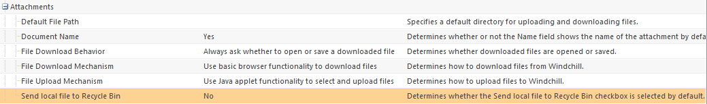
Option to Remove Local File on Check-in
File remains on the user’s desktop so 2 copies now exist
File is removed from the user’s system.
Only the Windchill version exists
Windchill 10
Before
What allows this magical capability? New Preference
Attachments > Send local file to the Recycle Bin

Slide 14
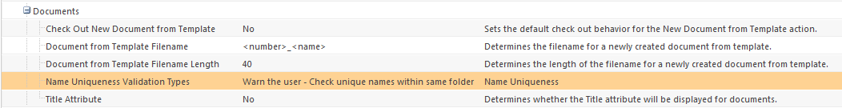
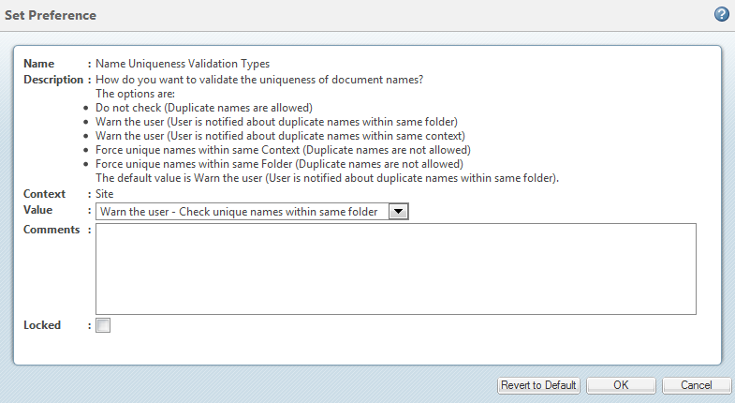
Restricting Document Name uniqueness
Allow uniqueness within a folder or within a context.
Preference is set at the Administration site
Documents > Name Uniqueness Validation Types
Value Options

Slide 15
Exercise: Group Discussion - Application Configuration Options
Scenario:
The business administrator will review and discuss the new application configuration options for document management.
Objectives:
Locate and Identify new options for Document Management.
Explain how options can be used to meet customer business requirements.
Steps:
Open Preference Manager at Different Context Levels
Locate and Review Configuration Options / Preferences for Document Management
Discuss how to apply the different preferences to meet customer requirements.
Duration: #TBD hour
TO DO
Add the detailed steps for this to the exercise book (Mosaic)
NOTE: There is some additional configuration options in the next section(s).
Notes:
NOTE: See Student Guide for detailed exercise steps.

Slide 16
General Usability Enhancements
In Summary…
Simplify document creation user interfaces
Single user interface for create single document and create document from template
Simplify the Check in page following “Edit Document” action
Remove redundant options that deal with file content
Add icons for the out-of-the-box documents subtypes
Agenda, document, General, Plan, minutes Etc.
Option to remove local file when check-in a document
Avoid Confusion over multiple copies on the user’s hard drive
Change the Default File Path preference
Documents are uploaded and downloaded from/to the default file path instead of an obscure Temporary Folder
Allow more flexibility for restricting Document Name uniqueness
Allow uniqueness within a folder or within a context.

Slide 17
Windchill Desktop Integration
Managing Microsoft Documents

Slide 18
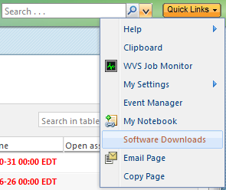
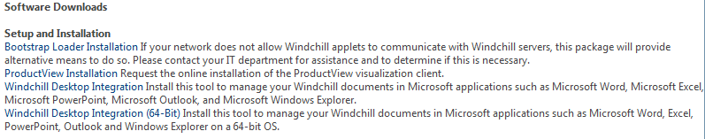
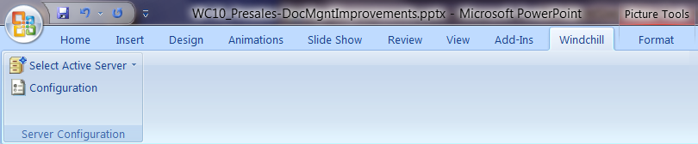
Desktop Integration (DTI)
Greatly Improved and Easier to Use
Download the DTI client software from Quick Links
Two client versions
32 bit OS
64 bit OS
NOTE: Use Mozilla Firefox for WC 10 C000 DTI release
Windchill Desktop Integration installation is correct when Windchill tab appears in the Microsoft product

Slide 19
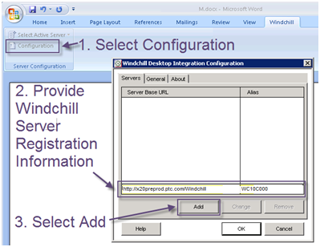
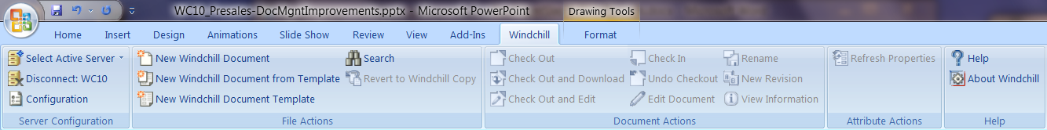
Configuration of Windchill Server
To use the new DTI functionality, you need to configure this client to Windchill.
3 easy steps:
Select Configuration
Provide Server Information
Select Add
Fully active Windchill Tab

Slide 20
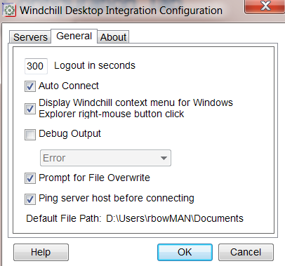
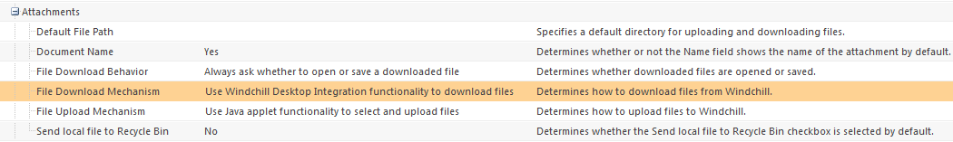
Additional Settings for Configuration of DTI
Specifies how DTI works for “Novice” user.
Options in the Configuration Tab
Auto Connect
Default Path
Preferences Download
File Download mechanism options
Use DTI
User Java Applet
Use basic browser

Slide 21
Demonstration: <Demonstration Title / Task>
Include po
Demonstration should cover key features.
Add DemoTitle / Task
Add Demo Scenario
Add Demo Objectives
Add Demo Steps
These are just high level steps. All sub-steps and screen shots will be detailed in the guide.
Add Demo Duration
NOTE: Recorded demonstrations are nice for instructors to have as a backup.
DELETE TEMPLATE NOTE
Scenario:
< Demonstration Scenario>
Objectives:
< Demonstration Objective A>
< Demonstration Objective B>
Steps:
<High Level Step 1>
<High Level Step 2>
<High Level Step 2>
Duration: #TBD hour
.

Slide 22
Exercise: Application Installation and Setup
Scenario:
The end user will install the application and perform initial setup.
Objective(s):
Install and Configure Windchill Desktop Integration
Steps:
Install Windchill Desktop Integration (PTC Office Add-In) on Client
Register Windchill Server in Windchill Desktop Integration
Duration: 15 minutes
.
Notes:
NOTE: See Student Guide for detailed exercise steps.

Slide 23
Exercise: Reviewing Configurations and Preferences
Scenario:
The business administrator will locate and review the available configuration and preference options for Documents.
Objectives:
Describe MS Office Windchill Application Configuration Options for Documents
Describe Windchill User Preference Options for Documents
Steps:
Locate and Review MS Office Windchill Application Configuration Options
Locate and Review Windchill User Preferences
Duration: 10 minutes
Notes:
NOTE: See Student Guide for detailed exercise steps.

Slide 24
Exercise: Using MS Office Windchill Document Actions
Scenario:
The end user will perform typical tasks using MS Office Windchill actions.
Objectives:
Create MS Office documents in Windchill
Review and update MS Office documents in Windchill
Steps:
Create New Windchill Document from MS Office
Download a Microsoft Office Document (DTI)
Create a New Revision of a Document
View Information from MS Office
Duration: 20 minutes
Notes:
NOTE: See Student Guide for detailed exercise steps.

Slide 25
Windchill Desktop Integration
Business Administration

Slide 26
Document Templates
A document template provides a means for standardizing common documents
Document templates are stored as documents; however, they have some unique characteristics:
They are created and managed from the Templates pages accessible only to administrators.
The document templates can be created in the context of a product, library, project, program, organization, or site.
Document templates with the same name can be created in different contexts.
The document template name must be unique within a context, regardless of the type of document template.
Document templates created in the context of a product or library can be revised. However, document templates created in the context of a project, program, organization, or the site can only be iterated.
Whether a specific document template appears in the list of available document templates when a user creates a document from a template is determined by the following:
The context from which the document template was created. Only the document templates created in the current context of the user or in a parent context appear in the list.
Whether the document template is enabled and visible; only document templates that are both enabled and visible appear in the list.
When there are multiple document templates with the same name in different contexts, then the document template that is in the lowest context in the hierarchy appears in the list.
The files used as the content for document templates come from files that have been created on your system and are then uploaded into Windchill.

Slide 27
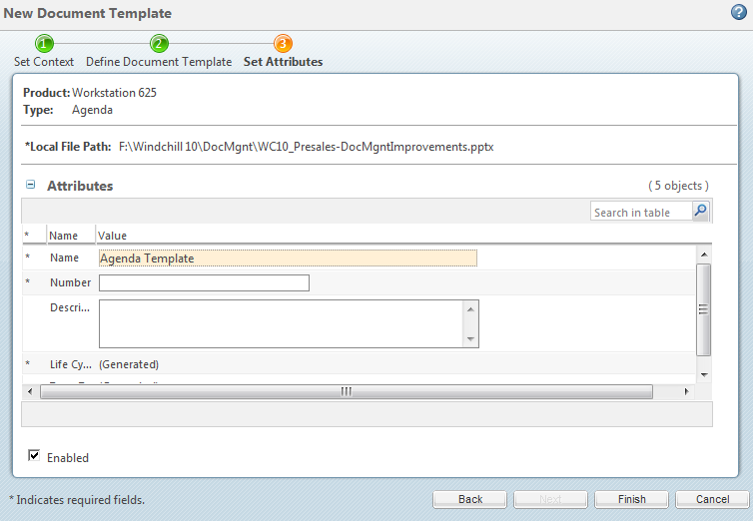
Document Templates
Additional Characteristics
Only administrators can create document templates.
Document Templates can be with DTI.
New Wizard enabled from Microsoft Products

Slide 28
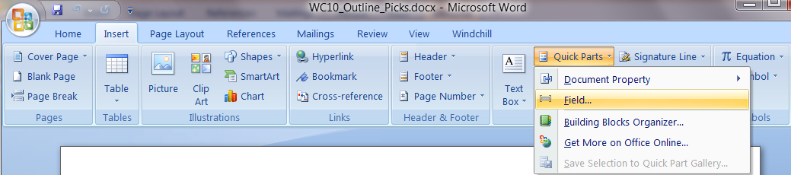
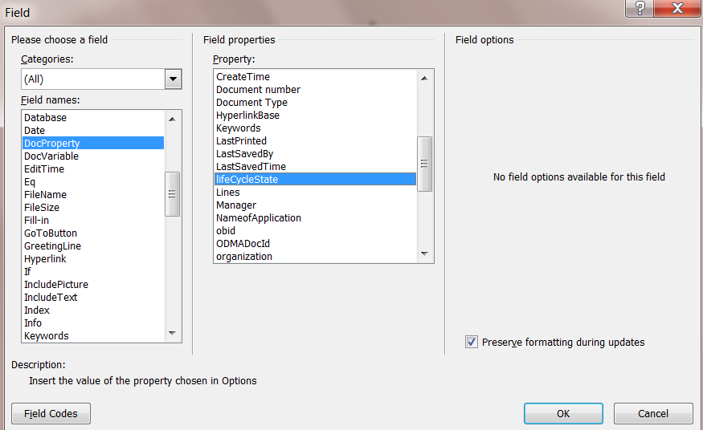
Inserting a Windchill Document Attribute in a Microsoft Office File
DTI maps Windchill document to Microsoft Office file properties
You can display Windchill document attributes in your Microsoft Office file as content so that when you open a document, it is updated with the latest Windchill attribute information.
Open a document from Windchill
Insert > Quick Parts > Field…
Categories: All
Field Name: Doc Property
Select Windchill Properties
Includes Doc Properties too

Slide 29
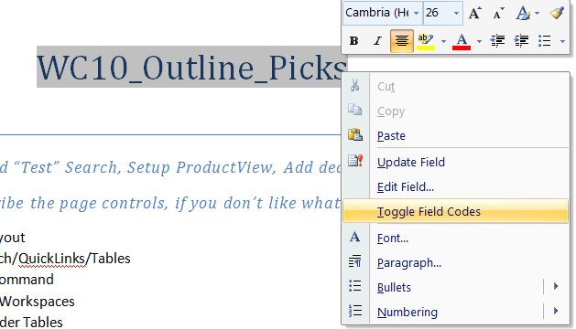

Inserting a Windchill Document Attribute in a Microsoft Office File
How do you know if it’s text of a Windchill Attribute?
Highlight the word and RMB
Document Fields highlight in grey
RMB and select Option to Toggle Field Codes
Displays Toggle Field name

Slide 30
Demonstration: Document Template Configuration
Include portion from WBT
Demonstration should cover key features.
Add DemoTitle / Task
Add Demo Scenario
Add Demo Objectives
Add Demo Steps
These are just high level steps. All sub-steps and screen shots will be detailed in the guide.
Add Demo Duration
NOTE: Recorded demonstrations are nice for instructors to have as a backup.
DELETE TEMPLATE NOTE
Scenario:
< Demonstration Scenario>
Objectives:
< Demonstration Objective A>
< Demonstration Objective B>
Steps:
<High Level Step 1>
<High Level Step 2>
<High Level Step 2>
Duration: #TBD hour
.

Slide 31
Exercise: Configure Windchill Document Templates
Scenario:
The Business Administrator will configure Document Templates in Windchill
Objectives:
Insert Properties into Windchill Documents
Create Document Templates that include Windchill Properties
Steps:
Create a New Document from Template
Create a New Windchill Document Template (DTI)
Insert Static Windchill Properties into Office Documents
Insert Dynamic Windchill Properties into Office Document
Create a Document Template with Windchill Property Fields
Duration: 30 minutes
NOTE: Detailed Steps for Exercises is available in Feature Function guide.
Notes:
NOTE: See Student Guide for detailed exercise steps.

Slide 32
Windchill Desktop Integration
Microsoft Office Integration

Slide 33
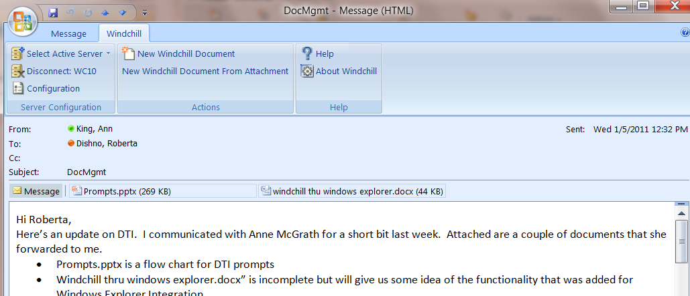
Microsoft Outlook Integration
Save Emails, Attachments, Calendar Meetings to Windchill with DTI
DTI Windchill Tab available in Outlook
Allows you to save the message or attachments to Windchill

Slide 34
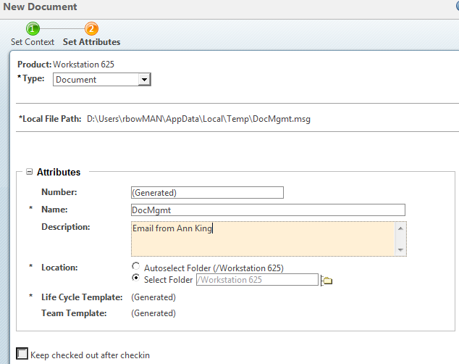
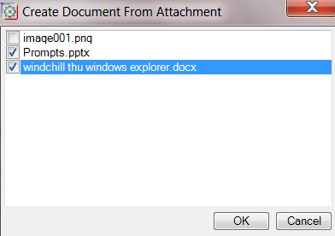
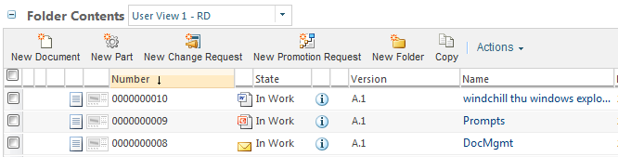
Microsoft Outlook Integration
Saving Emails and Attachments
DTI use the name of message and attachments
Set content
Select Type
Location
If you have multiple attachments
Select which attachments you want saved
Go through wizard individually for each attachment
When saved in Windchill, new icons easily show message

Slide 35
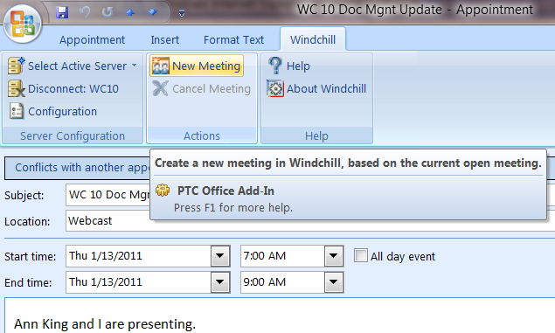
Create a meeting in Windchill through Microsoft Outlook
FYI – My Windchill Server is not connected to my exchange Server… this is all DTI.
From Outlook, you can create a New Meeting in Windchill.

Slide 36
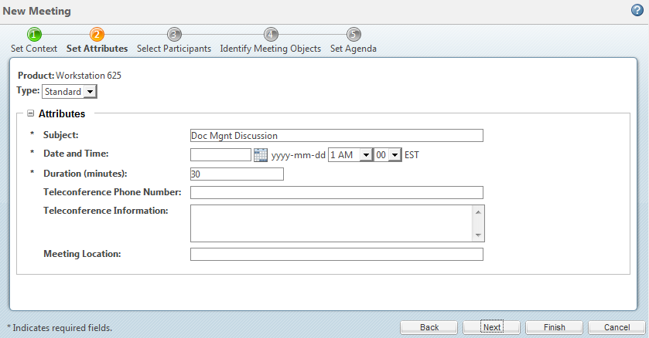
Create a meeting in Windchill through Microsoft Outlook
Use the same 5 step Windchill Meeting Wizard
Set Context
Set Attributes
Select Participants
Identify Meeting Objects
Set Agenda

Slide 37
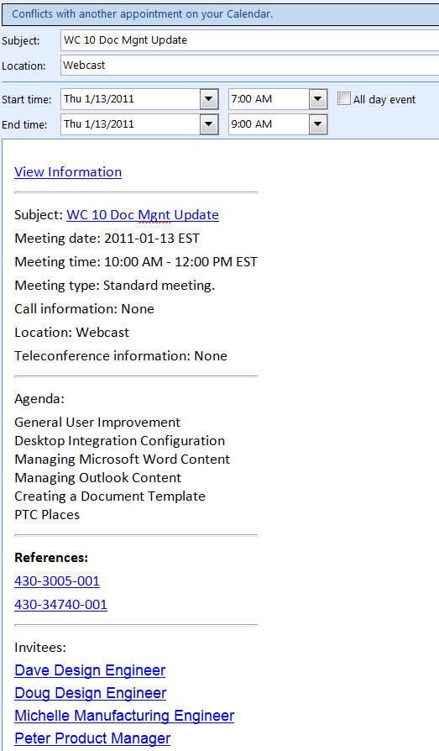
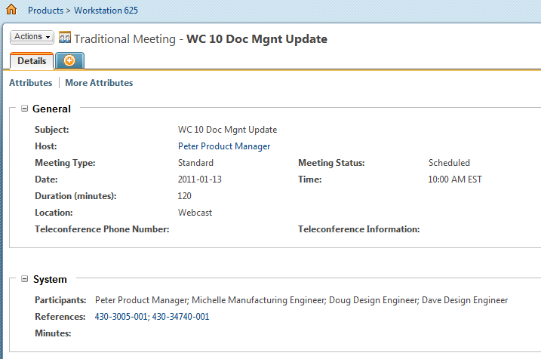
Meeting information in Windchill and Outlook
If a user cancels the meeting in either Windchill or Microsoft Outlook, the associated Windchill or Microsoft Outlook meeting will be cancelled as well.
However, users will have to manually update any changes to the meeting in both locations.
Windchill 10 Meeting
Outlook Meeting

Slide 38
Demonstration: DTI Outlook Integration
Include portion from WBT
Demonstration should cover key features.
Add Demo Scenario
Add Demo Objectives
Add Demo Steps
These are just high level steps. All sub-steps and screen shots will be detailed in the guide.
Add Demo Duration
NOTE: Recorded demonstrations are nice for instructors to have as a backup.
DELETE TEMPLATE NOTE
Scenario:
< Demonstration Scenario>
Objectives:
< Demonstration Objective A>
< Demonstration Objective B>
Steps:
<High Level Step 1>
<High Level Step 2>
<High Level Step 2>
Duration: #TBD hour
.

Slide 39
Exercise: Discovering Windchill Integration for MS Outlook
Scenario:
The end user will discover the integral capabilities between Microsoft Outlook and Windchill
Objectives:
Create Outlook appointment for meetings managed in Windchill ProjectLink
Create Windchill Documents to record Outlook Messages and/or Attachments
Steps:
Create a Meeting in Outlook using Windchill
Save an Outlook Message as a New Windchill Document
Create New Windchill Document(s) from Outlook Message Attachments
Duration: 30 minutes
Notes:
NOTE: See Student Guide for detailed exercise steps.

Slide 40
Windchill Desktop Integration
Windchill Integration with Windows Explorer

Slide 41
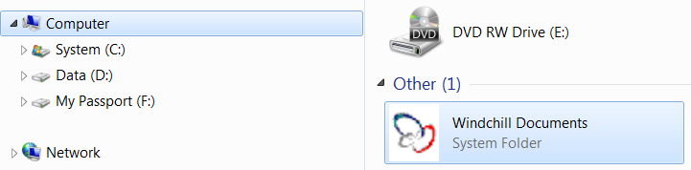
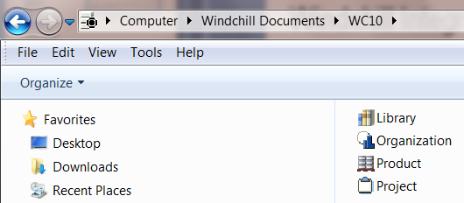
Integration of Windchill and Windows Explorer
Windchill Integration
After DTI is installed, go to Computer > Windchill Documents
Allows navigation of links from Windchill Server
Best demonstrated with Explorer display of List or Small Icons

Slide 42
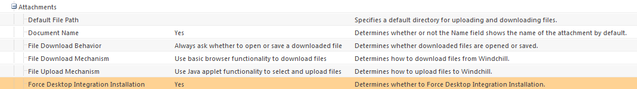
Integration of Windchill and Windows Explorer
Windchill Integration
Allow browsing Windchill from within supported MS Applications
File>Open to download an existing document from Windchill
File>Save As to create new Windchill document
Browse Windchill while performing operations such as Insert>Picture From File
NOTE: not support on 64-bit clients with C000
Allow browsing Windchill from Windows Explorer
Browse Product/Library/Project Folders for Documents in windows Explorer
Double-click to open document
Drag & drop from Windchill to desktop to download
Drag and Drop from desktop to Windchill to create
Administrators can force usage of Windchill desktop integration
Install Windchill Desktop Integration when downloading document
Force use of Windchill Desktop Integration with Attachment preference

Slide 43
Exercise: Finding Windchill Documents in Windows Explorer
Scenario:
The end user will locate Windchill documents using Windows Explorer
Objectives:
Identify Windchill documents that are locally downloaded
Browse Windchill cabinets and folders to view metadata for Windchill Document using Explorer
Create new Windchill Document using Drag and Drop with Windows Explorer
Steps:
Navigate to Windchill Documents in Windows Explorer
Change View and Display Windchill Attributes
Drag and Drop in Windows Explorer
Duration: 40 minutes
Notes:
NOTE: See Student Guide for detailed exercise steps.

Slide 44
Windchill 10.0 Update – Document Management
Summary

Slide 45
Summary
Since you have successfully completed this module, you are now able to:
Describe new product capabilities in Windchill 10 enabling improved Document Management
Manage Documents using Windchill Desktop Integration
Configure Windchill Application to meet various business requirements for Document Management

Slide 46
Assessment Questions
Q1: True / False
Customers are going to love the new Windchill integration with MS Office.
Add Assessment Questions
NEED MORE ASSESSMENT QUESTIONS
Notes:
A1: True

Slide 47
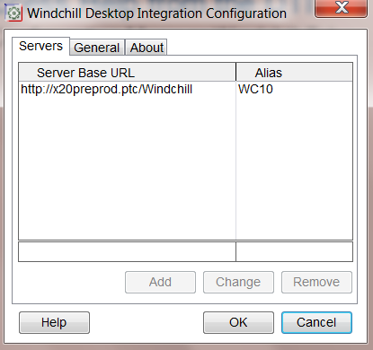
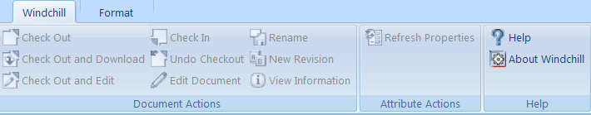
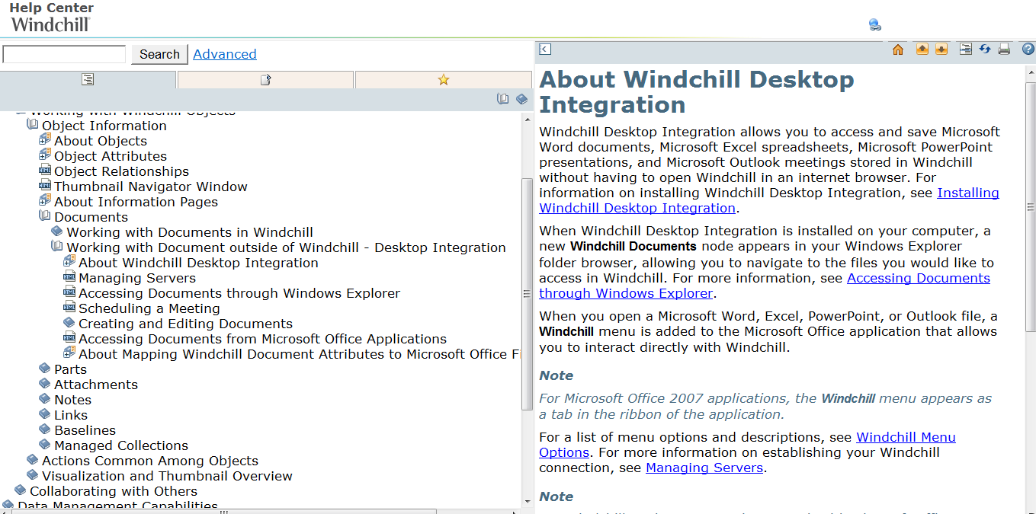
Where to find Help on DTI
I’m asked this question a lot…Really…. ☺
You need to access Help from the DTI
Either in the Configuration Menu or Windchill Tab

Slide 49
Appendix
Supporting Information

Slide 50
Process flow when closing a document
User closes a document in the office application
Is the document checked-out?
Yes
No
By the user?
No
Is it the latest version in PDM?
Yes
No
Yes
Prompt:
Do you want to check-in the document?
Prompt:
Version in not the latest one, do you want to Update the document?
Prompt:
Do you want to Update the document?
No
No
No
Yes
Yes
Yes
The document is checked-in and closed
The document is closed
The document is updated and closed
The document is closed
The document is updated and closed

Slide 51
Exercise: Changing Windchill Preferences
Scenario:
The business administrator will set preferences to control download and default file paths.
Objectives:
Differentiate the behaviour and explain the purpose of different combinations of preference for file download and default file path.
Steps:
Set File Download Mechanism and Default File Path
Duration: 15 minutes
Notes:
NOTE: See Student Guide for detailed exercise steps.

Slide 52
Exercise: Setting Client Configuration Options
Scenario:
The end user will set client options for Windchill Desktop Integration
Objectives:
Set user client options
Steps:
Display Windchill context menu for Windchill Explorer right-mouse button click
Duration: 10 minutes
Notes:
NOTE: See Student Guide for detailed exercise steps.

