Slide 1
Windchill 10.0 Update - <Topic> Customer Exercise Scenario
December 2010
Notes:
Overview
Description:
Describe one or more typical customer scenarios to use the new enhancements together for a complete business task.
Scenario must be storyboard / use cased based; not feature/function.
Deliverables:
1-2 PPT slides per exercise with narration and slide notes
Detailed exercises (Word document)
Demonstration video
5 assessment questions and answers
Q – more than a few PPT slides per scenario

Slide 2

Agenda
Introduce Exercise Scenario
Process Description
Process Overview
Summary & Q&A

Slide 3
Introduce Exercise Scenario
Windchill 10.0 Update - <Topic>
Scenario
<Description of Scenario Application>
Objectives
<Objective 1>
<Objective 2>
See detailed steps for exercise in supporting Word Document.
Create Exercise Scenario Introduction Slide
Update <Topic > sub-title
Update the <Description of Scenario Application>
Update objectives
DELETE TEMPLATE NOTE

Slide 4
<Process Name> Process Overview
Use this flowchart format to capture high level steps and key activities, decisions, and flow using the client’s terminology. Note this does not have to capture the process exactly. The intent is to understand the basic process flow and scope (boundaries), not every specific activity and task detail of the process or the role responsible for performing it.
Step 1: <step name (verb-noun)>
<activity name 1.1 (verb-noun)>
<inputs>
Step 2: <step name (verb-noun)>
<activity name 2.1 (verb-noun)>
<decision (verb-noun)>
<interim objectives>
Step 3: <step name (verb-noun)>
<activity name 3.1 (verb-noun)>
<activity name 3.2 (verb-noun)>
<decision>
<interim objectives>
Step 4: <step name (verb-noun)>
<activity name 4.1 (verb-noun)>
<activity name 4.2 (verb-noun)>
<activity name 4.3 (verb-noun)>
<decision>
<outputs>
1.
Activity 1.1
Input
2.
Activity 2.1
Clarify
Provide Process Overview (this slide) and/or Future Process Description (see next slide)
Process Description Overview
Update the <Process 1> (in title)
Provide Process Overview for Exercise Context
Create Process Description
Identify Portions of the Process that are applicable to (New / WC10 Update) Product Capabilities.
DELETE TEMPLATE NOTE
Process Interface
Decision
3.
Activity 3.1
Activity 3.2
Processes Interfaced
Re-Work
Decision
4.
Activity 4.1
Processes Interfaced
Activity 4.2
Re-Work
Decision
Activity 4.3
Output
Notes:
Process Description Summary
https://pds.ptc.com/Windchill/servlet/TypeBasedIncludeServlet?oid=OR%3Awt.doc.WTDocument%3A776736710&u8=1

Slide 5
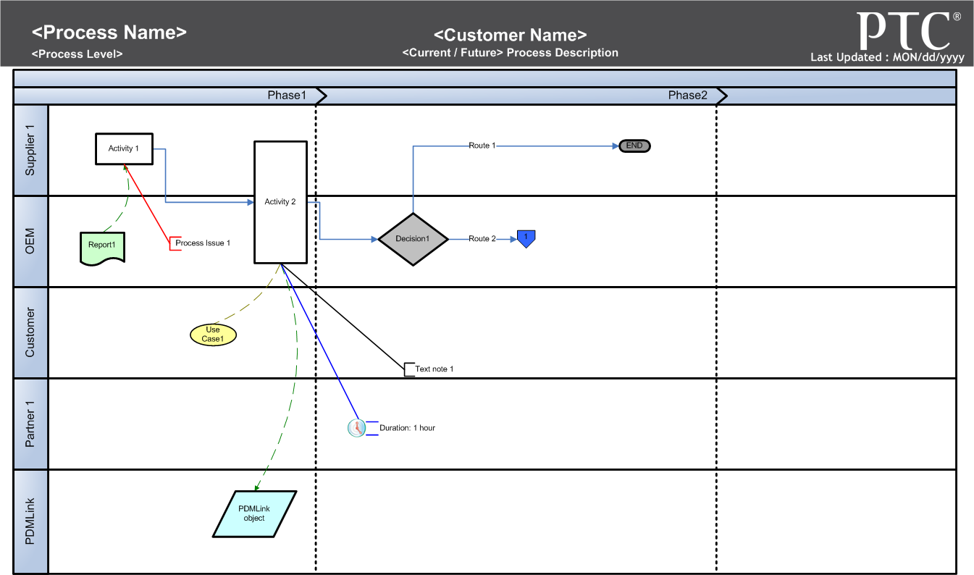
<Process 1 > Process Description
Provide Future Process Description (see previous slide) and/or Process Overview (this slide)
Identify Processes
Update the <Process 1> (in title)
Provide Future Process Description for Exercise Context
Use Process Description template
Create General Future Process Description
Identify Portions of the Process that are applicable to (New / WC10 Update) Product Capabilities.
DELETE TEMPLATE NOTE
Notes:
Use Process Description template
https://pds.ptc.com/Windchill/servlet/TypeBasedIncludeServlet?oid=OR%3Awt.doc.WTDocument%3A776802007&u8=1

Slide 6
Exercise Scenario Summary
<Topic>- Packages
Create Exercise Scenario Summary Slide
Update <Topic > sub-title
Add bullet point to summarize key points
DELETE TEMPLATE NOTE

Slide 7
Assessment Questions
Create Assessment Questions
Questions should not be tricky but should be used to reiterate key points in the training
Questions can be Multiple Choice or True / False.
Add answer to questions in notes. If necessary, provide a learning tip along with the answer.
DELETE TEMPLATE NOTE
Question 1 related to Exercise Scenario
Provide multi choice list with some correct and some incorrect options.
List option choices a, b, c… with answer included in notes
Question 2 related to Exercise
Provide multi choice list with some correct and some incorrect options.
List option choices a, b, c… with answer included in notes

Slide 9
Windchill 10.0 Update - Packages Customer Exercise Scenario
Example
December 2010
Notes:
Overview
Description:
Describe one or more typical customer scenarios to use the new enhancements together for a complete business task.
Scenario must be storyboard / use cased based; not feature/function.
Deliverables:
1-2 PPT slides per exercise with narration and slide notes
Detailed exercises (Word document)
Demonstration video
5 assessment questions and answers
Q – more than a few PPT slides per scenario

Slide 10
Agenda
Example
Introduce Exercise Scenario
Process Description
Process Overview
Summary & Q&A

Slide 11
Introduce Exercise Scenario
Example
Windchill 9.1 Update - Packages
Scenario
The Design Team Lead for an Aerospace and Defense contractor will create a technical data package [Contract Delivery Requirements List (CDRL)] for delivery to the customer per the contract obligations.
Objectives
Initiate CDRL/SDRL process
Define package attributes
Add content to a package
Lock and create delivery record for package

Slide 12
CDRL/SDRL Process - Overview
Example
1. Creation
Contract information
* CDRL/SDRL List information
Analyze Requirements
Step 1: Create CDRL/SDRL Package
Understand Contract requirements
Define Package attributes
Step 2: Add contents
Create necessary contents for package reviews
Content Approved ? (using tech doc workflow, content routing)
Enter Data Items
Add Data Items to Collection
Design, Package, Instructions, CAD)
Define Collection Rules
Step 3: Approve Package
Approve / Track Package
Coordinate Package Rework if necessary
Step 4: Manage Delivery and Acceptance
Lock Package
Create Delivery Label
Deliver
Record Receipt
Record Acceptance
Define Package attributes
Complete?
From Contract
2. Add contents
Create necessary contents
Content
Approve?
Tech Doc WF, content routing
Enter Data Items
Add Data Items to Collection
3. Approval
Approve
Package?
Package Approval Routing
Coordinate Package Rework
4. Manage Delivery
Manage Delivery and Acceptance
Package Approval Routing
Approve?
CDRL/SDRL delivered
Notes:
The star indicates the steps that are covered in the exercise.

Slide 13
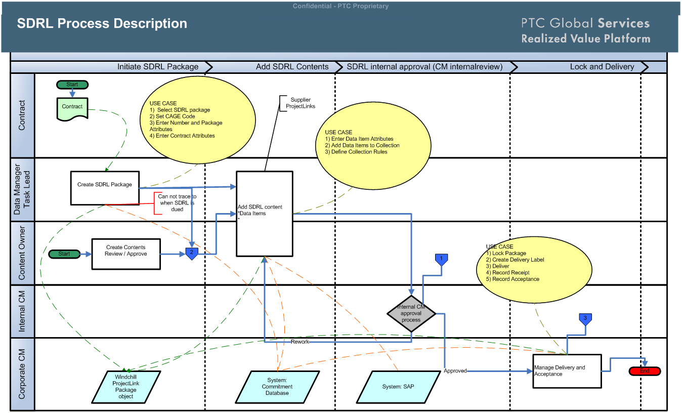
SDRL Package - Process Description
Example
Notes:
See Word document for detailed steps for the Exercise.

Slide 14
Exercise Scenario Summary
Example
Windchill 9.1 Update - Packages
User Interface will guide users through the process for creating a CDRL / SDRL packages
Easily collect related objects for package contents

Slide 15
Assessment Questions
Example
Q1: True / False
The user must not only know the values but also which attributes need to be included in the package details.
Q2: Multiple Choice
Select the items that are true statements after a package has been locked.
Answers
A. A delivery label can be created.
B. A new revision of the package can be created.
C. All of the contents can be zipped together for distribution
Answer Choice: More than one Answer can be Valid
Notes:
Answers:
Q1: False, the User interface will present the user with the attributes whose values need to be populate.
Q2: A, B, C are all correct

Slide 16
Appendix
Example
Additional Process Diagrams

Slide 17
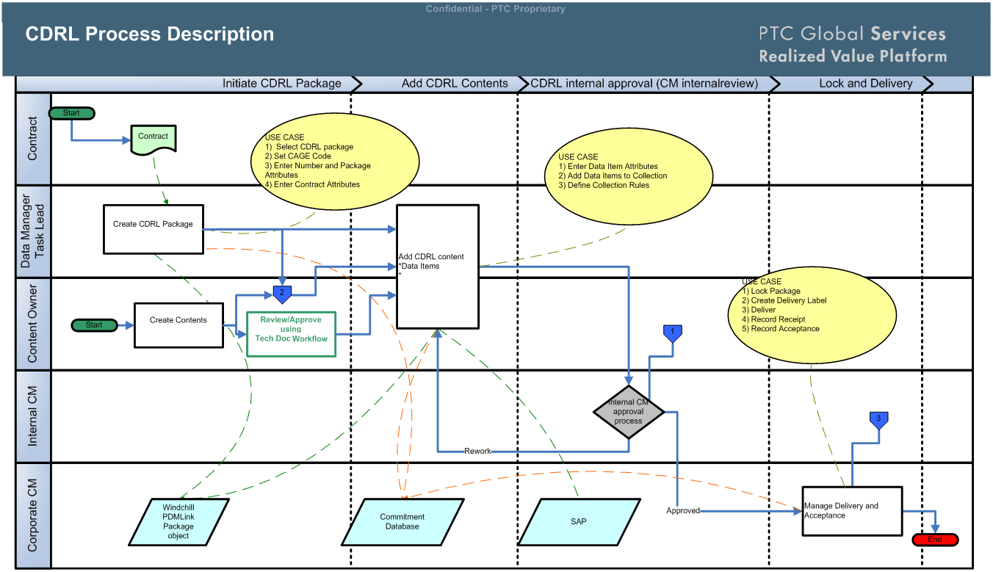
CDRL Package - Process Description
Example
Notes:
See Word document for detailed steps for the Exercise.

Slide 18
Example

