Slide 1
Windchill 10.0 Update - <Topic> Methods
Update the <Topic>
DELETE TEMPLATE NOTE
December 2010
Update the Date
DELETE TEMPLATE NOTE
Notes:
Process Landscape Work Package
Overview
Description:
Highlight the customer process(es) that are impacted by the enhancements / new Windchill product.
Highlight the process practices that are impacted by the enhancements / new Windchill product.
Example of customer(s) who would benefit the most
Deliverable:
2-3 slide PPT presentation with narration and slide notes
2-3 assessment questions and answers

Slide 2
Agenda
Purpose and Context
Description of (Types of) Methods
Compare (Types of) Methods
Identify Objectives for Methods Comparison
Summary
Assessment
Appendix
Methods comparison maybe be on specific methods or on a generic ‘type of’ method.
Update the “(Types of)” text to either remove completely or remove parenthesis
DELETE TEMPLATE NOTE

Slide 3
Purpose and Context
Activity / Task / Goal
Purpose
<Summary of the Activity, Task, and/or Goal that you are trying to achieve with the different methods.>
Customer Examples
Industry X example
Industry Y example
Generic example
NOTE: Reference the Process Landscape presentation for this topic for additional examples.
Define the purpose of the methods being compared
Provide industry specific or generic examples of where these methods may be applied.
DELETE TEMPLATE NOTE

Slide 4
Description of (Types of) Methods
Method 1: <Method 1>
High level description of Method
Key point(s) about method
Method 2: <Method 2>
High level description of Method
Key point(s) about method
Method 3: : <Method 1>
High level description of Method
Key point(s) about method
Update the <Methods #s>
These can be a specific Method or they can be a generic type of method. The generic type of method would be a grouping for a family of method variations.
Update the high level description of the (type of) method
Provide one or more Key points about the method
Different methods will provide varying degrees of support for the objectives on the previous slide. This will be identified in the chart on the next slide.
DELETE TEMPLATE NOTE

Slide 5
Compare (Types of) Methods
Objectives | <Method 1> | <Method 2> | <Method 3>
Objective A | Rating | Rating | Rating
Objective B | Rating | Rating | Rating
Objective C | Rating | Rating | Rating
Objective D | Rating | Rating | Rating
Objective E | Rating | Rating | Rating
Objective F | Rating | Rating | Rating
Update the <Method #s>
Update the <Objective #s>
Add Rating
For the situation of comparing methods between different product revisions, 95+% of cases should show a OOTB method on the new product release as superior to meet objectives.
DELETE TEMPLATE NOTE
Notes:
Ratings
--
-
0
+
++

Slide 6
Identify Objectives for Methods Comparison
Objective A
More detailed description / Key supporting objective
Key supporting objective(s)
Objective B
More detailed description / Key supporting objective
Key supporting objective
Objective C
More detailed description / Key supporting objective
Key supporting objective
Objective D
More detailed description / Key supporting objective
Key supporting objective
Update the <Objective #s>
Update the Key supporting details
These Objectives should be simple and provide a means to compare methods.
DELETE TEMPLATE NOTE

Slide 7
Summary
Benefits of using method(s) with new Windchill 10.0 <topic> capabilities:
Update the <topic>
Provide summary bullet points
DELETE TEMPLATE NOTE

Slide 8
Assessment Questions
Create Assessment Questions
Questions should not be tricky but should be used to reiterate key points in the training
Questions can be Multiple Choice or True / False.
DELETE TEMPLATE NOTE
Question 1 related to Objectives
Provide multi choice list with some correct and some incorrect options.
List option choices a, b, c… with only one correct answer
Question 2 related to Method Selection
Provide multi choice list with some correct and some incorrect options.
List option choices a, b, c… with only one correct answer
Question 3 related to Customers Benefit
Provide multi choice list with some correct and some incorrect options.
List option choices a, b, c… with only one correct answer

Slide 10
Appendix
Appendix is Optional. If additional information is not provided in Appendix:
Delete Appendix Template slides
Delete Appendix bullet from Agenda
DELETE TEMPLATE NOTE
Supporting information for Methods

Slide 11
Windchill 9.1 Update - Packages Methods
Example
December 2010
Notes:
Process Landscape Work Package
Overview
Description:
Highlight the customer process(es) that are impacted by the enhancements / new Windchill product.
Highlight the process practices that are impacted by the enhancements / new Windchill product.
Example of customer(s) who would benefit the most
Deliverable:
2-3 slide PPT presentation with narration and slide notes
2-3 assessment questions and answers

Slide 12
Agenda
Example
Purpose and Context
Description of Types of Methods
Compare Types of Methods
Identify Objectives for Methods Comparison
Summary
Assessment

Slide 13
Purpose and Context
Activity / Task / Goal
Purpose
To create, deliver, and track a collection of objects and content as a package.
Customer Examples
Aerospace and Defense customer create Contract Delivery Requirements List (CDRL) and Subcontractor Delivery Requirements List SDRL packages.
Automotive Original Equipment Manufacturer (OEM) Partners providing packages of content for sourcing collaboration.
NOTE: Reference the Process Landscape presentation for this topic for additional examples.

Slide 14
Description of Types of Methods
Example
Methods to Achieve Functionality Provided with Windchill 9.1 Packages
Method 1: Full Customization
Customer Specific Customization
Potential Changes to Windchill Data Model
Custom User Interface
Integrated or Standalone System
Method 2: Workflow
Step-by-step instructions captured in individual Workflow Task Assignments
Package Creation done manually
Method 3: OOTB 9.1
Method 4: OOTB 9.1 + WADM
Enables CDRL/SDRL soft-types
Notes:
Method 2: Workflow
Workflow Task Assignments
Step-by-step instructions captured in individual Workflow Task Assignments
Package Creation done manually
No presentation layer
Version Issues

Slide 15
Example: Methods Comparison
Example
Objectives | Full Customization | Workflow | OOTB WC 9.1 Packages | WC 9.1 Packages with WADM
Create a Collection | ++ | + | ++ | ++
Control Access | 0 | 0 | ++ | ++
Export for Distribution | 0 | -- | ++ | ++
Manage Contract Information | ++ | - | - | ++
Event Notification | - | + | ++ | ++
Tract Distribution | + | 0 | ++ | ++
Manage Updates to Collection | 0 | -- | ++ | ++
Out of the Box Capabilities | -- | - | ++ | 0

Slide 16
Identify Objectives for Methods Comparison
Example
Objectives Used to Compare Methods to Windchill 9.1 Packages Capabilities
Create a Collection
Create a collection of Windchill Objects
Any user with appropriate access can create a collection
Control Access
Limit access to collections
Export for Distribution
Automated export the collection of Windchill Objects for distribution
Manage Contract Information
Track attributes for contracts
Event Notification
Allow User Subscription
Track Distribution
Automatic delivery of Collection
Track distribution of Collection
Manage Updates to Collection
Provide and manage updates to collection
Out of the Box Capabilities
Reduce and/or Eliminate customizations
Enable easy System Upgrades
Notes:
Delivery of Package
Zip package
Delivery Labels
Track Delivery
Record Versions of Packages Delivered
Record Acceptance of Package
System Maintenance
Reduce potential Upgrade issues
Eliminate Customization
Subscriptions
Email notification based on events or actions on the package
Access Controls
Ad Hoc or Policy Access Control Rules on Packages

Slide 17
Summary
Example
Benefits of using method(s) with new Windchill 9.1 Packages capabilities:
Easy User Interface
Easily Collected related objects
Out of the Box Capabilities
Out of the Box Workflow

Slide 18
Assessment Questions
Example
Q1: Multiple Choice
Identify the similarities in the 9.1 Workflow method and the 10.0 OOTB Packages method.
Answers
A. Hard modeling of attributes is required
B. Step by Step instructional guidance provided
C. Easily create a new version of a collection
Answer Choice: More than one Answer can be Valid
Q2: True / False
Customers will find it easy to collect and add related objects to package when they are linked in to a common enterprise business object in Windchill.
Q3: True / False
Customers using Packages with WADM will need to Customize to add contract attributes to the package.
Notes:
Q1: Answer – B
A: Hard modeling of attributes is not required for either method.
B: THIS IS A SIMILIARITY - The workflow method provided guidance in the workflow task. The OOTB method provides guidance in the UI.
C: The OOTB Packages provides the ability to easily create new versions of a collection. However, this was not available with the workflow method.
Q2: True
Q3: False

Slide 19
Appendix
Example
Supporting Information for Various Methods

Slide 20
Method 1: Full Customization
Example
Summary
Customer Specific Customization
Potential Changes to Windchill Data Model
Custom User Interface
Integrated or Standalone System
Notes:
Customer specific
Data Model
Modeled objects created for packages
Custom UI
Ideally leverages WCA/JCA model
Could be DCA
APIs
Custom APIs
Possible to leverage Info*Engine

Slide 21
Method 2: Workflow
Example
Summary
Workflow Task Assignments
Step-by-step instructions captured in individual Workflow Task Assignments
Package Creation done manually
No presentation layer
Version Issues

Slide 22
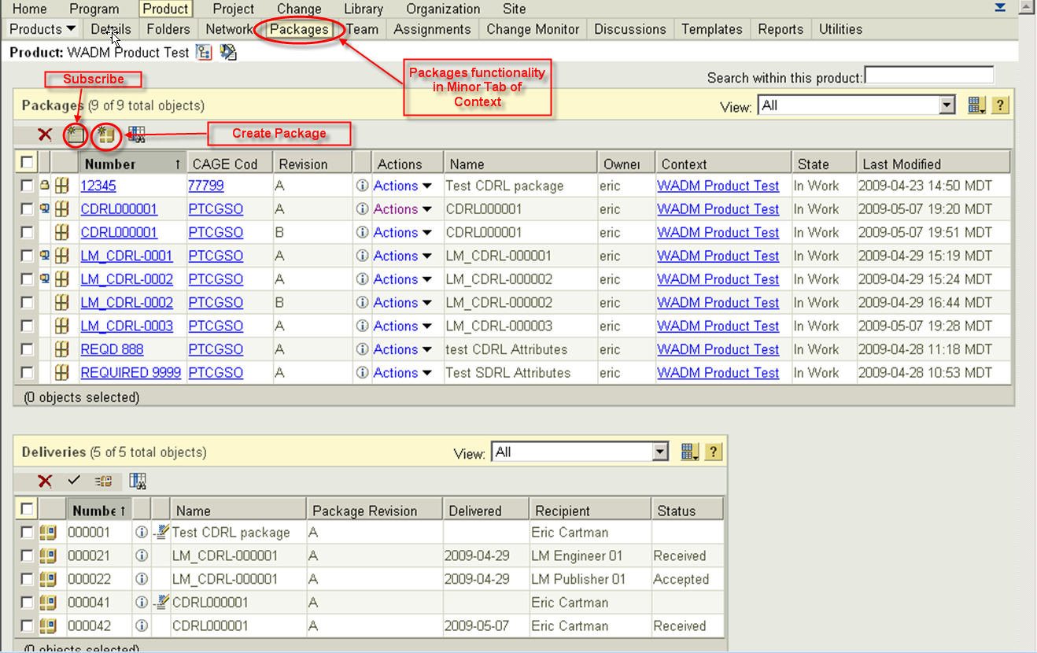
Methods Details
Example
Method 3: OOTB 9.1
Summary
OOTB Capabilities include
Create Package
Deliver Package
Track Package
NOTE: See Feature and Function Training for Additional Details

Slide 23
Methods Details
Example
Method 4: OOTB 9.1 with WADM
Summary
All capabilities as OOTB WC 9.1 included
Addition of WADM enables CDRL/SDRL soft-types
NOTE: See Feature and Function Training for Additional Details

