Slide 1

Windchill 8.0 Update
Lifecycle & Workflow Administration
Module 4 – Lifecycle Templates

Slide 2
Lifecycle Templates
New Lifecycle Templates:
  One Phase Development
  Two Phase Development
  Library Development
These templates are in the “Site” container
The templates are referenced by Object Initialization Rules in Product and Library templates

Slide 3
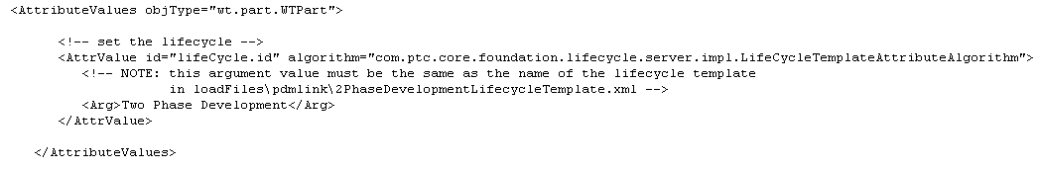
Lifecycle Templates
When a Product is created based on the “Product Design” template, these Object Initialization Rules are created:
  EPM Document
    EPMDocument assigned to “One Phase Development” lifecycle
  Document
    WTDocument assigned to “One Phase Development” lifecycle
  Part
    WTPart assigned to “Two Phase Development” lifecycle

Slide 4

Lifecycle Templates
One Phase Development
  A lifecycle to manage items that may undergo a single review phase in their development

Slide 5
Lifecycle Templates
One Phase Development
  Actions at “Design” phase
Promotion
Change Release
Set State
Lock
Revise
Version Series: Numeric

Slide 6
Lifecycle Templates
One Phase Development
  Actions at “Prototype” phase
Change Release
Promotion
Lock
Revise
Version Series: Numeric

Slide 7
Lifecycle Templates
One Phase Development
  Actions at “Released” phase
Promotion
Lock
Revise
Version Series: Mil Std

Slide 8
Lifecycle Templates
One Phase Development
  Actions at “Obsolescence” phase
Promotion
Lock
Revise
Version Series: Mil Std

Slide 9
Lifecycle Templates
One Phase Development
  Actions at “Under Review” phase
Revise
Version Series: Mil Std

Slide 10
Lifecycle Templates
Two Phase Development
  A lifecycle to manage items that may undergo a two review phases in their development – a group level work-in-process review phase and a formal review phase

Slide 11
Lifecycle Templates
Two Phase Development
  Actions at “Design” phase
Promotion
Set State
Lock
Revise
Version Series: Numeric

Slide 12
Lifecycle Templates
Two Phase Development
  Actions at “Prototype In Work” phase
Promotion
Lock
Revise
Version Series: Numeric

Slide 13
Lifecycle Templates
Two Phase Development
  Actions at “Prototype” phase
Promotion
Lock
Revise
Version Series: Numeric

Slide 14
Lifecycle Templates
Two Phase Development
  Actions at “Production Change” phase
Change Release
Revise
Version Series: Mil Std

Slide 15
Lifecycle Templates
Two Phase Development
  Actions at “Released” phase
Promotion
Lock
Revise
Version Series: Mil Std

Slide 16
Lifecycle Templates
Two Phase Development
  Actions at “Obsolescence” phase
Promotion
Lock
Revise
Version Series: Mil Std

Slide 17
Lifecycle Templates
Two Phase Development
  Actions at “Under Review” phase
Revise
Version Series: Mil Std

Slide 18
Lifecycle Templates
The “Library Development” lifecycle is provided, but is not referenced in any Library template Object Initialization Rules

Slide 19

Lifecycle Templates
Library Development
  A lifecycle to manage items that typically undergo a simplified review phase in their development

Slide 20
Lifecycle Templates
Library Development
  Actions at “Design” phase
Promotion
Set State
Lock
Revise
Version Series: Numeric

Slide 21
Lifecycle Templates
Library Development
  Actions at “Released” phase
Promotion
Lock
Revise
Version Series: Mil Std

Slide 22
Lifecycle Templates
Library Development
  Actions at “Under Review” phase
Revise
Version Series: Mil Std

