Slide 1

Windchill Hardware Sizing Guidance Template

Slide 2


Windchill Hardware Sizing – Scenario 1
User Totals
  110 CAD Users
  100 Non-CAD Users
Main/Host Site
  TBD
Remote Sites
  TBD
Assumptions
  30% of CAD users are concurrently using Windchill
  CAD users use 3 times more resources than Non-CAD users
  20% of Non-CAD users are concurrently using Windchill
  W = Number of named CAD users that the system will need to support = 110
  X = Number of named non-CAD users that the system will need to support = 100
  Y = Number of Active CAD users = (W * .3) = 33
  Z = Number of Active Non-CAD users = (X * .20) = 20
  A = Weighted number of Active users = (3Y+Z) = (3*33)+20 = 119
Recommendation
  For a Windows platform (single core 3 GHz CPU)
    Application Tier: 2 CPUs with 12 GB of RAM
    Database Tier: 2 CPUs with 4 GB of RAM
    Replication Servers: 2 CPUs with 4 GB of RAM
    CAD Worker: 2 CPU with 2-4 GB RAM – Enough memory to open largest Pro/ENGINEER Assembly to be published)
    FAST Server (Search Engine): 2 CPU’s with 4 GB

Slide 3
Windchill Hardware Sizing – Scenario 2
User Totals
  110 CAD Users
  300 Non-CAD Users
Main/Host Site
  TBD
Remote Sites
  TBD
Assumptions
  30% of CAD users are concurrently using Windchill
  CAD users use 3 times more resources than Non-CAD users
  20% of Non-CAD users are concurrently using Windchill
  W = Number of named CAD users that the system will need to support = 110
  X = Number of named non-CAD users that the system will need to support = 300
  Y = Number of Active CAD users = (W * .3) = 33
  Z = Number of Active Non-CAD users = (X * .20) = 60
  A = Weighted number of Active users = (3Y+Z) = (3*33)+60 = 159
Recommendation
  For a Windows platform (single core 3 GHz CPU)
    Application Tier: 4 CPUs with 16 GB of RAM
    Database Tier: 4 CPUs with 8 GB of RAM
    Replication Server: 2 CPUs with 4 GB of RAM
    CAD Worker: 2 CPU with 2-4 GB RAM – Enough memory to open largest Pro/ENGINEER Assembly to be published)
    FAST Server (Search Engine): 2 CPU’s with 4 GB

Slide 4
Windchill Hardware Sizing – Scenario 3
User Totals
  110 CAD Users
  300 Non-CAD Users
Main/Host Site
  TBD
Remote Sites
  TBD
Assumptions
  50% of CAD users are concurrently using Windchill
  CAD users use 3 times more resources than Non-CAD users
  20% of Non-CAD users are concurrently using Windchill
  W = Number of named CAD users that the system will need to support = 110
  X = Number of named non-CAD users that the system will need to support = 300
  Y = Number of Active CAD users = (W * .5) = 50
  Z = Number of Active Non-CAD users = (X * .20) = 60
  A = Weighted number of Active users = (3Y+Z) = (3*50)+60 = 210
Recommendation
  For a Windows platform (single core 3 GHz CPU)
    Application Tier: 4 CPUs with 16 GB of RAM
    Database Tier: 4 CPUs with 8 GB of RAM
    Replication Server: 2 CPUs with 4 GB of RAM
    CAD Worker: 2 CPU with 2-4 GB RAM – Enough memory to open largest Pro/ENGINEER Assembly to be published)
    FAST Server (Search Engine): 2 CPU’s with 4 GB

Slide 5
Windchill Hardware Sizing – Scenario 4
User Totals
  110 CAD Users
  300 Non-CAD Users
Main/Host Site
  TBD
Remote Sites
  TBD
Assumptions
  50% of CAD users are concurrently using Windchill
  CAD users use 4 times more resources than Non-CAD users
  20% of Non-CAD users are concurrently using Windchill
  W = Number of named CAD users that the system will need to support = 110
  X = Number of named non-CAD users that the system will need to support = 300
  Y = Number of Active CAD users = (W * .5) = 50
  Z = Number of Active Non-CAD users = (X * .20) = 60
  A = Weighted number of Active users = (4Y+Z) = (4*50)+60 = 260
Recommendation
  For a Windows platform (single core 3 GHz CPU)
    Application Tier: 4 CPUs with 16 GB of RAM
    Database Tier: 4 CPUs with 8 GB of RAM
    Replication Server: 2 CPUs with 4 GB of RAM
    CAD Worker: 2 CPU with 2-4 GB RAM – Enough memory to open largest Pro/ENGINEER Assembly to be published)
    FAST Server (Search Engine): 2 CPU’s with 4 GB

Slide 6
Windchill Hardware Sizing – Scenario 5
User Totals
  110 CAD Users
  300 Non-CAD Users
Main/Host Site
  TBD
Remote Sites
  TBD
Assumptions
  75% of CAD users are concurrently using Windchill
  CAD users use 4 times more resources than Non-CAD users
  20% of Non-CAD users are concurrently using Windchill
  W = Number of named CAD users that the system will need to support = 110
  X = Number of named non-CAD users that the system will need to support = 300
  Y = Number of Active CAD users = (W * .75) = 82.5
  Z = Number of Active Non-CAD users = (X * .20) = 60
  A = Weighted number of Active users=(4Y+Z) = (4*82.5)+60 = 390
Recommendation
  For a Windows platform (single core 3 GHz CPU)
    Application Tier: 8 CPUs with 16 GB of RAM
    Database Tier: 8 CPUs with 8 GB of RAM
    Replication Server: 2 CPUs with 4 GB of RAM
    CAD Worker: 2 CPU with 2-4 GB RAM – Enough memory to open largest Pro/ENGINEER Assembly to be published)
    FAST Server (Search Engine): 2 CPU’s with 4 GB

Slide 7
Windchill Hardware Sizing – Scenario 6
User Totals
  110 CAD Users
  300 Non-CAD Users
Main/Host Site
  TBD
Remote Sites
  TBD
Assumptions
  100% of CAD users are concurrently using Windchill
  CAD users use 4 times more resources than Non-CAD users
  20% of Non-CAD users are concurrently using Windchill
  W = Number of named CAD users that the system will need to support = 110
  X = Number of named non-CAD users that the system will need to support = 300
  Y = Number of Active CAD users = (W * 1.00) = 110
  Z = Number of Active Non-CAD users = (X * .20) = 60
  A = Weighted number of Active users= (4Y+Z) = (4*110)+60 = 500
Recommendation
  For a Windows platform (single core 3 GHz CPU)
    Application Tier: 8 CPUs with 20 GB of RAM
    Database Tier: 8 CPUs with 12 GB of RAM
    Replication Server: 2 CPUs with 4 GB of RAM
    CAD Worker: 2 CPU with 2-4 GB RAM – Enough memory to open largest Pro/ENGINEER Assembly to be published)
    FAST Server (Search Engine): 2 CPU’s with 4 GB

Slide 8
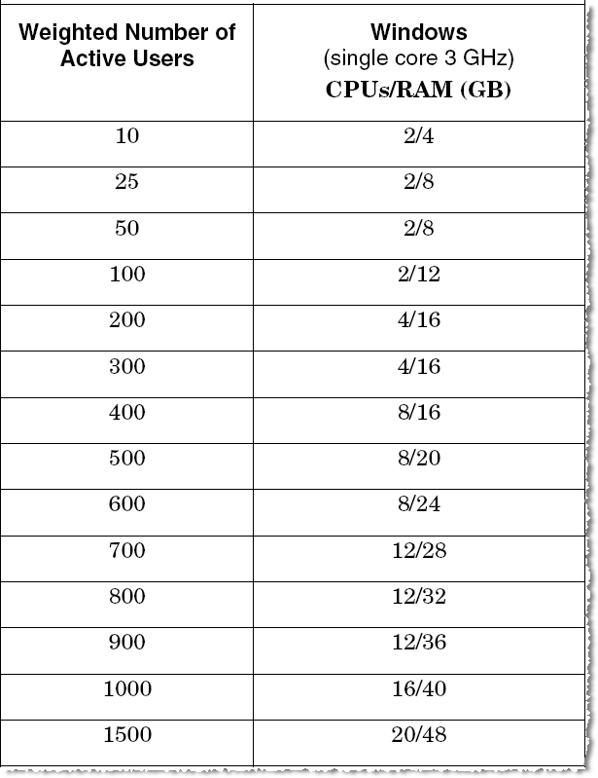
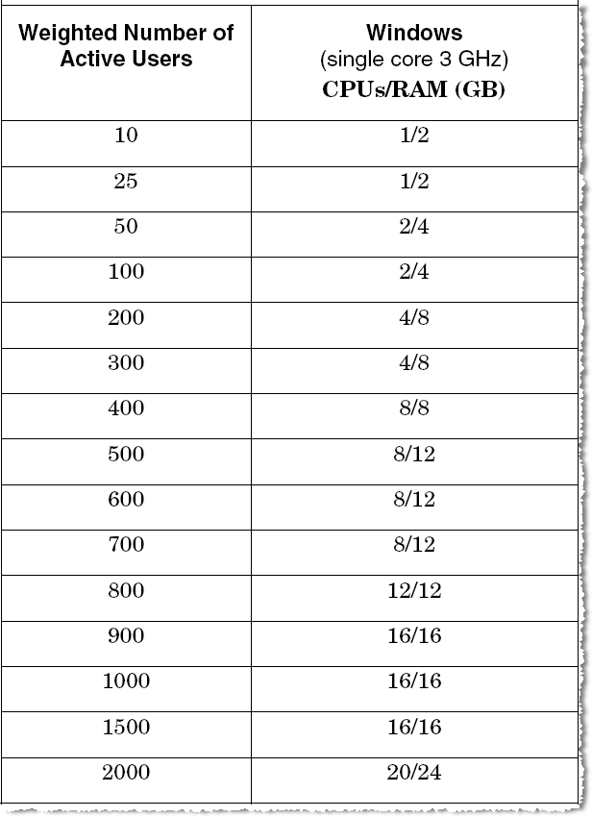
Application and Database Server Guidelines
Application Server Database Server

Slide 9
Comparison
 | Scenario 1 A = 119 | Scenario 2 A = 159 | Scenario 3 A = 210 | Scenario 4 A = 260 | Scenario 5 A = 390 | Scenario 6 A = 500
Application Tier | 2/12 | 4/16 | 4/16 | 4/16 | 8/16 | 8/20
Database Tier | 2/4 | 4/8 | 4/8 | 4/8 | 8/8 | 8/12

Slide 10
Windchill Physical Architecture
Flexible Deployment Options
From 10 to 10,000 Users with Robust High-Availability

Slide 11
Small (up to 100 Users)
Monolithic Server
  WAN enabled
    Web proxy (https://www.yourname.com/pds)
    Internal and external access
    1 remote site
  Simple installation and configuration
  RAID disk array
Application Scalability
  Multiple threads per process
  Multiple processes per core
Web Proxy
Firewall
Monolithic Server
LAN 1
Content Cache
Disk Array

Slide 12
Medium (up to 500 Users)
Two-Tiered Server
  Separates application logic from data
  Supports any number of LAN-based file servers
  RAID disk array
Application Scalability
  Multiple threads per process
  Multiple processes per core
  Multiple cores per processor
Web Proxy
Firewall
Monolithic Server
LAN 1
Content Cache
LAN 2
Content Cache
LAN N
Content Cache
Data Server
Disk Array

Slide 13
Medium (up to 500 Users) and High-Availability
Clustered Server
  Application tier active-active failover
  Small number of remote sites
  Dedicated data server
  RAID storage
Maintainable and Scalable
  “Cluster of one” (or two)
  Logical application access point
  Single point of data recovery
  Symmetric server configurations
Application Scalability
  Multiple threads per process
  Multiple processes per core
  Multiple cores per processor
  Multiple processors per cluster
Web Proxy
Firewall
Load Balancer
LAN 1
Content Cache
App Server
LAN 2
App Server
Content Cache
Background
Data Server
Disk Array
Notes:
Background server runs all non-interactive services: background method server, master cache, RetrievalWare, Aphelion, Office worker, and CAD workers. If workers are required, this must be a Windows box.
Application servers run Apache, Tomcat, and Windchill (foreground method servers only).

Slide 14
Large (up to 10,000 Users) and High-Availability
Clustered Server
  Highly scalable
  Highly available
  Very secure (additional firewall)
  As many remote sites as justified
  Add additional application servers to scale to higher numbers of users
  Redundant data servers
  Balance with network and other infrastructure resources to maximize performance
Web Proxy
Firewall
Load Balancer
LAN 1
Content Cache
App Server
LAN 2
App Server
App Server
App Server
Content Cache
LAN N
Background
Content Cache
Worker
Firewall
Data Server
Data Server
Disk Array

