Slide 1

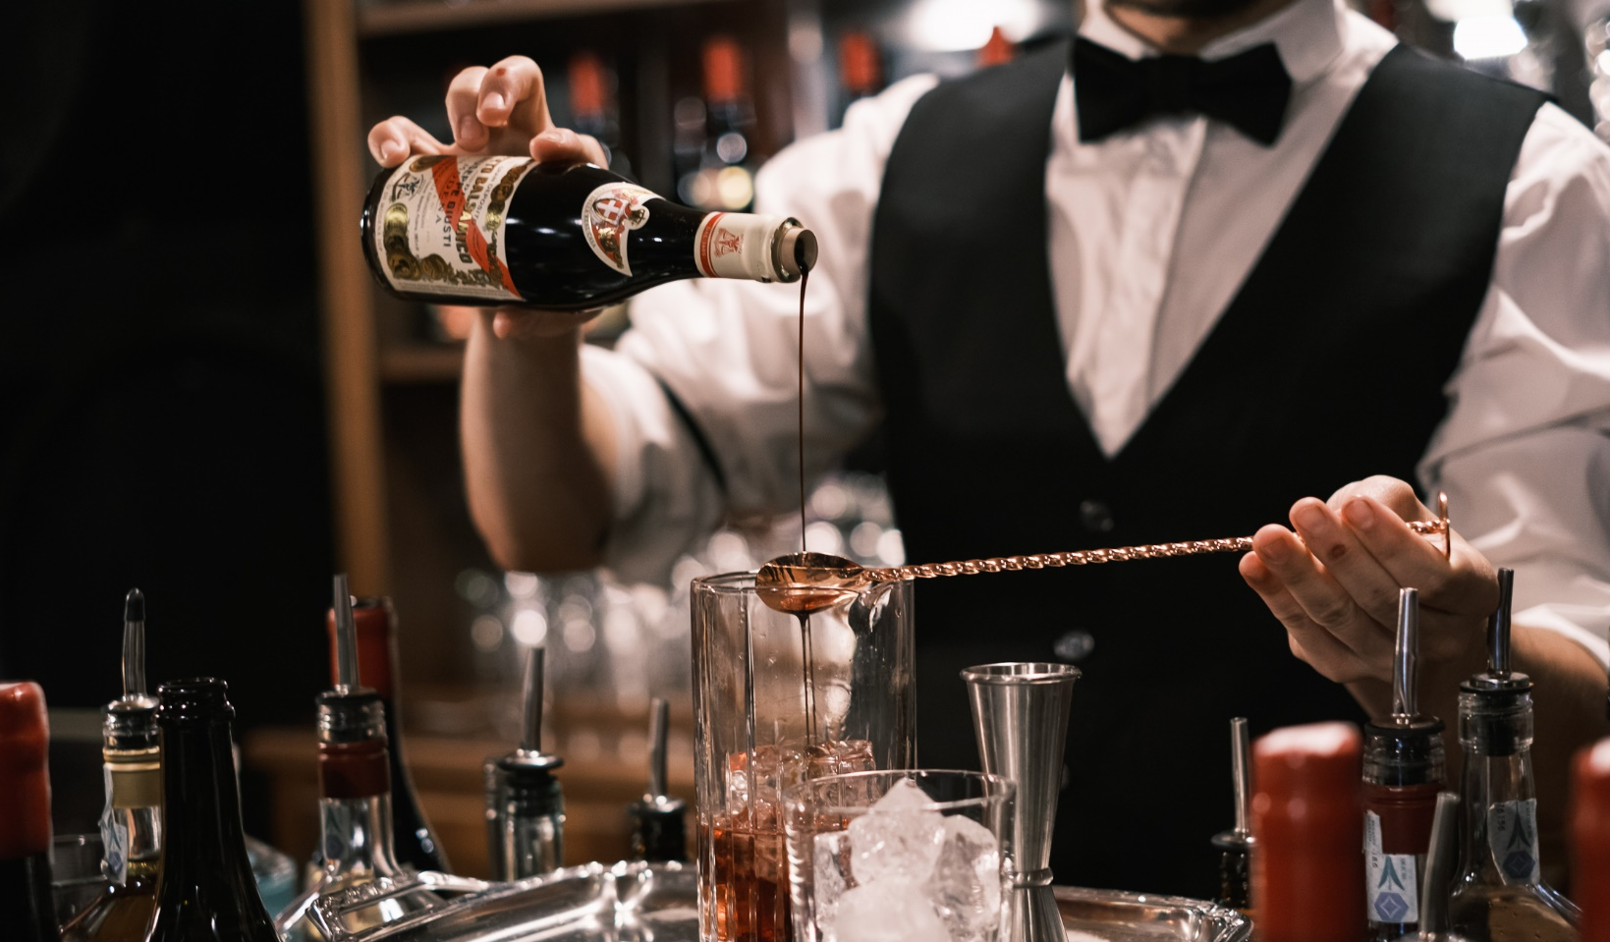

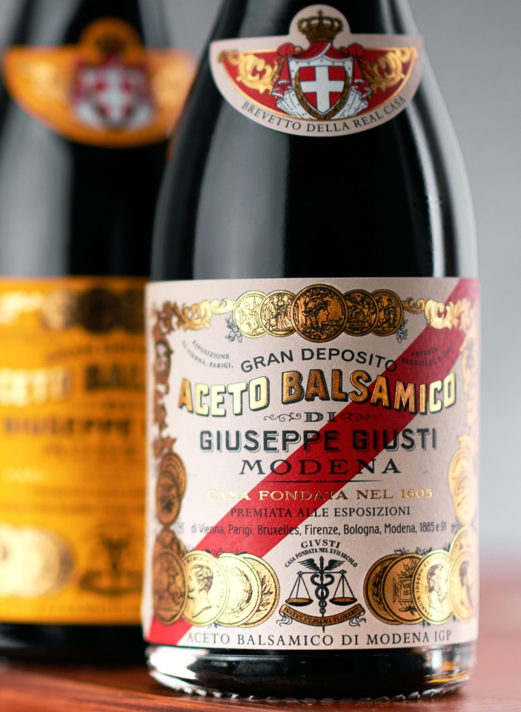
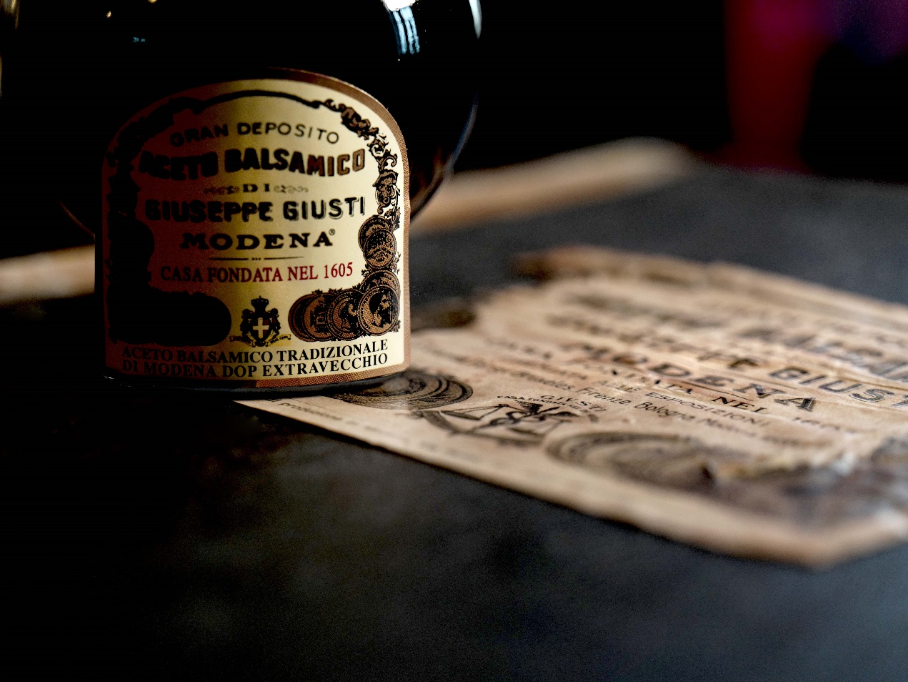
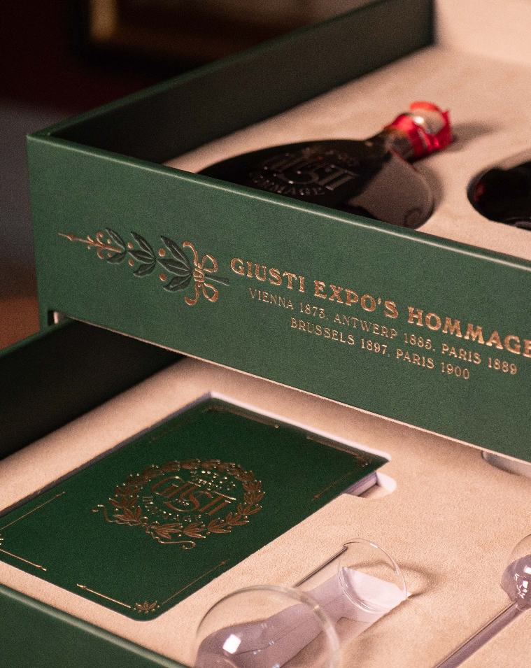

검색 로그인 회원가입
HISTORY products LOCATION board ABOUT
제품 보기
매장 찾기
SINCE 1605
ITALY’S OLDEST
BALSAMIC VINEGAR PRODUCER
Since the seventeenth century, the Giusti family has been producing balsamic vinegar, passing down a recipe that creates a complex harmony of flavors and a product of excellence, appreciated all over the world.
자세히 보기
서울시 XX구 XX로 000 XXX빌딩 8F | TEL : 02-999-9999 | FAX : 02-999-9998
사업자등록번호 : 000-12-00000 | 통신판매업신로 : 종로 제0000호 | 관리자모드
좋은시스템 문의 메일 : webmaster@joeun.com
ⓒ2022 Giuseppe Giusti Korea.Co.,Ltd. All Rights Reserved.

Slide 2


Slide 3

검색 홍길동님 로그아웃
HISTORY products LOCATION board
제품 보기
매장 찾기
SINCE 1605
ITALY’S OLDEST
BALSAMIC VINEGAR PRODUCER
Since the seventeenth century, the Giusti family has been producing balsamic vinegar, passing down a recipe that creates a complex harmony of flavors and a product of excellence, appreciated all over the world.
자세히 보기
서울시 XX구 XX로 000 XXX빌딩 8F | TEL : 02-999-9999 | FAX : 02-999-9998
사업자등록번호 : 000-12-00000 | 통신판매업신로 : 종로 제0000호 | 관리자모드
좋은시스템 문의 메일 : webmaster@joeun.com
ⓒ2022 Giuseppe Giusti Korea.Co.,Ltd. All Rights Reserved.

