Slide 1
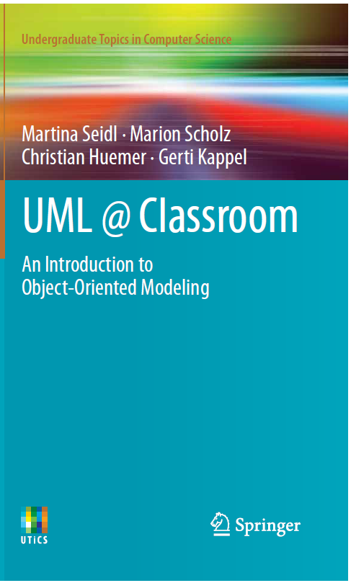
Object-Oriented Modeling
Use Case Diagram
Slides accompanying UML@Classroom
Version 1.0

Slide 2
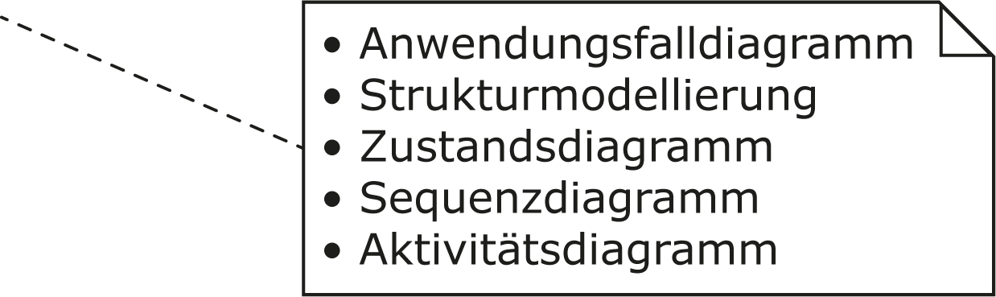
Literature
The lecture is based on the following book:
UML @ Classroom: An Introduction to Object-Oriented Modeling
Martina Seidl, Marion Scholz, Christian Huemer and Gerti Kappel
Springer Publishing, 2015
ISBN 3319127411
Use Case Diagram
Structure Modeling
State Machine Diagram
Sequence Diagram
Activity Diagram

Slide 3
Content
Introduction
Use cases
Actors
Relationships between use cases and actors
Relationships between use cases
Relationships between actors
Description of use cases
Best practices
Typical errors
Notation elements

Slide 4
Introduction
The use case is a fundamental concept of many object-oriented development methods.
Use case diagrams express the expectations of the customers/stakeholders
essential for a detailed design
The use case diagram is used during the entire analysis and design process.
We can use a use case diagram to answer the following questions:
What is being described? (The system.)
Who interacts with the system? (The actors.)
What can the actors do? (The use cases.)

Slide 5
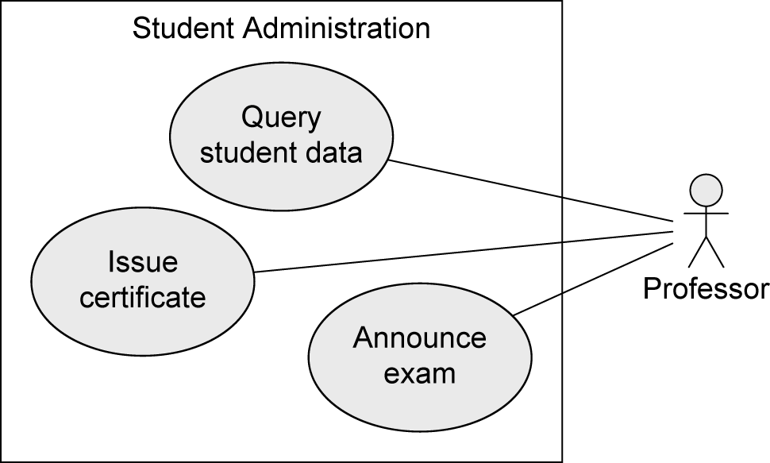
Example: Student Administration System
System
(what is being described?)
Student administration system
Actors
(who interacts with the system?)
Professor
Use cases (what can the actors do?)
Query student data
Issue certificate
Announce exam

Slide 6
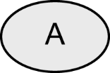
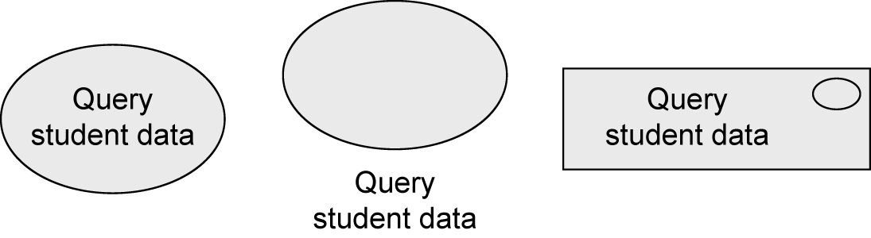
Use Case
Describes functionality expected from the system under development.
Provides tangible benefit for one or more actors that communicate with this use case.
Derived from collected customer wishes.
Set of all use cases describes the functionality that a system shall provide.
Documents the functionality that a system offers.
Alternative notations:

Slide 7

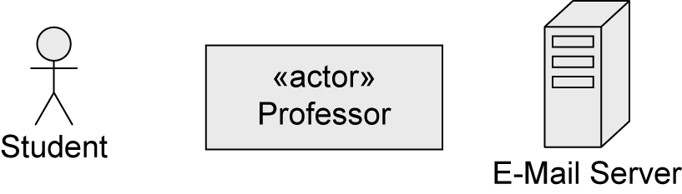
Actor (1/3)
Actors interact with the system …
by using use cases, i.e., the actors initiate the execution of use cases.
by being used by use cases, i.e., the actors provide functionality for the execution of use cases.
Actors represent roles that users adopt.
Specific users can adopt and set aside multiple roles simultaneously.
Actors are not part of the system, i.e., they are outside of the system boundaries.
Alternative notations:

Slide 8
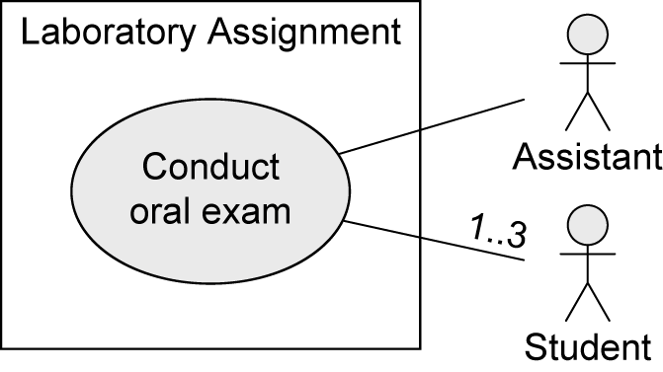
Actor (2/3)
Usually user data is also administered within the system. This data is modeled within the system in the form of objects and classes.
Example: actor Assistant
The actor Assistant interacts with the system Laboratory Assignment by using it.
The class Assistant describes objects representing user data (e.g., name, ssNr, …).

Slide 9
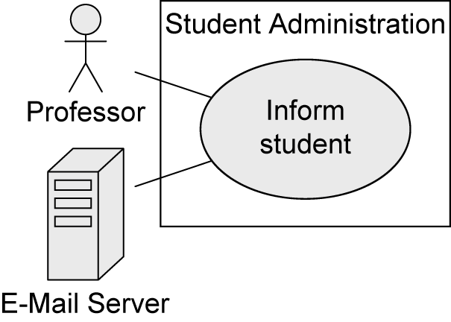
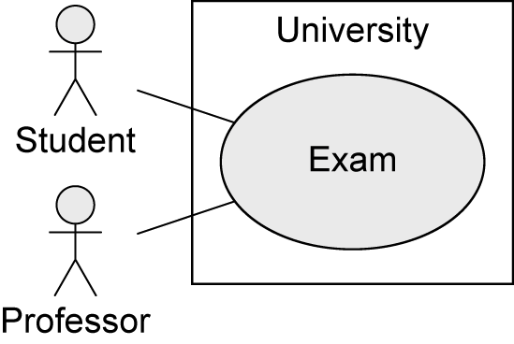
Actor (3/3)
Human
E.g., Student, Professor
Non-human
E.g., E-Mail Server
Primary: has the main benefit of the execution of the use case
Secondary: receives no direct benefit
Active: initiates the execution of the use case
Passive: provides functionality for the execution of the use case
Example:
Human
Primary
Active
Human
Primary
Active
Non-human
Secondary
Passive
Human
Secondary
Active

Slide 10
Relationships between Use Cases and Actors
Actors are connected with use cases via solid lines (associations).
Every actor must communicate with at least one use case.
An association is always binary.
Multiplicities may be specified.

Slide 11
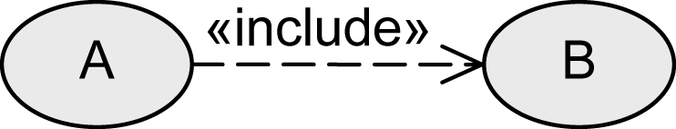
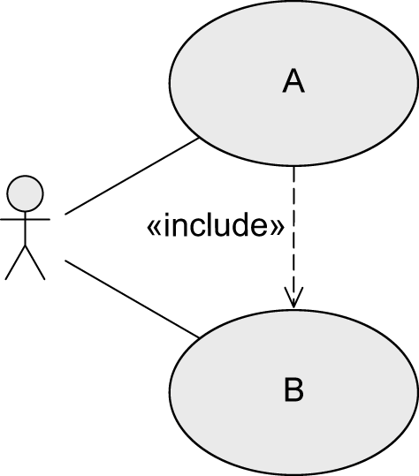
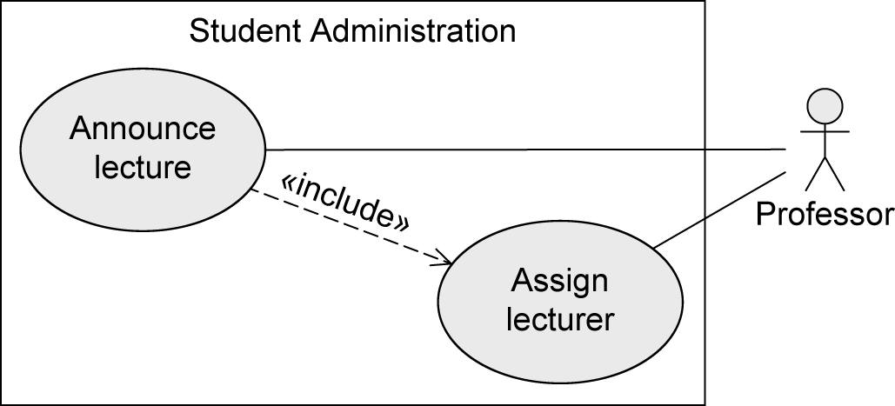
Relationships between Use Cases
«inlcude» - Relationship
The behavior of one use case (included use case) is integrated in the behavior of another use case (base use case)
Example:
Base use case
requires the behavior of the included use
case to be able to offer its functionality
Included use case
may be executed on its own

Slide 12
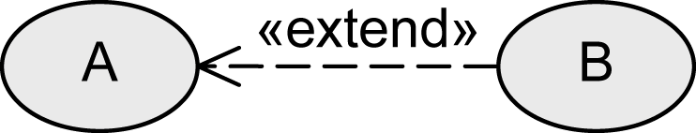

Relationships between Use Cases
«extend» - Relationship
The behavior of one use case (extending use case) may be integrated in the behavior of another use case (base use case) but does not have to.
Both use cases may also be executed independently of each other.
A decides if B is executed.
Extension points define at which point the behavior is integrated.
Conditions define under which circumstances the behavior is integrated.
Base use case
Extending use case

Slide 13
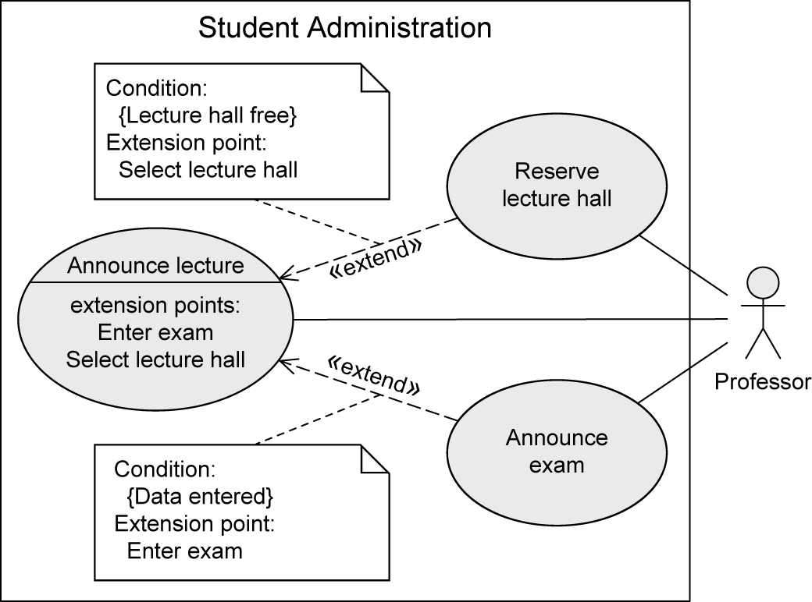
Relationships between Use Cases
«extend» - Relationship: Extension Points
Extension points are written directly within the use case.
Specification of multiple extension points is possible.
Example:

Slide 14
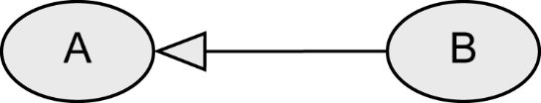
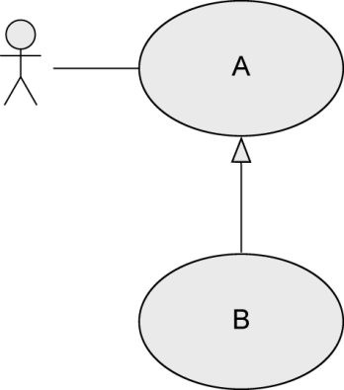
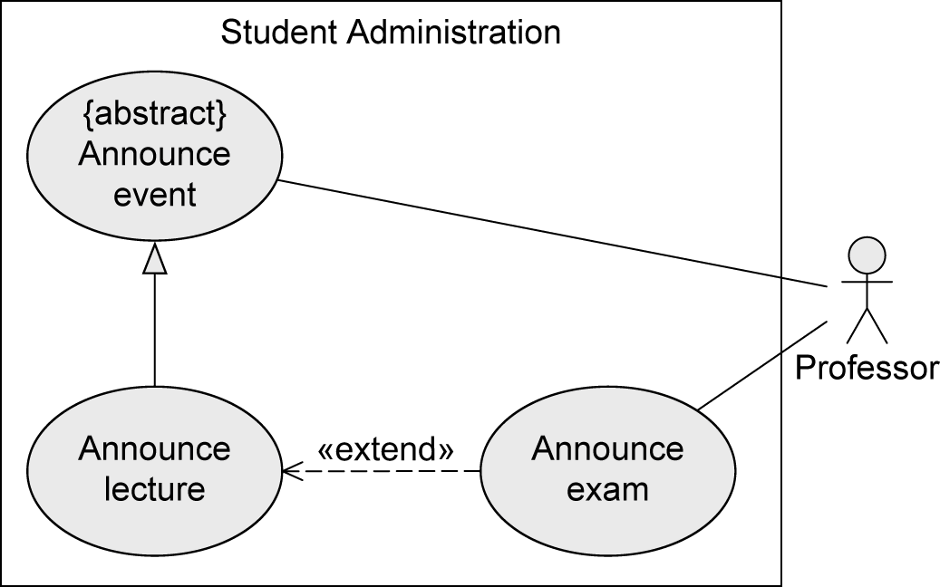
Relationships between Use Cases
Generalization of Use Cases
Use case A generalizes use case B.
B inherits the behavior of A and may either extend or overwrite it.
B also inherits all relationships from A.
B adopts the basic functionality of A but decides itself what part of A is executed or changed.
A may be labeled {abstract}
Cannot be executed directly
Only B is executable
Example:
Base use case
Sub use case

Slide 15
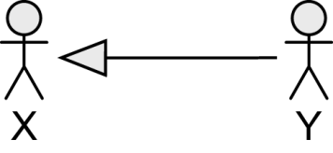
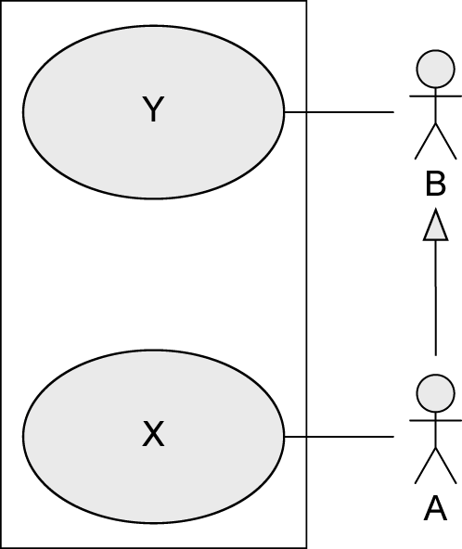
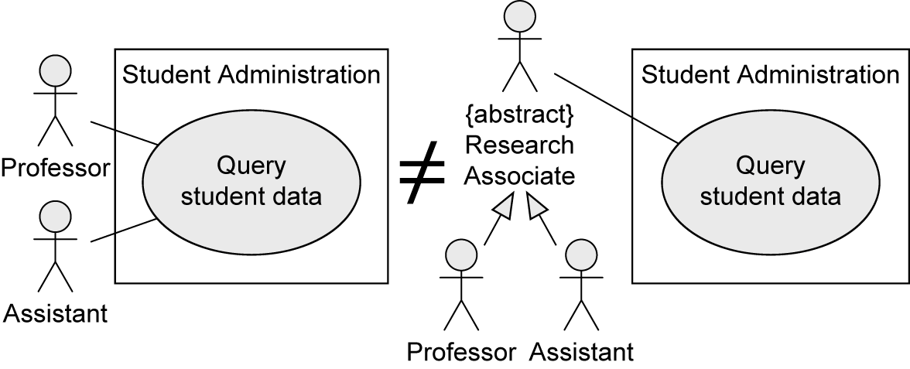
Relationships between Actors
Generalization of Actors
Actor A inherits from actor B.
A can communicate with X and Y.
B can only communicate with Y.
Multiple inheritance is permitted.
Abstract actors are possible.
Example:
Super-actor
Sub-actor
Professor AND Assistant needed for executing Query student data
Professor OR Assistant needed for executing Query student data

Slide 16
Description of Use Cases
Structured approach
Name
Short description
Precondition: prerequisite for successful execution
Postcondition: system state after successful execution
Error situations: errors relevant to the problem domain
System state on the occurrence of an error
Actors that communicate with the use case
Trigger: events which initiate/start the use case
Standard process: individual steps to be taken
Alternative processes: deviations from the standard process [A. Cockburn: Writing Effective Use Cases, Addison Wesley, 2000]

Slide 17
Description of Use Cases - Example
Name: Reserve lecture hall
Short description: An employee reserves a lecture hall at the university for an event.
Precondition: The employee is authorized to reserve lecture halls.
Postcondition: A lecture hall is reserved.
Error situations: There is no free lecture hall.
System state in the event of an error: The employee has not reserved a lecture hall.
Actors: Employee
Trigger: Employee requires a lecture hall.
Standard process: (1) Employee logs in to the system.
(2) Employee selects the lecture hall.
(3) Employee selects the date.
(4) System confirms that the lecture hall is free.
(5) Employee confirms the reservation.
Alternative processes: (4’) Lecture hall is not free.
(5’) System proposes an alternative lecture hall.
(6’) Employee selects alternative lecture hall and confirms the reservation.

Slide 18
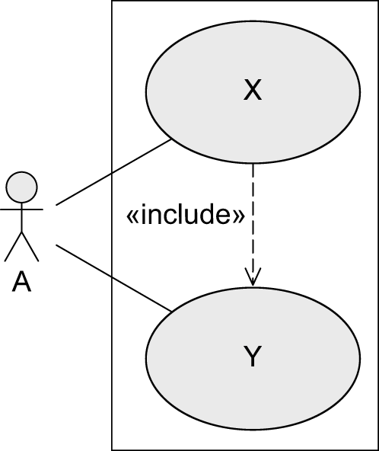

Best Practices
«include»
UML standard
Best practice

Slide 19


Best Practices
«extend»
UML standard
Best practice

Slide 20
Best Practices
Identifying Actors
Who uses the main use cases?
Who needs support for their daily work?
Who is responsible for system administration?
What are the external devices/(software) systems with which the system must communicate?
Who is interested in the results of the system?

Slide 21
Best Practices
Identifying Use Cases
What are the main tasks that an actor must perform?
Does an actor want to query or even modify information contained in the system?
Does an actor want to inform the system about changes in other systems?
Should an actor be informed about unexpected events within the system?

Slide 22
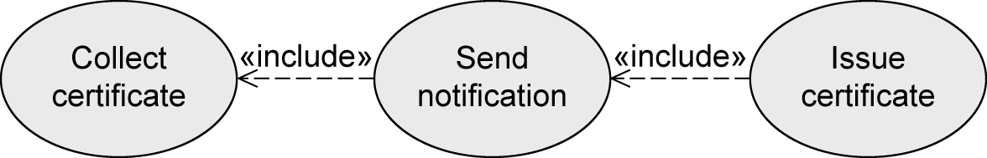
Best Practices
Typical Errors To Avoid (1/5)
Use case diagrams do not model processes/workflows!

Slide 23
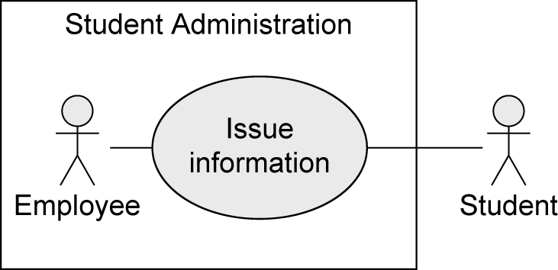
Best Practices
Typical Errors To Avoid (2/5)
Actors are not part of the system, hence, they are positioned outside the system boundaries!

Slide 24
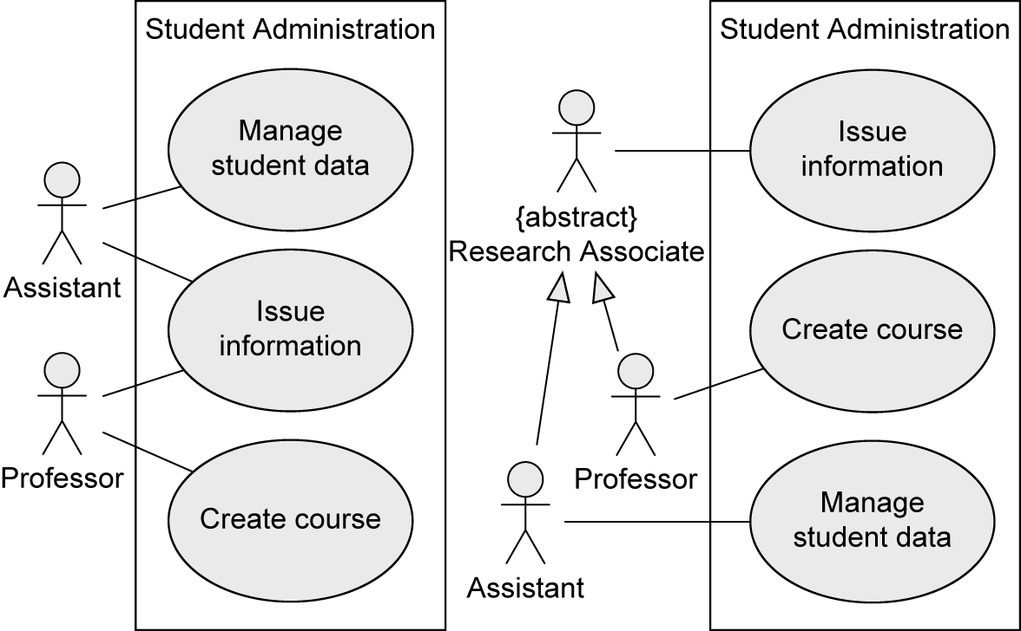
Best Practices
Typical Errors To Avoid (3/5)
Use case Issue information needs EITHER one actor Assistant OR one actor Professor for execution
✓

Slide 25
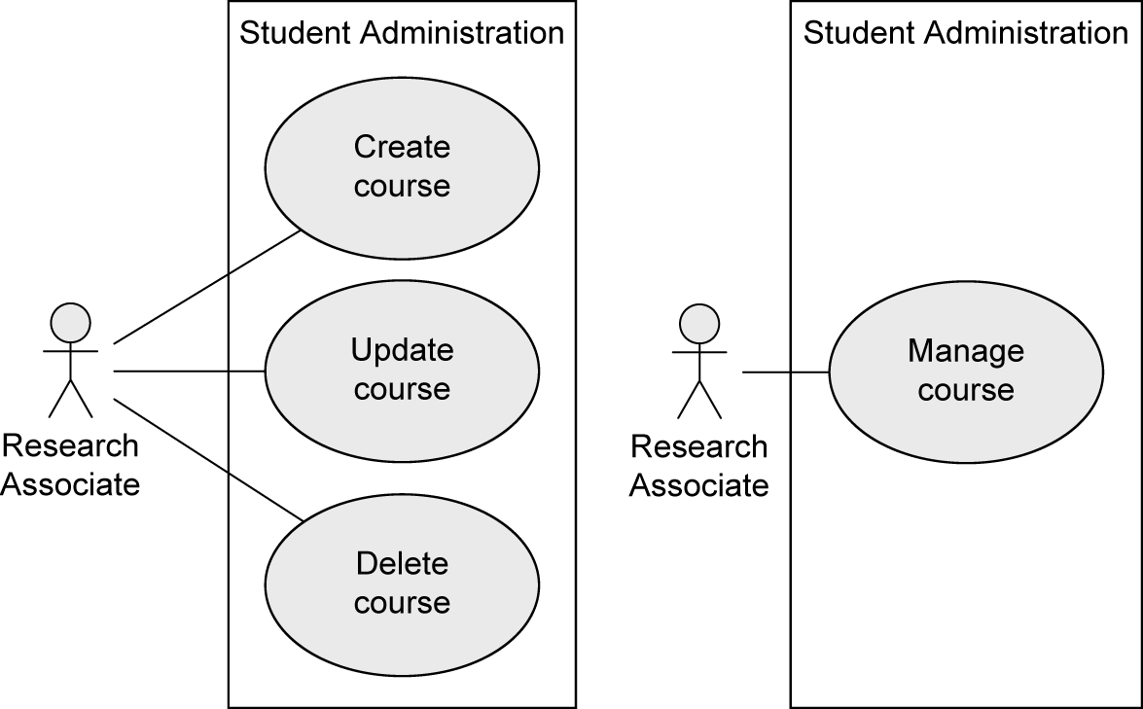
Best Practices
Typical Errors To Avoid (4/5)
Many small use cases that have the same objective may be grouped to form one use case
✓

Slide 26
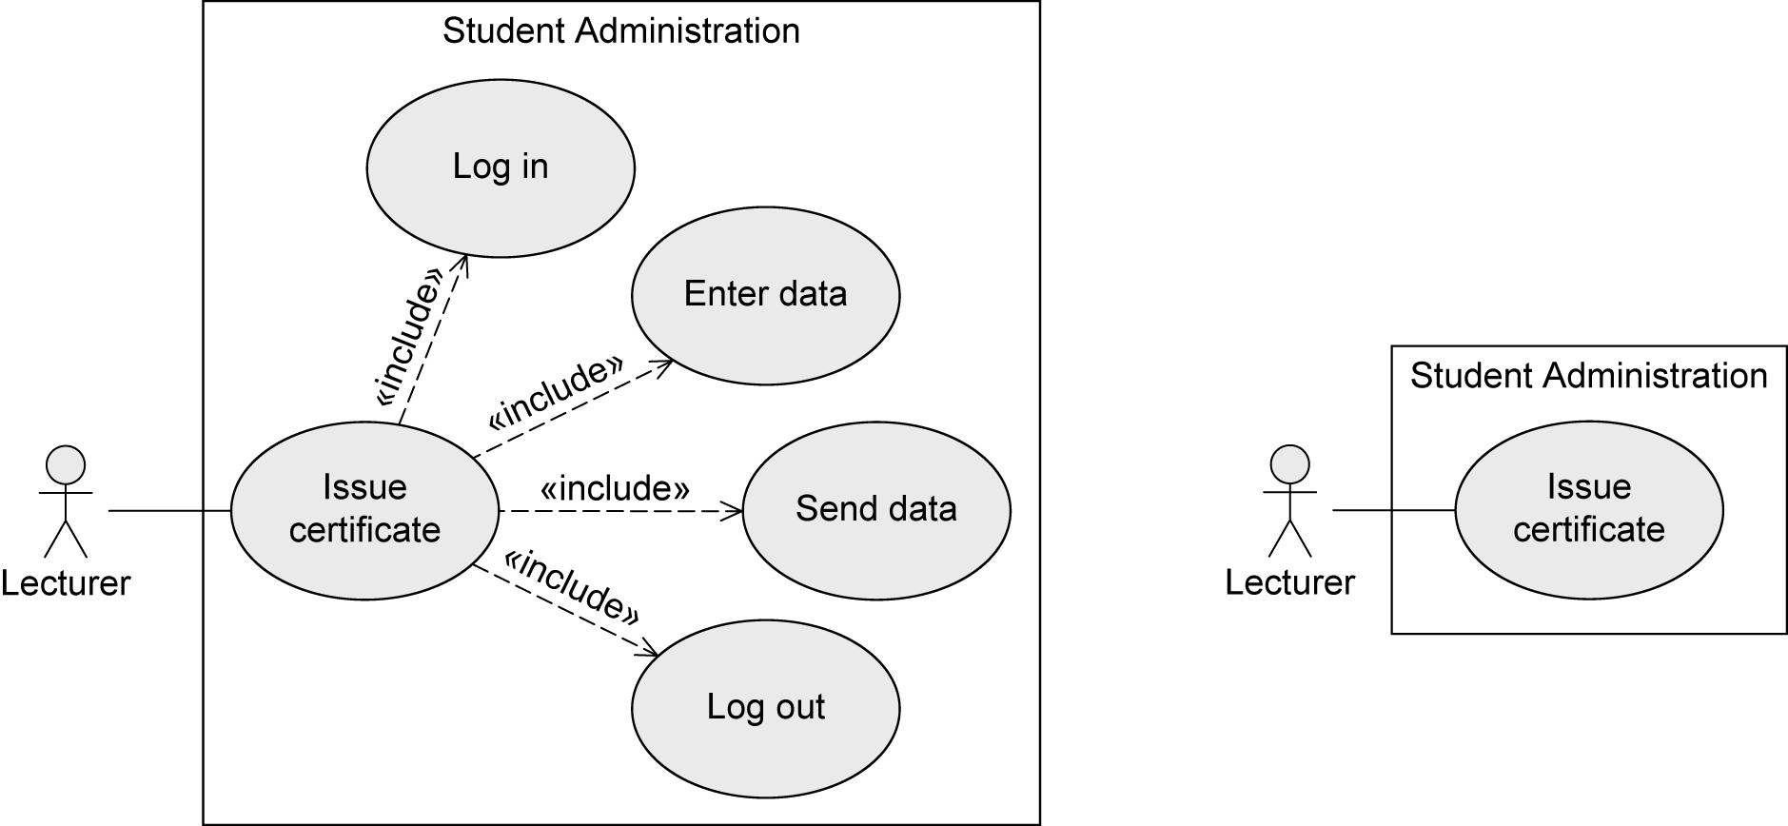
Best Practices
Typical Errors To Avoid (5/5)
The various steps are part of the use cases, not separate use cases themselves! -> NO functional decomposition
✓

Slide 27
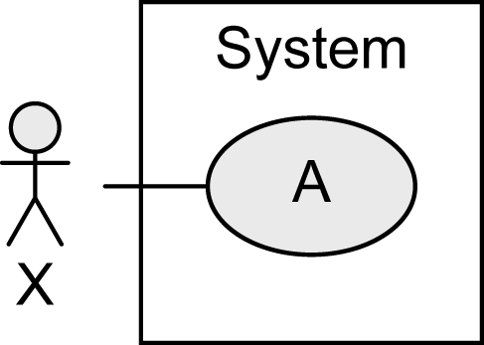

Notation Elements (1/2)
Name | Notation | Description
System |  | Boundaries between the system and the users of the system
Use case |  | Unit of functionality of the system
Actor |  | Role of the users of the system

Slide 28





Notation Elements (2/2)
Name | Notation | Description
Association |  | Relationship between use cases and actors
Generalization |  | Inheritance relationship between actors or use cases
Extend relationship |  | B extends A: optional use of use case B by use case A
Include relationship |  | A includes B: required use of use case B by use case A

