Slide 1

Object-Oriented Modeling
State Machine Diagram
Slides accompanying UML@Classroom
Version 1.0

Slide 2
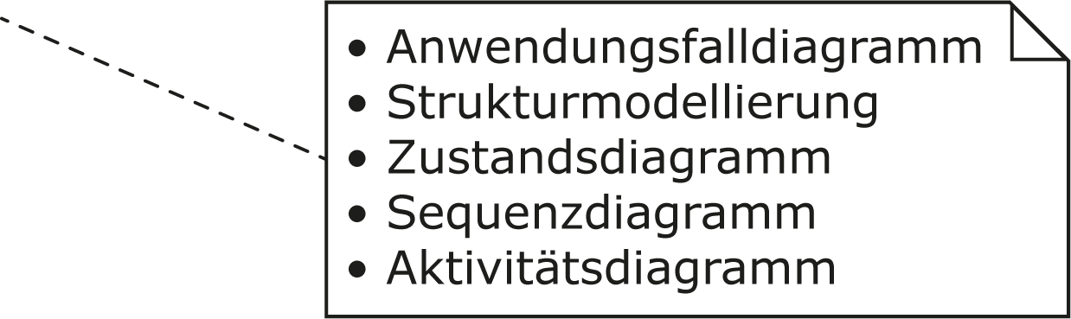
Literature
The lecture is based on the following book:
UML @ Classroom: An Introduction to Object-Oriented Modeling
Martina Seidl, Marion Scholz, Christian Huemer and Gerti Kappel
Springer Publishing, 2015
ISBN 3319127411
Use Case Diagram
Structure Modeling
State Machine Diagram
Sequence Diagram
Activity Diagram

Slide 3
Content
Introduction
States
Transitions
Types of events
Types of states
Entry and exit points

Slide 4
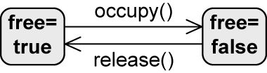
Introduction
Every object takes a finite number of different states during its life
State machine diagram is used as follows:
To model the possible states of a system or object
To show how state transitions occur as a consequence of events
To show what behavior the system or object exhibits in each state
Example: high-level description of the behavior of a lecture hall
Transition
State

Slide 5
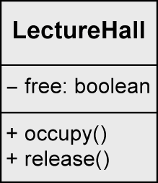
Example: Lecture Hall with Details
class LectureHall {
private boolean free;
public void occupy() {
free=false;
}
public void release() {
free=true;
}
}

Slide 6

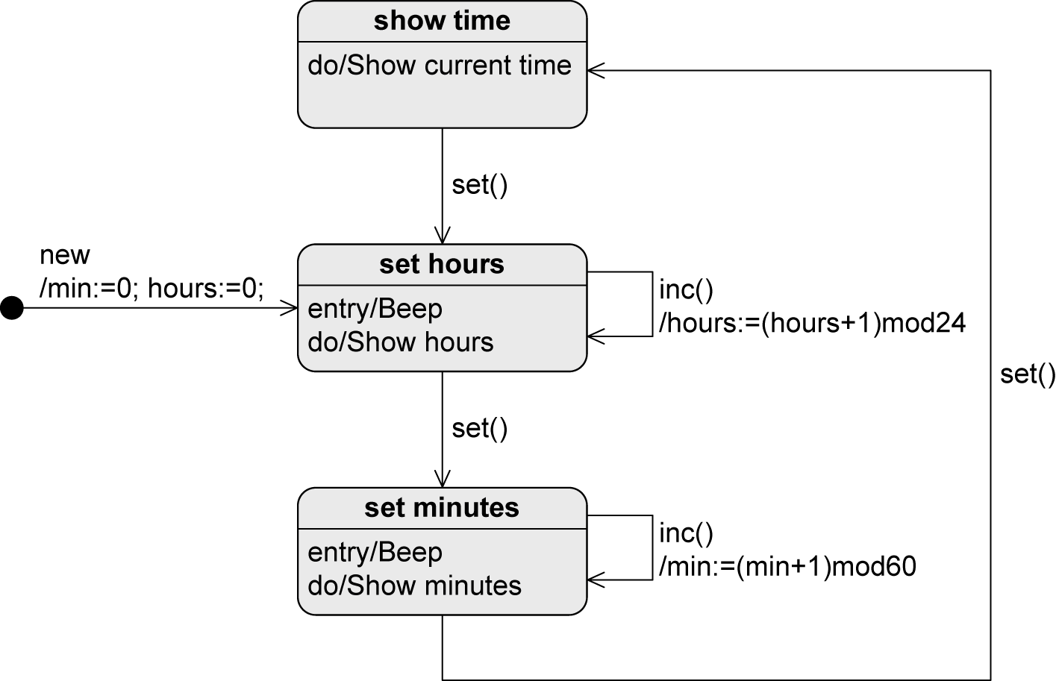
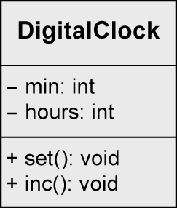
Example: Digital Clock

Slide 7
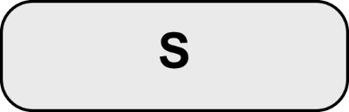
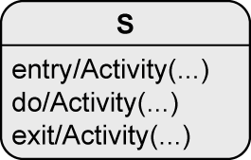
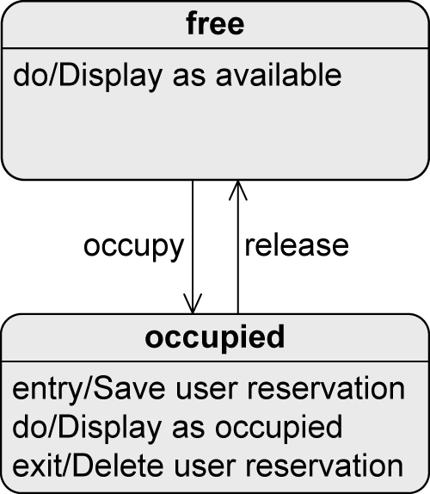
State
States = nodes of the state machine
When a state is active
The object is in that state
All internal activities specified in this state can be executed
An activity can consist of multiple actions
entry / Activity(...)
Executed when the object enters the state
exit / Activity(...)
Executed when the object exits the state
do / Activity(...)
Executed while the object remains in this state

Slide 8

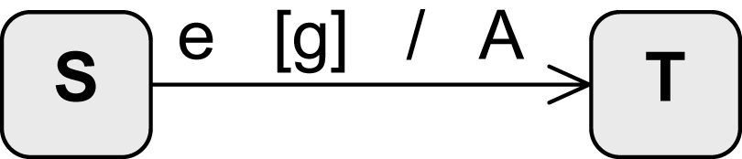
Transition
Change from one state to another
Event
Guard
Sequence of actions (effect)
Source state
Transition
Target state

Slide 9
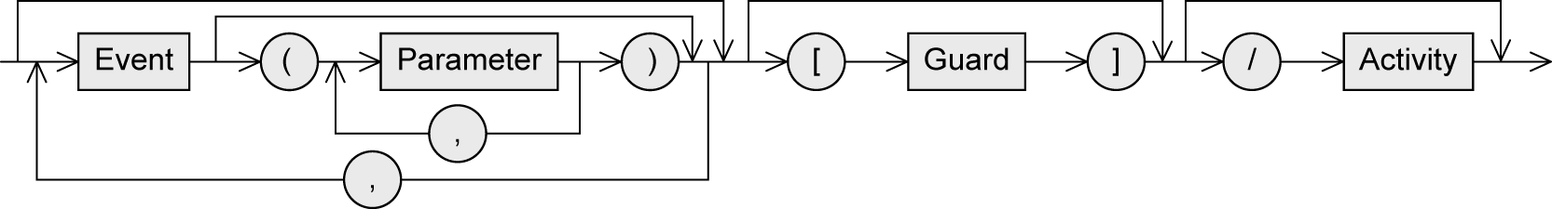
Transition – Syntax
Event (trigger)
Exogenous stimulus
Can trigger a state transition
Guard (condition)
Boolean expression
If the event occurs, the guard is checked
If the guard is true
All activities in the current state are terminated
Any relevant exit activity is executed
The transition takes place
If the guard is false
No state transition takes place, the event is discarded
Activity (effect)
Sequence of actions executed during the state transition

Slide 10
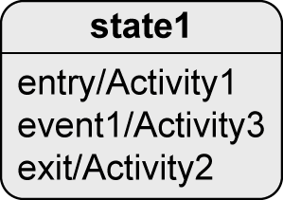
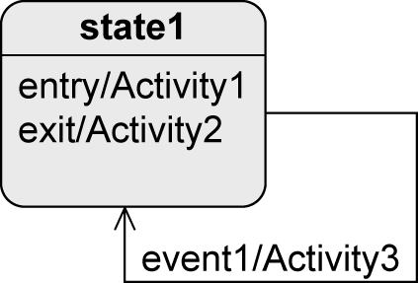
Transition – Types (1/2)
Internal transition
External transition
If event1 occurs
Object remains in state1
Activity3 is executed
If event1 occurs
Object leaves state1 and Activity2 is executed
Activity3 is executed
Object enters state1 and Activity1 is executed

Slide 11




Transition – Types (2/2)
When do the following transitions take place?
If e1 occurs, A1 is aborted and the object changes to S2
If e1 occurs and g1 evaluates to true, A1 is aborted and the object changes to S2
As soon as the execution of A1 is finished, a completion event is generated that initiates the transition to S2
As soon as the execution of A1 is finished, a completion event is generated; if g1 evaluates to true, the transition takes place; If not, this transition can never happen

Slide 12
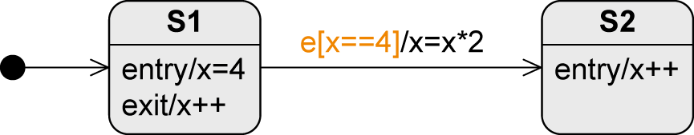
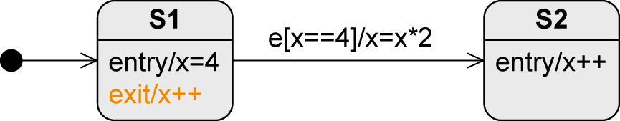
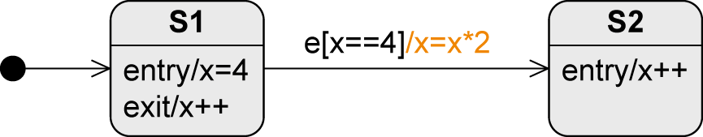
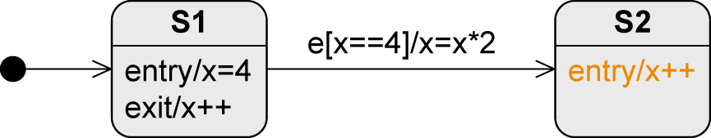
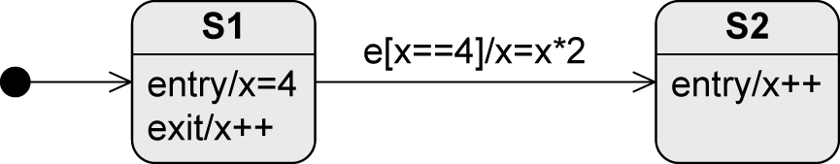
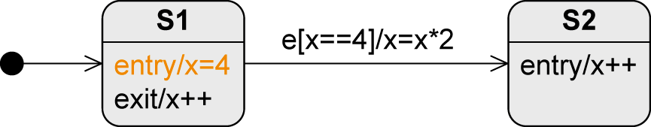
Transition – Sequence of Activity Executions
Assume S1 is active … what is the value of x after e occurred?
S1 becomes active, x is set to the value 4
e occurs, the guard is checked and evaluates to true
S1 is left, x is set to 5
The transition takes place, x is set to 10
S2 is entered, x is set to 11

Slide 13
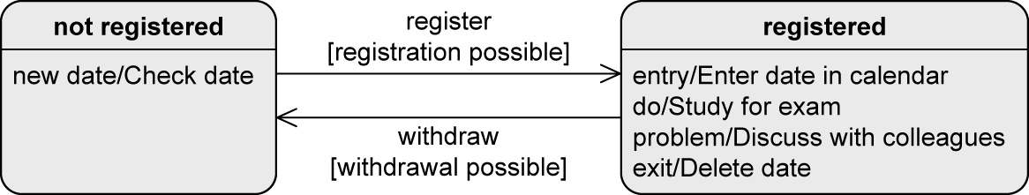
Example: Registration Status of an Exam

Slide 14
Event – Types (1/2)
Signal event
Receipt of a signal
E.g., rightmousedown, sendSMS(message)
Call event
Operation call
E.g., occupy(user,lectureHall), register(exam)
Time event
Time-based state transition
Relative: based on the time of the occurrence of the event
E.g., after(5 seconds)
Absolute
E.g., when(time==16:00), when(date==20150101)

Slide 15
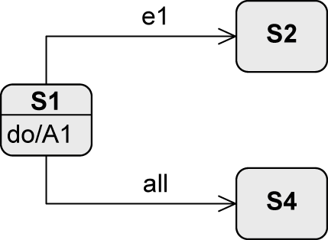
Event – Types (2/2)
Any receive event
Occurs when any event occurs that does not trigger another transition from the active state
Keyword all
Completion event
Generated automatically when everything to be done in the current state is completed
Change event
Permanently checking whether a condition becomes true
E.g., when(x > y), after(90min)

Slide 16
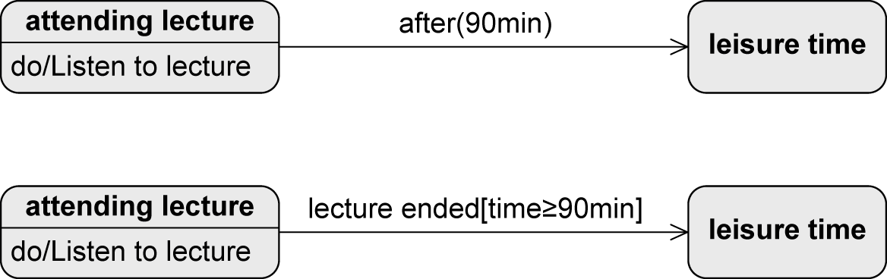
Change Event vs. Guard
Checked permanently
Only checked when event occurs
Question: What if the lecture is shorter than 90min?

Slide 17

Initial State
“Start” of a state machine diagram
Pseudostate
Transient, i.e., system cannot remain in that state
Rather a control structure than a real state
No incoming edges
If >1 outgoing edges
Guards must be mutually exclusive and cover all possible cases to ensure that exactly one target state is reached
If initial state becomes active, the object immediately switches to the next state
No events allowed on the outgoing edges (exception: new())

Slide 18


Final State and Terminate Node
Final State
Real state
Marks the end of the sequence of states
Object can remain in a final state forever
Terminate Node
Pseudostate
Terminates the state machine
The modeled object ceases to exist (= is deleted)

Slide 19
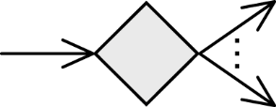
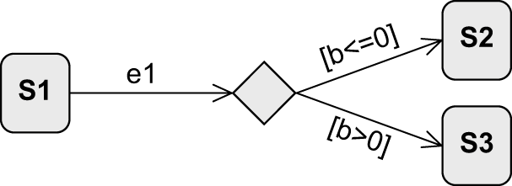
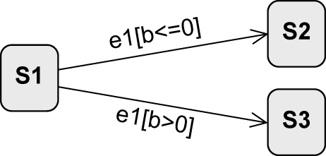
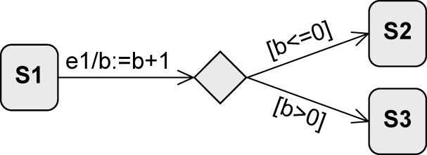
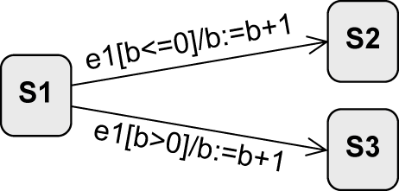
Decision Node
Pseudostate
Used to model alternative transitions
equivalent?
=
equivalent?
≠

Slide 20
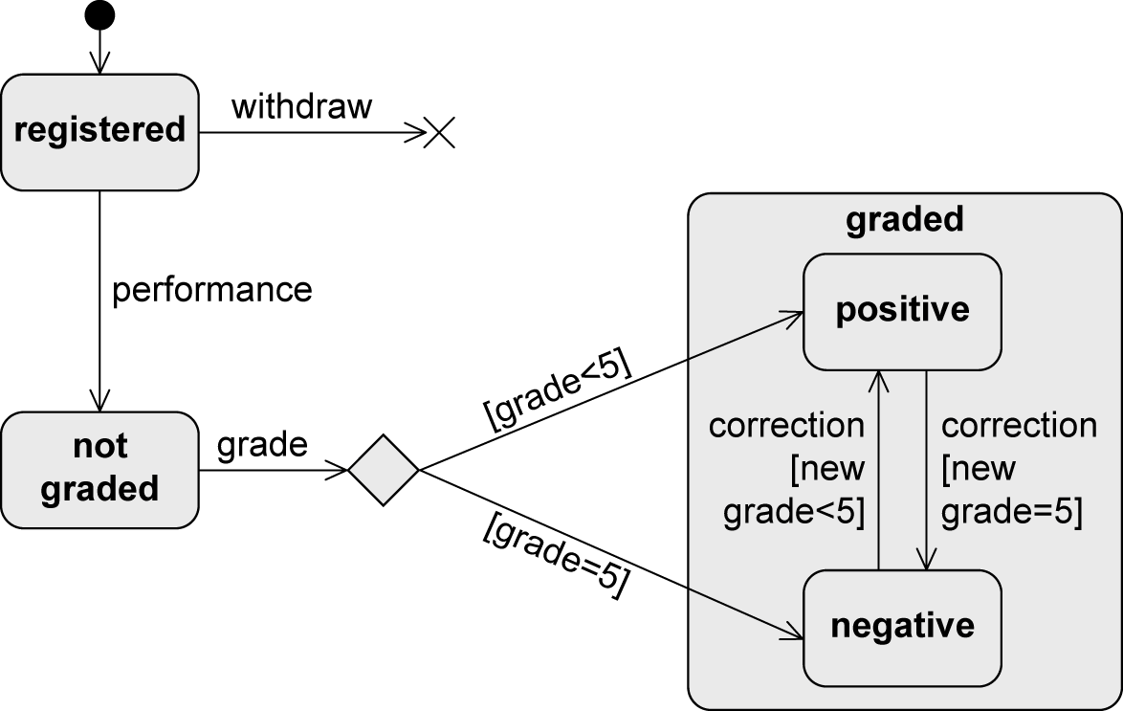
Example: Decision Node

Slide 21
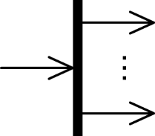
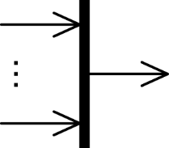
Parallelization and Synchronization Node
Parallelization node
Pseudostate
Splits the control flow into multiple concurrent flows
1 incoming edge
>1 outgoing edges
Synchronization node
Pseudostate
Merges multiple concurrent flows
>1 incoming edges
1 outgoing edge

Slide 22
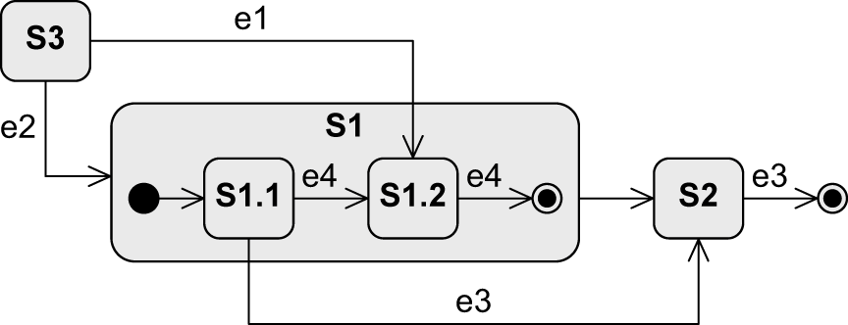
Composite State
Synonyms: complex state, nested state
Contains other states – “substates“
Only one of its substates is active at any point in time
Arbitrary nesting depth of substates
Composite state
Substates

Slide 23
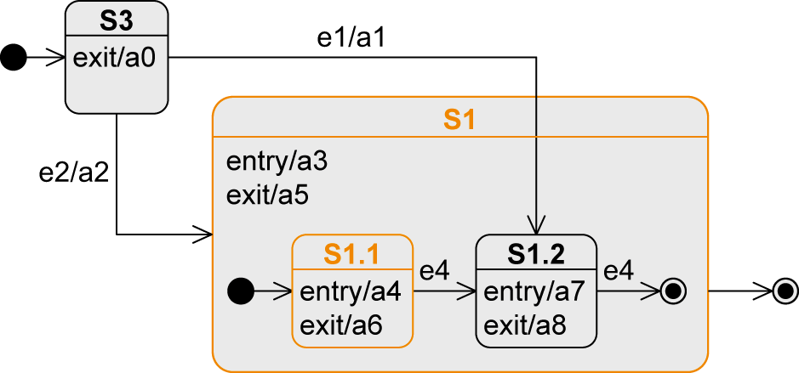
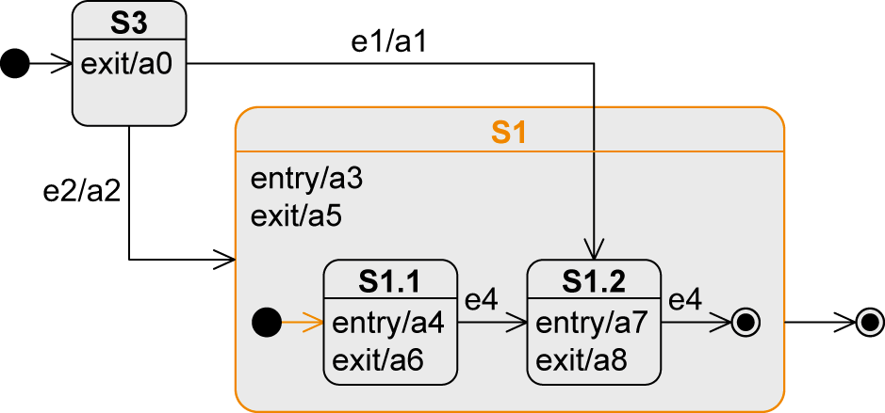
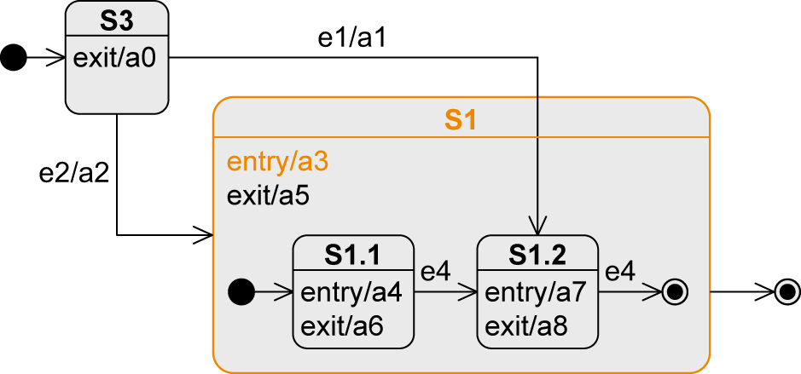
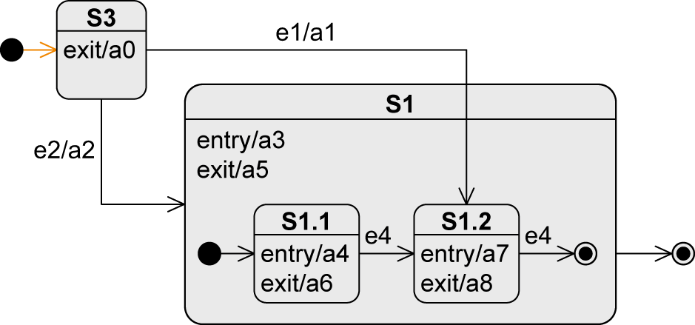
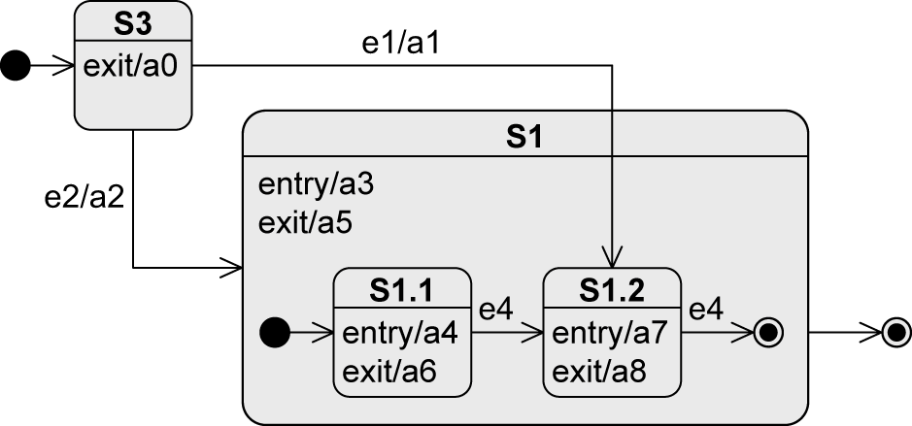
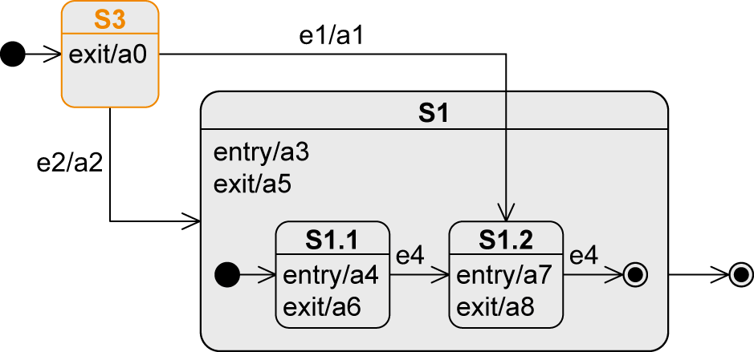
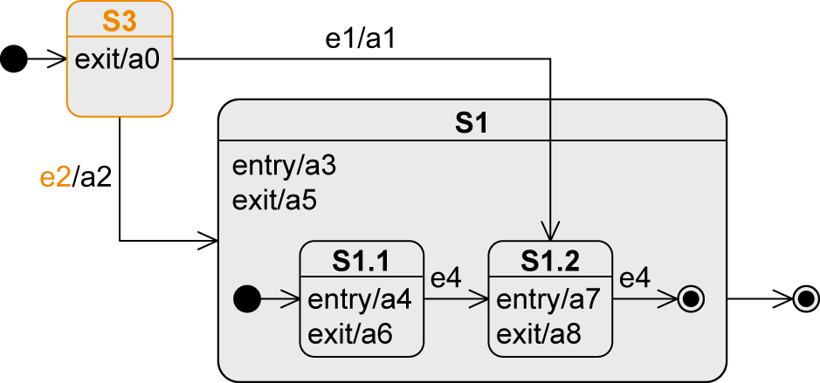
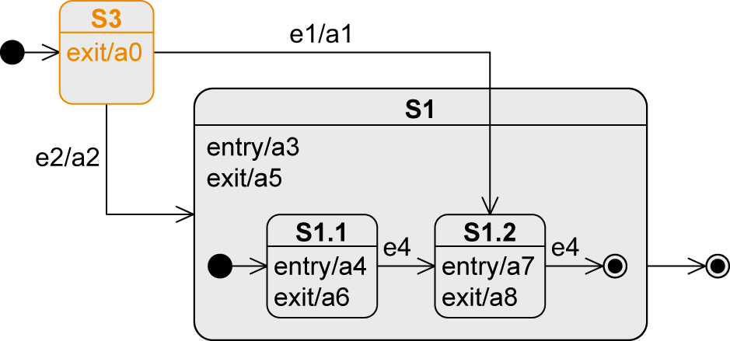
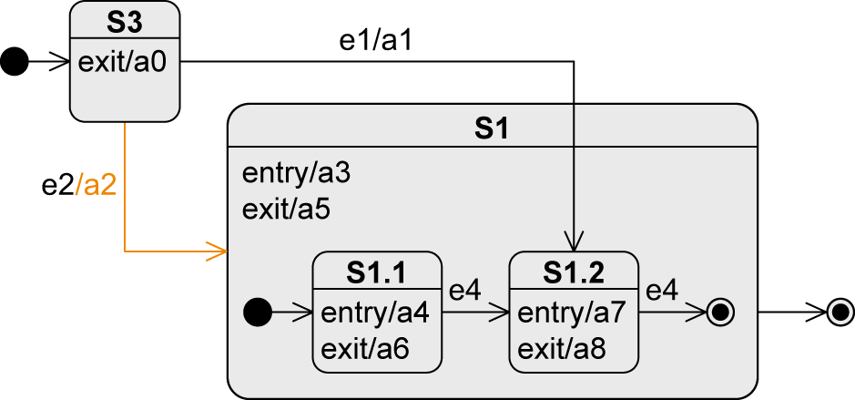
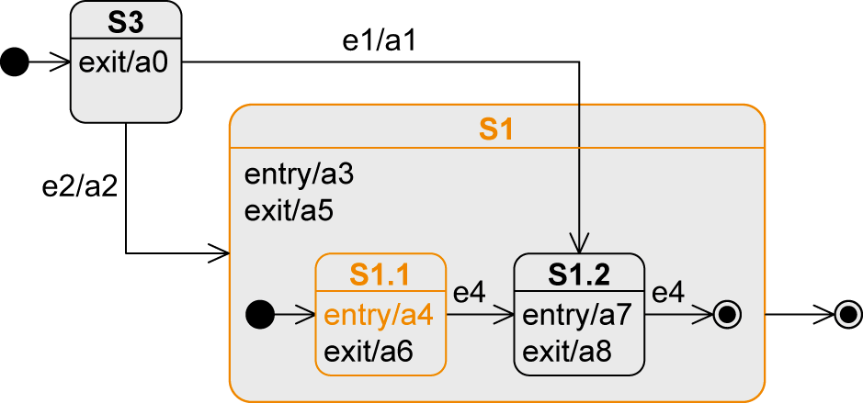
Entering a Composite State (1/2)
Transition to the boundary
Initial node of composite state is activated
Event | State | Executed Activities
„Beginning“ | S3
e2 | S1/S1.1 | a0-a2-a3-a4

Slide 24
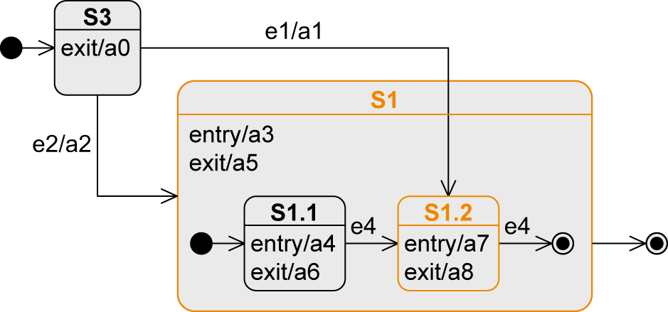
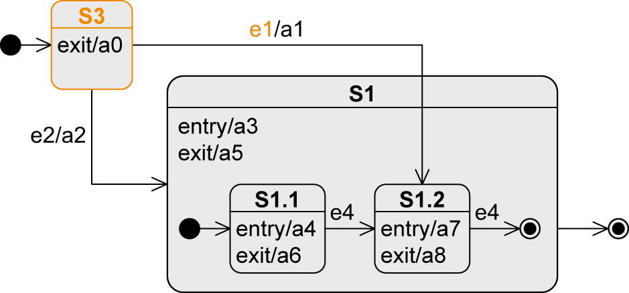
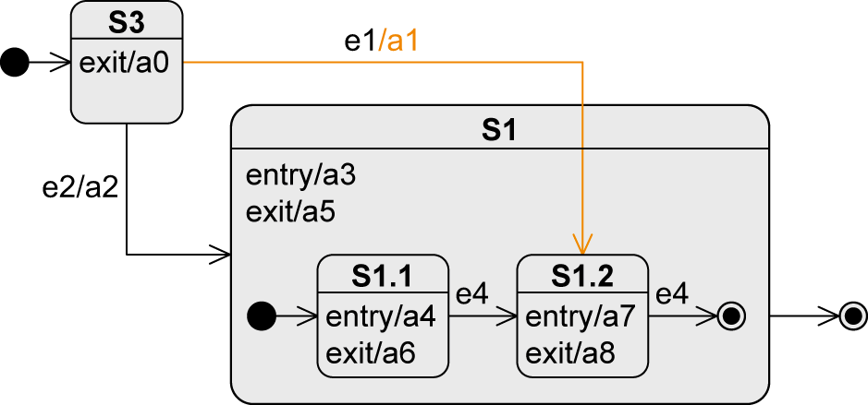
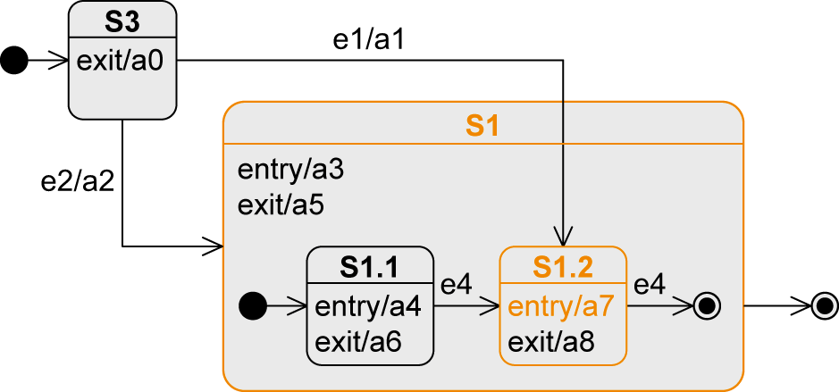
Entering a Composite State (2/2)
Transition to a substate
Substate is activated
Event | State | Executed Activities
„Beginning“ | S3
e1 | S1/S1.2 | a0-a1-a3-a7
23

Slide 25
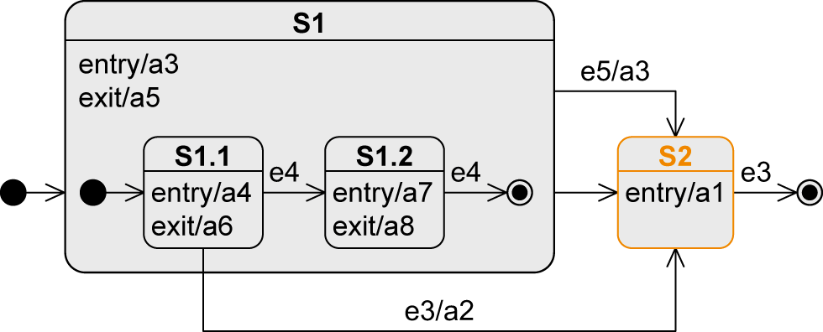
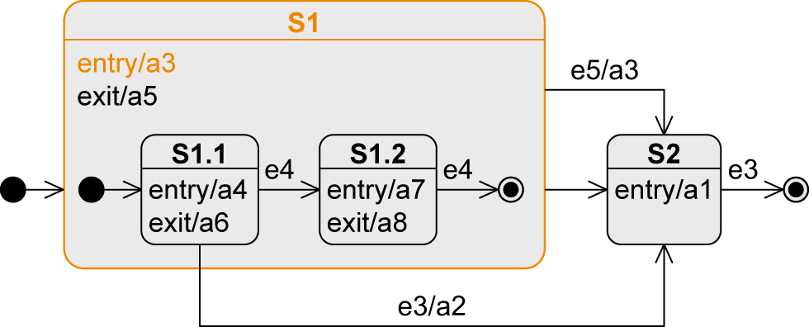
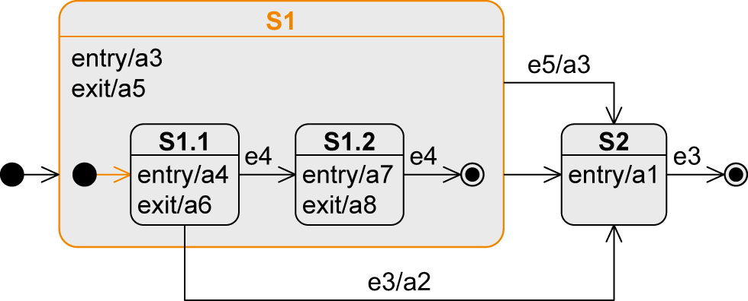
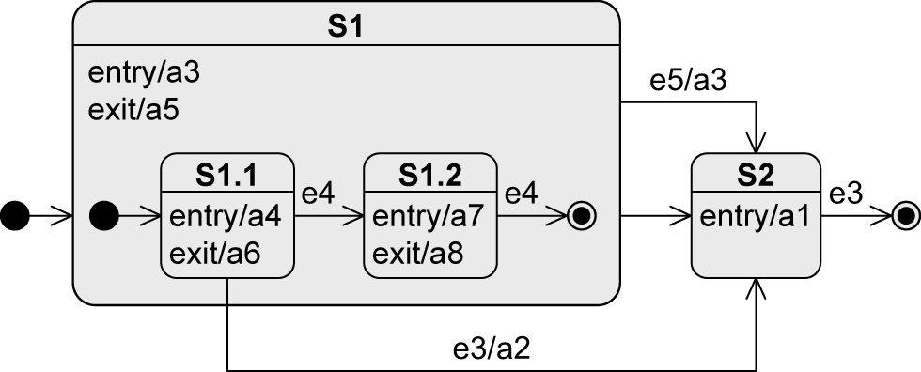
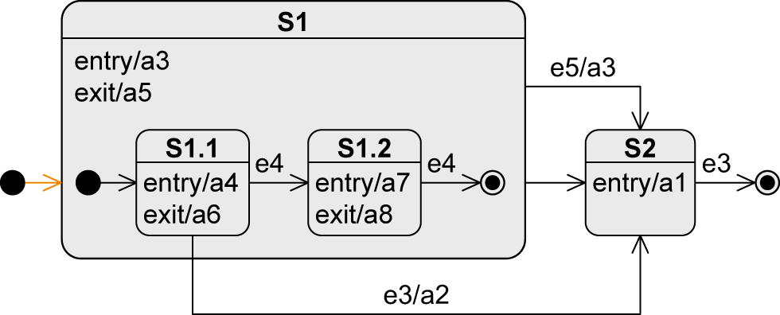
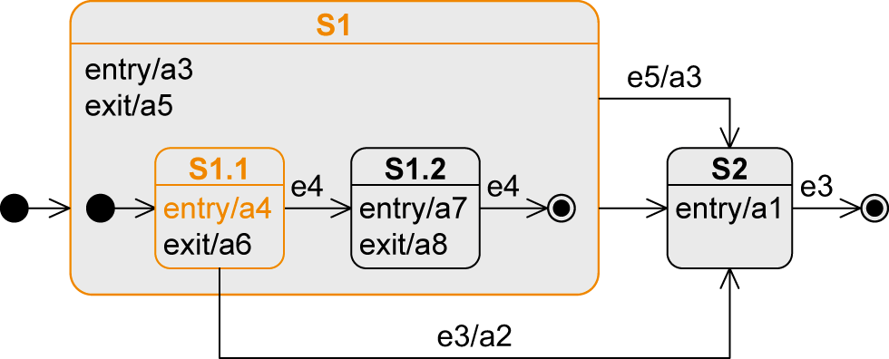





Exiting from a Composite State (1/3)
Transition from a substate
Event | State | Executed Activities
„Beginning“ | S1/S1.1 | a3-a4
e3 | S2 | a6-a5-a2-a1

Slide 26


Exiting from a Composite State (2/3)
Transition from the composite state
Event | State | Executed Activities
„Beginning“ | S1/S1.1 | a3-a4
e5 | S2 | a6-a5-a3-a1
No matter which substate of S1 is active, as soon as e5 occurs, the system changes to S2

Slide 27







Exiting from a Composite State (3/3)
Completion transition from the composite state
Event | State | Executed Activities
„Beginning“ | S1/S1.1 | a3-a4
e4 | S1/S1.2 | a6-a7
e4 | S2 | a8-a5-a1

Slide 28

Orthogonal State
Composite state is divided into two or more regions separated by a dashed line
One state of each region is always active at any point in time, i.e., concurrent substates
Entry: transition to the boundary of the orthogonal state activates the initial states of all regions
Exit: final state must be reached in all regions to trigger completion event
Using parallelization and synchronization node to enter different substates

Slide 29


Submachine State (SMS)
To reuse parts of state machine diagrams in other state machine diagrams
Notation: state:submachineState
As soon as the submachine state is activated, the behavior of the submachine is executed
Corresponds to calling a subroutine in programming languages
Refinement symbol
(optional)

Slide 30


History State
Remembers which substate of a composite state was the last active one
Activates the “old” substate and all entry activities are conducted sequentially from the outside to the inside of the composite state
Exactly one outgoing edge of the history state points to a substate which is used if
the composite state was never active before
the composite state was exited via the final state
Shallow history state restores the state that is on the same level of the composite state
Deep history state restores the last active substate over the entire nesting depth

Slide 31

Example: History State (1/4)
Event | State
„Beginning“ | S5
e1 | S4/S1/S1.1
e2 | S1.2
e10 | S5
e9 | (H→) S1/S1.1

Slide 32
Example: History State (2/4)
Event | State
„Beginning“ | S5
e1 | S4/S1/S1.1
e2 | S1.2
e10 | S5
e8 | (H*→) S1.2

Slide 33
Example: History State (3/4)
Event | State
„Beginning“ | S5
e9 | (H→) S1/S1.1

Slide 34
Example: History State (4/4)
Event | State
„Beginning“ | S5
e8 | (H*→) S3/S3.1

Slide 35


Entry and Exit Points
Encapsulation mechanism
A composite state shall be entered or exited via a state other than the initial and final states
The external transition must/need not know the structure of the composite state
External view

Slide 36


Example: Entry and Exit Points

Slide 37

Notation Elements (1/2)
Name | Notation | Description
State |  | Description of a specific “time span” in which an object finds itself during its “life cycle”. Within a state, activities can be executed by the object.
Transition |  | State transition e from a source state S to a target state T
Initial state |  | Start of a state machine diagram
Final state |  | End of a state machine diagram
Terminate node |  | Termination of an object’s state machine diagram

Slide 38

Notation Elements (2/2)
Name | Syntax | Beschreibung
Decision node |  | Node from which multiple alternative transitions can origin
Parallelization node |  | Splitting of a transition into multiple parallel transitions
Synchronization node |  | Merging of multiple parallel transitions into one transition
Shallow / deep history state |  | “Return address” to a substate or a nested substate of a composite state

