Slide 1

Object-Oriented Modeling
Sequence Diagram
Slides accompanying UML@Classroom
Version 1.0

Slide 2
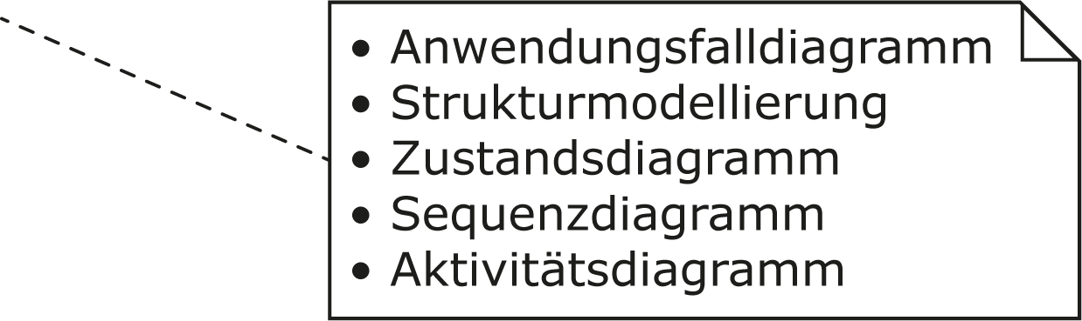
Literature
The lecture is based on the following book:
UML @ Classroom: An Introduction to Object-Oriented Modeling
Martina Seidl, Marion Scholz, Christian Huemer and Gerti Kappel
Springer Publishing, 2015
ISBN 3319127411
Use Case Diagram
Structure Modeling
State Machine Diagram
Sequence Diagram
Activity Diagram

Slide 3
Content
Introduction
Interactions and interaction partners
Messages
Combined fragments
Branches and loops
Concurrency and order
Filters and assertions
Further language elements
Further types of interaction diagrams

Slide 4
Introduction
Modeling inter-object behavior
= interactions between objects
Interaction
Specifies how messages and data are exchanged between interaction partners
Interaction partners
Human (lecturer, administrator, …)
Non-human (server, printer, executable software, …)
Examples of interactions
Conversation between persons
Message exchange between humans and a software system
Communication protocols
Sequence of method calls in a program
…

Slide 5
Interaction Diagrams
Used to specify interactions
Modeling concrete scenarios
Describing communication sequences at different levels of detail
Interaction Diagrams show the following:
Interaction of a system with its environment
Interaction between system parts in order to show how a specific use case can be implemented
Interprocess communication in which the partners involved must observe certain protocols
Communication at class level (operation calls, inter-object behavior)

Slide 6
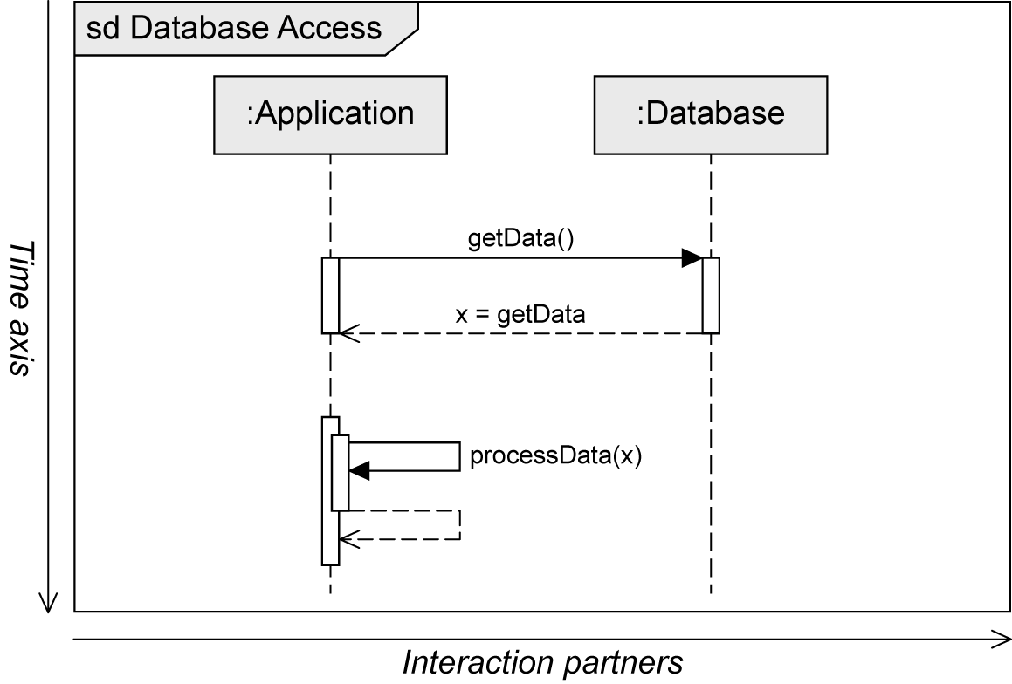
Sequence Diagram
Two-dimensional diagram
Horizontal axis: involved interaction partners
Vertical axis: chronological order of the interaction
Interaction = sequence of event specifications

Slide 7
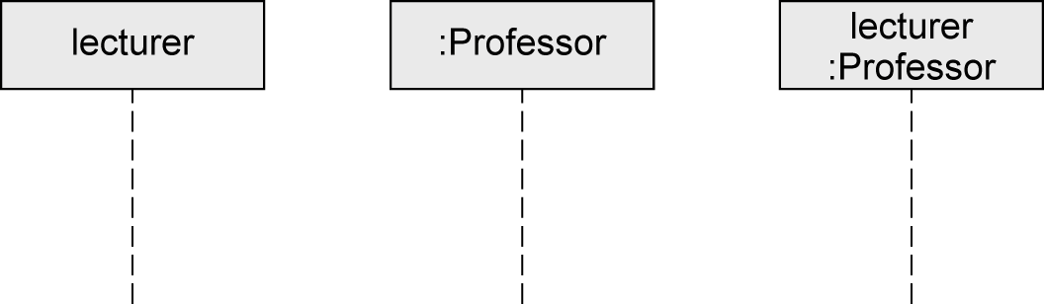
Interaction Partners
Interaction partners are depicted as lifelines
Head of the lifeline
Rectangle that contains the expression roleName:Class
Roles are a more general concept than objects
Object can take on different roles over its lifetime
Body of the lifeline
Vertical, usually dashed line
Represents the lifetime of the object associated with it
Head of the lifeline
Body of the Lifeline

Slide 8
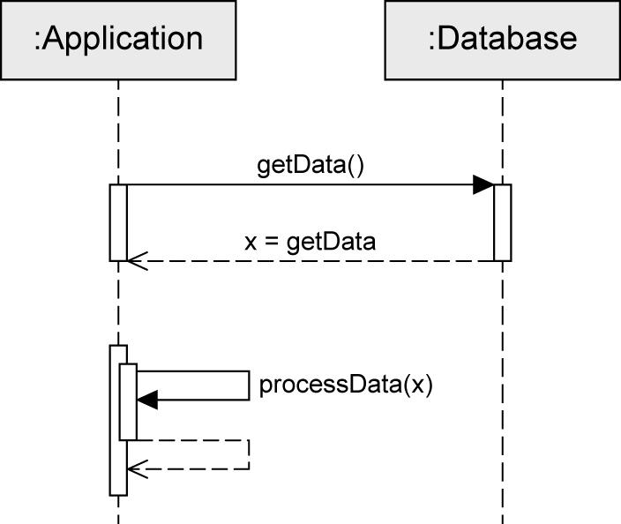
Exchanging Messages (1/2)
Interaction: sequence of events
Message is defined via send event and receive event
Execution specification
Continuous bar
Used to visualize when an interaction partner executes some behavior
Send event
Receive event
Execution specification

Slide 9
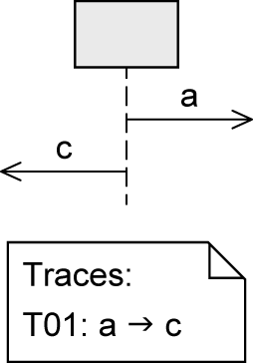
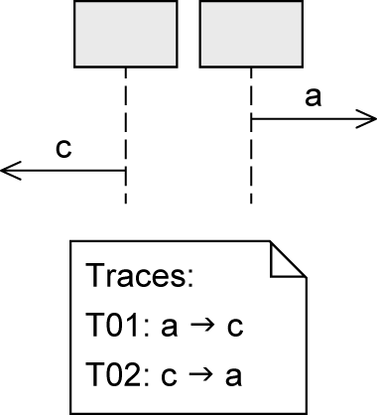
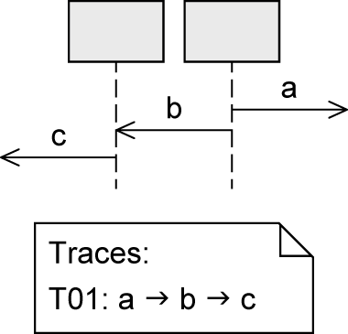
Exchanging Messages (2/2)
Order of messages:
… on one lifeline
… on different lifelines
»Happens before«
… on different lifelines which exchange messages

Slide 10
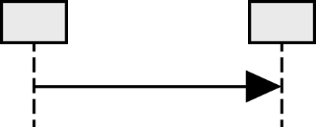
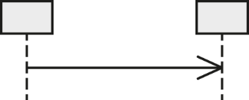

Messages (1/3)
Synchronous message
Sender waits until it has received a response message before continuing
Syntax of message name: msg(par1,par2)
msg: the name of the message
par: parameters separated by commas
Asynchronous message
Sender continues without waiting for a response message
Syntax of message name: msg(par1,par2)
Response message
May be omitted if content and location are obvious
Syntax: att=msg(par1,par2):val
att: the return value can optionally be assigned to a variable
msg: the name of the message
par: parameters separated by commas
val: return value

Slide 11
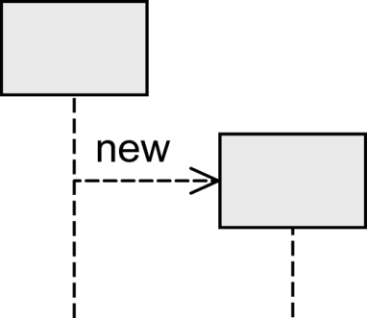
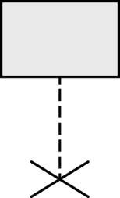
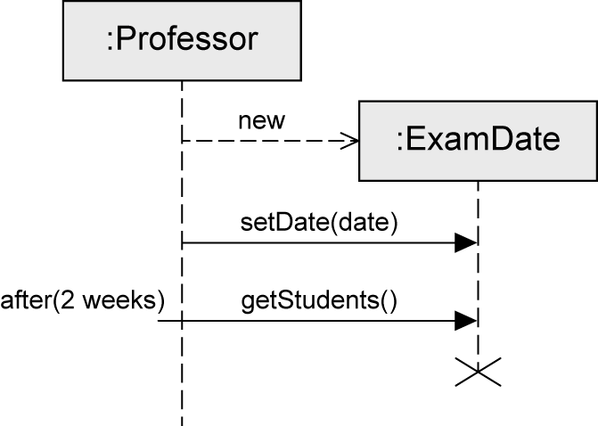
Messages (2/3)
Object creation
Dashed arrow
Arrowhead points to the head of the lifeline of the object to be created
Keyword new
Object destruction
Object is deleted
Large cross (×) at the end of the lifeline

Slide 12
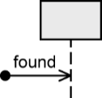
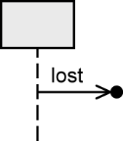
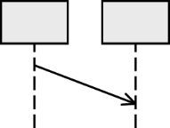
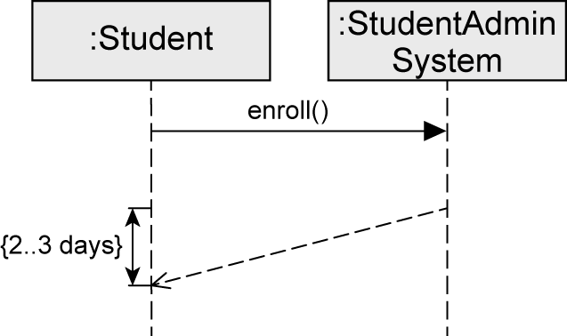
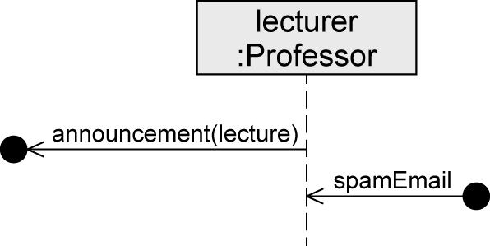
Messages (3/3)
Found message
Sender of a message is unknown or not relevant
Lost message
Receiver of a message is unknown or not relevant
Time-consuming message
"Message with duration"
Usually messages are assumed to be transmitted without any loss of time
Express that time elapses between the sending and the receipt of a message

Slide 13
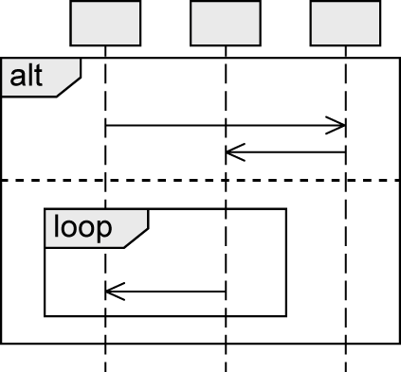
Combined Fragments
Model various control structures
12 predefined types of operators
Combined Fragment
Operator
Operand
Operand
Operand

Slide 14
Types of Combined Fragments
 | Operator | Purpose
 | alt | Alternative interaction
 | opt | Optional interaction
 | loop | Repeated interaction
 | break | Exception interaction
 | seq | Weak order
 | strict | Strict order
 | par | Concurrent interaction
 | critical | Atomic interaction
 | ignore | Irrelevant interaction
 | consider | Relevant interaction
 | assert | Asserted interaction
 | neg | Invalid interaction
Branches and loops
Concurrency and order
Filters and assertions

Slide 15
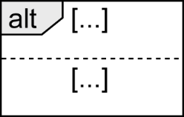
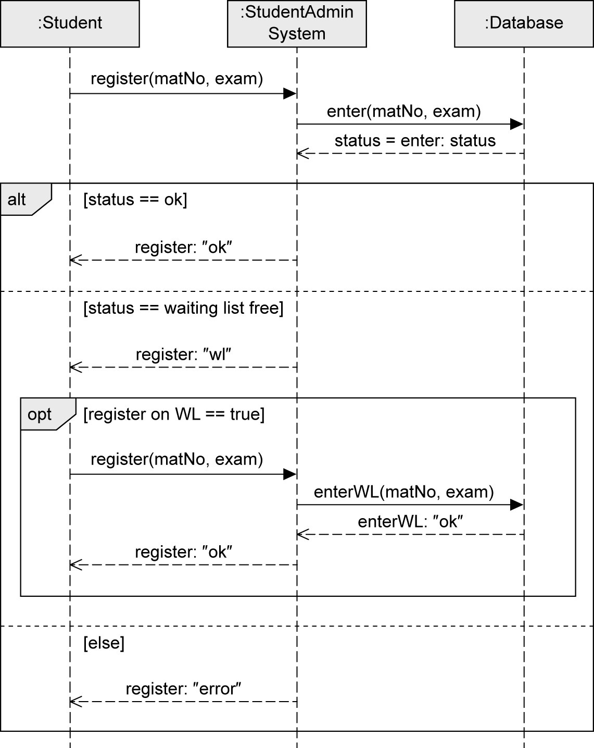
alt Fragment
To model alternative sequences
Similar to switch statement in Java
Guards are used to select the one path to be executed
Guards
Modeled in square brackets
default: true
predefined: [else]
Multiple operands
Guards have to be disjoint to avoid indeterministic behavior

Slide 16
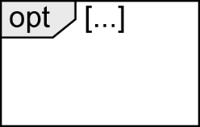
opt Fragment
To model an optional sequence
Actual execution at runtime is dependent on the guard
Exactly one operand
Similar to if statement without else branch
equivalent to alt fragment with two operands, one of which is empty

Slide 17
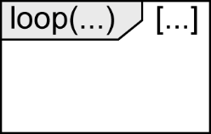
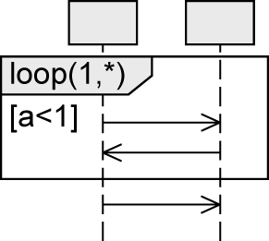
loop Fragment
To express that a sequence is to be executed repeatedly
Exactly one operand
Keyword loop followed by the minimal/maximal number of iterations (min..max) or (min,max)
default: (*) .. no upper limit
Guard
Evaluated as soon as the minimum number of iterations has taken place
Checked for each iteration within the (min,max) limits
If the guard evaluates to false, the execution of the loop is terminated
Max
Min
Guard
Notation alternatives:
loop(3,8) = loop(3..8)
loop(8,8) = loop (8)
loop = loop (*) = loop(0,*)
loop is executed at least once, then as long as a<1 is true

Slide 18
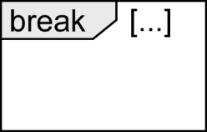
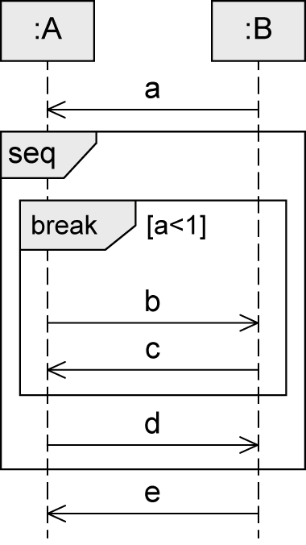
break Fragment
Simple form of exception handling
Exactly one operand with a guard
If the guard is true:
Interactions within this operand are executed
Remaining operations of the surrounding fragment are omitted
Interaction continues in the next higher level fragment
Different behavior than opt fragment
Not executed if break is executed

Slide 19
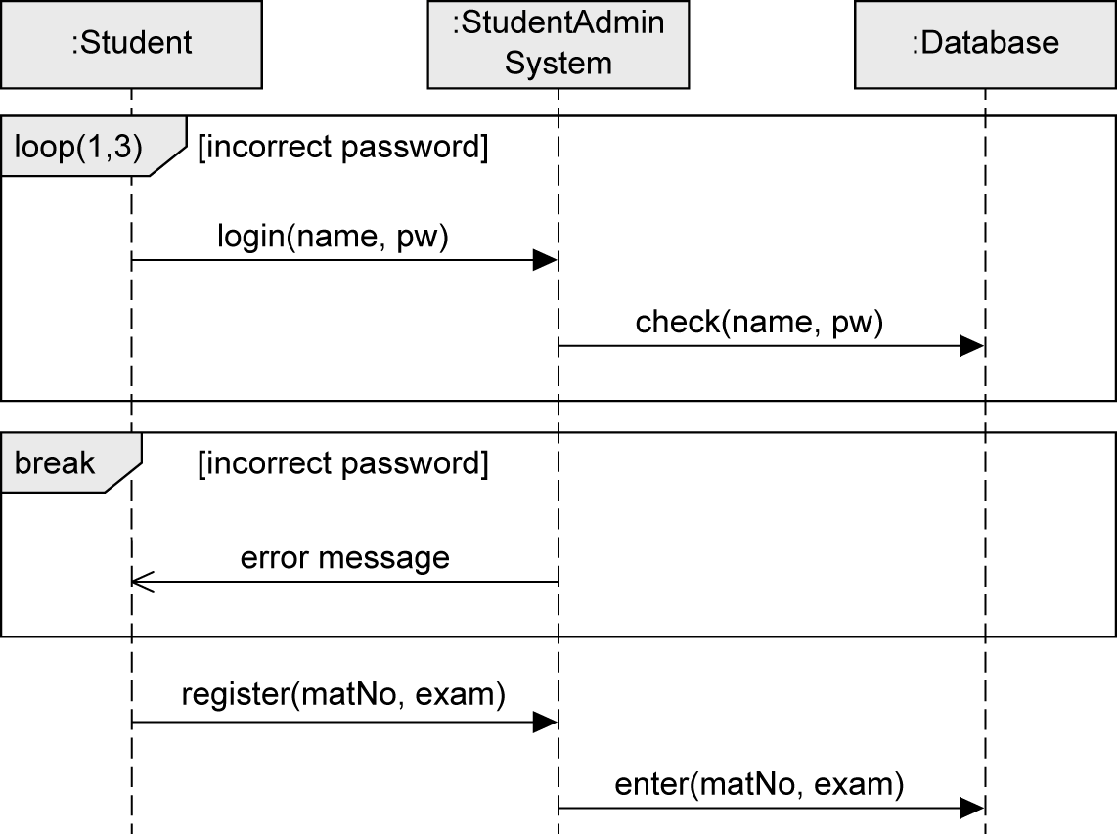
loop and break Fragment - Example

Slide 20
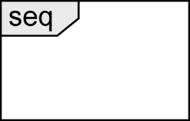
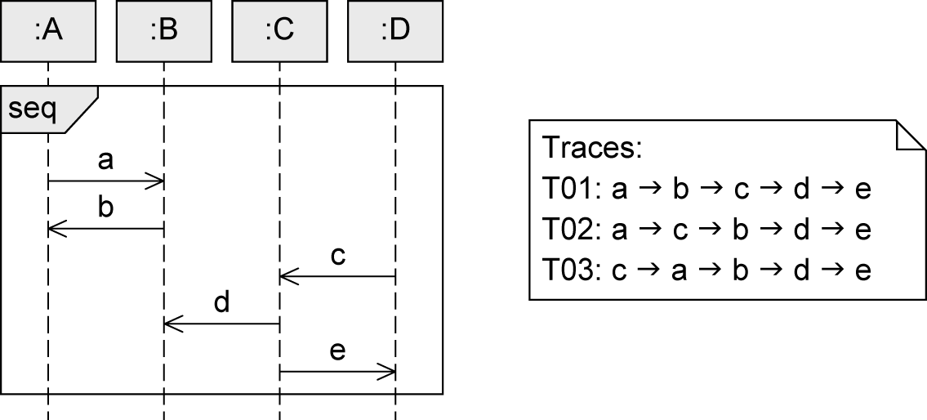
seq Fragment
Default order of events
Weak sequencing:
The ordering of events within each of the operands is maintained in the result.
Events on different lifelines from different operands may come in any order.
Events on the same lifeline from different operands are ordered such that an event of the first operand comes before that of the second operand.

Slide 21
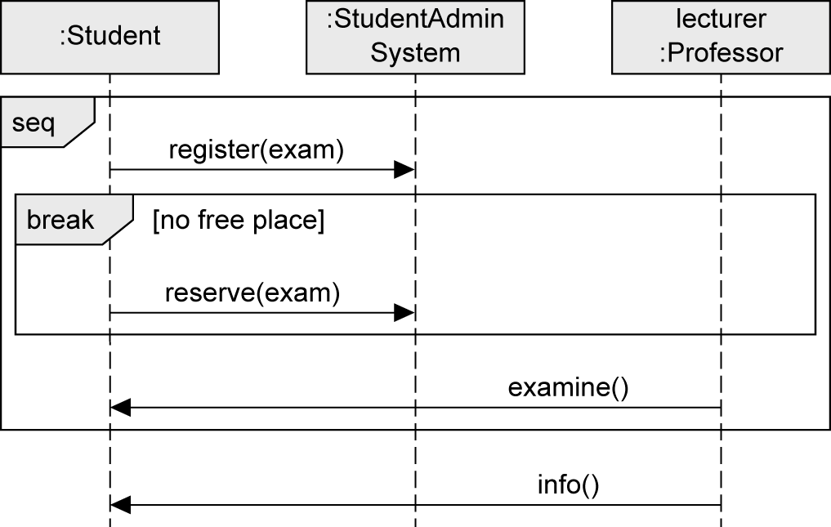
seq Fragment – Example

Slide 22
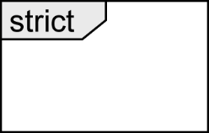
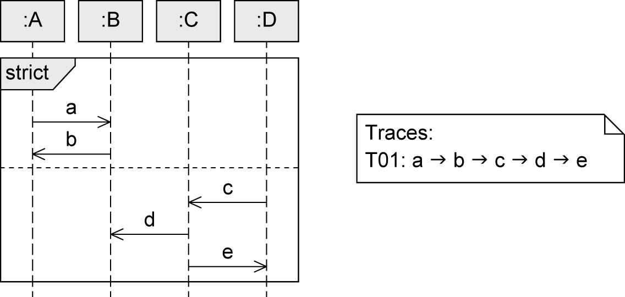
strict Fragment
Sequential interaction with order
Order of event occurrences on different lifelines between different operands is significant
Messages in an operand that is higher up on the vertical axis are always exchanged before the messages in an operand that is lower down on the vertical axis

Slide 23
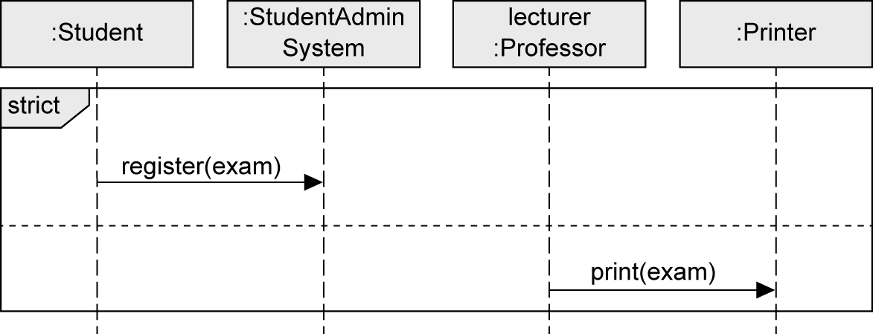
strict Fragment - Example

Slide 24
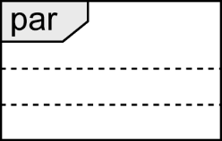
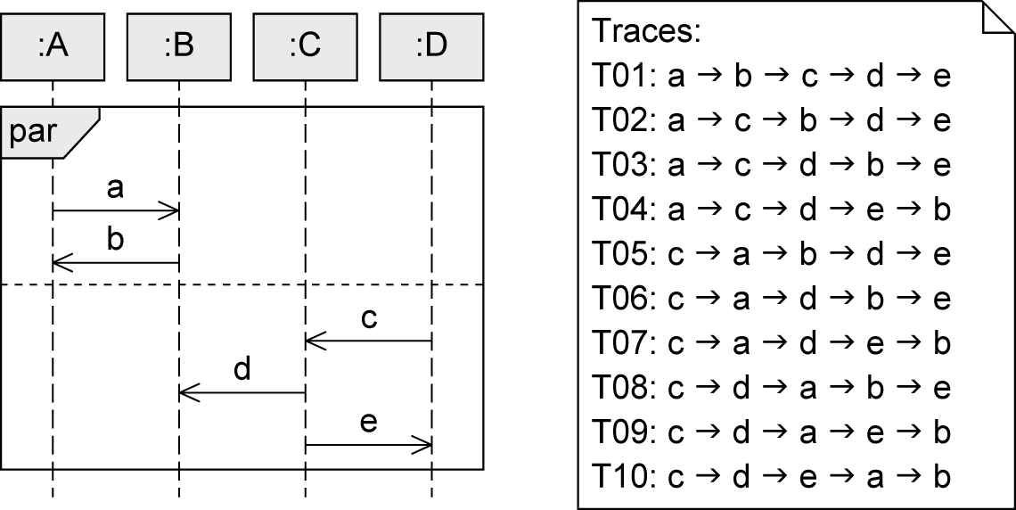
par Fragment
To set aside chronological order between messages in different operands
Execution paths of different operands can be interleaved
Restrictions of each operand need to be respected
Order of the different operands is irrelevant
Concurrency, no true parallelism

Slide 25
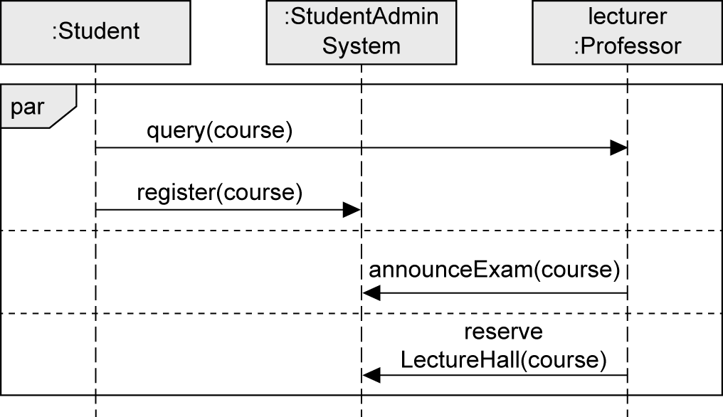
par Fragment - Example

Slide 26
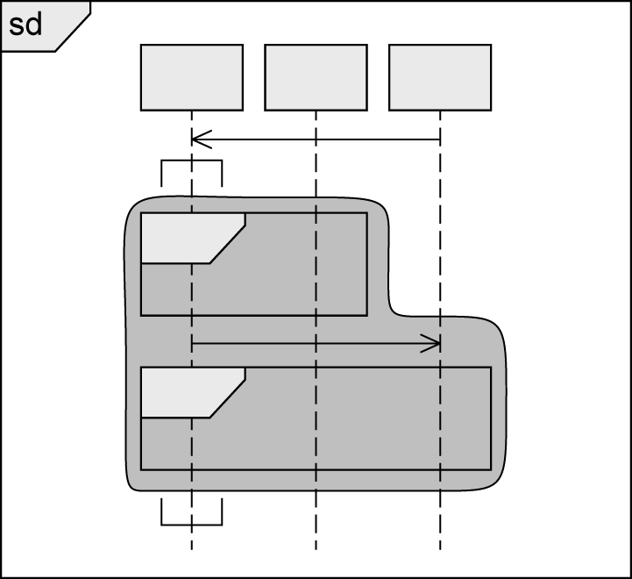
Coregion
To model concurrent events of a single lifeline
Order of event occurrences within a coregion is not restricted
Area of the lifeline to be covered by the coregion is marked by square brackets rotated by 90 degrees
Impact of
coregion
Coregion

Slide 27
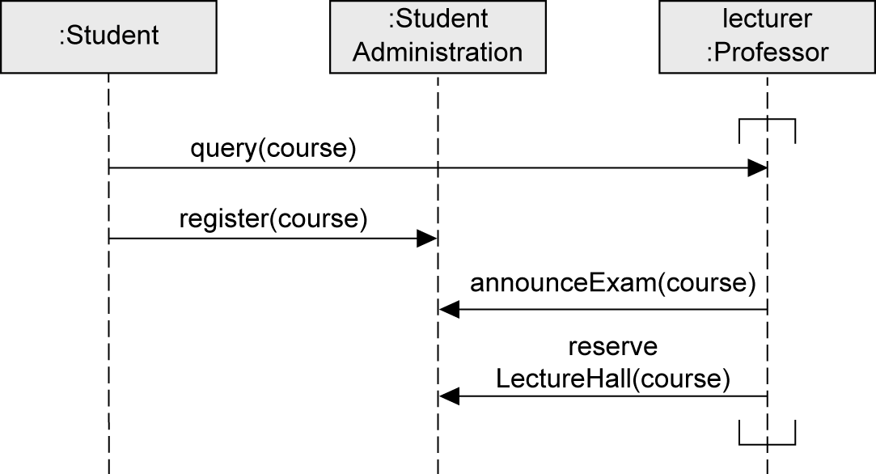
Coregion – Example

Slide 28
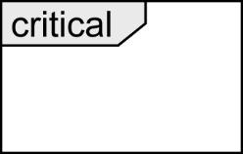
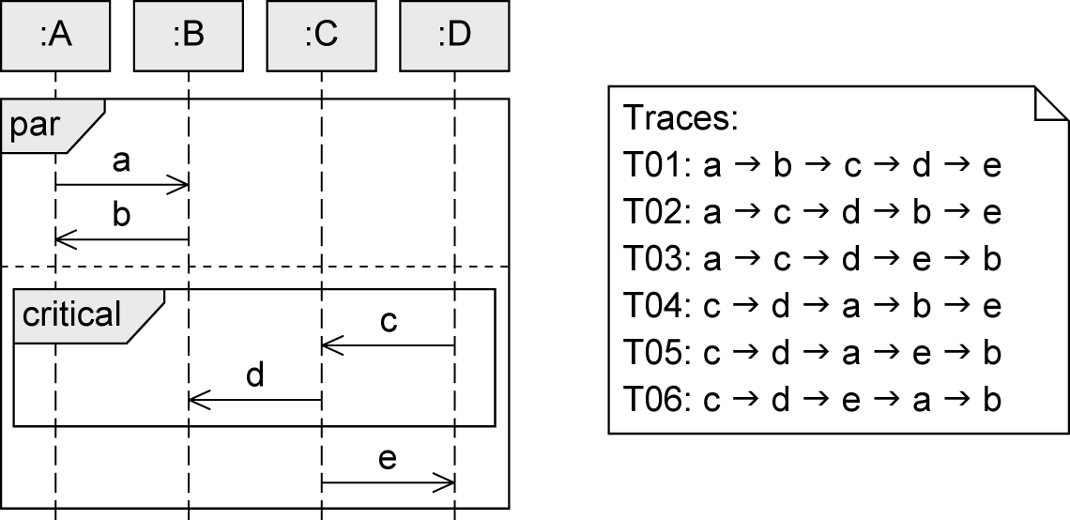
critical Fragment
Atomic area in the interaction (one operand)
To make sure that certain parts of an interaction are not interrupted by unexpected events
Order within critical: default order seq

Slide 29
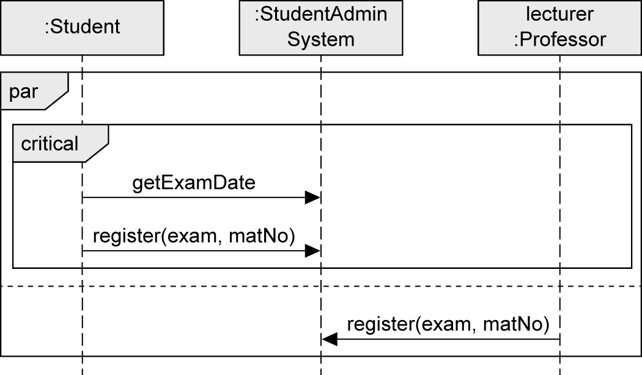
critical Fragment - Example

Slide 30
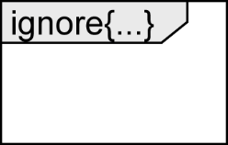
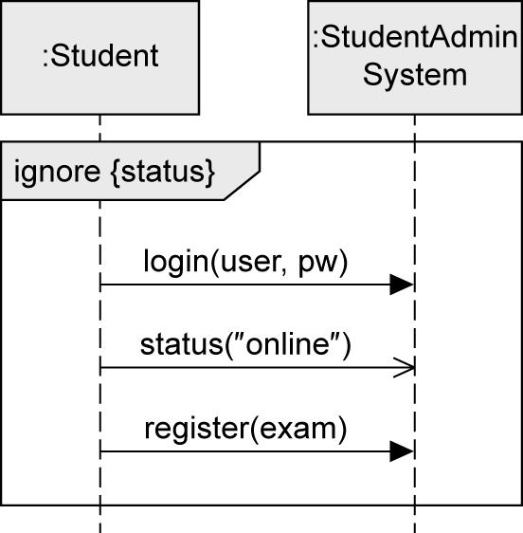
ignore Fragment
To indicate irrelevant messages
Messages may occur at runtime but have no further significance
Exactly one operand
Irrelevant messages in curly brackets after the keyword ignore

Slide 31
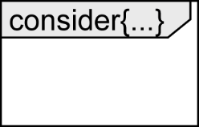
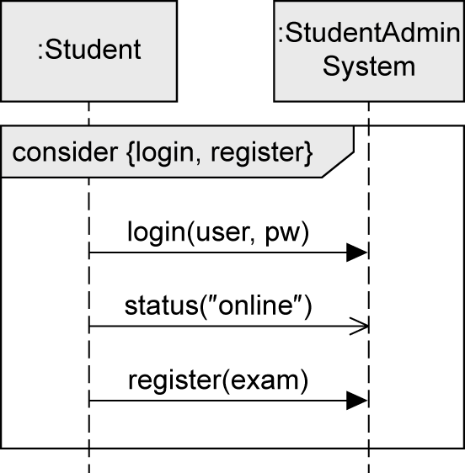
consider Fragment
To specify those messages that are of particular importance for the interaction under consideration
Exactly one operand, dual to ignore fragment
Considered messages in curly brackets after the keyword consider

Slide 32
ignore vs. consider

Slide 33
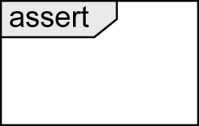
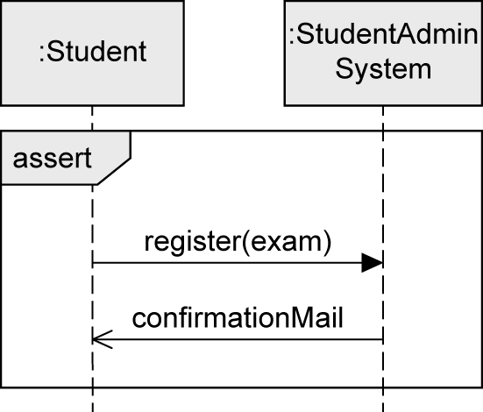
assert Fragment
To identify certain modeled traces as mandatory
Deviations that occur in reality but that are not included in the diagram are not permitted
Exactly one operand

Slide 34
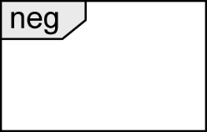
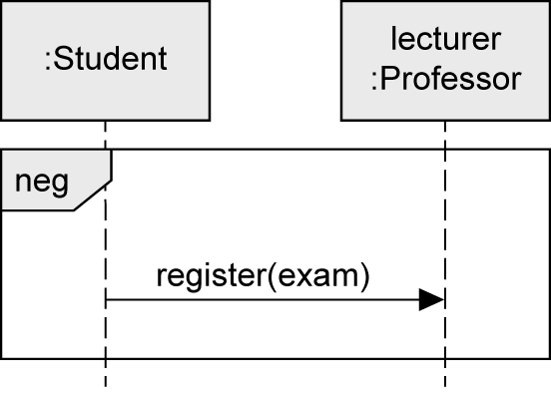
neg Fragment
To model invalid interactions
Describing situations that must not occur
Exactly one operand
Purpose
Explicitly highlighting frequently occurring errors
Depicting relevant, incorrect sequences

Slide 35
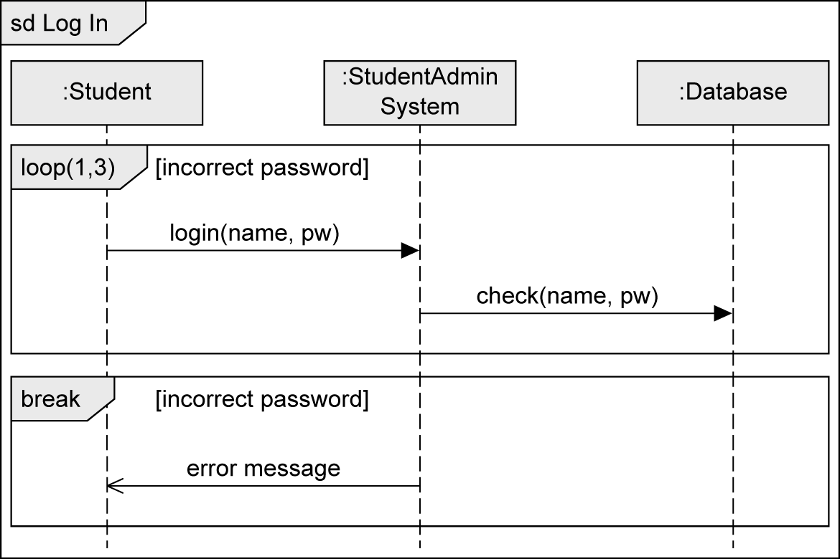
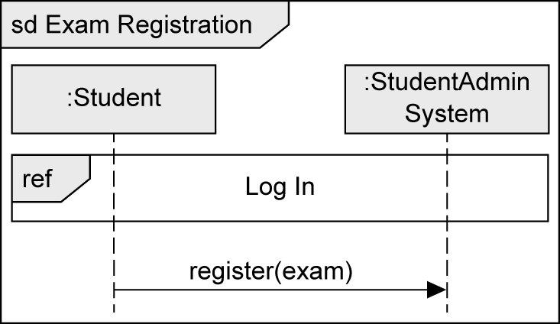
Interaction Reference
Integrates one sequence diagram in another sequence diagram

Slide 36


Gate
Allows you to send and receive messages beyond the boundaries of the interaction fragment

Slide 37


Continuation Marker
Modularizes the operands of an alt fragment
Breaks down complex interactions into parts and connect them to one another with markers
Start marker points to target marker
No return to the start marker (in contrast to an interaction reference)
Target
marker
Start
marker

Slide 38


Local Attributes and Parameters
Every sequence diagram is enclosed by a rectangular frame with a small pentagon in the upper left corner
Keyword sd, name of the sequence diagram, parameters (optional)
Example:
void func (int par1, int par2) {
int x = 0;
String y = "Test";
...
}
Option 1:
Parameter
Option 2:
Local
attributes

Slide 39

Time Constraints
Types
Point in time for event occurrence
Relative: e.g., after(5sec)
Absolute: e.g., at(12.00)
Time period between two events
{lower..upper}
E.g., {12.00..13.00}
Predefined actions
now: current time
Can be assigned to an attribute and then used in a time constraint
Duration: calculation of the duration of a message transmission

Slide 40

State Invariant
Asserts that a certain condition must be fulfilled at a certain time
Always assigned to a specific lifeline
Evaluation before the subsequent event occurs
If the state invariant is not true, either the model or the implementation is incorrect
Three alternative notations:

Slide 41

Four Types of Interaction Diagrams (1/4)
Based on the same concepts
Generally equivalent for simple interactions, but different focus
Sequence diagram
Vertical axis:
chronological order
Horizontal axis:
interaction partners

Slide 42

Four Types of Interaction Diagrams (2/4)
Communication diagram
Models the relationships between communication partners
Focus: Who communicates with whom
Time is not a separate dimension
Message order via decimal classification

Slide 43

Four Types of Interaction Diagrams (3/4)
Timing diagram
Shows state changes of the interaction partners that result from the occurrence of events
Vertical axis: interaction partners
Horizontal axis: chronological order

Slide 44

Four Types of Interaction Diagrams (4/4)
Interaction overview diagram
Visualizes order of different interactions
Allows to place various interaction diagrams in a logical order
Basic notation concepts of activity diagram

Slide 45



Notation Elements (1/2)
Name | Notation | Description
Lifeline |  | Interaction partners involved in the communication
Destruction event |  | Time at which an interaction partner ceases to exist
Combined fragment |  | Control constructs

Slide 46




Notation Elements (2/2)
Name | Notation | Description
Synchronous message |  | Sender waits for a response message
Response message |  | Response to a synchronous message
Asynchronous communication |  | Sender continues its own work after sending the asynchronous message
Lost message |  | Message to an unknown receiver
Found message |  | Message from an unknown sender

