Slide 1
Final Presentation
AUTONOMOUS SYSTEM B
GROUP A
YOUNSUK CHOI
CAIO LUIZ CANDEIAS FLORES
UKAMAKA AKUMILI ANAEDU
PRITISH SANJAY SAMANT

Slide 2
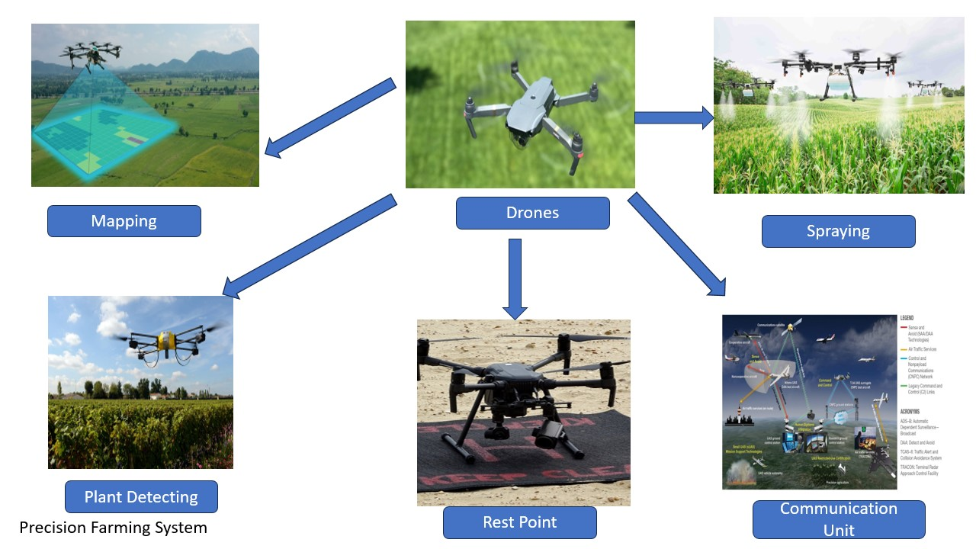
Autonomous Precision Farming System
Ukamaka Anaedu

Slide 3
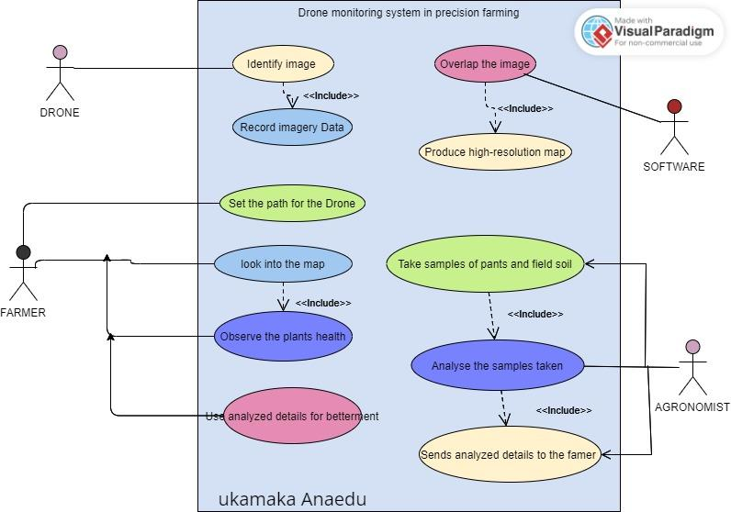
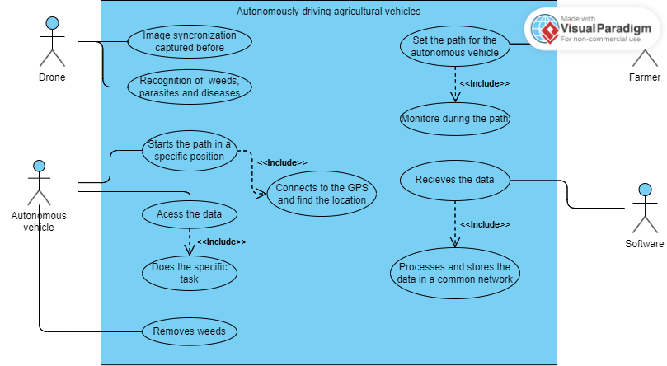
Use Cases
Ukamaka Anaedu

Slide 4
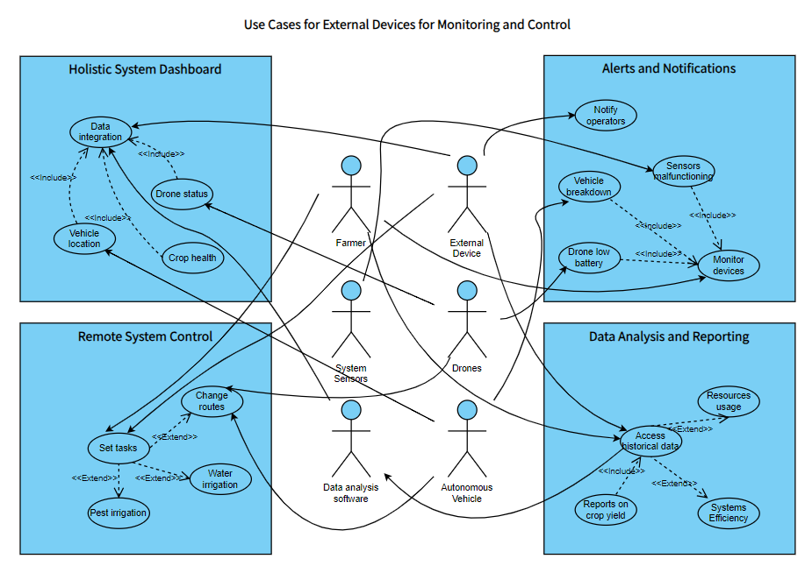
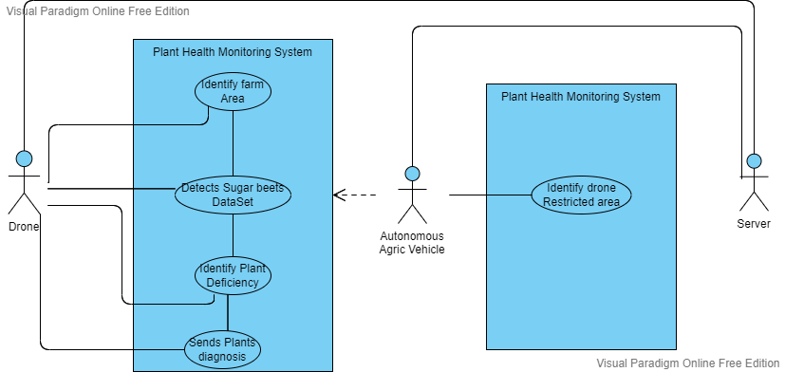
Ukamaka Anaedu

Slide 5
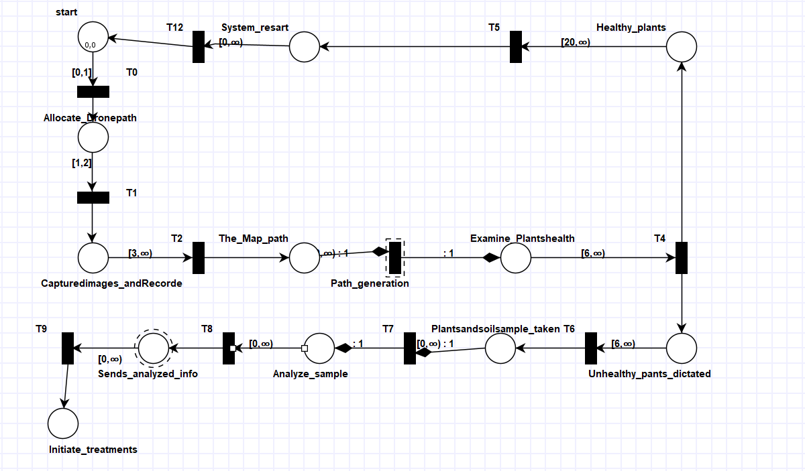
Separate Tapaal Model
Separate Tapaal Model
The Drone path is being introduced by famer, and then the drone start capturing and recording the data of the images which it will share with the server
Ukamaka Akumili Anaedu

Slide 6
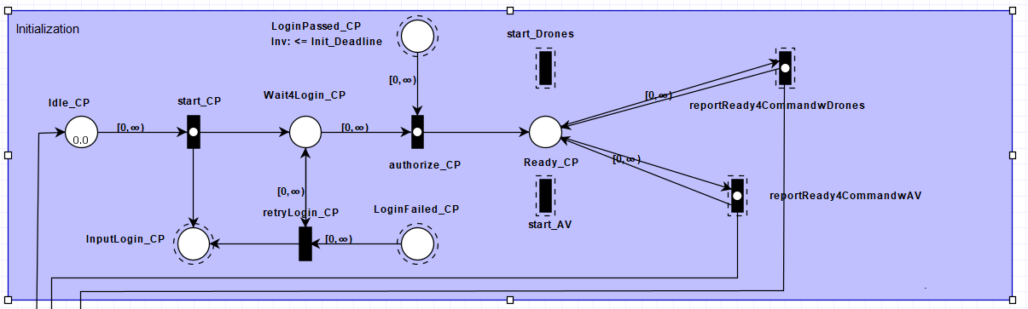
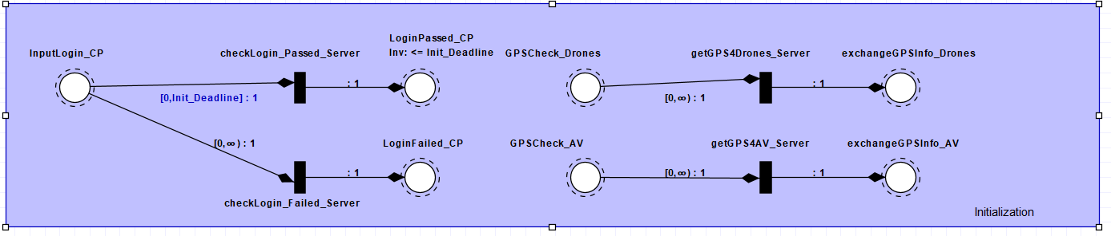
Modeling_Initialization
Farmer_
ControlPanel
Server_
ControlCenter
Younsuk Choi

Slide 7
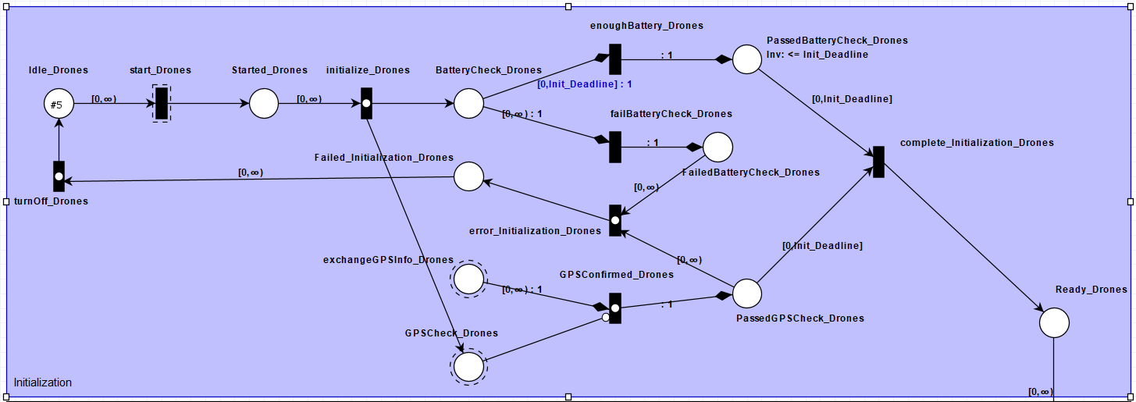
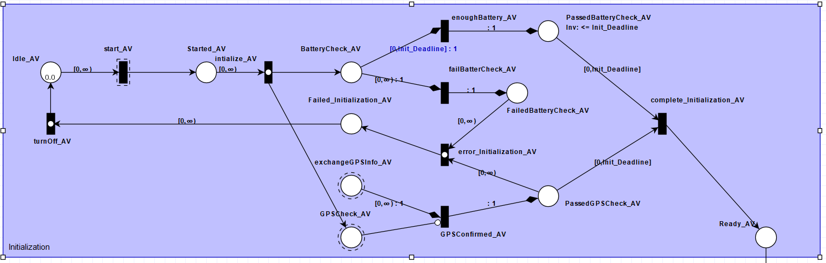
Modeling_Initialization
Drones
Autonomous
Vehicle
Younsuk Choi

Slide 8
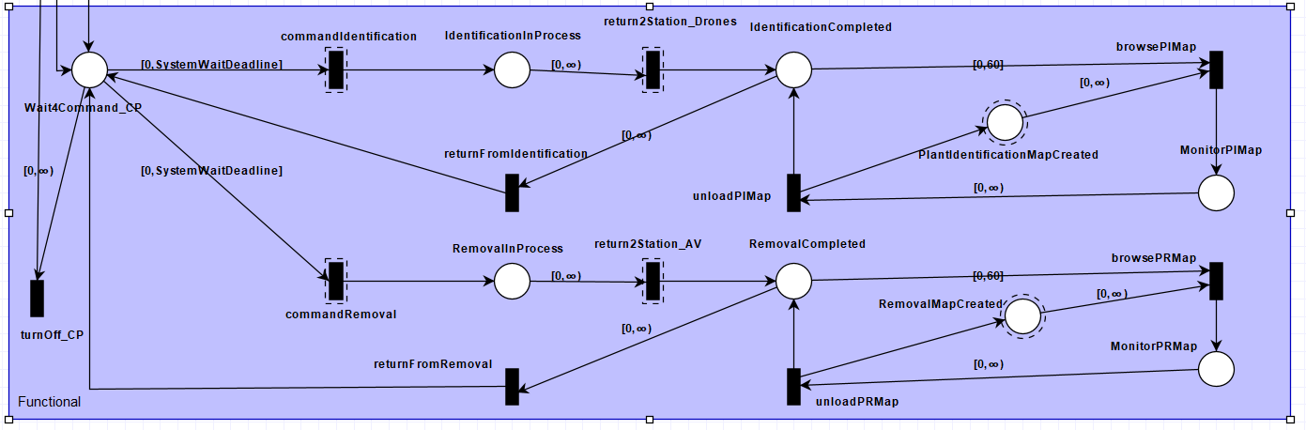
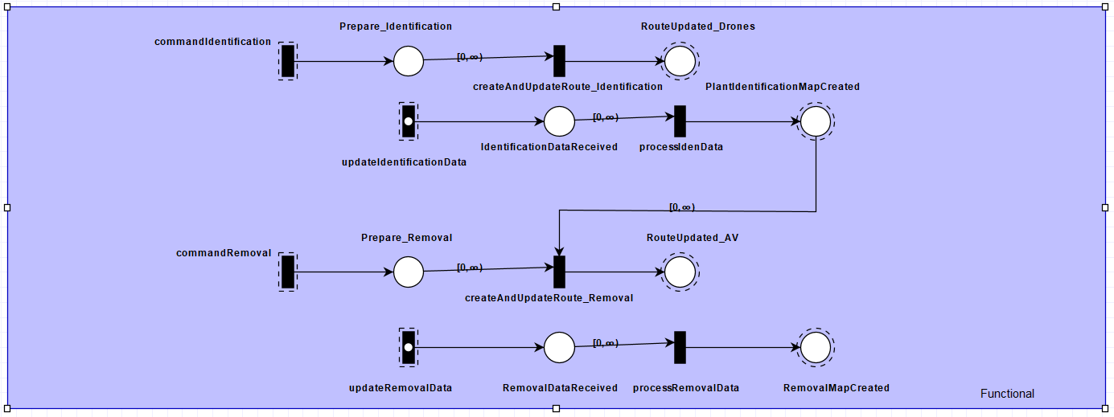
Modeling_Functionals
Farmer_
ControlPanel
Server_
ControlCenter
Younsuk Choi

Slide 9
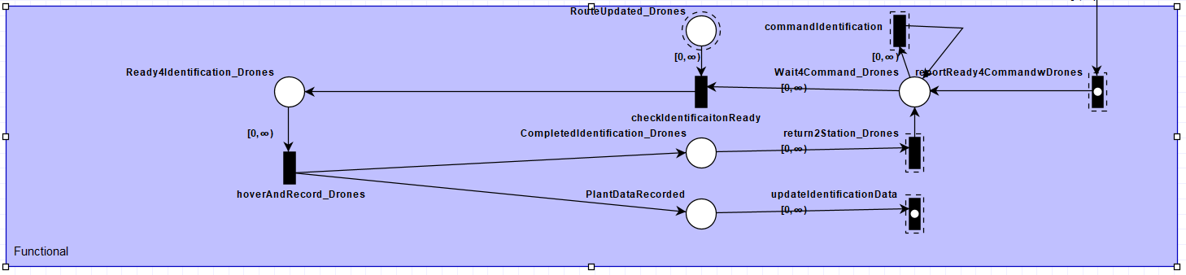
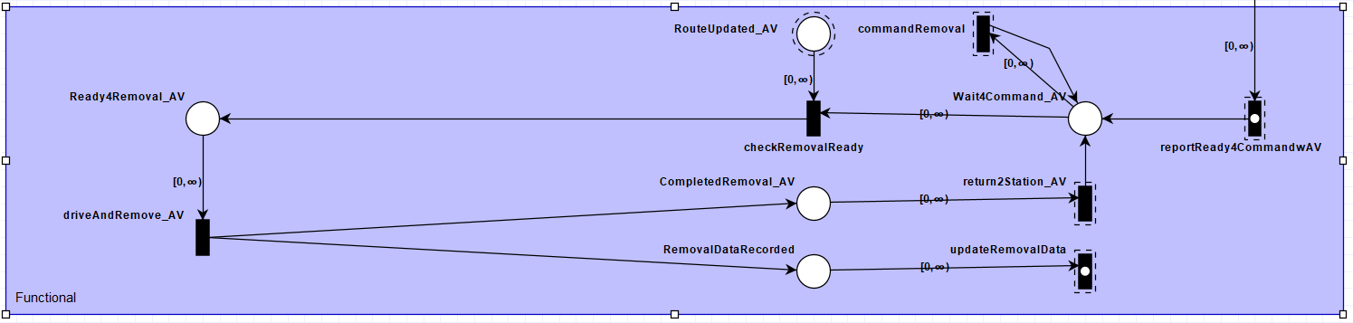
Modeling_Functionals
Drones
Autonomous
Vehicle
Younsuk Choi

Slide 10
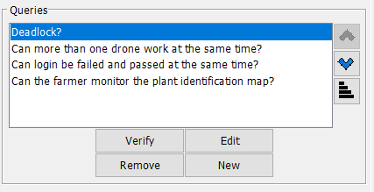
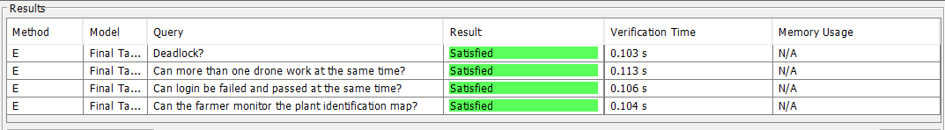
Verification
Deadlock
Reachability
AG !(deadlock)
AG !(Farmer_ControlPanel.MonitorPIMap = 1)
Safety Requirements
Functional Requirements
AG !(LoginFailed_CP = 1 and LoginPassed_CP = 1)
AG !(Farmer_ControlPanel.RemovalInProcess >= 2)
Younsuk Choi

Slide 11
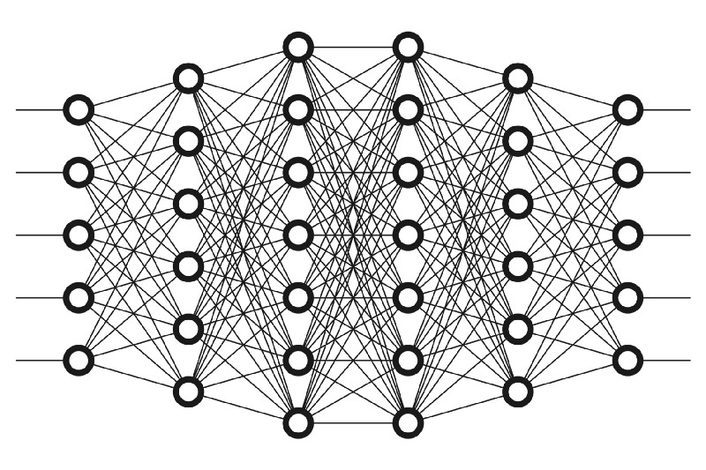
Deep Learning & CNN
Deep learning uses Artificial network to predict or classify different types of data.
It consists of different types of layers; input layer, hidden layers and output layer.
A convolutional neural network (CNN) is a type of artificial neural network used primarily for image recognition and processing, due to its ability to recognize patterns in images.
Types of CNN architectures – Lenet, VGGNet, ResNet, MobileNets, ZFNet, AlexNet, etc.
Pritish Sanjay Samant

Slide 12
Lenet Model
LeNet was developed in 1998 by Yann LeCun, Corinna Cortes, and Christopher Burges.
Lenet – First CNN architecture.
Lenet is an algorithm or architecture based on Convolutional Neural Network.
Three convolutional layers, two pooling layers, one fully connected layer, and one output layer make up the seven layers of the convolutional neural network Lenet.
Pritish Sanjay Samant

Slide 13
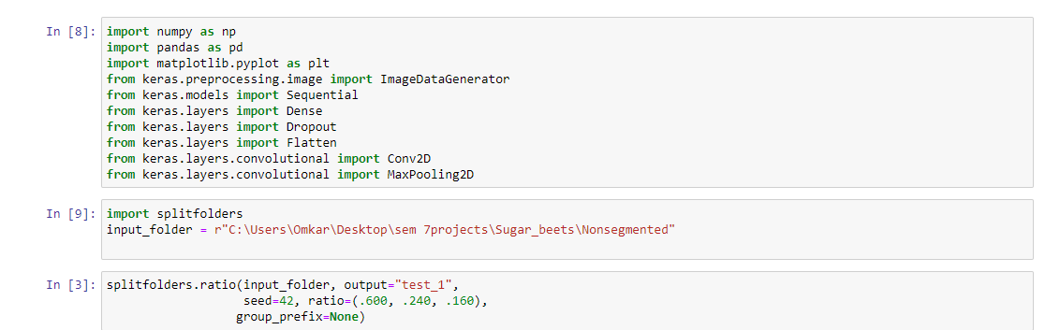
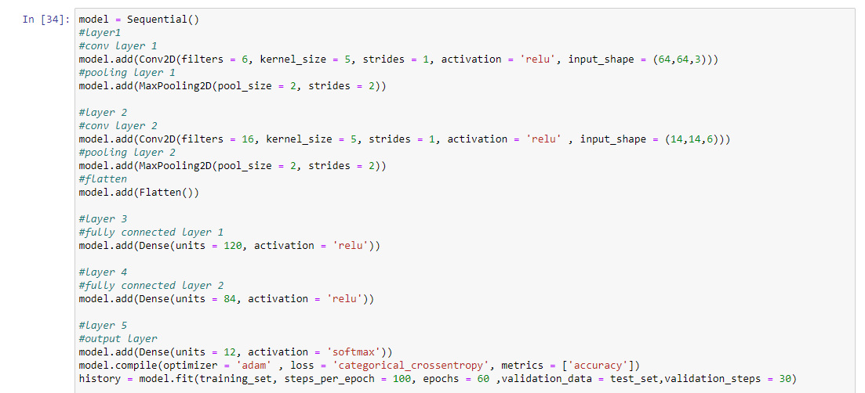
Lenet Model
Pritish Sanjay Samant

Slide 14
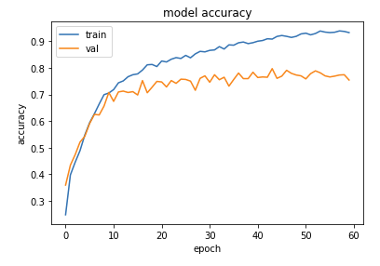
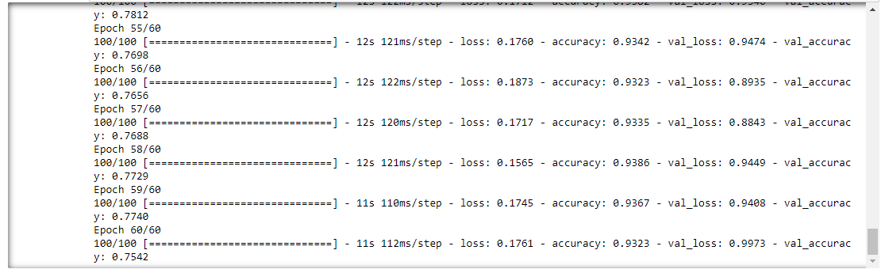
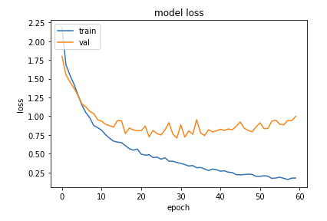
Lenet Model
Pritish Sanjay Samant

Slide 15
FastAI Model
Data preprocessing and type of classification (multi and bin)
Optimizations (such as learning rate, additional layers and freeze/unfreeze)
Evaluation metrics
Interpretation (curves and/or confusion matrix)
Caio Luiz Candeias Flores

Slide 16
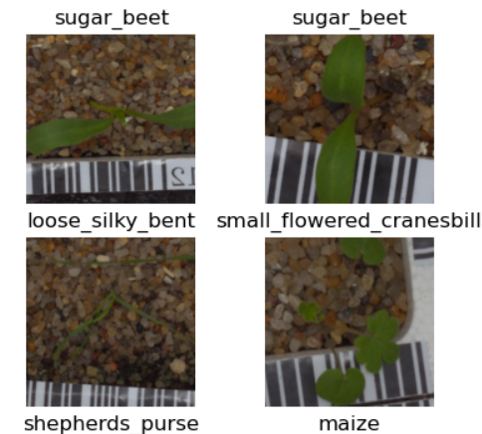
Data preprocessing
Data transformation - random crop and resize of 224 pixels
Normalization and batch size of 64 images
Verify the images before training
Caio Luiz Candeias Flores

Slide 17
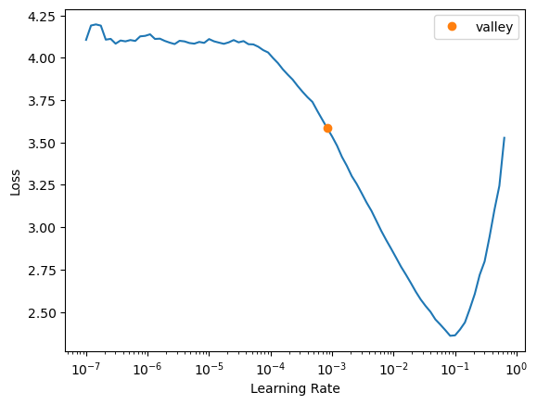
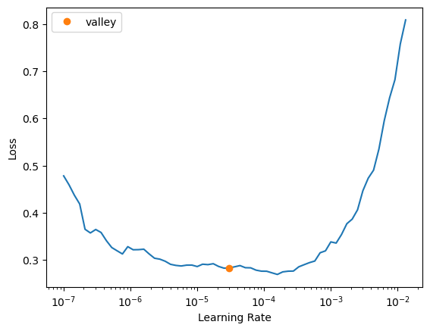
Optimizations Multi Classification - Learning Rate and Freeze/Unfreeze
Caio Luiz Candeias Flores

Slide 18
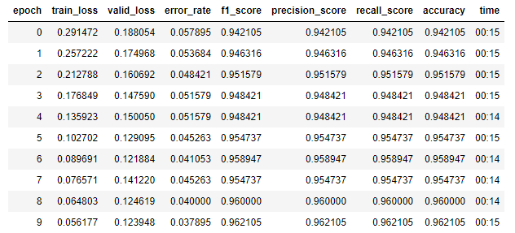
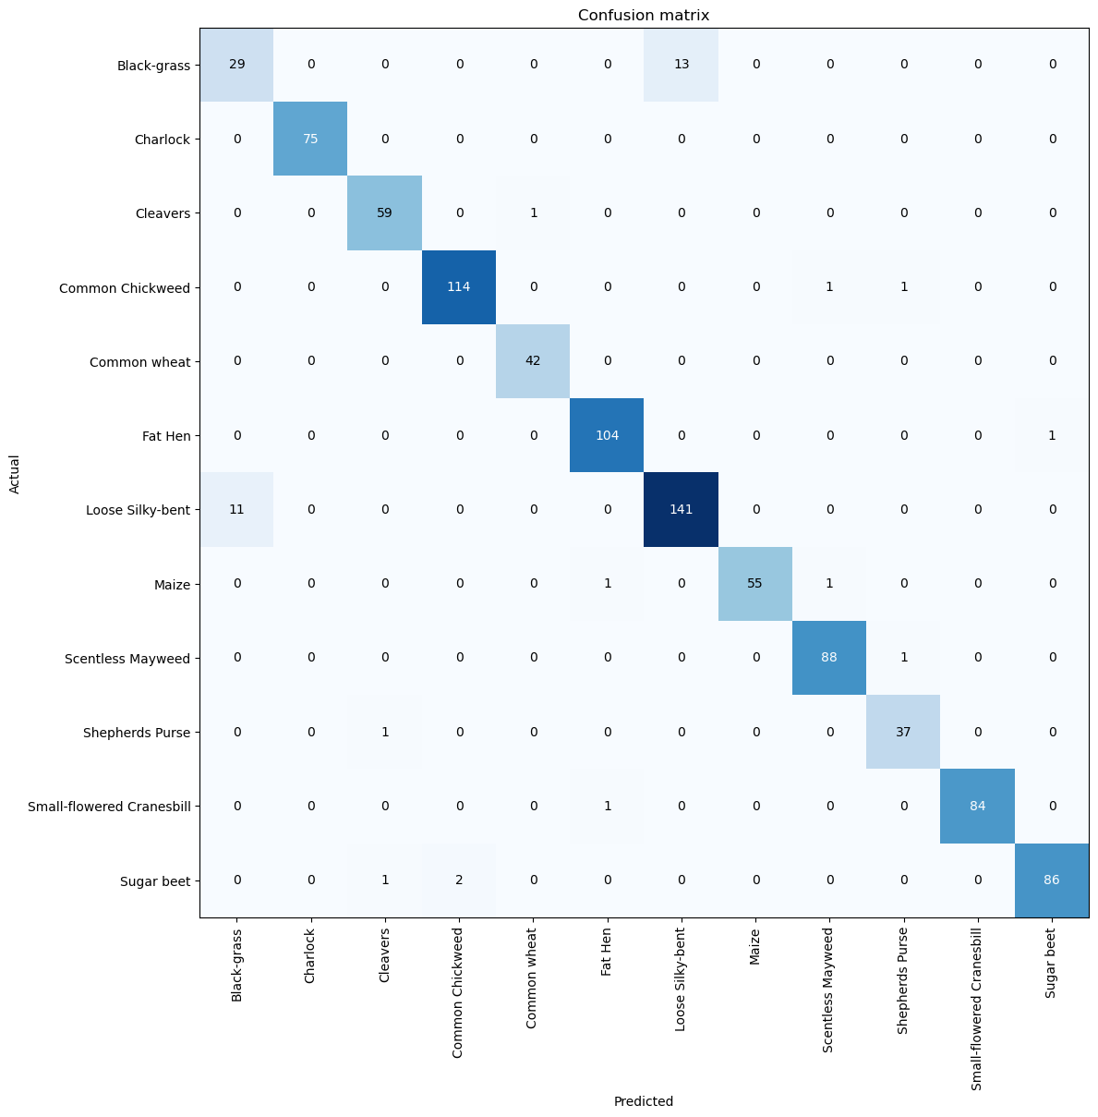
Evaluation Metrics - Multi Classification
Caio Luiz Candeias Flores

Slide 19
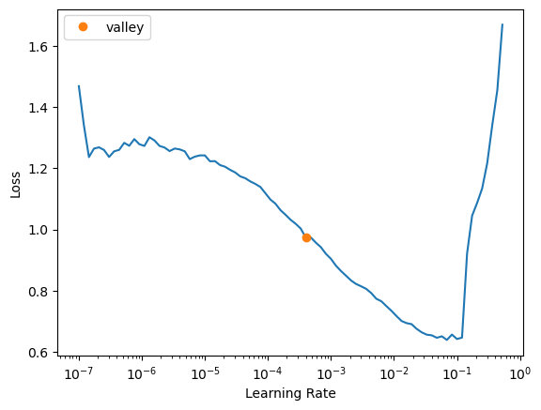
Optimizations Bin Classification - Learning Rate and Freeze/Unfreeze
Caio Luiz Candeias Flores

Slide 20
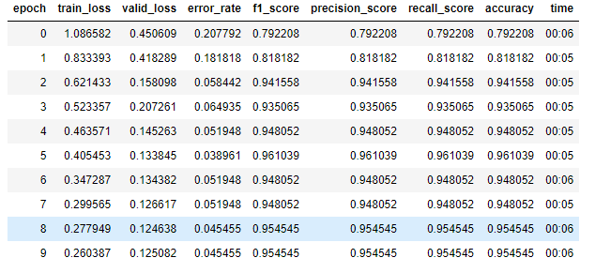
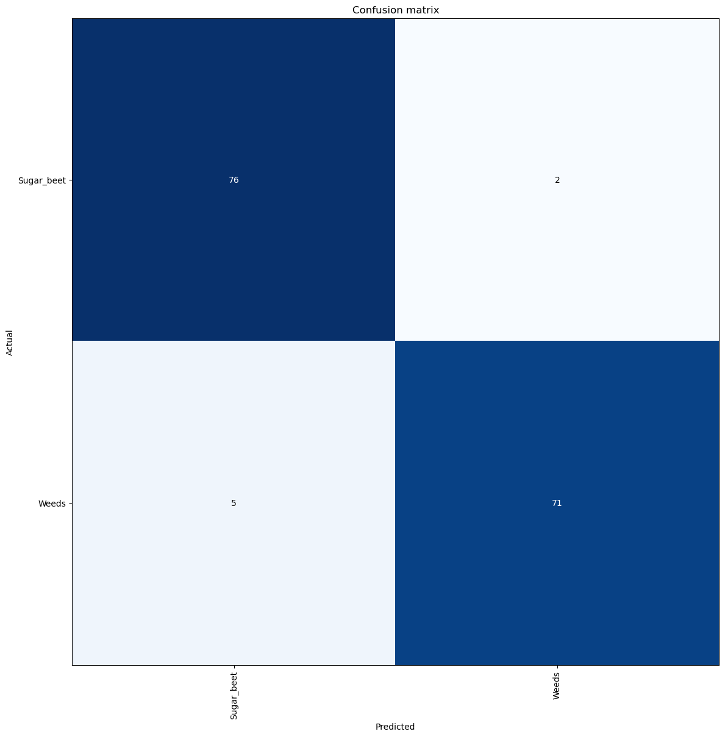
Evaluation Metrics - Bin Classification (Weed vs. Not Weed)
Caio Luiz Candeias Flores

Slide 21
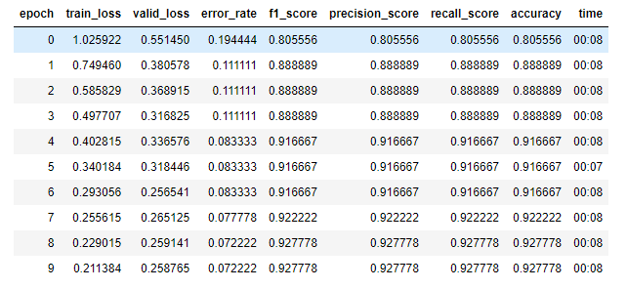

Evaluation Metrics - Bin Classification - Extracted Images With ffmpeg
Caio Luiz Candeias Flores

Slide 22
Competition Preparation
Dataset - images from 000 to 899
75 images from each class (50 rotated in 180º and 25 originals)
Organized randomly + .csv file

Slide 23
Thank you for the time!

