Slide 1
Presentation for Competition
Autonomous System B
Group A
Younsuk Choi
Caio Luiz Candeias Flores
Ukamaka Akumili Anaedu
Pritish Sanjay Samant
Younsuk Choi

Slide 2
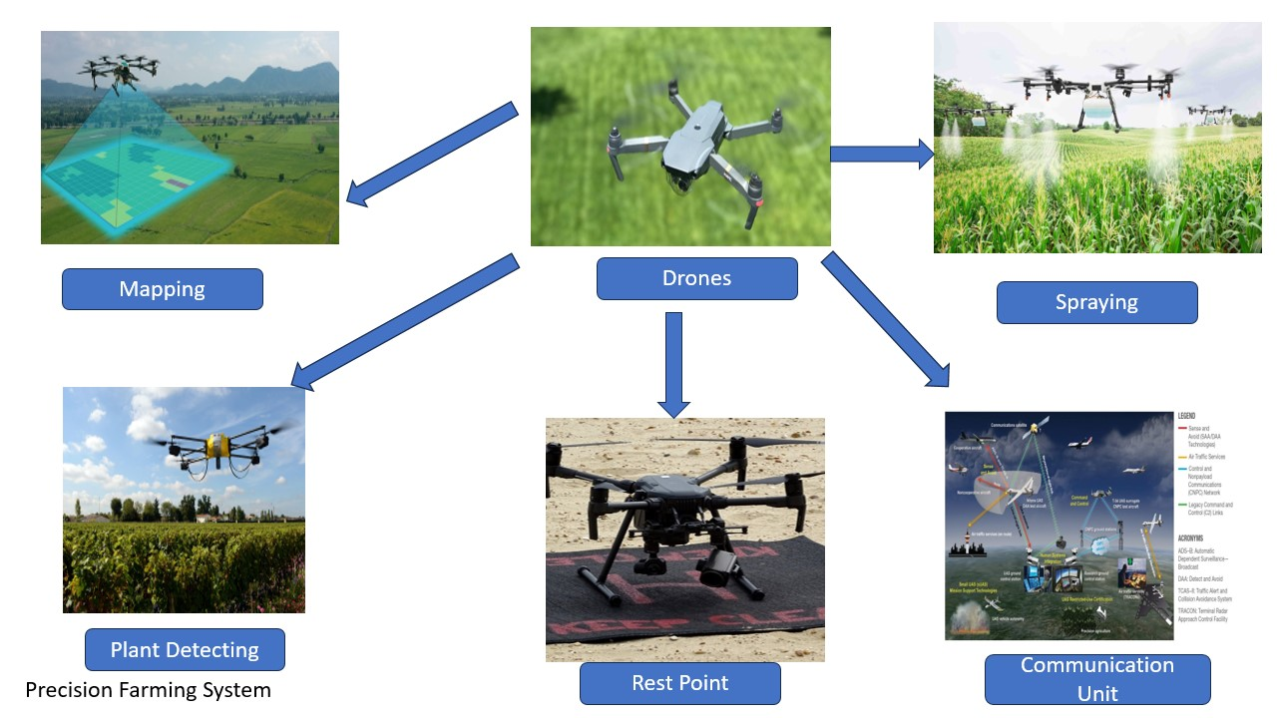
Autonomous Precision Farming System

Slide 3
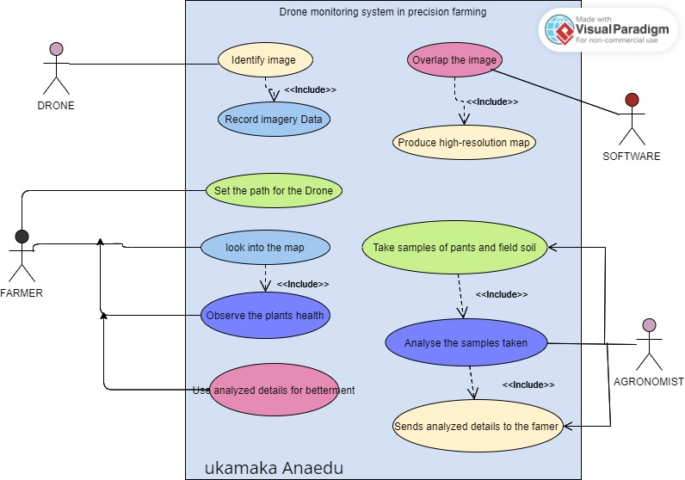
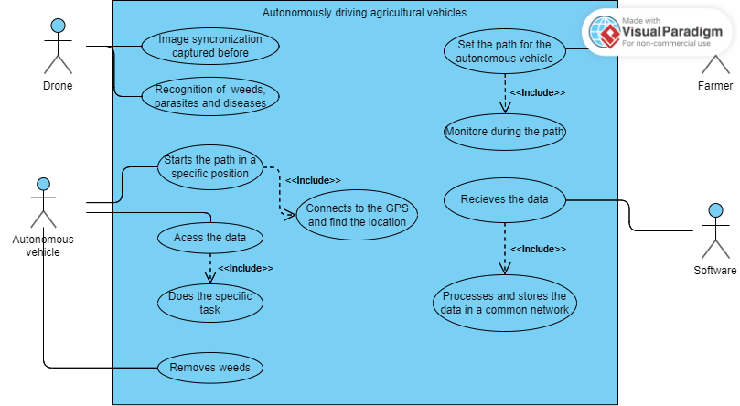
Use Cases

Slide 4
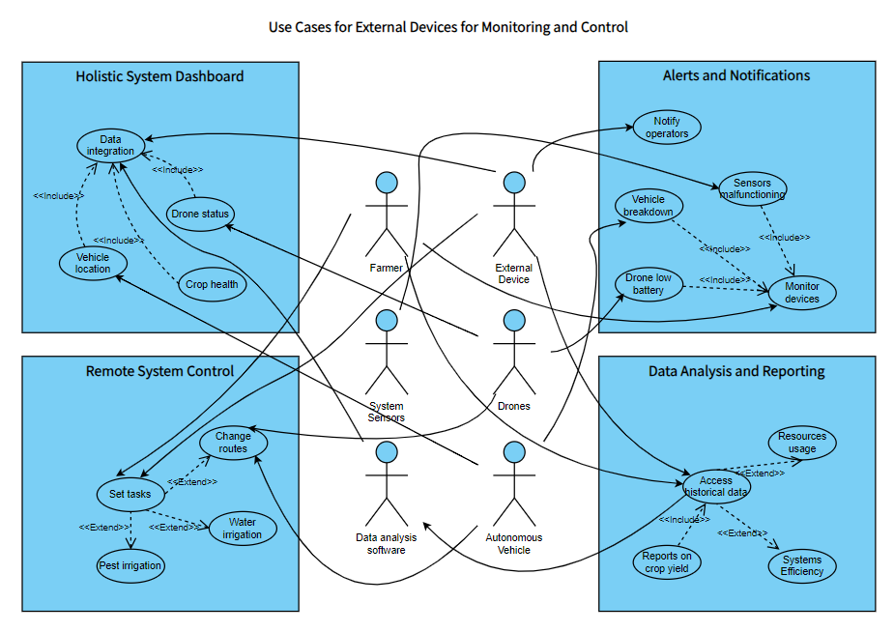
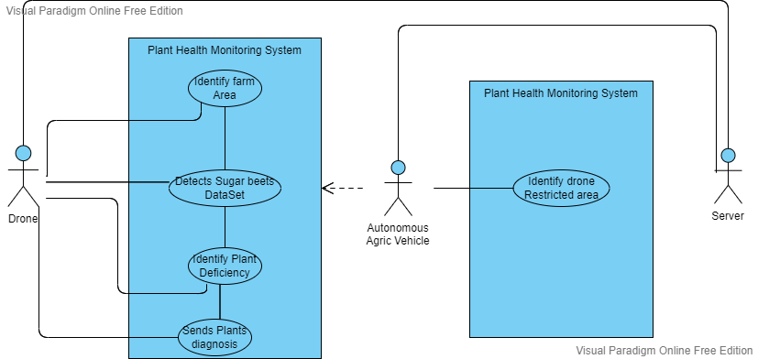

Slide 5
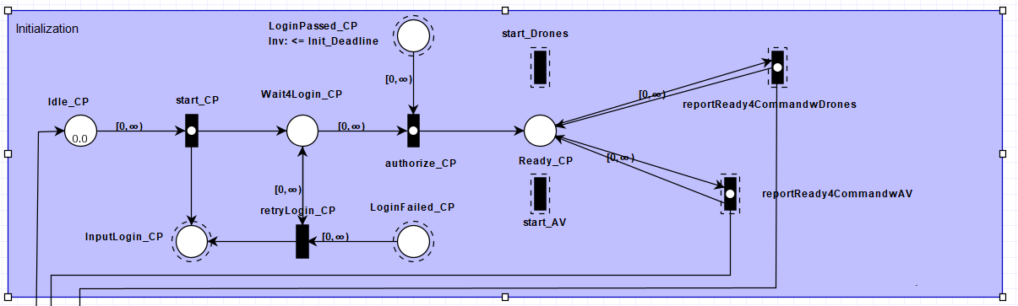
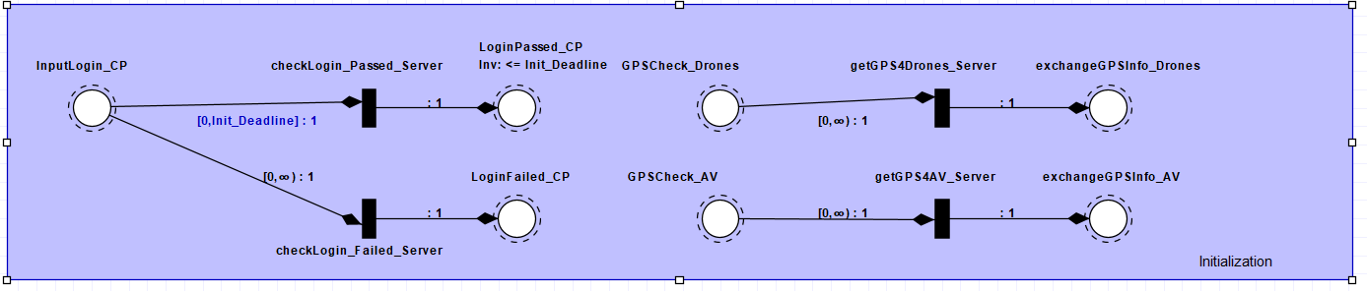
Modeling_Initialization
Farmer_
ControlPanel
Server_
ControlCenter
Younsuk Choi

Slide 6
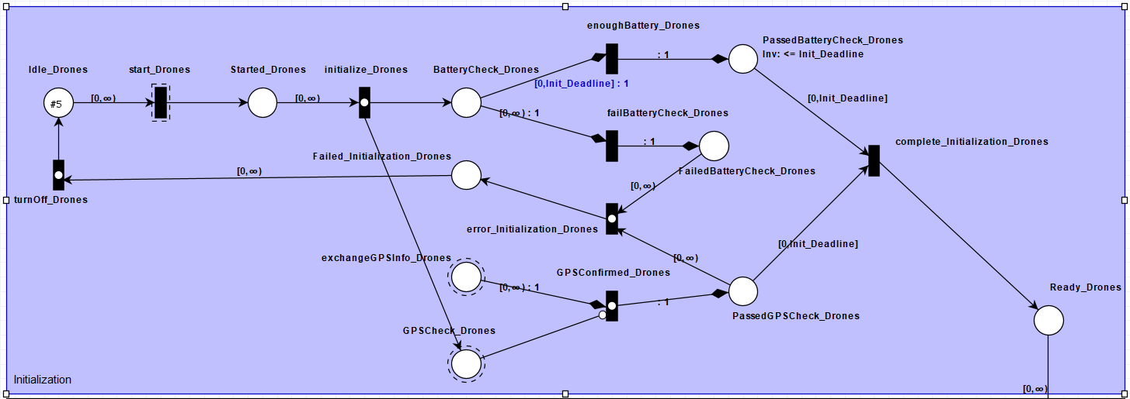
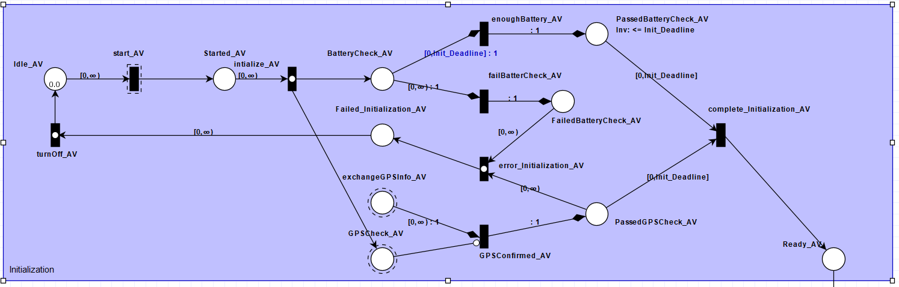
Modeling_Initialization
Drones
Autonomous
Vehicle
Younsuk Choi

Slide 7
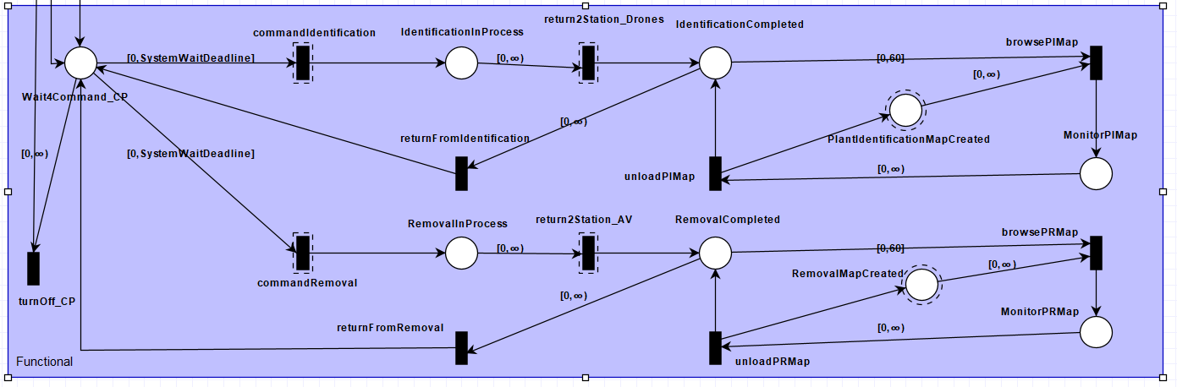
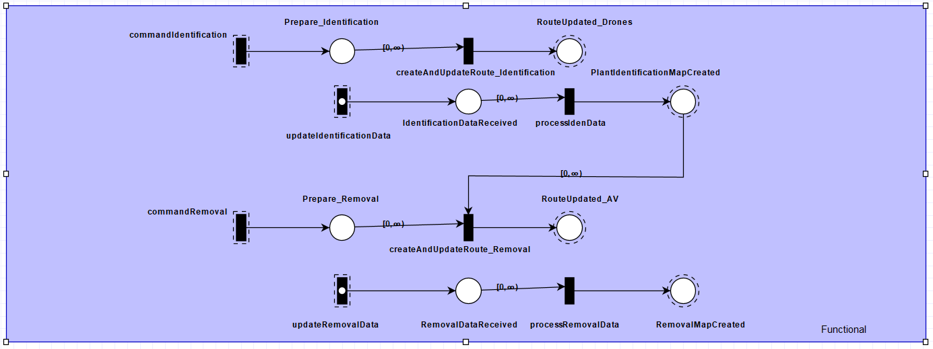
Modeling_Functionals
Farmer_
ControlPanel
Server_
ControlCenter
Younsuk Choi

Slide 8
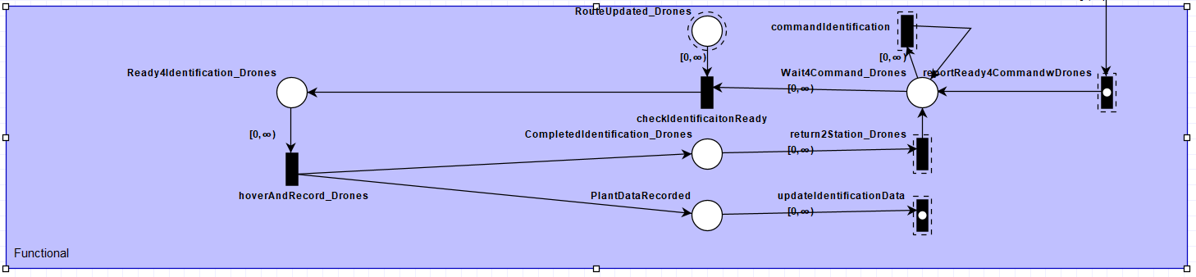
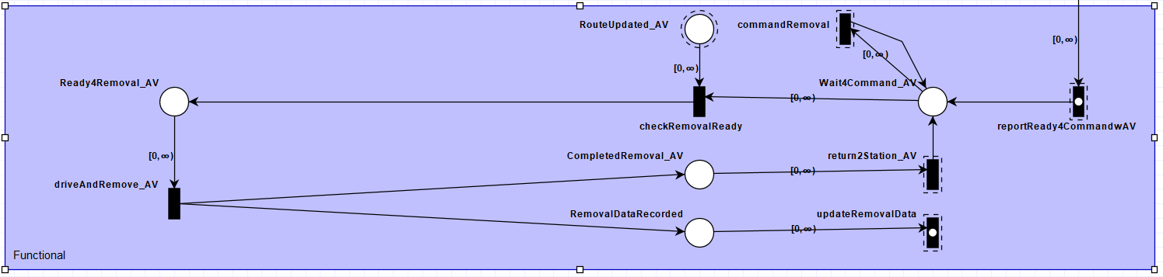
Modeling_Functionals
Drones
Autonomous
Vehicle
Younsuk Choi

Slide 9
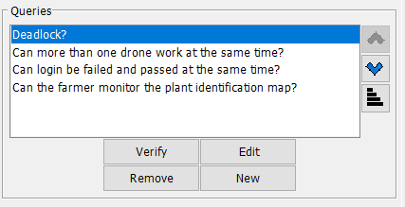
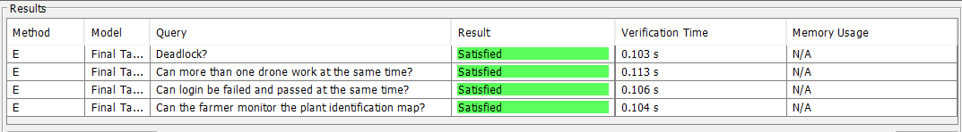
Verification
Deadlock
Reachability
AG !(deadlock)
AG !(Farmer_ControlPanel.MonitorPIMap = 1)
Safety Requirements
Functional Requirements
AG !(LoginFailed_CP = 1 and LoginPassed_CP = 1)
AG !(Farmer_ControlPanel.RemovalInProcess >= 2)
Younsuk Choi

Slide 10
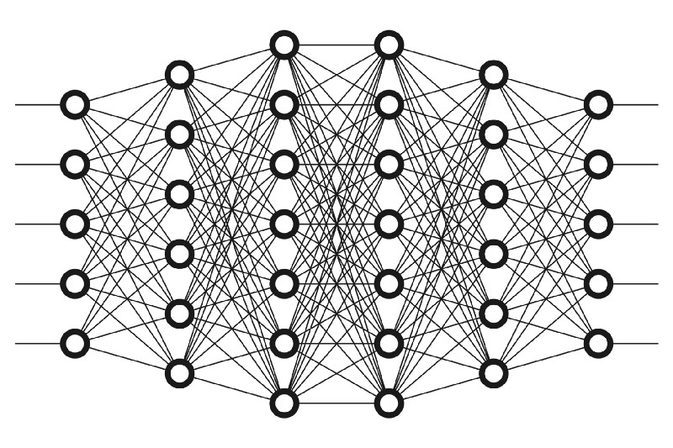
Deep Learning & CNN
Deep learning uses Artificial network to predict or classify different types of data.
It consists of different types of layers; input layer, hidden layers and output layer.
A convolutional neural network (CNN) is a type of artificial neural network used primarily for image recognition and processing, due to its ability to recognize patterns in images.
Types of CNN architectures – Lenet, VGGNet, ResNet, MobileNets, ZFNet, AlexNet, etc.
Pritish Sanjay Samant

Slide 11
Lenet Model
LeNet was developed in 1998 by Yann LeCun, Corinna Cortes, and Christopher Burges.
Lenet – First CNN architecture.
Lenet is an algorithm or architecture based on Convolutional Neural Network.
Three convolutional layers, two pooling layers, one fully connected layer, and one output layer make up the seven layers of the convolutional neural network Lenet.
Pritish Sanjay Samant

Slide 12
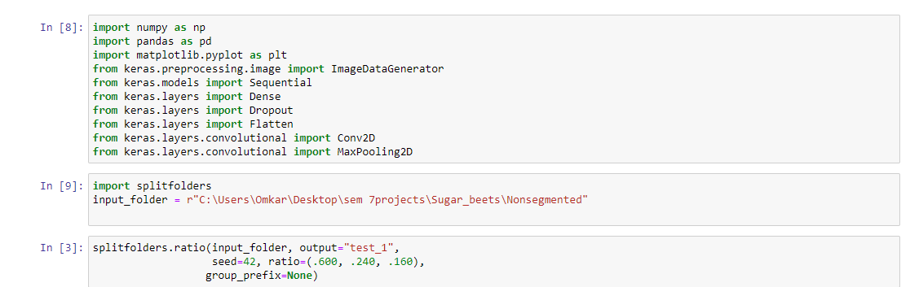
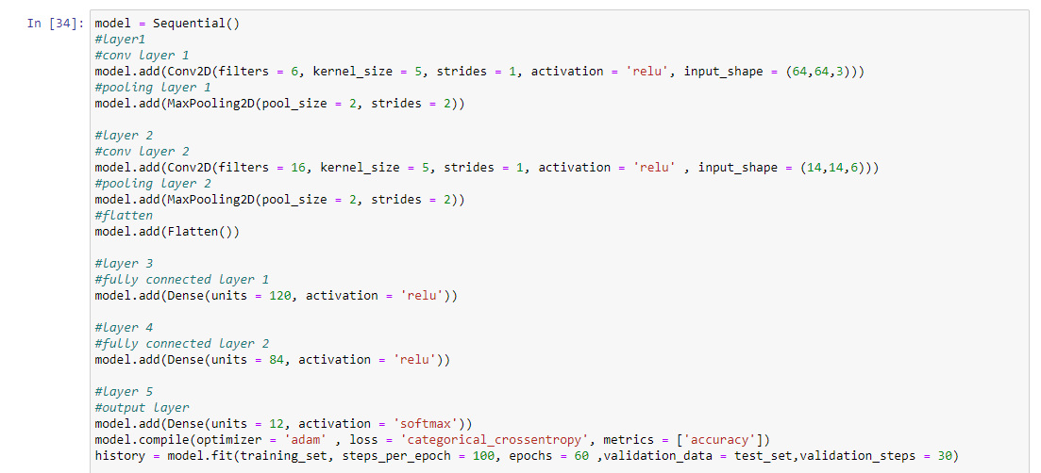
Lenet Model
Pritish Sanjay Samant

Slide 13
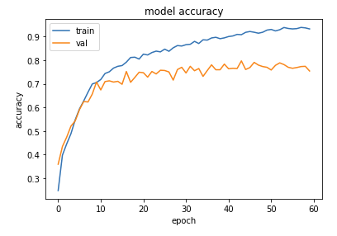
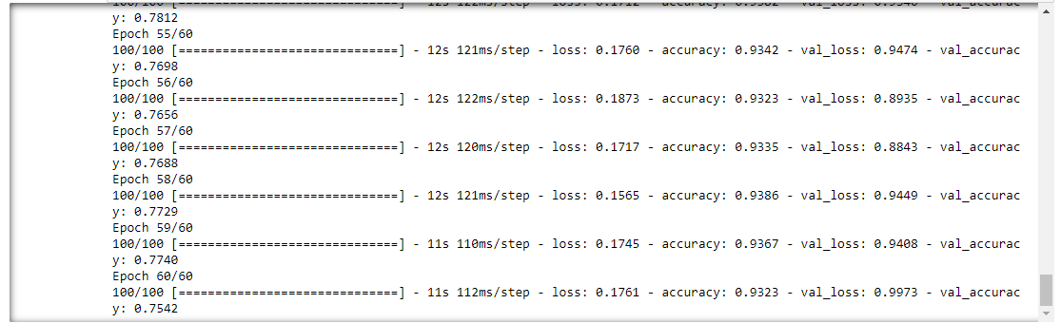
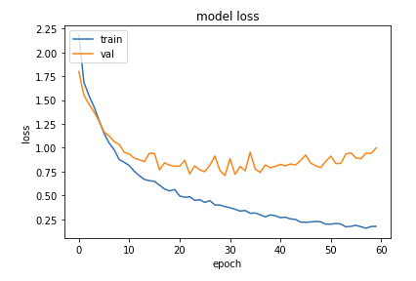
Lenet Model
Pritish Sanjay Samant

Slide 14
Topics to talk about for each model
Algorithms used for each model (ResNet50, FastAi, Lenet)
Dataset and type of classification
Optimizations (such as learning rate or additional layers)
Evaluation metrics
Interpretation (curves and/or confusion matrix)
Younsuk Choi

Slide 15
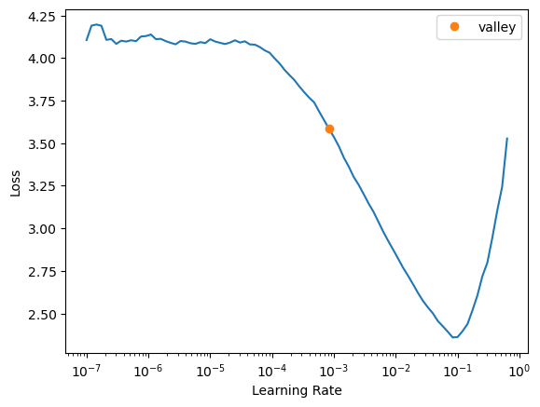
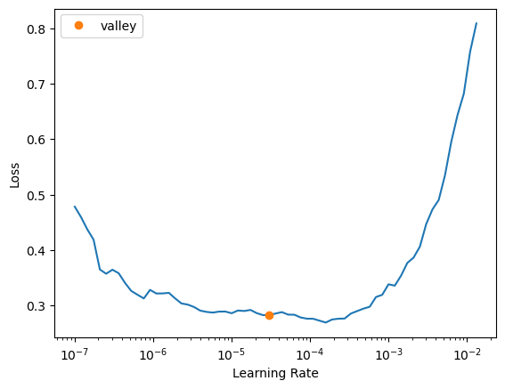
FastAi Model and variants - learning rate and freeze/unfreeze
Caio Luiz Candeias Flores

Slide 16
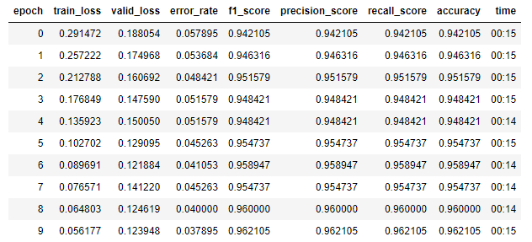
FastAi Model and variants - multiclassification
Caio Luiz Candeias Flores

Slide 17
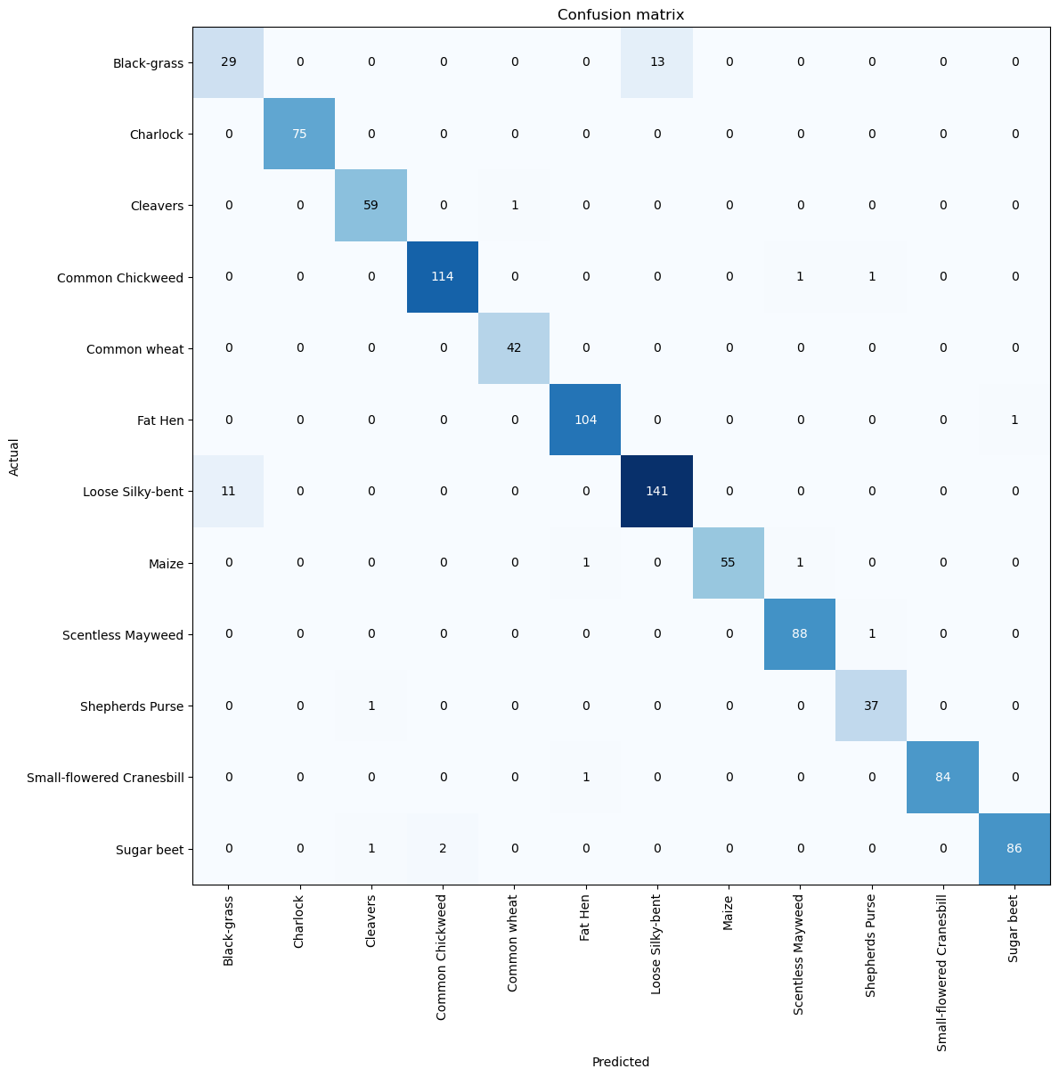
FastAi Model and variants - multiclassification
Caio Luiz Candeias Flores

Slide 18
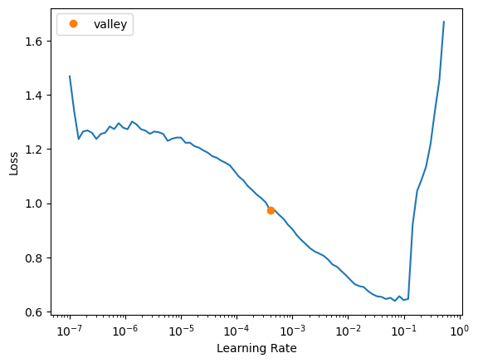
FastAi Model and variants - Binary classification with extracted images from the video
Caio Luiz Candeias Flores

Slide 19
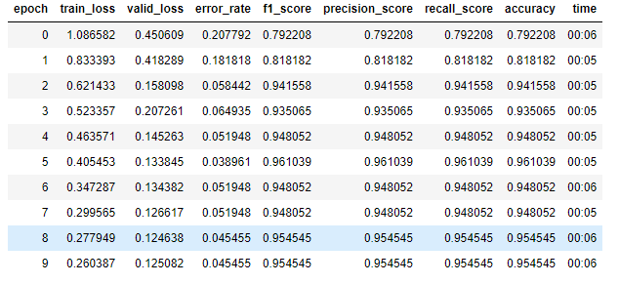
FastAi Model and variants - Binary classification (Weed vs Not Weed)
Caio Luiz Candeias Flores

Slide 20
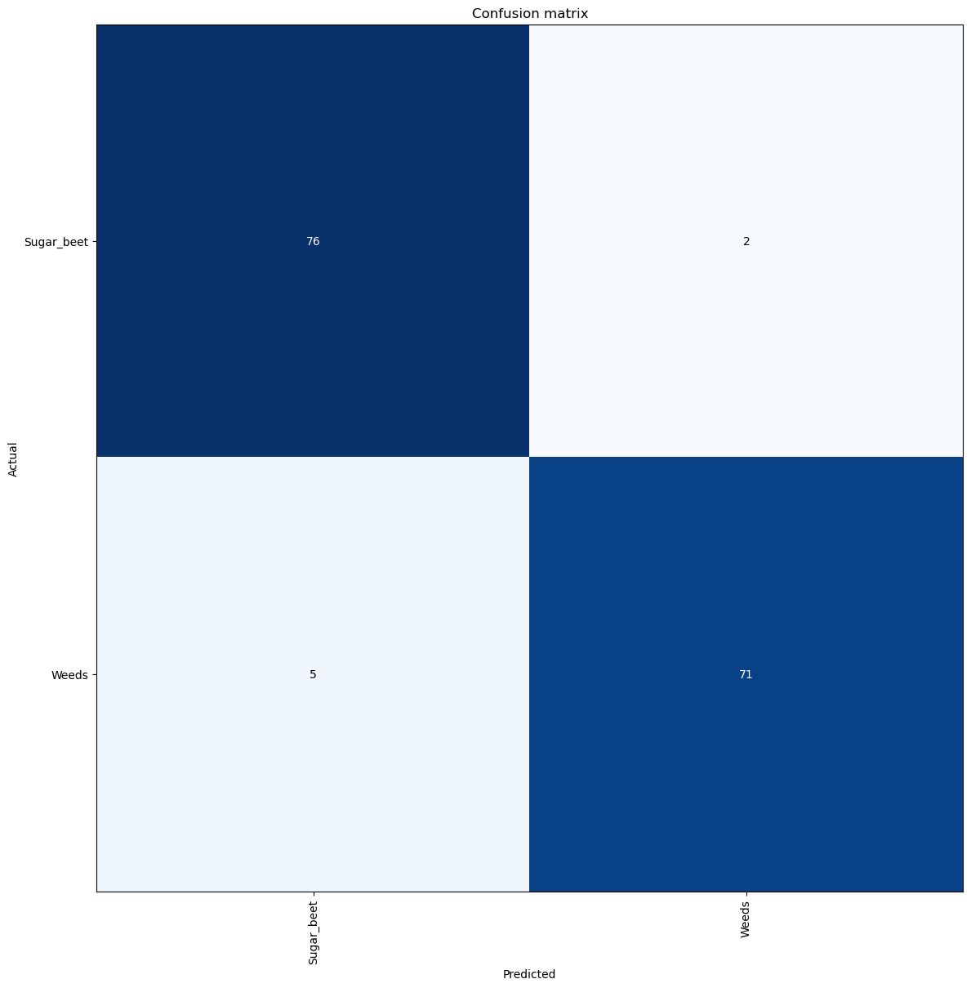
FastAi Model and variants - Binary classification (Weed vs Not Weed)
Caio Luiz Candeias Flores

Slide 21
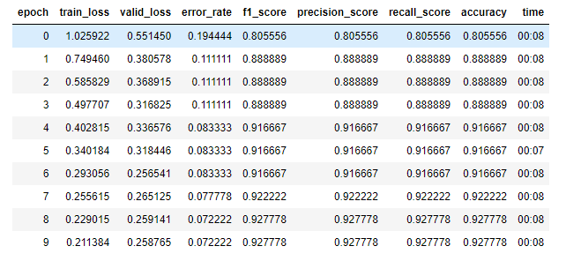
FastAi Model and variants - Binary classification extracted images from the video
Caio Luiz Candeias Flores

Slide 22

FastAi Model and variants - Binary classification extracted images from the video
Caio Luiz Candeias Flores

Slide 23
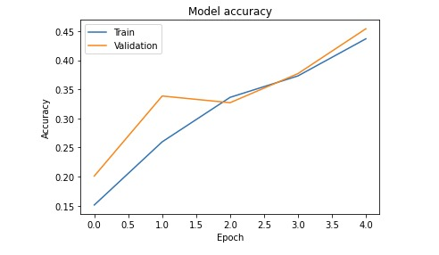
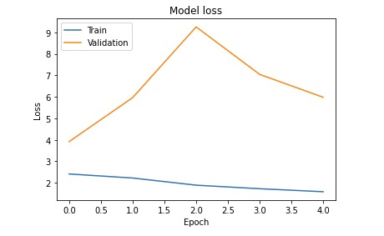
Lenet Model
Pritish Sanjay Samant

