Slide 1
Semantic Self-segmentation for Abstractive Summarization of Long Legal Documents in Low-resource Regimes
ArgLegalSumm: Improving Abstractive Summarization of Legal Documents with Argument Mining
Mohamed Elaraby, Diane Litman
Long Document Summarization in a Low Resource Setting using Pretrained Language Models
Ahsaas Bajaj et. al.
Gianluca Moro, Luca Ragazzi

Slide 2
Introduction :
Difficulties in summarization :
Long Document Summarization is not straightforward - Transformer models is limited by their memory complexity - also limits to max 4096 tokens
Extractive Summarizers - Tries to select few sentences ; - Humans produce more abstractive summaries
Sentence level significance in summaries for models - Extractive to Abstractive Summaries

Slide 3
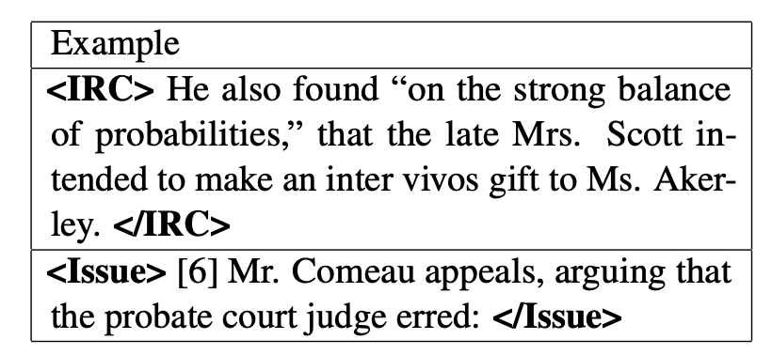
ArgLegalSumm: Improving Abstractive Summarization of Legal Documents with Argument Mining
Legal text have an argumentative nature in their texts - How to address this in summaries ?
Introduce argument role labelling of each sentence to the model
Classify each sentence as Issues, Reasons, and Conclusions : Manually Labelled

Slide 4
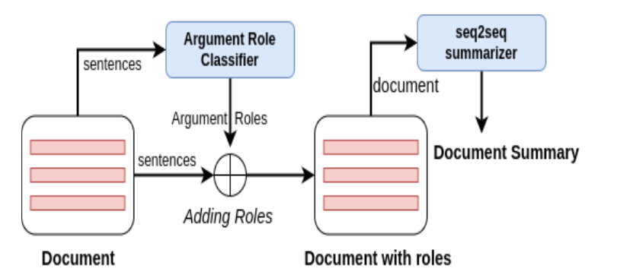
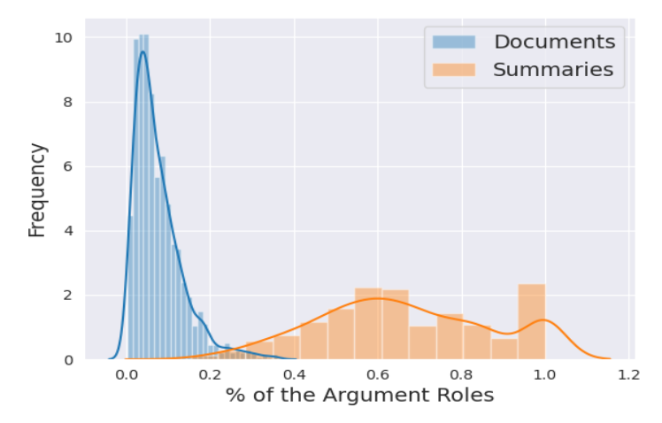
2. Train model to predict both the argumentative nature and then use them for summarization

Slide 5
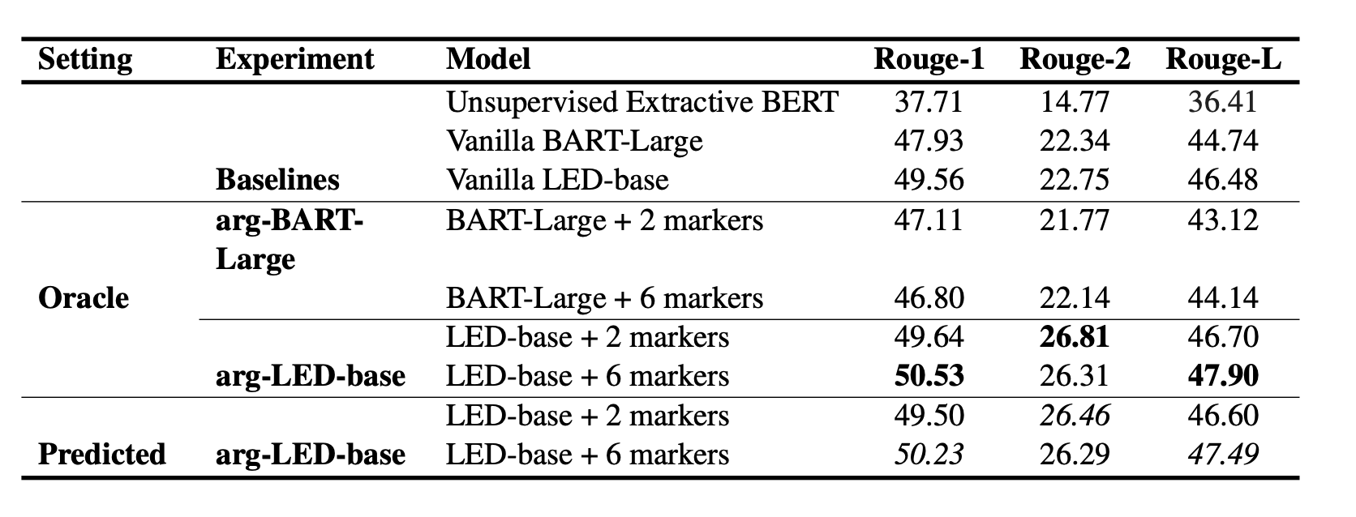
Results
Key Takeaway : After adding these argumentative classifiers, Longformer models perform slightly better on the summaries
Challenge : The model is limited by the restrictions of Longformer/BART models - 2048/4096 tokens

Slide 6
Long Document Summarization in a Low Resource Setting using Pretrained Language Models
Modern abstractive summarization methods are based on deep neural networks which often require large training datasets.
We study a challenging low-resource setting of summarizing long legal briefs with an average source document length of 4268 words and only 120 available (document, summary)
How do we do this ? - Introduce Salient Sentence in Source
Use these salient sentences for summarization
Generate an abstractive summary out of these extracted sentences
At high level its an Extract and Abstract Summarizer

Slide 7
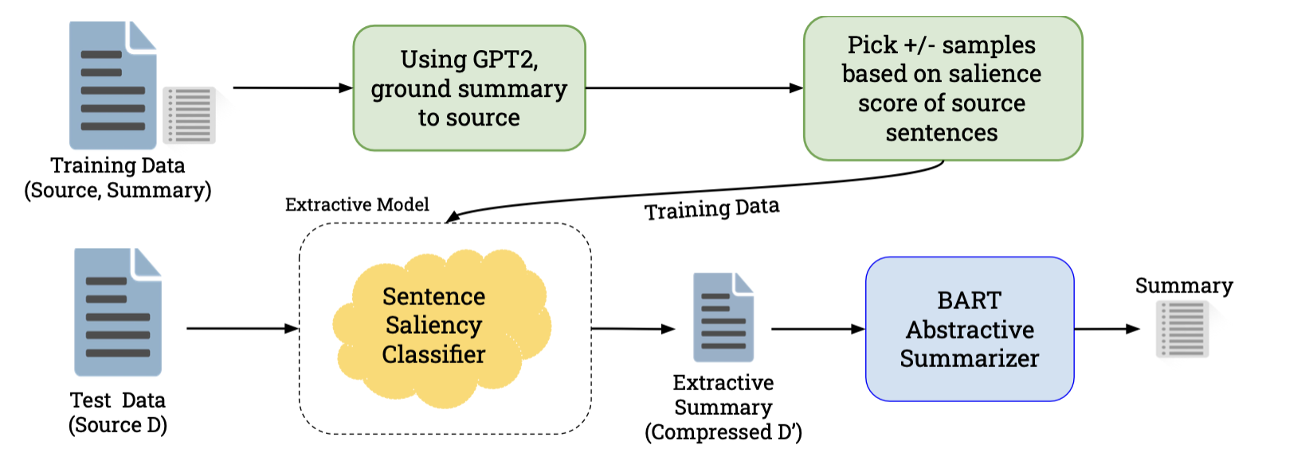
Data:
We curate 120 document-summary pairs from publicly available Amicus Briefs.
Extraction Stage:
content selection as a binary classification task, labeling every sentence in the source document as salient or non-salient
Training Data for Salience Classification
We construct it by grounding sentences of the ground truth summary to sentences in the source document.
Abstraction Stage
black-box pretrained abstractive summarizer trained on a related domain-BART

Slide 8
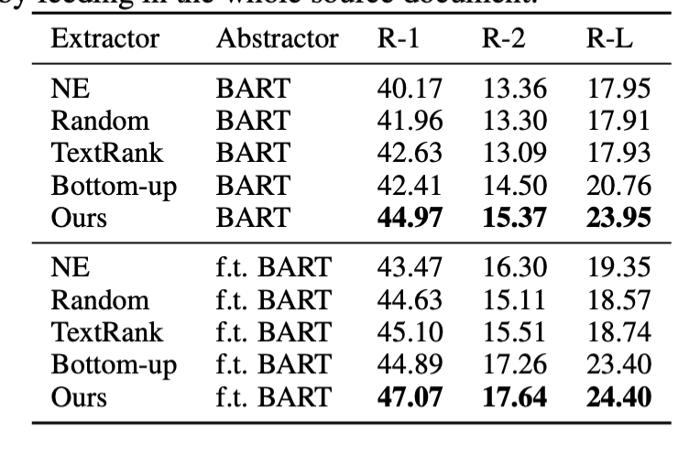
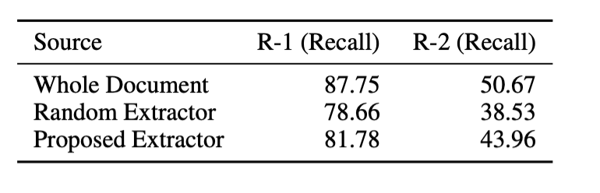
Results
ROUGE-1/2 (R-1/2) recall scores of the gold summary with respect to the the “Source” document. Our saliency-driven extractor performs better than a random selection of the same number of sentences and is close to the upperbound recall performance achieved by feeding in the whole source document.
Challenges : Limited by token length of models like BART etc.
Key takeaway:
The proposed algorithm compresses a document, allowing us to use a pretrained model (BART) to generate coherent & fluent summaries.

Slide 9
Semantic Self-segmentation for Abstractive Summarization of Long Legal Documents in Low-resource Regimes
Limitations of models (max token) is a bit problem
Can we expand model capability -> restricted by GPU power
How to efficiently break the document into chunks to capture all info
novel semantic self- segmentation (Se3) approach for long document summarization to address the critical problems of low-resource regimes, namely to process longer inputs than the GPU memory capacity and produce accurate summaries despite the availability of only a few dozens of training instance

Slide 10
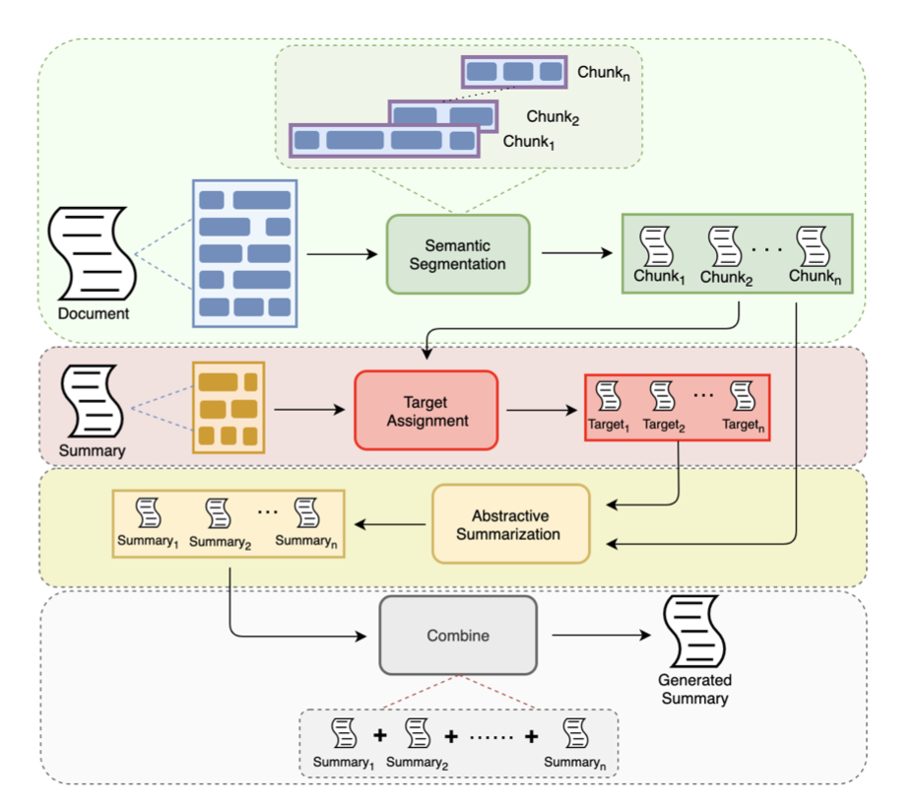
Compute the similarity : Take sentence pairs from actual summary chunk and each sentence in segmented chunk
Train Model with the pairs so that model learns how each part of chunk helps in overall summary
Structure-independent: it can be applied to any long document because it does not rely on textual characteristics.
Thematic-focused:eachchunkrepresentsasemanticunit expressed in the text where each sentence shares an informative topic with the others. Moreover, the sources are highly related to the targets, allowing models to focus on a specific document theme during training.
Data and memory-adaptable: it is possible to change the size of the chunks according to the available computational resources, enabling models fine-tuning with a limited GPU memory thanks to the short input sizes. Further, training data augment because each chunk is treated as an individual training instance.

Slide 11
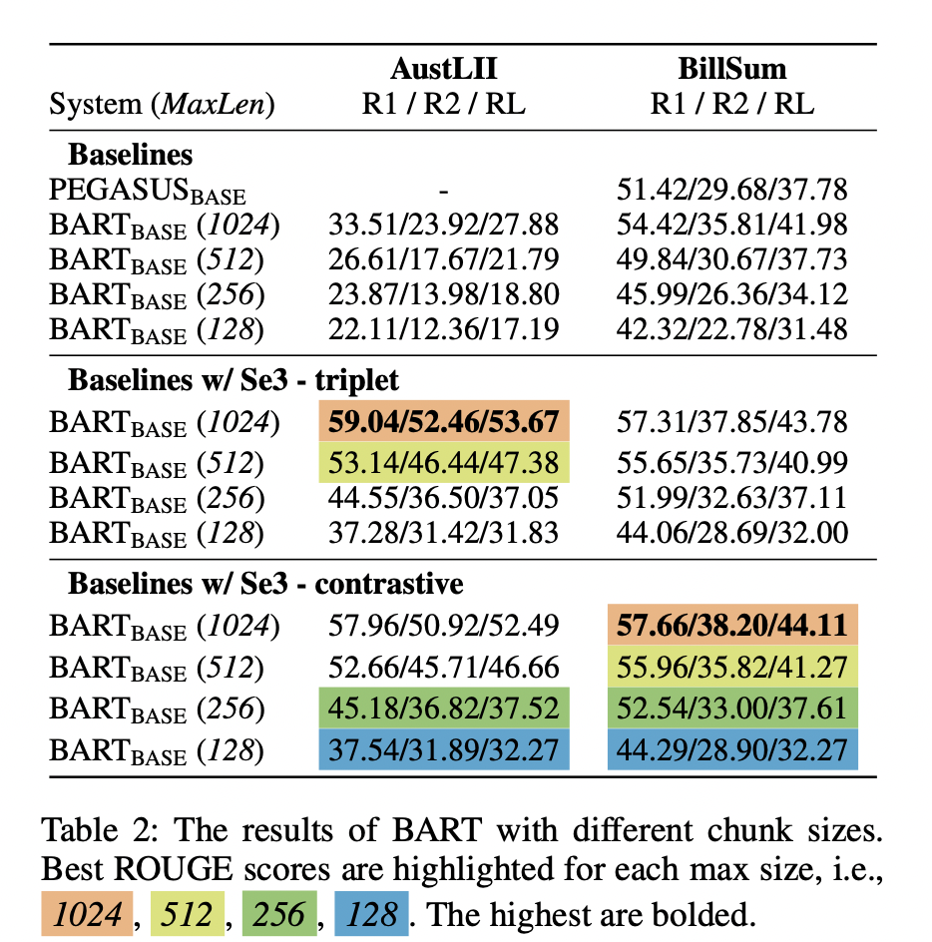
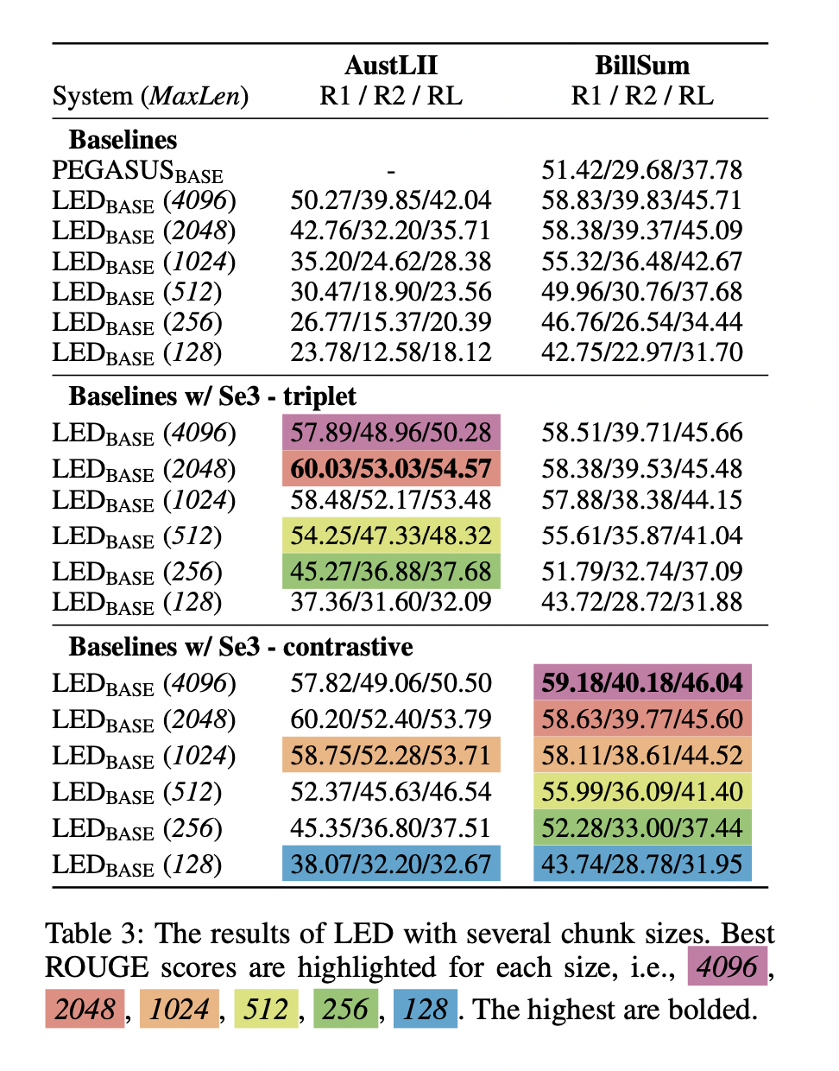
Key takeaway:
The proposed algorithm compresses a document is
able to handle long text without any restriction on the model.

