Slide 1
Missouri Botanical Garden Case Study
Presented By
Josef Staroba
04 June 2008
Production Director

Slide 2
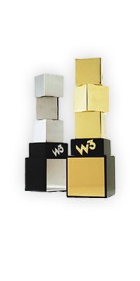



Who is SteadyRain?
Since 1999 – Celebrating our 12th Year.
Privately Held Company.
Consistently Named one of the Top Ten Largest Web Design Firms by the St. Louis Business Journal.
National Award-Winning Internet Strategy and Web Development Solutions.
100% “Satisfied” or “Extremely Satisfied” Client Rating in Customer Surveys.

Slide 3

Who is Missouri
Botanical Garden?
Established in 1859.
A center for botanical research and science education.
Major tourist attraction for the St. Louis area.
Employ hundreds of individuals with 57 contributing to the website.
Website averages 150,000 – 200,000 visitors each month.
Notes:
This is a test

Slide 4
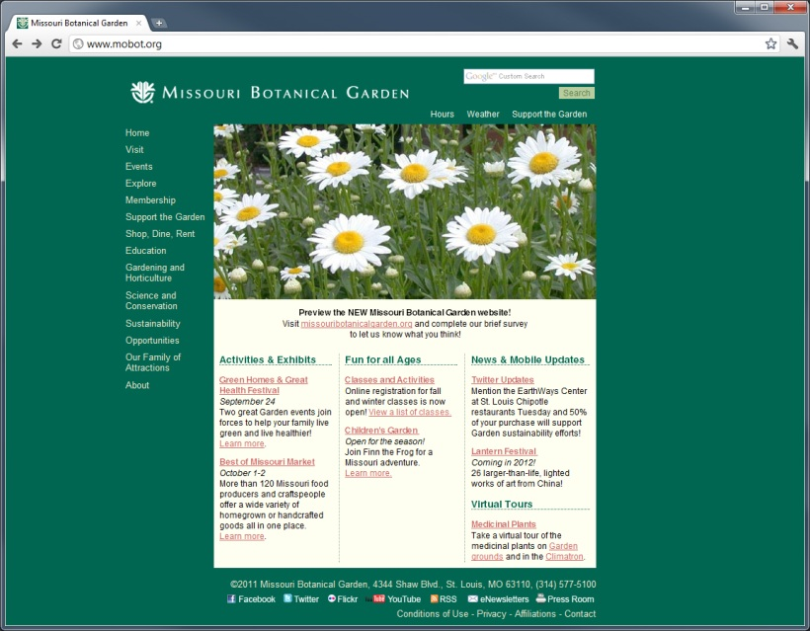
Goal of Project
Content Management & Consolidation.
Rethink User Experience.
Updated design.
User Management.
Transition.

Slide 5

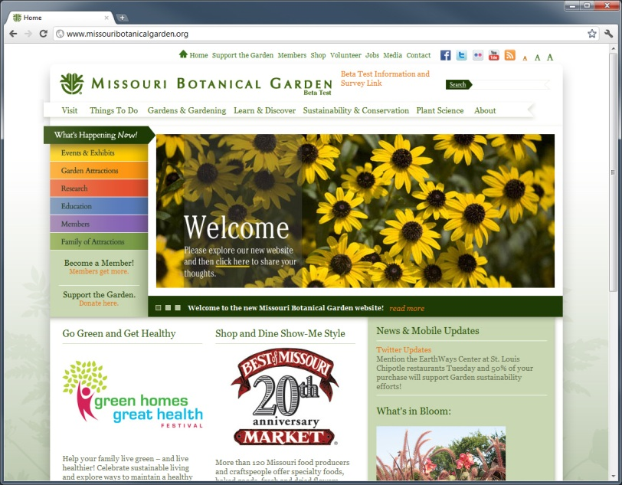
DotNetNuke is the best choice
DotNetNuke Professional.
Customizable Workflow System.
Granular Permissions.
Unlimited Technical Support.
Extensibility.

Slide 6
Guided Tour
www.missouribotanicalgarden.org

Slide 7
Challenges & Solutions
Anchor Tags.
Permissions.
Workflow.
Page Caching.
.Net URL Character Limit.
External Links.

Slide 8
3rd Party Modules Used
Ajax Content Rotator (Gumbo Soft)
No longer available
Coding Staff HTML Popup (Coding Staff)
http://www.codingstaff.com/products/dotnetnuke-modules/free-dnn-pop-up
Dig Article (Dignuke)
http://www.dignuke.com/Modules/digArticle.aspx
Dynamic Forms (DataSprings)
http://www.datasprings.com/products/dnn-modules/dynamic-forms
Site Map (DONEIN.NET)
http://www.donein.net/net_donein/Modules/SiteMapModule.aspx
iFinity URL Master (iFinity)
http://www.ifinity.com.au/Products/Url_Master_DNN_SEO_Urls

Slide 9
Questions?
Steadyrain
http://www.steadyrain.com
Missouri Botanical Garden
http://www.missouribotanicalgarden.org
Personal Blog
http://yoooee.com

