Slide 1

성남-KAIST AI [ Deep Learning 실습 ]
TAs: Kiwon Lee and Bae Gwangtak
Advisor: Junmo Kim
KAIST SIIT Lab
[ Contact Info. ]
Kiwon Lee: kaiser5072@kaist.ac.kr
Bae Gwangtak: gwangtak.bae@kaist.ac.kr
Junmo Kim: junmo.kim@kaist.ac.kr

Slide 2
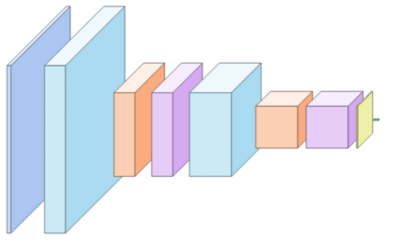

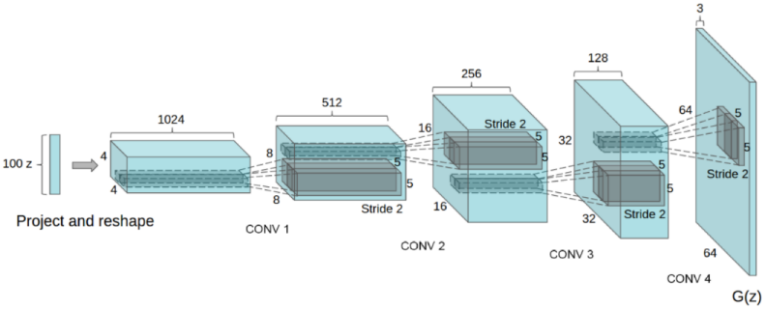
Tutorial Guidelines
Session 1. Supervised Learning (Image Classification)
Convolutional Neural Network (DIY network)
Session 2. Unsupervised Learning (Image Generation)
Generative Adversarial Network (GAN)
Classification

Slide 3
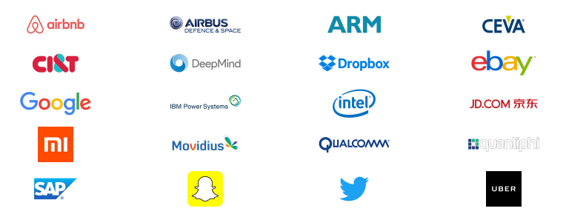
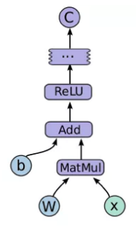
What is Tensorflow?
A python library
Google (Brain)
Open-source
Library for numerical computation using data flow graphs
CPU and GPU
https://www.tensorflow.org/

Slide 4
Install Requirements
CPU-only
Ubuntu 16.04 or later (64 bit)
masOS 10.12.6 (Sierra) or later (64 bit)
Windows 7 or later (64 bit) (Python 3 only)
GPU support
NVIDIA GPU card withi CUDA Compute Capability 3.5 or higher https://developer.nvidia.com/cuda-gpus
GPU drivers, CUDA Toolkit, cuDNN…

Slide 5
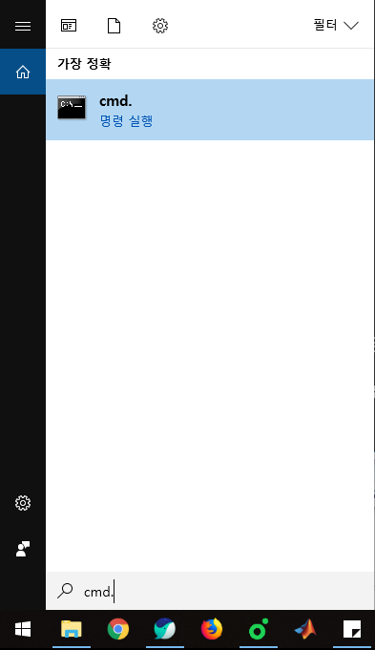
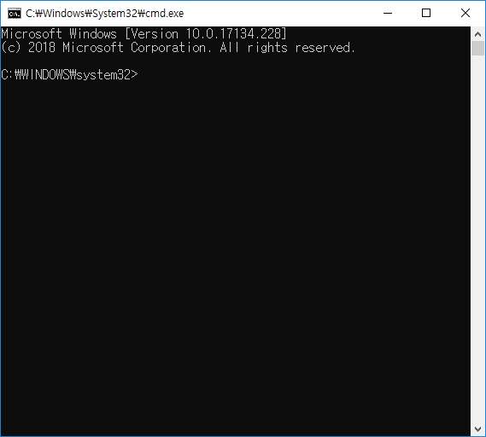
CPU-only Tensorflow (I)
Click windows + s button and execute terminal
python3 –-version
pip3 –-version
virtualenv --version

Slide 6
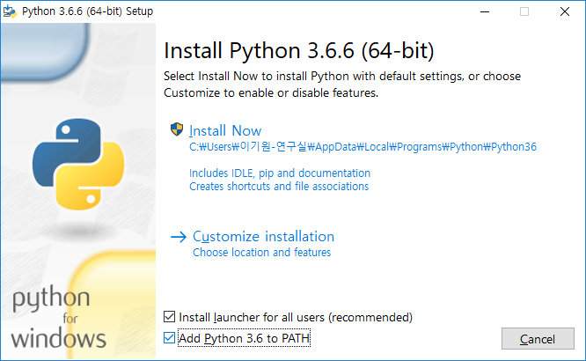
CPU-only Tensorflow (II)
Update build tools
Go to the Visual Studio downloads
Select Redistributables and Build Tools
Download and install the Microsoft Visual C++ 2015 Redistributable Update 3.
Install python 3

Slide 7
CPU-only Tensorflow (III)
Install virtualenv
Install Tensorflow
pip3 install –U pip virtualenv
pip3 install –user –upgrade tensorflow
python3 –c “import tensorflow as tf; print(tf.__version__)”

Slide 8
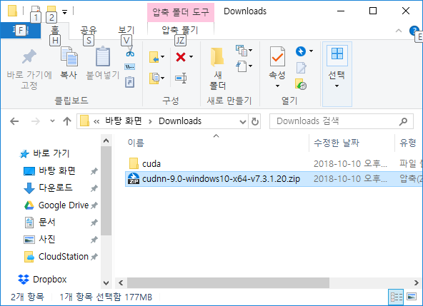

GPU support Tensorflow (I)
Requirements
https://www.tensorflow.org/install/gpu
CUDA Toolkit – Tensorflow supports CUDA 9.0
cuDNN SDK – ($≥$7.2)
Unzip the files

Slide 9
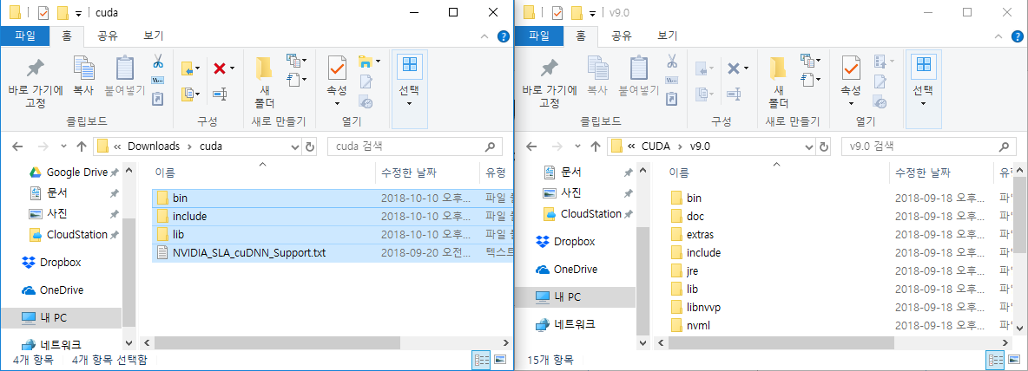
GPU support Tensorflow (II)
Copy the files to the folder where cuda is installed

Slide 10
GPU support Tensorflow (III)
Install Tensorflow
pip3 install –user –upgrade tensorflow-gpu
python3 –c “import tensorflow as tf; print(tf.__version__)”

Slide 11
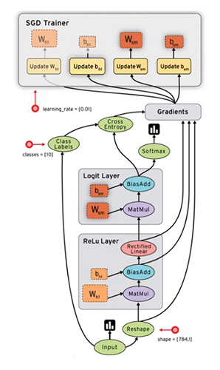
Principle
[ Tensorflow workflow ]
Draw your graph
Feed data
… and optimize
[ Graph ]
Placeholders: gates where we introduce examples.
Model: makes predictions. Set of variables and operations.
Cost function: function that computes the model error.
Optimizer: algorithm that optimizes the variables.

Slide 12
Example Code
import tensorflow as tf
mnist = tf.contrib.learn.datasets.load_dataset()
model.build_graph()
sess = tf.Session()
sess.run(tf.global_variables_initializer())
for t in range(max_iters):
sess.run(model.cost, model.train_op)

Slide 13
Graph, Data and Session
Targets
Graph
Layout of the prediction and learning process. It does not include data.
Data
Examples that will train the neural network. It consists on two kinds: inputs and targets.
Session
Where everything takes places. Here is where we feed the graph with data.
Session
Build graph
(your networks)
Inputs

Slide 14
Constant, variable, and placeholder
Difference between constant/variable and placeholder.
Placeholder: Feeding data to your graph during session.
Variable: learnable/not learnable
Constant: a fixed variable
[ Placeholder ]
images = tf.placeholder(tf.float32, shape=(hps.batch_size, 28, 28, 1), name='images')
[ Variable ]
w = tf.get_variable('weight/DW', [x.get_shape()[1], out_dim],
initializer=tf.uniform_unit_scaling_initializer(factor=1.0),
trainable=True)
[ Constant ]
Init = tf.ones(…) / tf.random_normal(…)

Slide 15
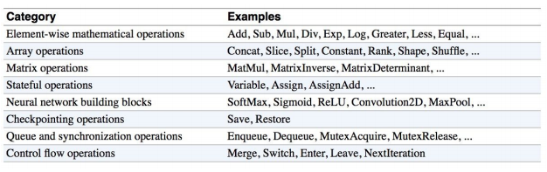
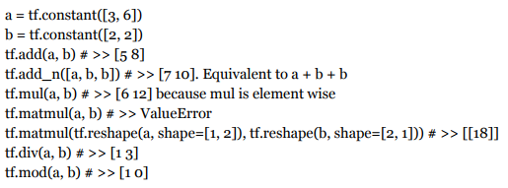
Operations
Tensorflow math ops are pretty standard, quite similar to Numpy.
Visit https://www.tensorflow.org/api_docs/cc/group/math-ops

Slide 16
Feeds and Fetches
Feeds
Designating specific operations to be ‘feed’ by using tf.placeholder().
Fetches
Execute the graph with a run() call on the Session object and pass in the tensors to retrieve.
All the ops needed to produce the values of the requested tensors are run once.
input1 = tf.placeholder(tf.float32)
input2 = tf.placeholder(tf.float32)
input3 = tf.placeholder(tf.float32)
intermed = tf.add(input2, input3)
mul = tf.mul(input1, intermed)
With tf.Session() as sess:
result = sess.run([output],
feed_dict={input1: 3.0,
input2: 2.0,
input3: 5.0})
print(result)
input1 = tf.constant([3.0])
input2 = tf.constant([2.0])
input3 = tf.constant([5.0])
intermed = tf.add(input2, input3)
mul = tf.mul(input1, intermed)
With tf.Session() as sess:
result = sess.run([mul, intermed])
print(result)

Slide 17
Coding by Examples

Slide 18
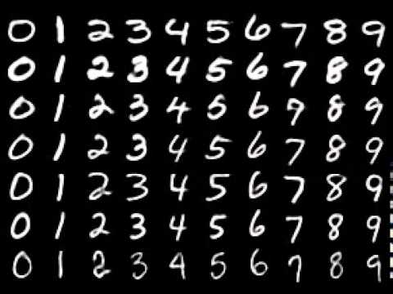
Image Classification
Task: image classification
Dataset: MNIST (28x28)
Network: Simple CNN (VGG-like)
Prepare your data
Build graph
Make session & Initialize
Run session

Slide 19
1. Prepare your data
Load MNIST data
Split train/val/test (image, label) pairs
from tensorflow.examples.tutorials.mnist import input_data mnist = input_data.read_data_sets(‘./data/', one_hot=True)
train_images = mnist.train.images
train_labels = mnist.train.labels
train_images = train_images.reshape([-1, 28, 28, 1]) / 255.
train_images = train_images[0:1000]
val_images = mnist.validation.images
val_labels = mnist.validation.labels
val_images = val_images.reshape([-1, 28, 28, 1]) / 255.

Slide 20
2. Build graph
From inputs to targets.
Data:
Network:
(CONV-BN-RELU) – POOL – (CONV-BN-RELU) – POOL – FC - SOFTMAX
x = tf.placeholder(tf.float32, shape=[hps.batch_size, 28, 28, 1]) y = tf.placeholder(tf.float32, shape=[hps.batch_size, 10])
Session
Placeholder x
CONV
BN
RELU
POOL
CONV
BN
RELU
POOL
FC
SOFTMAX
Cost
Placeholder y

Slide 21
2. Build graph - Convolution
Network:
(CONV-BN-RELU) – POOL – (CONV-BN-RELU) – POOL – FC - SOFTMAX
def conv(x, filter_size, in_filters, out_filters, strides=[1, 1, 1, 1]):
w = tf.get_variable(
'weight/DW', [filter_size, filter_size, in_filters, out_filters],
tf.float32, initializer=tf.uniform_unit_scaling_initializer(factor=2.0)) return tf.nn.conv2d(x, w, strides=[1, 1, 1, 1], padding='SAME')
Usage: y = conv(x, 3, in_filter, out_filter, stride)

Slide 22
2. Build graph – Batch normalization
Network:
(CONV-BN-RELU) – POOL – (CONV-BN-RELU) – POOL – FC - SOFTMAX
def batch_norm(x):
params_shape = [x.get_shape()[-1]]
beta = tf.get_variable('beta', params_shape, tf.float32,
initializer=tf.constant_initializer(0.0, tf.float32))
gamma = tf.get_variable('gamma', params_shape, tf.float32,
initializer=tf.constant_initializer(1.0, tf.float32))
mean, variance = tf.nn.moments(x, [0, 1, 2])
return tf.nn.batch_normalization(x, mean, variance, beta, gamma)
Usage: y = batch_norm(x)

Slide 23
2. Build graph – ReLU
Network:
(CONV-BN-RELU) – POOL – (CONV-BN-RELU) – POOL – FC - SOFTMAX
def relu(x, leakiness=0.0):
return tf.maximum(x, leakiness*x)
Usage: y = relu(x, leakiness)

Slide 24
2. Build graph – Pooling
Network:
(CONV-BN-RELU) – POOL – (CONV-BN-RELU) – POOL – FC - SOFTMAX
def max_pool(x): return tf.nn.max_pool(x, ksize=[1, 2, 2, 1], strides=[1, 2, 2, 1], padding='SAME')
def avg_pool(x): return tf.nn.avg_pool(x, ksize=[1, 2, 2, 1], strides=[1, 2, 2, 1], padding='SAME')
y = relu(x, leakiness)
Usage: y = max_pool(x)

Slide 25
2. Build graph – Fully connected
Network:
(CONV-BN-RELU) – POOL – (CONV-BN-RELU) – POOL – FC - SOFTMAX
def fully_connected(self, name, x, out_dim):
x = tf.reshape(x, [self.hps.batch_size, -1])
w = tf.get_variable(
'weight/DW', [x.get_shape()[1], out_dim],
initializer=tf.uniform_unit_scaling_initializer(factor=1.0))
b = tf.get_variable('bias', [out_dim],
initializer=tf.constant_initializer())
return tf.nn.xw_plus_b(x, w, b)
y = relu(x, leakiness)
Usage: y = fully_connected(x, num_classes)

Slide 26
2. Build graph – Cost function & Optimizer
Network:
(CONV-BN-RELU) – POOL – (CONV-BN-RELU) – POOL – FC - SOFTMAX
Cost function
(Cross entropy)
cent = tf.nn.softmax_cross_entropy_with_logits(logits=logits, labels=self.labels)
self.cost = tf.reduce_mean(cent, name='cent')
Optimizer
(SGD+momentum)
def build_train_op():
optimizer = tf.train.MomentumOptimizer(self.lrn_rate, 0.9)
train_vars = tf.trainable_variables()
grads = tf.gradients(self.cost, train_vars)
apply_op = optimizer.apply_gradients(zip(grads, train_vars),
global_step=self.global_step,
name='train_step')
train_ops = [apply_op] + self._extra_train_ops
self.train_op = tf.group(*train_ops)

Slide 27
3. Make session & Initialize
A Session object encapsulates the environment in which Operation objects are executed, and Tensor objects are evaluated.
sess = tf.Session()
sess.run(tf.global_variables_initializer())
4. Run session
(_, loss) = sess.run([model.train_op, model.cost],
feed_dict={model.lrn_rate: lrn_rate, model.images: batch_images,
model.labels: batch_labels})

Slide 28
Experiment
Image Classification

Slide 29
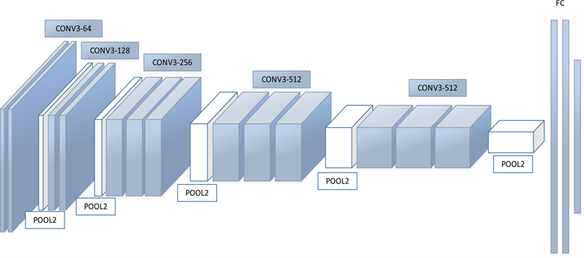


Task: Image Classification
MNIST classification
Provided code: VGG / ResNet architecture.

Slide 30
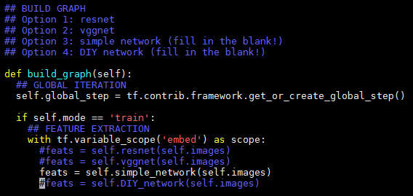
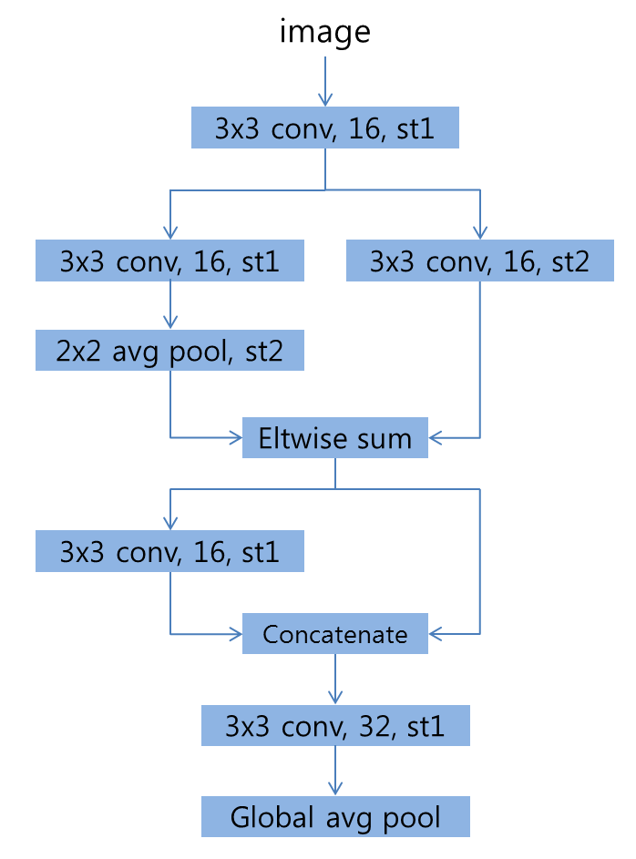
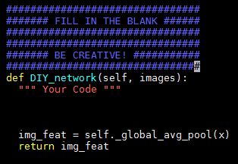
Task: Image Classification
Project goal 1: (Simple Network)
Implement the following architecture.
Project goal 2: (DIY Network)
Make your own architecture.

