Slide 1

Blockchains and Cryptocurrencies: What Financial Planners Need to Know
Jeffery T. Gorham, Senior Associate
November 17, 2017

Slide 2
Preview
Blockchains and Distributed Ledgers
Types of Cryptocurrencies (and uses)
Current Legal Landscape
Investment Potential and Concerns
Smart Contracts
Other Blockchain Uses

Slide 3
Blockchains and Distributed Ledgers

Slide 4
Blockchains and Distributed Ledgers
Blockchains
The technology behind cryptocurrencies.
Analogous to the TCP/IP Protocol that is the foundation of the internet
Blockchains are Distributed Ledgers
Ledgers are historically centralized and private
Blockchains are Decentralized or Distributed

Slide 5
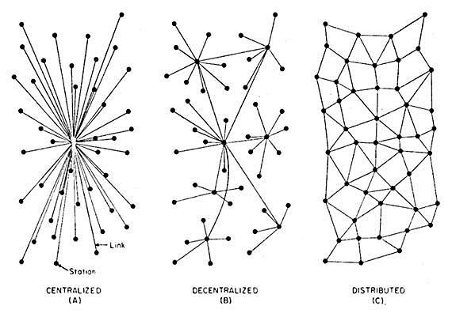

Slide 6
How Blockchains Work: Basics
Chronological Ledger
Transactions often “pseudo-anonymous”
Transactions are grouped together in “blocks”
Transactions are logged and stamped with information about the time, amount, and participants as if a notary is present at every transaction
Blockchain is not centralized (does not have one owner), therefore there are strict rules about how it must be maintained

Slide 7
How Blockchains Work: Maintenance
The individuals who maintain and update the Blockchain are “miners,” and they are paid a reward
The Miners process transactions by:
Solving a complex mathematical problem
Sending transactions to other nodes to be verified.

Slide 8
How Blockchains Work: Hashing
When all miners agree the problem has been solved correctly, the block is added to the chain and is visible to the entire network
The unbroken Hash (seal) confirms that the block, and therefore every block before it, is legitimate

Slide 9
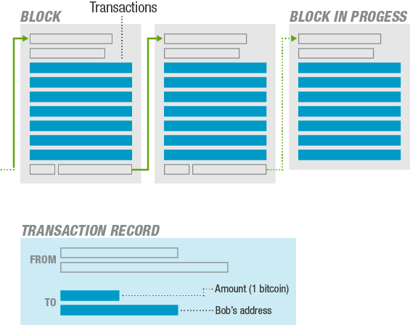

Slide 10
How Blockchains Work: Hashing (cont.)
Recall: Transactions must be validated by other network miners
Miners incentivized to add “valid” transactions via a reward; invalid transactions are rejected, and thus, no reward is given

Slide 11
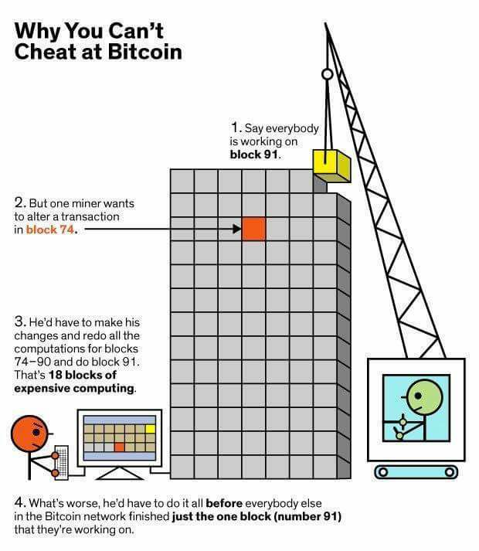

Slide 12
Types of Cryptocurrencies and Uses

Slide 13
Types of Cryptocurrencies and Uses
Bitcoin origins: Peer-to-Peer “cash-like” transactions
Limited Quantity (21 million coins)
No need for third-party intermediary
Double-spend problem

Slide 14
Types of Cryptocurrencies and Uses (cont.)
Protocol Tokens and Uses:
Store Value
Acts more like cash
Usually considered a security

Slide 15

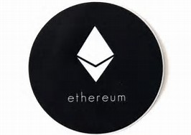

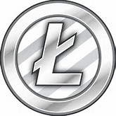
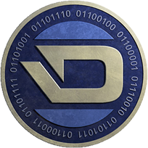
Types of Cryptocurrencies and Uses (cont.)
Protocol Tokens

Slide 16
Types of Cryptocurrencies and Uses (cont.)
Utility/Application Tokens and Uses:
May store value, but usually has a function
Acts similar to an arcade token
Sometimes considered a security, sometimes not

Slide 17
Current Regulatory Landscape

Slide 18
Current Regulatory Landscape
SEC
U.S. Treasury/FinCEN
IRS
State Regulators/Lawsuits

Slide 19
Investment Potential and Concerns

Slide 20
Investment Potential and Concerns
How and Where to Invest
Exchanges
Crypto ATMs
Peer-to-Peer

Slide 21
Investment Potential and Concerns
How and Where to Invest
ETFs
Futures
Hedge Funds
Initial Coin Offerings (ICOs)

Slide 22
Tax Concerns
As Income
Market Value of:
Currency
Good or Service Provided
As Property
Cost Basis
Capital Gains

Slide 23
Smart Contracts

Slide 24
Smart Contracts
Self-automated computer programs that can carry out the terms of any contract
Mostly based on objective conditions precedent
“If, then” criteria

Slide 25
Smart Contracts (cont.)
Variables: Readily Verifiable Data
Oracles

Slide 26
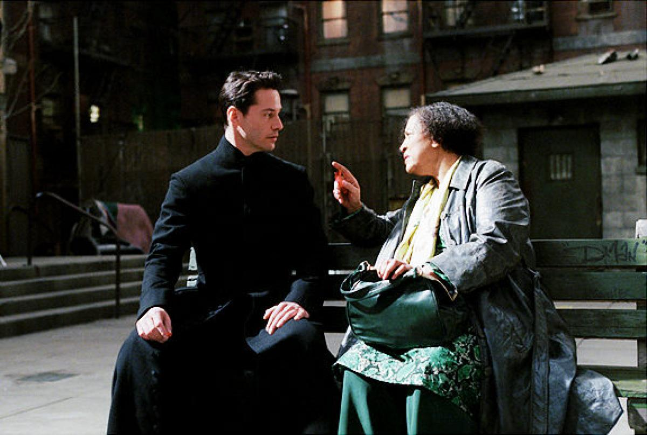

Slide 27
Smart Contracts (cont.)
Variables: Readily Verifiable Data
Oracles: Reliable sources
Social Security DMF
FAA Records
National Weather Service
Crowdsourcing
Voting

Slide 28
Smart Contracts (cont.)
Think: Escrow Agreements
Money held in escrow until performance is met
Once performance is validated, money released
Regulated by an unbiased party, which only seeks the objectively “right” answer, devoid of outside influence

Slide 29
Smart Contracts: Ethereum

Slide 30
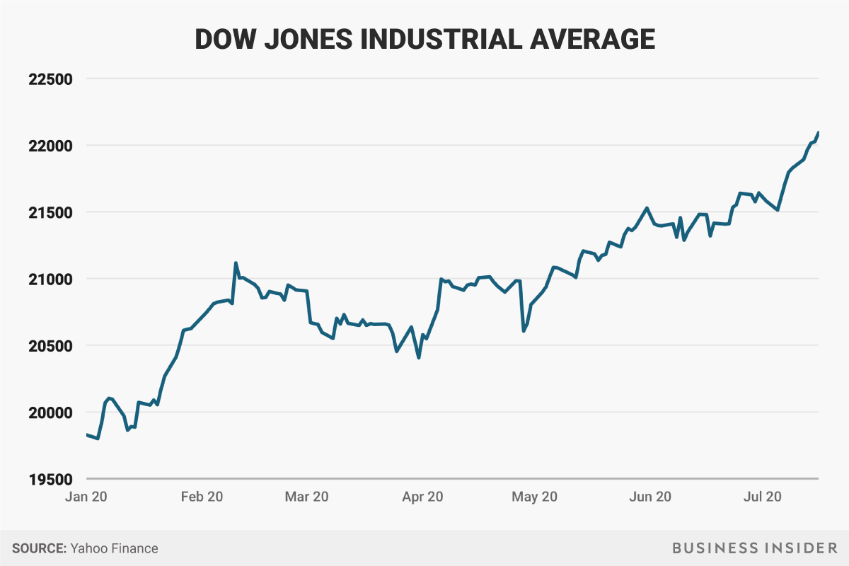

Slide 31
DAO: Distributed Autonomous Organization
DAO: the most popular Smart Contracts platform
A DAO is “a tightly packed collection of smart contracts written on the Ethereum blockchain”
A DAO’s smart contracts amount to a series of by-laws that determine how its constituency — anyone around the world who has bought DAO tokens with ethers — votes on decisions.

Slide 32
DAO: Distributed Autonomous Organization (cont.)
Ether: Entry Token used to:
Record transactions
Vote on outcomes
Purchase other tokens within the ecosystem
Transactional process (sharding)
Top level retains “master ledger”
Lower level nodes run Proof of Stake
Much more efficient from a scaling perspective (compared to Bitcoin simple Proof of Work)

Slide 33
Other Blockchain Applications

Slide 34
Other Blockchain Applications
Issuing Stocks and Bonds
Insurance
Land Registries
Supply Chain Integrity

Slide 35
Q&A
Jeff Gorham
Frost Brown Todd, LLC
JGorham@FBTLaw.com
(317) 237-382

