Slide 1

Blockchain beyond cryptocurrencies

Slide 2
When and how can enterprises adopt Blockchain?
What are some of the business use cases?
In this session…
Why and how will it disrupt industries?
What is Blockchain?

Slide 3
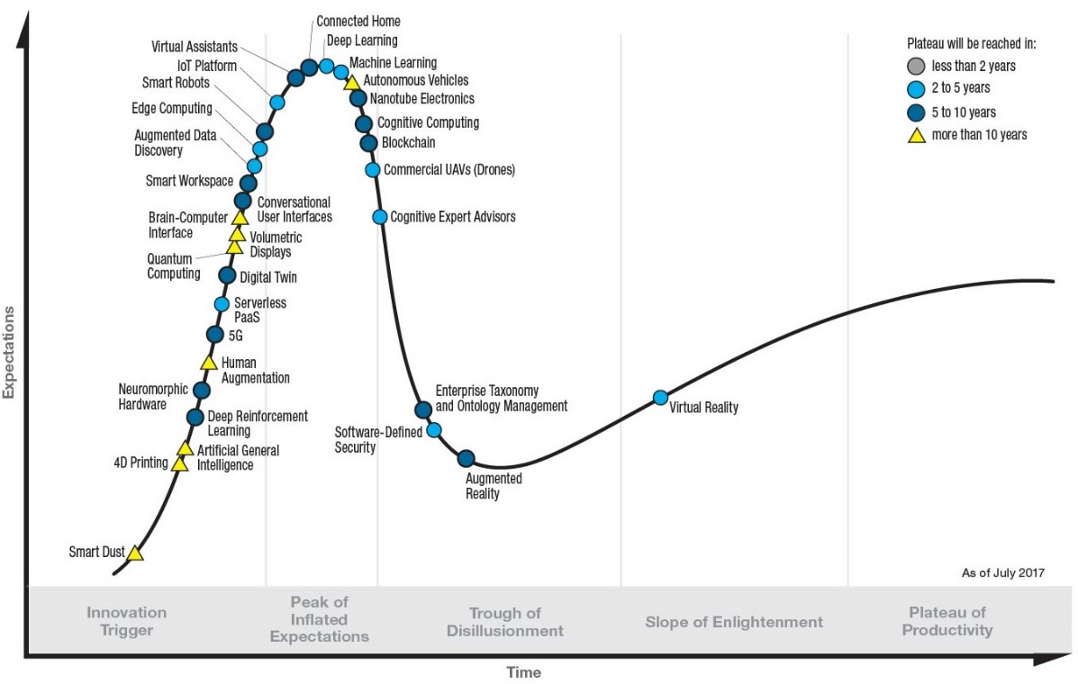
Blockchain @ peak hype
  2017 in numbers
  Bitcoin > $10,000
  Total cryptocurrency marketcap $330 Billion
  Up 1600% in 2017
  $3.6 billion raised so far in Initial Coin Offerings
Source: Gartner emerging technologies hype cycle, July 2017.

Slide 4


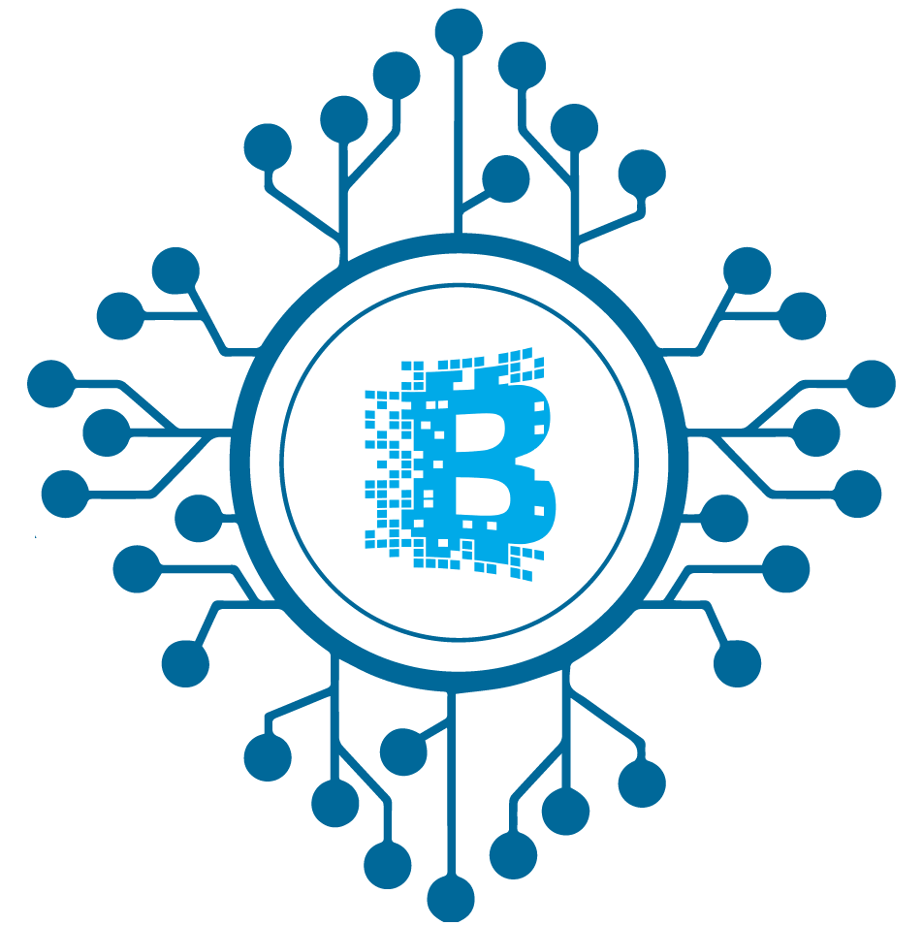


Immutable
Synchronized
Decentralized
What is Blockchain?
Secure
Shared Datastore
Verifiable

Slide 5




The computer science behind Blockchain
Cryptography
(Merkle hashes, Signing, Proof-of-Work)
Databases
(Transaction processing, Consistency, Linearization)
Distributed Systems
(Distributed consensus, Fault Tolerance, Replication)
Networking
(P2P networks, communication protocols)

Slide 6


Blockchain:
The beginning …
Chain of blocks
Markel hash tree, signing, cryptographic immutability
Shared Ledger
P2P Networks, Replication,
Distributed Consensus
Bitcoin: A Peer-to-Peer Electronic Cash System
- Satoshi Nakamoto
Proof-of-Work
Untrusted participants, mining, easy cryptographic verification
Incentivization
Mining rewards, transaction fees

Slide 7
Code that runs
on the Blockchain
Censorship Resistant
1
2
3
4
5
Smart Contracts
Immutable
Determinate computation in response to transactions
Can control Blockchain assets

Slide 8


Public Blockchains
Private Blockchains
  Open, anonymous participation
  Consortium of organizations
  Censorship resistant
  Verified identity and admission control
  Tokens needed to transact
  Decentralized ledger
  Need network effect
  Trusted single source of truth

Slide 9







Today
Tomorrow
Entity A
Entity B
Entity C
Entity A
Entity B
Entity C
Regulator
Trusted Intermediary
Auditor
Regulator
Auditor
… intermediaries, many versions of truth
... disintermediation, immutable shared-truth

Slide 10
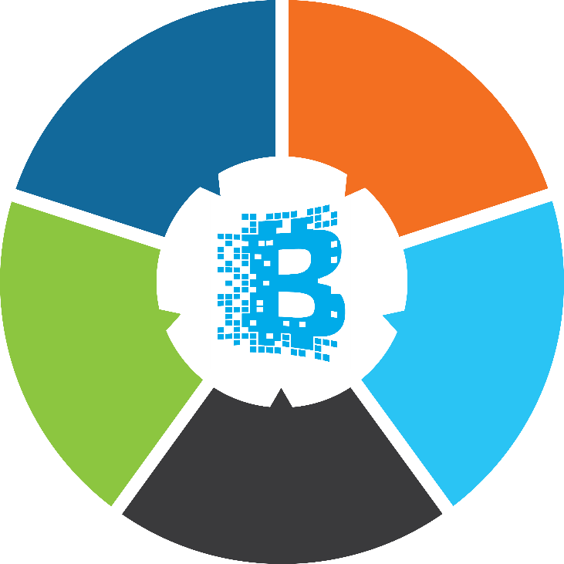





Strengthen security
Cut costs
What can blockchain do for businesses ?
Bring efficiency
Simplify compliance
New digital business models

Slide 11





Commercial Paper
Issuer
Investor
CRA
Demo
6. Request Investor DP Account
4. Request Credit Rating
1. Create CP and Request ISIN
8. Create CP Trade
5. Publish Credit Rating Doc
10. Send Payment Ref. ID
7. Publish
DP Account
9. Publish CP issuance to IPA
3. Publish CP Current,
CP Allocation and Redemption DP account
2. Verify LOI agreement and Allocate ISIN
11. Verify Payment
Bank
IPA
NSDL
Registrar

Slide 12
1
Cross-border Payments
Finance
2
  Know-your-customer
3
  Inter-bank netting and settlement
4
  Mortgage provenance and tracking
5
  Trade Finance

Slide 13
1
Government
Land Records
2
  Upholding service guarantees to citizens
3
  Inter-state or inter-agency settlements

Slide 14
Healthcare
1
Patient-centric health-records
2
  Pharmaceutical track and trace supply chain
3
  Tamper-proof clinical trials

Slide 15

Getting Started…
Do you really need
a Blockchain?
Single Source of Truth
Trusted Intermediary
Multiple Writers
Business
Network
Auditability

Slide 16
Leveraging Blockchain
5
Scale and deploy
4
Review and revise the pilot
3
Do a pilot with select partners
2
Build a proof-of-value prototype
1
Find natively digital processes that qualify

Slide 17
Blockchains – ongoing work
Enterprise adoption challenges
1
1
Performance – latency and throughput
Building a consortium
2
2
  Scaling the blockchain data-store
  Operational cost
3
3
  Data and transaction privacy
  Regulatory support
4
4
  More efficient consensus models
  Interoperable standards for blockchains
5
  Inter-blockchain transactions

Slide 18



1
Blockchain brings decentralized trust and immutable,
single source of truth
Value hinges on network effect
Confidentiality, interoperability and performance are key
Proof-of-Value Pilot Scale
The arc of the Internet is bending towards decentralization.
2
3
- Naval Ravikant — Entrepreneur, Investor
4

Slide 19



Questions and Suggestions?
Thank You!
Pandurang Kamat
Pandurang_kamat@persistent.com
@pandurangkamat
https://persistent.com/blockchain

