Slide 1
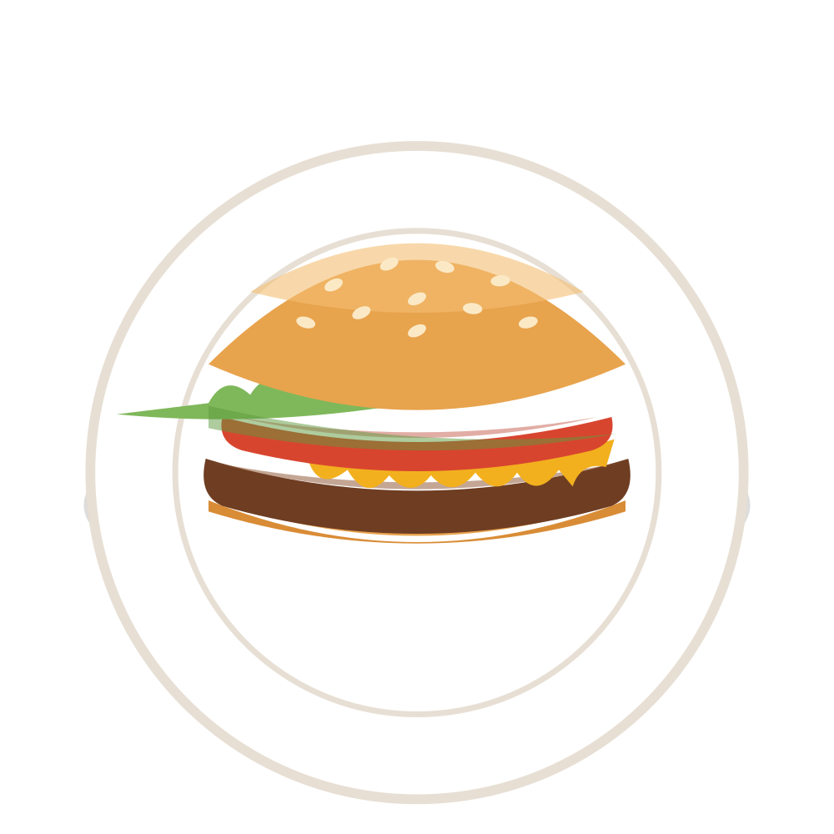
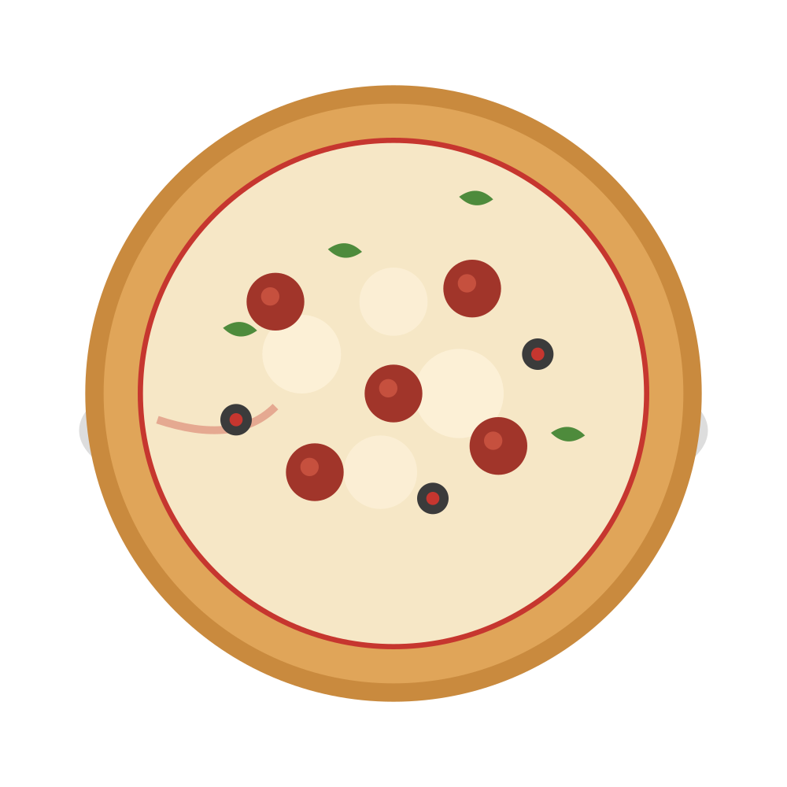
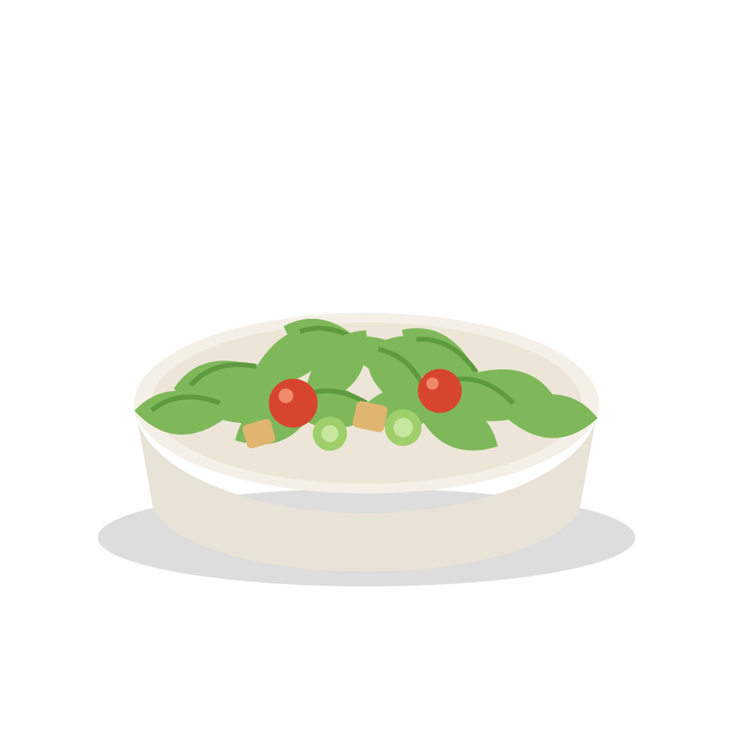
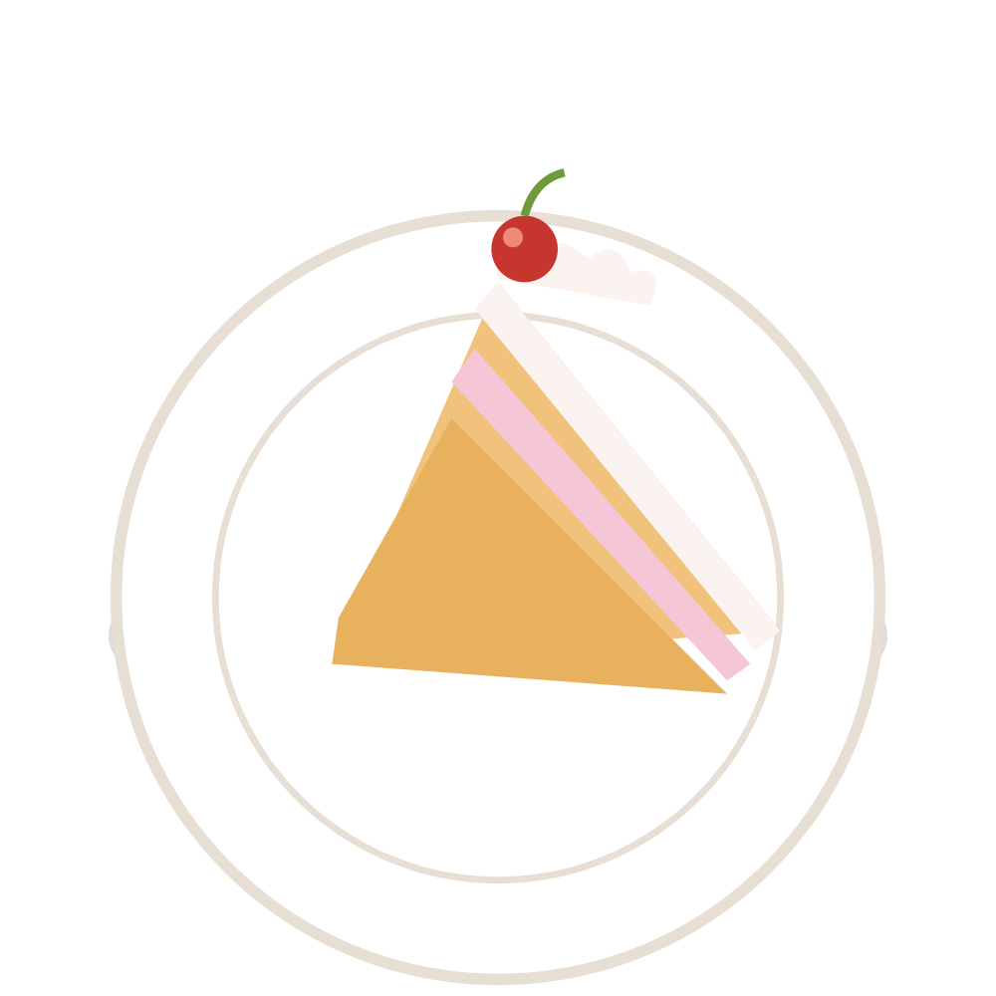
THE PSYCHOLOGY OF FOOD
What Would You Choose?
BURGER
PIZZA
SALAD
CAKE
You have 5 seconds. Choose one.
Presented by Nooha Iflal
Notes:
Good morning everyone. I'm Nooha Iflal, and today I'm going to talk about something we all do every single day — choose food. Let's start with a quick question. You have five seconds. Which one would you choose? (Pause — let people raise hands.) Interesting. But here's the question: Did you choose it because you were hungry, because you actually like it, or because of something else? Today, we're going to look at the psychology behind our food choices — and why sometimes our brain makes the decision before we even realise it. 🧠🍔

Slide 2
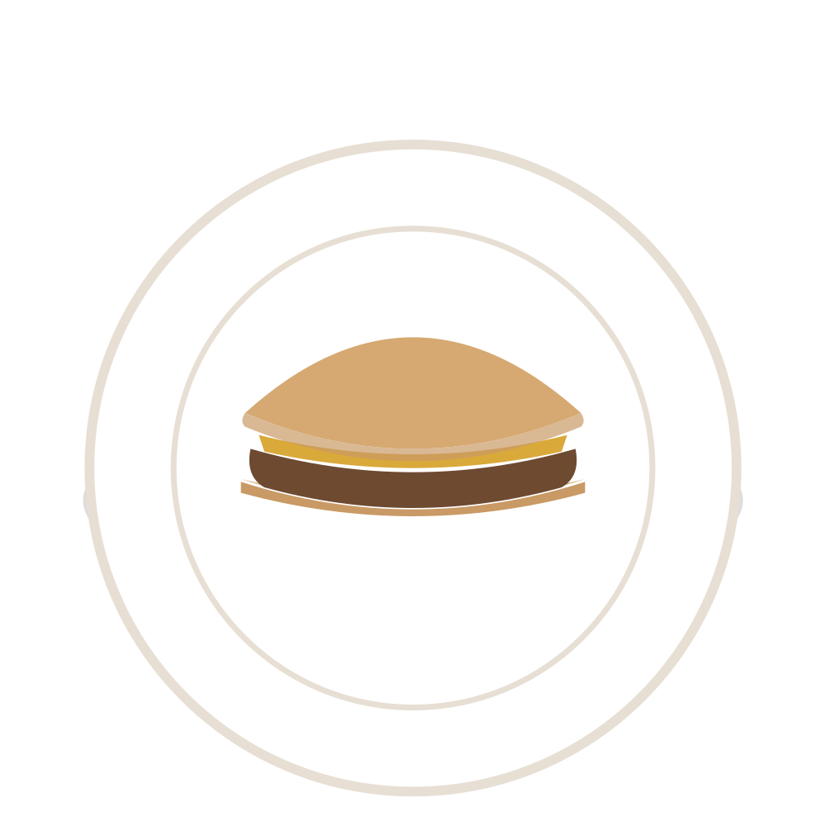
01 · VISUAL PSYCHOLOGY
Your Eyes Choose First
A
B
Same burger. A quick, plain snapshot.
Same burger. Styled, stacked, lit.
Which one looks tastier?
SEE
→
EXPECT
→
CHOOSE
Notes:
Most of us haven't tasted either one. But we're already making a decision. Our eyes are often the first thing involved in our food experience. Colour, shape, arrangement and presentation can create expectations about what something will taste like. Think about scrolling through Instagram or TikTok and suddenly seeing a really good-looking pizza. You might not have been hungry five seconds ago, but suddenly you're thinking about pizza. And somehow, the pizza always appears when you're trying to save money. 😂 See 👀 → Expect 🧠 → Choose 🍴

Slide 3
02 · THE WORDS ON THE PAGE
The Menu Is Playing Tricks On You
Same food. Different words.
TODAY'S SPECIAL
Restaurants carefully choose how food is described, where it sits on the page, and how the price is shown. Those choices quietly steer what catches your eye — and what you order.
The Classic Burger
$12
Chef's Signature Beef Burger
$15
We don't just read menus.
fire-grilled · caramelised onions · house sauce
We react to them.
Fries
$5
Which one would you order?
Notes:
Now let's forget the food itself for a moment and look at the words. If I simply say 'burger', that sounds normal. But if I say 'chef's signature fire-grilled beef burger with caramelised onions and house sauce'… suddenly it sounds much more special. Restaurants carefully think about how food is described, where items are placed on a menu, and how prices are presented. These things can influence what catches our attention and what we choose. Did anyone choose the second burger because it sounded better? 🍟

Slide 4
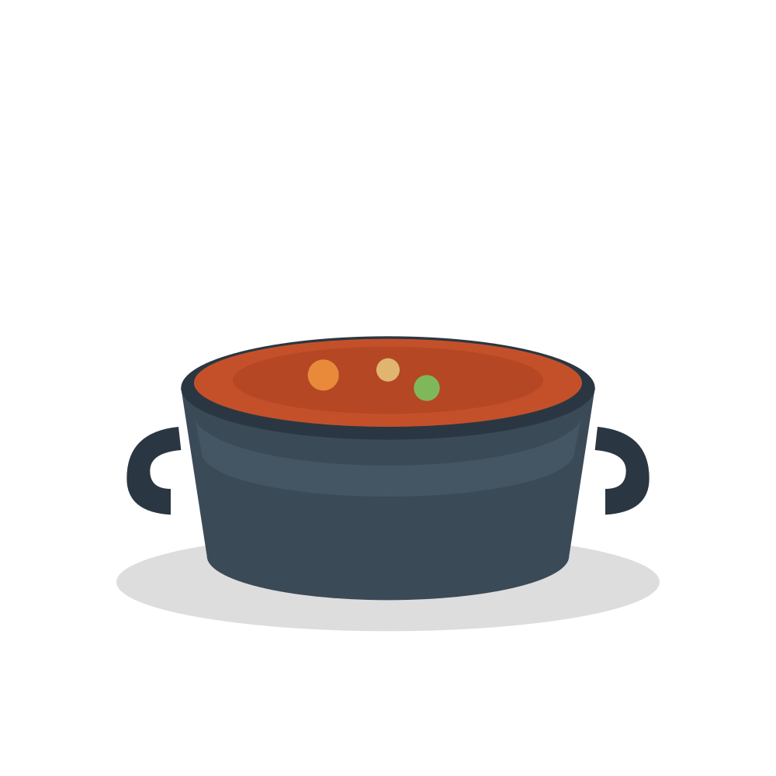
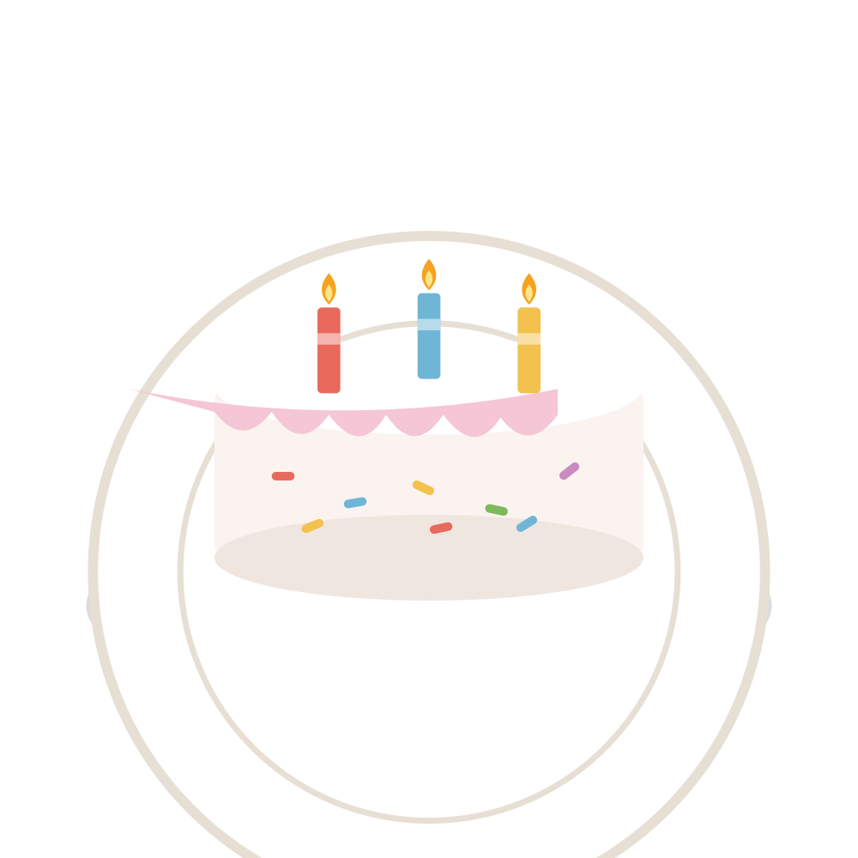
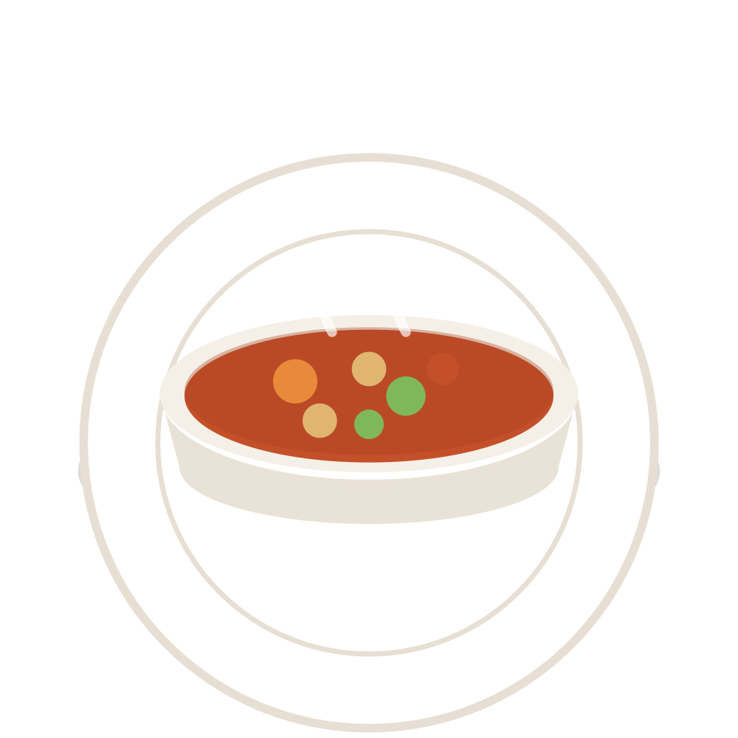

03 · MEMORY & EMOTION
Food Is Connected To Memories
Hunger isn't the whole story. Some foods carry a place, a person, a moment.
HOME COOKING
BIRTHDAY CAKE
FAMILY MEAL
TEA & COFFEE
What food takes you back?
That's one reason we don't all choose the same way — our memories choose with us.
Notes:
Food isn't only about hunger. Sometimes food is connected to memories. Think about one food that immediately reminds you of your childhood, your family, or a special occasion. (Give them a few seconds.) Maybe it's something your mother or grandmother used to make. Maybe it's a food you always had during celebrations. That's one reason we don't all choose food in the same way. Our experiences and memories can influence what feels comforting or appealing to us. Ask one coworker: Would you like to share one food that reminds you of home? ❤️

Slide 5
04 · BRINGING IT TOGETHER
So… Who Is Actually Choosing?
+
+
+
1
2
3
4
See
Expect
Remember
Read
colour & plating
before we taste
people & moments
words & prices
↓
WHAT WE CHOOSE
Do we choose food… or does food influence our choices?
Thank you. — So… what are you craving right now?
Notes:
So, after looking at all of this, we can see that choosing food isn't always as simple as 'I'm hungry, so I'll eat.' Our choices can be influenced by what we see, how food is presented, the words we read on a menu, and even the memories we have connected to certain foods. So the next time you choose something from a menu, maybe ask yourself… (pause) Did I choose this because I really wanted it — or did something influence me? Thank you. Now, after this presentation… what are you craving? 😂

