Slide 1

Data Science
SKPGRAM / CBOW (softmax)
Computer Sci. 최민혁
Computer Sci. 유원석

Slide 2
SKIPGRAM
CBOW
CBOW
2-1
Subset during preprocess
1-1
4-1
2-2
1-2
Optimizer = SGD
4-2
Dimension = 64
2-3
1-3
4-3
4-4
Saving model by pickle
2-4
1-4
Apply learning decay
1-5
2-5
4-5
5번째
4-6
6번째
feature
Role

Slide 3
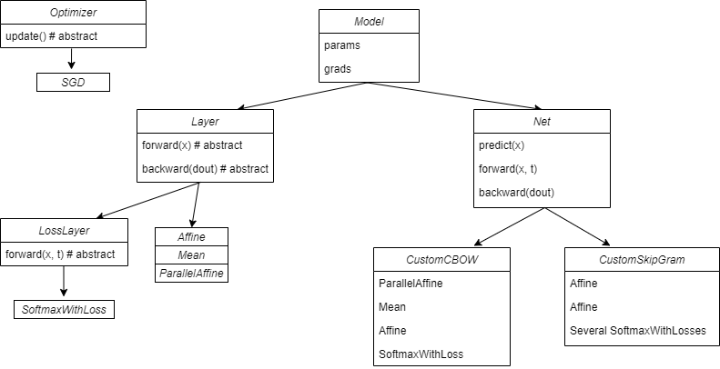
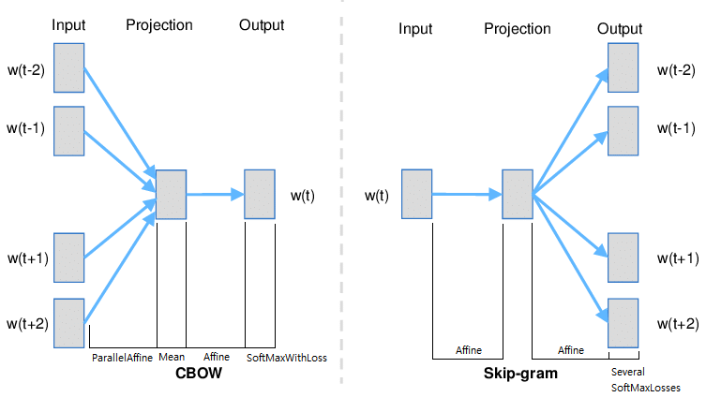
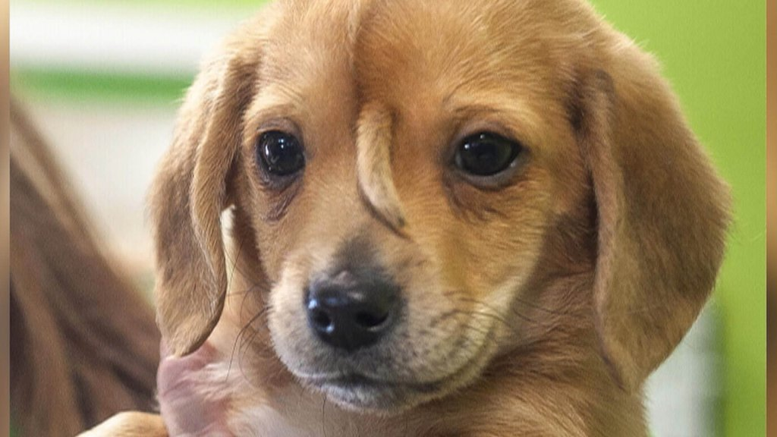
Code_diagram & Models
drawio
초안) results
CBOW is
SKIPGRAM is

Slide 4
감사합니다
1조
최민혁
유원석
- 참고 자료 / 출처 –
밑바닥부터 시작하는 딥러닝2

