Slide 1

Data Science
SKPGRAM / CBOW (softmax)
Computer Sci. 최민혁
Computer Sci. 창준
Computer Sci. 유원석

Slide 2
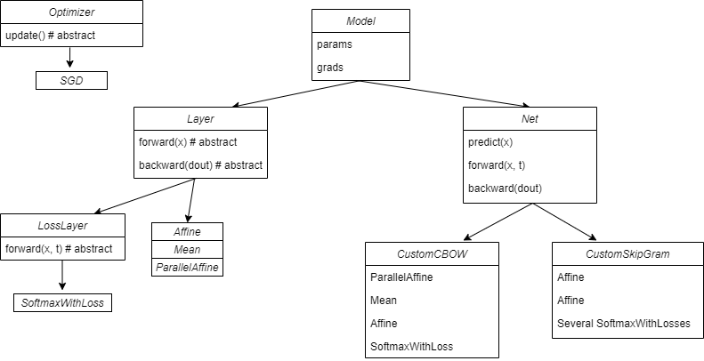
Implementation diagram

Slide 3
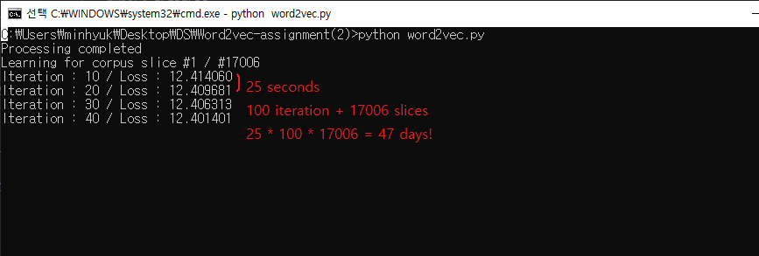
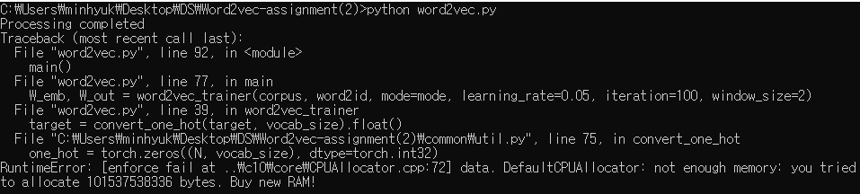
Challenge
Limited traning time
Lack of memory
So we needed to break whole corpus into slices

Slide 4
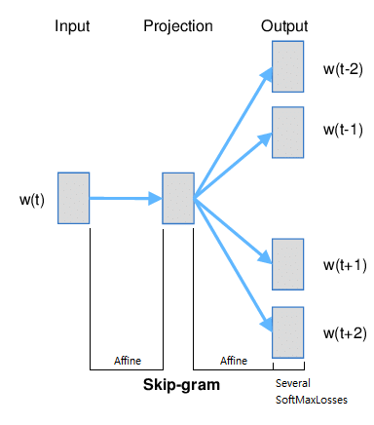
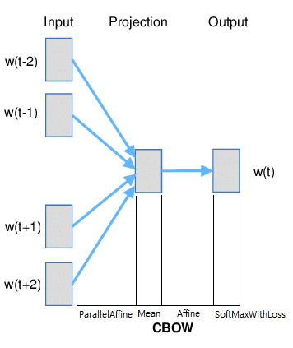
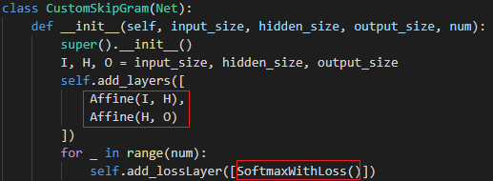
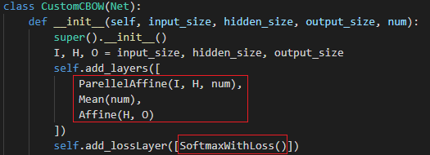
CBOW
SKIPGRAM
SKIPGRAM
■ Learning rate = 0.05
■ Iteration = 1000
■ Batch size = 100
■ Learning rate = 0.05
■ Window size = 3
■ Size of hidden layer = 64
● Subset
Because of a huge size of data, we needed to take a part of data which is used in debugging the code.
> Set to 1e-4 when debugging
> Set to 1.0 when testing
● Slicelen = 1000
A length of one slice of data. Slices are partly overlapped in proportion to window size so that some contexts won’t be omitted
최민혁 50%, 창준 10%, 유원석 40%
최민혁: model과 trainer 작성 그리고 CBOW 실행과 디버깅
유원석: trainer 작성과 SKIPGRAM 실행과 디버깅
창준 : 온라인 강의로 인하여 소통이 잘 이뤄지지 않았습니다.
평가 및 보고서작성 : 최민혁, 유원석
feature
Role

Slide 5
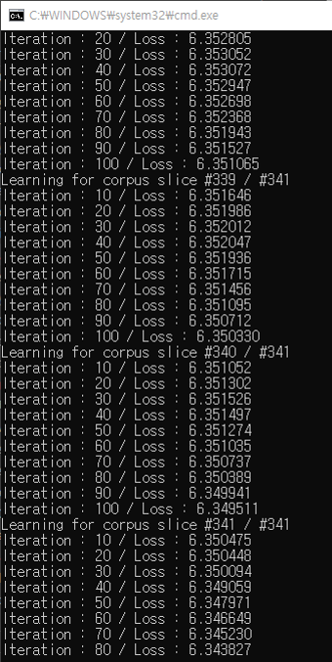
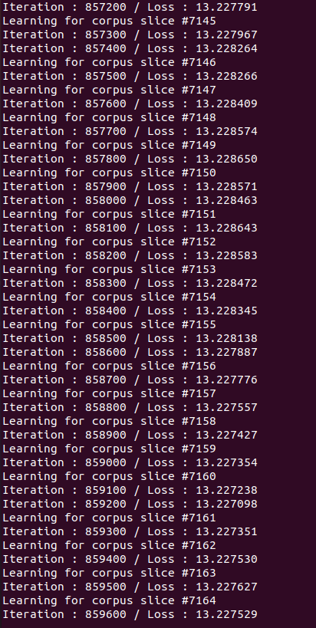
Training image
CBOW
Skip-gram

Slide 6
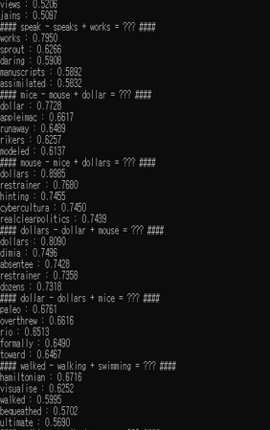
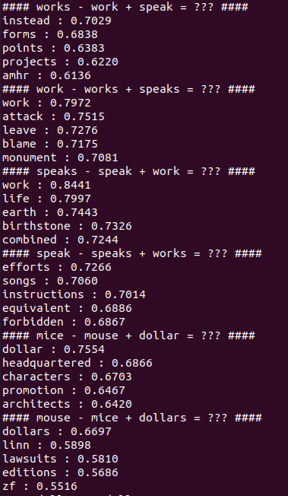
Similarity test
CBOW
Skip-gram
Result was not satisfactory
Why? → Lack of training time and data

Slide 7
감사합니다
1조
최민혁
유원석
- 참고 자료 / 출처 –
밑바닥부터 시작하는 딥러닝2

