Slide 1


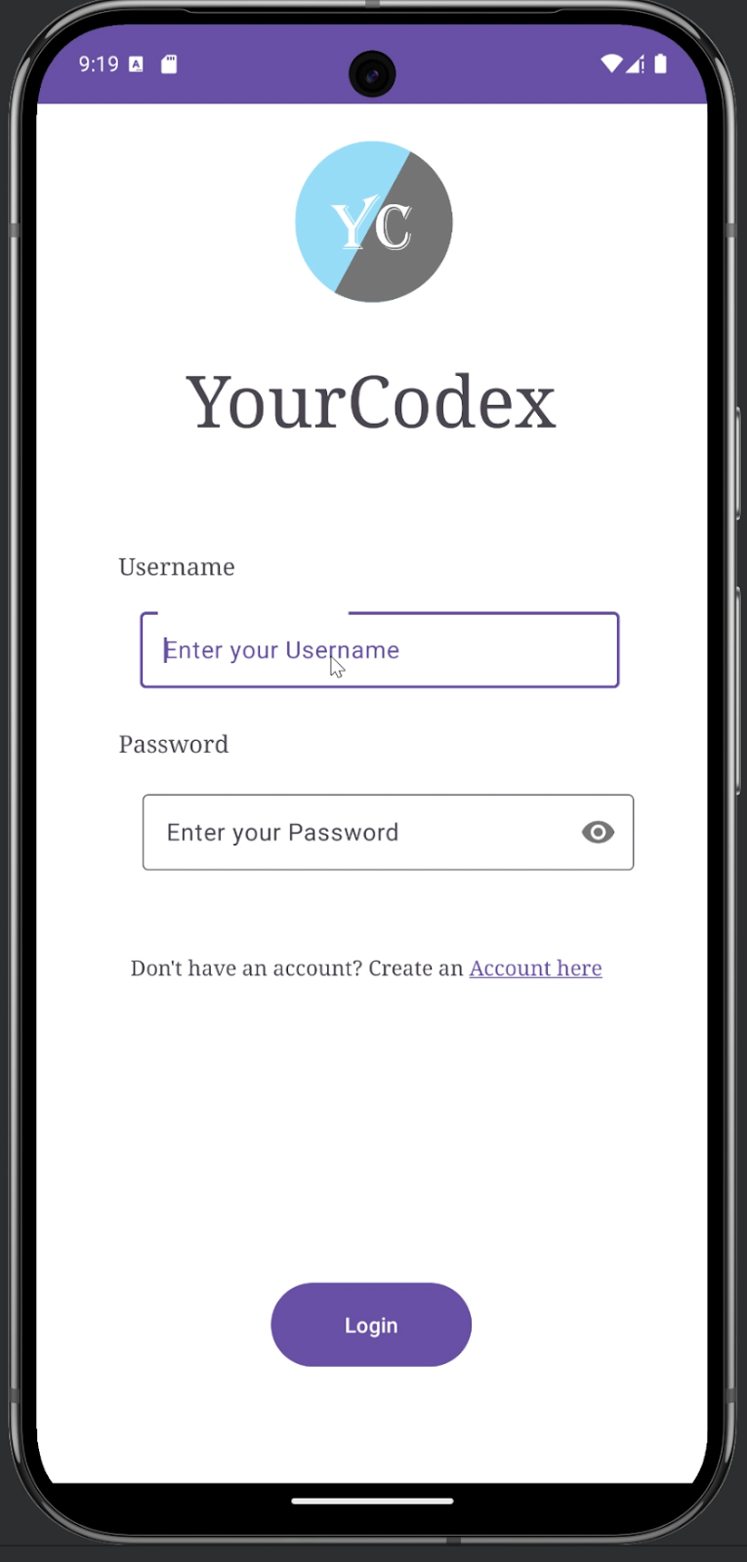
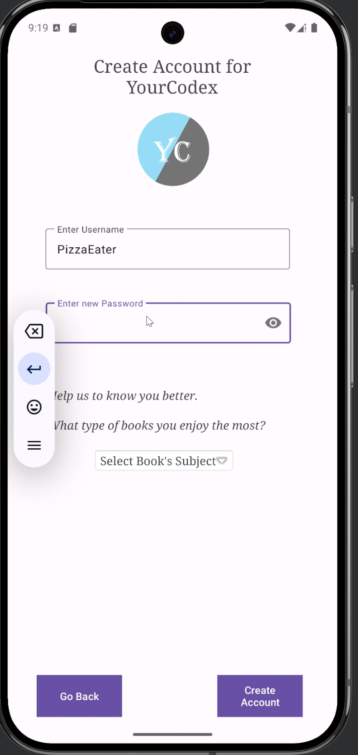
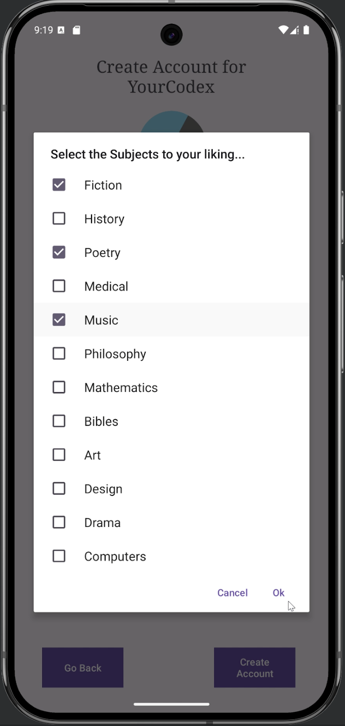
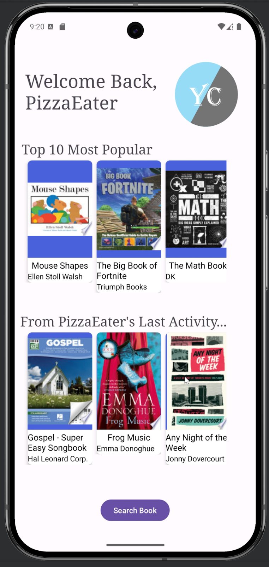
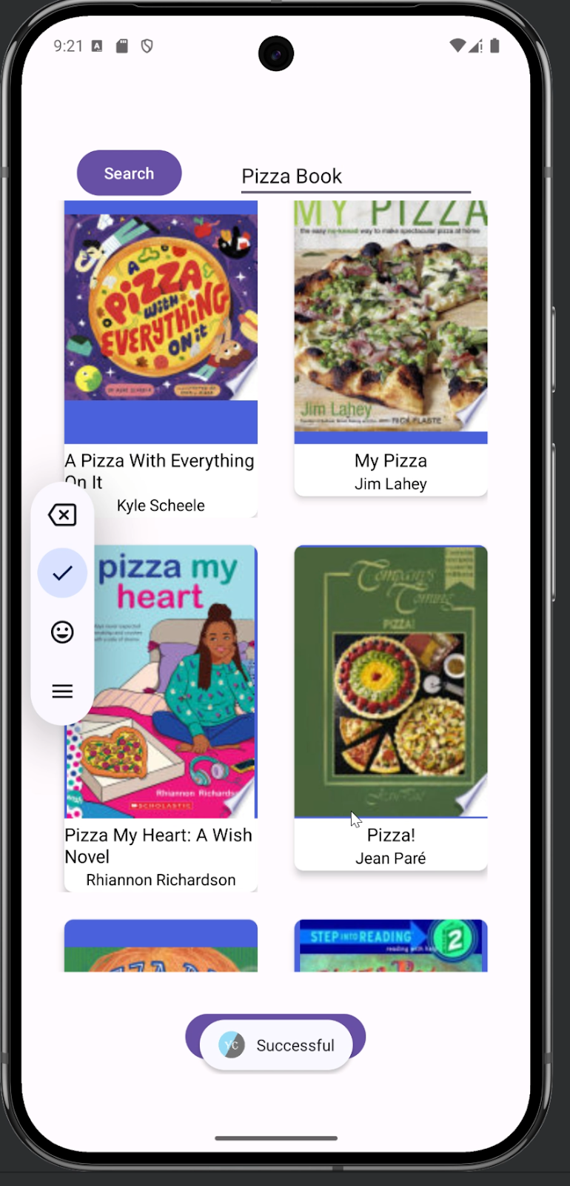
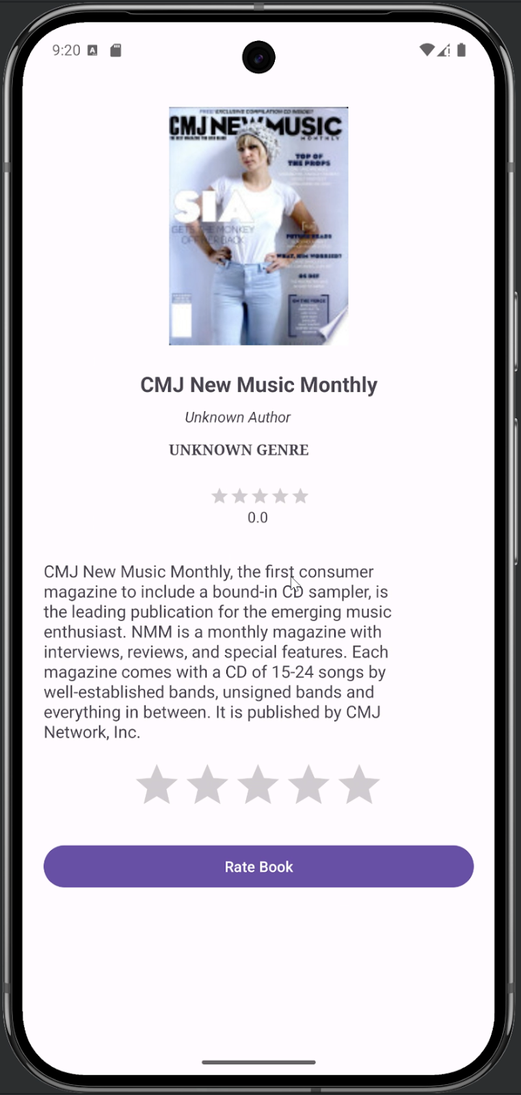
YourCodex Mobile App
Brock Young¹ and Jose Contreras²
^{1, 2}Thompson Rivers University.
¹T00708314@mytru.ca, ²T00714272@mytru.ca.
Introduction
Alternative Solutions
Final Solution
Limitations
The final solution was Solution 3 and was implemented as follows:
The proposed design of a Book Recommender System aims to bridge the gap between avid readers and undiscovered books. As more and more technology surrounds us with each passing year, a new demographic yearns to return to more traditional media to escape the overwhelming digitalization of everything.
Solution 1: Make a “Simulation” with all the knowledge gathered from the labs.
Hardware for the development of the Application…
Some initial ideas were not implemented such as Google Login directly.
Limited Firebase Storage
Solution 2: Use Google Books API with Picasso and Volley tool set.
Problem Definition
Future Work
The current society contains big flows of information across multiple media channels, making users to become tired or to do not find material that they might enjoy.
The development of YourCodex left a few areas that need more progress, being as:
Recommendation algorithm should be more detailed.
User Interface can upgraded
Solution 3: Use Google Books API with Retrofit client and Glide tool set.

