Slide 1
Adaptive sinusoidal spectral matching
for out-of-plane masonry walls
Where the scheme stands against SAFEGo US-1, and one decision I need
Yopi P. Oktiovan · Hanze University of Applied Sciences, Groningen
Internal progress report — follow-on from IMC2026 paper 164
Notes:
[0:30] Open: this is a follow-on from IMC2026 paper 164. The method works up to run 15 and that part is not in question. Today is about the last runs, and about one decision I need from the three of you. Do not apologise for the negative results - frame the whole talk as diagnosis, not failure.

Slide 2
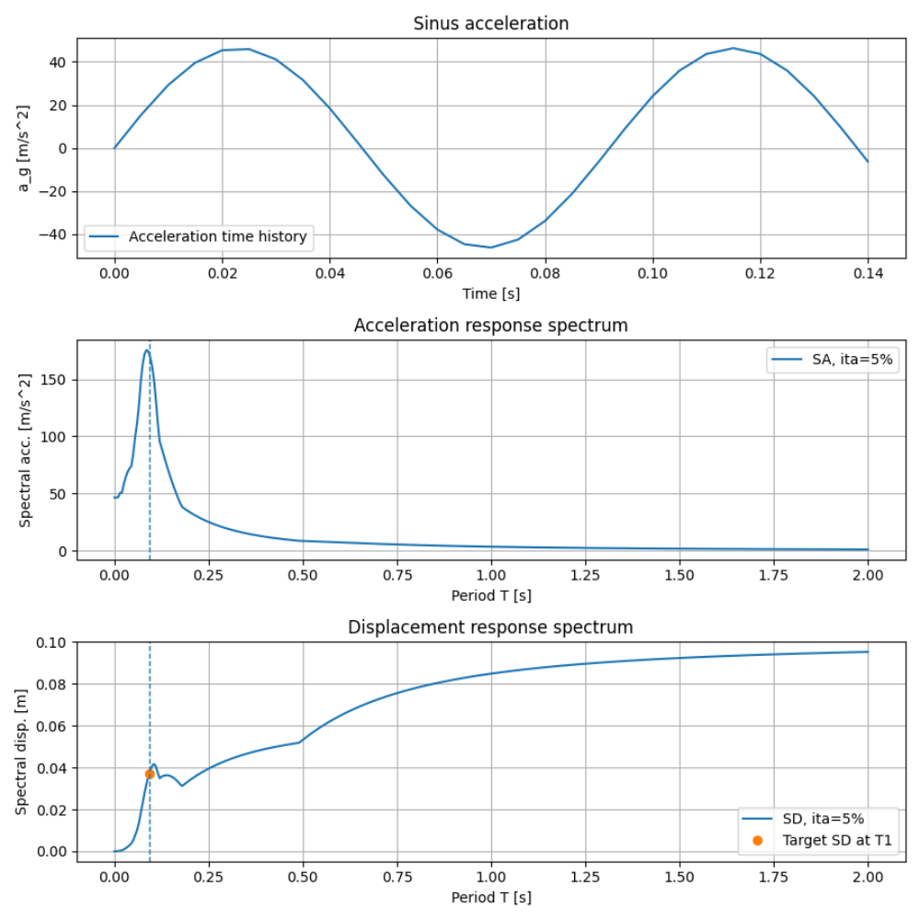
1
Where we started: the single-feed sinusoidal pulse
Bora’s original proposition — replace the full record with one calibrated sinusoid
≈10×
cheaper per loading step
Why it matters
The cost saving still holds.
Only the amplitude rule is in question.
Notes:
[1:30] Recap Bora's proposition for anyone not close to it: one calibrated velocity pulse instead of a 90 s record, amplitude set by a spectral match, re-calibrated at the softened period after every run. LAND THIS: the ~10x cost saving is the entire reason the surrogate exists and nothing today challenges it. Then be generous about what IMC2026 genuinely established - stiffness, period elongation, mechanism, damage pattern. You need the room to accept the diagnosis later, so establish first that you are not attacking the method.

Slide 3
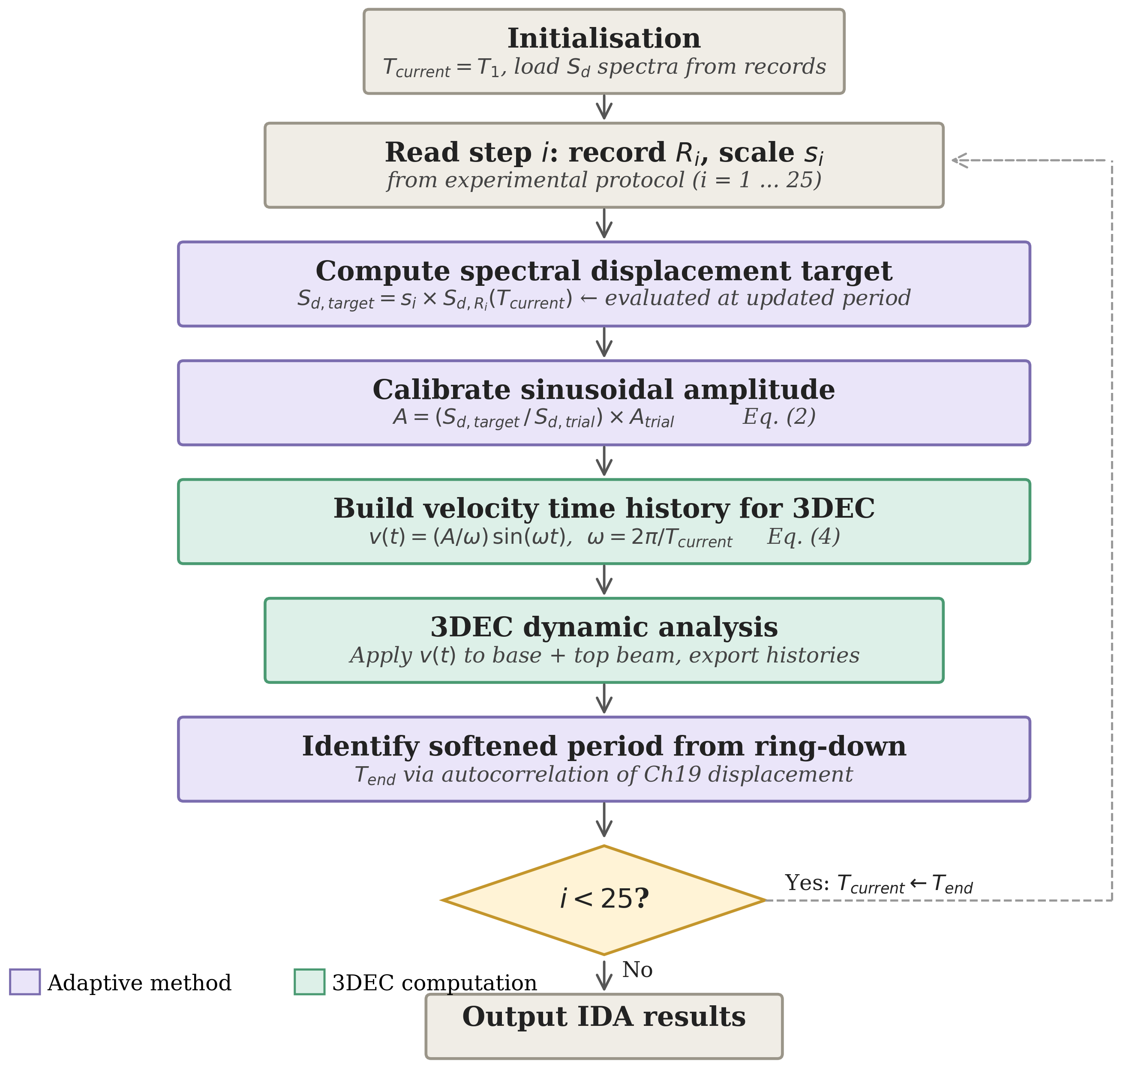
2
Where we’re going: adaptive scheme
Bora’s original proposition — replace the full record with one calibrated sinusoid
≈10×
cheaper per loading step
Why it matters
The cost saving still holds.
Only the amplitude rule is in question.
Notes:
[1:30] Recap Bora's proposition for anyone not close to it: one calibrated velocity pulse instead of a 90 s record, amplitude set by a spectral match, re-calibrated at the softened period after every run. LAND THIS: the ~10x cost saving is the entire reason the surrogate exists and nothing today challenges it. Then be generous about what IMC2026 genuinely established - stiffness, period elongation, mechanism, damage pattern. You need the room to accept the diagnosis later, so establish first that you are not attacking the method.

Slide 4
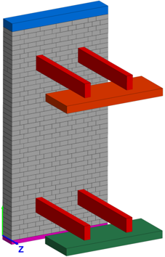
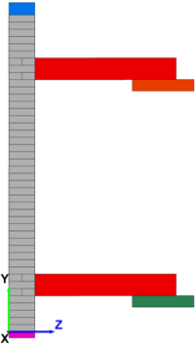
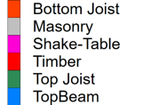
3
The model
3DEC 9 — rigid blocks, all nonlinearity in the joints
Blocks
Rigid. Wall 1.292 × 2.58 × 0.21 m, 1884 kg/m³. Timber joists at two levels; steel top beam and base.
Joints
MASON cohesive-frictional contact model: ft 0.2, c 0.3, fc 20 MPa, φ 36.9°, kn = ks = 2.5 GPa/m.
Top beam
Held horizontally, free to rotate. 10.35 kN spring load applied as a constant force.
Loading
Base and top beam driven with the measured table motion, scaled per Table 2.
This run
Small strain, no added damping — contact dissipation only.
Notes:
[1:00] One slide of orientation. Everything nonlinear lives in the joints - the blocks are rigid, so cracking, sliding and rocking are all contact behaviour under the MASON model. The top beam is the experiment's boundary: held sideways, free to rotate, spring load as a constant force. The caveats for the record run: small strain and no added damping.

Slide 5
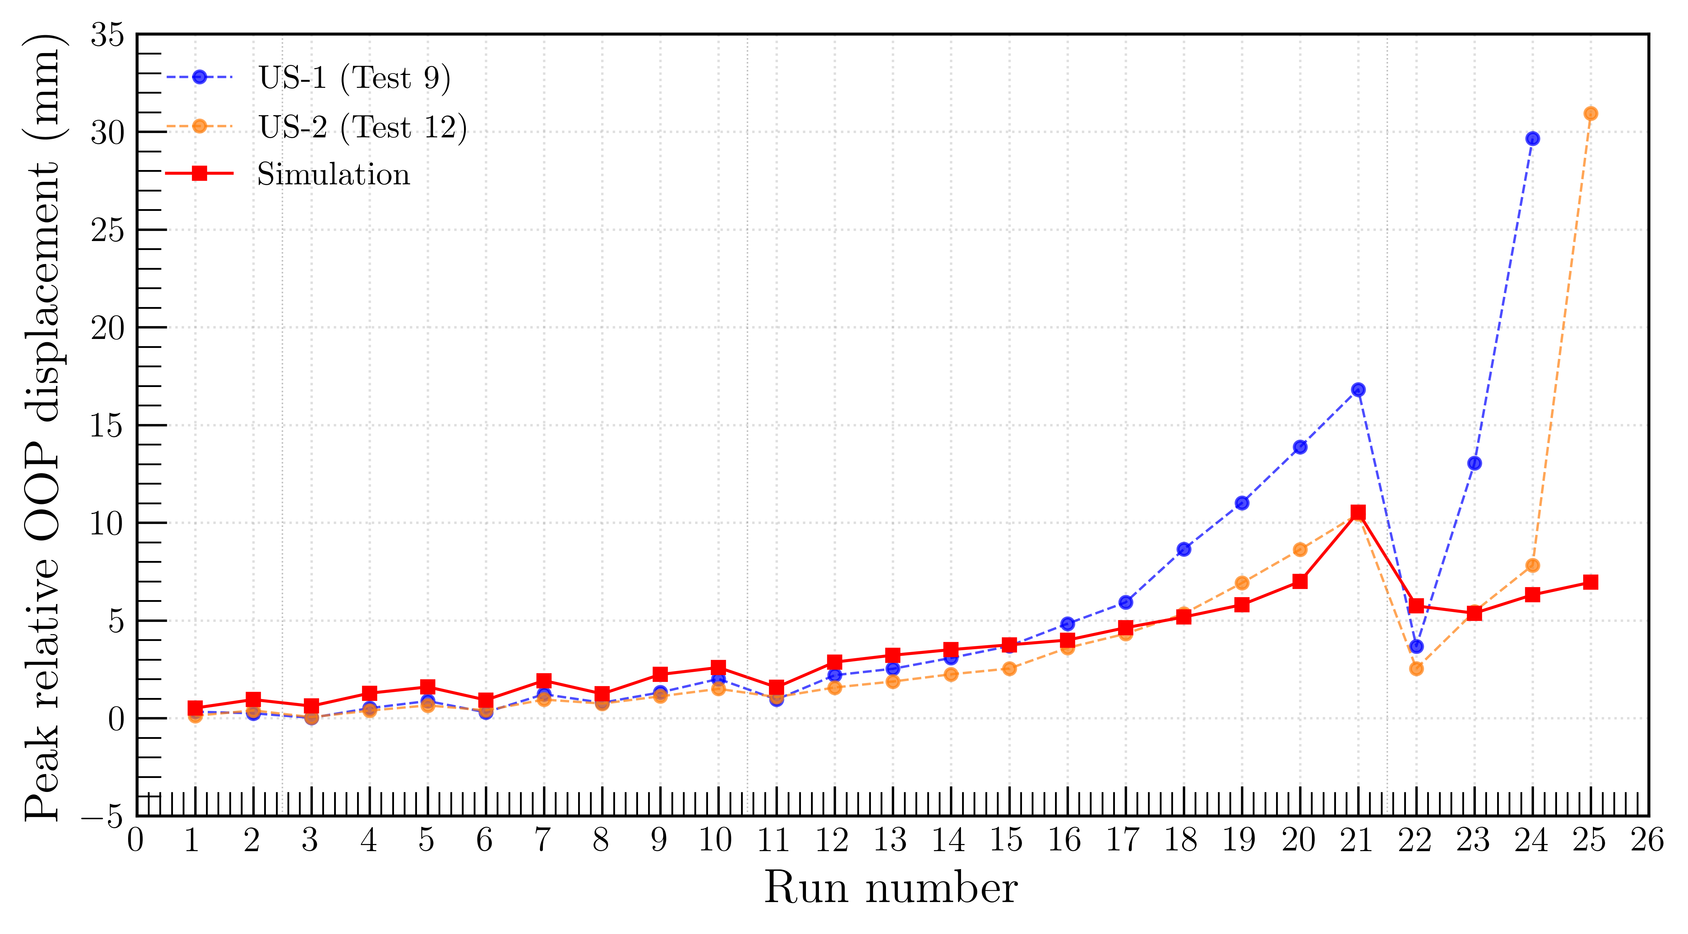
4
The open problem: the last runs
Everything up to run ~15 is fine. The last runs are not.
Run 21
16.4 mm measured
1.6 – 2.8× short
Run 24
29.5 mm measured
4.7 – 8.7× short
Our standing explanation
IMC2026: “3% Rayleigh suppresses rocking as the wall softens.”
IMC2026, symmetric adaptive pulse. Experiment and model separate from run ~16 onward.
CORRECTION: no wall collapsed. All four tests stopped at the table limit (0.78 g, ±70 mm stroke). US-1 and US-2 only lose strength after their peak.
Ranges span model variants.
Notes:
[2:00] Point at the figure: experiment and model separate from run 16 and never reconverge. Quote the RANGES, not single numbers - 1.6 to 2.8x at run 21, 4.7 to 8.7x at run 24 - and say plainly that the range exists because our own model variants disagree. ANTICIPATE: Ihsan will ask which run produced which number. Slide 8 of the IMC deck shows ~10.5 mm at run 21, slide 12 says 6.6-7.7 mm, my Maxwell runs give 5.9 mm. If you have not reconciled these by the meeting, concede it as an open bookkeeping item rather than improvising. Then put our published explanation on screen and say: that is what we wrote, and I now think it is incomplete.

Slide 6
5
The model reproduces what it is told to do
Peak response tracks the commanded spectral displacement — on two independent runs
 | Sd_target commanded | Model peak | Ratio
Run 21 (HU12 × 6.00) | 5.16 mm | 5.9 mm | 1.14
Run 24 (FR76 × 1.75) | 3.01 mm | 3.4 mm | 1.13
The consequence
The IDA is not measuring the wall.
It is redrawing the input spectrum.
What this rules out
The model returns what it is handed, to within 15%
Two records, two scale factors, same ratio to 1%
So the shortfall is not the contact model, the blocks, or the damping
Run 21 verified to 1.5% on PTA. Run 24 carries the FR76 input uncertainty.
Notes:
[2:00] THE PIVOT SLIDE. Two runs, different records, different scale factors, the same ratio to 1%. The model returns what it is handed to within 15%. Therefore the deficit sits upstream of the contact model, the block kinematics and the damping - none of those can be the cause if the model is already delivering its instruction faithfully. WEAKEST LINK: only run 21 is fully clean. FR76's input calibration is off by ~1.3x because Table 2's PTA is a four-specimen average. If pushed, lead with run 21 and concede run 24 carries that uncertainty. Land the consequence: if the model returns approximately Sd_target linearly, the IDA is not measuring nonlinear capacity - it is redrawing the input spectrum.

Slide 7
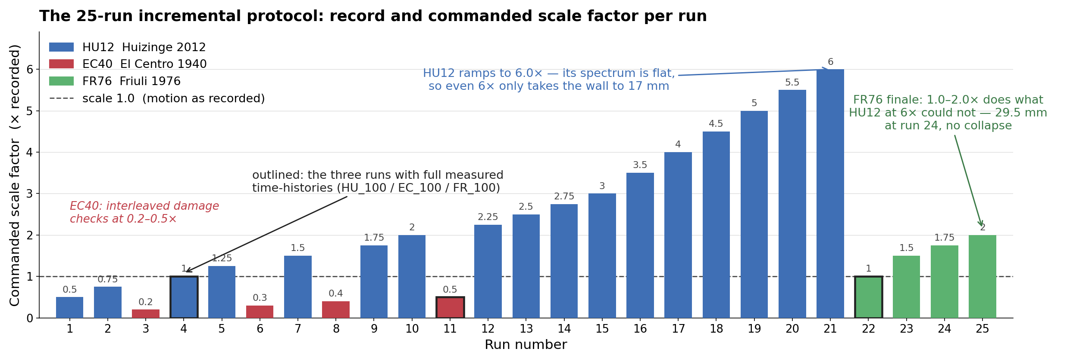
6
The loading protocol: 25 runs, three records
Table 2 of Moshfeghi et al. (2024) — the sequence every strategy must reproduce
Intensity is not the multiplier — it is the record. HU12 needs 6× to reach 17 mm; FR76 at 1–2× then produces 29.5 mm. Any loading scheme has to survive the record switch at run 22, which is exactly where ours failed.
Commanded scale factors from the full-record driver, mirroring Table 2. Flag for Ihsan: the lab file EC_100 is run 11, commanded at 0.5× in the driver — the EC40 naming and normalisation disagree.
Notes:
[1:30] Orientation slide - keep it quick. Three records, escalating multipliers, EC40 interleaved as low-amplitude damage checks. Two things to land: (1) the protocol is fixed by the experiment - we reproduce it, we do not redesign it; (2) the run-21 to run-22 transition - HU12 at 600% gives 17 mm, FR76 at 100% gives less, then 175% gives 29.5 mm. The record carries the demand, not the scale factor. That is why the single-pulse scheme, which sees only amplitude, breaks at run 22. CAVEAT if asked: EC40's data file is named EC_100 but the commanded scale there is 0.5 - a naming/normalisation mismatch we have flagged, not resolved.

Slide 8
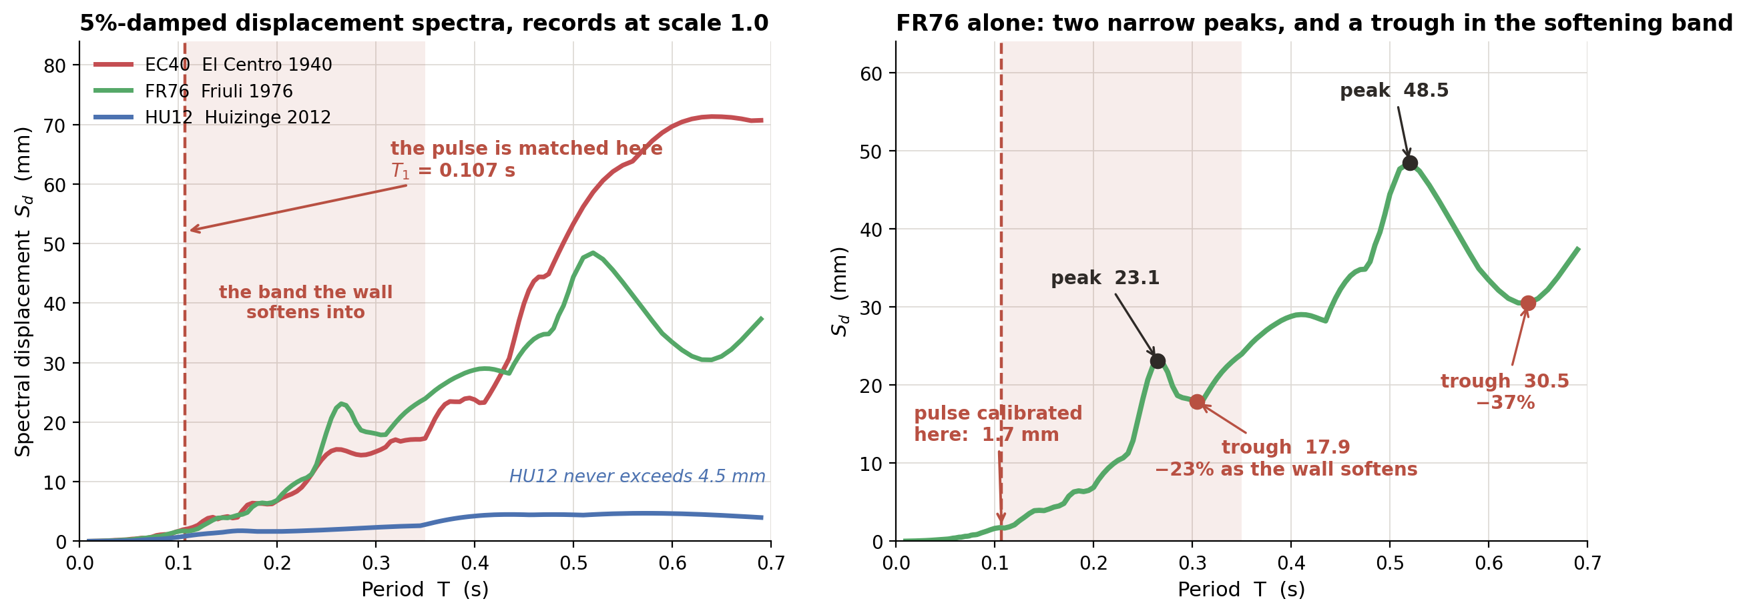
7
What the records actually offer, period by period
Exact 5%-damped displacement spectra — the quantity the pulse is calibrated against
The spectral growth predicts the gap, record by record. Matching at 0.30 s instead of 0.107 s multiplies the demand by ×2.7 (HU12), ×7.5 (EC40), ×10.5 (FR76). The shortfalls are 1.6–2.8× on HU12 and 4.7–8.7× on FR76.
5%-damped spectra of the achieved table motions (Moshfeghi et al. 2024). Shaded band: where the measured response puts the wall.
Notes:
[2:00] Left panel: where we match versus where the wall goes. The dashed line is our matching period; the shaded band is where the measured response says the wall actually is. Right panel is the argument - come back to it on the next slide. Growth factors: x2.7 HU12, x7.5 EC40, x10.5 FR76. Compare against the observed shortfalls of 1.6-2.8x on HU12 and 4.7-8.7x on FR76. THE SPECTRAL GROWTH PREDICTS THE GAP RECORD BY RECORD - that correspondence is the strongest single piece of evidence in the talk. Say it slowly.

Slide 9
8
Why FR76 breaks the single-pulse scheme
Three reasons, all of them properties of the record rather than the wall
Peaked, not broadband
What that means
23.1 mm at 0.265 s, 48.5 mm at 0.520 s. One pulse sits on one peak. A softening wall passes through both.
HU12 is flat — 1.6 to 4.5 mm across 0.15–0.7 s. On a flat spectrum the matching period hardly matters.
17 of the first 21 runs are HU12.
The FR76 runs are the first real test.
The trough inverts the adaptive feedback
Sd falls 23% from 0.265 to 0.305 s (HU12 −7%, EC40 −6%). Softening then means less demand, so the ladder stalls.
Steepest gradient, so the period choice hurts most
Slope 2.28 for FR76, 1.95 EC40, 0.97 HU12. A 10% period error costs 25% demand on FR76.
This does not sink the pulse. It sinks a one-frequency pulse matched at one period. Three ways out: a swept-frequency chirp; a two-component pulse at both peaks; or the real record for FR76.
Notes:
[2:30] LEAD WITH THE TROUGH. It is the point nobody in the room will have considered, and it attacks the ADAPTIVE part specifically rather than the pulse. Sd falls 23% between 0.265 and 0.305 s, so softening reduces the demand and the ladder stalls exactly where rocking begins. Then the peaked spectrum: two narrow peaks, a single-frequency pulse can sit on one but the wall sweeps through both. Then steepness. THE UNCOMFORTABLE PART - deliver it plainly, do not soften it: 17 of the first 21 runs are HU12, whose spectrum is flat, so the period choice barely mattered there. ANTICIPATE: Eleni may hear this as dismissing the validation. Answer: it does not invalidate it, it BOUNDS it - the method is validated for flat-spectrum records, which is a legitimate and publishable scope statement. Finish on the three repairs so the slide does not land as purely negative.

Slide 10
9
Where the demand is lost: the matching period
Sd read at the free-vibration period never reaches the measured displacement
Reading it
Sd at that period never passes 4.6 mm
Measured demand reaches 29.5 mm
The period that fits is 1.1× to 3.4× longer
Fig 14’s period is measured after shaking, at tiny amplitude. It tracks damage, not the period the wall moves at.
EC40 and FR76 use Table 2 PTA, an average over four specimens, lower than US-1 received. HU12 matches to 1.5%.
Notes:
[1:30] The per-run picture. Sd at the identified free-vibration period never exceeds 4.6 mm across all 24 runs while the measured demand reaches 29.5 mm. The one sentence that carries the whole talk: Figure 14's period is a POST-SHAKING, SMALL-AMPLITUDE damage indicator, not the period the wall responds at DURING shaking. We have been using a damage metric as a loading parameter. Note the caveat line - EC40 and FR76 rows carry the input-calibration issue; the HU12 ladder does not.

Slide 11
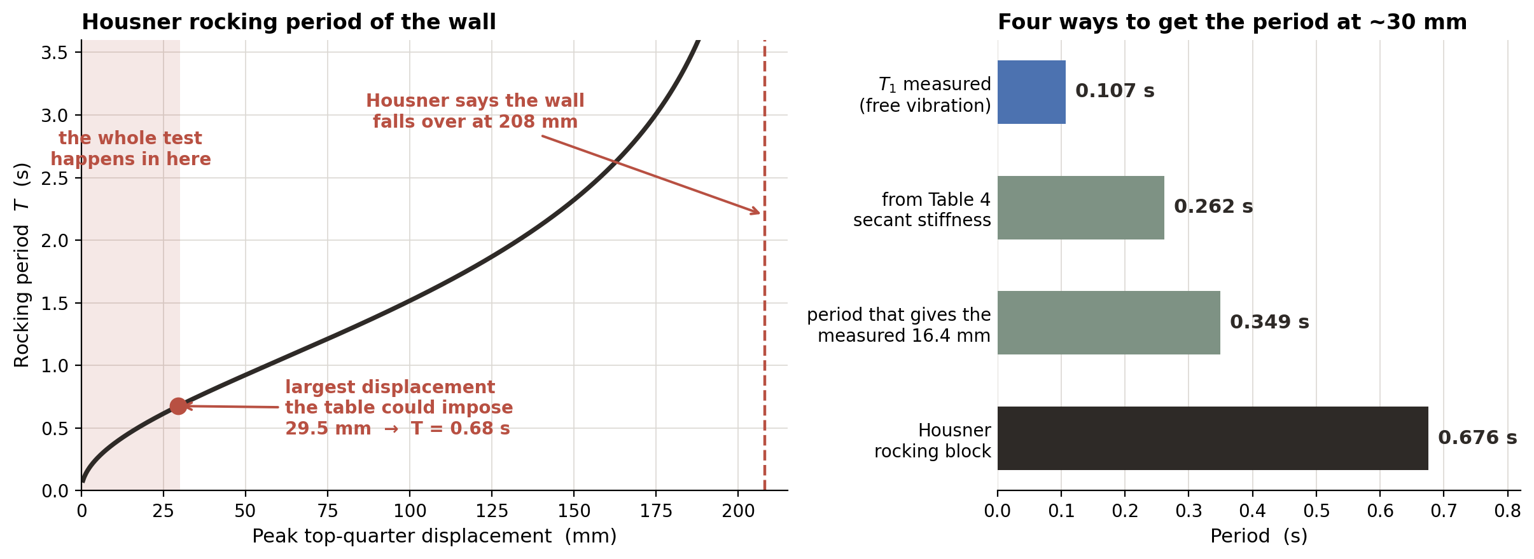
10
The rocking period, and why the formula is wrong here
The idea is right. The way we compute the period is not.
Housner is a free-standing block. Ours is held at the top, pressed by springs and tied to joists. It gives 0.68 s where the measurements say 0.26–0.35 s.
Notes:
[2:00] Explain the curve in one line: a rocking block has no fixed period - the further it leans, the slower it rocks, because the weight has less lever arm to push it back. That is the physics we are using, and the idea is sound. The problem is the formula. Housner assumes a free block; ours is restrained at the top, precompressed and tied to joists. Two independent checks say the period at 30 mm is 0.26-0.35 s, not 0.68 s. And Housner puts overturning at 208 mm while the test never went past 30 mm - so it would say the wall was nowhere near failure. Land this: keep the idea, replace the formula with a secant period from a pushover.

Slide 12
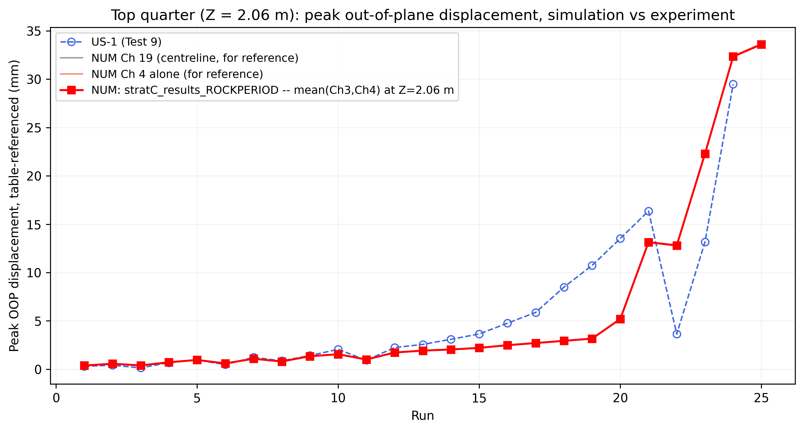
11
The rocking-period run: the result, and what it cost
It reaches the measurement. Look at the intensity it needed.
What it was driven at
run
commanded
table
21
0.82 g
0.78 g
22
0.87 g
0.27 g
23
1.20 g
0.42 g
24
1.67 g
0.48 g
25
2.80 g
0.76 g
The run 24 match was bought at 3.5× the table’s acceleration. Cycles also saturated at the code limit of 10.0 on runs 22–25, against 0.6–0.7 earlier. Shaping the pulse at the rocking period instead delivers the same demand at 0.30 / 0.44 / 0.52 / 0.57 g.
Notes:
[2:00] Show the result honestly. The curve crosses the experiment at run 24, but the log says runs 22-25 were driven at 0.87, 1.20, 1.67 and 2.80 g against a table that reached 0.78 g, and the cycle count hit its code limit of 10 on all four. So run 24 is not a prediction of 29.5 mm - the driver commanded 65.5 mm of spectral displacement and the model returned 32. The fix is one variable: shape the pulse at the rocking period rather than only reading Sd there. That gives the same demand at 0.30-0.57 g, all inside table capacity, and the commanded values then land within 5-11 percent of what the table actually applied. That last point is the result worth showing - the scheme finds the right intensity on its own.

Slide 13
12
Why the demand had to be 65 mm
The target and the pulse were set at two different periods
Before
After
What this means
v0, the completed run
v1, one variable changed
Run 24 is not a prediction of 29.5 mm.
We asked for 65.5 mm and the model gave back 32.
It returns about half because it softens during the pulse and drifts off the drive frequency.
Sd read at
0.484 s
Sd read at
0.484 s
pulse built at
0.131 s
pulse built at
0.484 s
target
65.5 mm
target
65.5 mm
needed
1.67 g
needed
0.52 g
cycles
10.0 (code limit)
cycles
0.64
Build the pulse at the period the target is read at. Same demand, a third of the acceleration, and the commanded values then land within 5–11% of what the table actually applied.
Notes:
[2:00] This is the diagnosis of the previous slide. We read the spectrum at the rocking period, about 0.48 s, where FR76 x1.75 offers 65.5 mm. But we built the pulse at 0.131 s, the ring-down period. Making a 0.131 s pulse deliver 65.5 mm of spectral displacement takes 1.67 g - that is the whole reason for the violent input. Say the key line plainly: run 24 is not a prediction of 29.5 mm, it is a demand of 65.5 mm that the model half-followed. The fix is one variable. Same target, 0.52 g instead of 1.67 g.

Slide 14
13
Two explanations — and one test that separates them
Both explain why the model is low. They disagree about what to change.
Damping
Matching period
The control run
IMC2026 position
this analysis
Drive the model with the measured table motion.
No period. No intensity measure. No damping assumption. Nothing to tune.
Records identified: runs 4, 11, 22.
3% Rayleigh suppresses rocking as the wall softens
Hysteresis slopes, mechanism and cracks all match
Fix: a damping model suited to rocking
We command Sd at 0.107 s; the wall moves at 0.26–0.35 s
Model returns about Sd_target on two runs
Fix: the period we read the spectrum at
Taking the period from the model’s own previous run has been tried four ways. All four stall: the wall does not crack, so the period never moves.
Notes:
[2:00] Set them side by side and be explicit that damping is our published position and you are not dismissing it. Both hypotheses are consistent with everything in IMC2026 - loop stiffness, mechanism, crack pattern. They differ only in what fixes it, which is why the room has to choose. Then the control run: drive the model with the measured table motion, no period choice, no intensity measure, no damping assumption, nothing to tune. Three simulations settle it. Mention the four self-locking variants briefly - the purpose is to stop anyone proposing what has already failed, not to dwell on it.

Slide 15
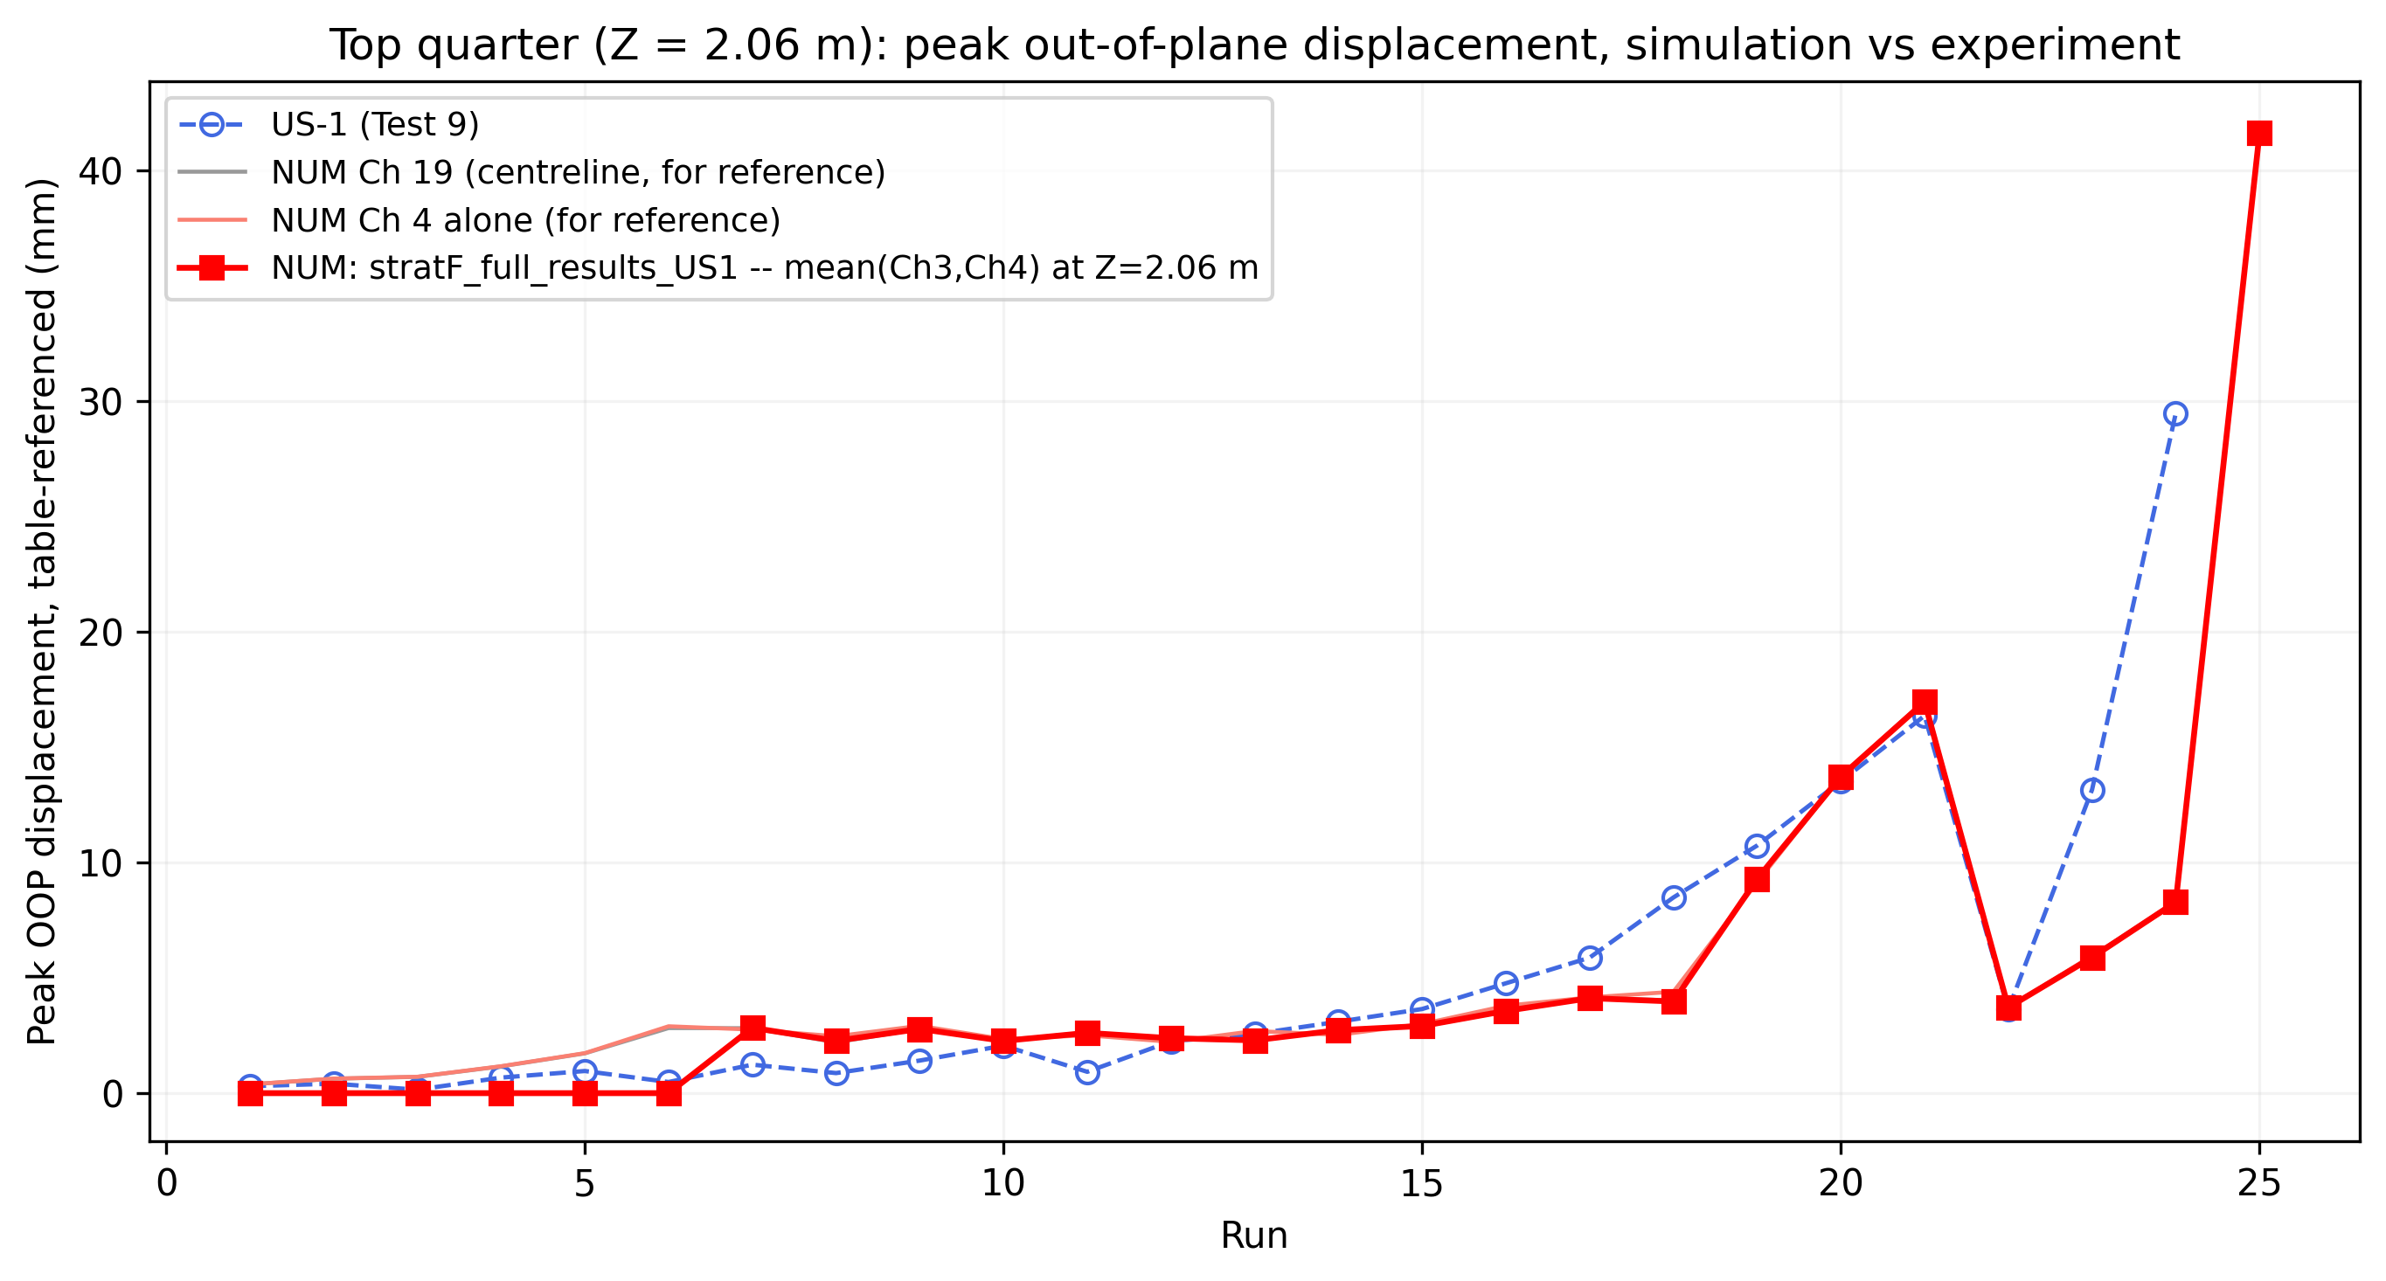
14
The control run, completed
Runs 1–25 with the measured records. Nothing tuned — only the Table 2 scale factors.
The verdict splits
Runs 1–22: the model matches — 17.0 vs 16.4 mm at run 21, and the run-22 dip is reproduced. The pulse gap here was the loading.
Runs 23–24: still 2.2× and 3.6× short with the real record. This gap is the model.
Run 25: 41.6 mm — the surge arrives one run late.
Caveat before treating 23–24 as final: this run used small strain and no damping — the driver itself warns large-displacement results need large strain on. Re-run 23–25 with large strain from the run-22 save (~1–2 h) before concluding.
Notes:
[2:00] This is the answer to question 1, and it splits. With the measured table motion and nothing adaptive at all, the model tracks the experiment through run 22 - including the dip at the record switch, which no pulse variant reproduced because it is a property of the record, not the intensity. So the under-prediction we have argued about all along was the LOADING for runs 1-22. But runs 23 and 24 stay short by 2.2x and 3.6x under the real record - there is no loading left to blame, so that residual is the MODEL. Candidates in order: small strain (this run had it off, and rocking softening is geometric), the bonded joist pockets, the rigid-block toe. Run 25 reaching 41.6 mm shows the model can go large - it gets there one run late, which reads as damage accumulating too slowly. One bookkeeping note: runs 1-6 report exactly zero while Ch4 alone reads about 2 mm - likely an export or averaging artefact, being checked.

Slide 16
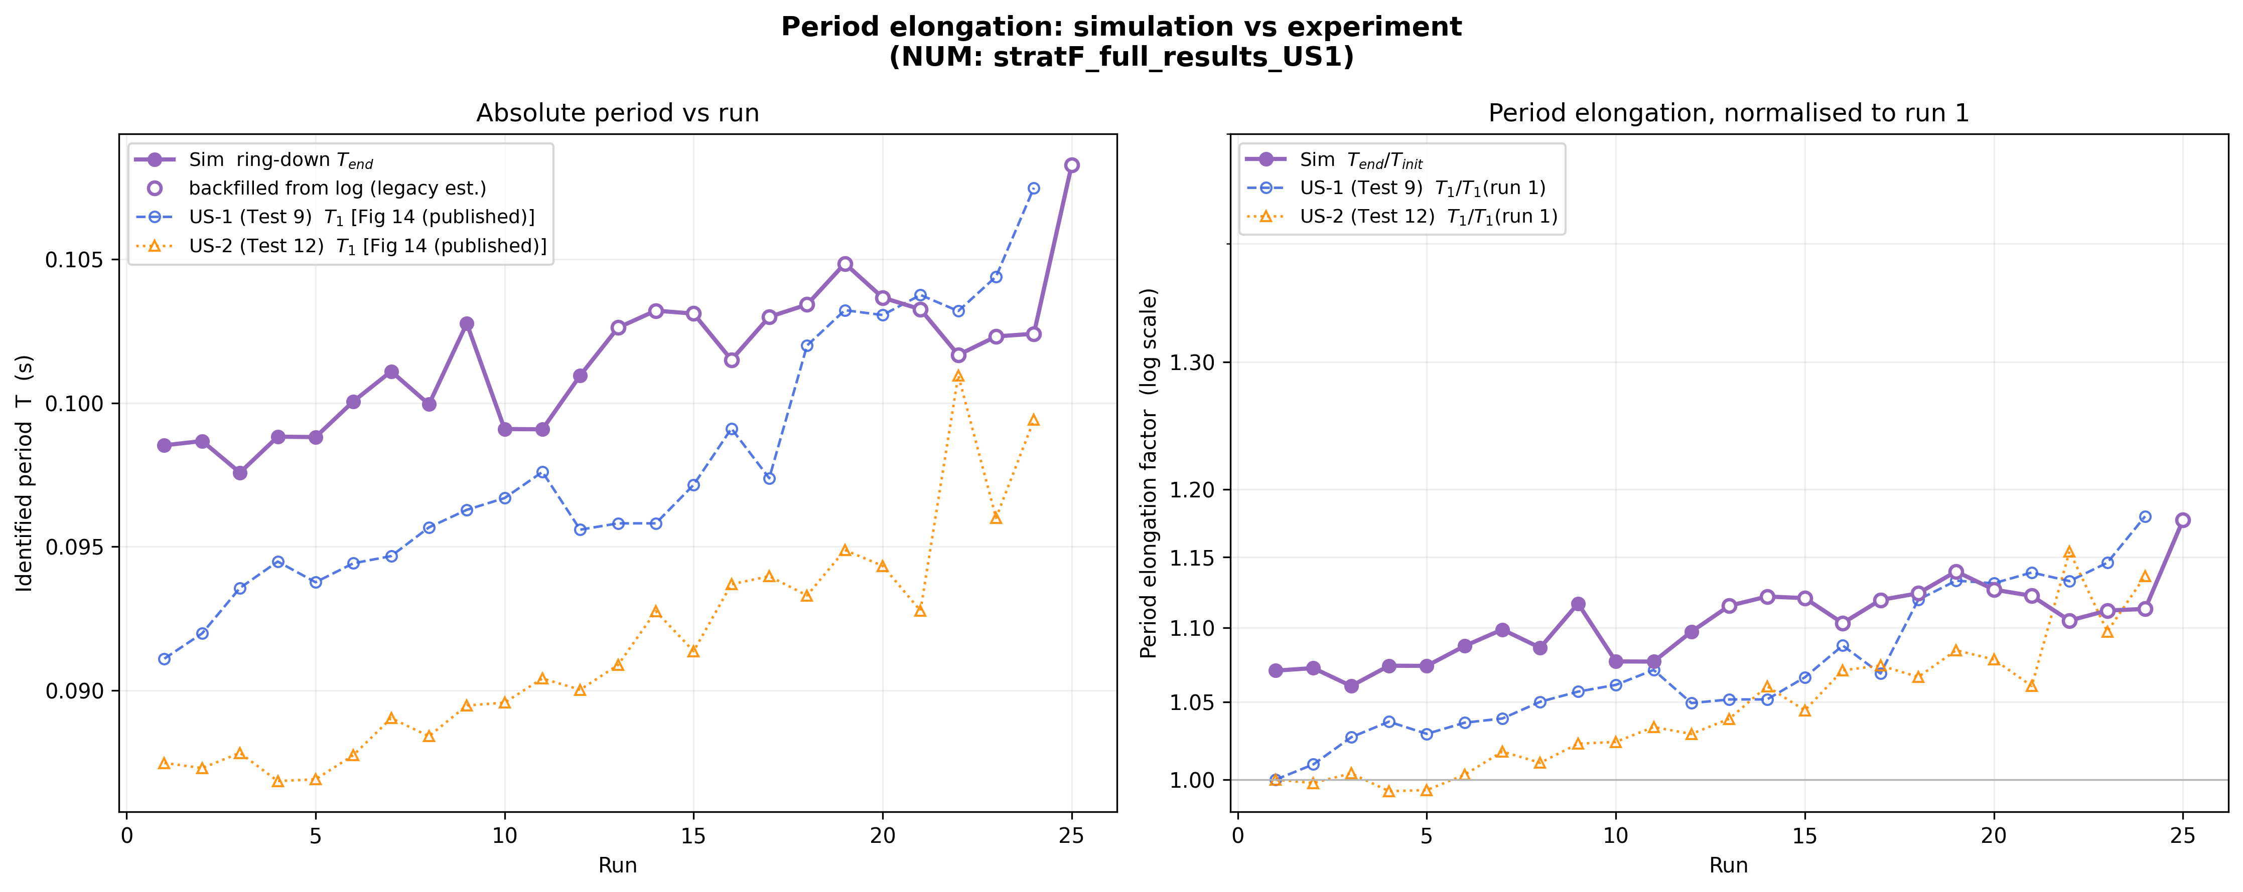
15
The control run: period and tilt
Same run, the other two measurements
Elongation ends together: model 1.18, US-1 1.18. Peak tilt tracks to run 21 with the run-22 dip. Residual tilt: the model holds zero to run 18, then leans; the walls drift from run 1 — the joist slip the bonded pockets cannot produce.
Notes:
[1:30] Period, right panel: the elongation curves end at the same place, 1.18 for both. The model starts 8 percent high in absolute terms (0.0985 vs 0.091 s) but accumulates damage at the right rate. Tilt, left: peak tilt tracks the experiment to run 21 and reproduces the run-22 dip. Tilt, right: the one clear miss - both walls lean steadily from run 1 (that is the joist slip, 8-12 mm cumulative in the paper) while the model holds zero until run 18. With the pockets bonded, the model has no mechanism for that early drift. It catches the late positive swing though, and ends near the measured value.

Slide 17
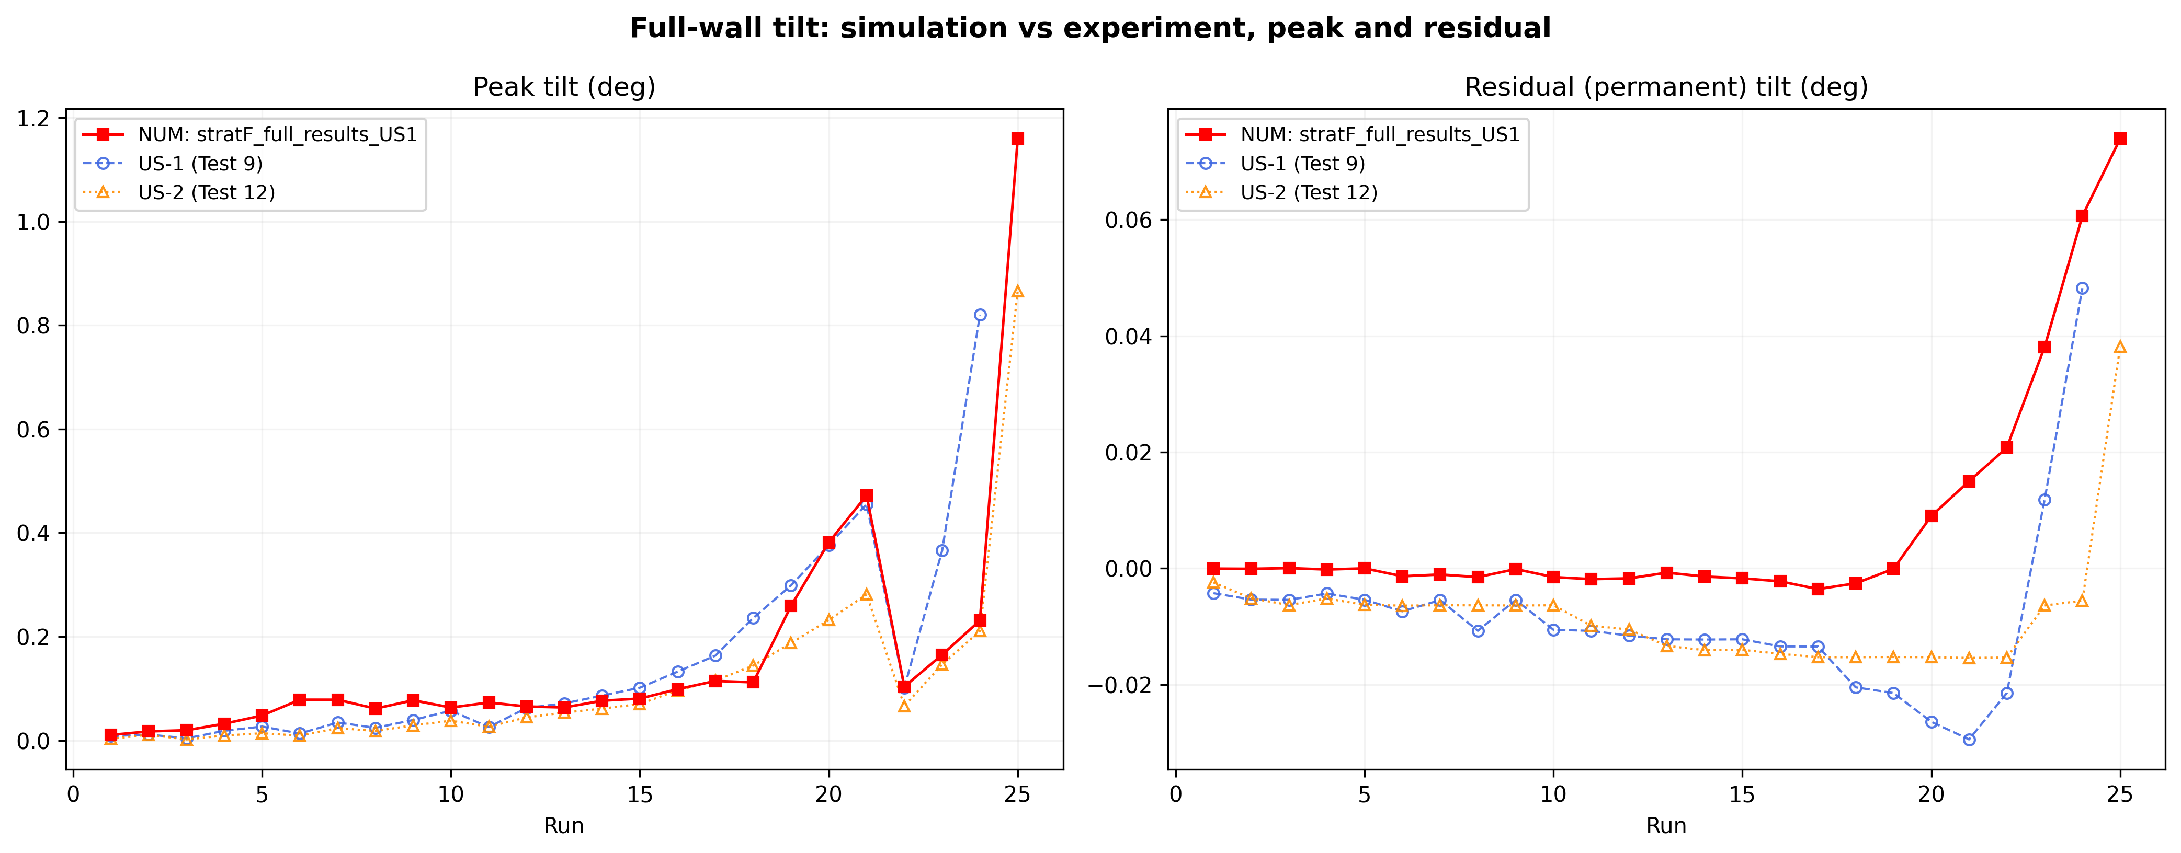
16
The control run: period and tilt
Same run, the other two measurements
Elongation ends together: model 1.18, US-1 1.18. Peak tilt tracks to run 21 with the run-22 dip. Residual tilt: the model holds zero to run 18, then leans; the walls drift from run 1 — the joist slip the bonded pockets cannot produce.
Notes:
[1:30] Period, right panel: the elongation curves end at the same place, 1.18 for both. The model starts 8 percent high in absolute terms (0.0985 vs 0.091 s) but accumulates damage at the right rate. Tilt, left: peak tilt tracks the experiment to run 21 and reproduces the run-22 dip. Tilt, right: the one clear miss - both walls lean steadily from run 1 (that is the joist slip, 8-12 mm cumulative in the paper) while the model holds zero until run 18. With the pockets bonded, the model has no mechanism for that early drift. It catches the late positive swing though, and ends near the measured value.

Slide 18
17
What I propose to do next
In this order. The first one cannot be tuned.
Pushover
1
One run. Force against displacement, compared with Table 4: 29.5 kN at 30 mm. Tells us whether the model is too strong. No period, no intensity measure, no damping assumption.
Re-run 22–25 with the pulse at the rocking period
2
Same targets, 0.30 / 0.44 / 0.52 / 0.57 g. Check whether the commanded intensity lands on what the table applied.
Replace Housner with the secant period
3
From the pushover curve. Removes the free-block assumption that gives 0.68 s where the measurements say 0.26–0.35 s.
Notes:
[1:30] Order matters. The pushover is first because it is the only test here that cannot be tuned into agreeing - one run, one anchor from Table 4. It also gives the secant period that replaces Housner, so steps 1 and 3 are the same simulation. Step 2 is the driver that is already written and is a one-variable change from the run you have seen. Step 4 is the data request; put it last so it does not swallow the discussion.

