Slide 1






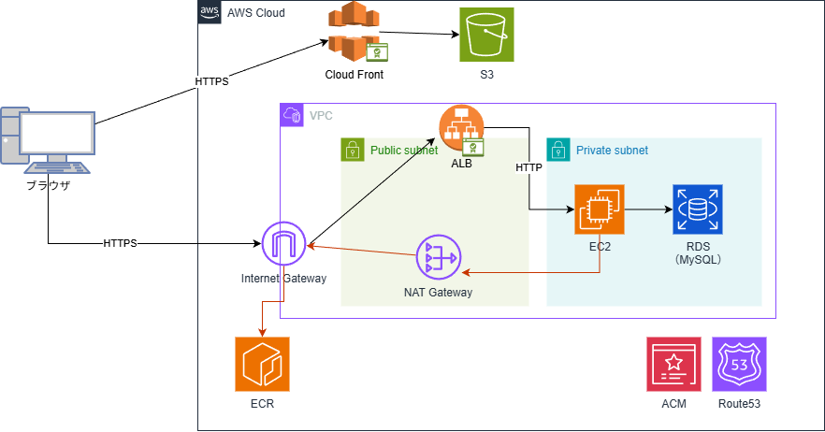




net/http, log/slog

