Slide 1


Property
services.
For homes and company facilities
Company profile
Oceanides Plumbing Siphoning &
Pest Management Services OPC
Illustrative architecture
Notes:
Company facts and contacts: clients/oceanides/company-profile/premium-content.json.
Blue corporate editorial direction informed by https://www.magnific.com/premium-vector/modern-company-profile-brochure-template-layout_422990779.htm. Layout and artwork are authored for Oceanides, not copied from the template.
Stock architecture: To Tao/Pexels, https://www.pexels.com/photo/windows-in-modern-office-building-14765373/ . License: https://www.pexels.com/license/ . Illustrative use only, not an Oceanides project.
This cover replaces the former white home-cutaway composition.

Slide 2
Company
background
2021
Established
Oceanides coordinates property services
for homes, condominiums and
company facilities.
Septic tank cleaning
and plumbing services
We remain your main contact for scheduling,
site access and service coordination from
inquiry to turnover.
Today
Five service groups
for property upkeep
Clear assessment. Agreed scope. Written quotation.
Notes:
Company facts and contacts: clients/oceanides/company-profile/premium-content.json.
Blue corporate editorial direction informed by https://www.magnific.com/premium-vector/modern-company-profile-brochure-template-layout_422990779.htm. Layout and artwork are authored for Oceanides, not copied from the template.
Founding year: the user-provided Oceanides.pptx, slide 1, states "Oceanides Plumbing Services was established in 2021".
No additional milestone dates, founders or achieved accreditations are inferred.
Mission: Provide professional service through clear assessment, practical solutions and cost-conscious planning.
Vision: Be a trusted service partner for the care and upkeep of homes and facilities.

Slide 3
Our service
offering
A defined scope for
each property concern.
01
Siphoning
02
Plumbing
Septic tank siphoning and cleaning.
Site and service assessment.
Declogging, pipe leak repairs
and plumbing troubleshooting.
03
Renovation & restoration
04
Pest control
House and condo repairs, ceilings,
roof leaks, waterproofing and cleaning.
Assessment, treatment scope
and service coordination.
05
Sewage treatment plant
On-site wastewater treatment projects.
Assessment and specialist coordination.
Notes:
Company facts and contacts: clients/oceanides/company-profile/premium-content.json.
Blue corporate editorial direction informed by https://www.magnific.com/premium-vector/modern-company-profile-brochure-template-layout_422990779.htm. Layout and artwork are authored for Oceanides, not copied from the template.
All five approved service groups are represented. Service details remain subject to the assessed site and agreed quotation.

Slide 4
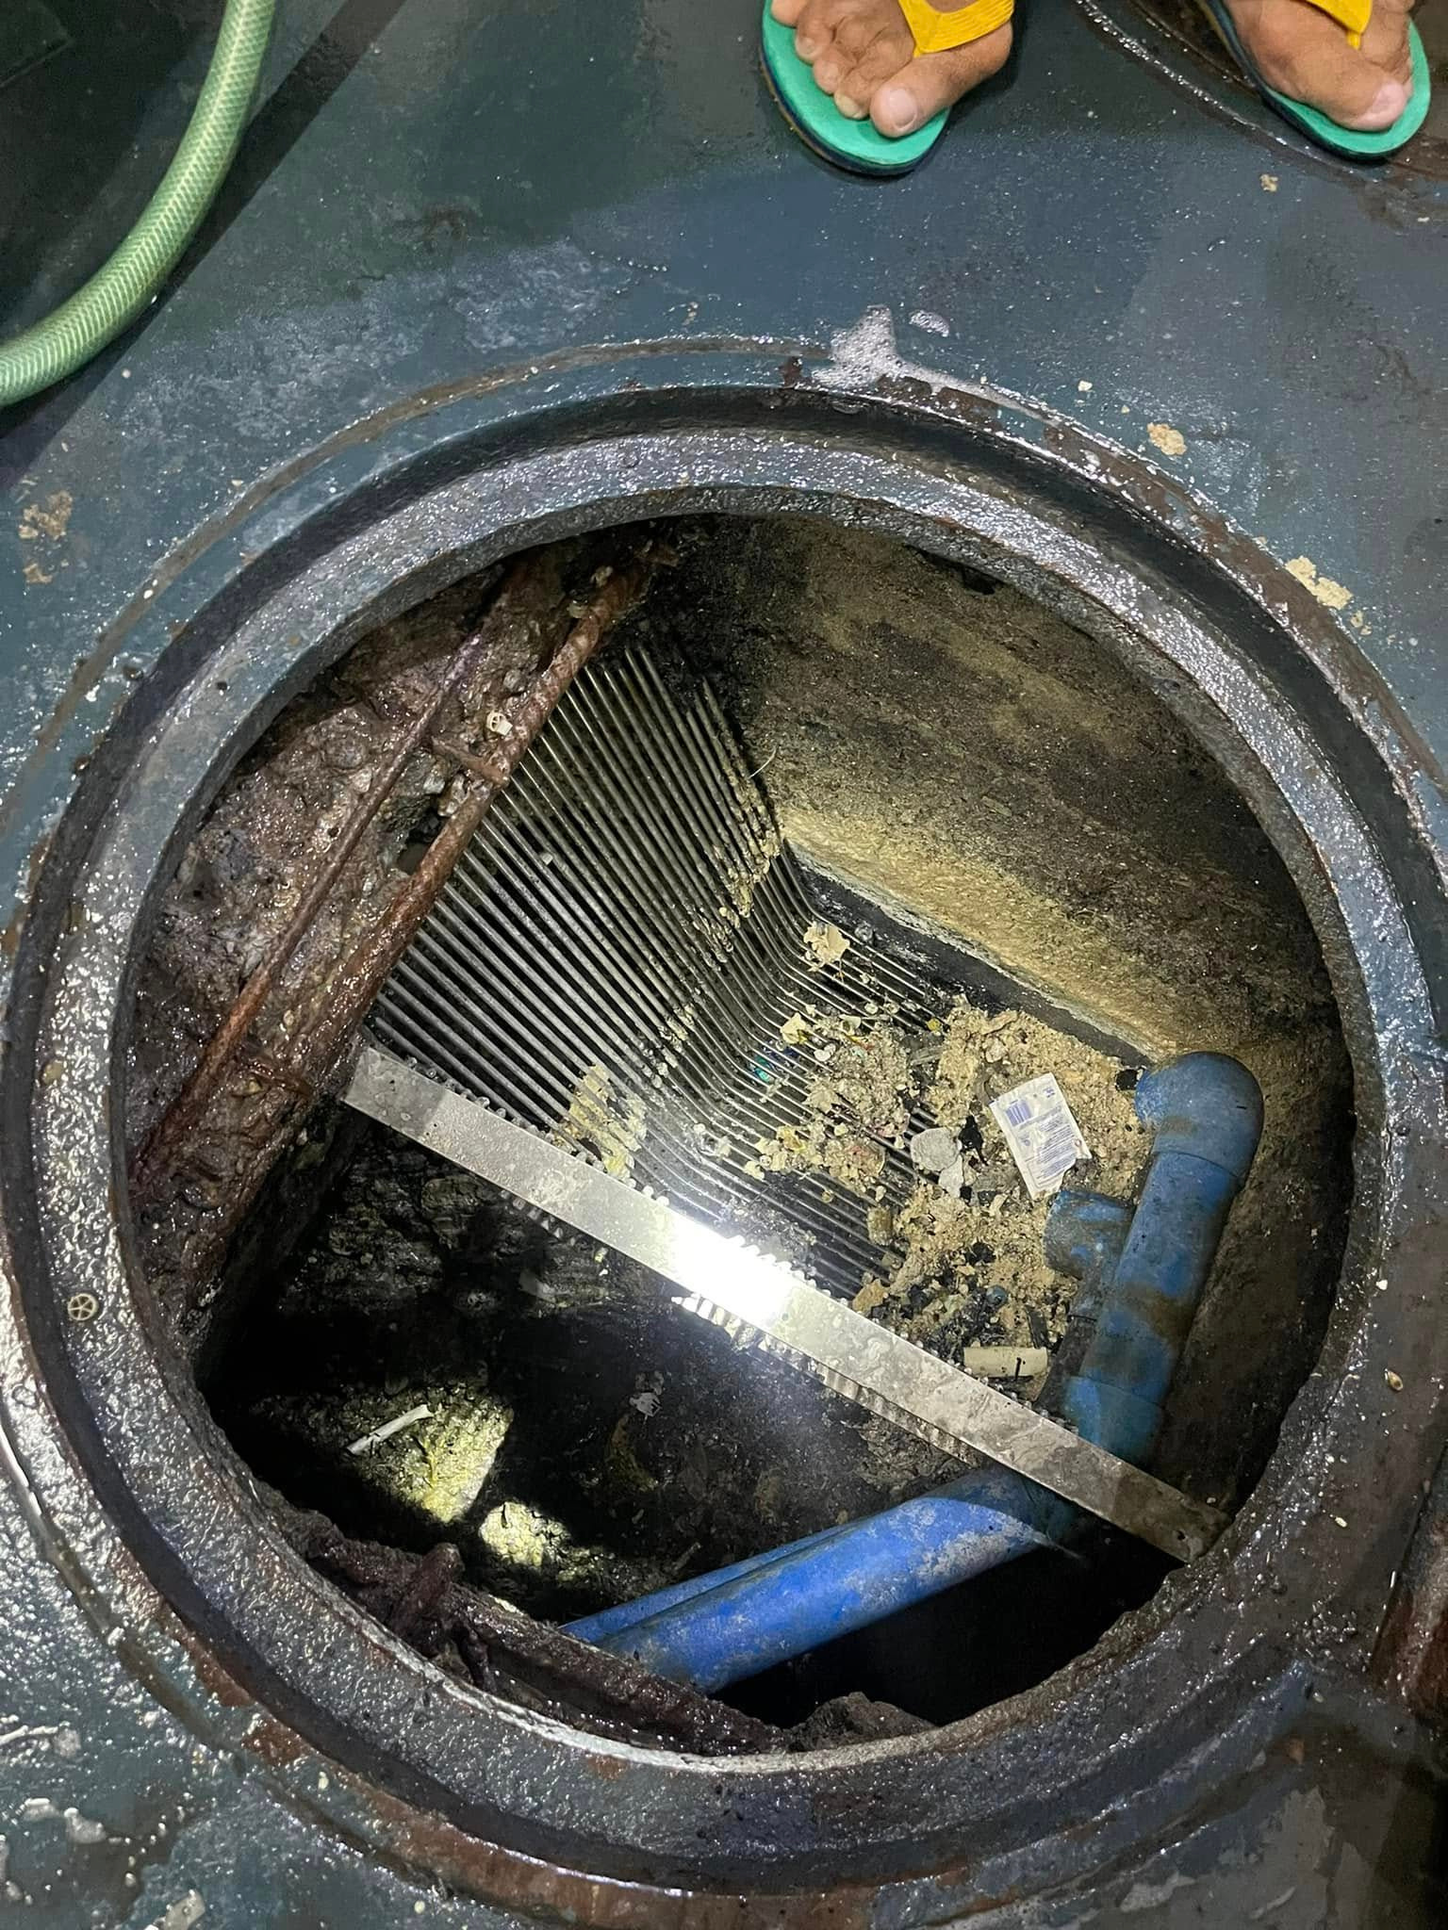
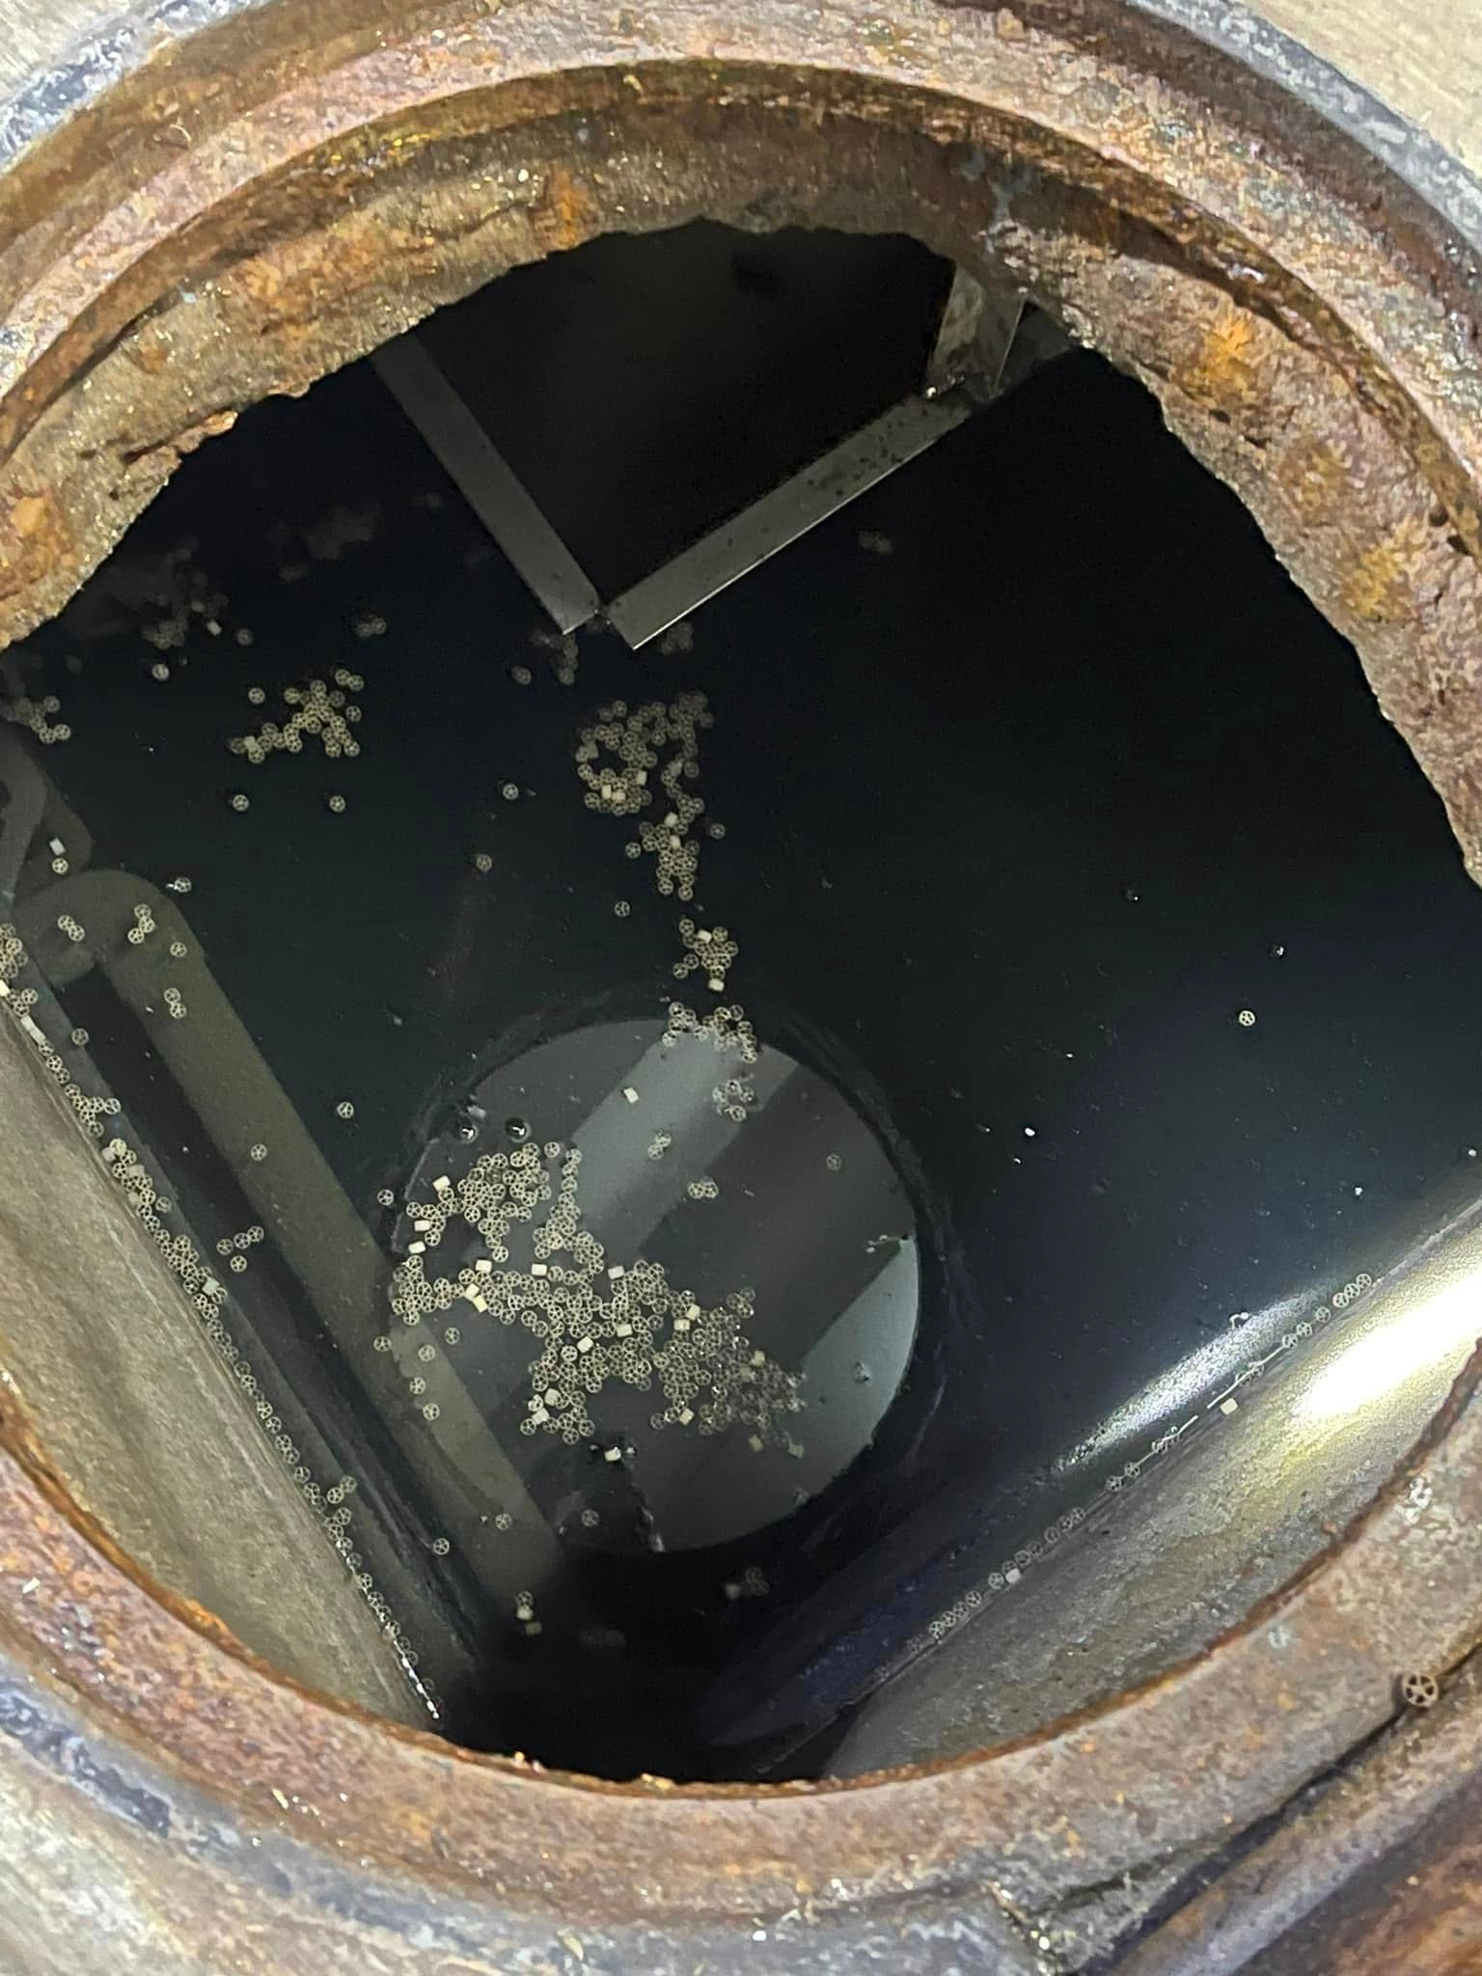
Original job photographs
Siphoning
Septic tank servicing
based on conditions
and site access.
Septic tank siphoning
Septic tank cleaning
Site assessment
Before service
After service
A documented job. Service needs vary by tank and site.
Notes:
Company facts and contacts: clients/oceanides/company-profile/premium-content.json.
Blue corporate editorial direction informed by https://www.magnific.com/premium-vector/modern-company-profile-brochure-template-layout_422990779.htm. Layout and artwork are authored for Oceanides, not copied from the template.
Original source files: clients/oceanides/assets/before-1.jpg and after-1.jpg.
The AI-recreated tb2-ba2 pair is excluded. Original proportions are preserved without cropping.
Photographs document this specific service, not a guarantee for every site.

Slide 5

Plumbing
Assessment and repair of
drainage, pipe and
water leak problems.
Drain declogging
Plumbing and pipe leak repairs
Troubleshooting based
on site findings
AI-generated service illustration
Notes:
Company facts and contacts: clients/oceanides/company-profile/premium-content.json.
Blue corporate editorial direction informed by https://www.magnific.com/premium-vector/modern-company-profile-brochure-template-layout_422990779.htm. Layout and artwork are authored for Oceanides, not copied from the template.
Illustration: company-profile/assets/plumbing-service.png. It does not depict Oceanides personnel or a completed project. Working hands, wrench and pipe remain visible.

Slide 6

Renovation &
restoration
Repairs and improvements tailored
to the property and agreed scope.
AI-generated service illustration
House and condo
renovation
Roof leak repair
and waterproofing
Ceiling repair or replacement
House cleaning within the agreed scope
Notes:
Company facts and contacts: clients/oceanides/company-profile/premium-content.json.
Blue corporate editorial direction informed by https://www.magnific.com/premium-vector/modern-company-profile-brochure-template-layout_422990779.htm. Layout and artwork are authored for Oceanides, not copied from the template.
All approved renovation and restoration scopes retained, including ceiling replacement, roof leaks, waterproofing and house cleaning.
Illustration: company-profile/assets/renovation-service.png. It is not evidence of Oceanides personnel or a completed job.

Slide 7
Pest control
Service planning starts with
the concern at your property.
Assessment
Treatment scope
Coordination
Review reported concerns
and signs of pest activity.
Base the proposed service
on site findings.
Arrange scheduling and
the appropriate contractor.
Notes:
Company facts and contacts: clients/oceanides/company-profile/premium-content.json.
Blue corporate editorial direction informed by https://www.magnific.com/premium-vector/modern-company-profile-brochure-template-layout_422990779.htm. Layout and artwork are authored for Oceanides, not copied from the template.
Pest service is presented as assessment-led planning and coordination. No unsupported pesticide, licensing, treatment guarantee or staff claim is introduced.

Slide 8
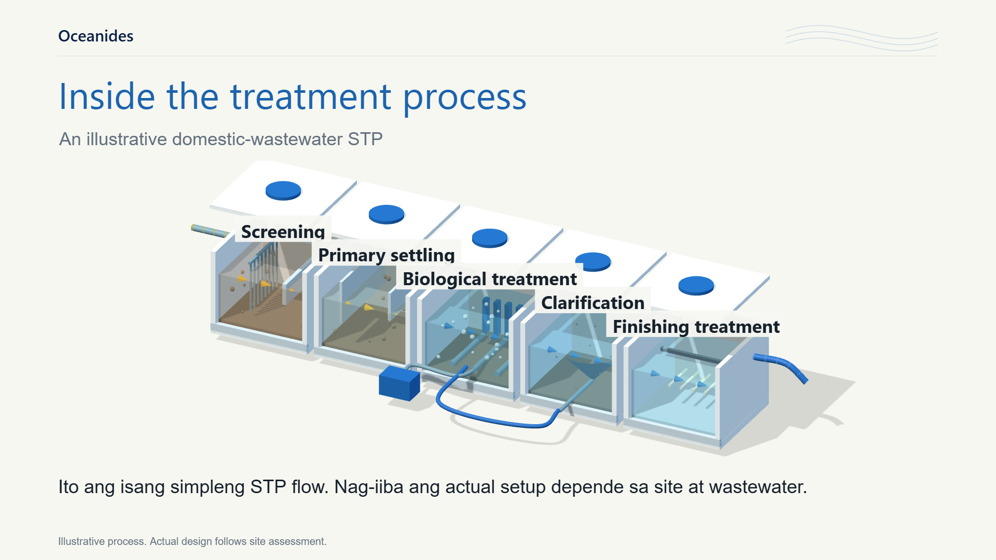
On-site
wastewater
treatment
Site requirements first
Volume. Space. Outlet. Operating costs.
Sewage treatment plant (STP)
Building wastewater treatment.
Assessment, technical proposal
and specialist coordination.
Sludge removal and equipment care
continue after installation.
Illustrative process. Actual design follows assessment.
Notes:
Company facts and contacts: clients/oceanides/company-profile/premium-content.json.
Blue corporate editorial direction informed by https://www.magnific.com/premium-vector/modern-company-profile-brochure-template-layout_422990779.htm. Layout and artwork are authored for Oceanides, not copied from the template.
Suitability depends on wastewater volume, available space, outlet requirements and operating costs. Capacity, treatment performance and maintenance follow the agreed technical proposal. Sludge removal and equipment care continue after installation.
Existing approved film model is illustrative, not a supplier-specific design or owned Oceanides facility.
https://www.youtube.com/watch?v=w_60iJEAf4c
https://www.epa.gov/npdes/peak-flows-sewage-treatment-plants
https://www.fujicleanusa.com/homeowners-faq
https://r7.emb.gov.ph/wp-content/uploads/2022/05/OPMS-DISCHARGE-PERMIT-Application-Guideline.pdf

Slide 9
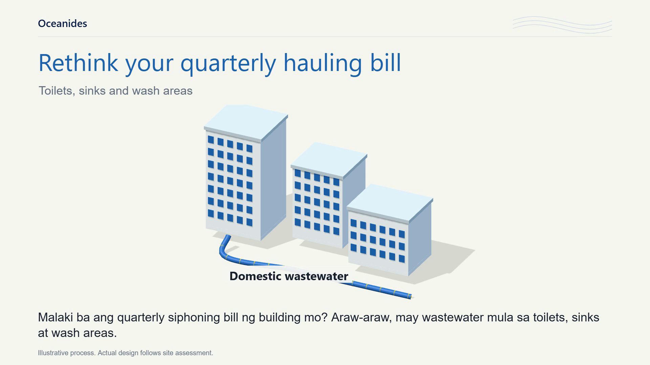
Notes:
Company facts and contacts: clients/oceanides/company-profile/premium-content.json.
Blue corporate editorial direction informed by https://www.magnific.com/premium-vector/modern-company-profile-brochure-template-layout_422990779.htm. Layout and artwork are authored for Oceanides, not copied from the template.
Click to play the embedded film. Duration 99.733 seconds. Approved picture sequence, narration and music remain byte-for-byte unchanged.
General treatment illustration. Site-specific suitability, capacity and maintenance follow the technical proposal.
https://www.youtube.com/watch?v=w_60iJEAf4c
https://www.epa.gov/npdes/peak-flows-sewage-treatment-plants
https://www.fujicleanusa.com/homeowners-faq
https://r7.emb.gov.ph/wp-content/uploads/2022/05/OPMS-DISCHARGE-PERMIT-Application-Guideline.pdf

Slide 10
Site assessment
and quotation
Contact
0917 671 6383
Share the service you need, the location
and your preferred inspection schedule.
Globe
marketing@
oceanidessepticandpest.com
01
02
03
04
Assess
Quote
Coordinate
Turn over
Tramo Street Corner Dandan,
Pasay City, Philippines 1300
Final scope, pricing and scheduling follow
the site assessment and agreed quotation.
Notes:
Company facts and contacts: clients/oceanides/company-profile/premium-content.json.
Blue corporate editorial direction informed by https://www.magnific.com/premium-vector/modern-company-profile-brochure-template-layout_422990779.htm. Layout and artwork are authored for Oceanides, not copied from the template.
Share your supplier requirements so we can coordinate company documents and project information for your review.
Tell us the service you need, the property location and your preferred inspection schedule. We will coordinate the assessment and prepare a quotation based on the findings.
Oceanides Plumbing Siphoning & Pest Management Services OPC

