Slide 1


Company profile
Property services
One point of contact
AI-generated property-services concept
Siphoning. Plumbing. Renovation & restoration. Pest control.
Oceanides Plumbing Siphoning & Pest Management Services OPC
Oceanides
01
Notes:
Logo: transparent outer-background derivative requested by Neil, from canonical clients/oceanides/assets/logo.jpg. Source and edit brief: company-profile/assets/generated-sources.json.
Service scope, Oceanides coordination and intended audience: user briefing in this chat.
Phone, email and address: user-supplied Facebook Page screenshot 1000040025.jpg; phone also explicitly confirmed by Neil.
Legal company name: workflows/oceanides_business_model.md, existing company records.
Design references: Apple 2025 Environmental Progress Report https://www.apple.com/environment/pdf/Apple_Environmental_Progress_Report_2025.pdf and OpenAI public Design Guidelines https://openai.com/brand/ ; profile-specific direction in clients/oceanides/DESIGN.md. No third-party brand marks used.
No assertion of supplier accreditation, equipment ownership, licenses, project volume, treatment-system capability or maintenance-free operation.
Cover: AI-generated conceptual property cutaway, not a real project or engineering plan. Exact generation brief: company-profile/assets/generated-sources.json.

Slide 2
Oceanides
Company profile
Services for the places
you live and work
Oceanides coordinates property services for homes, condominiums
and company facilities. Our service offering covers siphoning,
plumbing, renovation and restoration, and pest control.
Siphoning
Septic tank siphoning and cleaning.
Plumbing
Drain declogging and pipe leak repairs.
Renovation &
House and condominium repairs and
restoration
improvements.
Pest control
Site assessment, treatment scope and
service coordination.
One contact through turnover
Oceanides coordinates assessment, quotation and delivery, including specialist
contractors where required.
Oceanides
02
Notes:
Logo: transparent outer-background derivative requested by Neil, from canonical clients/oceanides/assets/logo.jpg. Source and edit brief: company-profile/assets/generated-sources.json.
Service scope, Oceanides coordination and intended audience: user briefing in this chat.
Phone, email and address: user-supplied Facebook Page screenshot 1000040025.jpg; phone also explicitly confirmed by Neil.
Legal company name: workflows/oceanides_business_model.md, existing company records.
Design references: Apple 2025 Environmental Progress Report https://www.apple.com/environment/pdf/Apple_Environmental_Progress_Report_2025.pdf and OpenAI public Design Guidelines https://openai.com/brand/ ; profile-specific direction in clients/oceanides/DESIGN.md. No third-party brand marks used.
No assertion of supplier accreditation, equipment ownership, licenses, project volume, treatment-system capability or maintenance-free operation.

Slide 3



Oceanides
Company profile
Siphoning &
plumbing
Septic tank services, drain declogging and plumbing repairs.
Service scope
Septic tank siphoning
Septic tank cleaning
Drain declogging
Pipe leak repairs
AI-generated service illustration
Actual siphoning work
Same site before and after service
Before service
After service
Scope follows site access and tank or pipe conditions.
Oceanides
03
Notes:
Logo: transparent outer-background derivative requested by Neil, from canonical clients/oceanides/assets/logo.jpg. Source and edit brief: company-profile/assets/generated-sources.json.
Service scope, Oceanides coordination and intended audience: user briefing in this chat.
Phone, email and address: user-supplied Facebook Page screenshot 1000040025.jpg; phone also explicitly confirmed by Neil.
Legal company name: workflows/oceanides_business_model.md, existing company records.
Design references: Apple 2025 Environmental Progress Report https://www.apple.com/environment/pdf/Apple_Environmental_Progress_Report_2025.pdf and OpenAI public Design Guidelines https://openai.com/brand/ ; profile-specific direction in clients/oceanides/DESIGN.md. No third-party brand marks used.
No assertion of supplier accreditation, equipment ownership, licenses, project volume, treatment-system capability or maintenance-free operation.
Matched before/after pair: clients/oceanides/assets/tb2-ba2-before.png and tb2-ba2-after.png. Neil confirmed real job photos on 2026-08-01; see client DESIGN.md and asset-builder source.Service scene: AI-generated fictional specialist, visibly labeled. Not an actual Oceanides employee or completed project. Exact generation brief: company-profile/assets/generated-sources.json.

Slide 4

Oceanides
Company profile
Renovation &
restoration
Repair and improvement work for houses and condominiums.
AI-generated service illustration
Ceilings
Water protection
Repair and replacement
Roof leak repair and waterproofing
Renovation & restoration
Cleaning
Houses and condominiums
House cleaning to agreed scope
Oceanides
04
Notes:
Logo: transparent outer-background derivative requested by Neil, from canonical clients/oceanides/assets/logo.jpg. Source and edit brief: company-profile/assets/generated-sources.json.
Service scope, Oceanides coordination and intended audience: user briefing in this chat.
Phone, email and address: user-supplied Facebook Page screenshot 1000040025.jpg; phone also explicitly confirmed by Neil.
Legal company name: workflows/oceanides_business_model.md, existing company records.
Design references: Apple 2025 Environmental Progress Report https://www.apple.com/environment/pdf/Apple_Environmental_Progress_Report_2025.pdf and OpenAI public Design Guidelines https://openai.com/brand/ ; profile-specific direction in clients/oceanides/DESIGN.md. No third-party brand marks used.
No assertion of supplier accreditation, equipment ownership, licenses, project volume, treatment-system capability or maintenance-free operation.
Service scene: AI-generated fictional specialist, visibly labeled. Not an actual Oceanides employee or completed project. Exact generation brief: company-profile/assets/generated-sources.json.

Slide 5
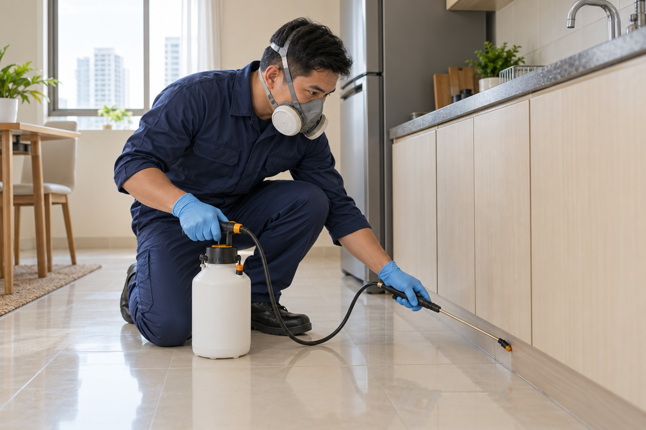
Oceanides
Company profile
AI-generated service illustration
Pest control
Pest control services based on an assessment of the property and the
pest concerns reported by the client.
Assessment of pest activity
Treatment scope based on site findings
Service scheduling and contractor coordination
Treatment and specialist requirements follow the site assessment.
Oceanides
05
Notes:
Logo: transparent outer-background derivative requested by Neil, from canonical clients/oceanides/assets/logo.jpg. Source and edit brief: company-profile/assets/generated-sources.json.
Service scope, Oceanides coordination and intended audience: user briefing in this chat.
Phone, email and address: user-supplied Facebook Page screenshot 1000040025.jpg; phone also explicitly confirmed by Neil.
Legal company name: workflows/oceanides_business_model.md, existing company records.
Design references: Apple 2025 Environmental Progress Report https://www.apple.com/environment/pdf/Apple_Environmental_Progress_Report_2025.pdf and OpenAI public Design Guidelines https://openai.com/brand/ ; profile-specific direction in clients/oceanides/DESIGN.md. No third-party brand marks used.
No assertion of supplier accreditation, equipment ownership, licenses, project volume, treatment-system capability or maintenance-free operation.
Service scene: AI-generated fictional specialist, visibly labeled. Not an actual Oceanides employee or completed project. Exact generation brief: company-profile/assets/generated-sources.json.

Slide 6
Your next step
Site assessment
Written quotation
Tell us the service, site location and preferred inspection schedule.
0917 671 6383
marketing@oceanidessepticandpest.com
Globe
Tramo Street Corner Dandan, Pasay City, Philippines 1300
Supplier accreditation
Share your procurement requirements. Oceanides can coordinate the company
documents and project information for your review.
Site assessment
Written quotation
Review the site and requirements.
Confirm the proposed scope and price.
Service coordination
Turnover
Arrange the field team or specialist.
Review the agreed work with the client.
Oceanides Plumbing Siphoning & Pest Management Services OPC
Final scope, pricing and scheduling depend on the site assessment and the agreed quotation.
Notes:
Logo: transparent outer-background derivative requested by Neil, from canonical clients/oceanides/assets/logo.jpg. Source and edit brief: company-profile/assets/generated-sources.json.
Service scope, Oceanides coordination and intended audience: user briefing in this chat.
Phone, email and address: user-supplied Facebook Page screenshot 1000040025.jpg; phone also explicitly confirmed by Neil.
Legal company name: workflows/oceanides_business_model.md, existing company records.
Design references: Apple 2025 Environmental Progress Report https://www.apple.com/environment/pdf/Apple_Environmental_Progress_Report_2025.pdf and OpenAI public Design Guidelines https://openai.com/brand/ ; profile-specific direction in clients/oceanides/DESIGN.md. No third-party brand marks used.
No assertion of supplier accreditation, equipment ownership, licenses, project volume, treatment-system capability or maintenance-free operation.

