Slide 1


OCEANIDES
Plumbing, Siphoning, and Pest Management Services OPC
Landline (02) 8633 8486 / (02) 8330 1329 Globe 0917 671 6383 Smart 0939 245 6217
marketing@oceanidessepticandpest.com | corporate@oceanidessepticandpest.com TIN 260-084-087-00000
COMPANY PROFILE
Property services
with Oceanides
Plumbing, septic tank services, pest
management, cleaning and property
improvement.
Commercial / Industrial / Residential
OCEANIDES
AI-generated conceptual illustration; not a completed project or engineering plan.
oceanidesph.com | facebook.com/OceanidesMalabanan
FIRST DRAFT
marketing@oceanidessepticandpest.com | corporate@oceanidessepticandpest.com
01
Notes:
Company profile cover. Company details supplied in voice interview 2026-10-11. Logo source unchanged.
Company interview and design instructions: 2026-10-11. Owner review required before customer circulation. Contact details from supplied HEADER 111 DOCX. Existing logo retained.
Suggested presentation script
Managing a property means keeping essential services working while your business continues. A full septic tank, blocked drain, plumbing leak, pest concern, or damaged ceiling can quickly add work for your team. Oceanides brings these service needs together through one familiar point of contact.
We began with plumbing and septic tank services, building ongoing relationships through repeat service. Today, Oceanides Plumbing, Siphoning, and Pest Management Services OPC offers a broader range of property services, including grease tank cleaning, pest management, general cleaning, renovation, restoration, and air-conditioning cleaning. Each engagement begins with a clear scope and a schedule agreed with your team.
For properties reviewing their wastewater arrangements, we also propose an onsite treatment system assessment. Our first step is to understand the site and confirm the right technical approach. We can then present an installation and operating proposal, including maintenance responsibilities and the support available after turnover. Any projected maintenance or cost benefit will be based on the actual site and proposed system.
We would welcome the opportunity to review your current service needs and prepare a practical proposal. Whether you need one immediate service or a coordinated maintenance plan, Oceanides is ready to discuss how we can support your property.

Slide 2
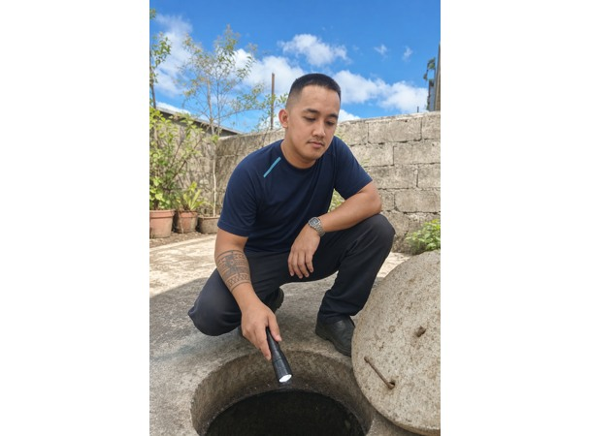
OCEANIDES
Plumbing, Siphoning, and Pest Management Services OPC
Landline (02) 8633 8486 / (02) 8330 1329 Globe 0917 671 6383 Smart 0939 245 6217
marketing@oceanidessepticandpest.com | corporate@oceanidessepticandpest.com TIN 260-084-087-00000
COMPANY OVERVIEW
About Oceanides
Oceanides brings essential property services together through one
service partner. We serve commercial, industrial and residential
properties, including restaurants, hotels, offices, warehouses, factories,
hospitals and homes.
Registered in 2023 as Oceanides Plumbing Services under DTI; now an
SEC-registered One Person Corporation.
Customer relationships built through recurring septic tank, grease tank
and plumbing service.
OCEANIDES
AI-generated service illustration
oceanidesph.com | facebook.com/OceanidesMalabanan
FIRST DRAFT
marketing@oceanidessepticandpest.com | corporate@oceanidessepticandpest.com
02
Notes:
Company overview. History and scope are owner-reported in the interview.
Company interview and design instructions: 2026-10-11. Owner review required before customer circulation. Contact details from supplied HEADER 111 DOCX. Existing logo retained.

Slide 3
OCEANIDES
Plumbing, Siphoning, and Pest Management Services OPC
Landline (02) 8633 8486 / (02) 8330 1329 Globe 0917 671 6383 Smart 0939 245 6217
marketing@oceanidessepticandpest.com | corporate@oceanidessepticandpest.com TIN 260-084-087-00000
SERVICE DIRECTORY
Our services
01
Septic tank siphoning
07
Pest management
02
Manual septic tank cleaning
08
General cleaning
03
Plumbing services
09
Renovation and restoration
04
Excavation services
10
Air-conditioning cleaning
05
Drain and pipe declogging
11
Onsite wastewater treatment systems
06
Grease tank and trap cleaning
OCEANIDES
oceanidesph.com | facebook.com/OceanidesMalabanan
FIRST DRAFT
marketing@oceanidessepticandpest.com | corporate@oceanidessepticandpest.com
03
Notes:
Service directory. Scope supplied by company owner. All work subject to site review and agreed quotation.
Company interview and design instructions: 2026-10-11. Owner review required before customer circulation. Contact details from supplied HEADER 111 DOCX. Existing logo retained.

Slide 4
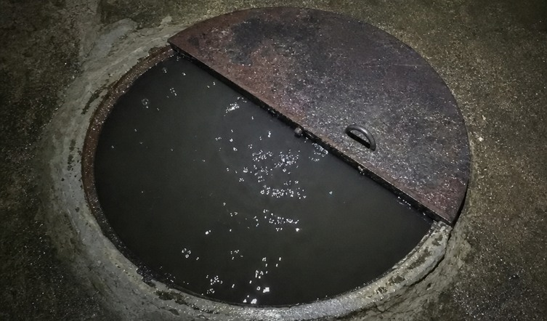
OCEANIDES
Plumbing, Siphoning, and Pest Management Services OPC
Landline (02) 8633 8486 / (02) 8330 1329 Globe 0917 671 6383 Smart 0939 245 6217
marketing@oceanidessepticandpest.com | corporate@oceanidessepticandpest.com TIN 260-084-087-00000
SERVICE 01
Septic Tank Siphoning
Plan septic tank servicing before an overflow disrupts
your property.
Oceanides provides septic tank siphoning for commercial, industrial,
and residential properties. We coordinate access, the work area, and the
agreed service schedule with your site representative.
01
Review of tank access and service requirements
02
Removal of accumulated septic contents within the agreed scope
03
Coordination with site personnel during the work
04
Recommendations for the next service based on site conditions
OCEANIDES
AI-generated service illustration
oceanidesph.com | facebook.com/OceanidesMalabanan
FIRST DRAFT
marketing@oceanidessepticandpest.com | corporate@oceanidessepticandpest.com
04
Notes:
Service: Septic Tank Siphoning. Copy based on owner interview; illustrative scope, final method and quotation follow assessment.
AI-generated service illustration; original image clients/oceanides/assets/tb2-hero-manhole.png
Company interview and design instructions: 2026-10-11. Owner review required before customer circulation. Contact details from supplied HEADER 111 DOCX. Existing logo retained.

Slide 5
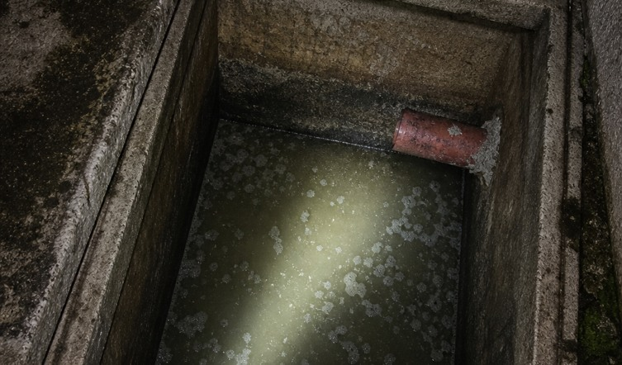
OCEANIDES
Plumbing, Siphoning, and Pest Management Services OPC
Landline (02) 8633 8486 / (02) 8330 1329 Globe 0917 671 6383 Smart 0939 245 6217
marketing@oceanidessepticandpest.com | corporate@oceanidessepticandpest.com TIN 260-084-087-00000
SERVICE 02
Manual Septic Tank Cleaning
Address deposits and buildup that require more
detailed cleaning.
Oceanides assesses deposits that need detailed cleaning beyond
siphoning. The method follows tank condition and access. Any
confined-space entry requires qualified personnel, suitable equipment,
and applicable safety procedures.
01
Assessment of remaining sludge and solid deposits
02
Selection of a suitable cleaning method
03
Detailed cleaning within the agreed work area
OCEANIDES
04
AI-generated service illustration
Site turnover and maintenance observations
oceanidesph.com | facebook.com/OceanidesMalabanan
FIRST DRAFT
marketing@oceanidessepticandpest.com | corporate@oceanidessepticandpest.com
05
Notes:
Service: Manual Septic Tank Cleaning. Copy based on owner interview; illustrative scope, final method and quotation follow assessment.
AI-generated service illustration; original image clients/oceanides/assets/tb2-hero-tank.png
Company interview and design instructions: 2026-10-11. Owner review required before customer circulation. Contact details from supplied HEADER 111 DOCX. Existing logo retained.

Slide 6
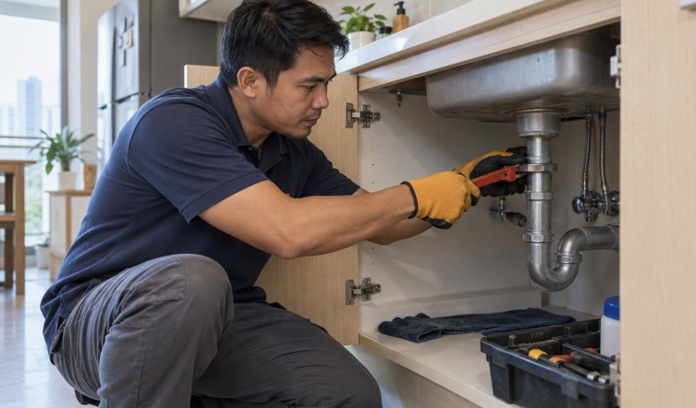
OCEANIDES
Plumbing, Siphoning, and Pest Management Services OPC
Landline (02) 8633 8486 / (02) 8330 1329 Globe 0917 671 6383 Smart 0939 245 6217
marketing@oceanidessepticandpest.com | corporate@oceanidessepticandpest.com TIN 260-084-087-00000
SERVICE 03
Plumbing Services
Keep your property's water supply and drainage
working.
Oceanides handles plumbing assessment, repairs, and installation work
for existing properties and renovation projects. We identify the affected
area and explain the proposed work before implementation.
01
Water supply and drainage assessment
02
Pipe and fixture repair or replacement
03
Installation and alteration within the approved scope
04
Functional checks and site turnover
OCEANIDES
AI-generated service illustration
oceanidesph.com | facebook.com/OceanidesMalabanan
FIRST DRAFT
marketing@oceanidessepticandpest.com | corporate@oceanidessepticandpest.com
06
Notes:
Service: Plumbing Services. Copy based on owner interview; illustrative scope, final method and quotation follow assessment.
AI-generated service illustration; original image clients/oceanides/company-profile/assets-interview/plumbing-service.png
Company interview and design instructions: 2026-10-11. Owner review required before customer circulation. Contact details from supplied HEADER 111 DOCX. Existing logo retained.

Slide 7
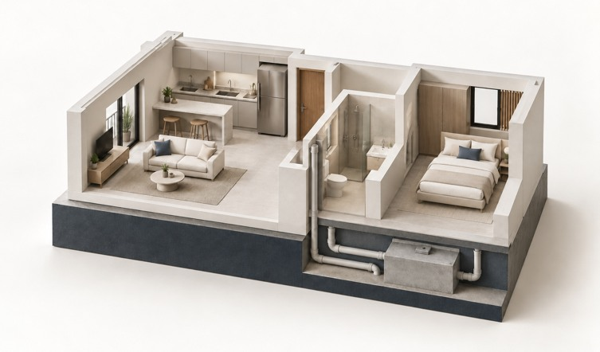
OCEANIDES
Plumbing, Siphoning, and Pest Management Services OPC
Landline (02) 8633 8486 / (02) 8330 1329 Globe 0917 671 6383 Smart 0939 245 6217
marketing@oceanidessepticandpest.com | corporate@oceanidessepticandpest.com TIN 260-084-087-00000
SERVICE 04
Excavation Services
Create access for the underground work your property
needs.
Oceanides provides excavation support for plumbing, drainage, septic
tank, and related property works. The method and boundaries follow a
site review, utility coordination, and the approved work scope.
01
Site access and excavation scope review
02
Coordination of known utilities and work boundaries
03
Excavation for agreed plumbing or drainage works
04
Backfilling and surface reinstatement where included
OCEANIDES
Conceptual property illustration; not an excavation plan
oceanidesph.com | facebook.com/OceanidesMalabanan
FIRST DRAFT
marketing@oceanidessepticandpest.com | corporate@oceanidessepticandpest.com
07
Notes:
Service: Excavation Services. Copy based on owner interview; illustrative scope, final method and quotation follow assessment.
Conceptual property illustration; not an excavation plan; original image clients/oceanides/company-profile/assets-interview/cover-property-minimal.png
Company interview and design instructions: 2026-10-11. Owner review required before customer circulation. Contact details from supplied HEADER 111 DOCX. Existing logo retained.

Slide 8
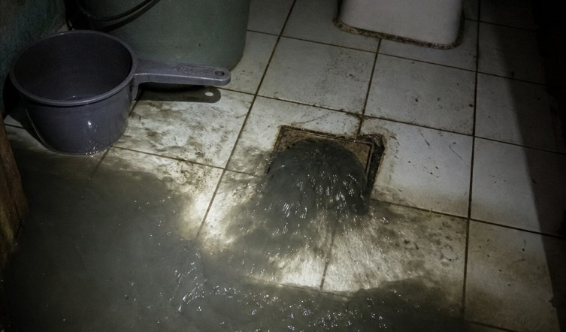
OCEANIDES
Plumbing, Siphoning, and Pest Management Services OPC
Landline (02) 8633 8486 / (02) 8330 1329 Globe 0917 671 6383 Smart 0939 245 6217
marketing@oceanidessepticandpest.com | corporate@oceanidessepticandpest.com TIN 260-084-087-00000
SERVICE 05
Drain and Pipe Declogging
Address slow drains and blocked lines before problems
spread.
Oceanides assesses drainage blockages and applies a suitable clearing
method based on pipe condition, access, and the likely cause. Recurring
blockages may require a separate repair or further inspection.
01
Review of the affected drainage line
02
Clearing of accessible blockages within scope
03
Water-flow checks after the work
04
Advice on recurring issues and further repairs
OCEANIDES
AI-generated illustration of a drainage concern
oceanidesph.com | facebook.com/OceanidesMalabanan
FIRST DRAFT
marketing@oceanidessepticandpest.com | corporate@oceanidessepticandpest.com
08
Notes:
Service: Drain and Pipe Declogging. Copy based on owner interview; illustrative scope, final method and quotation follow assessment.
AI-generated illustration of a drainage concern; original image clients/oceanides/assets/tb2-hero-banyo.png
Company interview and design instructions: 2026-10-11. Owner review required before customer circulation. Contact details from supplied HEADER 111 DOCX. Existing logo retained.

Slide 9
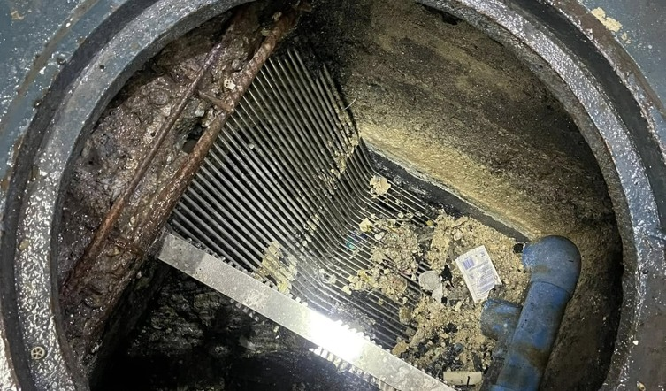
OCEANIDES
Plumbing, Siphoning, and Pest Management Services OPC
Landline (02) 8633 8486 / (02) 8330 1329 Globe 0917 671 6383 Smart 0939 245 6217
marketing@oceanidessepticandpest.com | corporate@oceanidessepticandpest.com TIN 260-084-087-00000
SERVICE 06
Grease Tank and Trap Cleaning
Keep grease buildup from becoming a recurring
kitchen drainage problem.
Oceanides provides grease tank and grease trap cleaning for
food-service properties and other sites with grease-management
needs. Work is coordinated around access and your operating schedule.
01
Assessment of grease tank or trap access
02
Removal of accumulated grease and settled waste
03
Cleaning of accessible internal areas within scope
04
Recommendations for a practical cleaning schedule
OCEANIDES
Oceanides project photo; site identity not specified
oceanidesph.com | facebook.com/OceanidesMalabanan
FIRST DRAFT
marketing@oceanidessepticandpest.com | corporate@oceanidessepticandpest.com
09
Notes:
Service: Grease Tank and Trap Cleaning. Copy based on owner interview; illustrative scope, final method and quotation follow assessment.
Oceanides project photo; site identity not specified; original image clients/oceanides/assets/before-1.jpg
Company interview and design instructions: 2026-10-11. Owner review required before customer circulation. Contact details from supplied HEADER 111 DOCX. Existing logo retained.

Slide 10
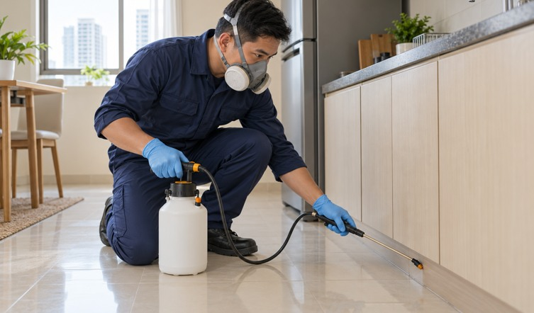
OCEANIDES
Plumbing, Siphoning, and Pest Management Services OPC
Landline (02) 8633 8486 / (02) 8330 1329 Globe 0917 671 6383 Smart 0939 245 6217
marketing@oceanidessepticandpest.com | corporate@oceanidessepticandpest.com TIN 260-084-087-00000
SERVICE 07
Pest Management Services
Protect the spaces where people work, stay, and dine.
Oceanides develops a pest-management scope around the pest
concern, property use, and site findings. Programs can support
restaurants, hotels, condominiums, offices, warehouses, and residential
properties.
01
Site inspection and pest concern assessment
02
Treatment plan for the identified concern
03
Coordination of preparation and re-entry instructions
04
Follow-up and prevention advice within the agreed program
OCEANIDES
AI-generated service illustration
oceanidesph.com | facebook.com/OceanidesMalabanan
FIRST DRAFT
marketing@oceanidessepticandpest.com | corporate@oceanidessepticandpest.com
10
Notes:
Service: Pest Management Services. Copy based on owner interview; illustrative scope, final method and quotation follow assessment.
AI-generated service illustration; original image clients/oceanides/company-profile/assets-interview/pest-control-service.png
Company interview and design instructions: 2026-10-11. Owner review required before customer circulation. Contact details from supplied HEADER 111 DOCX. Existing logo retained.

Slide 11

OCEANIDES
Plumbing, Siphoning, and Pest Management Services OPC
Landline (02) 8633 8486 / (02) 8330 1329 Globe 0917 671 6383 Smart 0939 245 6217
marketing@oceanidessepticandpest.com | corporate@oceanidessepticandpest.com TIN 260-084-087-00000
SERVICE 08
General Cleaning Services
Present a cleaner, better-cared-for space to everyone
who enters.
Oceanides provides cleaning support for commercial and residential
properties. Cleaning areas, frequency, materials, and exclusions are
defined with the client before work starts.
01
Site walkthrough and cleaning checklist
02
Cleaning of agreed rooms and common areas
03
Coordination around occupancy and site access
04
Completion review with the client representative
OCEANIDES
Illustrative property interior; not an Oceanides project
oceanidesph.com | facebook.com/OceanidesMalabanan
FIRST DRAFT
marketing@oceanidessepticandpest.com | corporate@oceanidessepticandpest.com
11
Notes:
Service: General Cleaning Services. Copy based on owner interview; illustrative scope, final method and quotation follow assessment.
Illustrative property interior; not an Oceanides project; original image clients/oceanides/company-profile/assets-interview/interior-pexels-8089170.jpg
Stock photo: Max Vakhtbovych, https://www.pexels.com/photo/an-interior-of-a-living-room-8089170/ ; license https://www.pexels.com/license/
Company interview and design instructions: 2026-10-11. Owner review required before customer circulation. Contact details from supplied HEADER 111 DOCX. Existing logo retained.

Slide 12

OCEANIDES
Plumbing, Siphoning, and Pest Management Services OPC
Landline (02) 8633 8486 / (02) 8330 1329 Globe 0917 671 6383 Smart 0939 245 6217
marketing@oceanidessepticandpest.com | corporate@oceanidessepticandpest.com TIN 260-084-087-00000
SERVICE 09
Renovation, Restoration and Leak Repairs
Repair damaged spaces and plan improvements with a
defined scope.
Oceanides accepts renovation and restoration work for homes,
condominiums, and commercial properties, including ceiling repairs and
water-leak concerns. The proposed work follows a site assessment, with
specialist involvement where the project requires it.
01
Site assessment of damage and requested improvements
02
Ceiling repair and restoration within scope
03
Water-leak investigation and proposed corrective work
OCEANIDES
04
AI-generated service illustration
Renovation coordination and agreed finish review
oceanidesph.com | facebook.com/OceanidesMalabanan
FIRST DRAFT
marketing@oceanidessepticandpest.com | corporate@oceanidessepticandpest.com
12
Notes:
Service: Renovation, Restoration and Leak Repairs. Copy based on owner interview; illustrative scope, final method and quotation follow assessment.
AI-generated service illustration; original image clients/oceanides/company-profile/assets-interview/renovation-service.png
Company interview and design instructions: 2026-10-11. Owner review required before customer circulation. Contact details from supplied HEADER 111 DOCX. Existing logo retained.

Slide 13
OCEANIDES
Plumbing, Siphoning, and Pest Management Services OPC
Landline (02) 8633 8486 / (02) 8330 1329 Globe 0917 671 6383 Smart 0939 245 6217
marketing@oceanidessepticandpest.com | corporate@oceanidessepticandpest.com TIN 260-084-087-00000
SERVICE 10
Air-Conditioning Cleaning
Include your air-conditioning units in your property
maintenance plan.
Oceanides provides air-conditioning cleaning based on unit type,
access, and condition. Cleaning findings that require repair or further
technical work are discussed separately with the client.
01
Review of unit type and service access
02
Cleaning of agreed accessible components
03
Drainage and visible-condition observations
04
Basic operation check after cleaning
OCEANIDES
Illustrative indoor setting; aircon service photo to follow
oceanidesph.com | facebook.com/OceanidesMalabanan
FIRST DRAFT
marketing@oceanidessepticandpest.com | corporate@oceanidessepticandpest.com
13
Notes:
Service: Air-Conditioning Cleaning. Copy based on owner interview; illustrative scope, final method and quotation follow assessment.
Illustrative indoor setting; aircon service photo to follow; original image clients/oceanides/company-profile/assets-interview/interior-pexels-8089170.jpg
Stock photo: Max Vakhtbovych, https://www.pexels.com/photo/an-interior-of-a-living-room-8089170/ ; license https://www.pexels.com/license/
Company interview and design instructions: 2026-10-11. Owner review required before customer circulation. Contact details from supplied HEADER 111 DOCX. Existing logo retained.

Slide 14
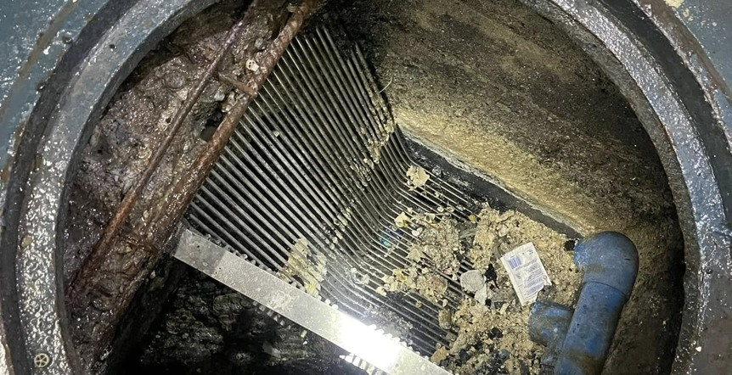
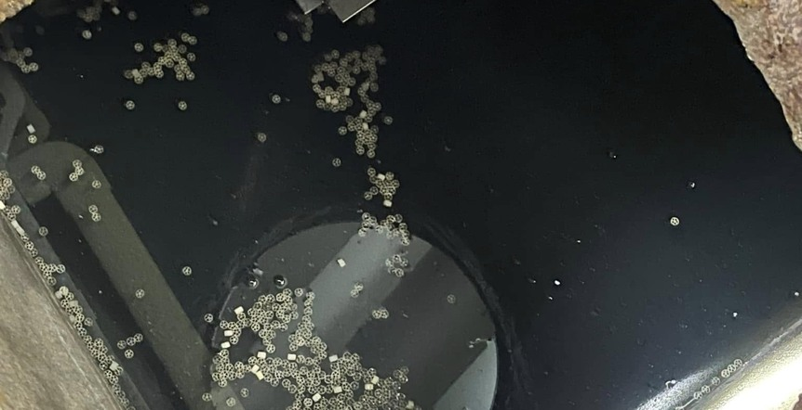
OCEANIDES
Plumbing, Siphoning, and Pest Management Services OPC
Landline (02) 8633 8486 / (02) 8330 1329 Globe 0917 671 6383 Smart 0939 245 6217
marketing@oceanidessepticandpest.com | corporate@oceanidessepticandpest.com TIN 260-084-087-00000
PROJECT PHOTOGRAPHS
A closer look at our work
OCEANIDES
BEFORE
AFTER
Actual Oceanides photos from the existing asset library. Project site and date to be added.
oceanidesph.com | facebook.com/OceanidesMalabanan
FIRST DRAFT
marketing@oceanidessepticandpest.com | corporate@oceanidessepticandpest.com
14
Notes:
Actual photo pair from assets/before-1.jpg and after-1.jpg; provenance recorded in organic/VALUE-WEEK-01.md. No specific client claimed.
Company interview and design instructions: 2026-10-11. Owner review required before customer circulation. Contact details from supplied HEADER 111 DOCX. Existing logo retained.

Slide 15
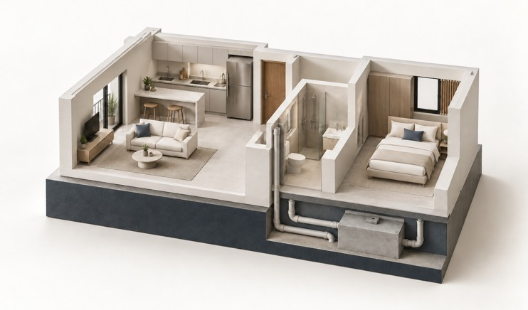
OCEANIDES
Plumbing, Siphoning, and Pest Management Services OPC
Landline (02) 8633 8486 / (02) 8330 1329 Globe 0917 671 6383 Smart 0939 245 6217
marketing@oceanidessepticandpest.com | corporate@oceanidessepticandpest.com TIN 260-084-087-00000
NEW SERVICE OFFER
Onsite wastewater treatment systems
A treatment system installed at your property,
with Oceanides coordinating the project and
agreed ongoing support.
We begin with the existing wastewater setup, site constraints and
operating needs. The technical proposal defines the process,
capacity, installation scope and service requirements.
OCEANIDES
Conceptual illustration; not the proposed equipment or a technical design.
Regular operation, inspection, servicing and sludge removal remain part of the system plan.
oceanidesph.com | facebook.com/OceanidesMalabanan
FIRST DRAFT
marketing@oceanidessepticandpest.com | corporate@oceanidessepticandpest.com
15
Notes:
Onsite treatment system offer. The interview used Septage Treatment Facility; exact technology not yet documented, so final terminology, design and capacity await technical review.
Company interview and design instructions: 2026-10-11. Owner review required before customer circulation. Contact details from supplied HEADER 111 DOCX. Existing logo retained.

Slide 16
OCEANIDES
Plumbing, Siphoning, and Pest Management Services OPC
Landline (02) 8633 8486 / (02) 8330 1329 Globe 0917 671 6383 Smart 0939 245 6217
marketing@oceanidessepticandpest.com | corporate@oceanidessepticandpest.com TIN 260-084-087-00000
HOW THE OFFER WORKS
Treatment project and ongoing support
01
Assess the site
02
Define the proposal
Review current tanks, wastewater flows, access and
Confirm technical design, capacity, installation scope
operating needs.
and quotation.
03
Install and hand over
04
Support operation
Coordinate specialist delivery and agreed operator
Agree servicing, troubleshooting and
guidance.
permit-document assistance.
OCEANIDES
Potential maintenance savings are evaluated against the current service pattern and the proposed system. Support scope, fees and responsibilities are agreed
in writing.
oceanidesph.com | facebook.com/OceanidesMalabanan
FIRST DRAFT
marketing@oceanidessepticandpest.com | corporate@oceanidessepticandpest.com
16
Notes:
Treatment project steps are proposed scope. Any cost savings, permit scope, warranty and ongoing support terms must be defined in a project-specific agreement.
Company interview and design instructions: 2026-10-11. Owner review required before customer circulation. Contact details from supplied HEADER 111 DOCX. Existing logo retained.

Slide 17
OCEANIDES
Plumbing, Siphoning, and Pest Management Services OPC
Landline (02) 8633 8486 / (02) 8330 1329 Globe 0917 671 6383 Smart 0939 245 6217
marketing@oceanidessepticandpest.com | corporate@oceanidessepticandpest.com TIN 260-084-087-00000
COMPANY OWNER SUPPLIED REFERENCES
Selected clients and service experience
Ayala Land
San Miguel Beer
Jollibee Foods Corporation
Hotel Sogo
Mang Inasal
KFC
Kenny Rogers
Eagle Cement
OCEANIDES
Experience includes septic tank, plumbing, grease tank, cleaning and pest-management work, as applicable to each engagement.
First-draft reference list: specific contracted entities, branches, sites and service records to be confirmed.
oceanidesph.com | facebook.com/OceanidesMalabanan
FIRST DRAFT
marketing@oceanidessepticandpest.com | corporate@oceanidessepticandpest.com
17
Notes:
Client names and relationships are company owner statements in interview, not independently verified. Confirm contracted entity, branch/site, work scope and permission before external client promotion. No endorsement asserted.
Company interview and design instructions: 2026-10-11. Owner review required before customer circulation. Contact details from supplied HEADER 111 DOCX. Existing logo retained.

Slide 18
OCEANIDES
Plumbing, Siphoning, and Pest Management Services OPC
Landline (02) 8633 8486 / (02) 8330 1329 Globe 0917 671 6383 Smart 0939 245 6217
marketing@oceanidessepticandpest.com | corporate@oceanidessepticandpest.com TIN 260-084-087-00000
PROPOSED ROLE STRUCTURE FOR CONFIRMATION
Organizational structure
President / CEO
Operations
HR and Administration
Finance and Accounting
Sales and Marketing
Manager and supervisors
Personnel coordination
Billing and collections
Inquiries and proposals
Technicians and service crews
Office administration
Accounting records
Client relationships
OCEANIDES
Positions and reporting lines are a draft for management review. Names and final appointments to be added.
oceanidesph.com | facebook.com/OceanidesMalabanan
FIRST DRAFT
marketing@oceanidessepticandpest.com | corporate@oceanidessepticandpest.com
18
Notes:
Organization chart is a proposed role-based draft for owner confirmation; no individual or headcount is invented. Native editable boxes indicate reporting levels.
Company interview and design instructions: 2026-10-11. Owner review required before customer circulation. Contact details from supplied HEADER 111 DOCX. Existing logo retained.

Slide 19
OCEANIDES
Plumbing, Siphoning, and Pest Management Services OPC
Landline (02) 8633 8486 / (02) 8330 1329 Globe 0917 671 6383 Smart 0939 245 6217
marketing@oceanidessepticandpest.com | corporate@oceanidessepticandpest.com TIN 260-084-087-00000
DOCUMENT APPENDIX
Company registration and supporting documents
Supporting documents can be submitted with the project or supplier-accreditation package.
SEC registration
OPC certificate and exact registration details
BIR registration
Certificate of Registration and tax documentation
Business permits
Current permit copies for the relevant entity
Service-specific documents
Applicable clearances, agreements and project documents
OCEANIDES
Permit scans and validity details will be inserted after the owner provides the current copies. This draft does not establish license validity or
accreditation.
oceanidesph.com | facebook.com/OceanidesMalabanan
FIRST DRAFT
marketing@oceanidessepticandpest.com | corporate@oceanidessepticandpest.com
19
Notes:
The owner reports company registration and permits. Current copies have not been supplied for this draft; validity and accreditation are not established by this profile. Agency logos are not permit copies.
Company interview and design instructions: 2026-10-11. Owner review required before customer circulation. Contact details from supplied HEADER 111 DOCX. Existing logo retained.

Slide 20
OCEANIDES
Plumbing, Siphoning, and Pest Management Services OPC
Landline (02) 8633 8486 / (02) 8330 1329 Globe 0917 671 6383 Smart 0939 245 6217
marketing@oceanidessepticandpest.com | corporate@oceanidessepticandpest.com TIN 260-084-087-00000
METRO MANILA AND NEARBY PROVINCES FIRST
Service coverage
Priority areas
Wider reach
Metro Manila
Central and Northern Luzon
Cavite, Laguna, Batangas and Rizal
Nationwide service by arrangement
Bulacan, Pampanga and Bataan
Zambales, including Subic and Olongapo
OCEANIDES
Availability and schedule are confirmed for each site and service request.
oceanidesph.com | facebook.com/OceanidesMalabanan
FIRST DRAFT
marketing@oceanidessepticandpest.com | corporate@oceanidessepticandpest.com
20
Notes:
Service coverage as stated by owner; scheduling depends on service, site access and team availability. No instant nationwide arrival promise.
Company interview and design instructions: 2026-10-11. Owner review required before customer circulation. Contact details from supplied HEADER 111 DOCX. Existing logo retained.

Slide 21
OCEANIDES
Plumbing, Siphoning, and Pest Management Services OPC
Landline (02) 8633 8486 / (02) 8330 1329 Globe 0917 671 6383 Smart 0939 245 6217
marketing@oceanidessepticandpest.com | corporate@oceanidessepticandpest.com TIN 260-084-087-00000
PRIORITY SERVICE AREAS
Metro Manila
Cities and municipalities covered
Caloocan
Marikina
Quezon City
Las Piñas
Muntinlupa
San Juan
Makati
Navotas
Taguig
Malabon
Parañaque
Valenzuela
Mandaluyong
Pasay
Pateros
Manila
Pasig
OCEANIDES
Geographic names: Philippine Statistics Authority PSGC. Availability and project schedule confirmed upon inquiry.
oceanidesph.com | facebook.com/OceanidesMalabanan
FIRST DRAFT
marketing@oceanidessepticandpest.com | corporate@oceanidessepticandpest.com
21
Notes:
Coverage supplied by owner. City/municipality names checked against Philippine Statistics Authority PSGC: https://psa.gov.ph/classification/psgc/summary
Company interview and design instructions: 2026-10-11. Owner review required before customer circulation. Contact details from supplied HEADER 111 DOCX. Existing logo retained.

Slide 22
OCEANIDES
Plumbing, Siphoning, and Pest Management Services OPC
Landline (02) 8633 8486 / (02) 8330 1329 Globe 0917 671 6383 Smart 0939 245 6217
marketing@oceanidessepticandpest.com | corporate@oceanidessepticandpest.com TIN 260-084-087-00000
PRIORITY SERVICE AREAS
Cavite
Cities and municipalities covered
Bacoor
Alfonso
Naic
Carmona
Amadeo
Noveleta
Cavite City
General Emilio Aguinaldo
Rosario
Dasmariñas
Indang
Silang
General Trias
Kawit
Tanza
Imus
Magallanes
Ternate
Tagaytay
Maragondon
General Mariano Alvarez
Trece Martires
Mendez
OCEANIDES
Geographic names: Philippine Statistics Authority PSGC. Availability and project schedule confirmed upon inquiry.
oceanidesph.com | facebook.com/OceanidesMalabanan
FIRST DRAFT
marketing@oceanidessepticandpest.com | corporate@oceanidessepticandpest.com
22
Notes:
Coverage supplied by owner. City/municipality names checked against Philippine Statistics Authority PSGC: https://psa.gov.ph/classification/psgc/citimuni/0402100000
Company interview and design instructions: 2026-10-11. Owner review required before customer circulation. Contact details from supplied HEADER 111 DOCX. Existing logo retained.

Slide 23
OCEANIDES
Plumbing, Siphoning, and Pest Management Services OPC
Landline (02) 8633 8486 / (02) 8330 1329 Globe 0917 671 6383 Smart 0939 245 6217
marketing@oceanidessepticandpest.com | corporate@oceanidessepticandpest.com TIN 260-084-087-00000
PRIORITY SERVICE AREAS
Laguna
Cities and municipalities covered
Biñan
Famy
Paete
Cabuyao
Kalayaan
Pagsanjan
Calamba
Liliw
Pakil
San Pablo
Los Baños
Pangil
San Pedro
Luisiana
Pila
Santa Rosa
Lumban
Rizal
Alaminos
Mabitac
Santa Cruz
Bay
Magdalena
Santa Maria
Calauan
Majayjay
Siniloan
Cavinti
Nagcarlan
Victoria
OCEANIDES
Geographic names: Philippine Statistics Authority PSGC. Availability and project schedule confirmed upon inquiry.
oceanidesph.com | facebook.com/OceanidesMalabanan
FIRST DRAFT
marketing@oceanidessepticandpest.com | corporate@oceanidessepticandpest.com
23
Notes:
Coverage supplied by owner. City/municipality names checked against Philippine Statistics Authority PSGC: https://psa.gov.ph/classification/psgc/citimuni/0403400000
Company interview and design instructions: 2026-10-11. Owner review required before customer circulation. Contact details from supplied HEADER 111 DOCX. Existing logo retained.

Slide 24
OCEANIDES
Plumbing, Siphoning, and Pest Management Services OPC
Landline (02) 8633 8486 / (02) 8330 1329 Globe 0917 671 6383 Smart 0939 245 6217
marketing@oceanidessepticandpest.com | corporate@oceanidessepticandpest.com TIN 260-084-087-00000
PRIORITY SERVICE AREAS
Batangas
Cities and municipalities covered
Batangas City
Ibaan
San Juan
Calaca
Laurel
San Luis
Lipa
Lemery
San Nicolas
Santo Tomas
Lian
San Pascual
Tanauan
Lobo
Santa Teresita
Agoncillo
Mabini
Taal
Alitagtag
Malvar
Talisay
Balayan
Mataasnakahoy
Taysan
Balete
Nasugbu
Tingloy
Bauan
Padre Garcia
Tuy
Calatagan
Rosario
OCEANIDES
Cuenca
San Jose
Geographic names: Philippine Statistics Authority PSGC. Availability and project schedule confirmed upon inquiry.
oceanidesph.com | facebook.com/OceanidesMalabanan
FIRST DRAFT
marketing@oceanidessepticandpest.com | corporate@oceanidessepticandpest.com
24
Notes:
Coverage supplied by owner. City/municipality names checked against Philippine Statistics Authority PSGC: https://psa.gov.ph/classification/psgc/citimuni/0401000000
Company interview and design instructions: 2026-10-11. Owner review required before customer circulation. Contact details from supplied HEADER 111 DOCX. Existing logo retained.

Slide 25
OCEANIDES
Plumbing, Siphoning, and Pest Management Services OPC
Landline (02) 8633 8486 / (02) 8330 1329 Globe 0917 671 6383 Smart 0939 245 6217
marketing@oceanidessepticandpest.com | corporate@oceanidessepticandpest.com TIN 260-084-087-00000
PRIORITY SERVICE AREAS
Rizal
Cities and municipalities covered
Antipolo
Cardona
San Mateo
Angono
Jala-Jala
Tanay
Baras
Rodriguez
Taytay
Binangonan
Morong
Teresa
Cainta
Pililla
OCEANIDES
Geographic names: Philippine Statistics Authority PSGC. Availability and project schedule confirmed upon inquiry.
oceanidesph.com | facebook.com/OceanidesMalabanan
FIRST DRAFT
marketing@oceanidessepticandpest.com | corporate@oceanidessepticandpest.com
25
Notes:
Coverage supplied by owner. City/municipality names checked against Philippine Statistics Authority PSGC: https://psa.gov.ph/classification/psgc/citimuni/0405800000
Company interview and design instructions: 2026-10-11. Owner review required before customer circulation. Contact details from supplied HEADER 111 DOCX. Existing logo retained.

Slide 26
OCEANIDES
Plumbing, Siphoning, and Pest Management Services OPC
Landline (02) 8633 8486 / (02) 8330 1329 Globe 0917 671 6383 Smart 0939 245 6217
marketing@oceanidessepticandpest.com | corporate@oceanidessepticandpest.com TIN 260-084-087-00000
PRIORITY SERVICE AREAS
Bulacan
Cities and municipalities covered
Baliwag
Bustos
Paombong
Malolos
Calumpit
Plaridel
Meycauayan
Guiguinto
Pulilan
San Jose del Monte
Hagonoy
San Ildefonso
Angat
Marilao
San Miguel
Balagtas
Norzagaray
San Rafael
Bocaue
Obando
Santa Maria
Bulacan
Pandi
Doña Remedios Trinidad
OCEANIDES
Geographic names: Philippine Statistics Authority PSGC. Availability and project schedule confirmed upon inquiry.
oceanidesph.com | facebook.com/OceanidesMalabanan
FIRST DRAFT
marketing@oceanidessepticandpest.com | corporate@oceanidessepticandpest.com
26
Notes:
Coverage supplied by owner. City/municipality names checked against Philippine Statistics Authority PSGC: https://psa.gov.ph/classification/psgc/citimuni/0301400000
Company interview and design instructions: 2026-10-11. Owner review required before customer circulation. Contact details from supplied HEADER 111 DOCX. Existing logo retained.

Slide 27
OCEANIDES
Plumbing, Siphoning, and Pest Management Services OPC
Landline (02) 8633 8486 / (02) 8330 1329 Globe 0917 671 6383 Smart 0939 245 6217
marketing@oceanidessepticandpest.com | corporate@oceanidessepticandpest.com TIN 260-084-087-00000
PRIORITY SERVICE AREAS
Pampanga and Angeles
Cities and municipalities covered
Angeles
Guagua
San Luis
Mabalacat
Lubao
San Simon
San Fernando
Macabebe
Santa Ana
Apalit
Magalang
Santa Rita
Arayat
Masantol
Santo Tomas
Bacolor
Mexico
Sasmuan
Candaba
Minalin
Floridablanca
Porac
OCEANIDES
Geographic names: Philippine Statistics Authority PSGC. Availability and project schedule confirmed upon inquiry.
oceanidesph.com | facebook.com/OceanidesMalabanan
FIRST DRAFT
marketing@oceanidessepticandpest.com | corporate@oceanidessepticandpest.com
27
Notes:
Coverage supplied by owner. City/municipality names checked against Philippine Statistics Authority PSGC: https://psa.gov.ph/classification/psgc/summary
Company interview and design instructions: 2026-10-11. Owner review required before customer circulation. Contact details from supplied HEADER 111 DOCX. Existing logo retained.

Slide 28
OCEANIDES
Plumbing, Siphoning, and Pest Management Services OPC
Landline (02) 8633 8486 / (02) 8330 1329 Globe 0917 671 6383 Smart 0939 245 6217
marketing@oceanidessepticandpest.com | corporate@oceanidessepticandpest.com TIN 260-084-087-00000
PRIORITY SERVICE AREAS
Zambales and Olongapo
Cities and municipalities covered
Olongapo
Iba
San Marcelino
Botolan
Masinloc
San Narciso
Cabangan
Palauig
Santa Cruz
Candelaria
San Antonio
Subic
Castillejos
San Felipe
OCEANIDES
Geographic names: Philippine Statistics Authority PSGC. Availability and project schedule confirmed upon inquiry.
oceanidesph.com | facebook.com/OceanidesMalabanan
FIRST DRAFT
marketing@oceanidessepticandpest.com | corporate@oceanidessepticandpest.com
28
Notes:
Coverage supplied by owner. City/municipality names checked against Philippine Statistics Authority PSGC: https://psa.gov.ph/classification/psgc/summary
Company interview and design instructions: 2026-10-11. Owner review required before customer circulation. Contact details from supplied HEADER 111 DOCX. Existing logo retained.

Slide 29
OCEANIDES
Plumbing, Siphoning, and Pest Management Services OPC
Landline (02) 8633 8486 / (02) 8330 1329 Globe 0917 671 6383 Smart 0939 245 6217
marketing@oceanidessepticandpest.com | corporate@oceanidessepticandpest.com TIN 260-084-087-00000
PRIORITY SERVICE AREAS
Bataan
Cities and municipalities covered
Balanga
Hermosa
Orani
Abucay
Limay
Orion
Bagac
Mariveles
Pilar
Dinalupihan
Morong
Samal
OCEANIDES
Geographic names: Philippine Statistics Authority PSGC. Availability and project schedule confirmed upon inquiry.
oceanidesph.com | facebook.com/OceanidesMalabanan
FIRST DRAFT
marketing@oceanidessepticandpest.com | corporate@oceanidessepticandpest.com
29
Notes:
Coverage supplied by owner. City/municipality names checked against Philippine Statistics Authority PSGC: https://psa.gov.ph/classification/psgc/citimuni/0300800000
Company interview and design instructions: 2026-10-11. Owner review required before customer circulation. Contact details from supplied HEADER 111 DOCX. Existing logo retained.

Slide 30
OCEANIDES
Plumbing, Siphoning, and Pest Management Services OPC
Landline (02) 8633 8486 / (02) 8330 1329 Globe 0917 671 6383 Smart 0939 245 6217
marketing@oceanidessepticandpest.com | corporate@oceanidessepticandpest.com TIN 260-084-087-00000
FROM INQUIRY TO FOLLOW-UP
Working with Oceanides
01
Tell us what you need
Share the service, property location, concerns and preferred schedule.
02
Arrange a site assessment
Review conditions, access and the requirements of the work.
03
Approve a written quotation
Confirm the scope, cost, schedule and responsibilities.
04
Complete the work and review
Coordinate service delivery, turnover and agreed follow-up.
OCEANIDES
oceanidesph.com | facebook.com/OceanidesMalabanan
FIRST DRAFT
marketing@oceanidessepticandpest.com | corporate@oceanidessepticandpest.com
30
Notes:
Proposed service engagement workflow; exact agreement defines scope, timing, cost and documentation.
Company interview and design instructions: 2026-10-11. Owner review required before customer circulation. Contact details from supplied HEADER 111 DOCX. Existing logo retained.

Slide 31
OCEANIDES
Plumbing, Siphoning, and Pest Management Services OPC
Landline (02) 8633 8486 / (02) 8330 1329 Globe 0917 671 6383 Smart 0939 245 6217
marketing@oceanidessepticandpest.com | corporate@oceanidessepticandpest.com TIN 260-084-087-00000
CONTACT OCEANIDES
Discuss your property service needs
Arrange a site assessment
Tell us the service you need, your site location and your preferred inspection schedule. We will
coordinate the next step and prepare a proposal for the agreed scope.
0917 671 6383
0939 245 6217
(02) 8633 8486 / (02) 8330 1329
OCEANIDES
marketing@oceanidessepticandpest.com
oceanidesph.com | facebook.com/OceanidesMalabanan
FIRST DRAFT
marketing@oceanidessepticandpest.com | corporate@oceanidessepticandpest.com
31
Notes:
Contact details from owner supplied attached HEADER 111 DOCX. Website and Facebook from existing client configuration. Confirm contact and TIN before broad circulation.
Company interview and design instructions: 2026-10-11. Owner review required before customer circulation. Contact details from supplied HEADER 111 DOCX. Existing logo retained.

